Slide 1

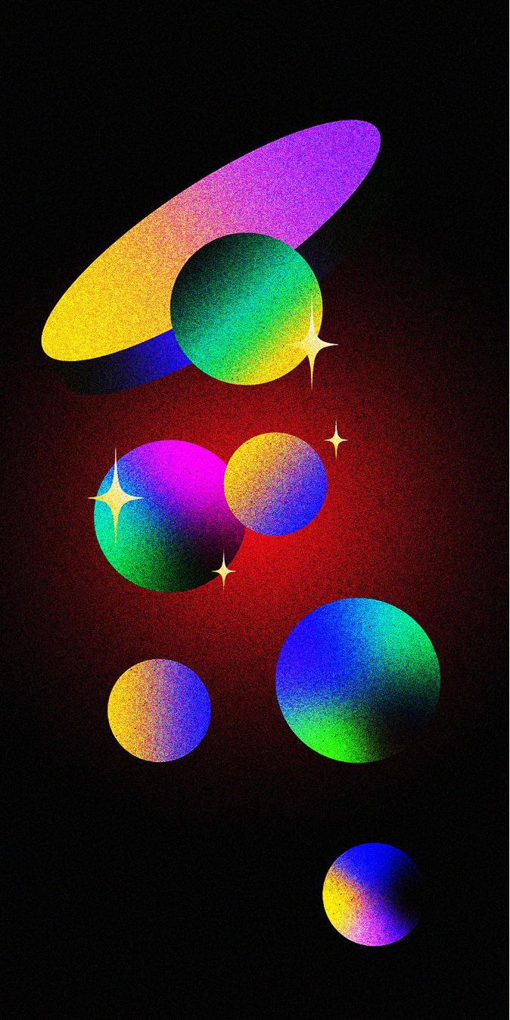


Ratios and Proportions
Using ratios to compare quantities

Slide 2

How to Use This Presentation
Google Slides
PowerPoint
Canva
Click on the "Google Slides" button below this presentation preview. Make sure to sign in to your Google account. Click on "Make a copy." Start editing your presentation.
Alternative: Click on the "Share" button on the top right corner in Canva and click on "More" at the bottom of the menu. Enter "Google Drive" in the search bar and click on the GDrive icon to add this design as a Google slide in your GDrive.
Click on the "PowerPoint" button below
this presentation preview. Start editing
  your presentation.
Alternative: From Canva template file, Click on the "Share" button on the top right corner in Canva and click on "More" at the bottom of the menu. Enter "PowerPoint" in the search bar and click on the PowerPoint icon
  to download.
  Click on the "Canva" button under this presentation preview. Start editing your presentation. You need to sign in to your Canva account.

Slide 3


Lesson Outline
Understanding Ratios
Equivalent Ratios
Simplified Ratios
Activity

Slide 4




How many hours do you spend playing games
in a day?

Slide 5

Learning Outcomes:
  By the end of this lesson, you'll be able to:
  Understand the concept of ratios
  Identify and create equivalent ratios
  Simplify ratios
  Apply ratios to solve problems

Slide 6



Understanding Ratios
  Ratios are used to compare the number of one thing to another. It's written in the form a : b, which is read as "a to b."
Example:
  The ratio of the number of apples to the number of bananas is
2 : 5
2 apples for every 5 bananas

Slide 7

Different Types of Ratios
  We can express ratios in different forms.
2
2 : 5
2 : 7
5
  Part to part ratio
  Part to
  whole ratio
  Ratio as a fraction

Slide 8




Part
to Part Ratio
  There are 3 volleyballs for
  every 8 basketballs.
  Comparing one part to another part.
3
:
8
part
  part

Slide 9
Part to Whole Ratio
  There are 3 volleyballs and 11 balls in total.
  There are 8 basketballs and 11 balls in total.
  Comparing one part to the whole or the total quantity.
3
:
11
8
:
11
  part
  whole
  part
  whole

Slide 10


Part to Whole Ratio
  There are 3 volleyballs and 11 balls in total.
  There are 8 basketballs and 11 balls in total.
  Comparing one part to the whole or the total quantity.
3
8
3 : 11
8 : 11
11
11
Tip:
  The numerator shows the left side, while the denominator shows the right side.

Slide 11



Checkpoint Task
  Express the ratio of oranges to lemons into different types.
?
  Part to Part
?
  Part to Whole
  Fraction
?
?

Slide 12

Checkpoint Task
  Express the ratio of oranges to lemons into different types.
ANSWER KEY
7 : 10
  Part to Part
7 : 17
10 : 17
  Part to Whole
  Fraction
7
10
17
17

Slide 13
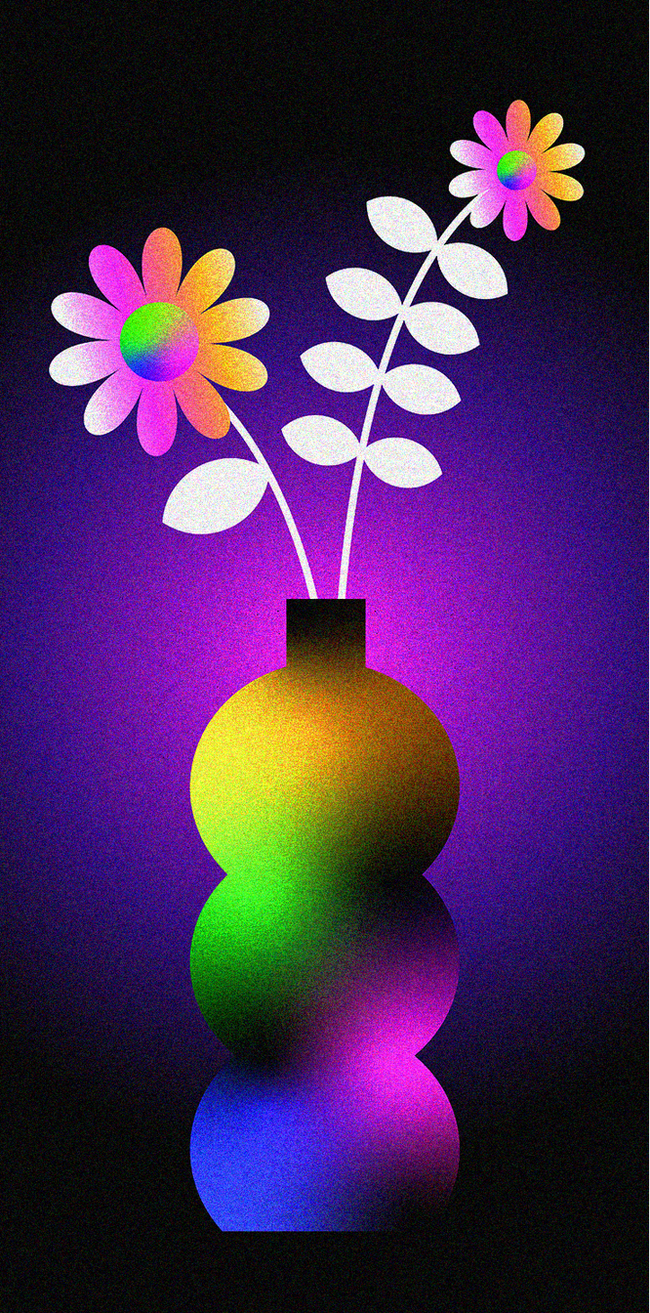
Equivalent Ratios
  Refer to two or more ratios that have the same value.
×2
1 : 3
2 : 6
  Multiplying or dividing both parts of a ratio by the same number will result in an equivalent ratio.
=
×2

Slide 14

Simplified Ratios
  Refer to a ratio that has been expressed in its simplest form.
5 : 10
5
10
=
:
5
5
1 : 2
  Dividing both parts of a ratio by a common factor will result in a simplified ratio.
=

Slide 15

Think about it
3 : 24
3
24
=
:
3
3
1 : 8
=
The simplified ratio of
  3 : 24 is 1 : 8.

Slide 16
Think about it
  If you spend 3 hours in a day playing your favorite game, what simplified ratio can you use to represent it?

Slide 17

Great
work!
  Today, you learned how to:
  visualize and write the ratio of two given numbers
  simplify ratios
  identify equivalent ratios

Slide 18

References
  MathSpace. "4.01 Introduction to Ratios | Grade 6 Math | Common Core 6 - 2023 Edition" Accessed 2 June 2023, https://mathspace.co/textbooks/syllabuses/Syllabus-1155/topics/Topic-21889/subtopics/Subtopic-279746/.
  MathSpace. "4.02 Equivalent and Simplified Ratio | Grade 6 Math | Common Core 6 - 2023 Edition" Accessed 2 June 2023, https://mathspace.co/textbooks/syllabuses/Syllabus-1155/topics/Topic-21889/subtopics/Subtopic-279747/

Slide 19







































Resource
Page
  Use these design resources in your Canva Presentation.
  This presentation template uses the following free fonts:
  Titles: Archivo Black
  Headers: Josephin Sans Bold
  Body Copy: Josephin Sans
  You can find these fonts online too. Happy designing!
  Don't forget to delete this page before presenting.

Slide 20
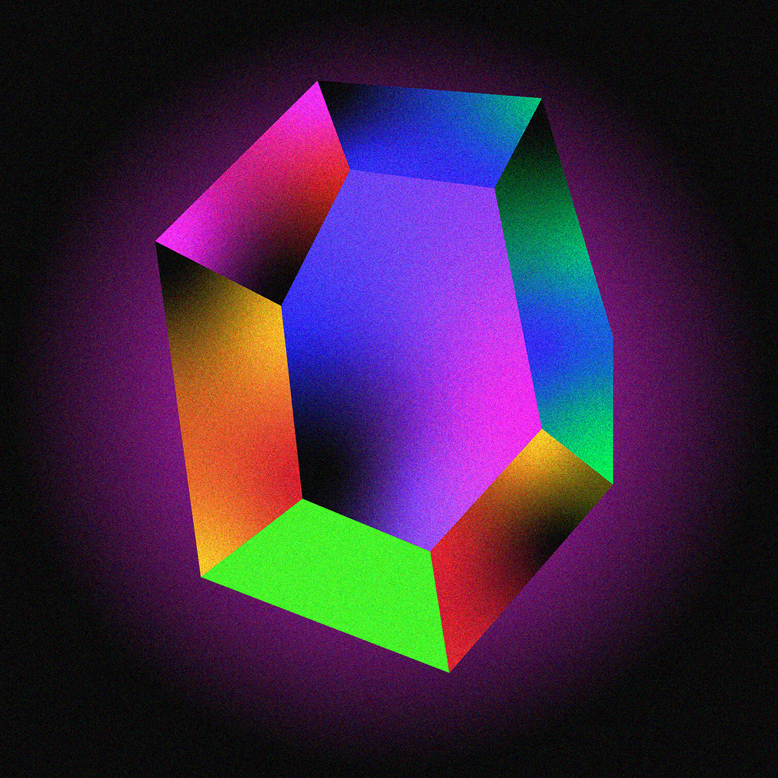

This presentation template is free for everyone to use thanks to the following:
  SlidesCarnival for the presentation template
  Pexels for the photos
Happy designing!

