Slide 1

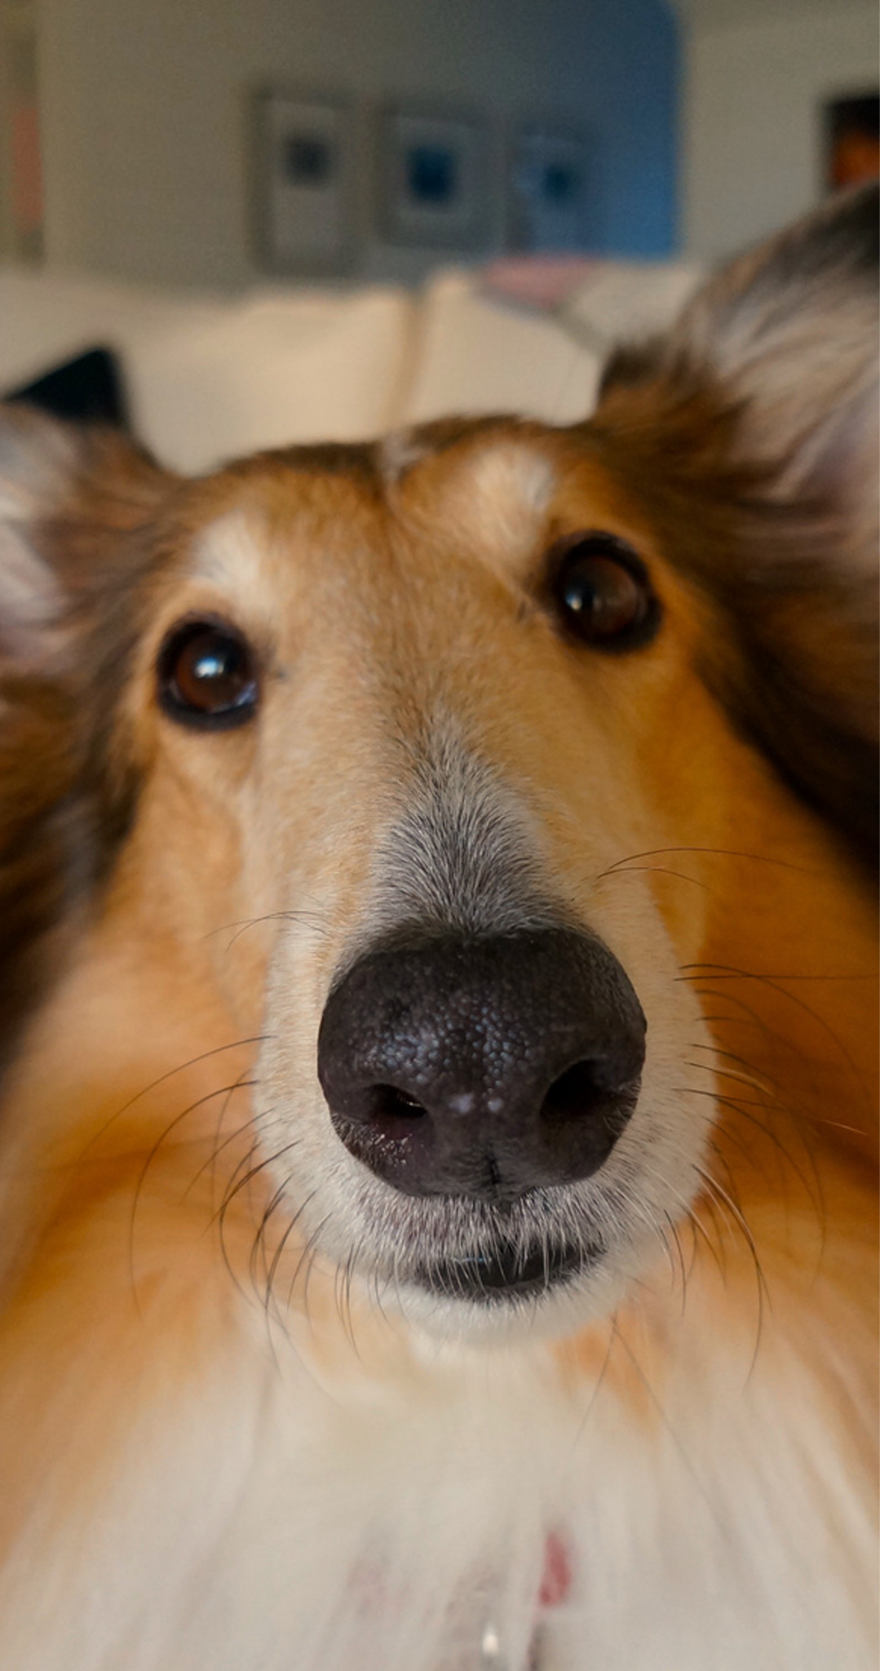
DOG MEME
SLIDES

Slide 2


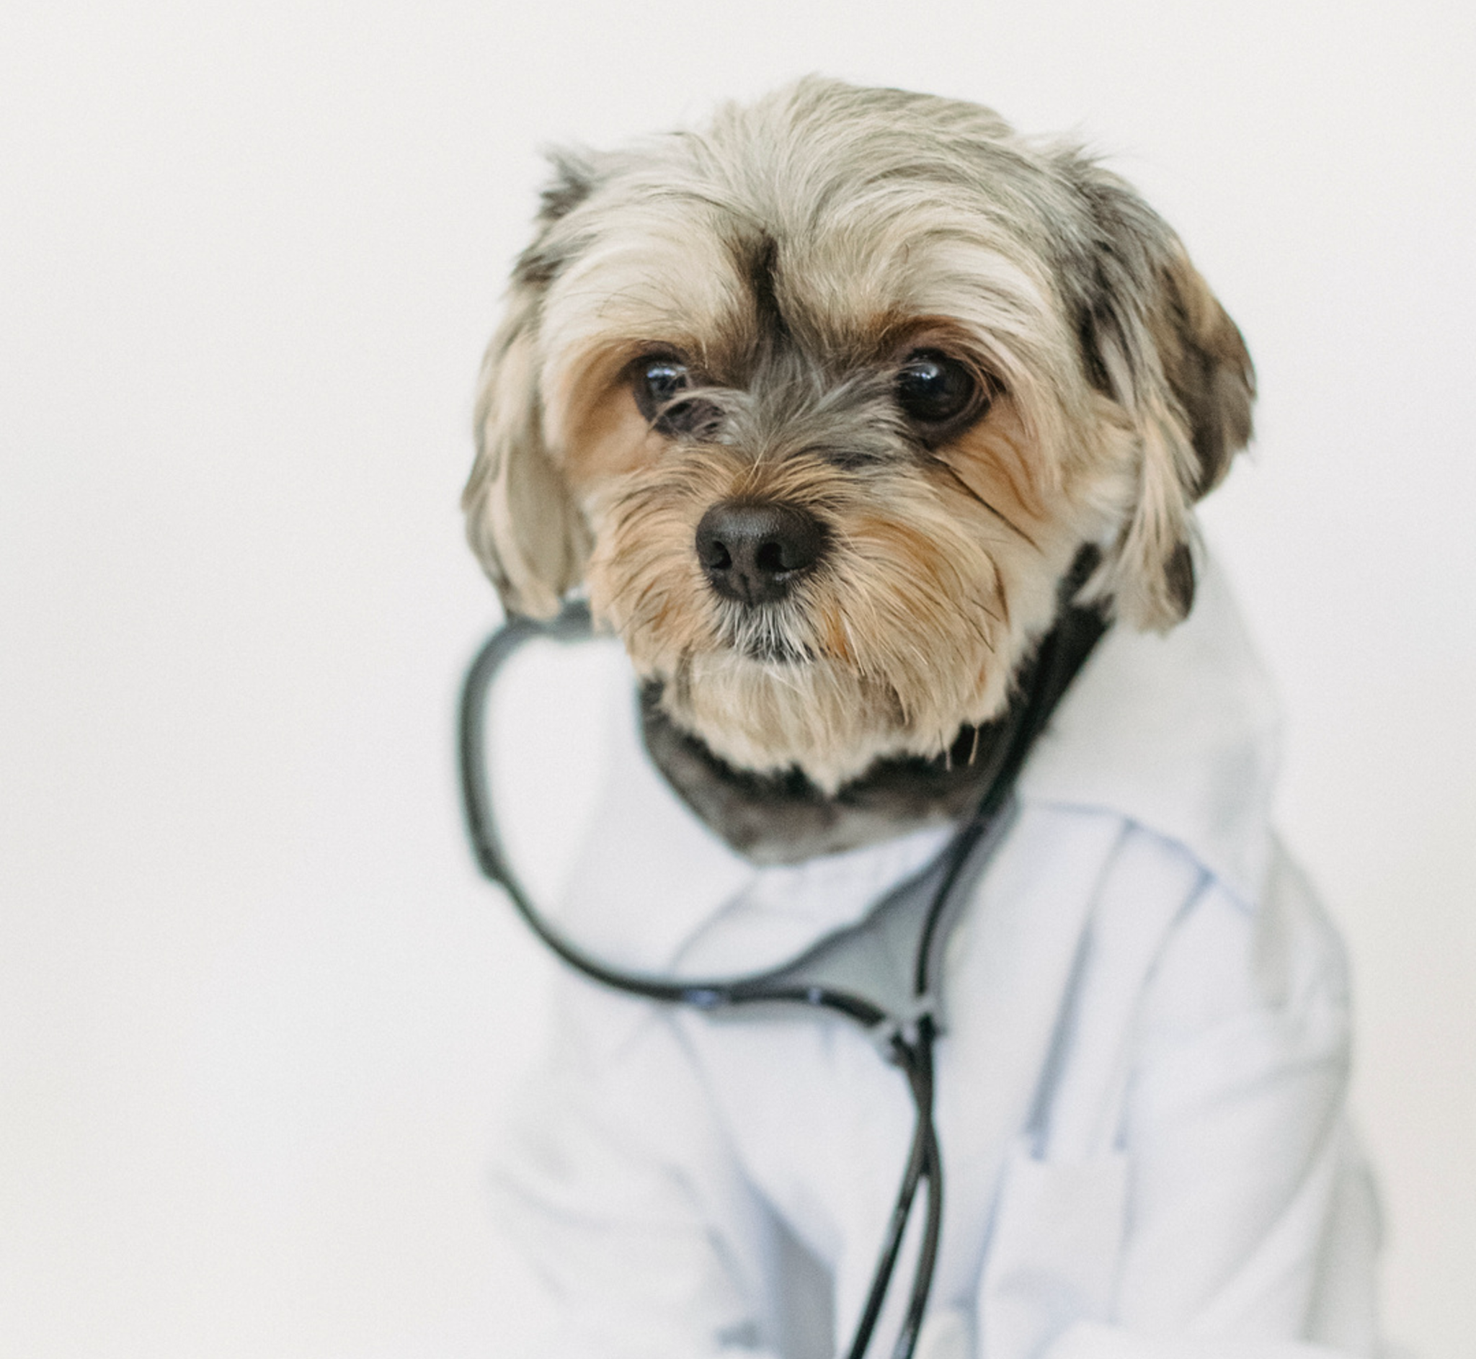
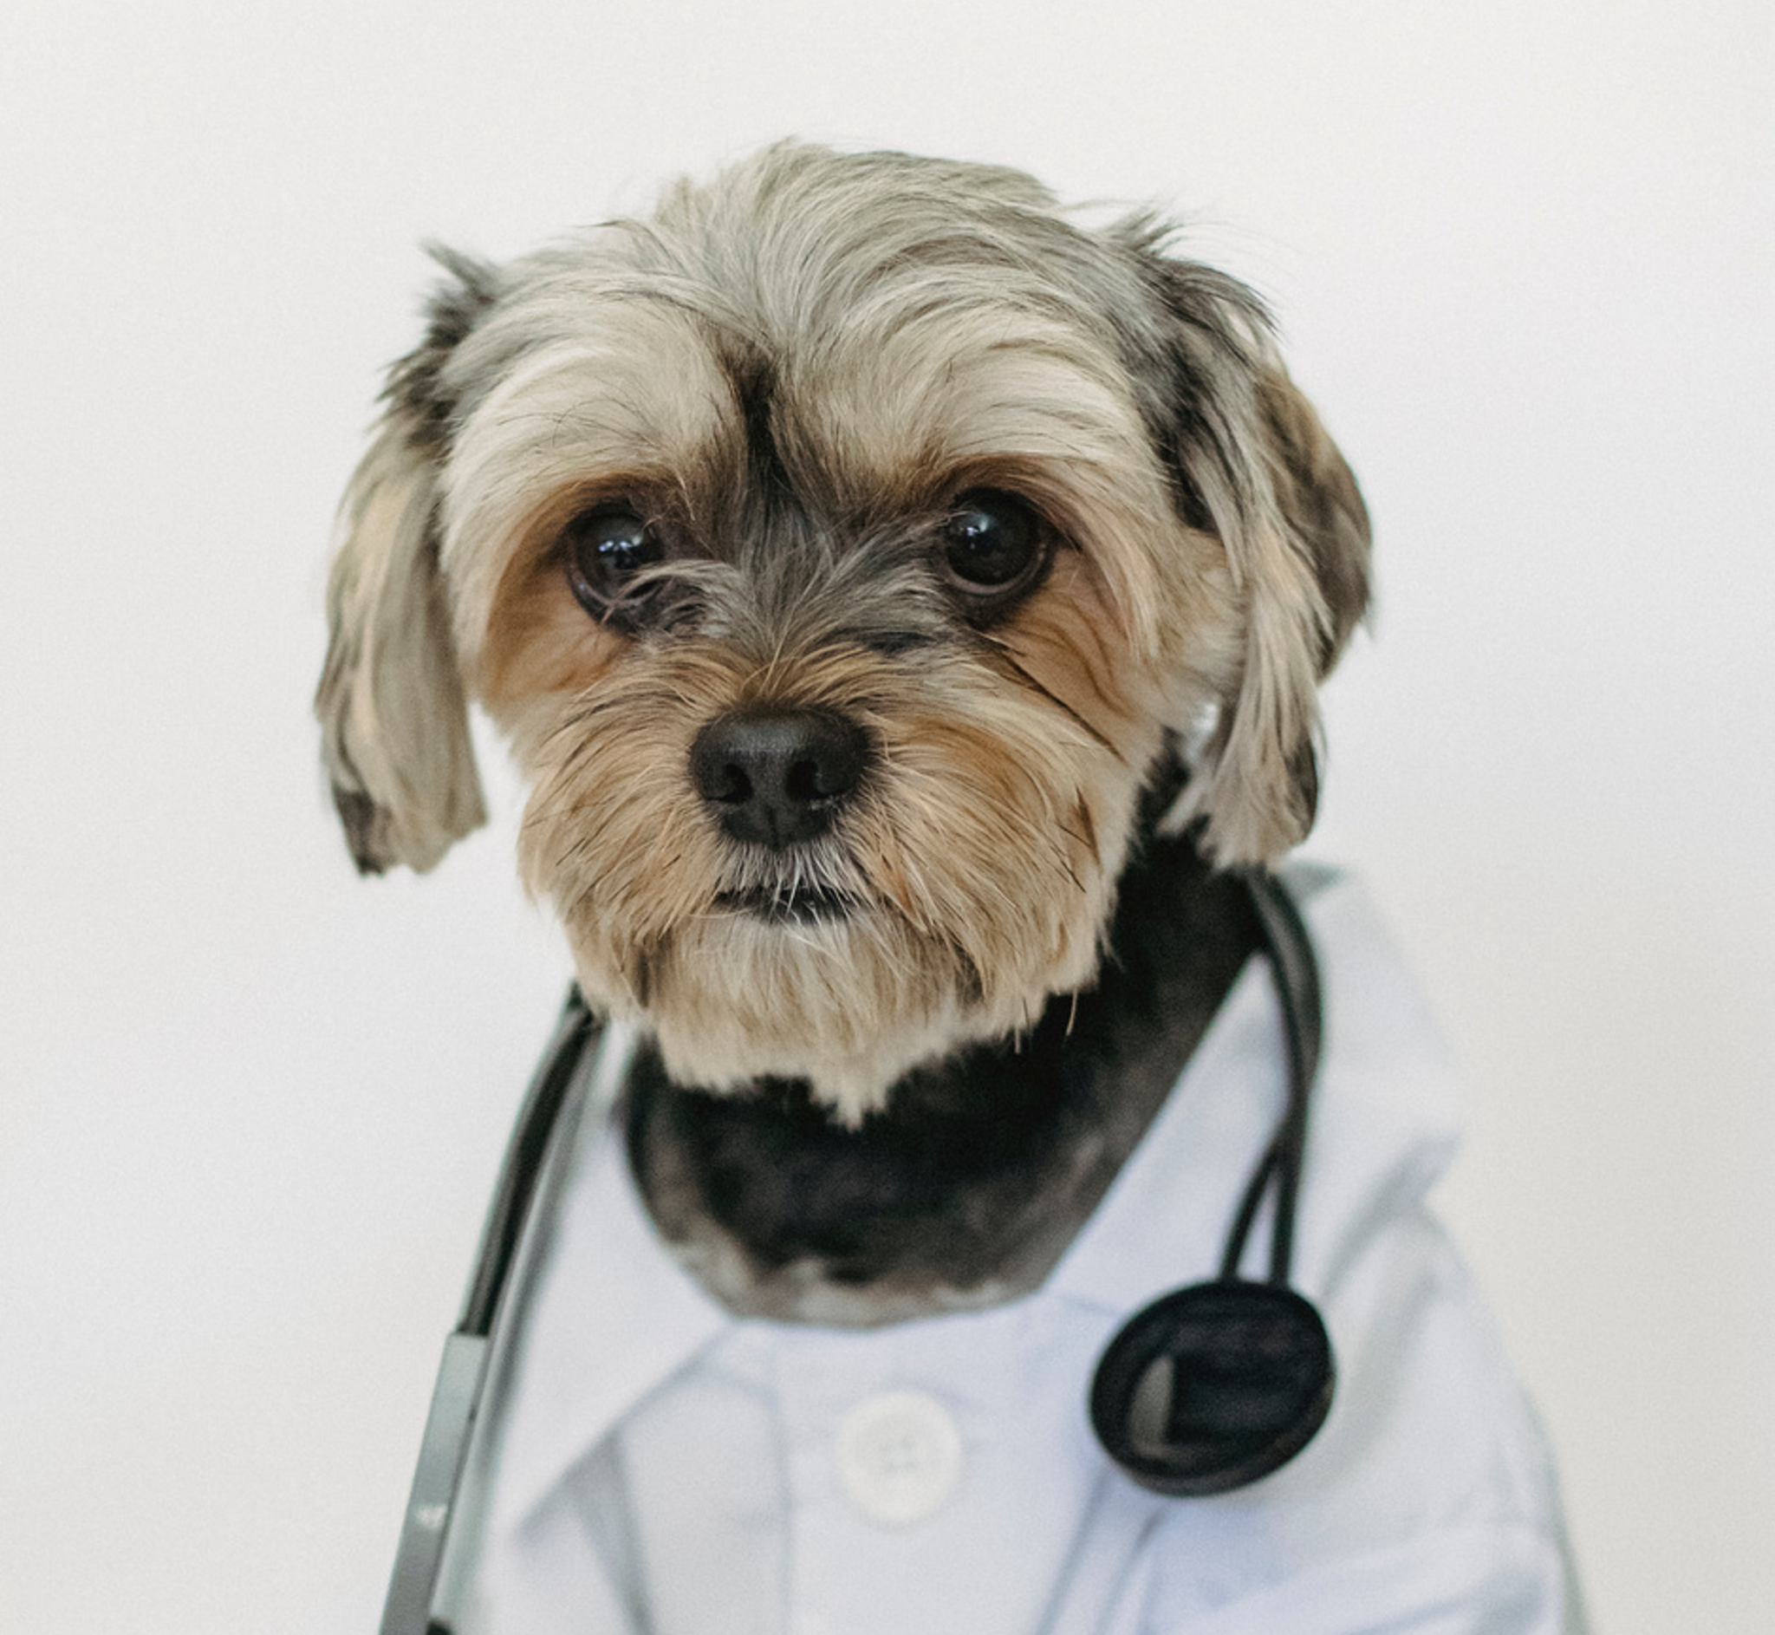
Bella the Poodle
@mrs.poodle
Is he a veterinarian or a dog doctor?

Slide 3

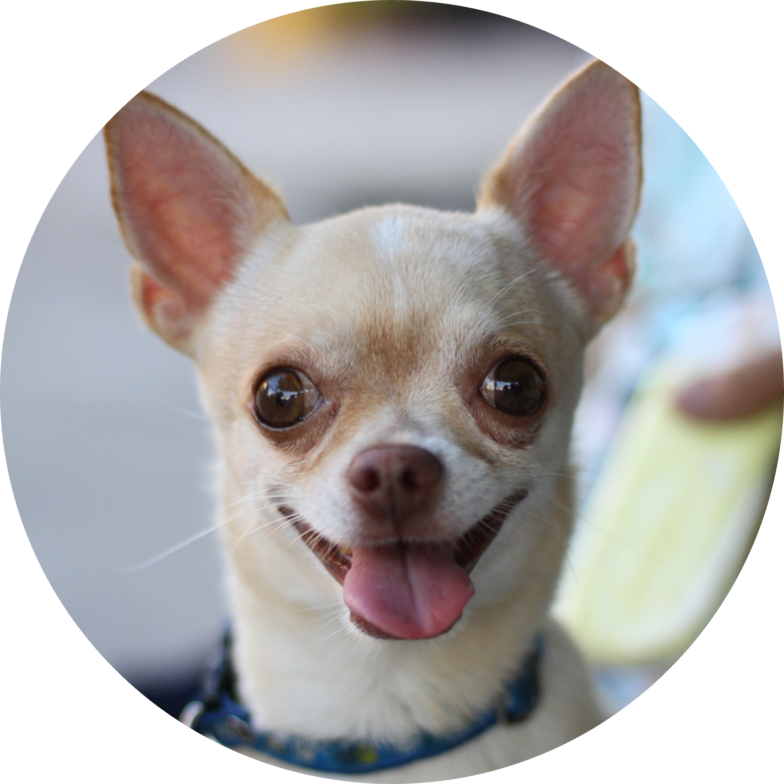
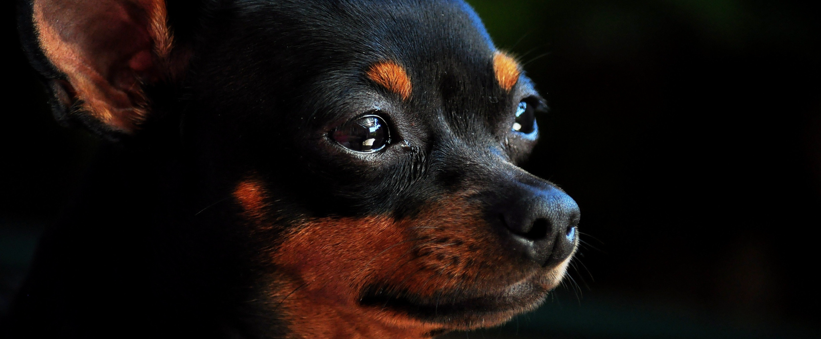
Little Charity
@littlecharity
Me realizing dog heaven probably doesn’t exist.

Slide 4


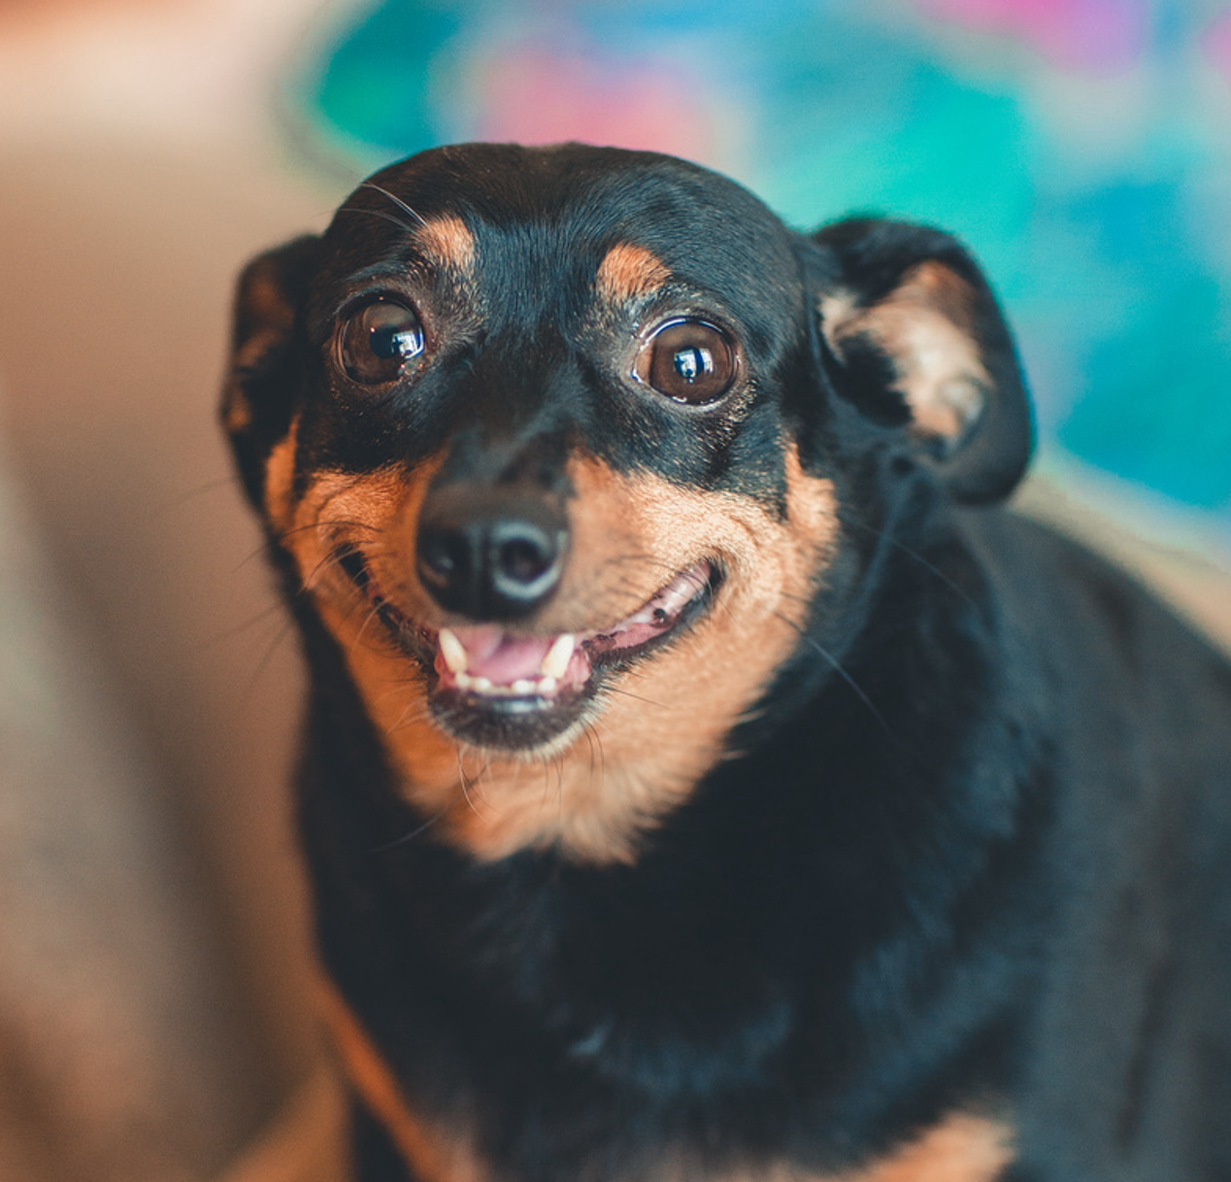


Jam Jackson
@chihuahualover
someone left me a surprise gift...

Slide 5
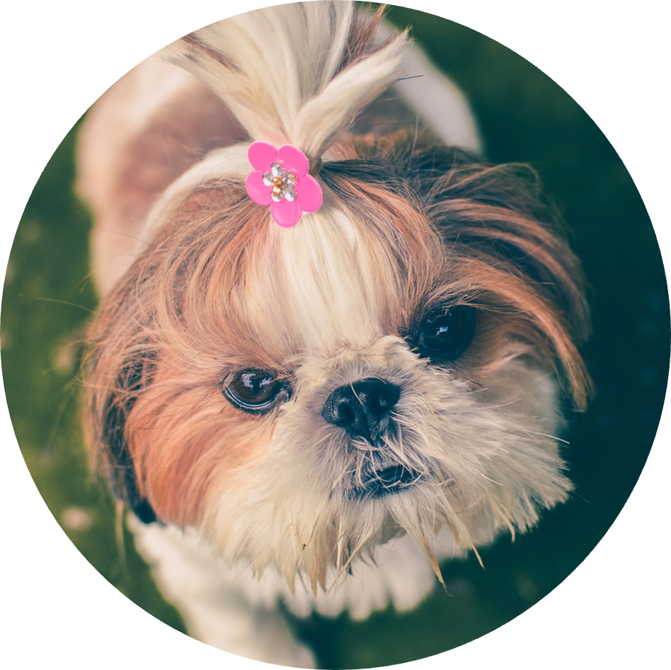
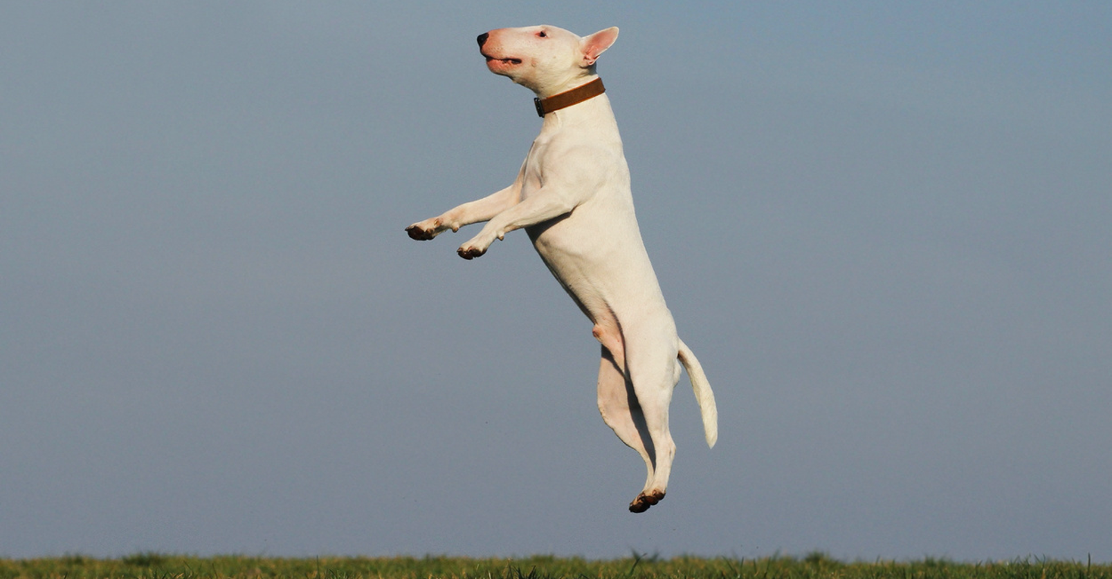
Coco the Cutie
@cococutie
UFO sighting!!!

Slide 6
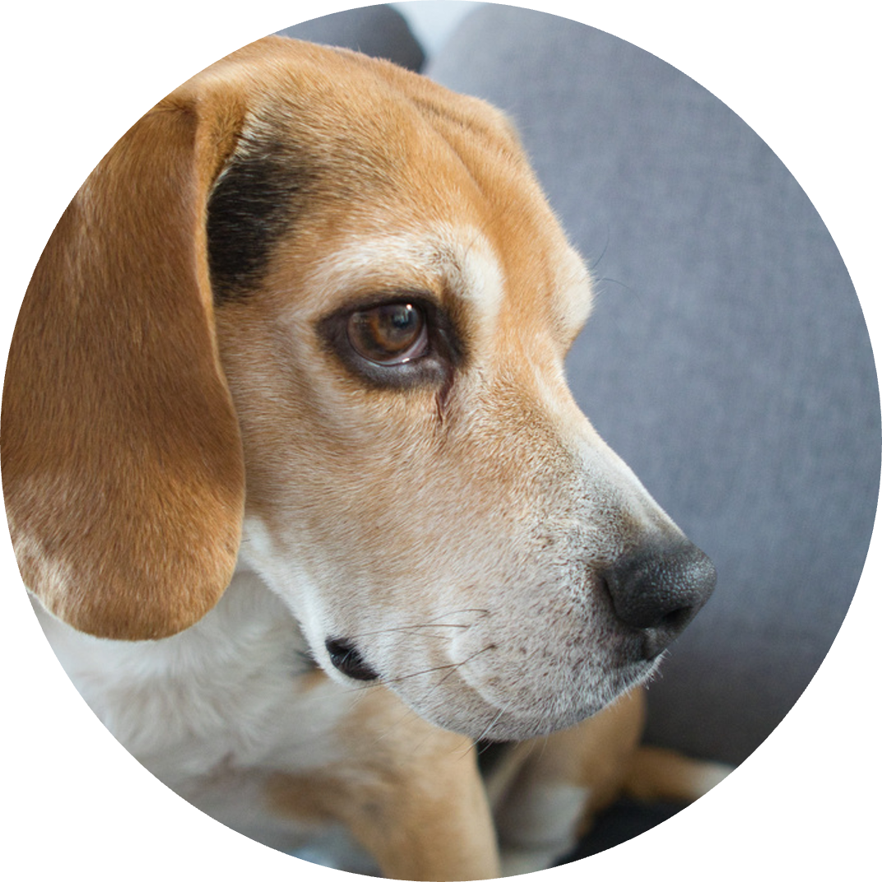
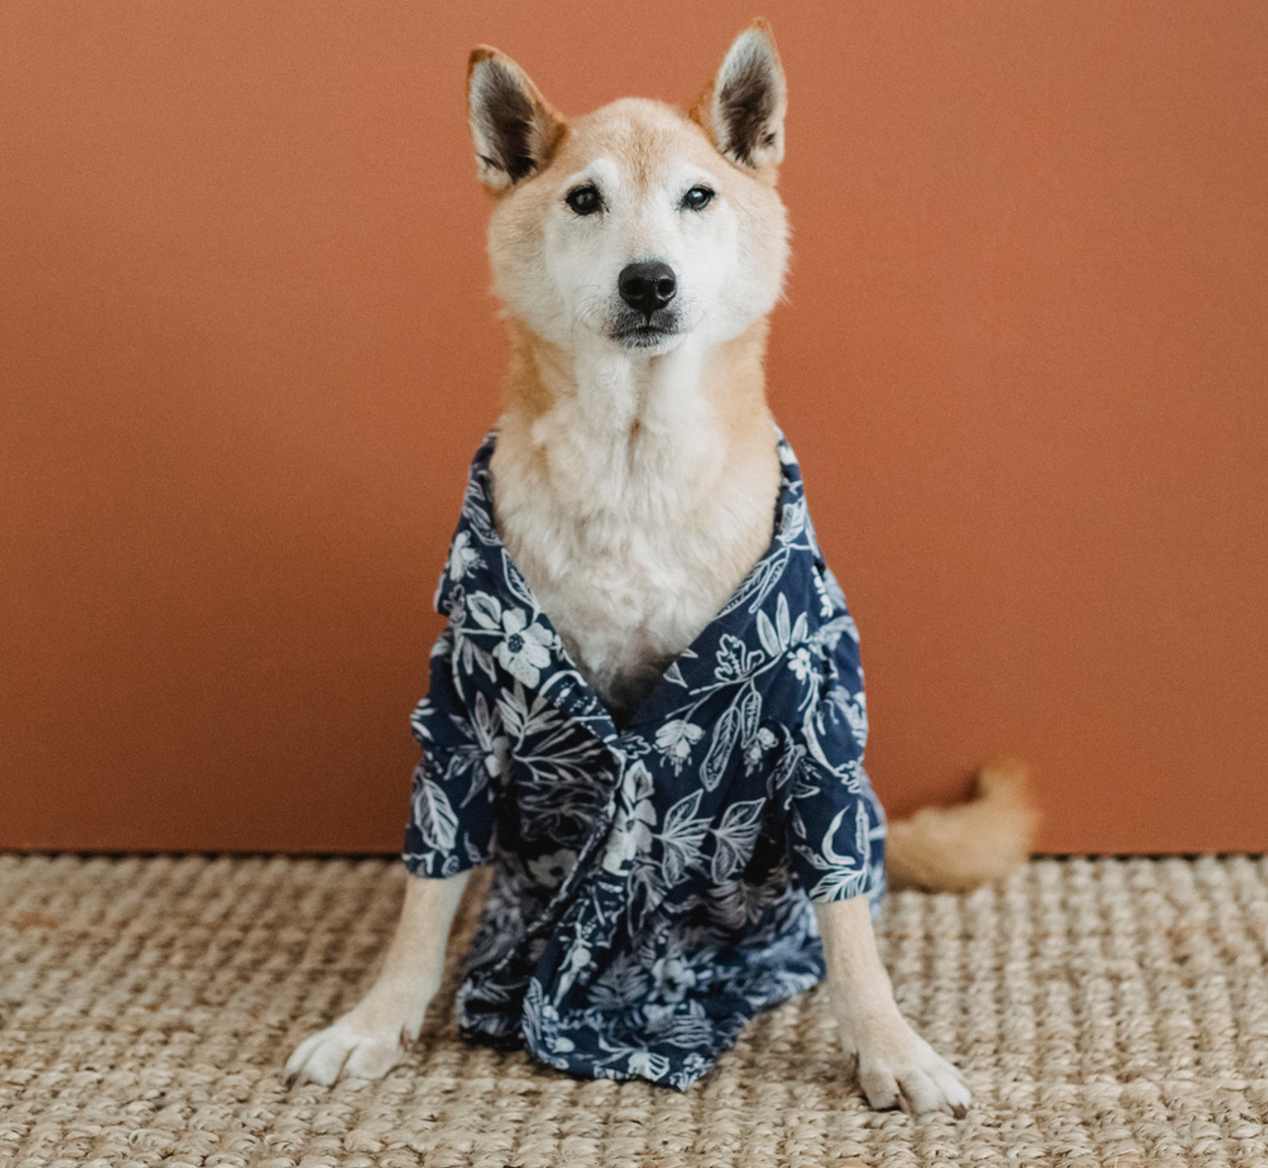
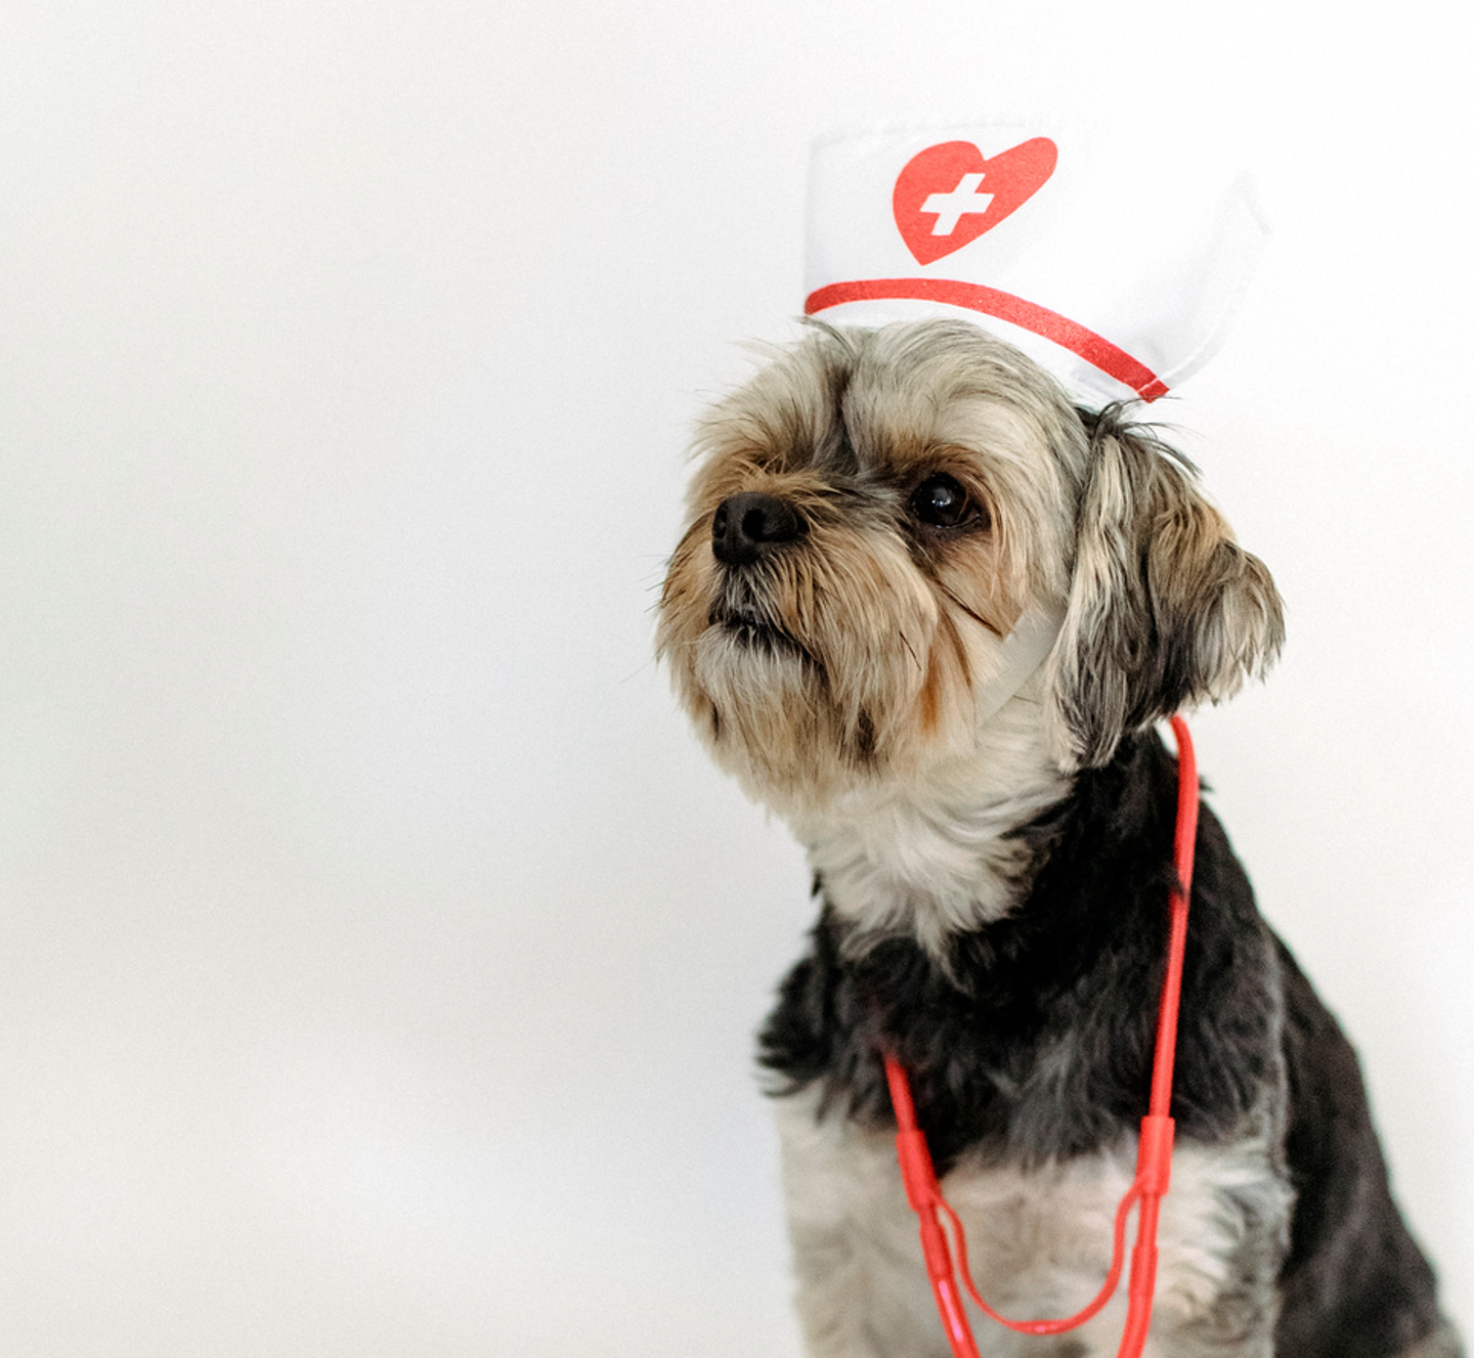
Best Beagle Otis
@bemyotis
How I dress
vs my actual profession

Slide 7
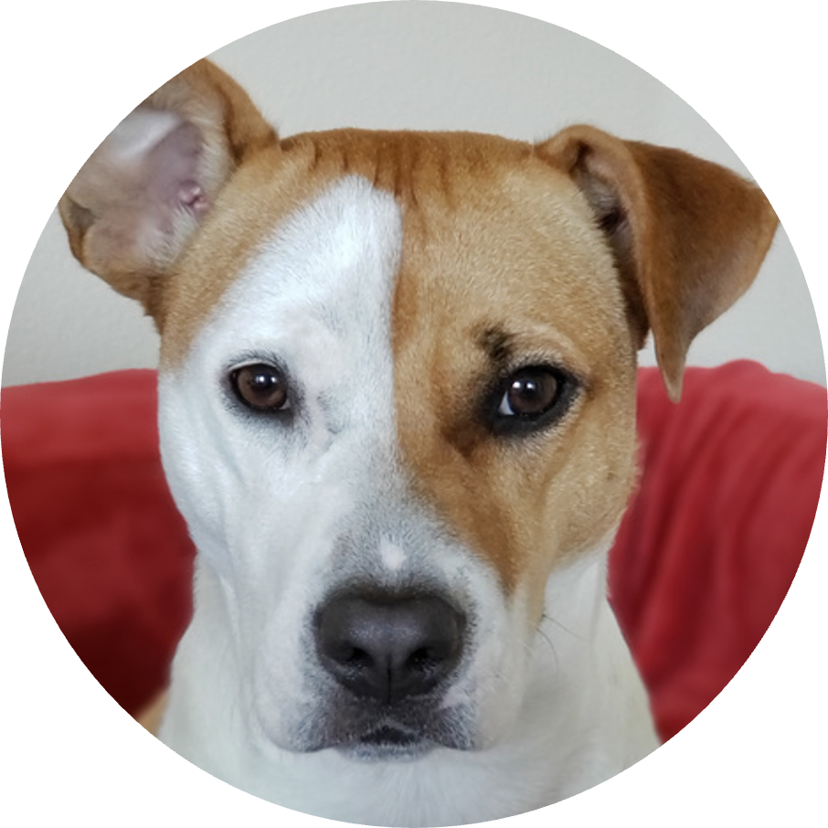
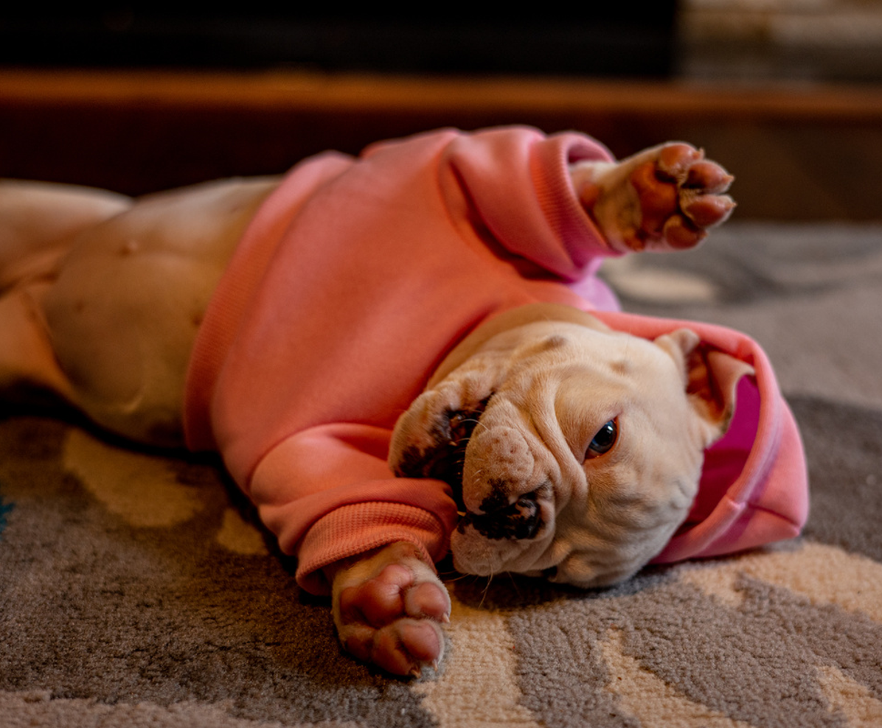
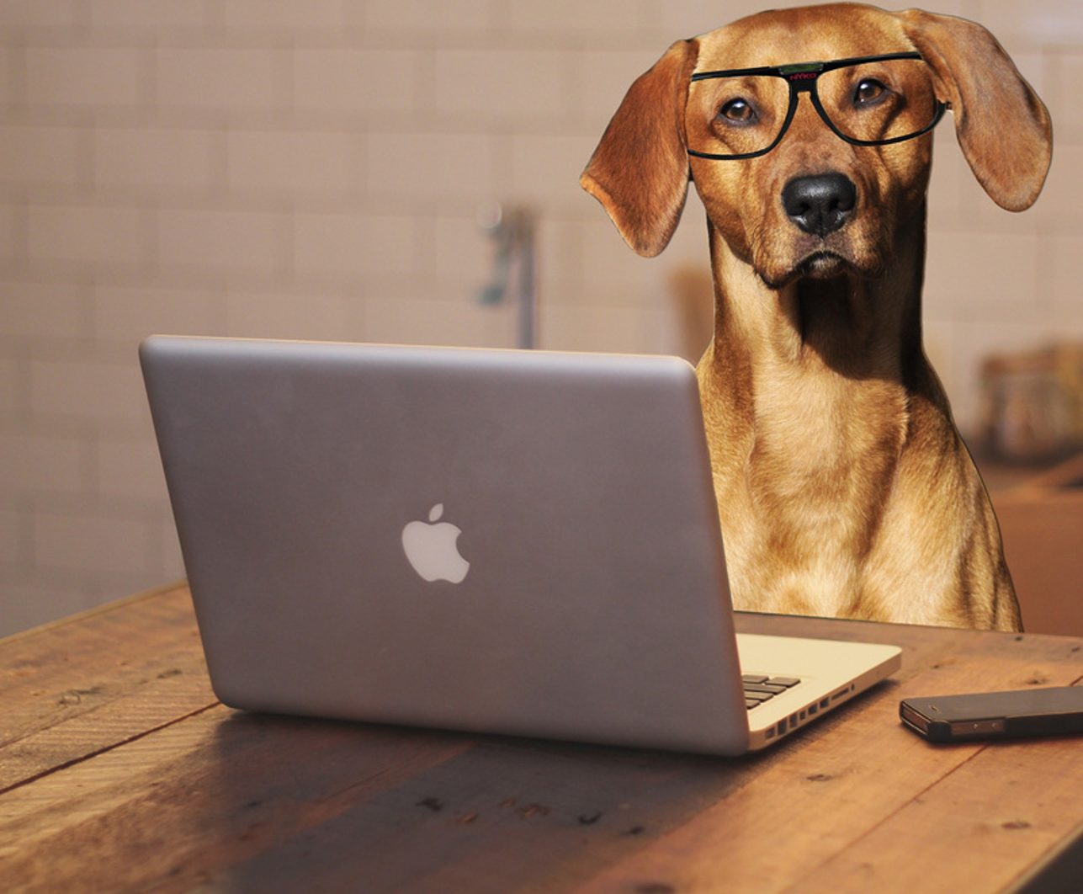
Pepper Potts
@thatsmePepper
Online meeting with audio only
Online meeting with video

Slide 8
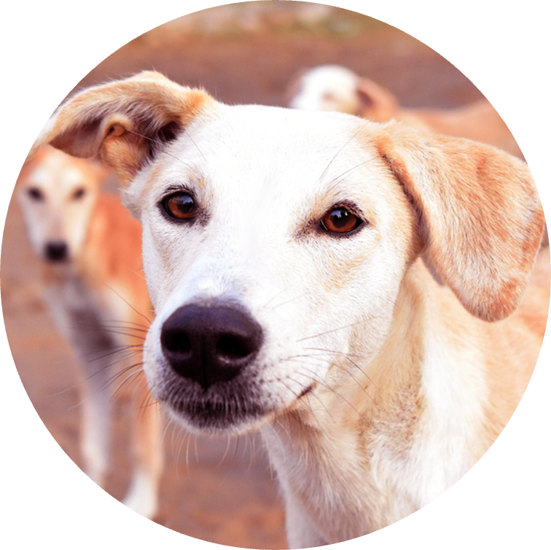
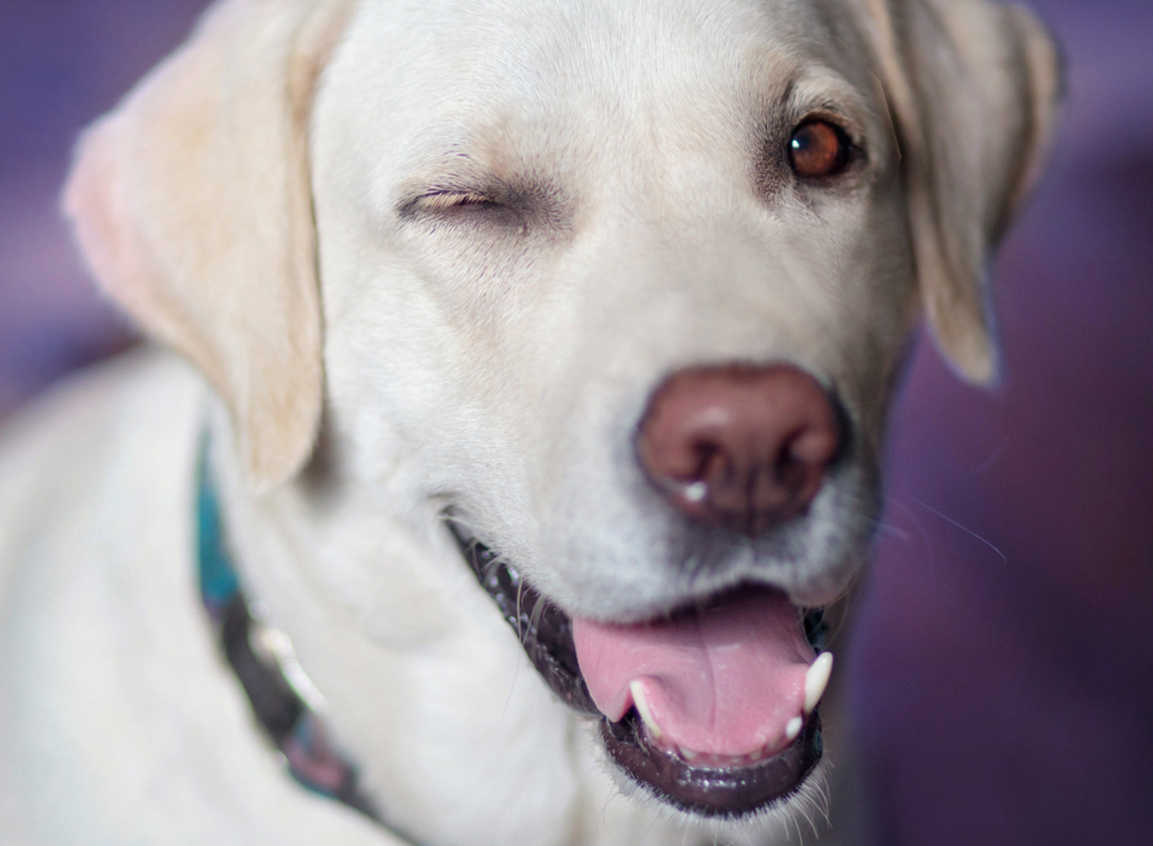
Crunchy Munchie
@crunchymunchie
When the cat gets in trouble for something I did

Slide 9
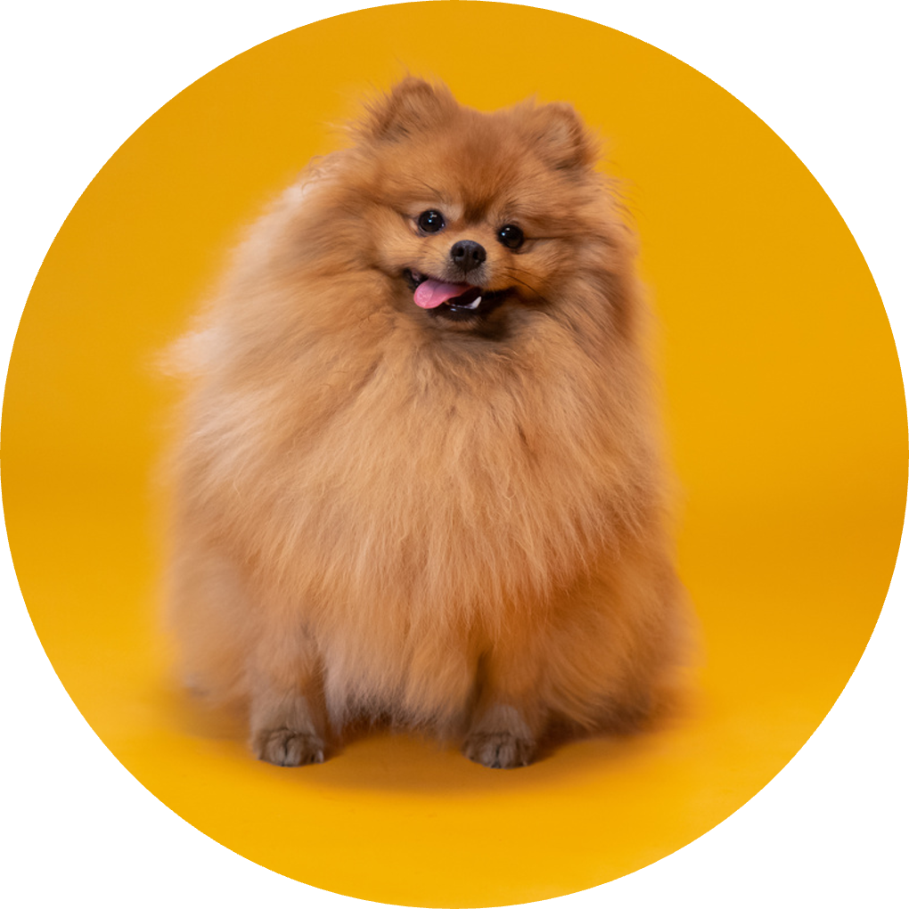
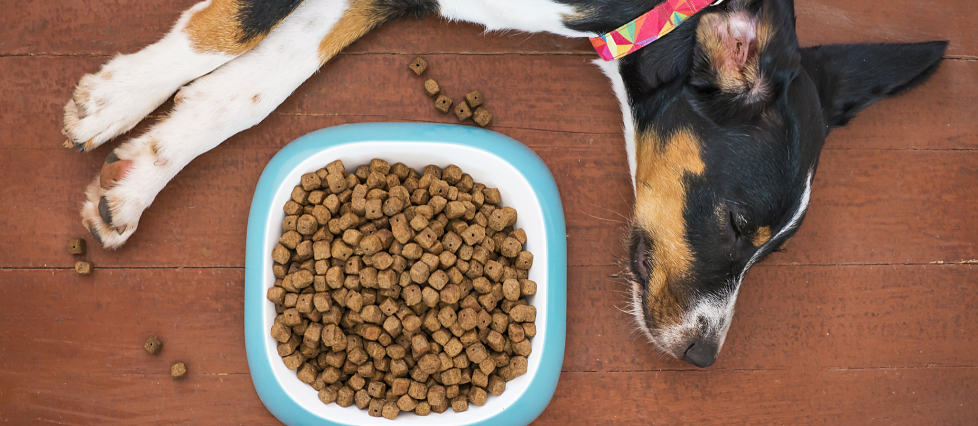
Sweetie Maya
@mayanotthebird
Me: Productivity is off the woof!
Also me after lunch time:

Slide 10
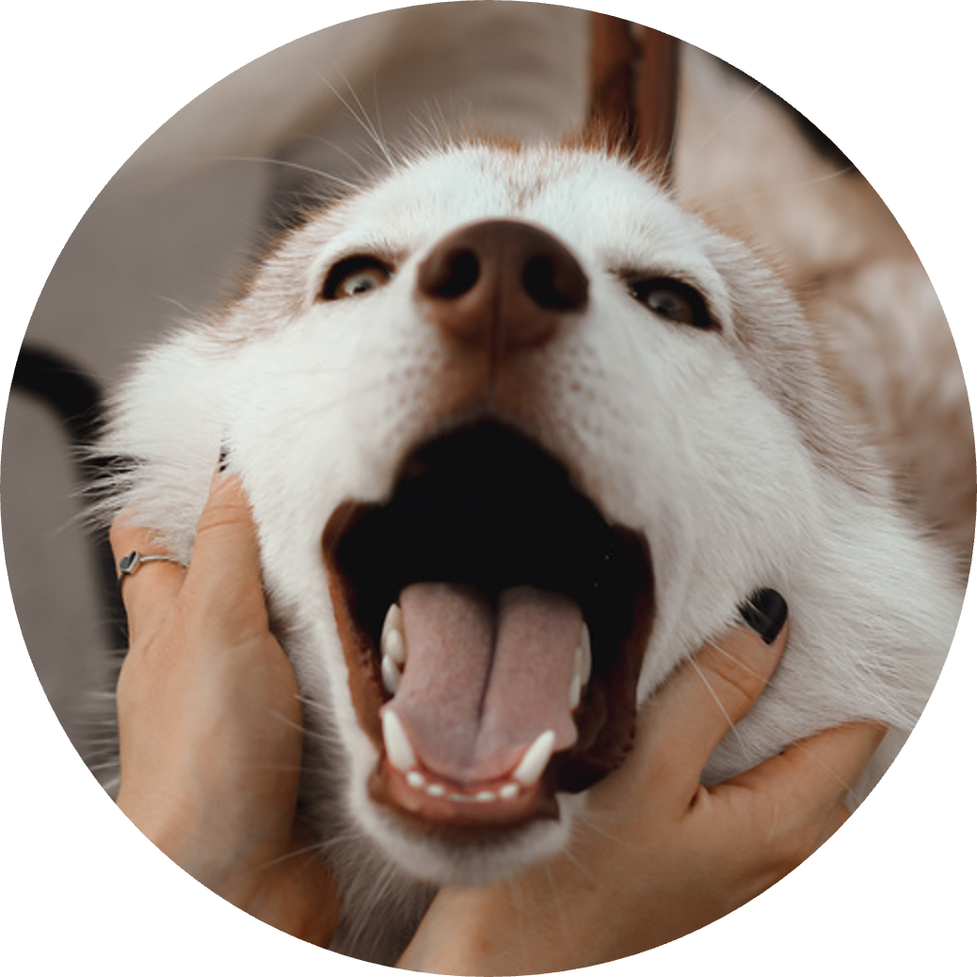
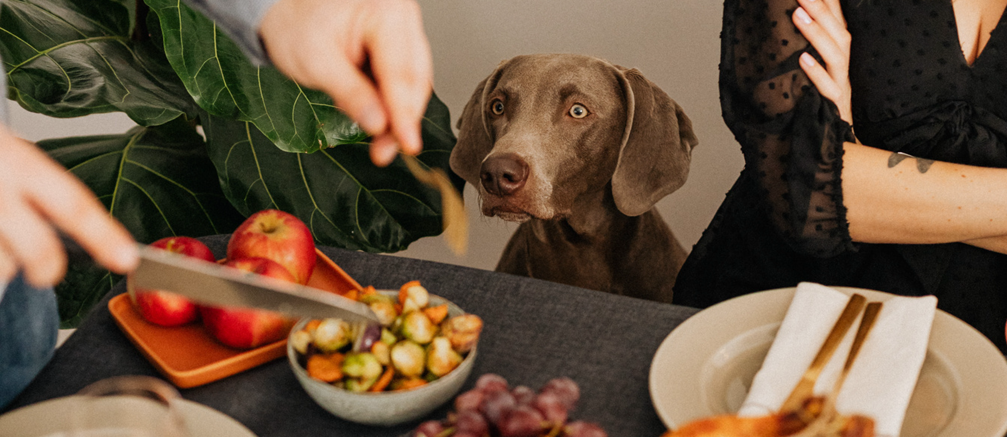
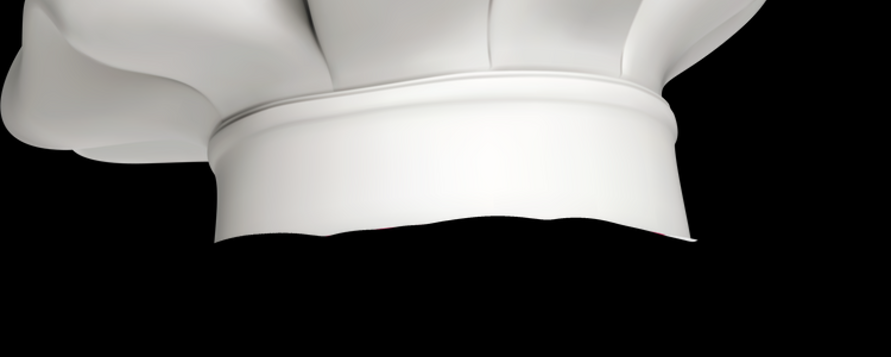
Mr. Paddington
@huskywusky
Let him cook!!!

Slide 11

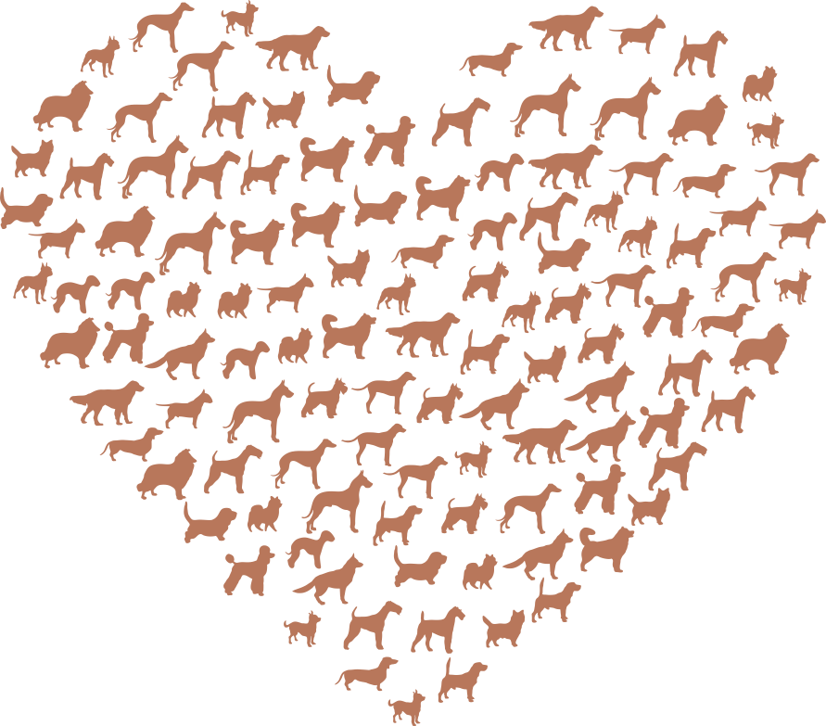
Resource Page
  Use these design resources in your Canva Presentation.
Fonts
  Design Elements
  This presentation template
  uses the following free fonts:
  Titles and Body:
LIBRE FRANKLIN
  You can find these fonts online too.
Colors
  Don't forget to delete this page before presenting.

Slide 12


Credits
  This presentation template is free for everyone to use thanks to the following:
  for the presentation template
  PEXELS, PIXABAY
  for the photos
  Happy designing!

