Slide 1
ANIMAL RESCUE
Non - Profit Presentation

Slide 2
HOW TO USE THIS PRESENTATION
Google Slides
PowerPoint
Canva
Click on the "Google Slides" button below this presentation preview.
Click on "Make a copy."
Start editing your presentation.
You need to sign in to your Google account.
Click on the "PowerPoint" button below this presentation preview.
Start editing your presentation.
Download and install the fonts used in this presentation as listed on the next page.
Click on the "Canva" button under this presentation preview.
Start editing your presentation.
You need to sign in to your Canva account.
00

Slide 3
TABLE OF CONTENTS
1. Introduction
Elaborate on what you want to discuss.
2. Our Projects
Elaborate on what you want to discuss.
3. About Us
Elaborate on what you want to discuss.
4. Fun Facts
Elaborate on what you want to discuss.
00

Slide 4
INTRODUCTION
Elaborate on what you want to discuss.
01

Slide 5
WELCOME TO PRESENTATION
I'm Rain, and I'll be sharing with you my beautiful ideas. Follow me at @reallygreatsite to learn more.
Presentations are communication tools that can be used as demonstrations, lectures, speeches, reports, and more. It is mostly presented before an audience.
02

Slide 6
OUR COMPANY
Who we are?
Briefly elaborate on what you want to discuss. Let your viewers know who you are and what drives you.
Presentations are communication tools. It is mostly presented before an audience.
Our mission is to rescue, rehabilitate, and rehome animals, while also promoting animal welfare and responsible pet ownership. We strive to provide a safe and nurturing environment for animals.
What do we do?
Briefly elaborate on what you want to discuss. Let your viewers know who you are and what drives you.
Presentations are communication tools. It is mostly presented before an audience.
Our mission is to rescue, rehabilitate, and rehome animals, while also promoting animal welfare and responsible pet ownership. We strive to provide a safe and nurturing environment for animals.
03

Slide 7
OUR FOUNDER
Jane Doe
Presentations are communication tools that can be used as demonstrations, lectures, speeches, reports, and more. It is mostly presented before an audience.
04

Slide 8
ADD A TEAM MEMBERS PAGE
Jane Doe
Jane Doe
FOUNDER
ANIMAL RESCUER
Elaborate on what you want to discuss. Maybe add some background to give your audience a better idea of who your team is and what they bring to the table.
Elaborate on what you want to discuss. Maybe add some background to give your audience a better idea of who your team is and what they bring to the table.
John Doe
John Dog
VETERINARIAN
GOOD BOY
Elaborate on what you want to discuss. Maybe add some background to give your audience a better idea of who your team is and what they bring to the table.
Elaborate on what you want to discuss. Maybe add some background to give your audience a better idea of who your team is and what they bring to the table.
05

Slide 9
OUR PROJECTS
Elaborate on what you want to discuss.
06

Slide 10
GALLERY
Elaborate here.
07

Slide 11
GALLERY
Elaborate here.
08

Slide 12
ANALYSIS
Elaborate on the featured statistics.
100%
5%
88%
You can elaborate on the featured statistic here.
You can elaborate on the featured statistic here.
You can elaborate on the featured statistic here.
09

Slide 13
ANALYSIS
Elaborate on the featured statistics.
40
30
20
10
0
Item 1
Item 2
Item 3
Item 4
Item 5
10

Slide 14
ABOUT US
Elaborate on what you want to discuss.
12

Slide 15
Service 1
OUR ORGANIZATION
Elaborate on what you want to discuss.
Service 2
Elaborate on what you want to discuss.
Service 3
Elaborate on what you want to discuss.
Service 4
Elaborate on what you want to discuss.
13

Slide 16
FUN FACTS
Elaborate on what you want to discuss.
14

Slide 17
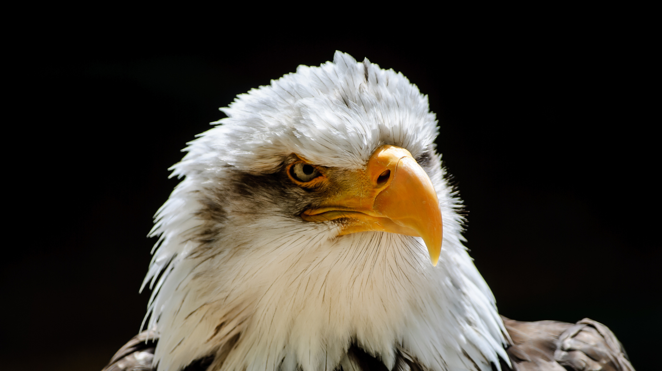
EAGLES FACTS
1.
They’re One of the World’s Largest Raptors.
Bald Eagles can weigh up to 15lb., and are between 28-38 inches in size. Their wingspan can reach up to 7.5 feet.
3.
They Mate for Life.
When it comes to commitment, Bald Eagle couples are in it for the long haul. They typically mate for life—meaning they can be coupled monogamously for 30 years.
2.
They Aren’t Actually Bald.
Since Bald Eagles sport a white head of feathers, so where did the “bald” moniker come from? It turns out that it was a translation of the old English word “piebald,” meaning “white” or “white-headed.”
15

Slide 18
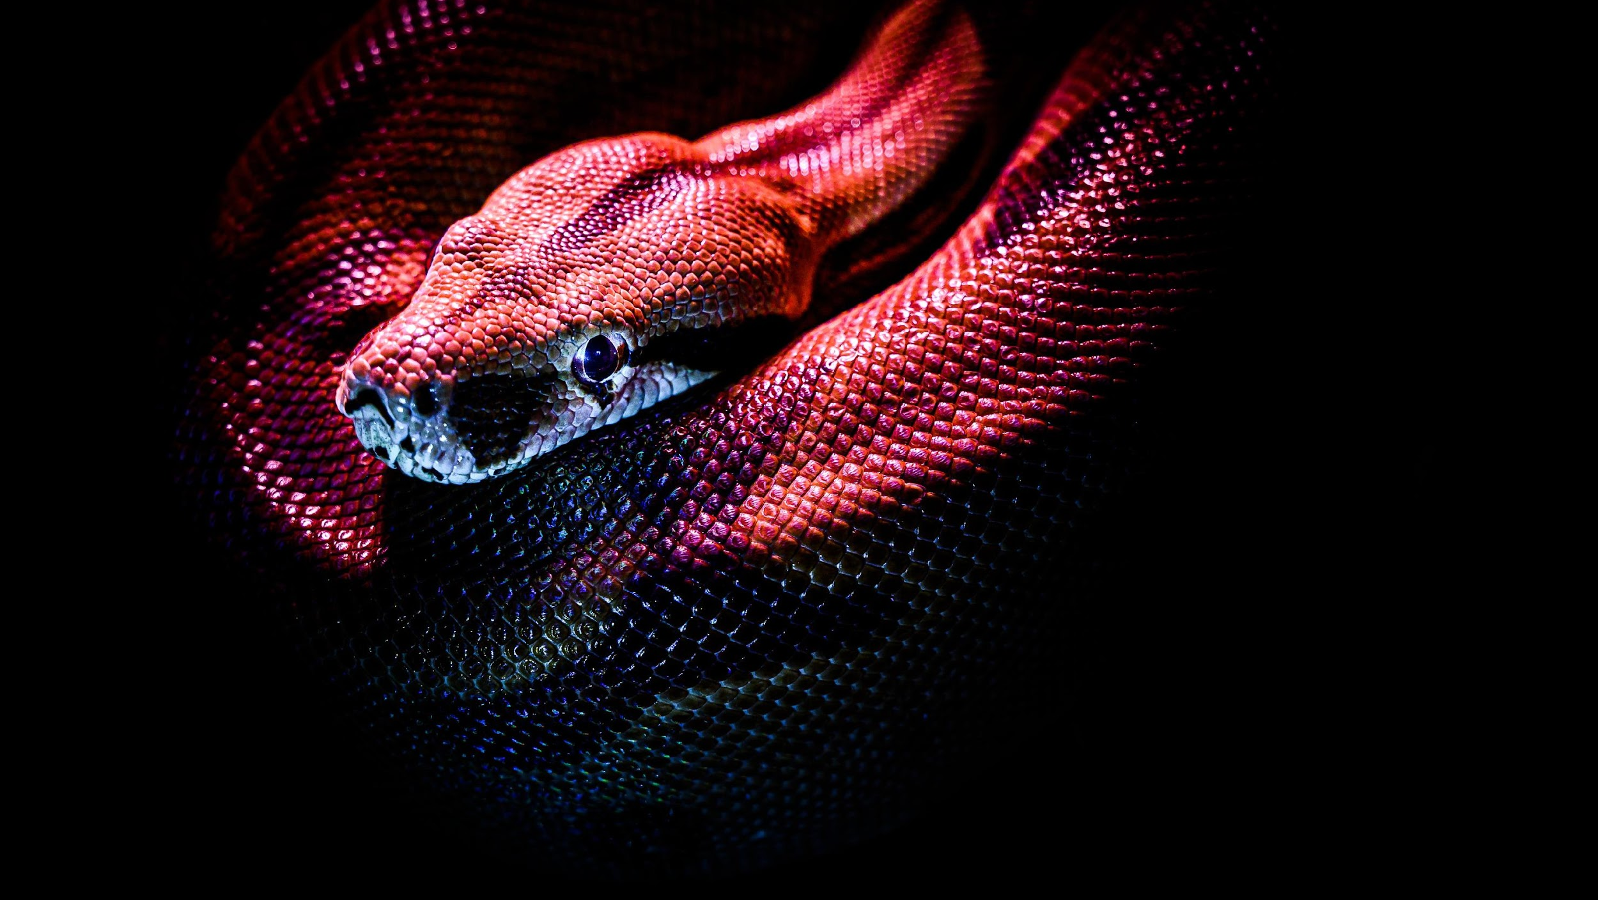
SNAKE FACTS
1.
They are “solar-powered”.
Reptiles sometimes get labelled ‘cold-blooded’ but this is incorrect as their blood isn’t actually cold. The accurate term is ectothermic, meaning their body temperature is variable and regulated by external sources.
2.
Snakes don't have eyelids.
Ever wondered why snakes might give you an eerie feeling? They don’t have eyelids! This means they don’t blink and have to sleep with their eyes wide open.
3.
They smell with their tongues.
Snakes do have nostrils, but they don’t use them to smell. Instead they have evolved to smell with their tongue and by using their Jacobson’s organ in the roof of their mouth.
16

Slide 19
WRITE AN ORIGINAL STATEMENT OR INSPIRING QUOTE
— Include a credit, citation, or supporting message
17

Slide 20
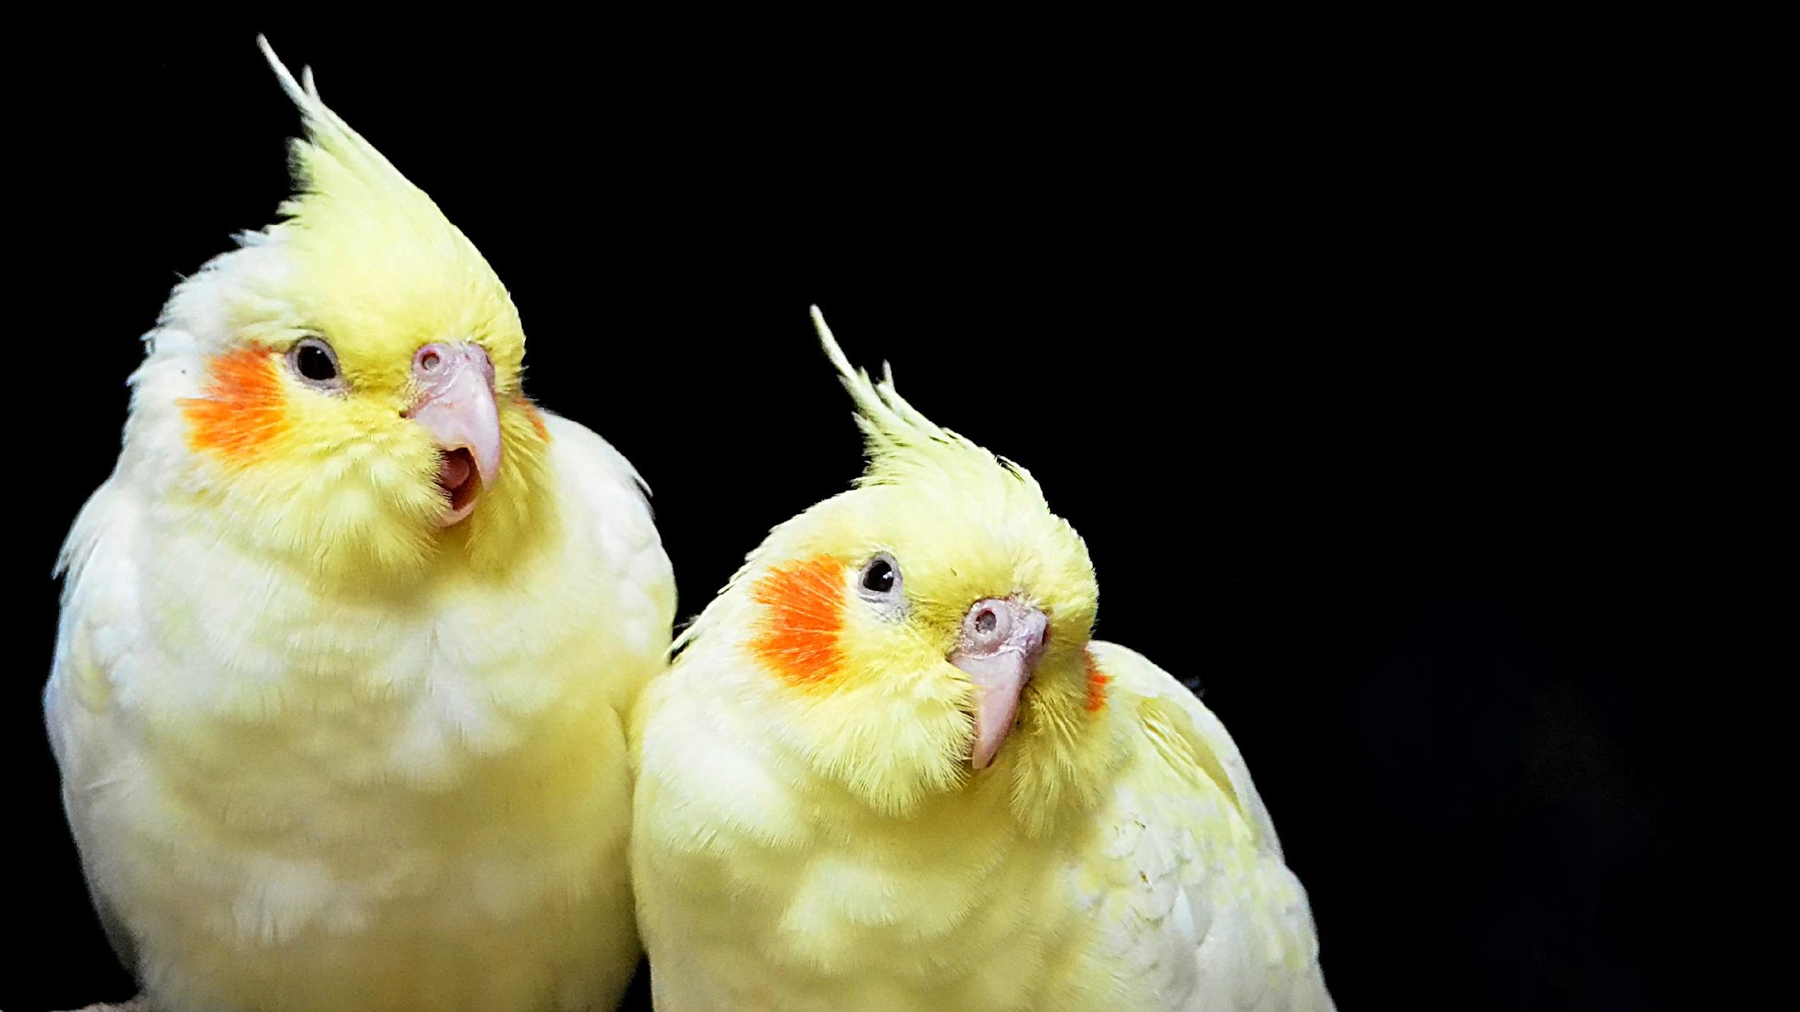
Contact Us
123 Anywhere St., Any City,ST 12345
123-456-7890
hello@reallygreatsite.com
@reallygreatsite
reallygreatsite.com
00

Slide 21
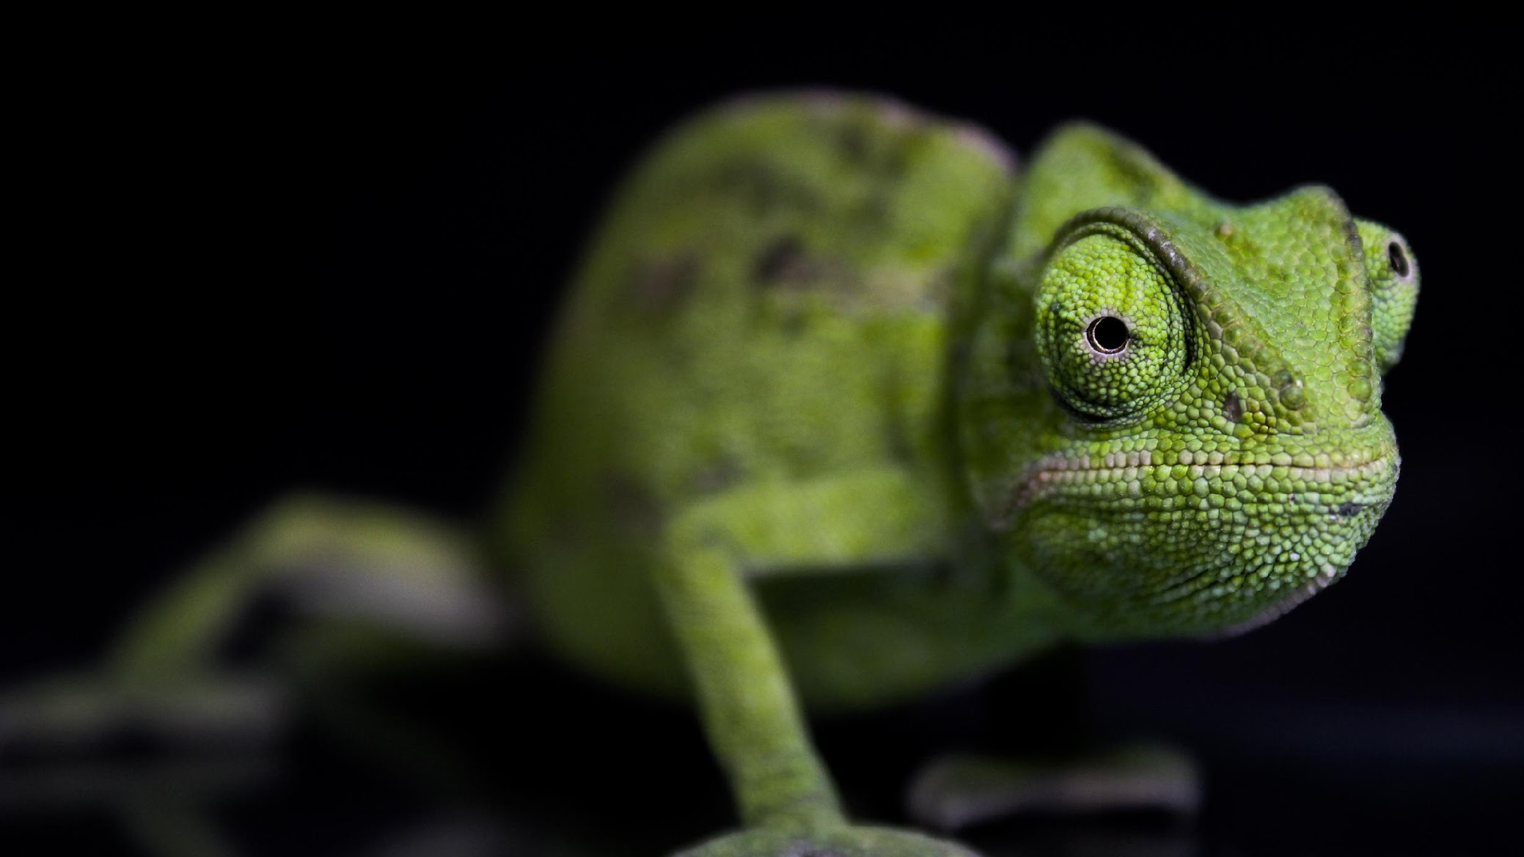
Credits
This presentation template is free for everyone to use thanks to the following:
SlidesCarnival for the presentation template
Pexels for the photos
Happy designing!
00

Slide 22
Resource
Page
Use these design resources in your Canva Presentation.
You can find these fonts online too. Happy designing!
Don't forget to delete this page before presenting.
This presentation template uses the following free fonts:
Titles: Inter
Headers: Inter
Body Copy: Inter
Footer: Ovo
00

Slide 23
Free templates for all your presentation needs
For PowerPoint, Google Slides, and Canva
100% free for personal or commercial use
Ready to use, professional, and customizable
Blow your audience away with attractive visuals
00

