Slide 1







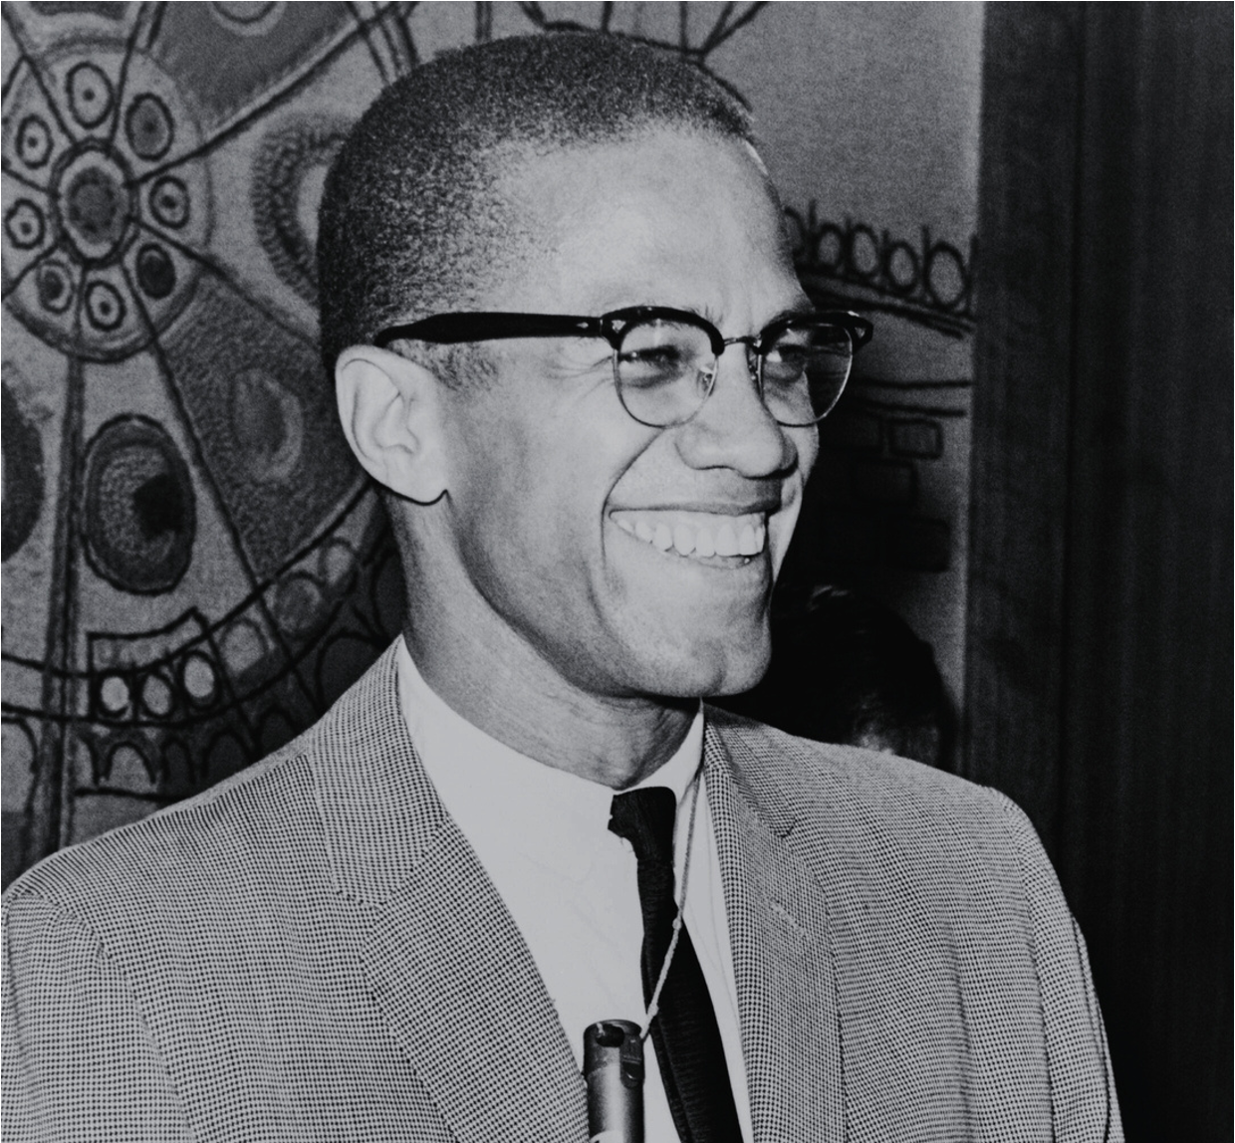






Black History
Month
martin luther king
harriet tubman
malcolm X
EVERY FEBRUARY
Black History Month is an annual observance in several countries, including the United States and Canada, dedicated to honoring the achievements and contributions of African Americans and recognizing their central role in history. It is celebrated during the month of February in the United States and in February or October in Canada.

Slide 2
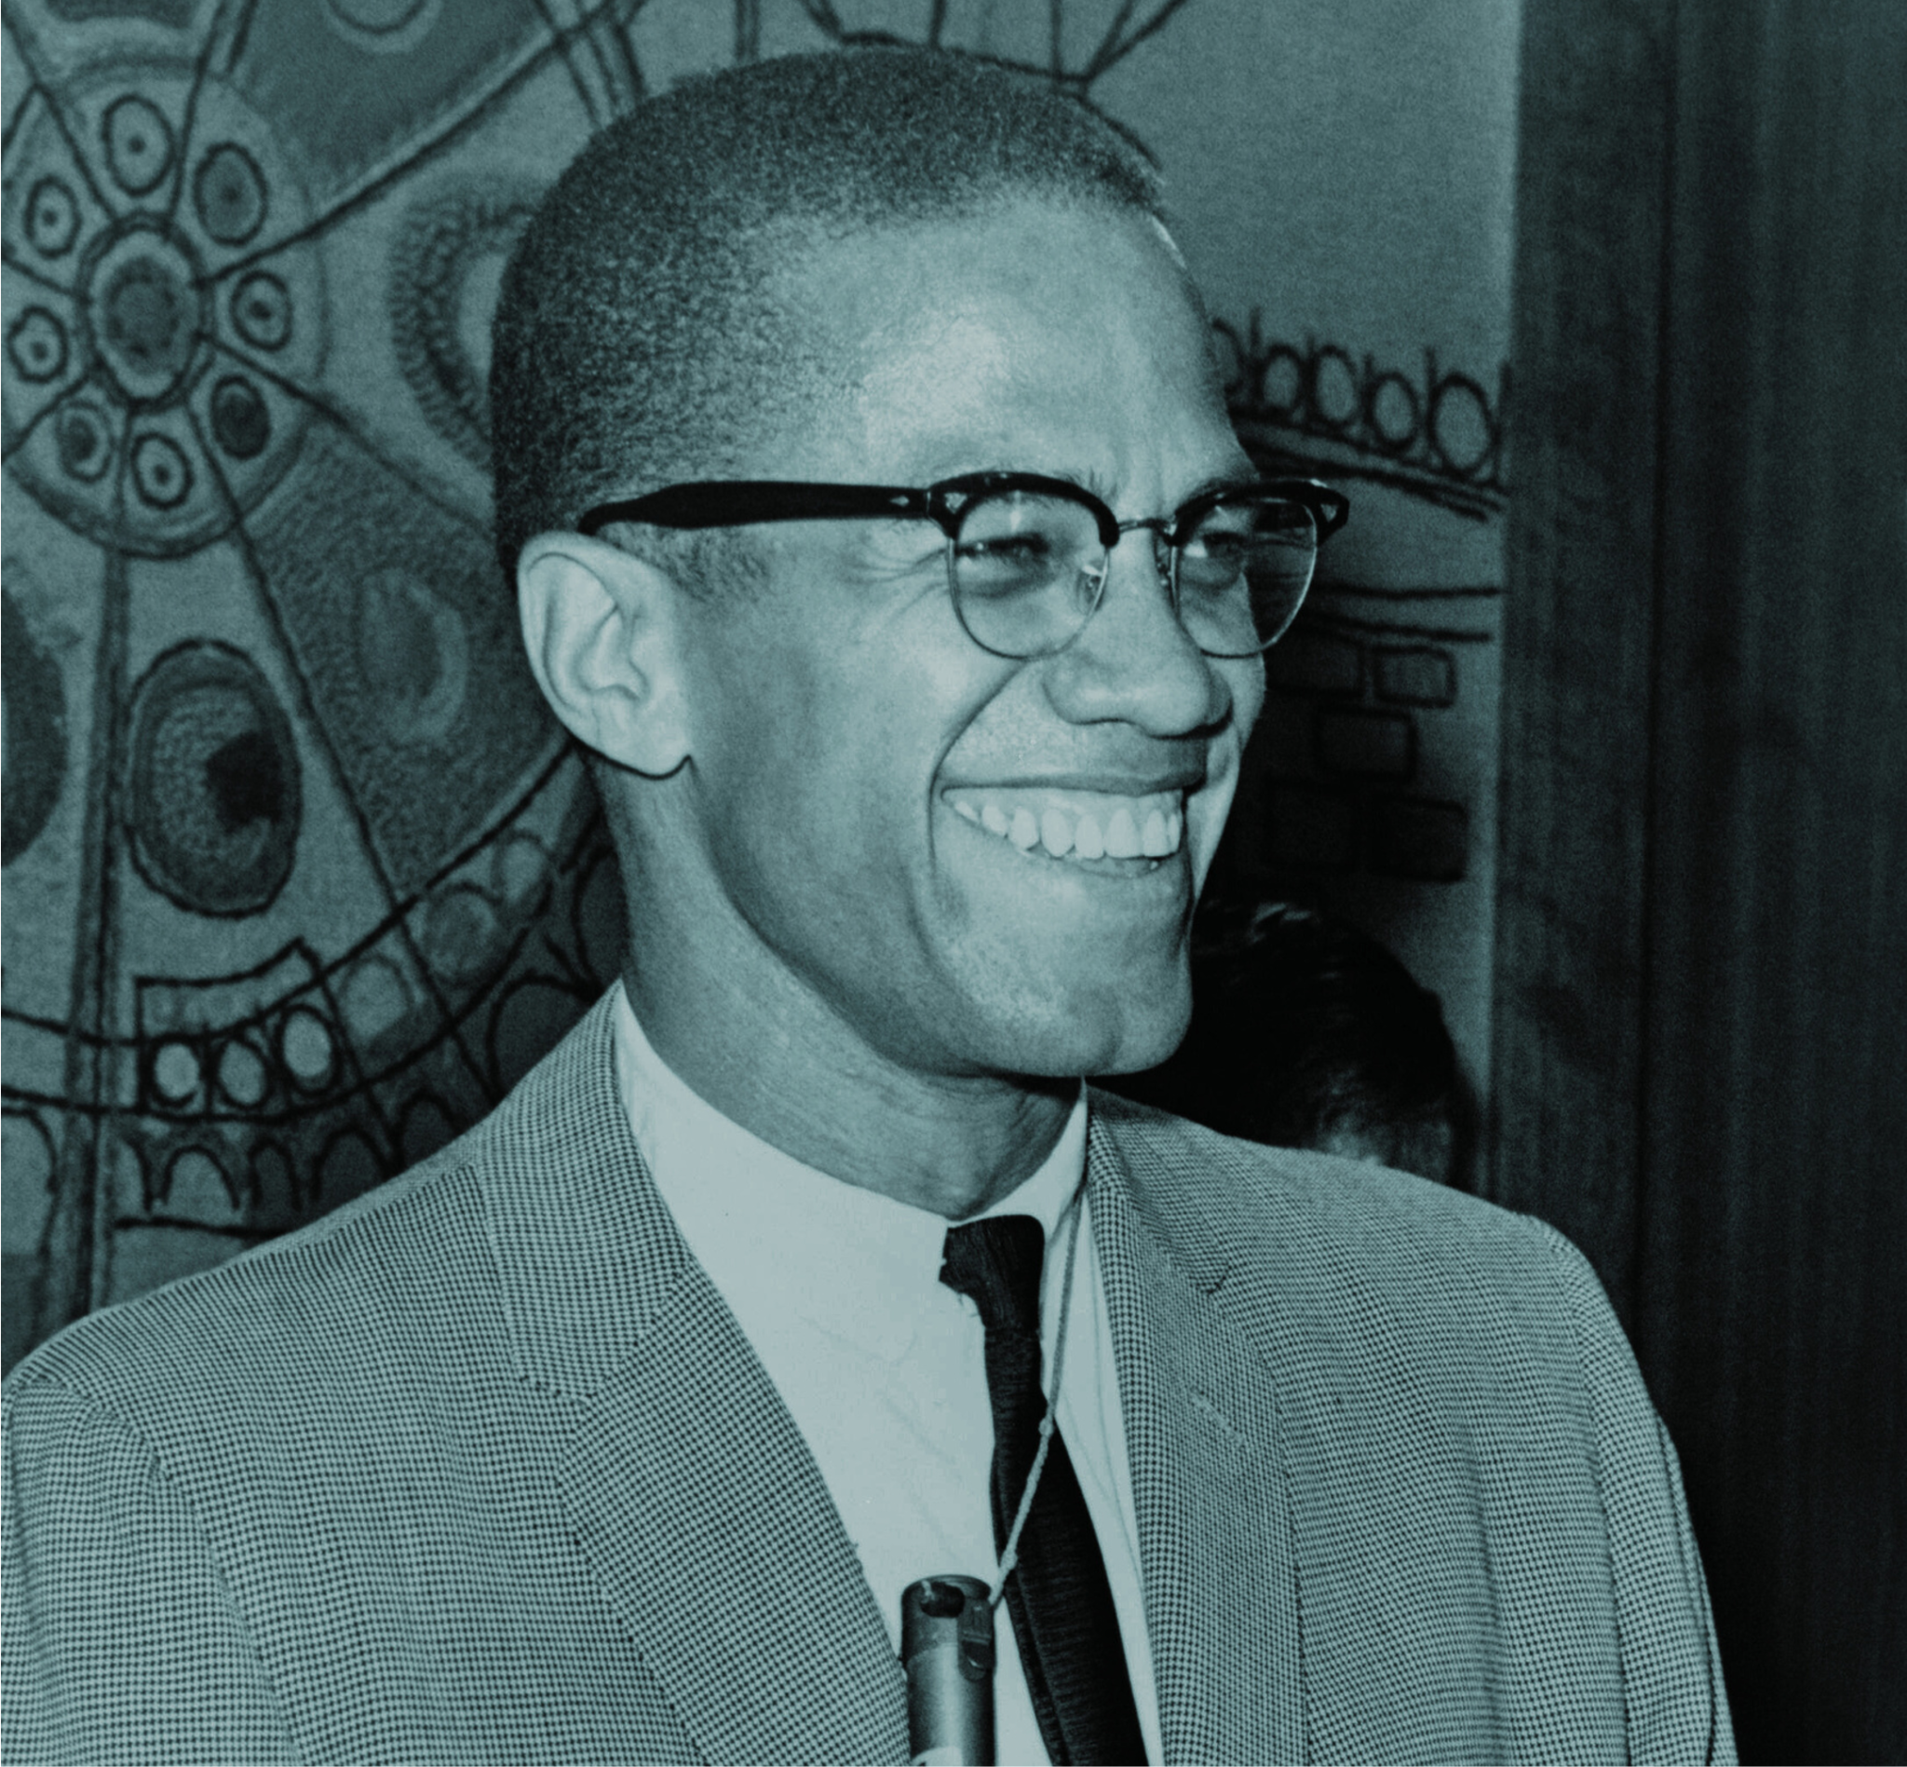
BLACK HISTORY MONTH
FEB
Black History Month is an annual observance in several countries, including the United States and Canada, dedicated to honoring the achievements and contributions of African Americans and recognizing their central role in history. It is celebrated during the month of February in the United States and in February or October in Canada.

Slide 3

RESOURCES
Use these design resources in your Canva Poster Design
This poster template uses the following free fonts:
design one: east sea dokdo cyrillic / montserrat
design two: forum
You can find these fonts online too. Don't forget to delete this page before presenting.

Slide 4

CREDITS
This poster design template is free for everyone to use thanks to the following:
for the poster template
for the photos
Happy designing!
SLIDESCARNIVAL
PEXELS

