Slide 1
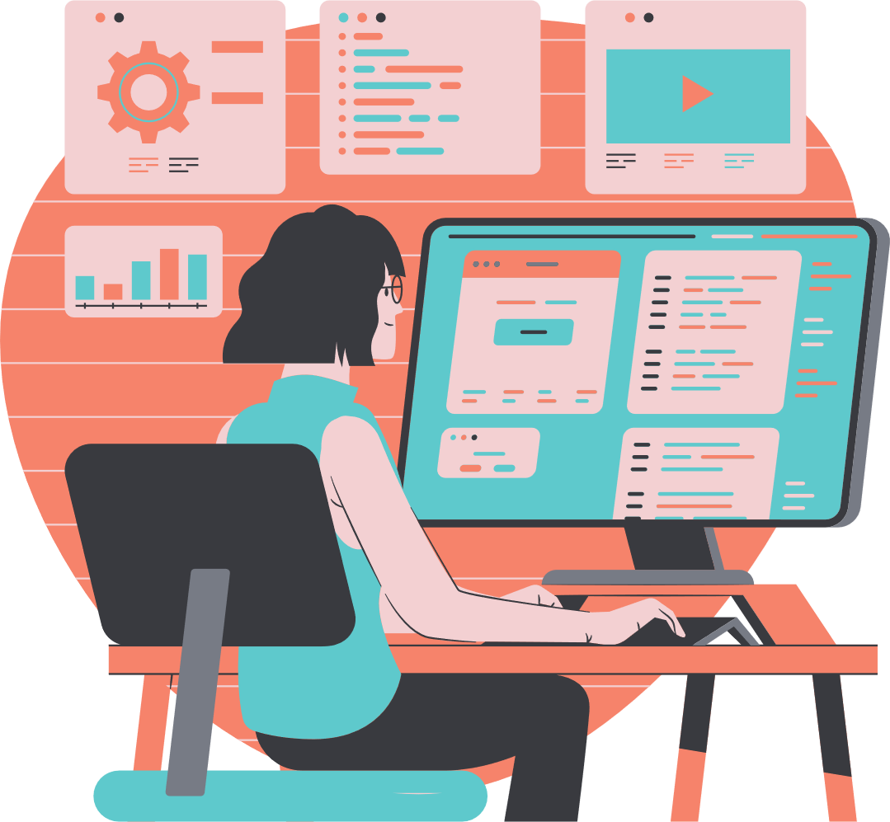
PROGRAMMING LESSON
PRESENTATION

Slide 2
TABLE OF CONTENTS
01
04
INTRODUCTION
OBJECTIVE
02
05
OUR LESSON
MATERIALS
03
PROGRAMMING

Slide 3
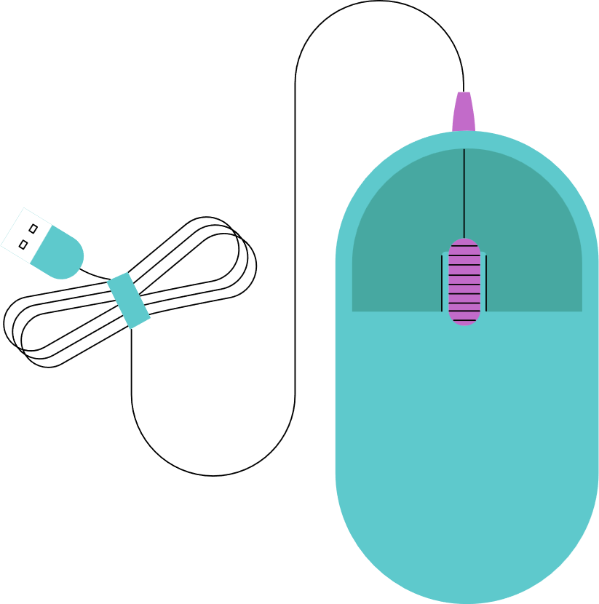
01
INTRODUCTION
Welcome to a world where words come alive, where ideas dance across the page like stars in the night sky. In this realm of creativity and imagination, we embark on a journey of discovery and inspiration. As we delve into the depths of our minds and hearts, we uncover stories waiting to be told, dreams yearning to be realized, and wisdom eager to be shared.
Here, words are not just letters strung together; they are the building blocks of new worlds, the bridges between souls, and the keys to unlocking the mysteries of the universe. So let us embrace the power of language, let us celebrate the beauty of storytelling, and let us together create a tapestry of words that will enchant, enlighten, and endure.
Join me as we explore the boundless possibilities of the written word, where every sentence is a brushstroke painting a picture, every paragraph a melody singing a song, and every chapter a journey leading us to places unknown. Together, we will weave a tapestry of tales that will resonate across time and space, forging connections that transcend boundaries and uniting us in the universal language of storytelling.

Slide 4
WELCOME TO PRESENTATION
I'm Rain, and I'll be sharing with you my beautiful ideas. Follow me at @reallygreatsite to learn more.

Slide 5
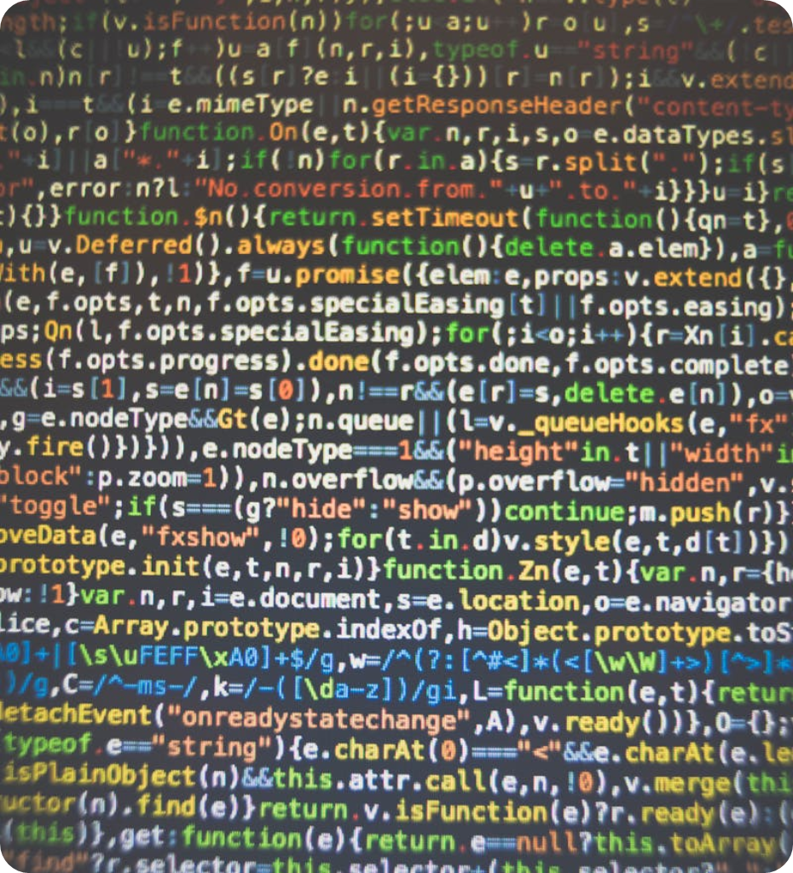
GETTING STARTED WITH PYTHON
Whether you're looking to dive into coding for the first time or expanding your programming skills, Python is a great language to learn. Known for its simplicity and versatility, Python is used in a wide range of applications, from web development to data science and automation.
To get started with Python, you'll need to install the Python interpreter on your computer. You can download the latest version of Python from the official website and follow the installation instructions for your operating system.
Once Python is installed, you can start writing and running Python code using a text editor or an integrated development environment (IDE). There are many resources available online to help you learn Python, including tutorials, documentation, and online courses.
One of the best ways to learn Python is by practicing coding exercises and projects. By working on real-world problems and projects, you'll not only improve your Python skills but also gain practical experience in using the language.

Slide 6
EXPLAIN INSTALL PYTHON
INSTALL
INSTALL
INSTALL
Elaborate on what you want to discuss.
Elaborate on what you want to discuss.
Elaborate on what you want to discuss.

Slide 7
PROGRAMMING
02
Welcome to a world where words come alive, where ideas dance across the page like stars in the night sky. In this realm of creativity and imagination, we embark on a journey of discovery and inspiration. As we delve into the depths of our minds and hearts, we uncover stories waiting to be told, dreams yearning to be realized, and wisdom eager to be shared.
Here, words are not just letters strung together; they are the building blocks of new worlds, the bridges between souls, and the keys to unlocking the mysteries of the universe. So let us embrace the power of language, let us celebrate the beauty of storytelling, and let us together create a tapestry of words that will enchant, enlighten, and endure.
Join me as we explore the boundless possibilities of the written word, where every sentence is a brushstroke painting a picture, every paragraph a melody singing a song, and every chapter a journey leading us to places unknown. Together, we will weave a tapestry of tales that will resonate across time and space, forging connections that transcend boundaries and uniting us in the universal language of storytelling.

Slide 8
VARIABLES AND DATA TYPES
VARIABLES AND DATA TYPES
VARIABLES AND DATA TYPES
VARIABLES AND DATA TYPES

Slide 9
GALLERY IMAGE
What can you say about your projects? Share it here!

Slide 10
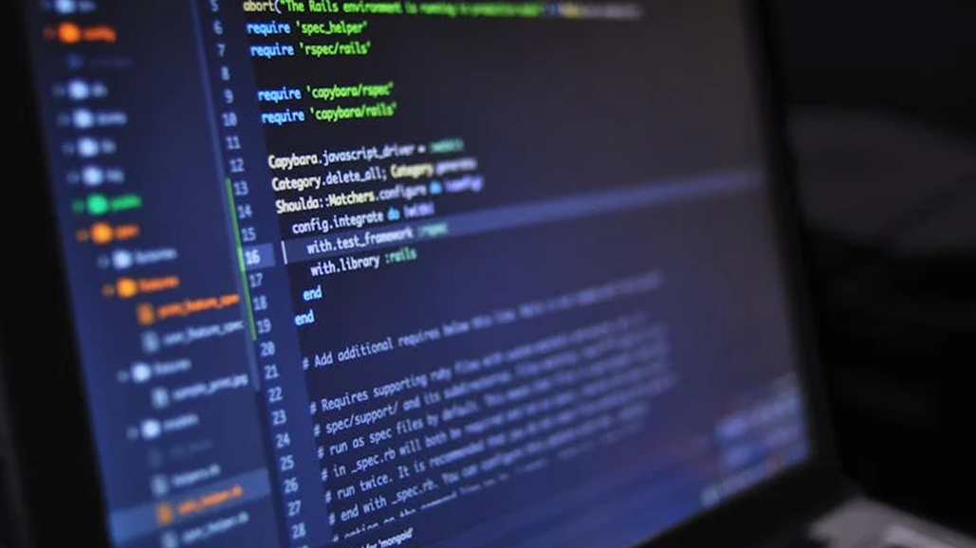
CONTROL FLOW
Control flow is a fundamental concept in programming that determines the order in which instructions are executed in a program. It allows developers to make decisions, repeat actions, and create complex algorithms. By using control flow statements such as if-else, loops, and switch cases, programmers can direct the flow of their code and make it more efficient and responsive.
Understanding control flow is essential for writing clear, logical code that performs the desired actions in a predictable manner. Mastering control flow empowers developers to create dynamic and interactive software that can handle a variety of scenarios with precision and grace.
Understanding control flow is essential for writing clear, logical code that performs the desired actions in a predictable manner. Mastering control flow empowers developers to create dynamic and interactive software that can handle a variety of scenarios with precision and grace.

Slide 11
THIS IS TABLE
TABLE
TABLE
TABLE
TABLE
Control flow is a fundamental concept in programming that determines the order in which instructions are executed in a program. It allows developers to make decisions, repeat actions, and create complex algorithms. By using control flow statements such as if-else, loops, and switch cases, programmers can direct the flow of their code and make it more efficient and responsive.
Control flow is a fundamental concept in programming that determines the order in which instructions are executed in a program. It allows developers to make decisions, repeat actions, and create complex algorithms. By using control flow statements such as if-else, loops, and switch cases, programmers can direct the flow of their code and make it more efficient and responsive.
Control flow is a fundamental concept in programming that determines the order in which instructions are executed in a program. It allows developers to make decisions, repeat actions, and create complex algorithms. By using control flow statements such as if-else, loops, and switch cases, programmers can direct the flow of their code and make it more efficient and responsive.
Control flow is a fundamental concept in programming that determines the order in which instructions are executed in a program. It allows developers to make decisions, repeat actions, and create complex algorithms. By using control flow statements such as if-else, loops, and switch cases, programmers can direct the flow of their code and make it more efficient and responsive.

Slide 12
OUR TEACHER
YOUR NAME
YOUR NAME
Elaborate on what you want to discuss.
Elaborate on what you want to discuss.

Slide 13
05
MATERIALS
In the realm of crafting and creating, materials are the foundation upon which masterpieces are built. From the delicate fibers of cotton to the sturdy structure of wood, each material carries its own unique qualities and potential. The choice of materials can greatly influence the outcome of a project, whether it be a cozy knitted sweater, a vibrant painting, or a handcrafted piece of furniture.
As creators, we carefully select our materials, considering their texture, color, durability, and sustainability. With a keen eye and a creative spirit, we transform these raw materials into works of art that speak volumes about our passion and imagination. So let us embrace the beauty and versatility of materials, for they are the building blocks of our creative endeavors.

Slide 14
USES OF THE SUBJECT
SUBJECT
SUBJECT
Elaborate on what you want to discuss.
Elaborate on what you want to discuss.

Slide 15
WORLD MAP LESSON
WORLD MAP
WORLD MAP

Slide 16
WRITE AN ORIGINAL STATEMENT OR INSPIRING QUOTE

Slide 17
THANK YOU!

Slide 18
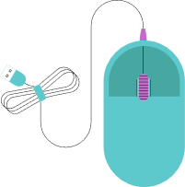
RESOURCE PAGE
Use these design resources in your Canva Presentation.
You can find these fonts online too. Happy designing!
Don't forget to delete this page before presenting.
This presentation template uses the following free fonts:
Titles: Anton
Headers: Anton
Body Copy: Arimo

Slide 19
CREDITS
This presentation template is free for everyone to use thanks to the following:
SlidesCarnival for the presentation template
Pexels for the photos
HAPPY DESIGNING!

