Slide 1
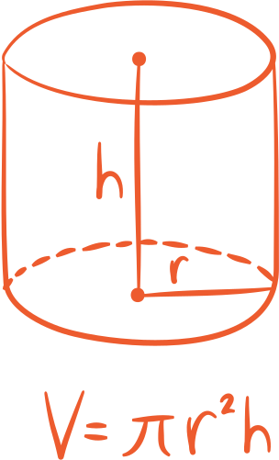


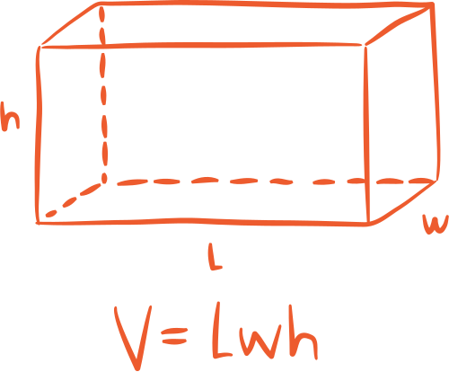

For 7th & 8th grade
Mathematics
Quiz
With teacher Canva

Slide 2
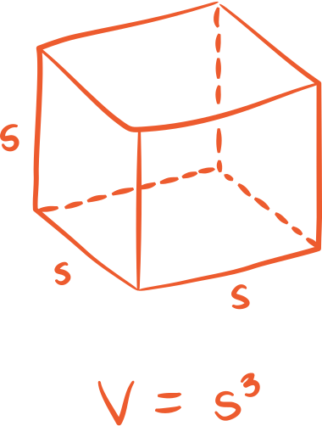
How to Use This Presentation
Google Slides
PowerPoint
Canva
Click on the "Google Slides" button below this presentation preview. Make sure to sign in to your Google account. Click on "Make a copy." Start editing your presentation.
Alternative: Click on the "Share" button on the top right corner in Canva and click on "More" at the bottom of the menu. Enter "Google Drive" in the search bar and click on the GDrive icon to add this design as a Google slide in your GDrive.
Click on the "PowerPoint" button below this presentation preview. Start editing your presentation.
Alternative: From Canva template file, Click on the "Share" button on the top right corner in Canva and click on "More" at the bottom of the menu. Enter "PowerPoint" in the search bar and click on the PowerPoint icon to download.
Click on the "Canva" button under this presentation preview. Start editing your presentation. You need to sign in to your Canva account.

Slide 3
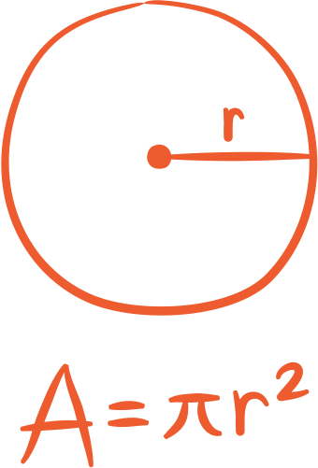
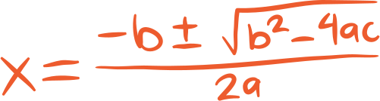


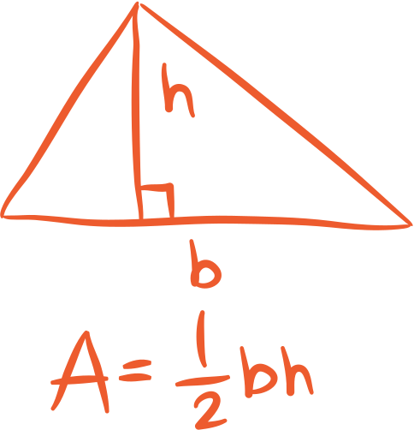

Add an Agenda Page
Section A
Section B
Section C
01
02
03
Describe the topic
of this section.
Describe the topic
of this section.
Describe the topic
of this section.

Slide 4




Hello
there!
I'm Rain, and I'll be sharing with you my beautiful ideas. Follow me at @reallygreatsite to learn more.

Slide 5

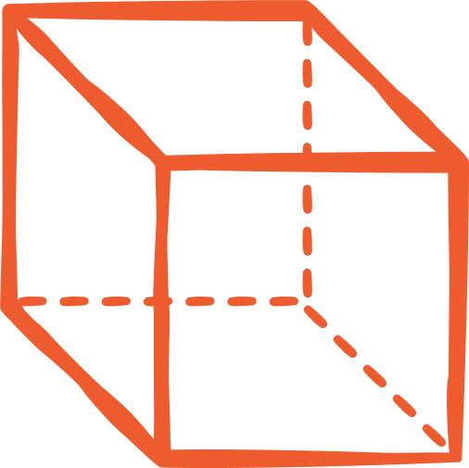
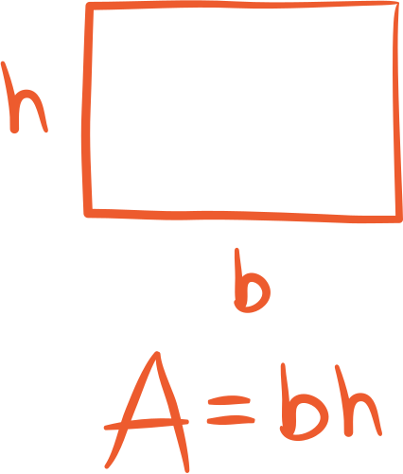
Add a main point
Briefly elaborate on
what you want to discuss.
Add a main point
Briefly elaborate on
what you want to discuss.
Directions
Add a main point
Briefly elaborate on
what you want to discuss.

Slide 6

Write Your Topic or Idea
Elaborate on what you want to discuss.
Elaborate on what you want to discuss.
Elaborate on what you want to discuss.
Elaborate on what you want to discuss.

Slide 7


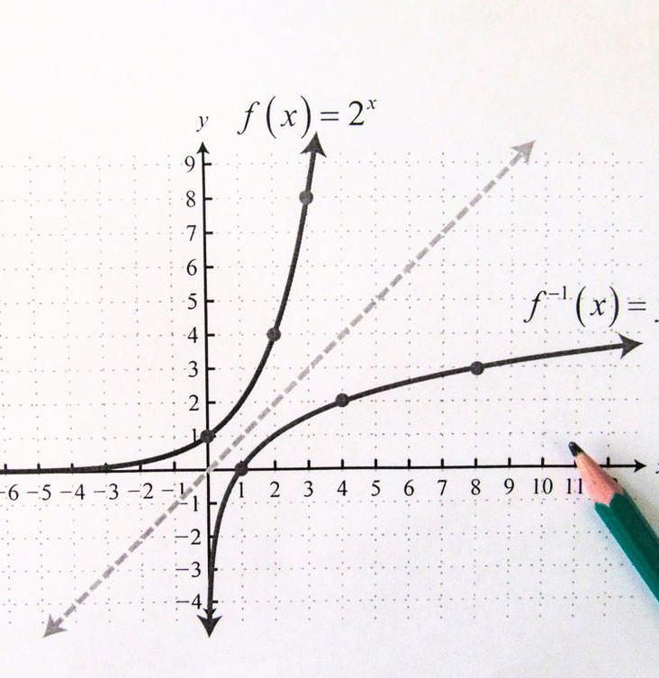

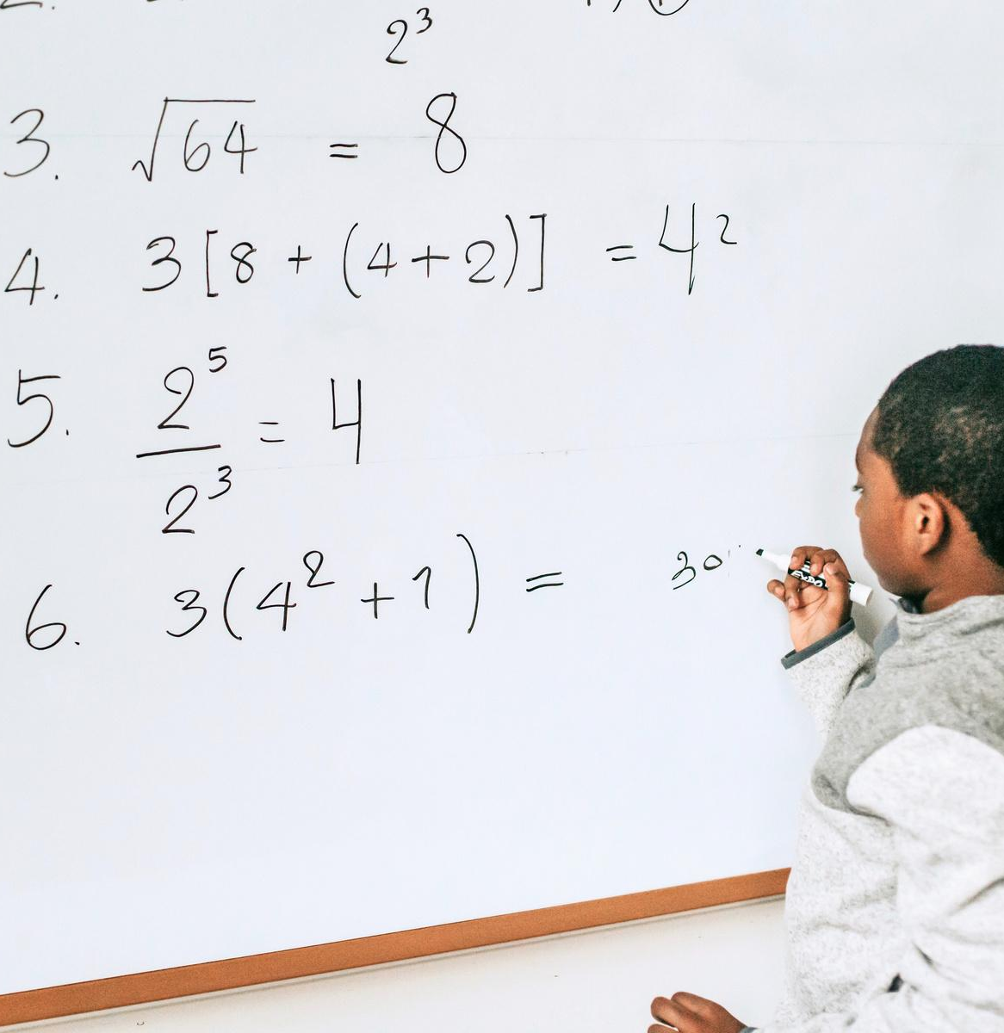
Quiz Categories
Add a main point
Add a main point
Add a main point
Briefly elaborate on
what you want to discuss.
Briefly elaborate on
what you want to discuss.
Briefly elaborate on
what you want to discuss.

Slide 8




SECTION 1
TEST 01

Slide 9
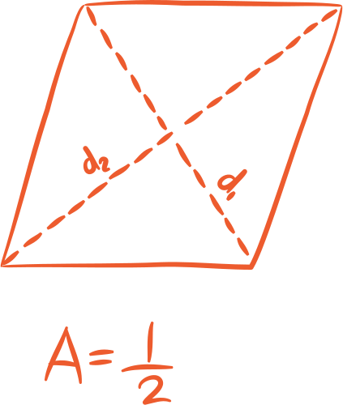

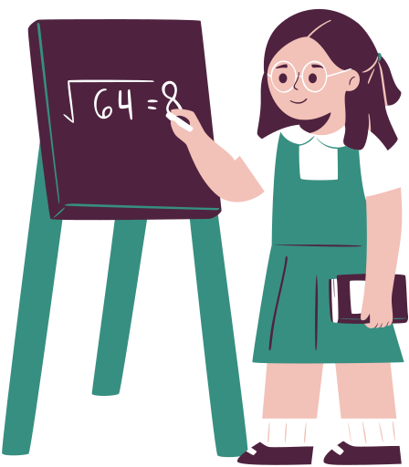
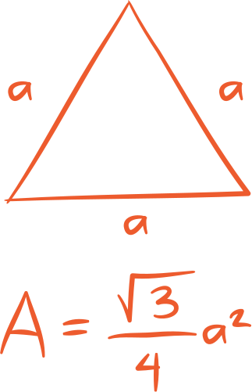
Write an original statement or inspiring quote
Include a credit, citation, or supporting message

Slide 10

If 3a + 2 = a + 6, then
which of these is incorrect?
Question 1
A
B
3a + 2 - a = 6
2a = 6 + 2
C
D
2a = 4
a = 4⁄2

Slide 11




SECTION 2
TEST 02

Slide 12




Question 1
If 9x - 2 = 7, then which of
the following is not correct?
A.
C.
9x = 7 + 2
x = 9⁄9
B.
D.
9x = 9
x = 2

Slide 13



Answer
The correct
answer is D. x = 2
To be correct, the last
item would need to be x = 1

Slide 14


Multiple Choices
If x + 4 = b,
what is the value of x?
A
B.
C.
D.
4b
-4b
b+4
b-4

Slide 15
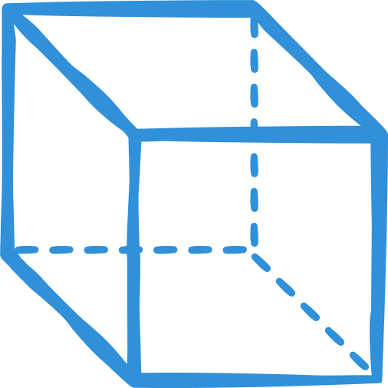


Answer
When + 4 crosses over to the other side of the equals sign it must be changed to - 4
a.
b - 4

Slide 16
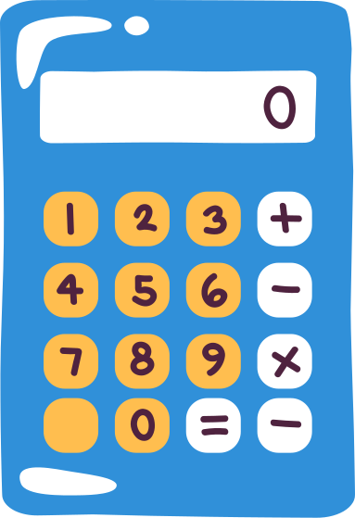
50
Ranking
40
Elaborate on what you want to discuss.
30
20
10
0
Item 1
Item 2
Item 3
Item 4
Item 5

Slide 17


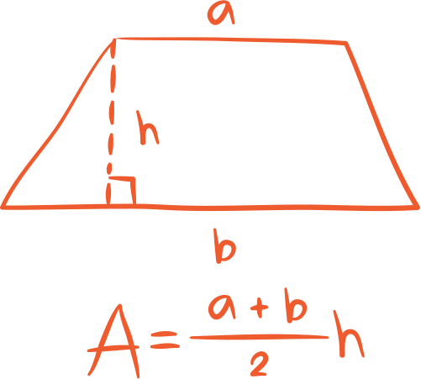
Add Students Page
Name
Name
Name
Name
Title or Position
Title or Position
Title or Position
Title or Position

Slide 18




Thank you!
Write a closing statement or call-to-action here.

Slide 19

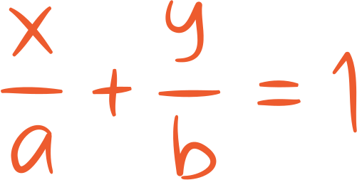
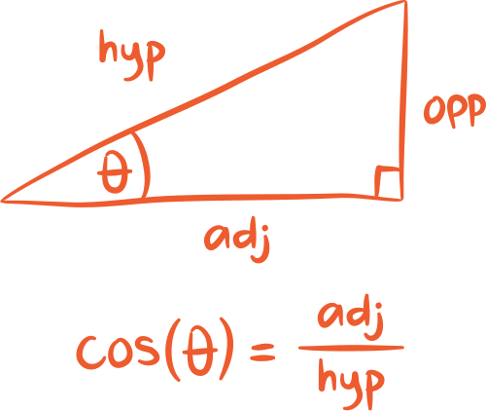
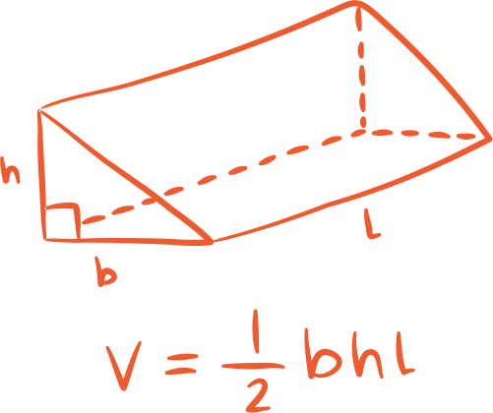
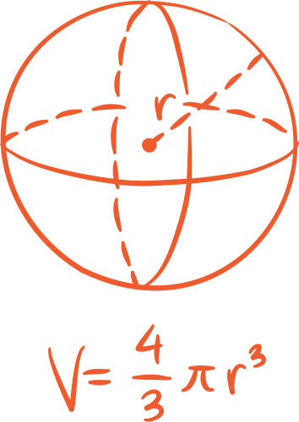
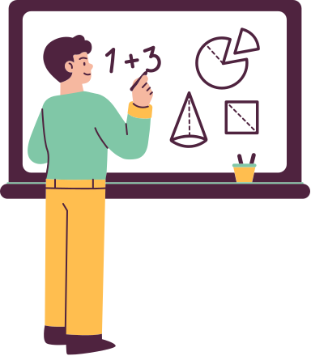



Resource
Page
Use these design resources in your Canva Presentation.
Use these design resources in your Canva Presentation.
Titles: Caveat Brush
Headers: Roboto
Body Copy: Roboto
You can find these fonts online too. Happy designing!

Slide 20


Credits
This presentation template is free for everyone to use thanks to the following:
SlidesCarnival for the presentation template
Pexels for the photos
Happy designing!

