Slide 1


LOGO HERE
CONTACT US
WATER
SAFETY
PRESENTATION

Slide 2
LOGO HERE
CONTACT US
TABLE OF CONTENTS
01
INTRODUCTION
02
OUR PROJECTS
03
ABOUT US

Slide 3
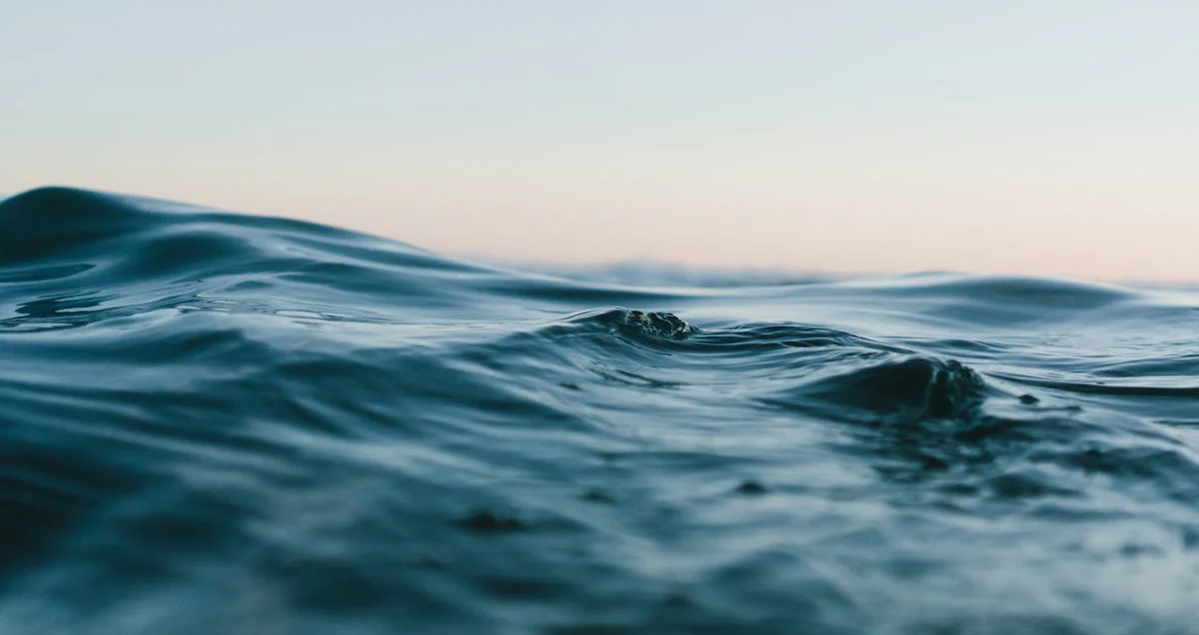
LOGO HERE
CONTACT US
WELCOME TO PRESENTATION
I'm Rain, and I'll be sharing with you my beautiful ideas. Follow me at @reallygreatsite to learn more.

Slide 4
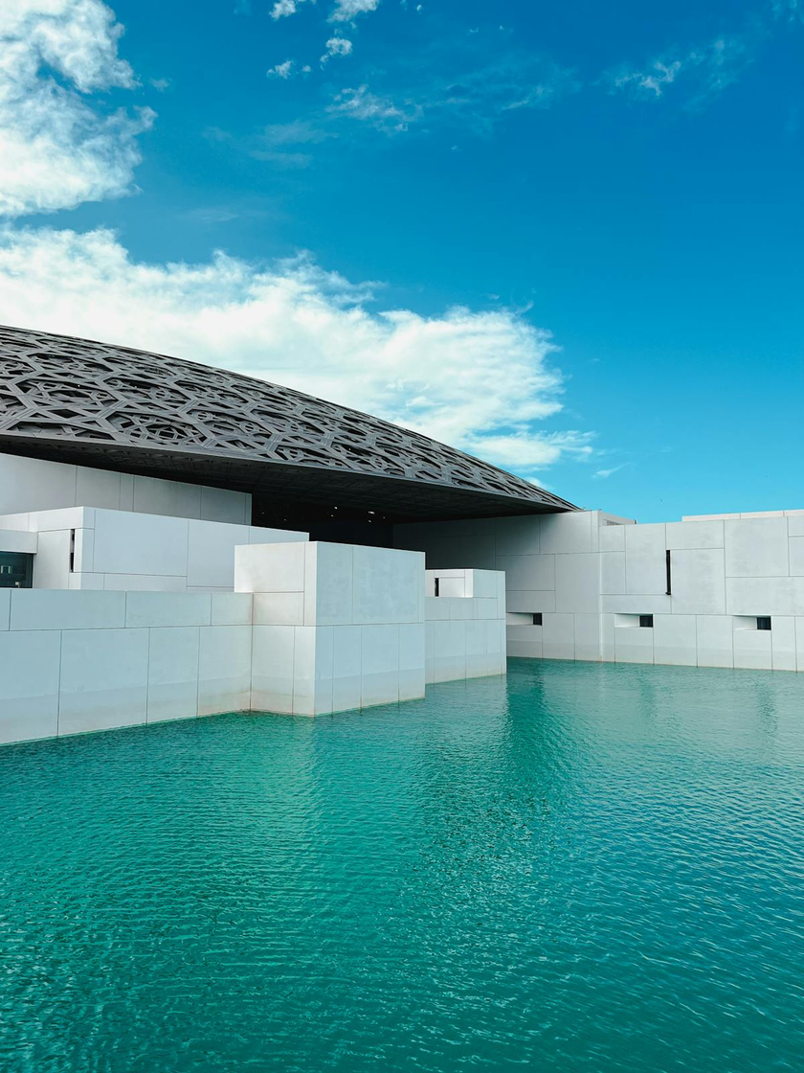


LOGO HERE
CONTACT US
OUR COMPANY
WHO WE ARE?
Briefly elaborate on what you want to discuss.
WHAT WE DO?
Briefly elaborate on what you want to discuss.

Slide 5

LOGO HERE
CONTACT US
INTRODUCTION
To the world of literature can be a transformative experience. Whether you are a seasoned reader or just beginning your journey, the pages of a book hold the power to transport you to distant lands, introduce you to unforgettable characters, and evoke a wide range of emotions.
In this introductory guide, we will explore various genres, offer tips for selecting the right book, and discuss the profound impact reading can have on your life. So, grab a cup of tea, find a cozy spot, and let's dive into the enchanting realm of stories and imagination.

Slide 6


LOGO HERE
CONTACT US
MISSION
VISION
The crew assembled in the control room, a blend of nerves and excitement palpable in the air. This wasn't just any mission; it was a pioneering endeavor that aimed to push the boundaries of human exploration and understanding. Each member brought unique skills and expertise, unified by a common goal:
to venture into the unknown and return with knowledge that could transform our understanding of the universe.
The crew assembled in the control room, a blend of nerves and excitement palpable in the air. This wasn't just any mission; it was a pioneering endeavor that aimed to push the boundaries of human exploration and understanding. Each member brought unique skills and expertise, unified by a common goal:
to venture into the unknown and return with knowledge that could transform our understanding of the universe.

Slide 7


LOGO HERE
CONTACT US
OUR PROJECTS
PROJECT 1
PROJECT 2
In the bustling heart of Silicon Valley, Project 1 emerged as a beacon of creativity and technological advancement. The team, consisting of bright minds from diverse backgrounds, came together with a shared vision: to revolutionize the way we interact with the digital world.
In the bustling heart of Silicon Valley, Project 1 emerged as a beacon of creativity and technological advancement. The team, consisting of bright minds from diverse backgrounds, came together with a shared vision: to revolutionize the way we interact with the digital world.

Slide 8
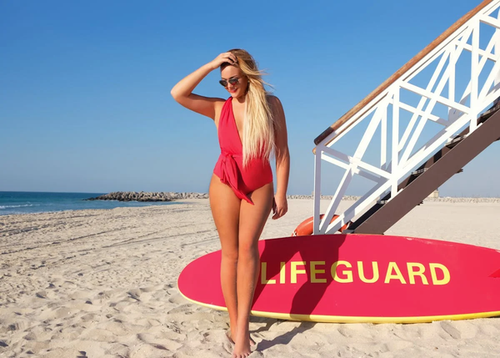
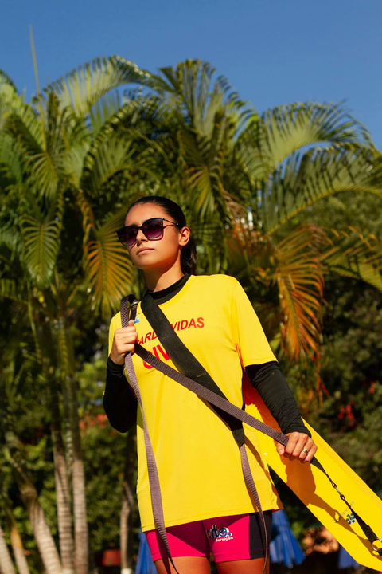
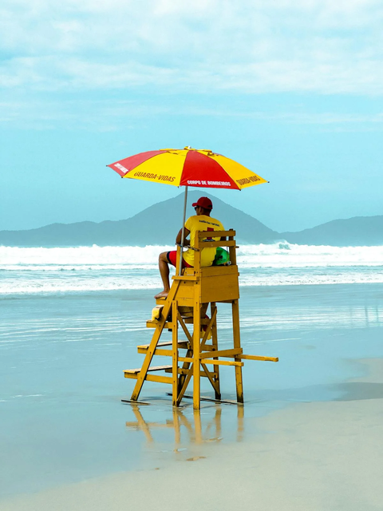
LOGO HERE
CONTACT US
TESTIMONIALS
NAME
NAME
NAME
Elaborate on what you want to discuss.
Elaborate on what you want to discuss.
Elaborate on what you want to discuss.

Slide 9




LOGO HERE
CONTACT US
WHAT WE OFFER
SERVICE 1
SERVICE 2
Elaborate on what you want to discuss.
Elaborate on what you want to discuss.
SERVICE 3
SERVICE 4
Elaborate on what you want to discuss.
Elaborate on what you want to discuss.

Slide 10
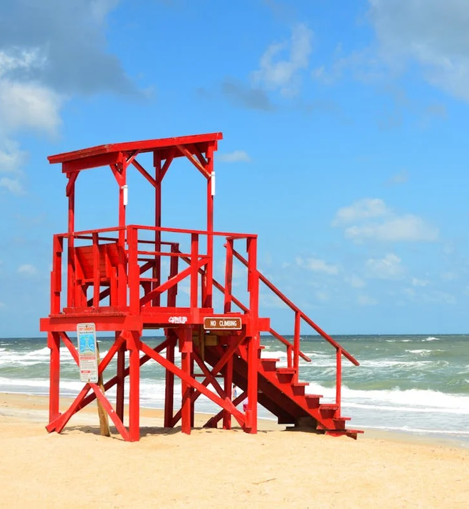
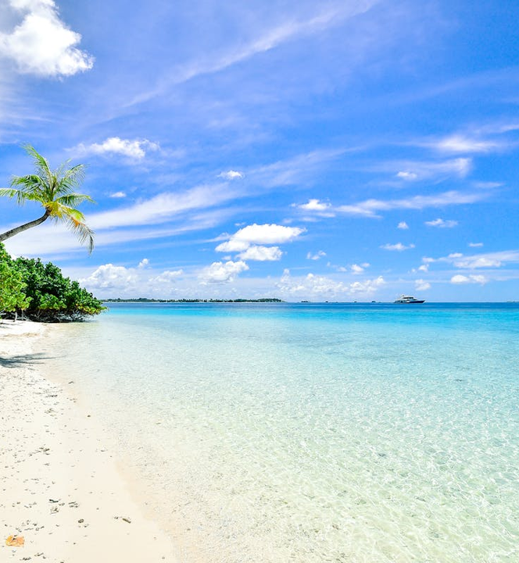
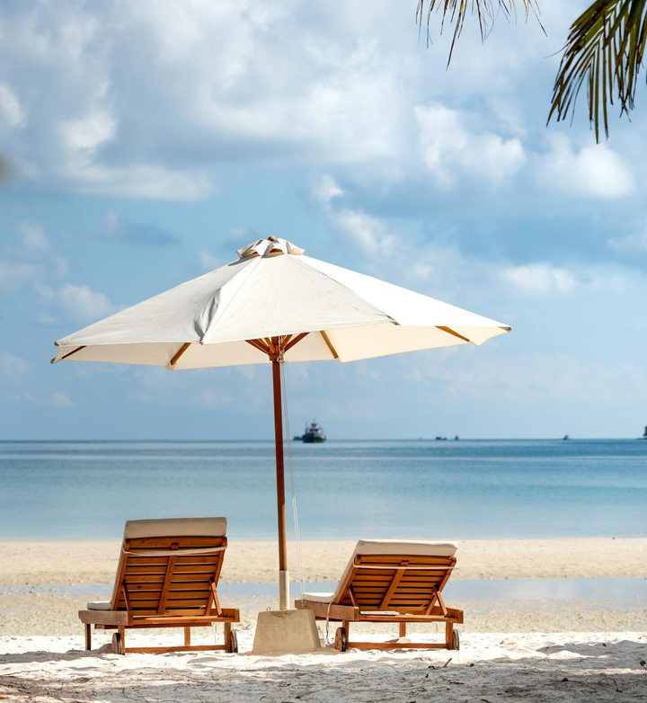
LOGO HERE
CONTACT US
GALLERY IMAGE
What can you say about your projects? Share it here!

Slide 11



LOGO HERE
CONTACT US
MARKET RESEARCH
Elaborate on the featured statistic.
Elaborate on the featured statistic.
Elaborate on the featured statistic.
Elaborate on the featured statistic.

Slide 12
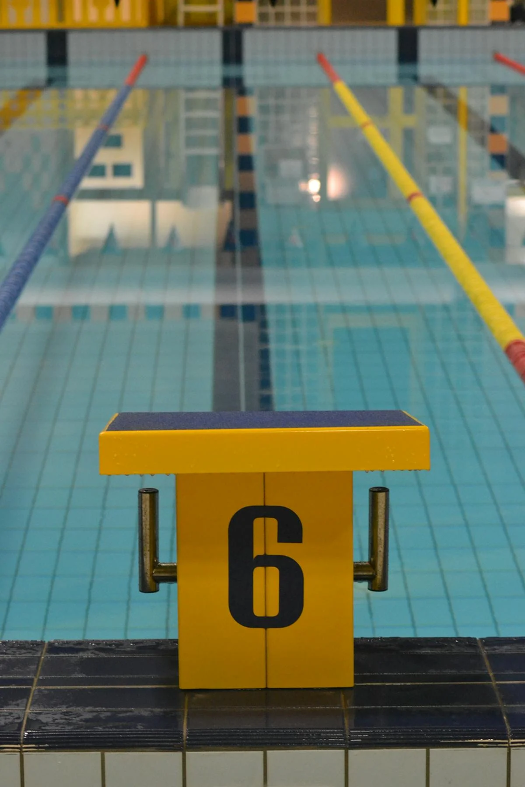
LOGO HERE
CONTACT US
POOL SAFETY
is a crucial aspect to consider, especially when children and pets are around. To ensure everyone can enjoy the water safely, it's important to follow several key guidelines.First and foremost, always supervise children whenever they are in or near the pool.
Drowning can happen quickly and silently, so constant vigilance is essential. It’s also beneficial to teach children how to swim and educate them about the dangers of water from an early age.
Installing a secure fence around the pool area with a self-latching gate can prevent unsupervised access. Pool alarms and safety covers provide additional layers of protection.

Slide 13
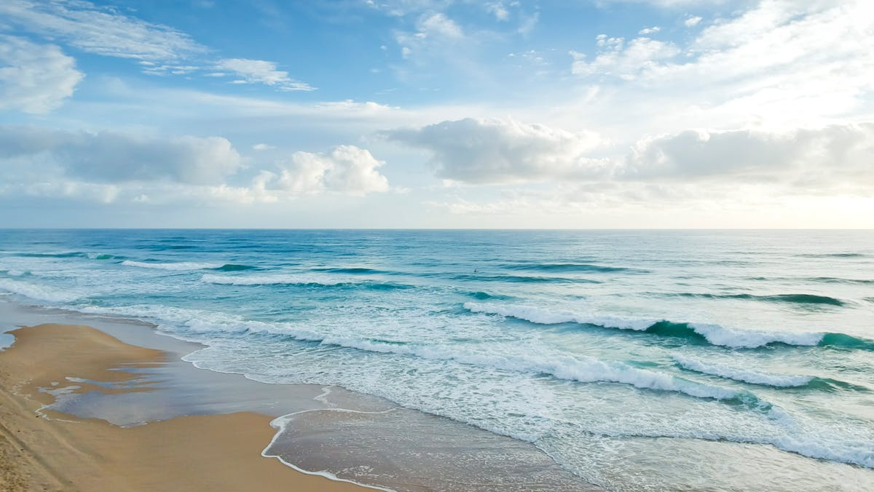
A PICTURE IS WORTH A THOUSAND WORDS

Slide 14

LOGO HERE
CONTACT US
BEACH SAFETY
Is of paramount importance for anyone planning to enjoy a day by the sea. Whether you're swimming, sunbathing, or playing in the sand, being aware of potential hazards and taking precautions can ensure a fun and safe experience for everyone. Here are some essential tips to keep in mind:
cidents and creating lasting, happy memories by the sea.
Swim near lifeguards
Understand rip currents
Use flotation devices
Pay attention to weather conditions

Slide 15
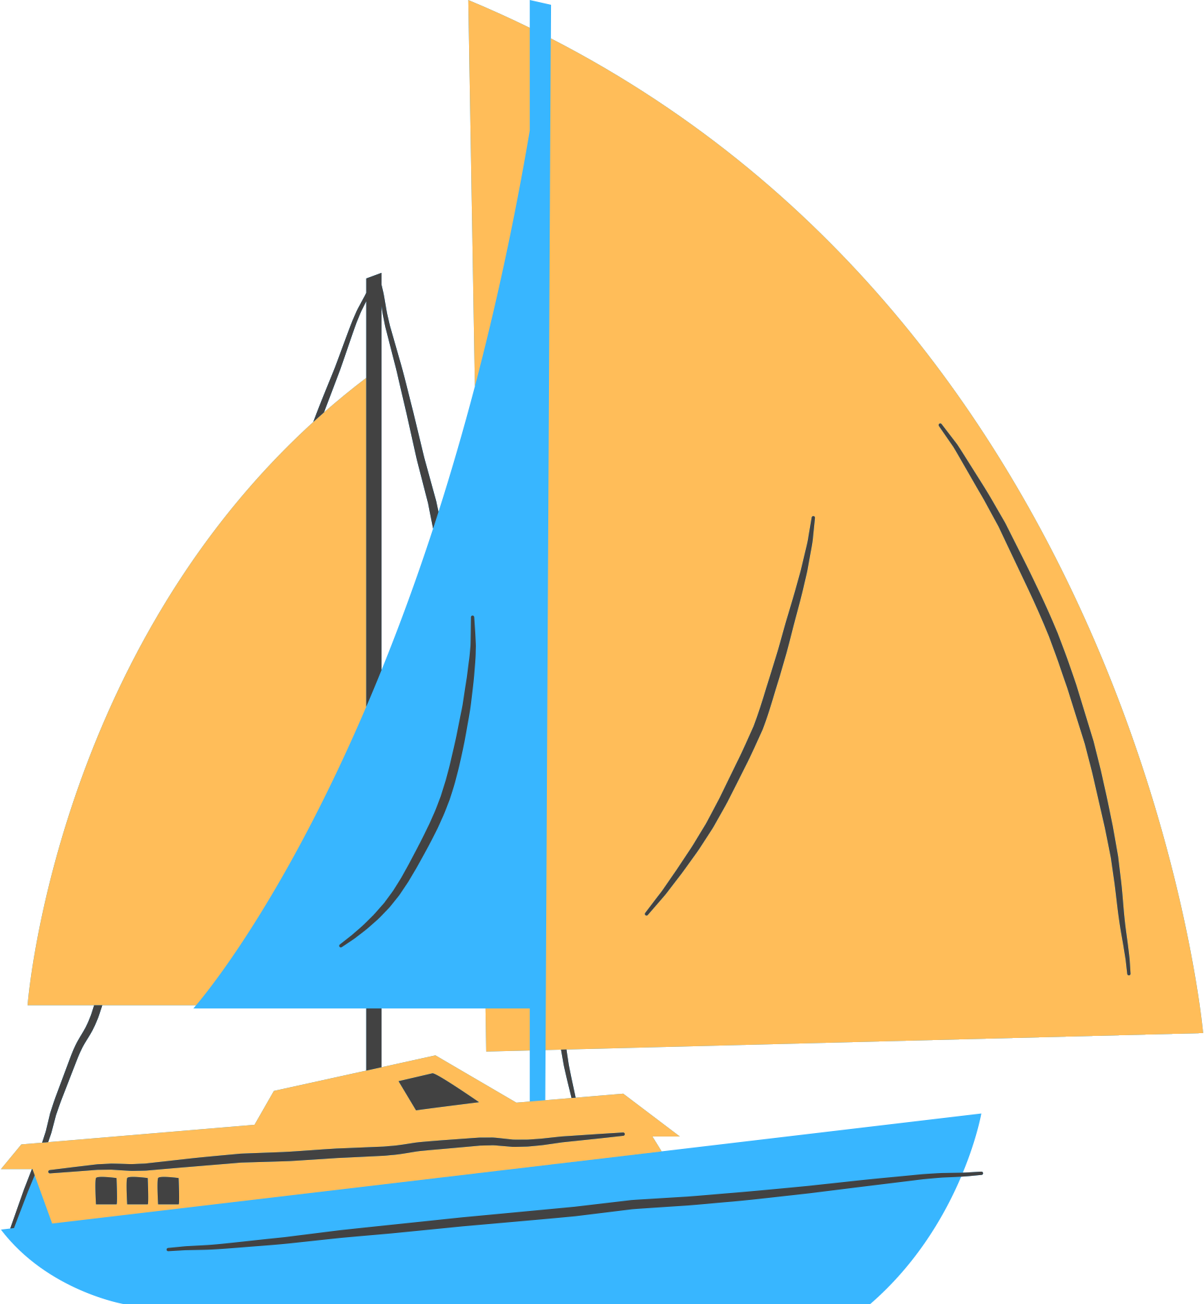
LOGO HERE
CONTACT US
BOATING SAFETY
is of utmost importance for ensuring a fun and secure experience on the water. Whether you're a seasoned sailor or a first-time boater, adhering to safety guidelines can prevent accidents and save lives. Here are some essential tips to keep in mind:
Wear Life Jackets: Always wear a properly fitted life jacket, and ensure that all passengers do the same. Life jackets are crucial in preventing drowning, especially in unexpected situations.
Check the Weather: Before setting out, check the weather forecast. Avoid boating in severe weather conditions, and be prepared for sudden changes in the weather.

Slide 16



LOGO HERE
CONTACT US
OUR HISTORY
POINT
POINT
POINT
Elaborate on what you want to discuss.
Elaborate on what you want to discuss.
Elaborate on what you want to discuss.

Slide 17
LOGO HERE
CONTACT US
WRITE AN ORIGINAL STATEMENT OR INSPIRING QUOTE
— Include a credit, citation, or supporting message

Slide 18



LOGO HERE
CONTACT US
CONTACT US
123 Anywhere St., Any City,ST 12345
123-456-7890
hello@reallygreatsite.com

Slide 19






RESOURCE
PAGE
Use these design resources in your Canva Presentation.
You can find these fonts online too. Happy designing!
Don't forget to delete this page before presenting.
This presentation template uses the following free fonts:
Titles: Dela gothic one
Headers: Dela gothic one
Body Copy: Arimo

Slide 20

CREDITS
This presentation template is free for everyone to use thanks to the following:
SlidesCarnival for the presentation template
Pexels for the photos
HAPPY DESIGNING!

