Slide 1
SCIENCE
AND
ENGINEERING
FOR PRACTICES
MIDDLE SCHOOL

Slide 2
How to Use This Presentation
Google Slides
PowerPoint
Canva
Click on the "Google Slides" button below this presentation preview. Make sure to sign in to your Google account. Click on "Make a copy." Start editing your presentation.
Alternative: Click on the "Share" button on the top right corner in Canva and click on "More" at the bottom of the menu. Enter "Google Drive" in the search bar and click on the GDrive icon to add this design as a Google slide in your GDrive.
Click on the "PowerPoint" button below this presentation preview. Start editing your presentation.
Alternative: From Canva template file, Click on the "Share" button on the top right corner in Canva and click on "More" at the bottom of the menu. Enter "PowerPoint" in the search bar and click on the PowerPoint icon to download.
Click on the "Canva" button under this presentation preview. Start editing your presentation. You need to sign in to your Canva account.

Slide 3
Table Of Contents
Introduction
Our Projects
About Us
Elaborate on what you want to discuss.
Elaborate on what you want to discuss.
Elaborate on what you want to discuss.

Slide 4
Introduction
1
The Science and Engineering Practices for Middle School are a set of eight practices that provide a framework for students to engage in scientific inquiry and engineering design. These practices include asking questions, developing and using models, planning and carrying out investigations, analyzing and interpreting data, using mathematics and computational thinking, constructing explanations, engaging in argument from evidence, and obtaining, evaluating, and communicating information.

Slide 5
Welcome To Presentation
I'm Rain, and I'll be sharing with you my beautiful ideas. Follow me at @reallygreatsite to learn more.

Slide 6
Our Projects
Who we are?
Briefly elaborate on what
you want to discuss.
What we do?
Briefly elaborate on what
you want to discuss.

Slide 7
Mission
Vision
The mission of Science and Engineering Practices for Middle School is to provide students with the opportunity to develop their scientific and engineering skills through hands-on experiences.
By engaging in practices such as asking questions, developing models, and analyzing data, students can deepen their understanding of core scientific concepts and learn how to apply them in real-world situations.
The vision for science and engineering practices in middle school is centered on three main components: using scientific inquiry and engineering design to solve problems, developing scientific literacy, and promoting equity and inclusivity in STEM education.
These practices encourage students to engage in hands-on, inquiry-based learning experiences that foster critical thinking, problem-solving skills, and creativity.

Slide 8
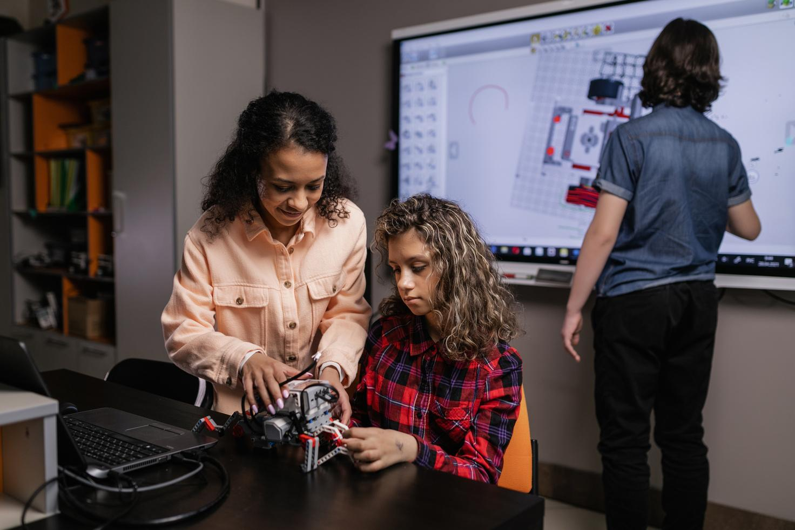
Our Projects
2
A Comprehensive Framework for Inquiry and Design in Middle School Science and Engineering. The Science and Engineering Practices for Middle School comprises eight practices that offer students a well-defined method for scientific inquiry and engineering design.
Improving Middle School Science and Engineering: A Comprehensive Framework for Inquiry and Design. The Science and Engineering Practices targeted at Middle School students offer a well-planned approach to scientific inquiry and engineering design.

Slide 9
What We Offer
Service One
Service Two
Elaborate on what you want to discuss.
Elaborate on what you want to discuss.
Service Three
Service Four
Elaborate on what you want to discuss.
Elaborate on what you want to discuss.

Slide 10
Gallery Image
What can you say about your projects? Share it here!

Slide 11
About Us
3
Middle School Science
and Engineering Practices:
A Comprehensive Framework for Inquiry and Design The Science and Engineering Practices for Middle School consist of eight practices which provide students with a structured approach to scientific inquiry and engineering design. These practices include asking questions, developing and using models, planning and conducting investigations, analyzing and interpreting data.

Slide 12
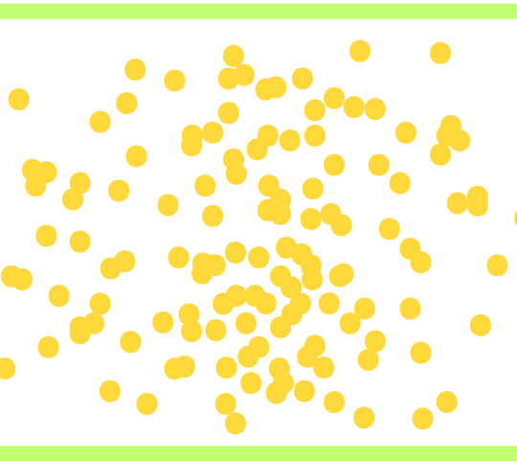
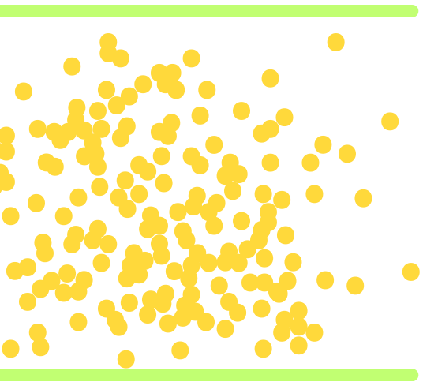
Empirical Research
Elaborate on the featured statistic.
Elaborate on the featured statistic.
Elaborate on the featured statistic.

Slide 13
Our History
The Significance of Science and Engineering Practices in Middle School Education:
For years, Science and Engineering Practices (SEPs) have been a crucial aspect of middle school science education. The foundation of SEPs can be traced back to the National Science Education Standards, which were introduced in 1996.
The Importance of Science and Engineering Practices in Middle School Education:
For many years, Science and Engineering Practices (SEPs) have been vital components of middle school science education. The development of SEPs can be traced back to the National Science Education Standards, which were issued in 1996.

Slide 14
Our Progress
01
03
Add a main point
Add a main point
Elaborate on what you want to discuss.
Elaborate on what you want to discuss.
02
04
Add a main point
Add a main point
Elaborate on what you want to discuss.
Elaborate on what you want to discuss.

Slide 15
Teachers
Client name
Client name
Client name
Elaborate on what you want to discuss.
Elaborate on what you want to discuss.
Elaborate on what you want to discuss.

Slide 16
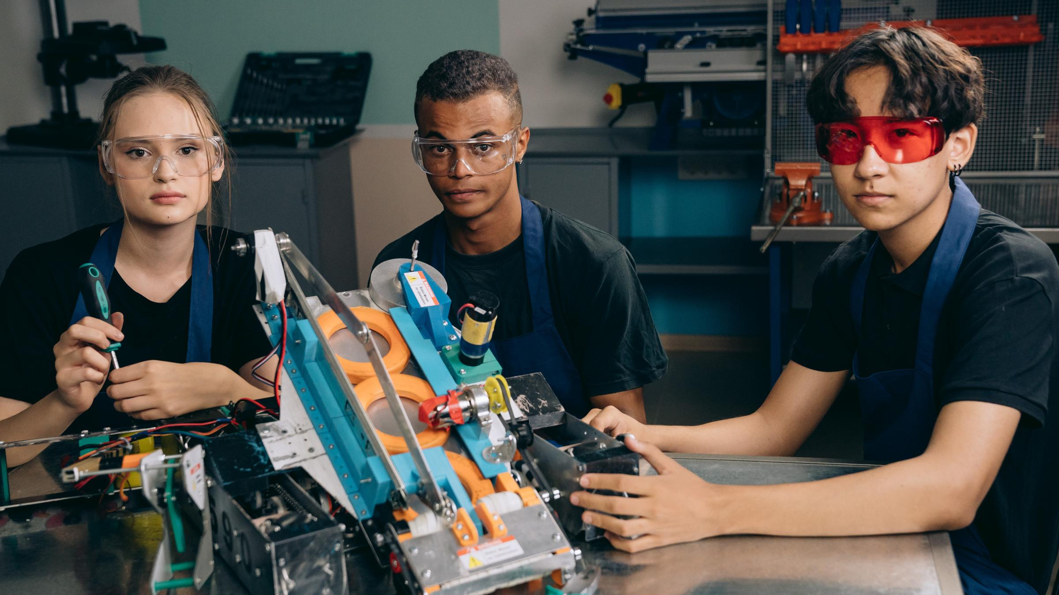
A picture is worth a thousand words

Slide 17
Write an original statement or inspiring quote
— Include a credit, citation, or supporting message

Slide 18
Contact US
123 Anywhere St., Any City,ST 12345
123-456-7890
hello@reallygreatsite.com
@reallygreatsite
reallygreatsite.com

Slide 19
Resource Page
Use these design resources in your Canva Presentation.
You can find these fonts online too.
Happy designing!
Don't forget to delete this page before presenting.
This presentation template uses the following free fonts:
Titles: Archivo Black
Headers: Open Sauce
Body Copy: Open Sauce

Slide 20
Credits
This presentation template is free for everyone to use thanks to the following:
SlidesCarnival for the presentation template
Pexels for the photos
Happy designing!

