Slide 1


LOGO
Home
About
Service
Contact
SOCIAL
NETWORKING
SERVICES
PITCH DECK

Slide 2


TABLE OF CONTENTS
01
02
03
INTRODUCTION
OUR PROJECTS
ABOUT US
Elaborate on what you want to discuss.
Elaborate on what you want to discuss.
Elaborate on what you want to discuss.

Slide 3




INTRODUCTION
Welcome to a journey of exploration and discovery. In this passage, we will delve into the depths of knowledge and embark on a quest for enlightenment.
Together, we will unravel the mysteries that lie ahead and unlock the secrets that await us. So, prepare your mind and open your heart to the wonders that are about to unfold. Let us begin this adventure of the intellect and spirit, united in our pursuit of understanding and growth.

Slide 4



WELCOME TO PRESENTATION
I'm Rain, and I'll be sharing with you my beautiful ideas. Follow me at @reallygreatsite to learn more.

Slide 5







CONTACT US
123 Anywhere St., Any City,ST 12345
123-456-7890
hello@reallygreatsite.com
@reallygreatsite
reallygreatsite.com

Slide 6




OUR COMPANY
WHO WE ARE?
WHAT WE DO?
Briefly elaborate on what you want to discuss.
Briefly elaborate on what you want to discuss.

Slide 7


MISSION
VISION
The word "mission" often evokes a sense of purpose, direction, and determination. A mission can be a goal or objective that guides our actions and decisions, giving us a sense of meaning and fulfillment.
It can be a personal mission, such as pursuing a passion or helping others, or a collective mission, like working towards a common cause or vision.Having a clear mission in life can provide focus and motivation, helping us overcome challenges and stay on course even when faced with obstacles.
A vision is like a guiding star, illuminating the path towards our dreams and goals. It is the map that leads us through the unknown, providing clarity and direction in times of uncertainty.
Our vision is the North Star that keeps us grounded, yet always reaching for the sky. It is the fuel that ignites our passion and drives us forward, even when the road ahead seems long and challenging.
Having a clear vision empowers us to make decisions.

Slide 8



OUR PROJECTS
Our projects are more than just tasks on a to-do list; they are the manifestation of our creativity, dedication, and passion. Each project is a journey filled with challenges, triumphs, and opportunities for growth. We pour our hearts and souls into every endeavor, striving to bring our visions to life and make a positive impact on the world around us.
From brainstorming ideas to executing plans, our projects are a reflection of our commitment to excellence and innovation. We embrace collaboration, diversity, and new perspectives, knowing that the best results often come from a blend of different talents and experiences.As we embark on new projects, we do so with excitement and determination, ready to push boundaries, break barriers, and exceed expectations.

Slide 9





WHAT WE OFFER
SERVICE ONE
SERVICE TWO
Elaborate on what you want to discuss.
Elaborate on what you want to discuss.
SERVICE THREE
SERVICE FOUR
Elaborate on what you want to discuss.
Elaborate on what you want to discuss.

Slide 10

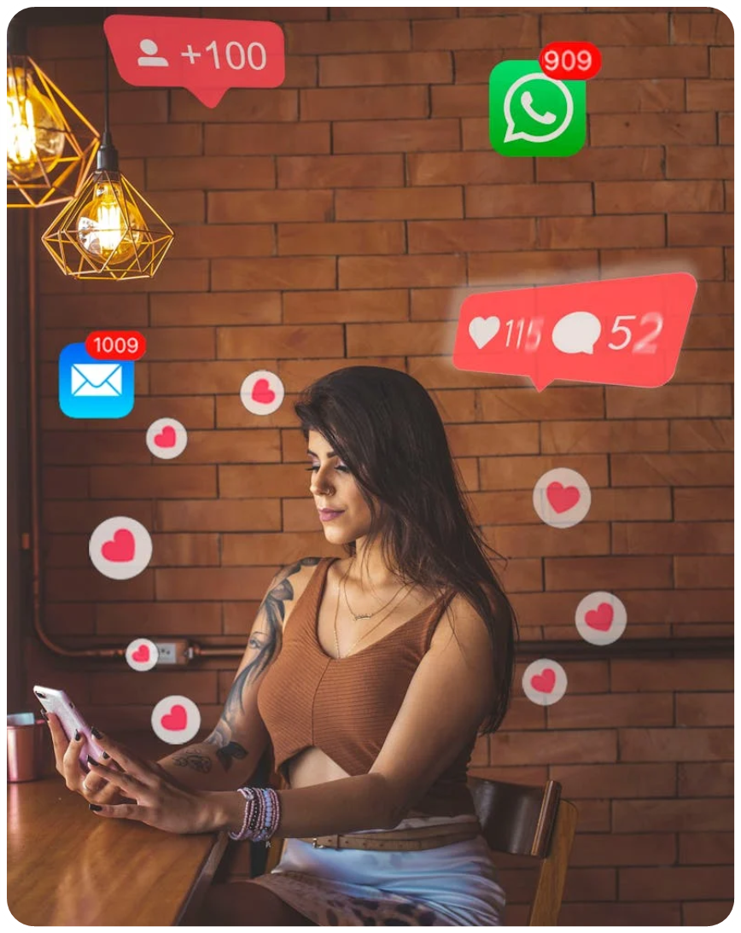
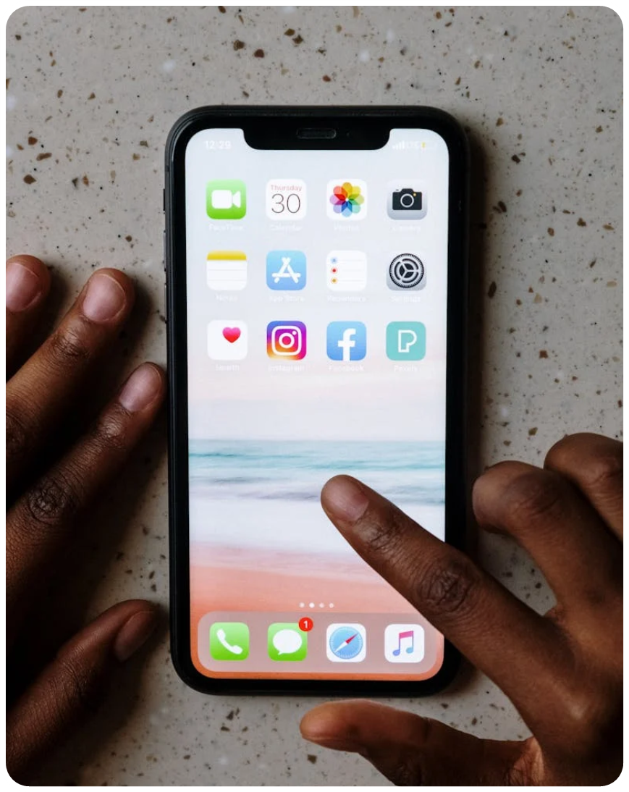
GALLERY IMAGE
What can you say about your projects? Share it here!

Slide 11




MARKET RESEARCH
Elaborate on the featured statistic
Elaborate on the featured statistic.
Elaborate on the featured statistic.
Elaborate on the featured statistic.

Slide 12

“ A PICTURE IS WORTH A THOUSAND WORDS “

Slide 13
S
W
STRENGTHS
WEAKNESSES
What sets you apart? What are your good qualities?
Are resources adequate? What do others do better than you?
O
T
OPPORTUNITIES
THREATS
Are demands shifting? How can it be improved?
What are factors outside of your control?

Slide 14



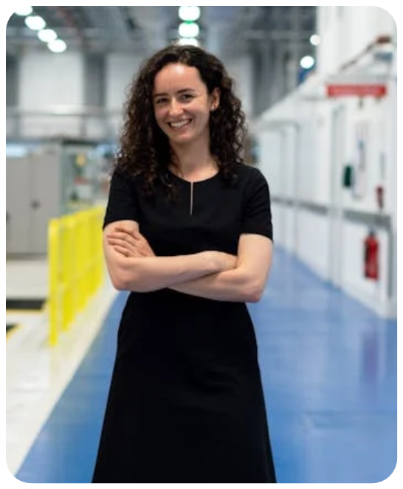
TESTIMONIALS
CLIENT NAME
CLIENT NAME
CLIENT NAME
Elaborate on what you want to discuss.
Elaborate on what you want to discuss.
Elaborate on what you want to discuss.

Slide 15

ABOUT US
We are a team of dedicated individuals who are passionate about making a difference. Our mission is to provide top-notch service to our customers and create a positive impact in our community.
With years of experience and a commitment to excellence, we strive to exceed expectations and deliver results that speak for themselves. Join us on this journey as we work together towards a brighter future for all.

Slide 16


OUR History
Presentations are communication tools that can be used as demonstrations, lectures, speeches, reports, and more. It is mostly presented before an audience.
A well-crafted presentation has the power to engage, educate, and inspire your audience. Whether you are sharing information, pitching an idea, or seeking to persuade, the key lies in capturing the attention of your listeners and conveying your message effectively.
To create a successful presentation, it is important to consider the needs and expectations of your audience, choose the right format, structure your content logically, use visuals to enhance understanding, and practice your delivery to ensure clarity and confidence.

Slide 17

OUR History
ADD A MAIN POINT
ADD A MAIN POINT
ADD A MAIN POINT
Elaborate on what you want to discuss.
Elaborate on what you want to discuss.
Elaborate on what you want to discuss.

Slide 18


WRITE AN ORIGINAL STATEMENT OR INSPIRING QUOTE
— Include a credit, citation, or supporting message

Slide 19

RESOURCE
PAGE
Use these design resources in your Canva Presentation.
You can find these fonts online too. Happy designing!
Don't forget to delete this page
before presenting.
This presentation template uses the following free fonts:
Titles: Archivo Black
Headers: Archivo Black
Body Copy: Open Sans

Slide 20



CREDITS
This presentation template is free for everyone to use thanks to the following:
SlidesCarnival for the presentation template
Pexels for the photos
HAPPY DESIGNING!

