Slide 1
COUNTING ACTIVITY
Thanksgiving Kids Activity Sheets
Can you count all of the leaves on this page?

Slide 2
IDENTIFYING ACTIVITY
Thanksgiving Kids Activity Sheets
Can you identify these tasty thanksgiving treats?

Slide 3
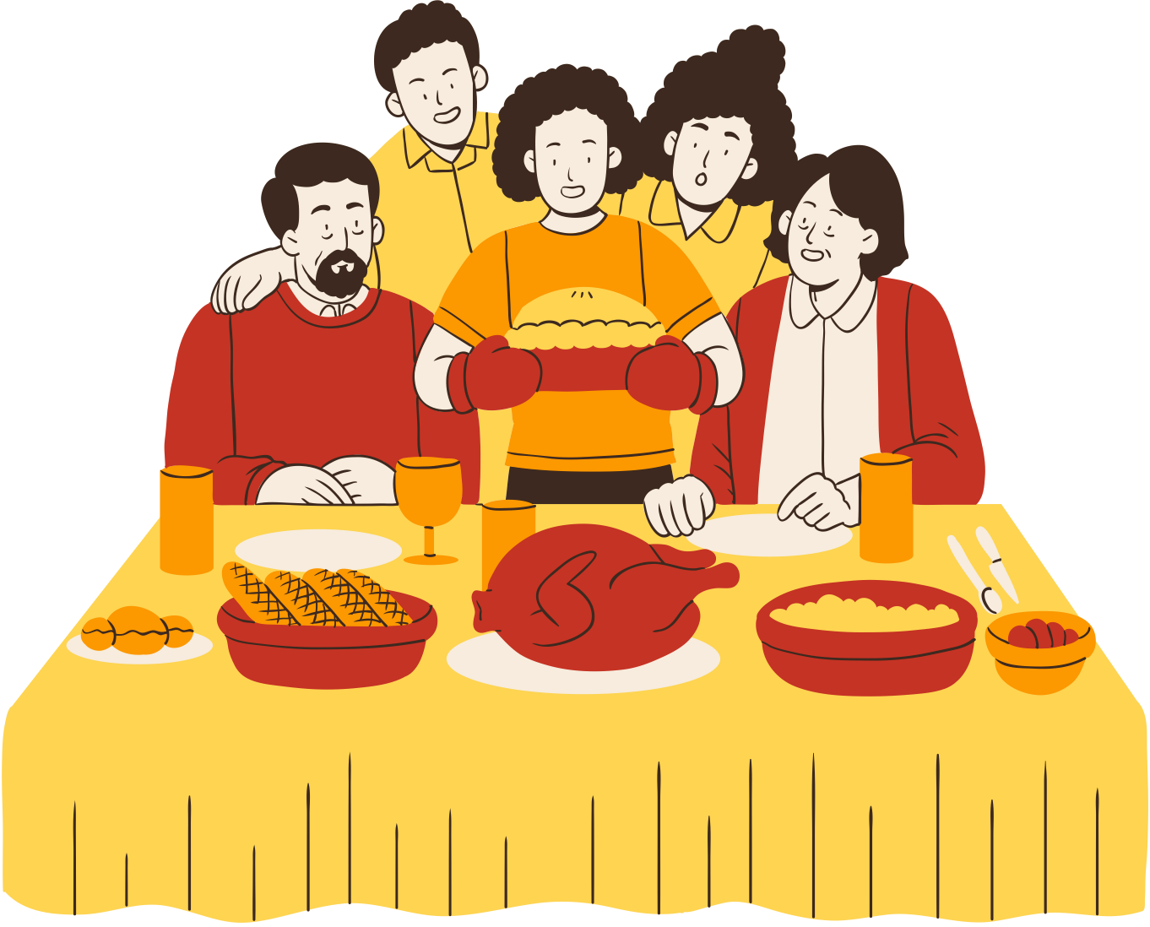
“I SPY” ACTIVITY
Thanksgiving Kids Activity Sheets
Can you see the following:
Pie
Picture Frame
Bread
Wine glass

Slide 4
RESOURCE PAGE
Use these design resources in your Canva Presentation.
Fonts
Colors
This presentation template
uses the following free fonts:
TITLES:
BERKSHIRE SWASH
HEADERS:
POPPINS
BODY COPY:
POPPINS
#F9CF9E
#B63F2F
#F7ECDD
#EF9C38
#3A2A21
#8A8E37
#FED451
You can find these fonts online too.
Design Elements
DON'T FORGET TO DELETE THIS PAGE BEFORE PRESENTING.

Slide 5
CREDITS
This presentation template is free for everyone to use thanks to the following:
for the presentation template
Pexels, Pixabay
for the photos
Happy designing!

