Slide 1
WWW.RAILROAD.COM
01/20
Railroad
Minitheme
HERE YOUR TEXT
Chugging along the tracks, the distant whistle of the locomotive fills the air, a familiar sound interwoven with memories of bygone eras.

Slide 2
WWW.RAILROAD.COM
02/20
Table Of Contents
Introduction
Overview
Elaborate on what you want to discuss.
Elaborate on what you want to discuss.
Services Offered
Infrastructure
Elaborate on what you want to discuss.
Elaborate on what you want to discuss.

Slide 3
WWW.RAILROAD.COM
03/20
Introduction
Welcome to [Company Name]'s presentation on the dynamic world of railroad transportation. As one of the leading players in the industry, we are excited to share with you our journey, expertise, and commitment to excellence.
Railroads have been a cornerstone of transportation for centuries, connecting people, communities, and economies across vast distances. In today's fast-paced global economy, the railroad industry continues to play a vital role in facilitating trade, transporting goods, and providing efficient passenger services.

Slide 4
WWW.RAILROAD.COM
04/20
Welcome To Presentation
I'm Rain, and I'll be sharing with you my beautiful ideas. Follow me at @reallygreatsite to learn more.

Slide 5
WWW.RAILROAD.COM
05/20
Our Company
Who we are?
Briefly elaborate on what you want to discuss.
What we do?
Briefly elaborate on what you want to discuss.

Slide 6
WWW.RAILROAD.COM
06/20
Company Overview
Founded in 20XX, our company is a leading provider of innovative solutions in the field of technology and digital services. With a strong commitment to excellence and customer satisfaction, we strive to deliver cutting-edge products that meet the evolving needs of our clients.
Our team of dedicated professionals is driven by a passion for creativity and a desire to make a positive impact in the world. By fostering a culture of collaboration and continuous improvement, we are able to stay ahead of industry trends and anticipate the needs of our customers.

Slide 7
WWW.RAILROAD.COM
07/20
Founding History
The origins of our organization trace back to a humble beginning, driven by a shared vision and unwavering dedication. It all started with a small group of individuals who believed in making a positive impact on their community. Through collaboration, hard work, and a deep sense of purpose, they laid the foundation for what would grow into the thriving entity we are today.
As the years passed, our commitment to our core values remained steadfast, guiding us through challenges and triumphs alike. Each milestone achieved, each obstacle overcome, only served to strengthen our resolve and deepen our connection to the community we serve.

Slide 8
WWW.RAILROAD.COM
08/20
Services Offered
Railroad Operations
Freight Transportation
Logistics
Passenger Transportation

Slide 9
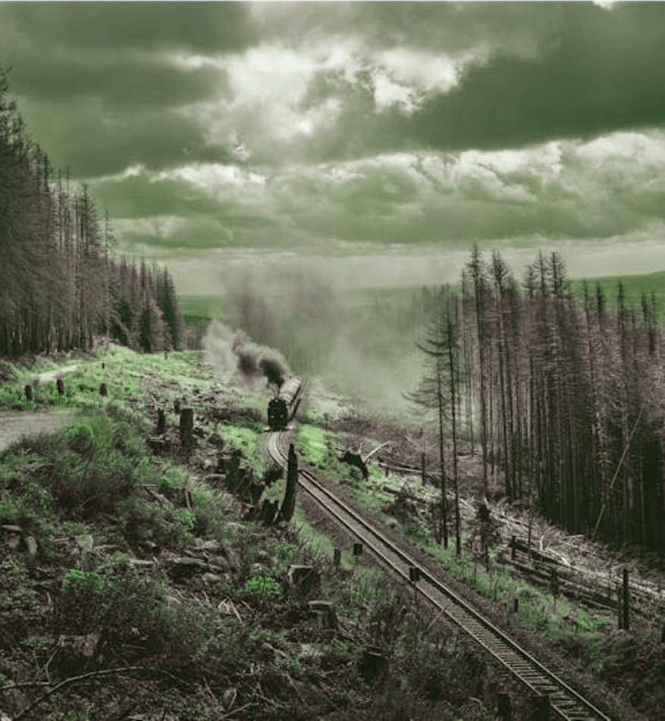
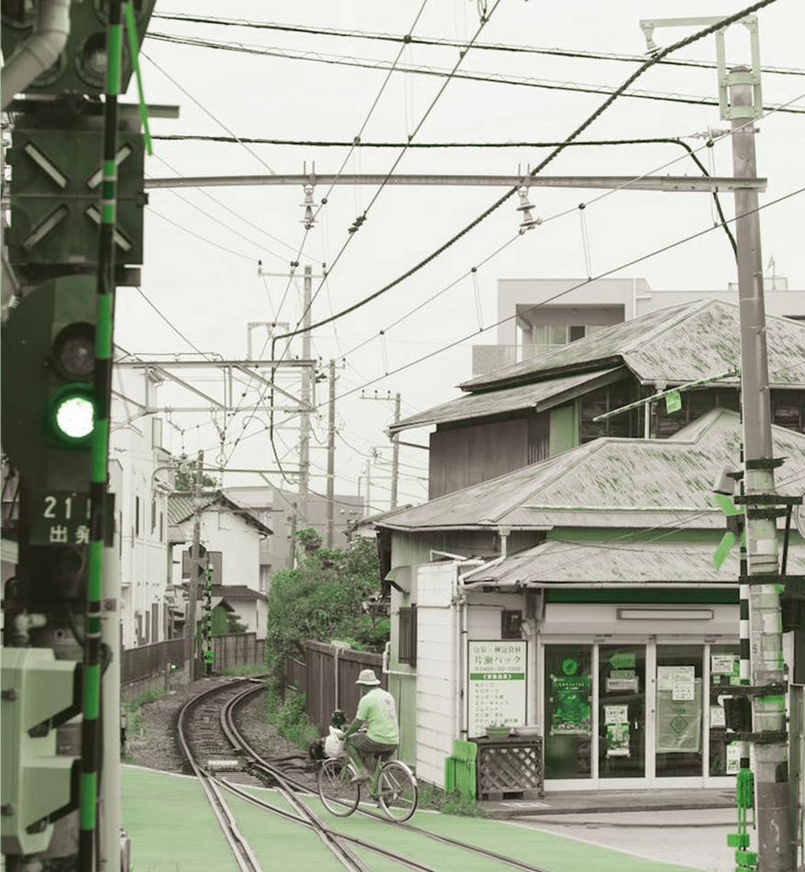
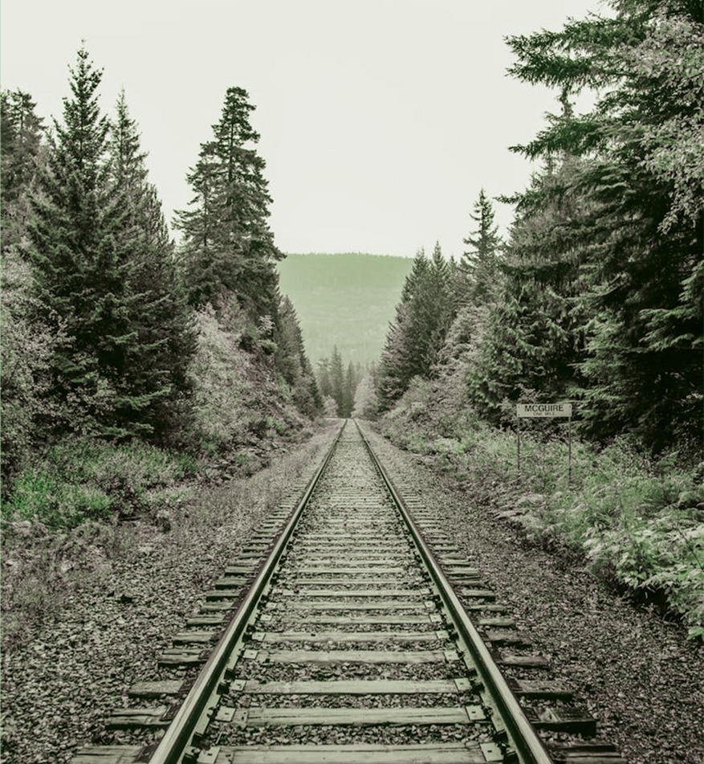
WWW.RAILROAD.COM
09/20
Gallery Image
What can you say about your projects? Share it here!

Slide 10
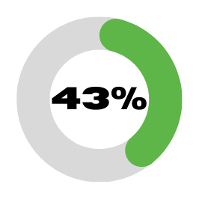
WWW.RAILROAD.COM
10/20
Market Research
Market Size
Industry Trends
Competitive Landscape
Elaborate on the featured statistic.
Elaborate on the featured statistic.
Elaborate on the featured statistic.

Slide 11
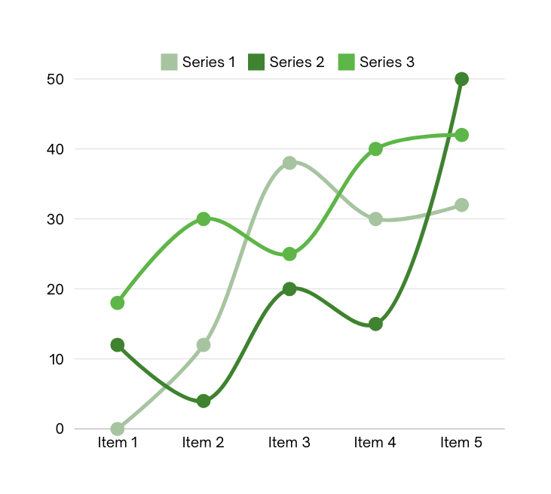
WWW.RAILROAD.COM
11/20
Regulatory Environment
In today's complex business landscape, navigating the regulatory environment is essential for companies aiming to maintain compliance and uphold ethical standards. Understanding the laws and regulations that govern their industry is crucial for organizations to avoid legal pitfalls and ensure sustainable operations. By staying informed about changes in regulations and proactively adapting their practices, businesses can not only protect themselves from potential penalties but also build a reputation for integrity and accountability. Embracing a culture of compliance and actively engaging with regulatory bodies can help companies thrive in a rapidly evolving regulatory environment.

Slide 12
WWW.RAILROAD.COM
12/20
OUR TEAM
ERIC BRANZ
SARA GEITS
VIOLA FREG
Elaborate on what you want to discuss.
Elaborate on what you want to discuss.
Elaborate on what you want to discuss.

Slide 13
WWW.RAILROAD.COM
13/20
Infrastructure
Railroad Network Overview
The intricate web of railroad networks plays a crucial role in connecting regions, transporting goods, and facilitating travel across vast distances. These networks encompass a diverse array of tracks, stations, and junctions that form the backbone of transportation infrastructure. From bustling urban centers to remote rural areas, the railroad network weaves together communities and economies, enabling the seamless flow of commerce and passengers.
As trains traverse the expansive network of rails, they carry not just cargo and passengers, but also a sense of history and adventure. The rhythmic chug of the locomotive, the clickety-clack of wheels on tracks, and the vast landscapes passing by create a unique and mesmerizing experience for travelers.

Slide 14
WWW.RAILROAD.COM
14/20
Safety and Compliance
Safety Standards
Safety standards are essential in any workplace or environment to ensure the well-being and protection of individuals. These standards are put in place to minimize hazards, prevent accidents, and promote a safe and healthy environment for everyone. By adhering to safety standards, organizations can create a culture of safety consciousness and responsibility among their employees. It is important to regularly review and update safety standards to stay current with best practices and regulations. Remember, safety is everyone's responsibility, and by prioritizing safety standards, we can all contribute to a safe and secure environment for all.

Slide 15
WWW.RAILROAD.COM
15/20
Technology Integration
GPS Tracking Systems
Digitalization Initiatives
GPS tracking systems have revolutionized the way we navigate and keep track of our vehicles and belongings.
Digitalization initiatives have become increasingly prevalent in today's fast-paced world. Organizations across industries are embracing digital transformation as a means to enhance efficiency.

Slide 16
A picture is worth a thousand words

Slide 17
WWW.RAILROAD.COM
17/20
Write an original statement or inspiring quote
— Include a credit, citation, or supporting message

Slide 18
WWW.RAILROAD.COM
18/20
Contact Info
Office Locations
Phone Numbers
Email Addresses

Slide 19
WWW.RAILROAD.COM
19/20
Resource Page
Use these design resources in your Canva Presentation.
You can find these fonts online too. Happy designing!
Don't forget to delete this page before presenting.
This presentation template uses the following free fonts:
Titles: IMPACT
Headers: IMPACT
Body Copy: Proxima Nova

Slide 20
WWW.RAILROAD.COM
20/20
Credits
This presentation template is free for everyone to use thanks to the following:
SlidesCarnival for the presentation template
Pexels for the photos
Happy designing!

