Slide 1

Background
Key Events
Aftermath
Afghanistan
1989 2021
War Slides
Understanding the Conflict from Start to Finish

Slide 2
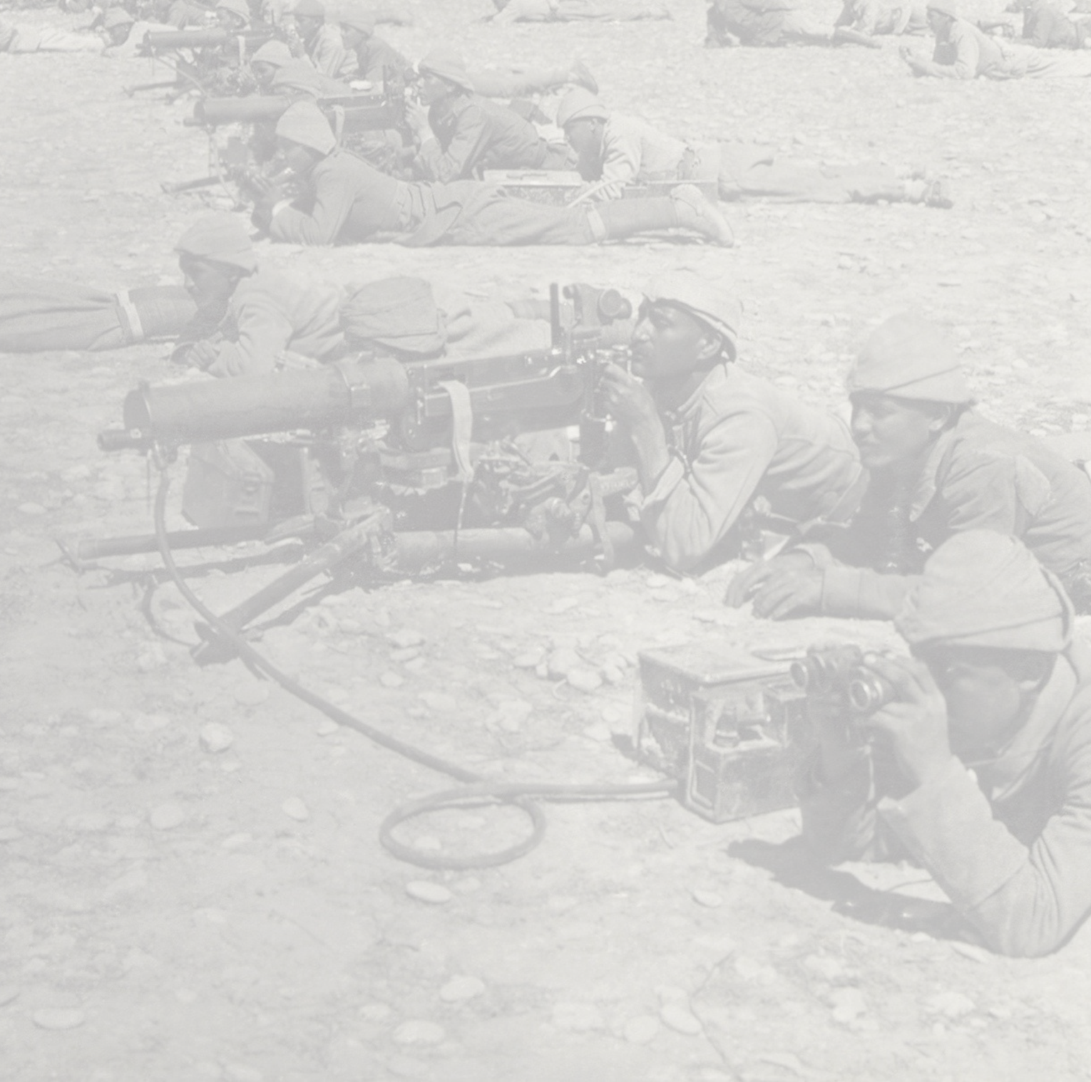
01
Background
Elaborate on what you want to discuss.
02
Table Of Contents
Key Events
Elaborate on what you want to discuss.
03
Aftermath
Elaborate on what you want to discuss.
Add photo description here
YYYY

Slide 3
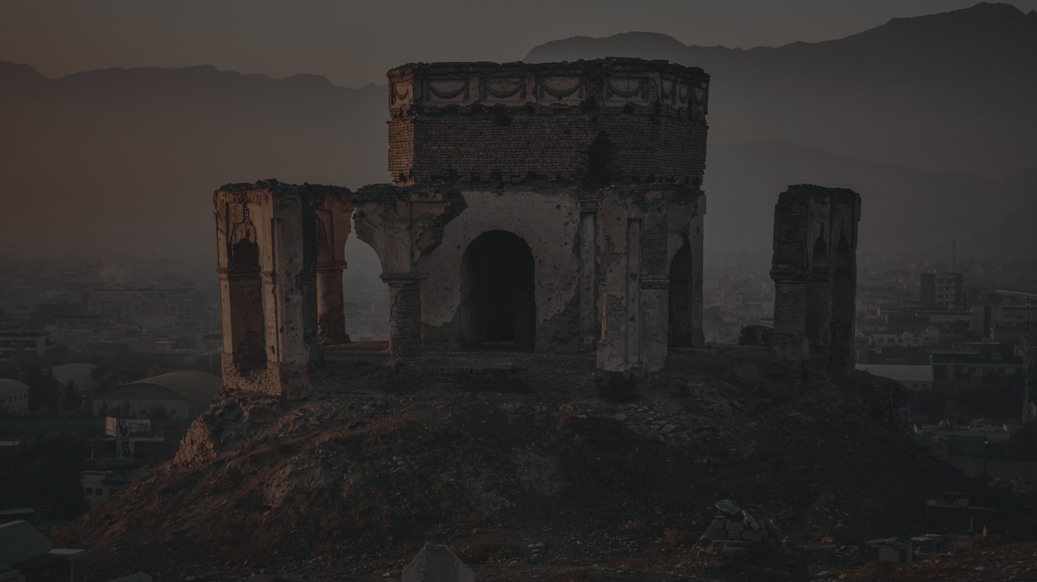
Background
Key Events
Aftermath
Afghanistan war:
Background
01
esse exercitation et proident nostrud excepteur nisi ad nulla anim sit commodo amet ea excepteur voluptate dolore minim et exercitation ipsum occaecat.

Slide 4
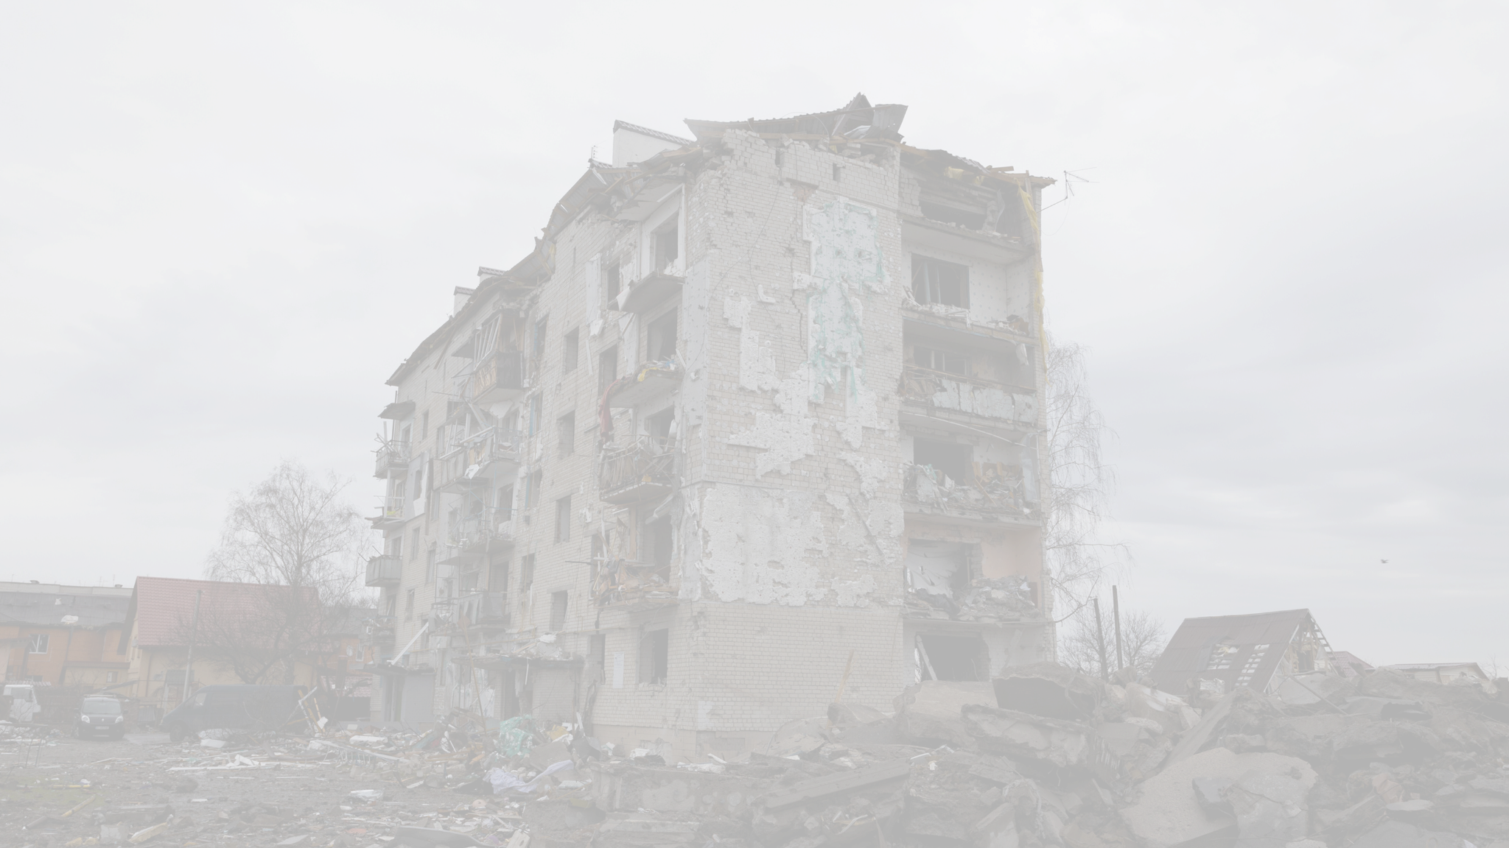
Afghanistan, located at the crossroads of Central and South Asia, has a rich history influenced by various empires. This slide will introduce Afghanistan’s geographical, cultural, and historical context.
Afghanistan, located at the crossroads of Central and South Asia, has a rich history influenced by various empires. This slide will introduce Afghanistan’s geographical, cultural, and historical context. Afghanistan, located at the crossroads of Central and South Asia, has a rich history influenced by various empires.
Afghanistan:
A Historical and Geopolitical Overview
Afghanistan, located at the crossroads of Central and South Asia, has a rich history influenced by various empires. This slide will introduce Afghanistan’s geographical, cultural, and historical context.

Slide 5

Background
Pre-1979 Afghanistan
The Soviet Invasion
Discuss the political landscape of Afghanistan prior to 1979, including the monarchy and the brief period of democracy.
On December 24, 1979, the Soviet Union invaded Afghanistan, aiming to support the communist government. This event sparked a decade-long conflict.
Rise of the Mujahideen
Soviet Withdrawal
Afghan guerrilla fighters, known as the Mujahideen, emerged to combat the Soviet forces, with substantial support from the US
and Pakistan.
The USSR, facing mounting casualties and international pressure, withdrew its troops in 1989, leaving behind a fragmented and war-torn country.

Slide 6

Background
Key Events
Aftermath
Afghanistan war:
Key Events
02
esse exercitation et proident nostrud excepteur nisi ad nulla anim sit commodo amet ea excepteur voluptate dolore minim et exercitation ipsum occaecat.

Slide 7

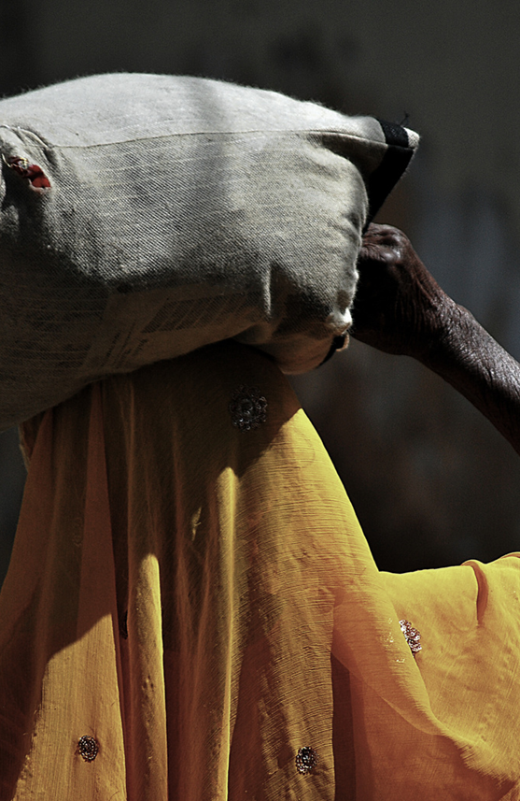

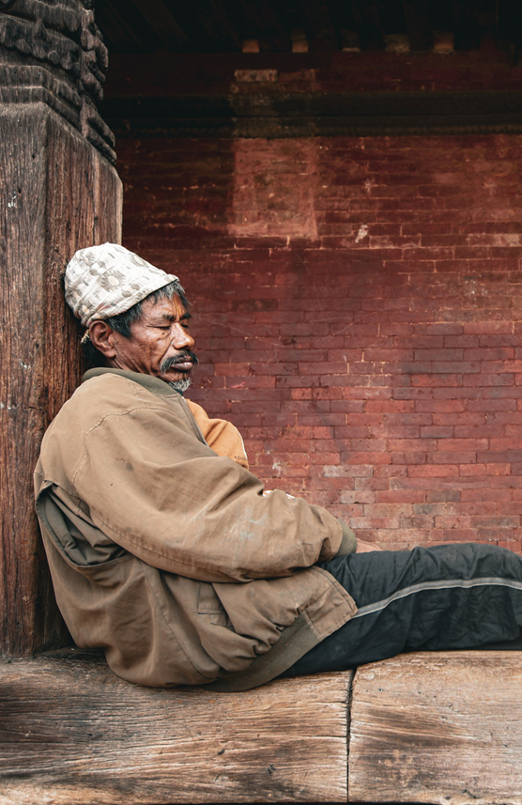
1989
1996
2001
2003
Elaborate on what you want to discuss.
Elaborate on what you want to discuss.
Elaborate on what you want to discuss.
Elaborate on what you want to discuss.

Slide 8
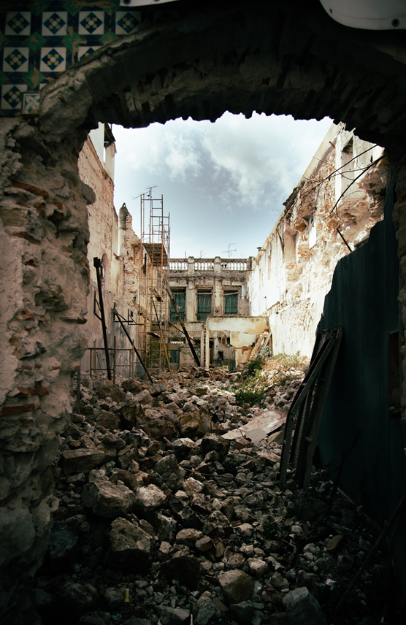
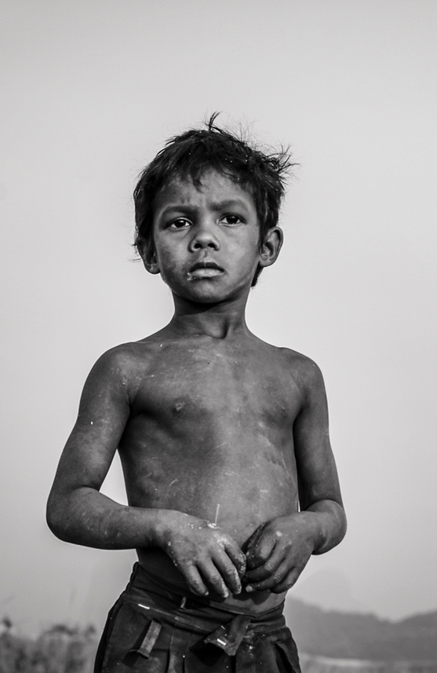
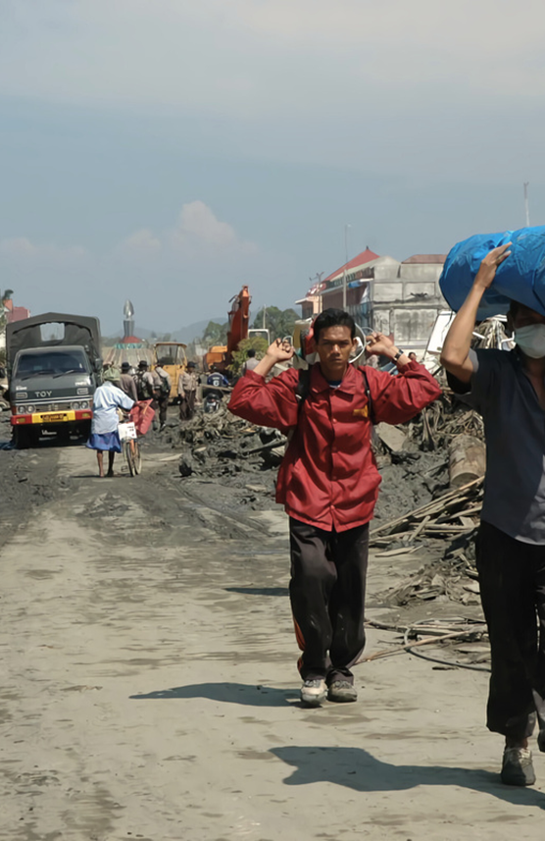
Timeline
2009
2011
2021
Elaborate on what you want to discuss.
Elaborate on what you want to discuss.
Elaborate on what you want to discuss.

Slide 9
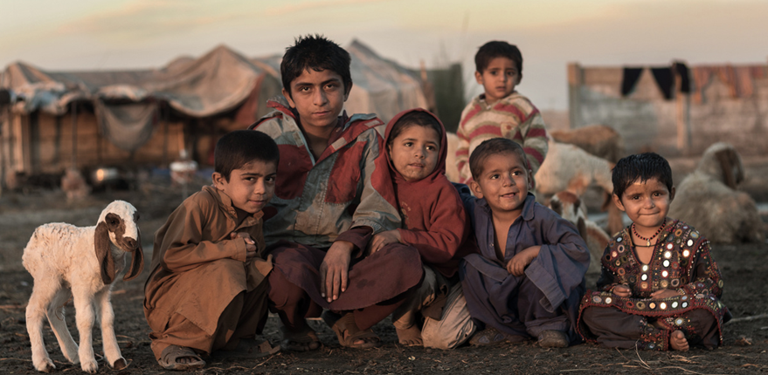

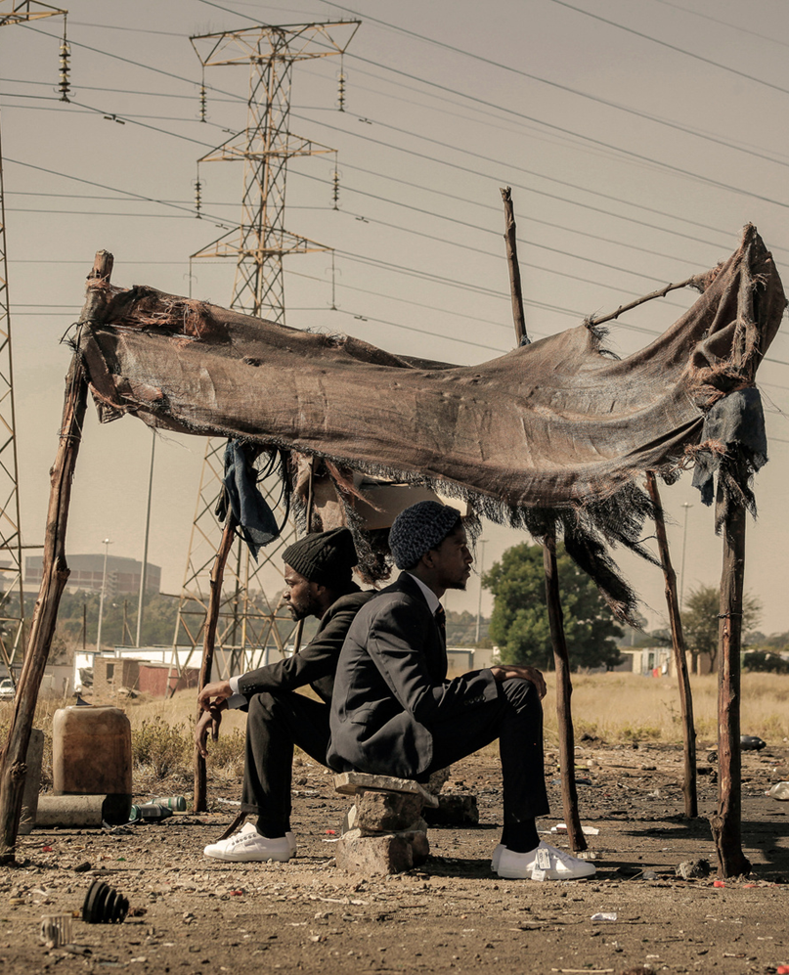
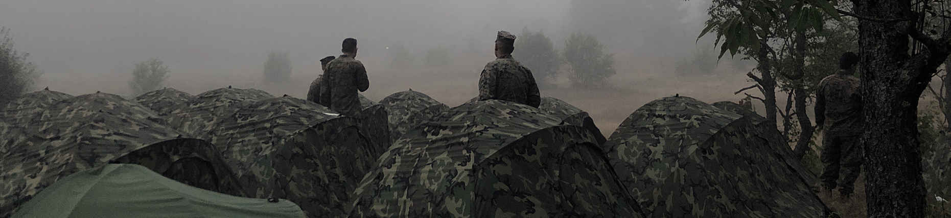
Gallery Image
What can you say about your projects? Share it here!
Add photo description here
Add photo description here
Add photo description here
Add photo description here

Slide 10

2.7m
46.000
54%
Displacement
Casualties
Poverty Rate
More than 2.7 million Afghan refugees worldwide.
Over 46,000 civilians killed since 2001.
Over 54% of the Afghan population lives below the poverty line.
Human and Economic Impact
esse exercitation et proident nostrud excepteur nisi ad nulla anim sit commodo amet ea excepteur voluptate dolore minim et exercitation ipsum occaecat.
esse exercitation et proident nostrud excepteur nisi ad nulla anim sit commodo amet ea excepteur voluptate dolore minim et exercitation ipsum occaecat.
of the Afghanistan War

Slide 11



Witnesses
Name Surname
Name Surname
Name Surname
Elaborate on what you want to discuss.
Elaborate on what you want to discuss.
Elaborate on what you want to discuss.

Slide 12
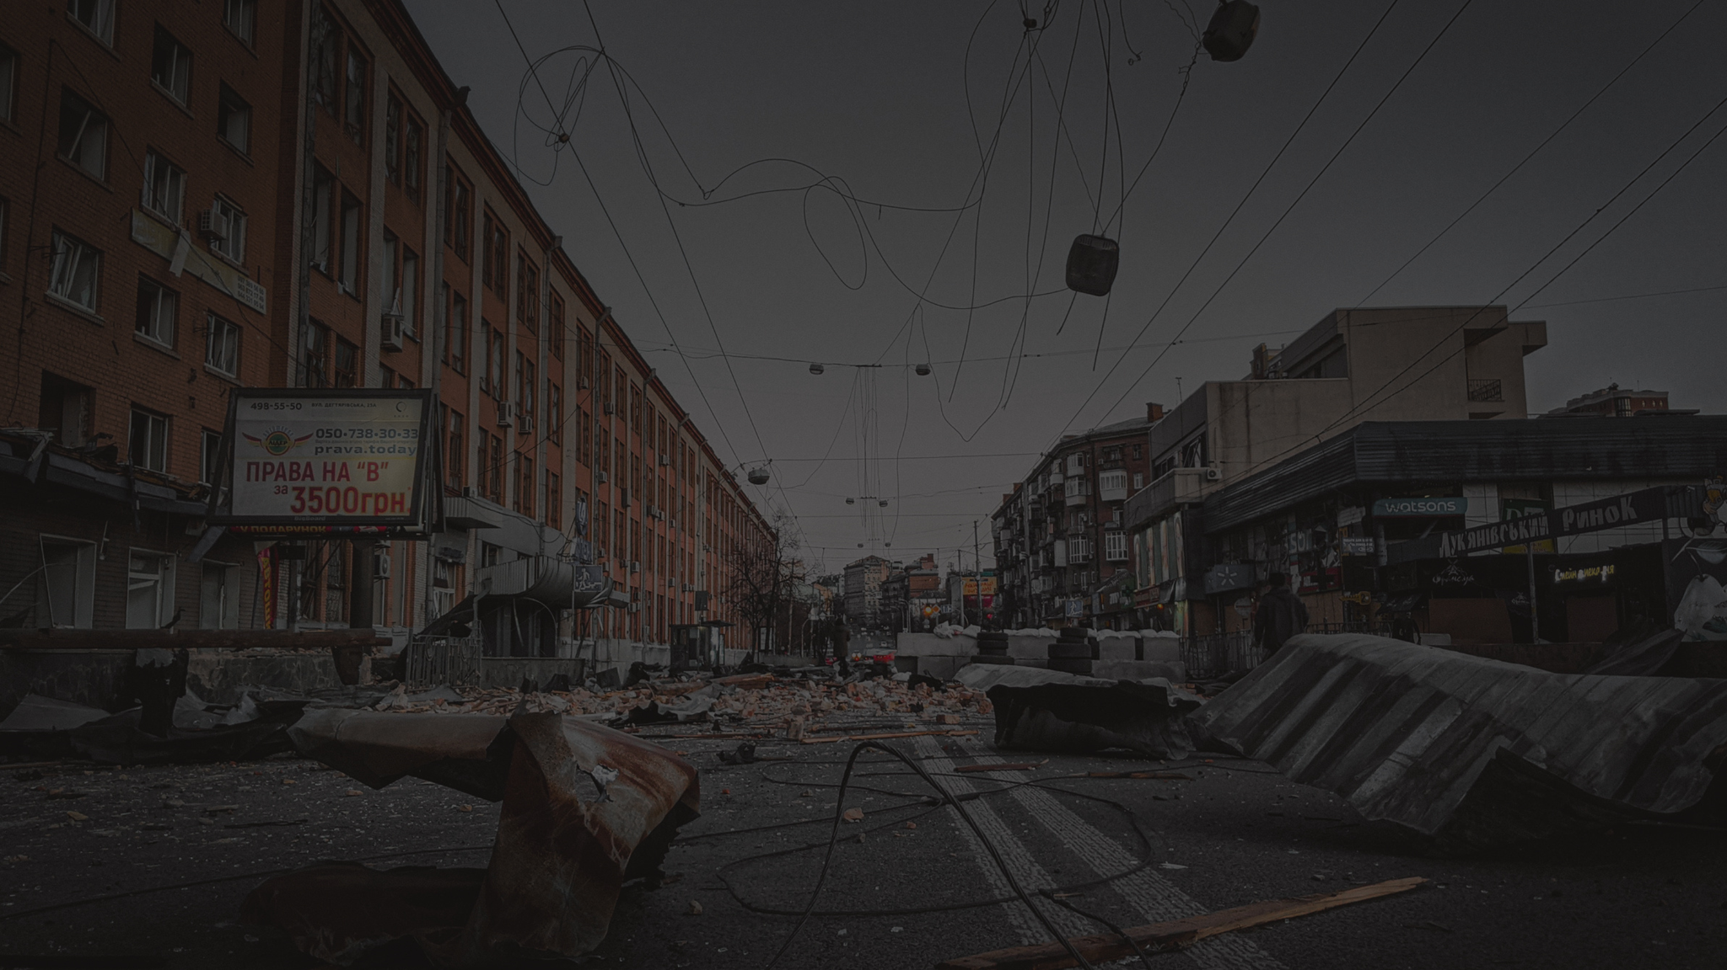
Background
Key Events
Aftermath
Afghanistan war:
Aftermath
03
esse exercitation et proident nostrud excepteur nisi ad nulla anim sit commodo amet ea excepteur voluptate dolore minim et exercitation ipsum occaecat.

Slide 13

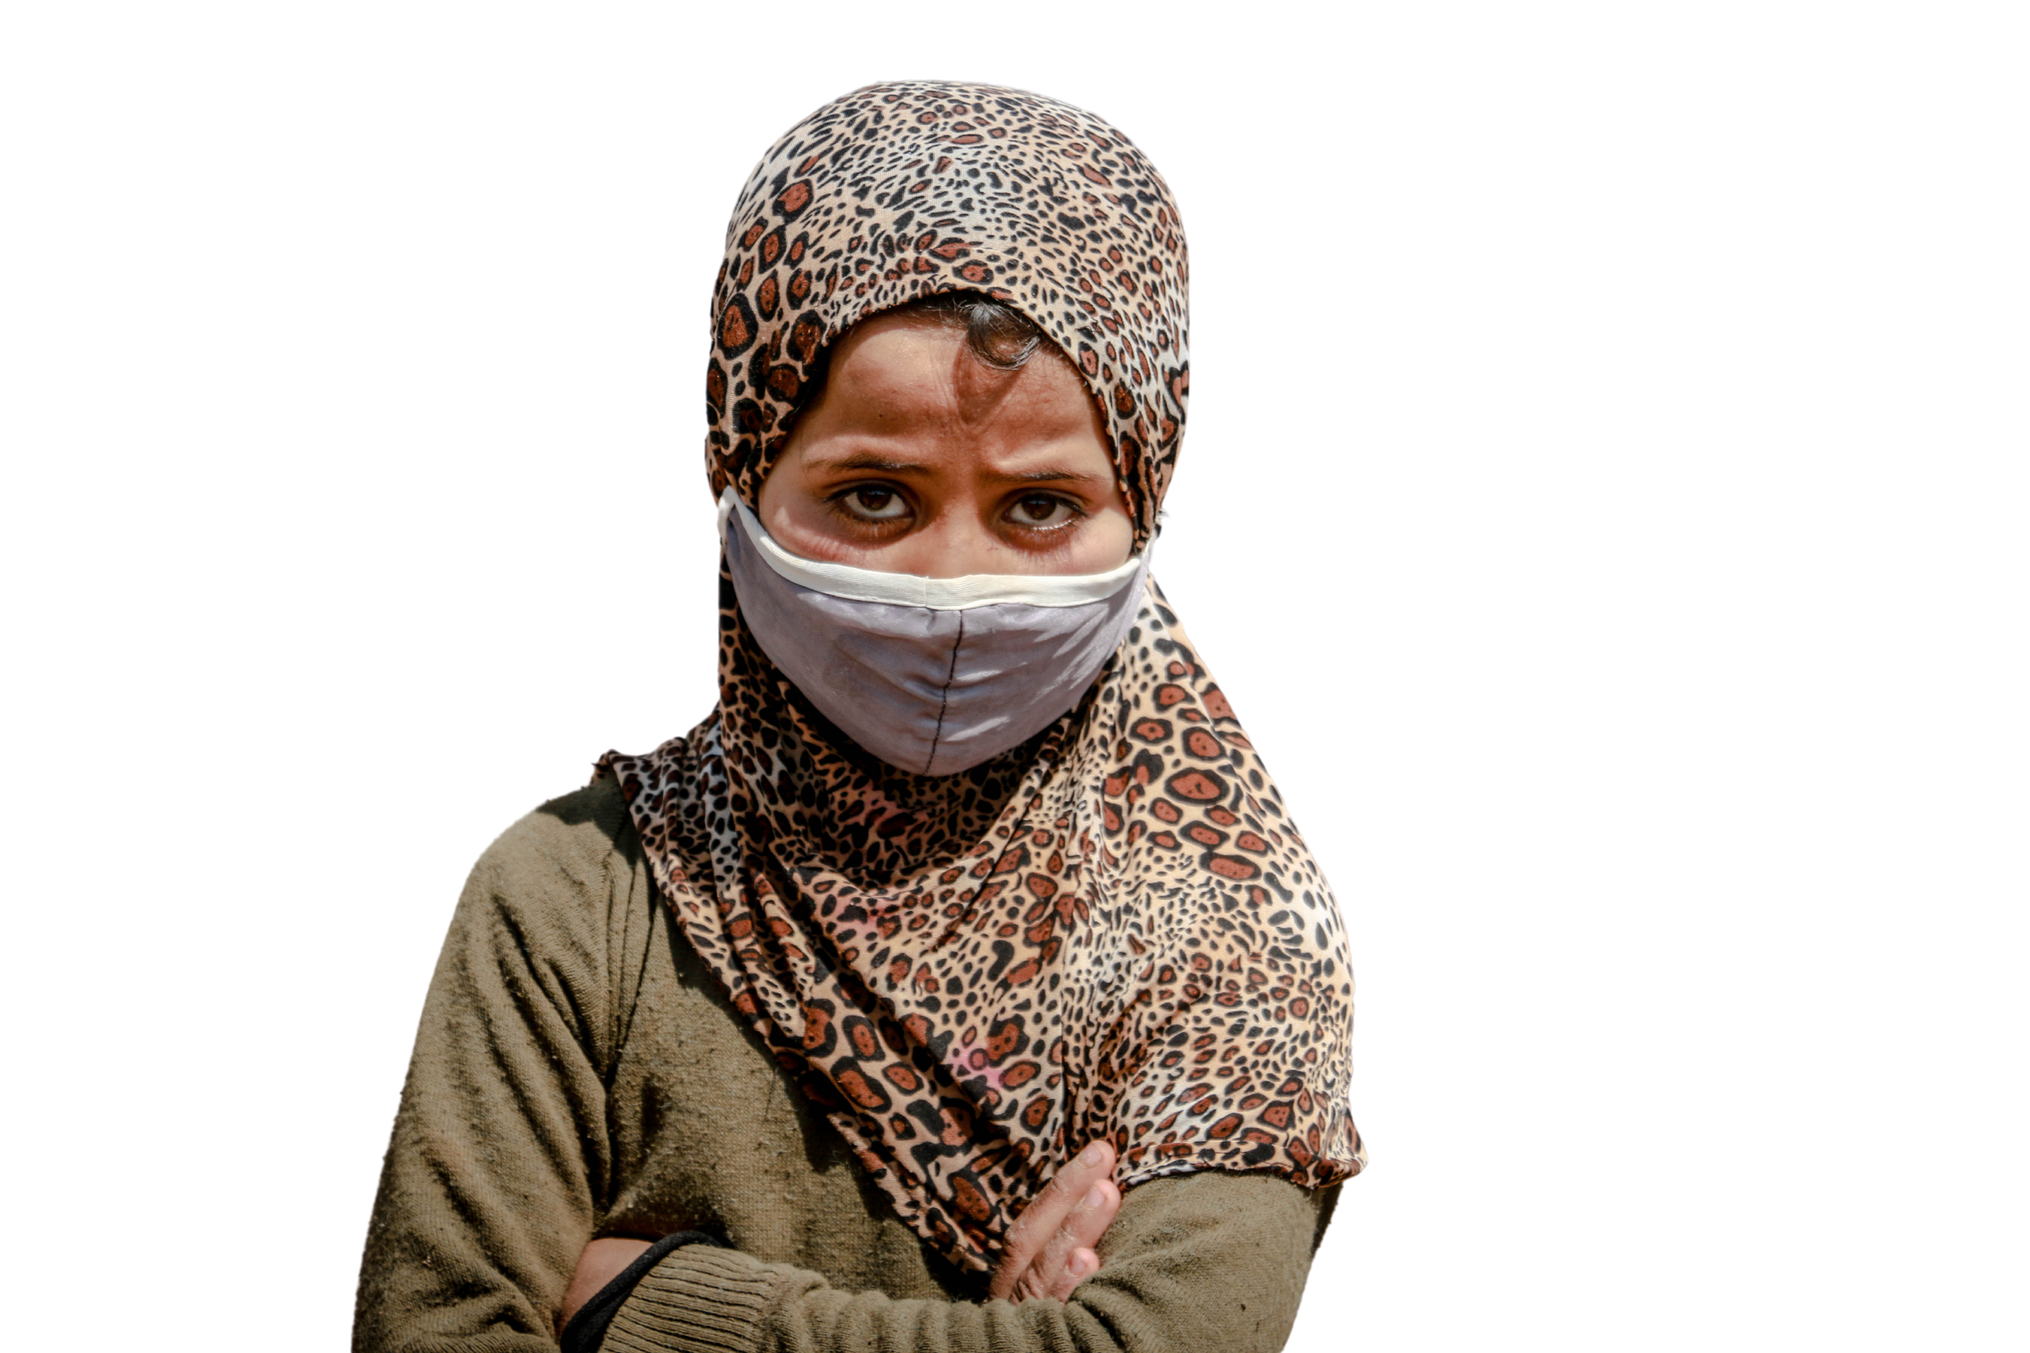
Impacts
01
03
Humanitarian Impact
Women's Rights
Elaborate on what you want to discuss.
Elaborate on what you want to discuss.
02
04
Refugee Crisis
Economic Impact
Elaborate on what you want to discuss.
Elaborate on what you want to discuss.

Slide 14
“
The Afghanistan War highlighted the complexities of nation-building and counterinsurgency, emphasizing the need for strategies that balance military action with political and humanitarian efforts. The immense human suffering underscored the necessity for robust humanitarian aid and long-term development strategies in post-conflict regions. The conflict also revealed the critical importance of safeguarding women's rights, with future efforts needing to prioritize gender equality and education.
The future of Afghanistan remains uncertain, requiring continued international support for peace-building initiatives, humanitarian aid, and inclusive governance to ensure long-term stability. The rapid fall of Kabul and the Taliban's return to power in 2021 shocked the world and highlighted the fragile nature of the gains made over two decades. It is crucial for the international community to engage with the new regime carefully, ensuring that human rights, especially those of women and minorities, are protected and that Afghanistan does not become a haven for terrorist organizations once again.
“
Conclusion
The war demonstrated the necessity of strong international coalitions and partnerships to address global security threats and rebuild war-torn nations. The future of Afghanistan remains uncertain, requiring continued international support for peace-building initiatives, humanitarian aid, and inclusive governance to ensure long-term stability. Ultimately, the Afghanistan War serves as a poignant reminder of the complex interplay between local dynamics and global geopolitics, calling for ongoing reflection and adaptation in international conflict resolution and peacekeeping strategies.

Slide 15
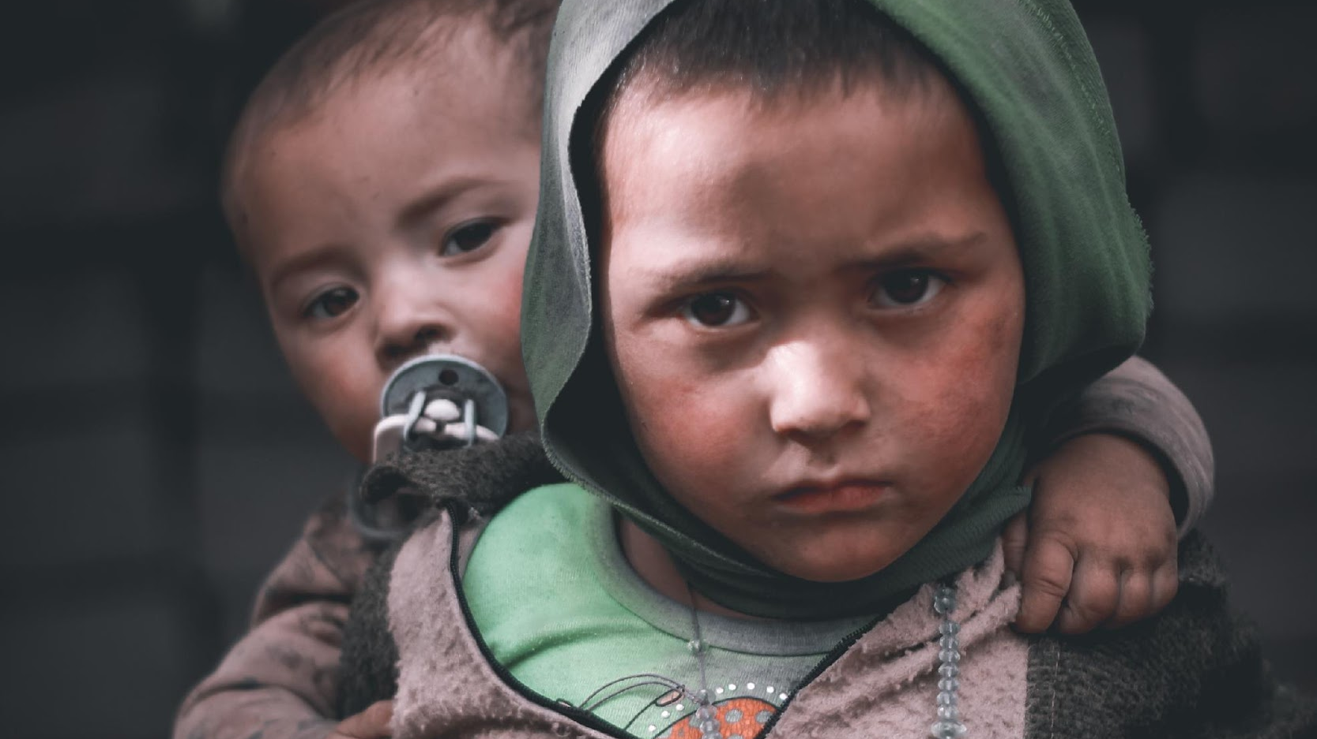
A picture is worth a thousand words

Slide 16
Afghanistan war:
Write an original statement or inspiring quote
— Include a credit, citation, or supporting message

Slide 17







































Resource Page
  Use these design resources in your Canva Presentation.
Fonts
Design Elements
This presentation template
uses the following free fonts:
TITLES:
ARAPEY
HEADERS:
RALEWAY
BODY COPY:
RALEWAY
You can find these fonts online too.
Colors
#1A1716
#FCFAFB
#E9C87E
  DON'T FORGET TO DELETE THIS PAGE BEFORE PRESENTING.

Slide 18

Credits
  This presentation template is free for everyone to use thanks to the following:
  for the presentation template
Pexels, Pixabay
  for the photos
  Happy designing!

