Slide 1
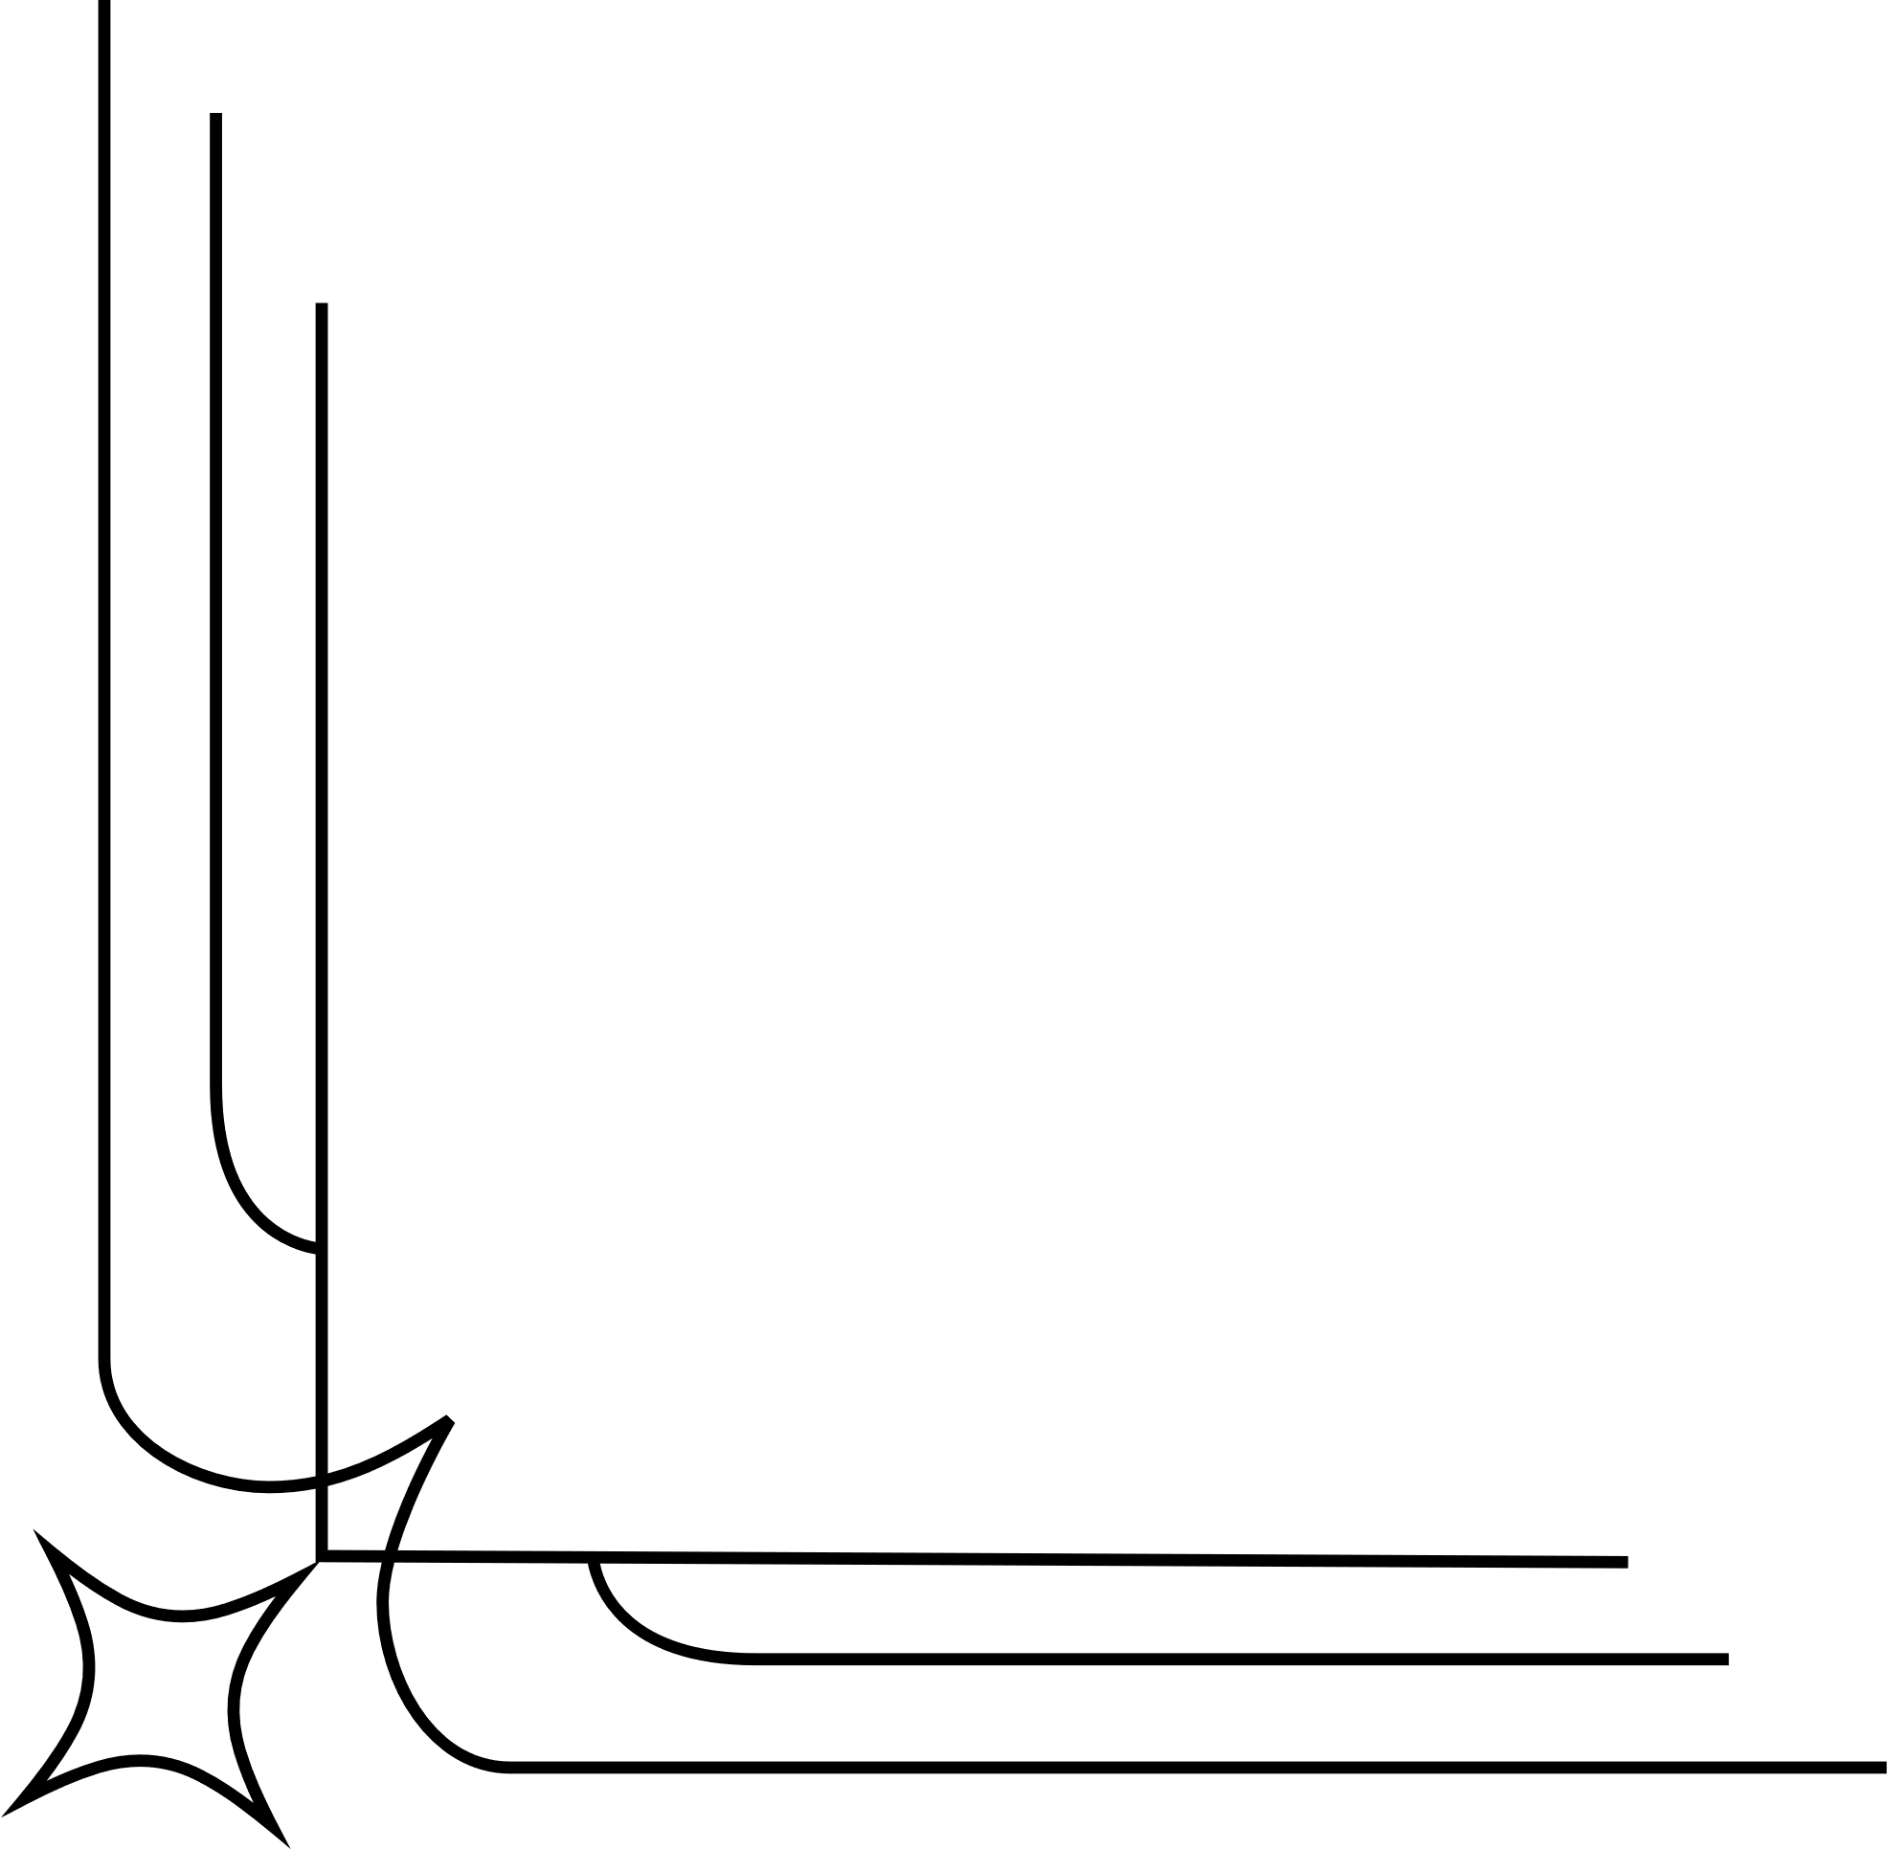



FANTASY
COLORING WORKSHEET

Slide 2
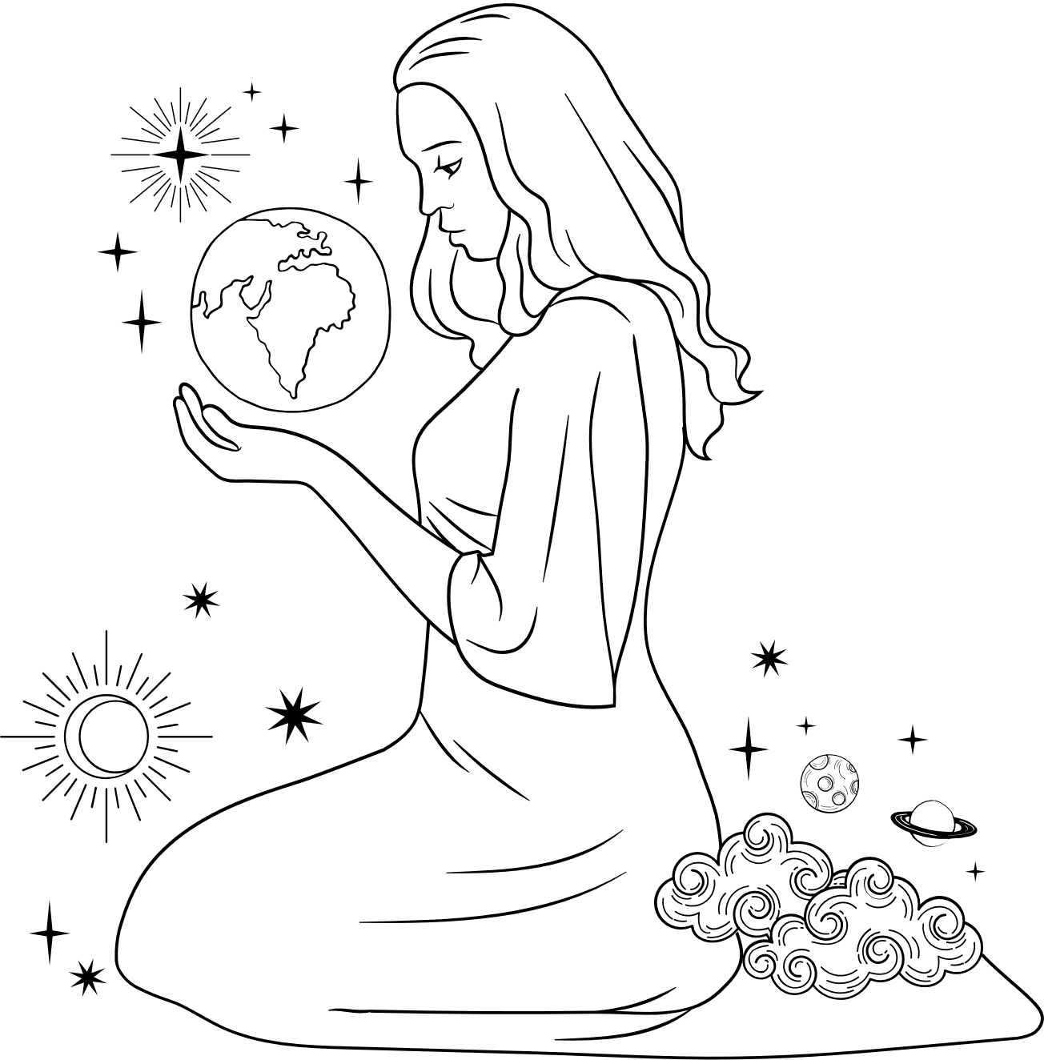

FANTASY
COLORING WORKSHEET

Slide 3
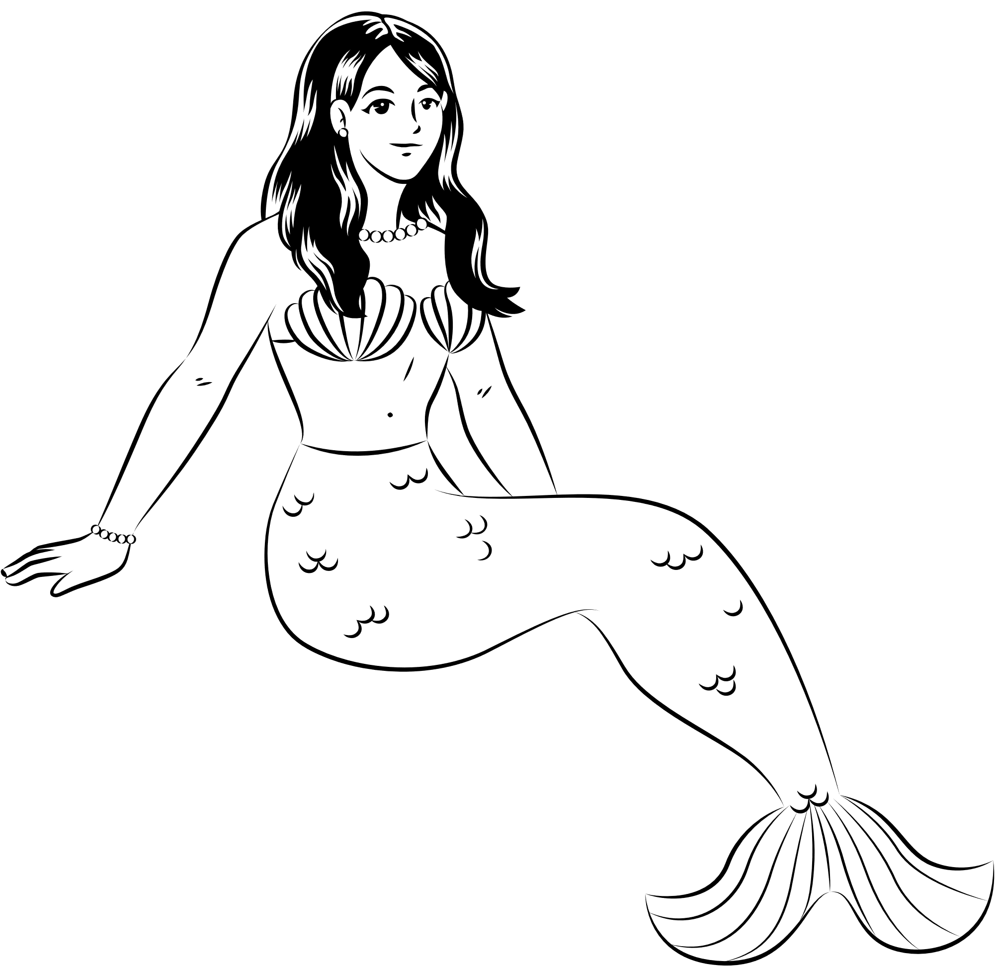

MERMAID

Slide 4
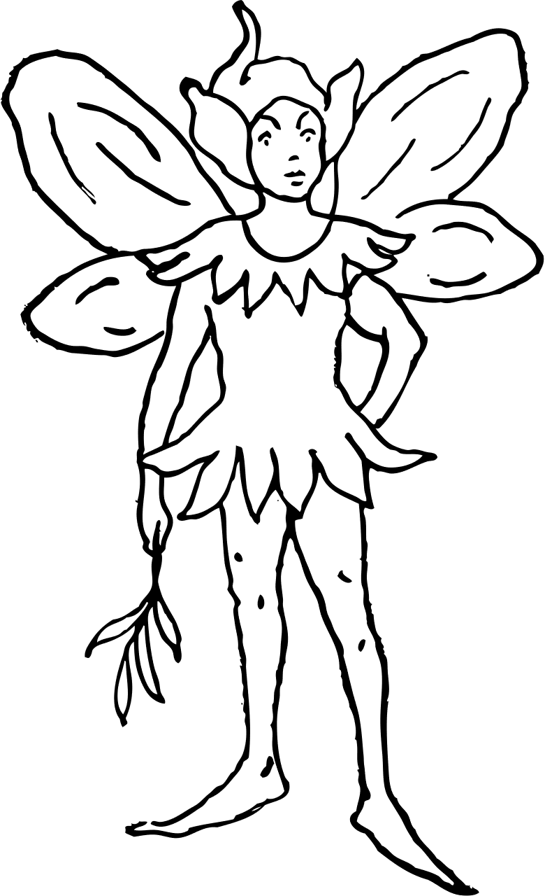
ELF

Slide 5

UNICORN

Slide 6
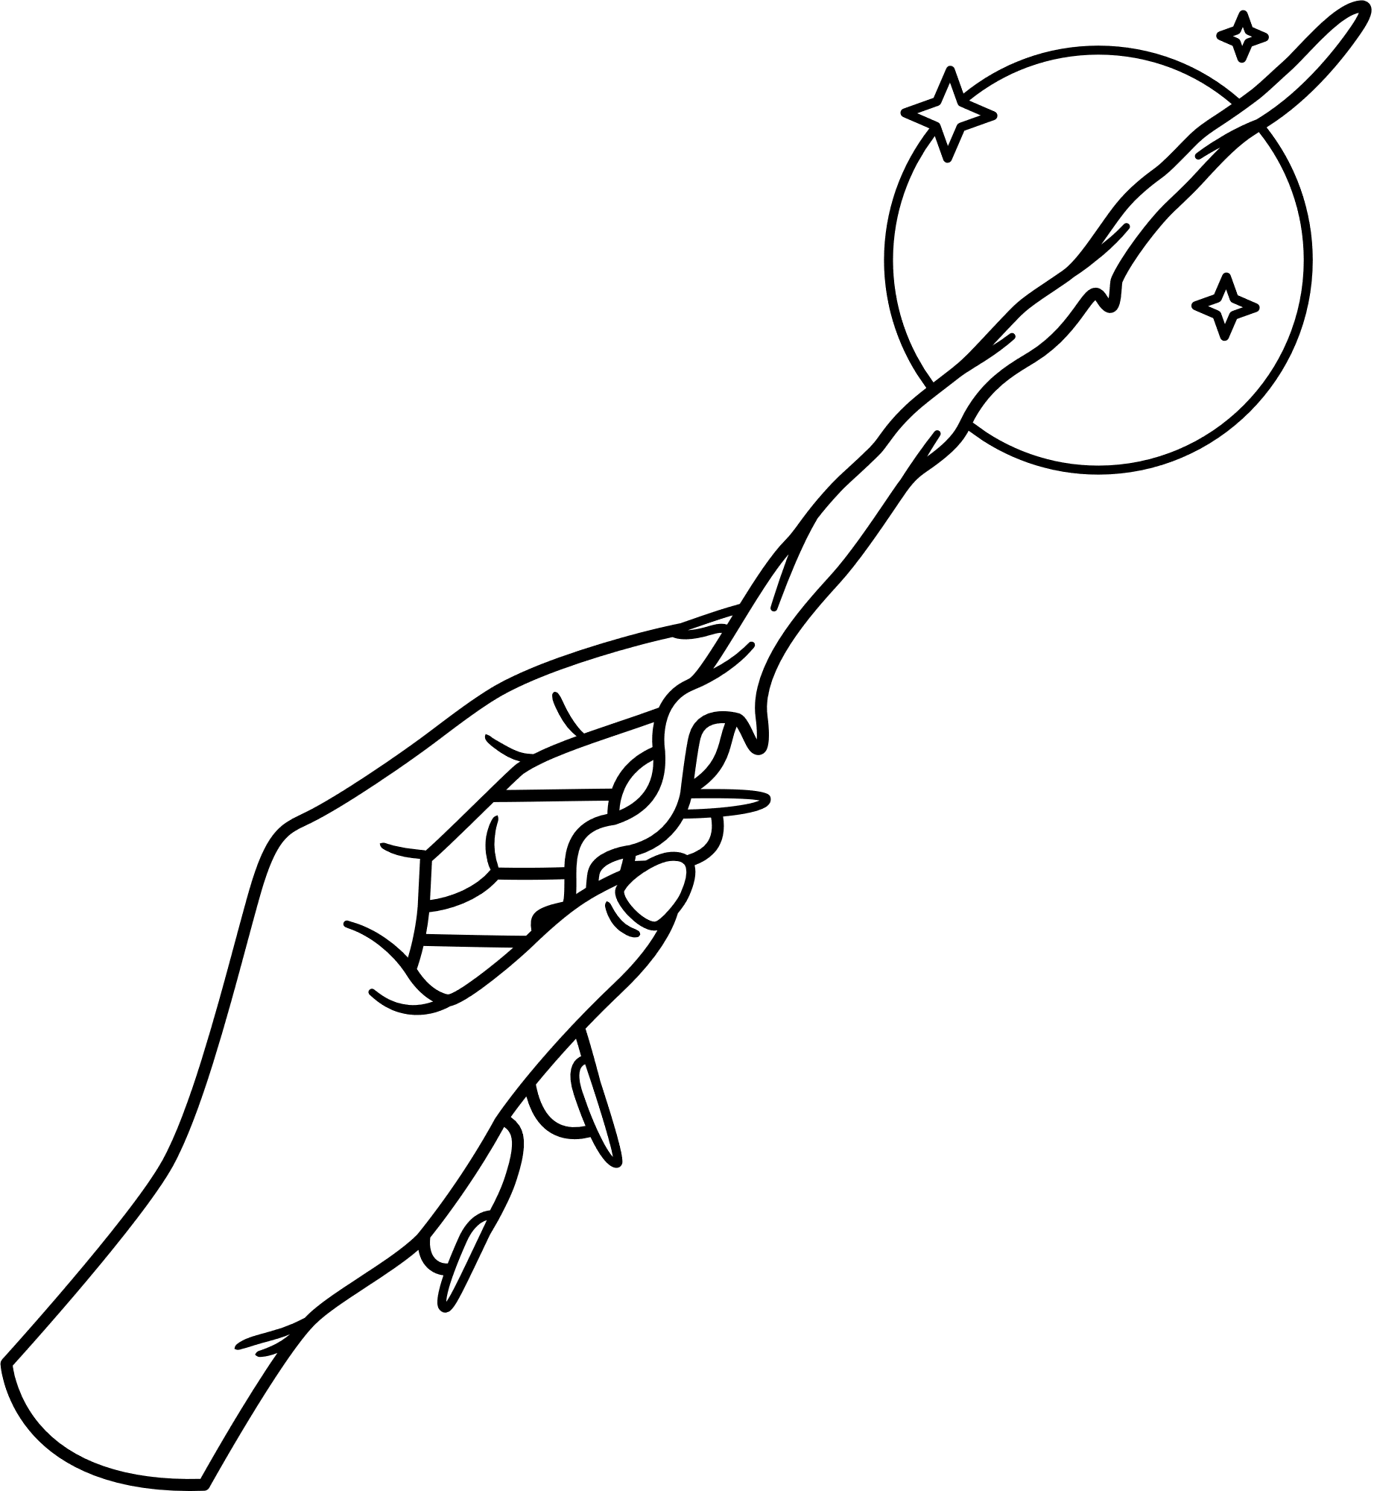

CRYSTALS

Slide 7
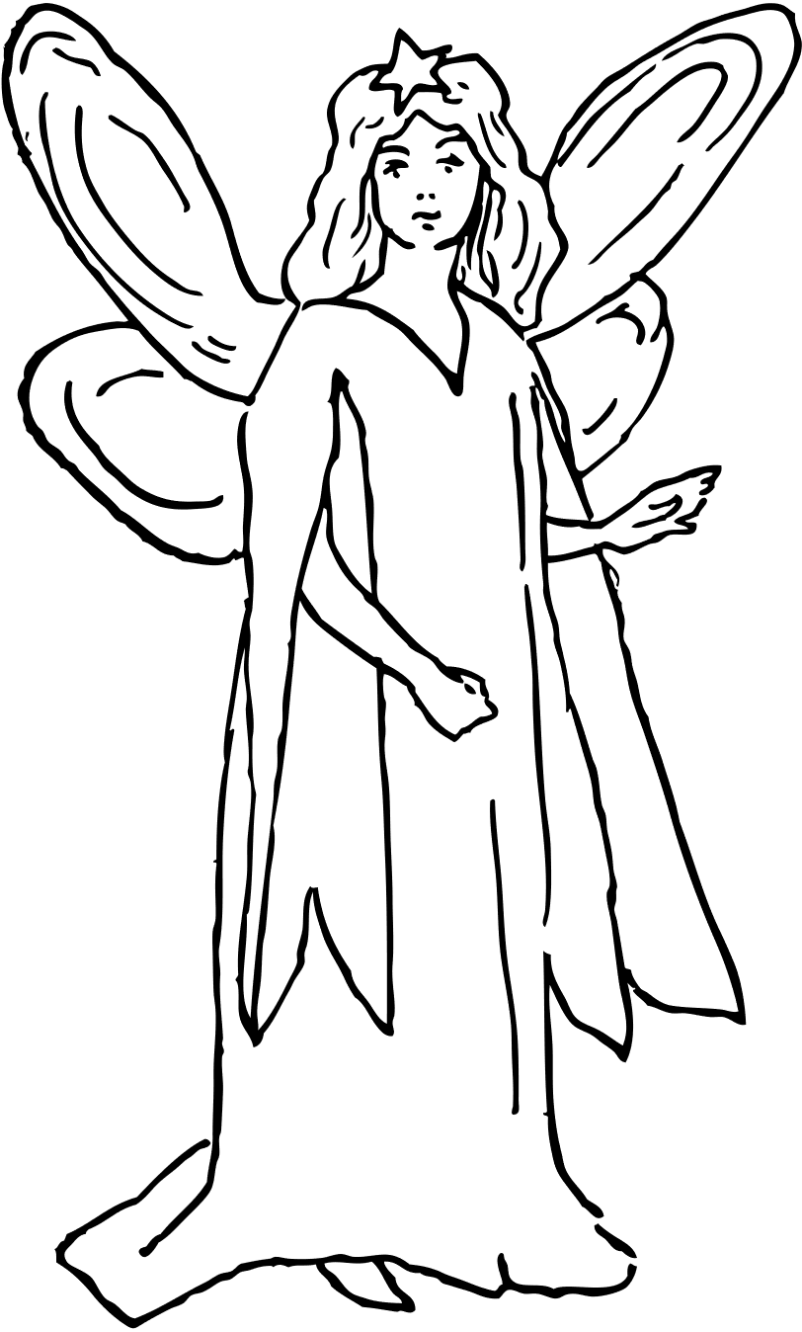
FAIRY

Slide 8
RESOURCE PAGE
  Use these design resources in your Canva Template.
Fonts
This template uses the following free fonts:
TITLES:
LONDRINA SHADOW
HEADERS:
LONDRINA SHADOW
BODY COPY:
LIVVIC
You can find these fonts online too.
Colors
#000000
#FFFFFF
Design Elements

Slide 9

CREDITS
  This template is free for everyone to use thanks to the following:
  for the template
Pexels, Pixabay
  for the photos
HAPPY DESIGNING!

