Slide 1

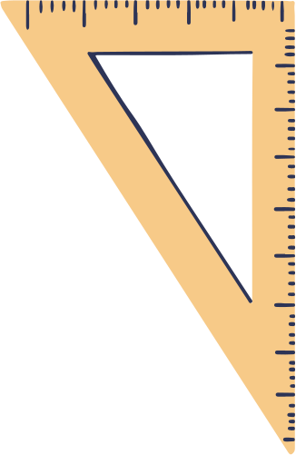
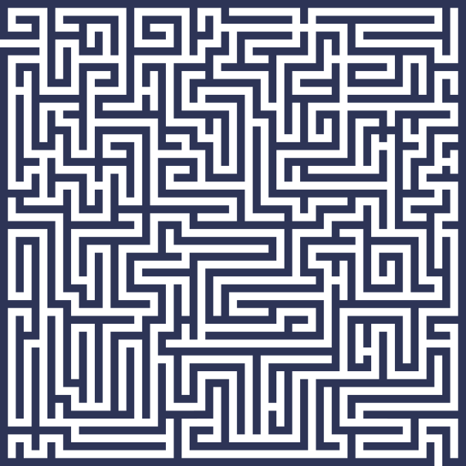

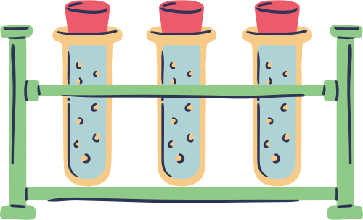


Name:
Date:
THE MAZE GAME
Can you help a student to find her books for an exam?

Slide 2








RESOURCE PAGE
  Use these design resources in your Canva Template.
Fonts
This template uses the following free fonts:
TITLES:
STAATLICHES
HEADERS:
STAATLICHES
BODY COPY:
NUNITO SANS
You can find these fonts online too.
Colors
#2D3456
#AFD2D5
#8FCA88
#EB5B6C
#ED7843
#F7CA88
Design Elements

Slide 3

CREDITS
  This presentation template is free for everyone to use thanks to the following:
  for the presentation template
Pexels, Pixabay
  for the photos
Happy designing!

