Slide 1

IN THE GARDEN
COLORING BOOK

Slide 2

TREES

Slide 3

SUNFLOWER

Slide 4

BUTTERFLY

Slide 5

BALL

Slide 6
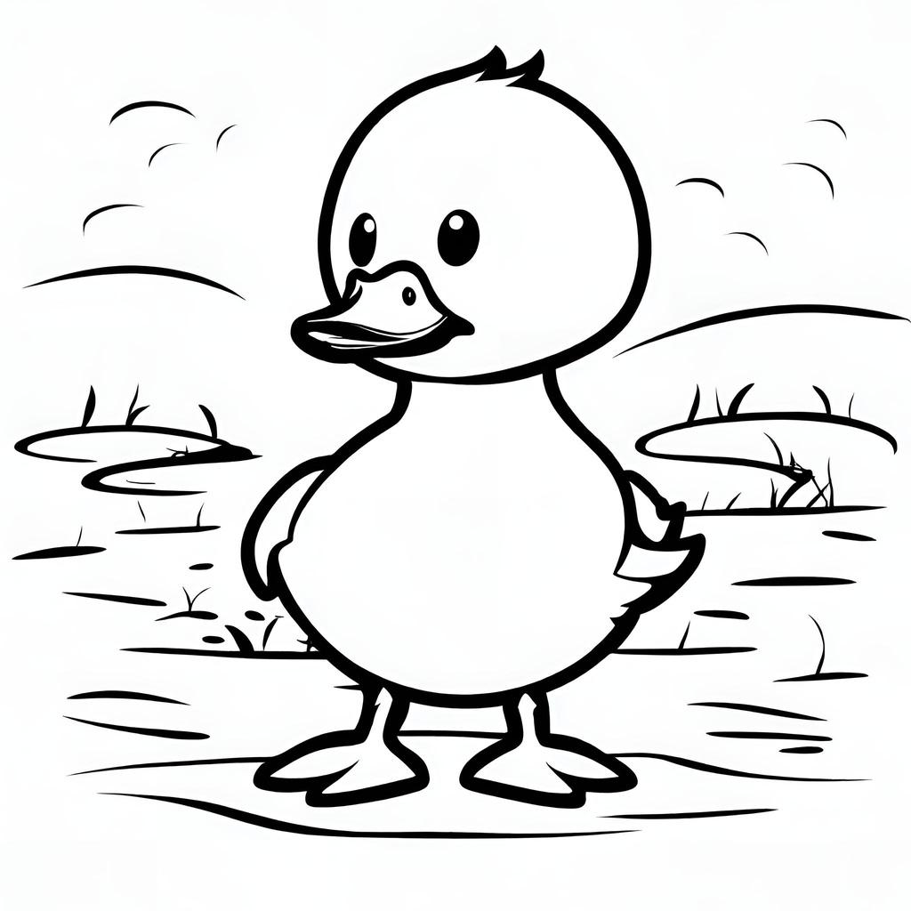
DUCK

Slide 7

PUPPY

Slide 8

MUSHROOM

Slide 9

SQUIRREL

Slide 10

CARROT

Slide 11
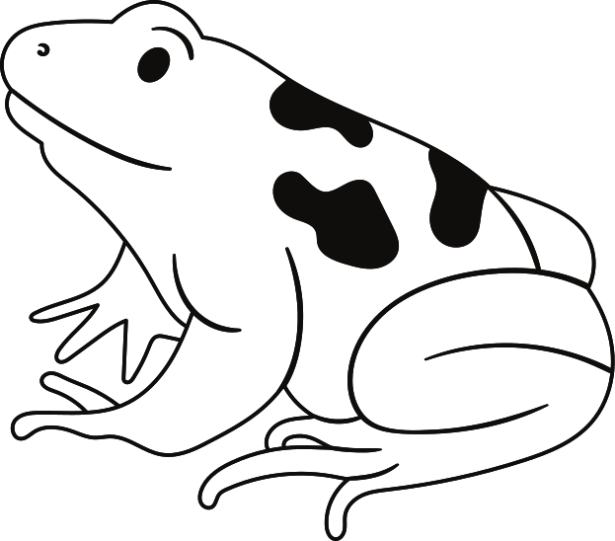
FROG

Slide 12
RESOURCE PAGE
  Use these design resources in your Canva Presentation.
Fonts
Colors
This presentation template
uses the following free fonts:
TITLES:
PAYTONE ONE
HEADERS:
PAYTONE ONE
Body:
DM SANS
#000000
#FFFFFF
You can find these fonts online too.

Slide 13

CREDITS
This presentation template is free for everyone to use
  thanks to the following:
  for the presentation template
Pexels, Pixabay
  for the photos
  HAPPY DESIGNING!

