Slide 1

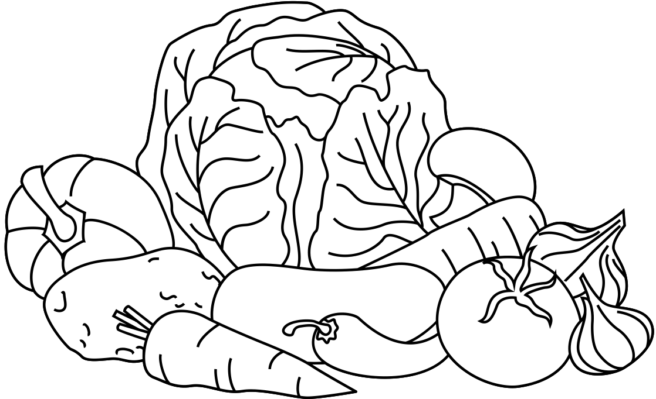
Vegetable Coloring Book
Name:
Class:

Slide 2


Carrot
Bell Pepper

Slide 3


Peas
Onion

Slide 4


Cabbage
Chili

Slide 5

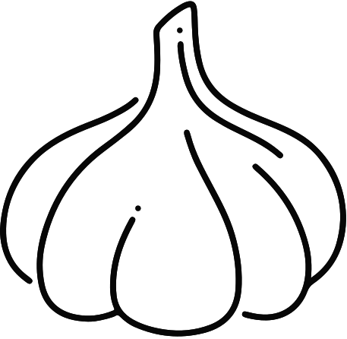
Broccoli
Garlic

Slide 6


Lettuce
Eggplant

Slide 7

RESOURCE PAGE
  Use these design resources in your Canva Presentation.
Fonts
Design Elements
This presentation template
uses the following free fonts:
TITLES:
FINGER PAINT
HEADERS:
FINGER PAINT
BODY COPY:
FINGER PAINT
You can find these fonts online too.
Colors
#000000
#FFFFFF
  DON'T FORGET TO DELETE THIS PAGE BEFORE PRESENTING.

Slide 8

CREDITS
  This presentation template is free for everyone to use thanks to the following:
  for the presentation template
Pexels, Pixabay
  for the photos
  Happy designing!

