Slide 1
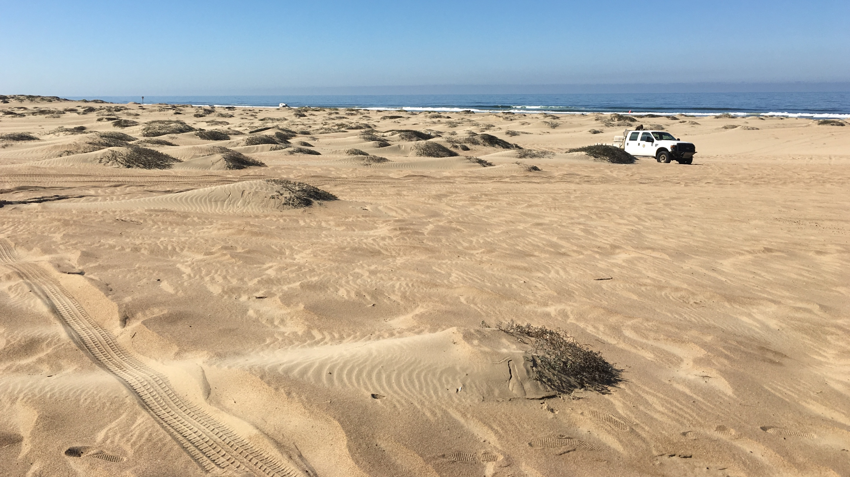


Ocean Dunes SVRA Dust Control
Update from the Science Advisory Group
J.A. Gillies, Desert Research Institute, Reno, NV
W.G. Nickling, Nickling Environmental, Cambridge, ON
I. Walker, Arizona State University, Tempe, AZ
Nickling Environmental, Ltd
R. Martin, E. Withycombe, C. Scheidlinger, M. Bush

Slide 2
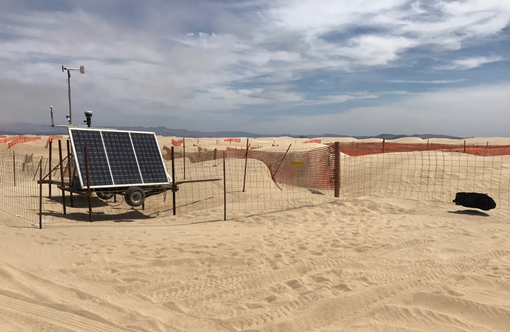
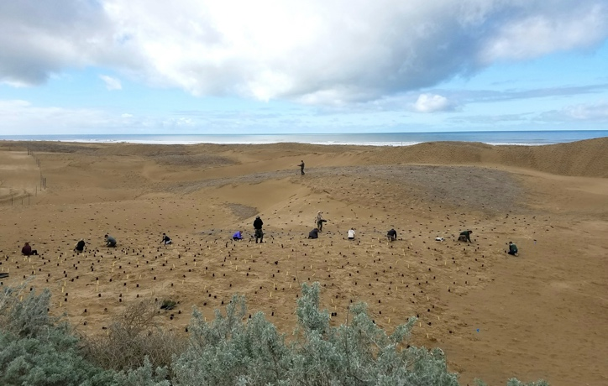
ODSVRA Dust Control updates from the SAG
Air Quality, 2019
PM Emission Characterizations (PM emission patterns and emissivity)
Air Quality PM Reduction Characterization – Regional PM modeling
Dust Control Activities, 2019
Dust Control Effectiveness, 2019
Dust Control Activities, 2020
Foredune Restoration, 2020

Slide 3
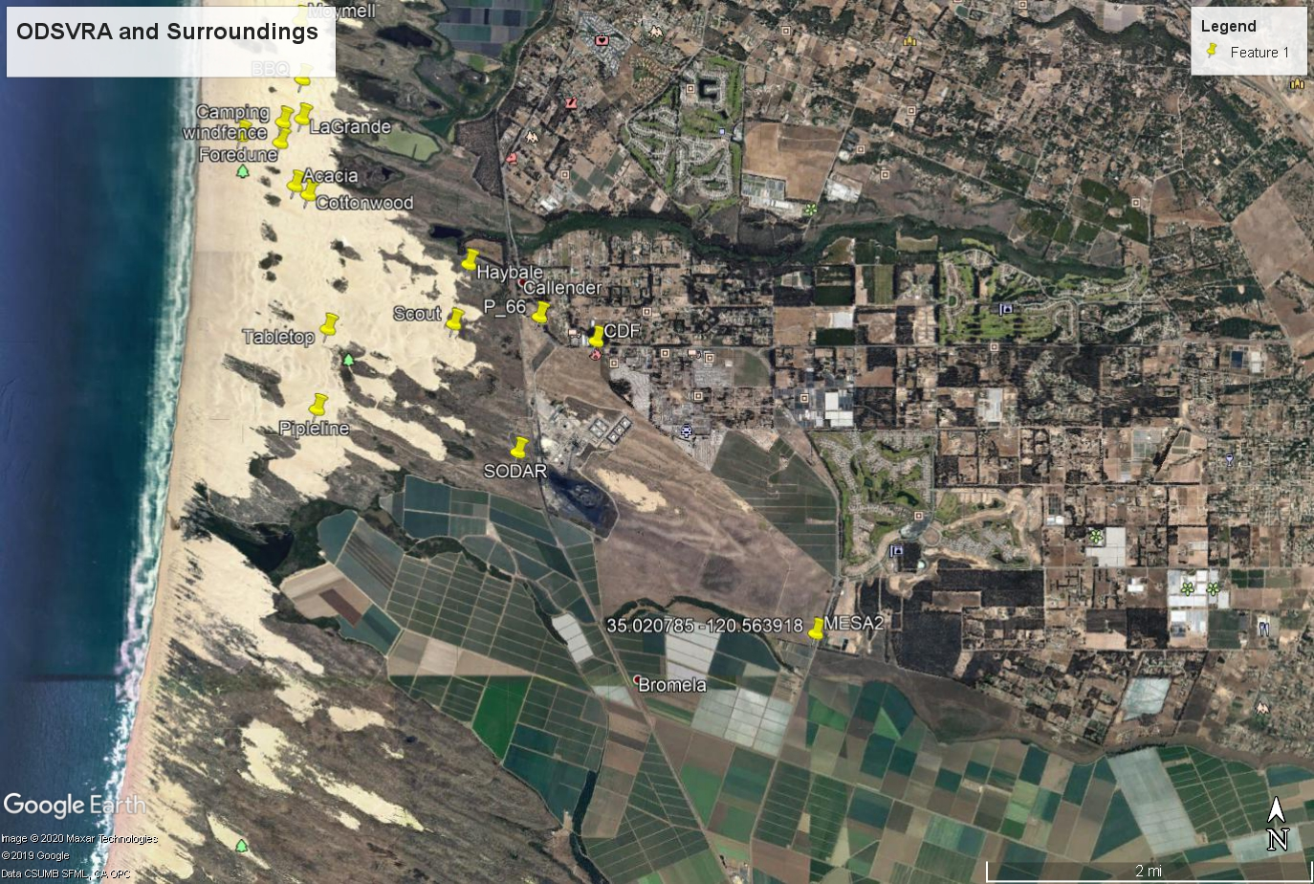
EPA
24 hr Mean Concentration (≥150 µg m⁻³)
CDF – 0
Mesa2 – 0
Oso Flaco – 0
State
24 hr Mean Concentration (≥50 µg m⁻³)
CDF – 35
Mesa2 – 34
Oso Flaco – 5
Air Quality 2019, Exceedances – PM₁₀
CDF
Mesa2

Slide 4
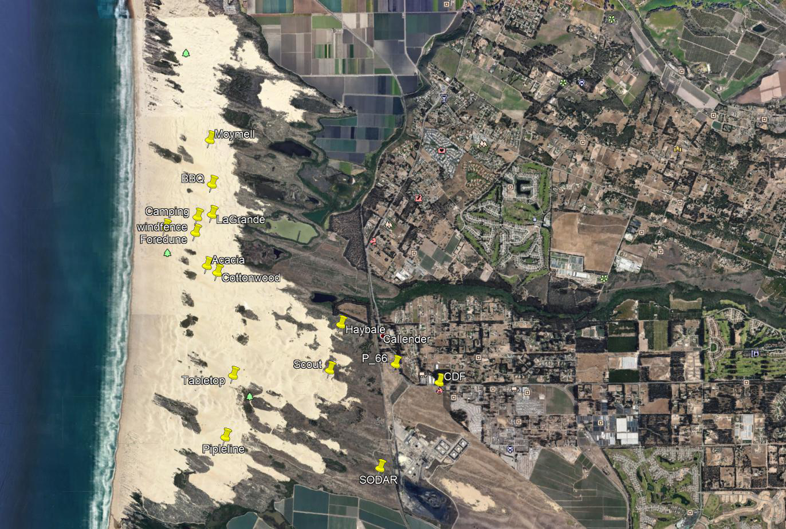
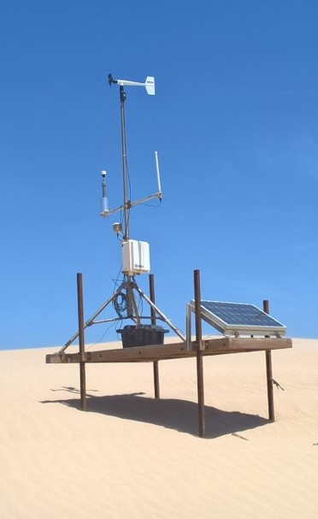
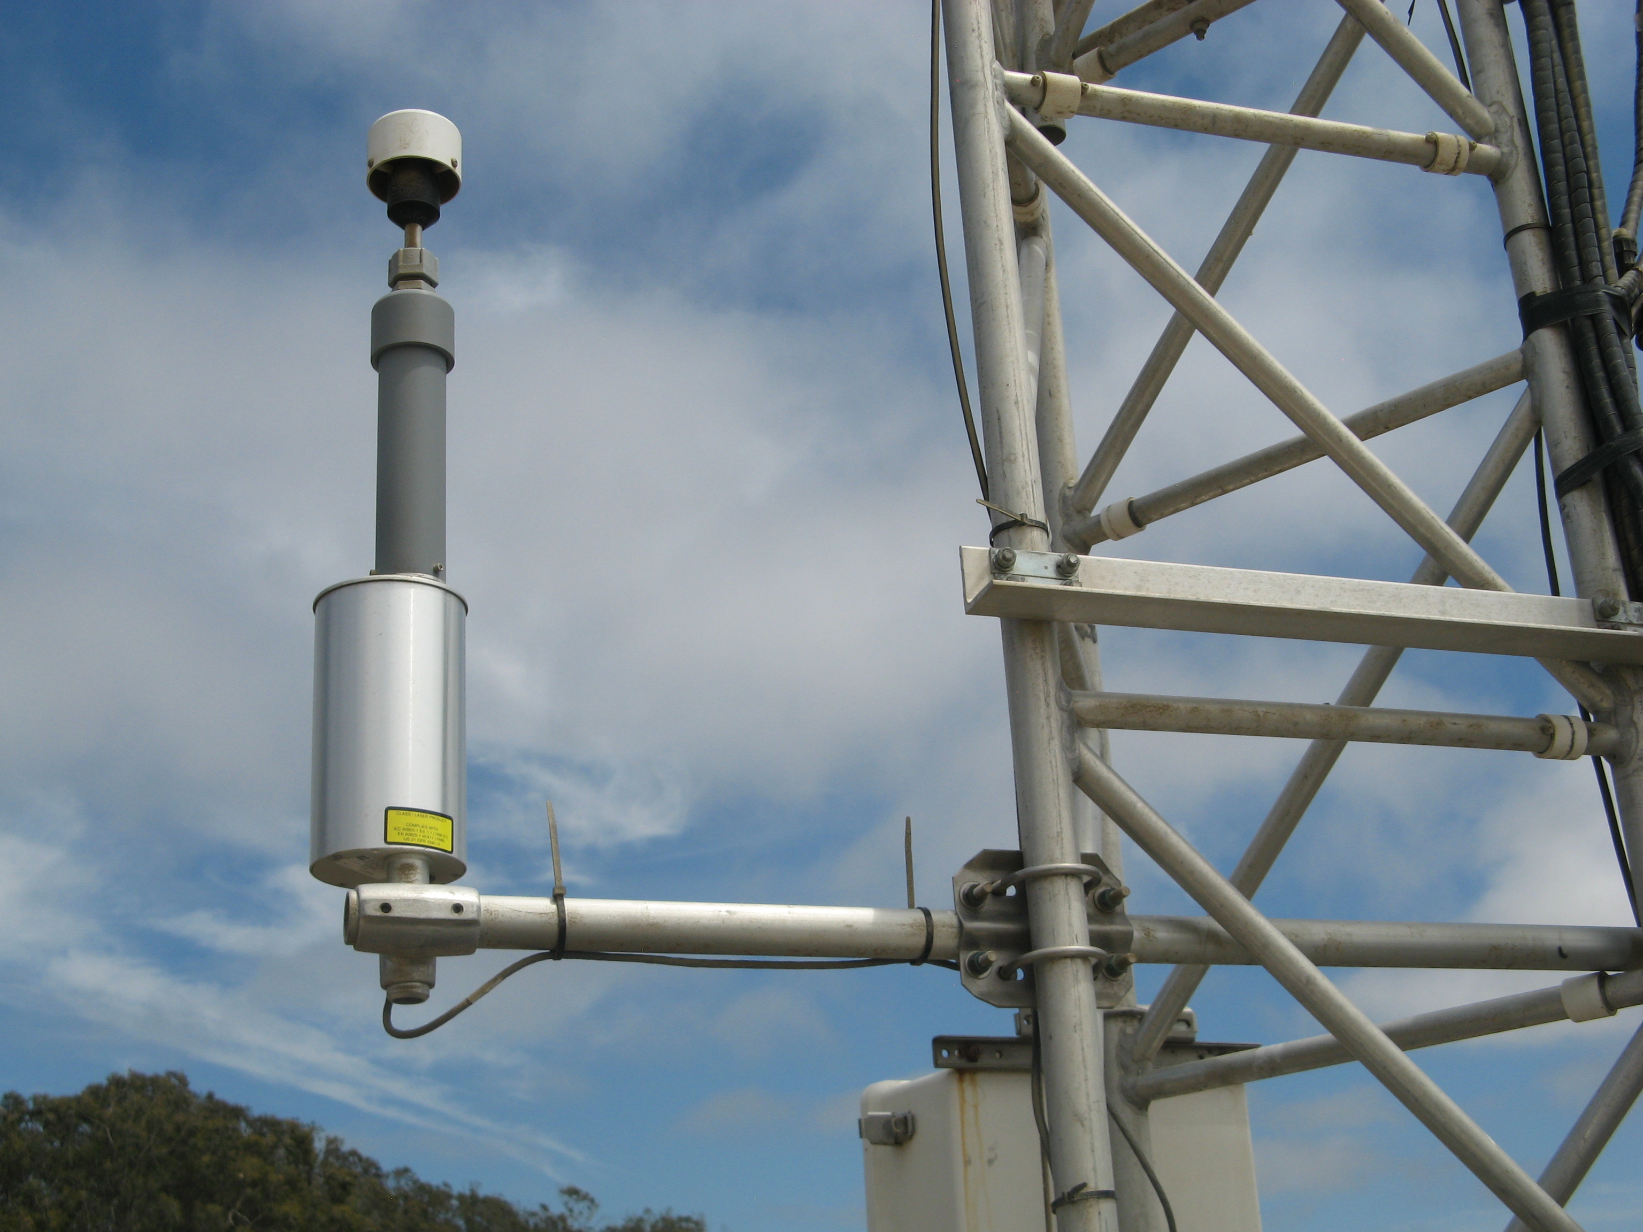
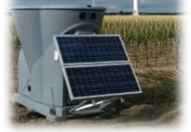
PM₁₀ Emission Patterns
(MetOne Aerosol Particle Profiler Network, and meteorology)
Most emissions occur in the west with comparatively lower input from points east of the BBQ, LG, and WF monitors
Multi-day events: first 1-2 days are (at comparable wind speeds) generally highest
Exceptions when moisture below the surface is “high”

Slide 5
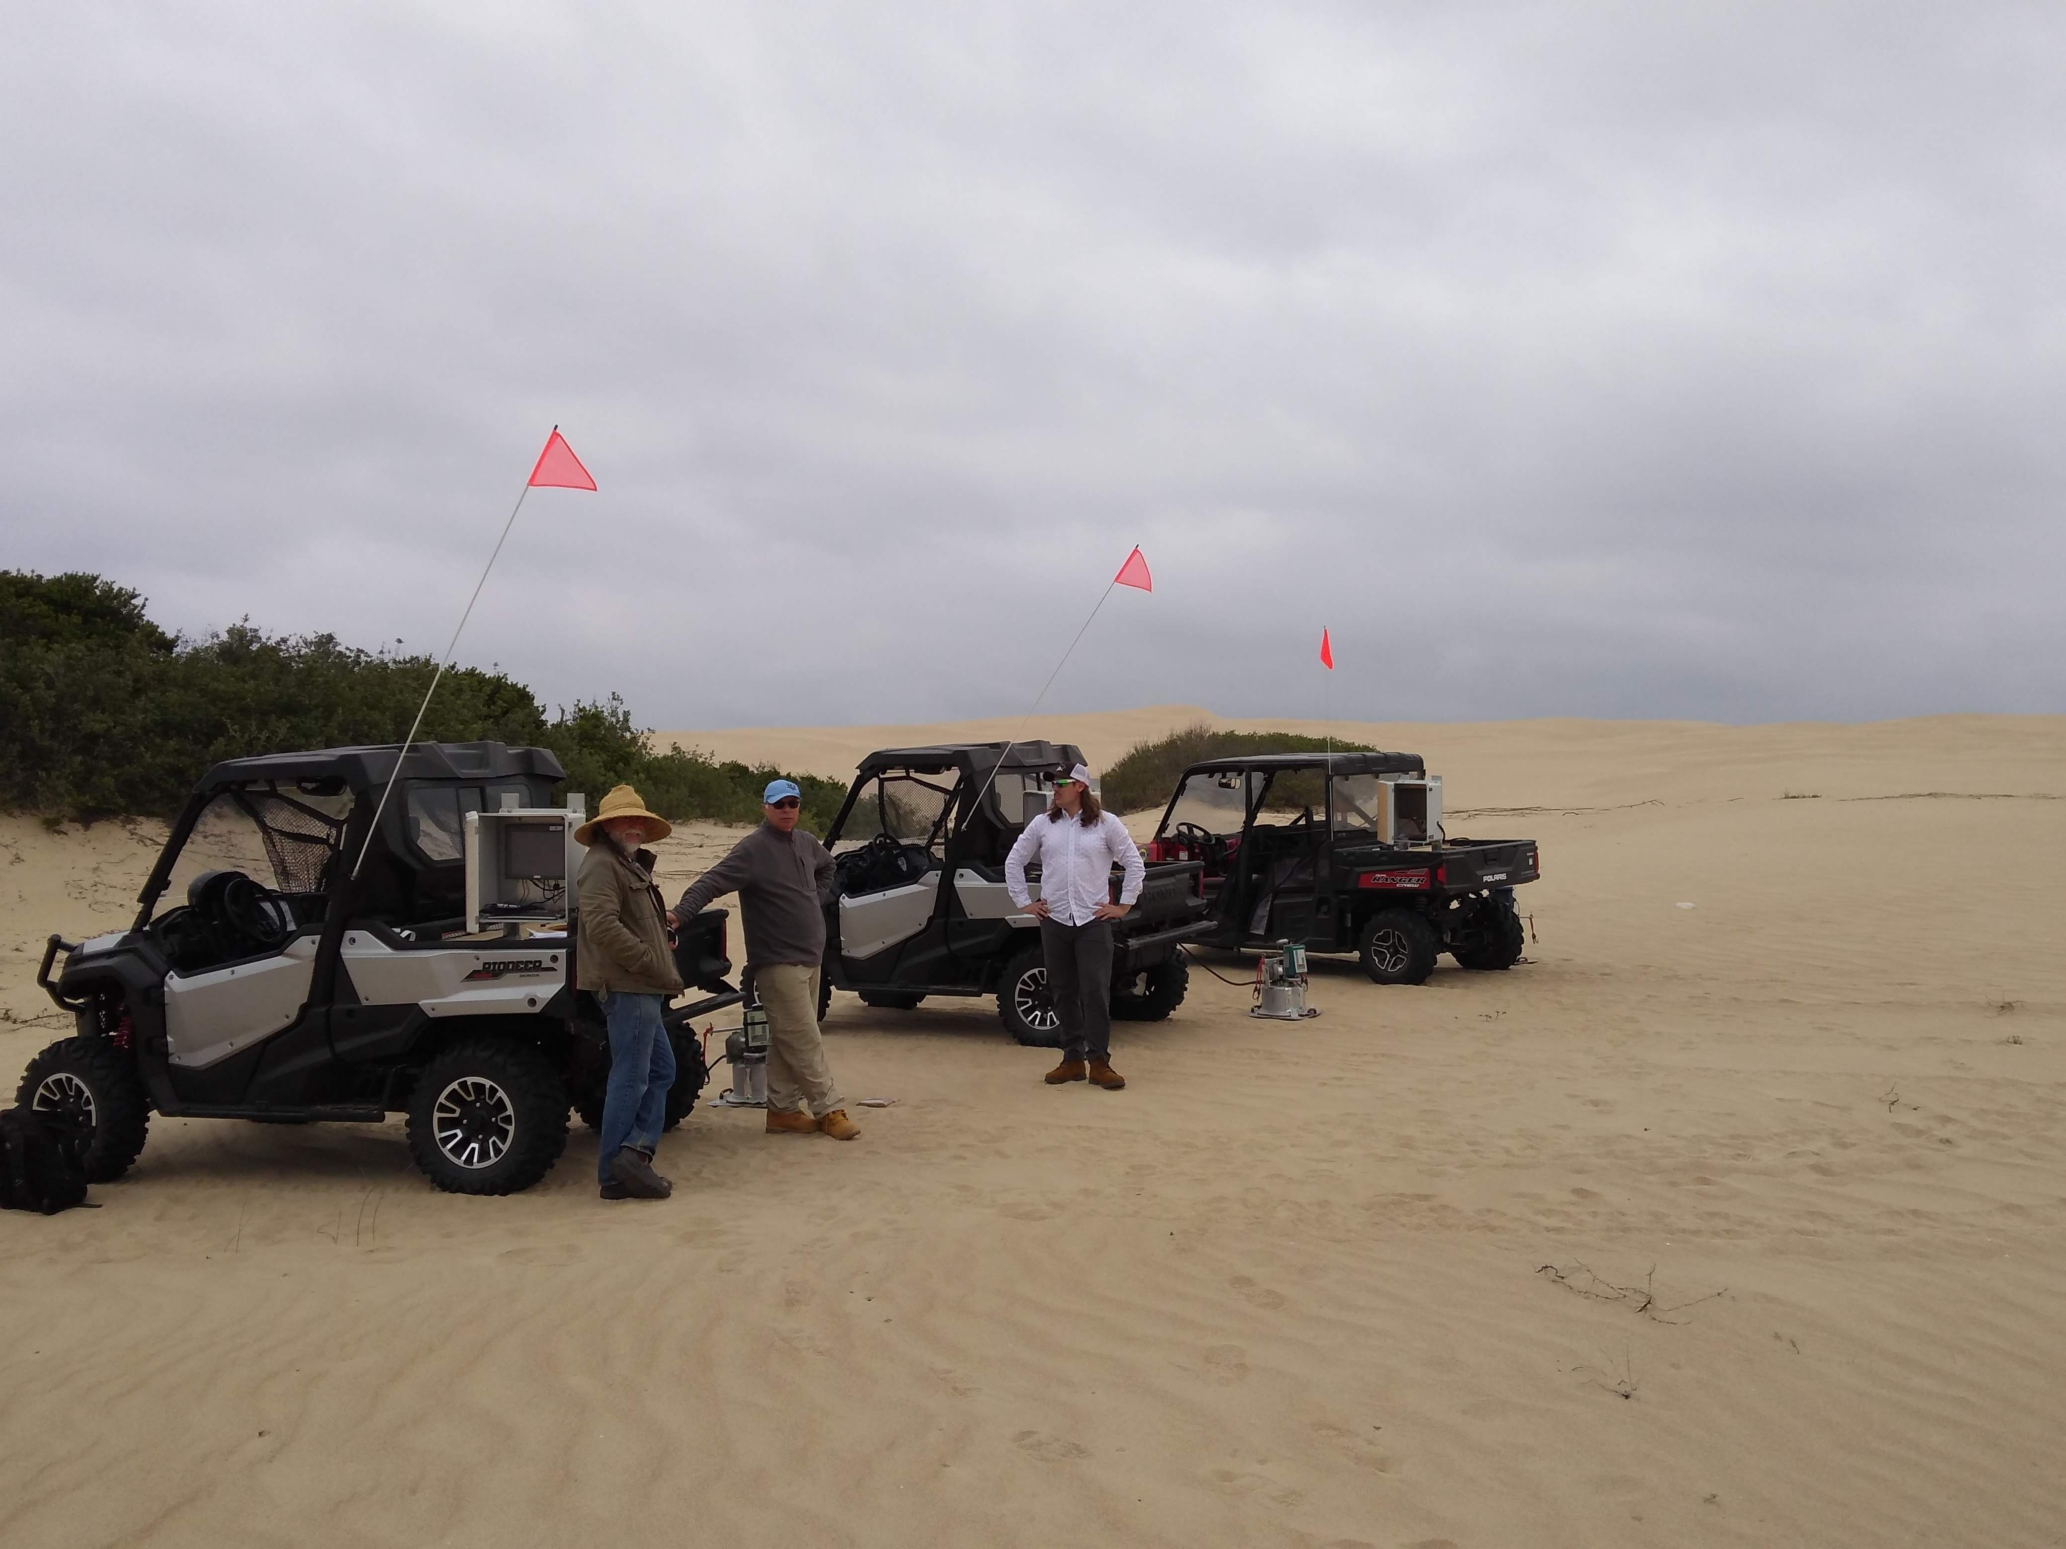
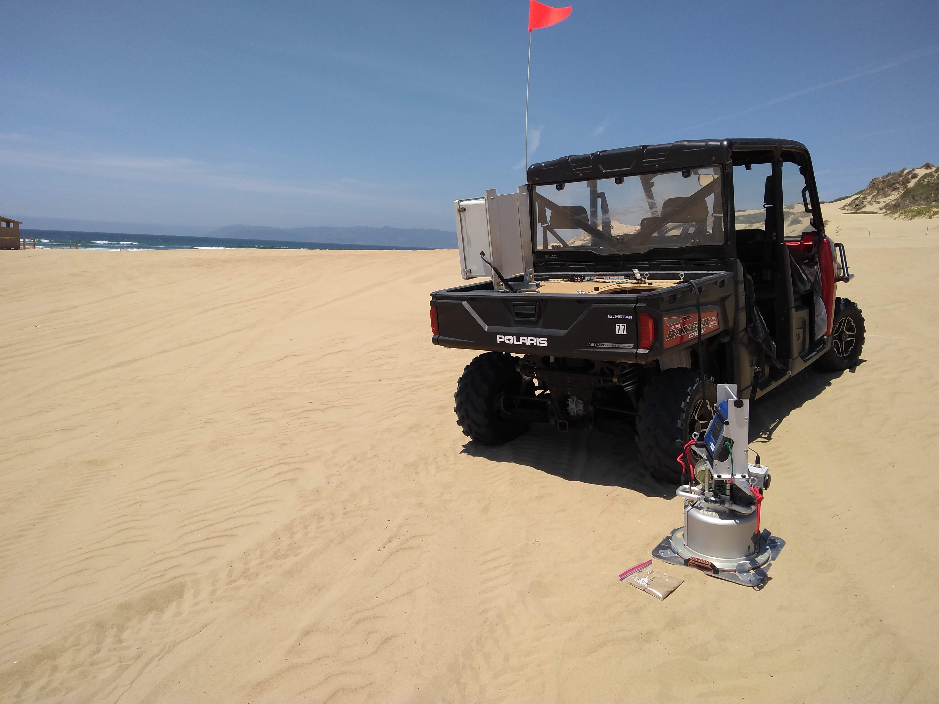
PM₁₀ Emission Characterizations
(PM₁₀ Emissivity)
May 2019, PI-SWERL® instrument was used to measure PM₁₀ emissivity (mg m⁻² s⁻¹) at >400 locations across the ODSVRA (riding and non-riding areas). November 2019, Plover exclosure and dune preserve measurements completed.

Slide 6
PM₁₀ Emissivity
Locations of PI-SWERL tests
At each location, 3 measurements of emissivity (3 wind speeds)
Sand sample collected
Moisture content measured/observed

Slide 7
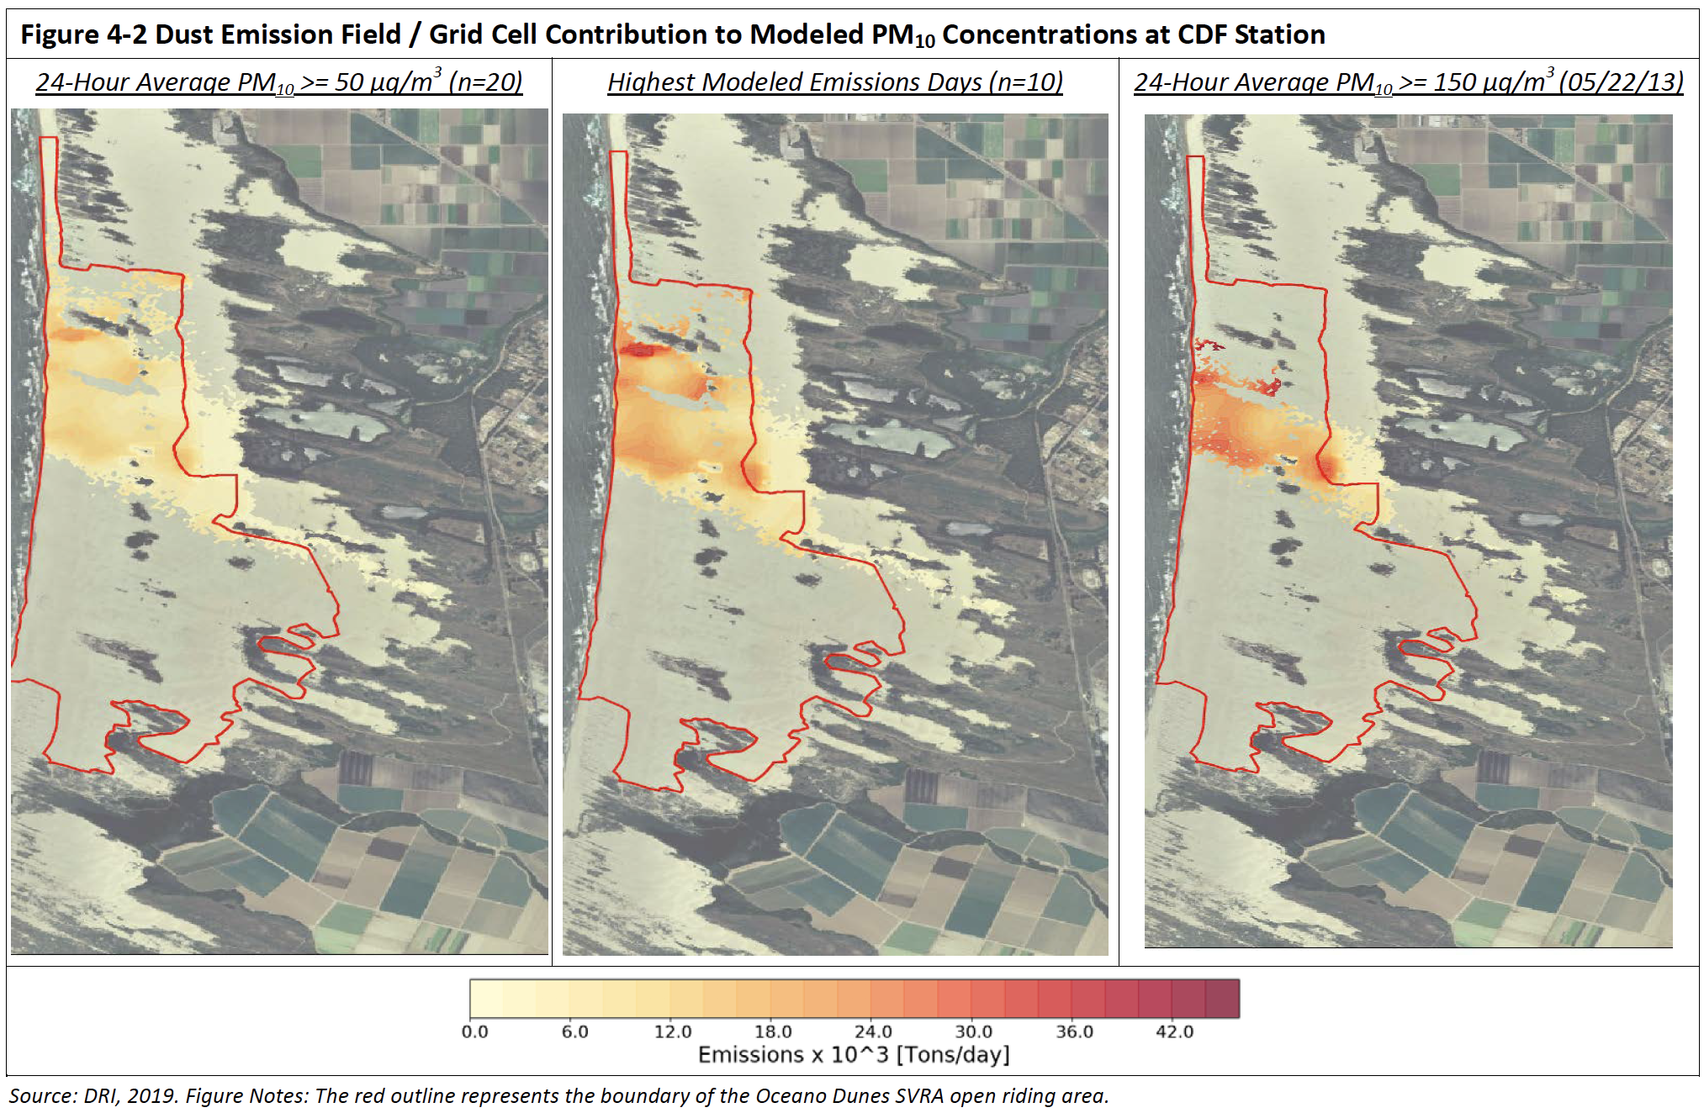
Oceano Dunes Dust Emissions Modeling: 2013
Amalgamation of 10 highest emission days, 2013, serves as the benchmark

Slide 8
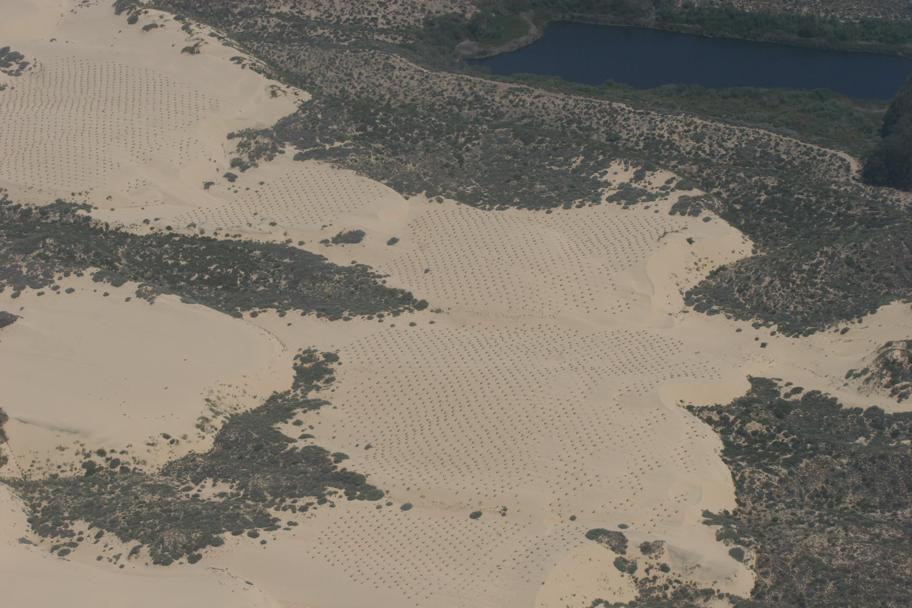
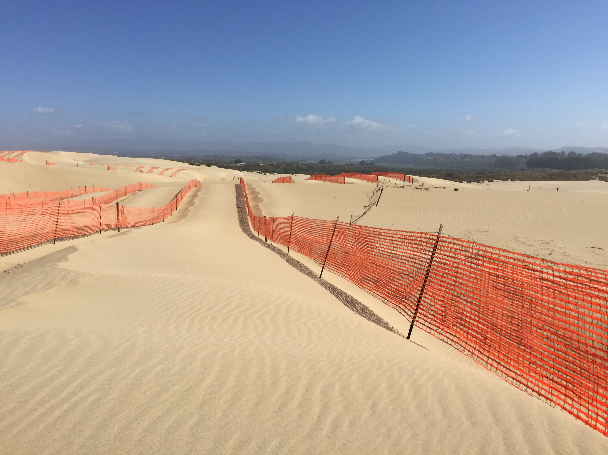
Dust Control Activities 2018-2019
36.1 acres of strawbales
  BBQ, 3,630 bales distributed over 27 acres
  Eucalyptus, 1,360 bales over 9.1 acres
  All bales broken and distributed to receive plants, fall 2018/winter 2019
44.1 acres of vegetation
  Native plants (106,000), native seed (450 pounds) , fertilizer, and sterile grass seed
48.6 acres of wind fencing
A net increase of 84.7 acres of control between summer 2018/July 31, 2019

Slide 9
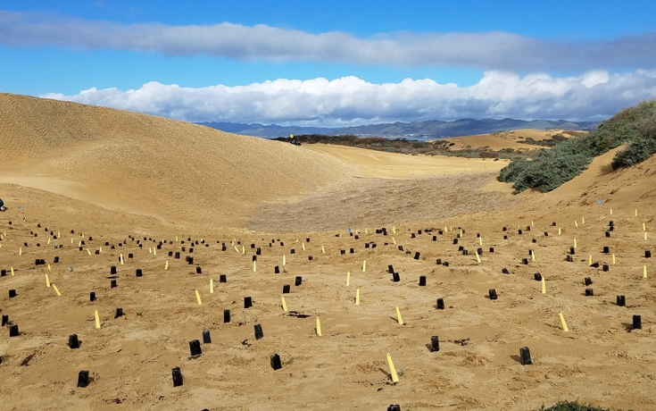
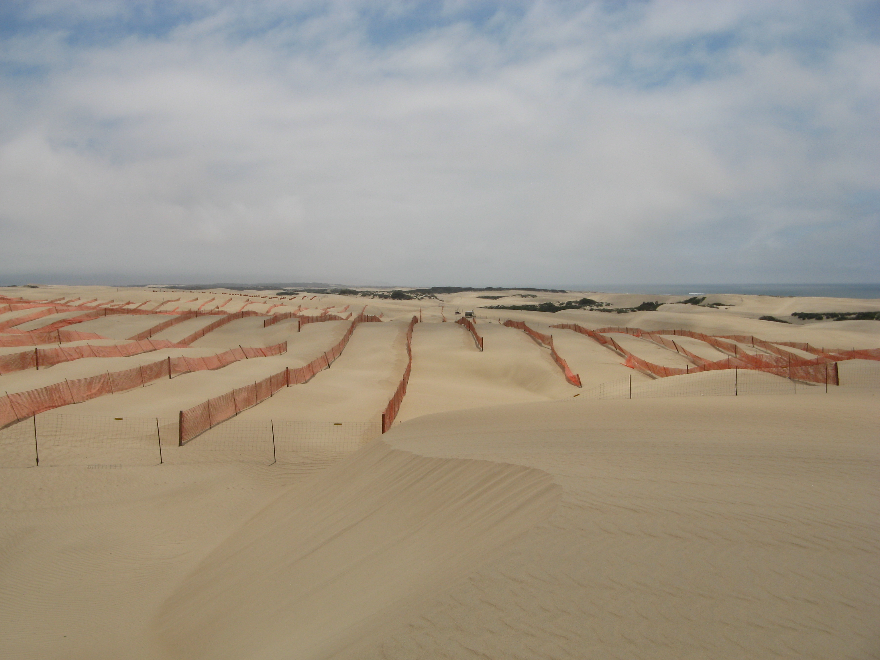
Dust Control Effectiveness, 2019
44.1 acres of vegetation (year one, with straw distributed, plants emplaced, and seeded):
Sand flux reduction of 42%, 0-80 feet
Sand flux reduction of 98% >80 feet
48.6 acres of wind fencing (spaced 7h apart, h=4 feet)
(30 acre, 2nd year ) sand flux reduction of 79%, >row 3
(7 acre, 1st year) sand flux reduction of 98%, >row 3

Slide 10
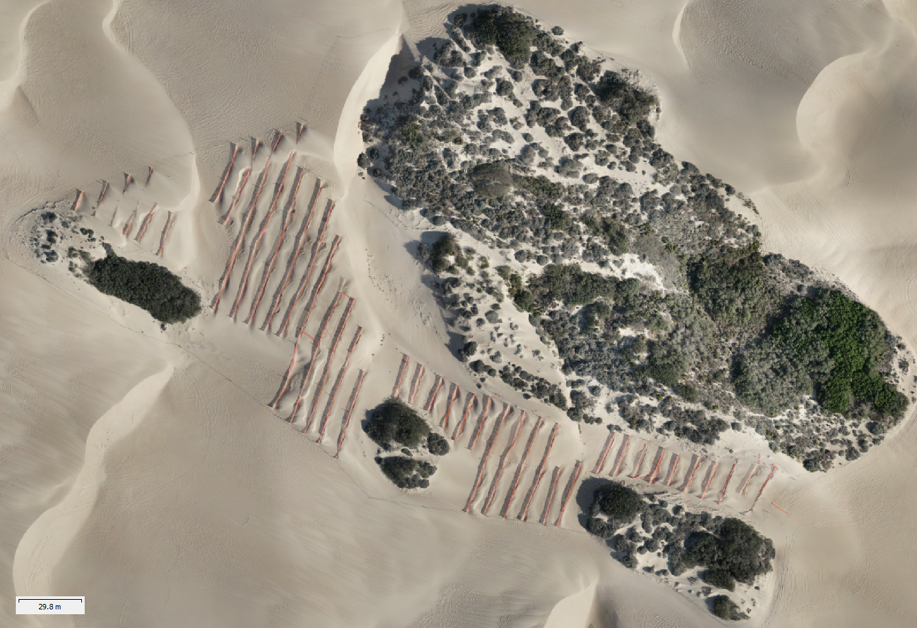
Dust Control: Sand Fences
7 acre, 1st year

Slide 11
Dust Control 2020
Permanent Control: Vegetation Projects
  Additional 4.2 acres in ODSVRA riding area
Temporary Controls: Sand Fences
  40 acres (2, 20 acre installations)
Foredune Restoration
  48 acres, 5 treatment types

Slide 12
Permanent Control: Vegetation Projects
  4.2 acres
Temporary Controls: Sand Fences
  40 acres (2, 20 acre installations)

Slide 13
Foredune Restoration Update
Established (reference) foredune
north of Oso Flaco Lake

Slide 14
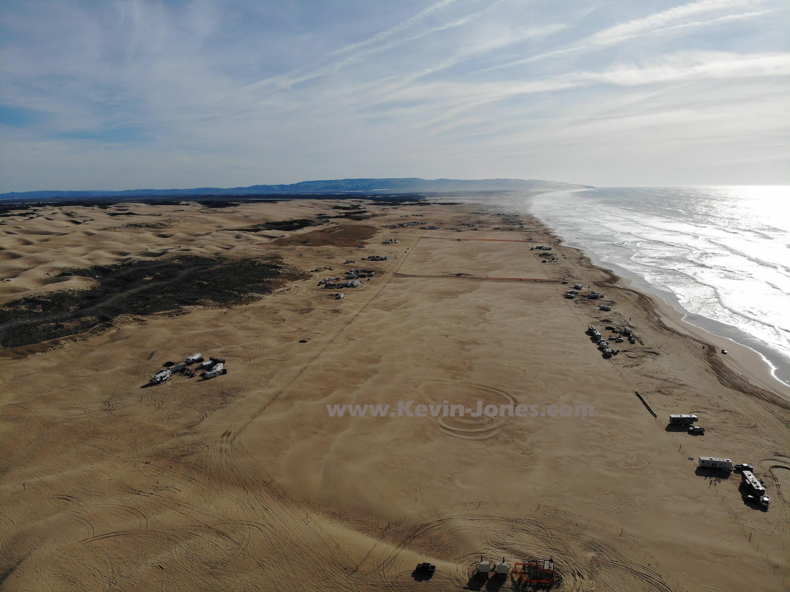
Area of Foredune Restoration

Slide 15
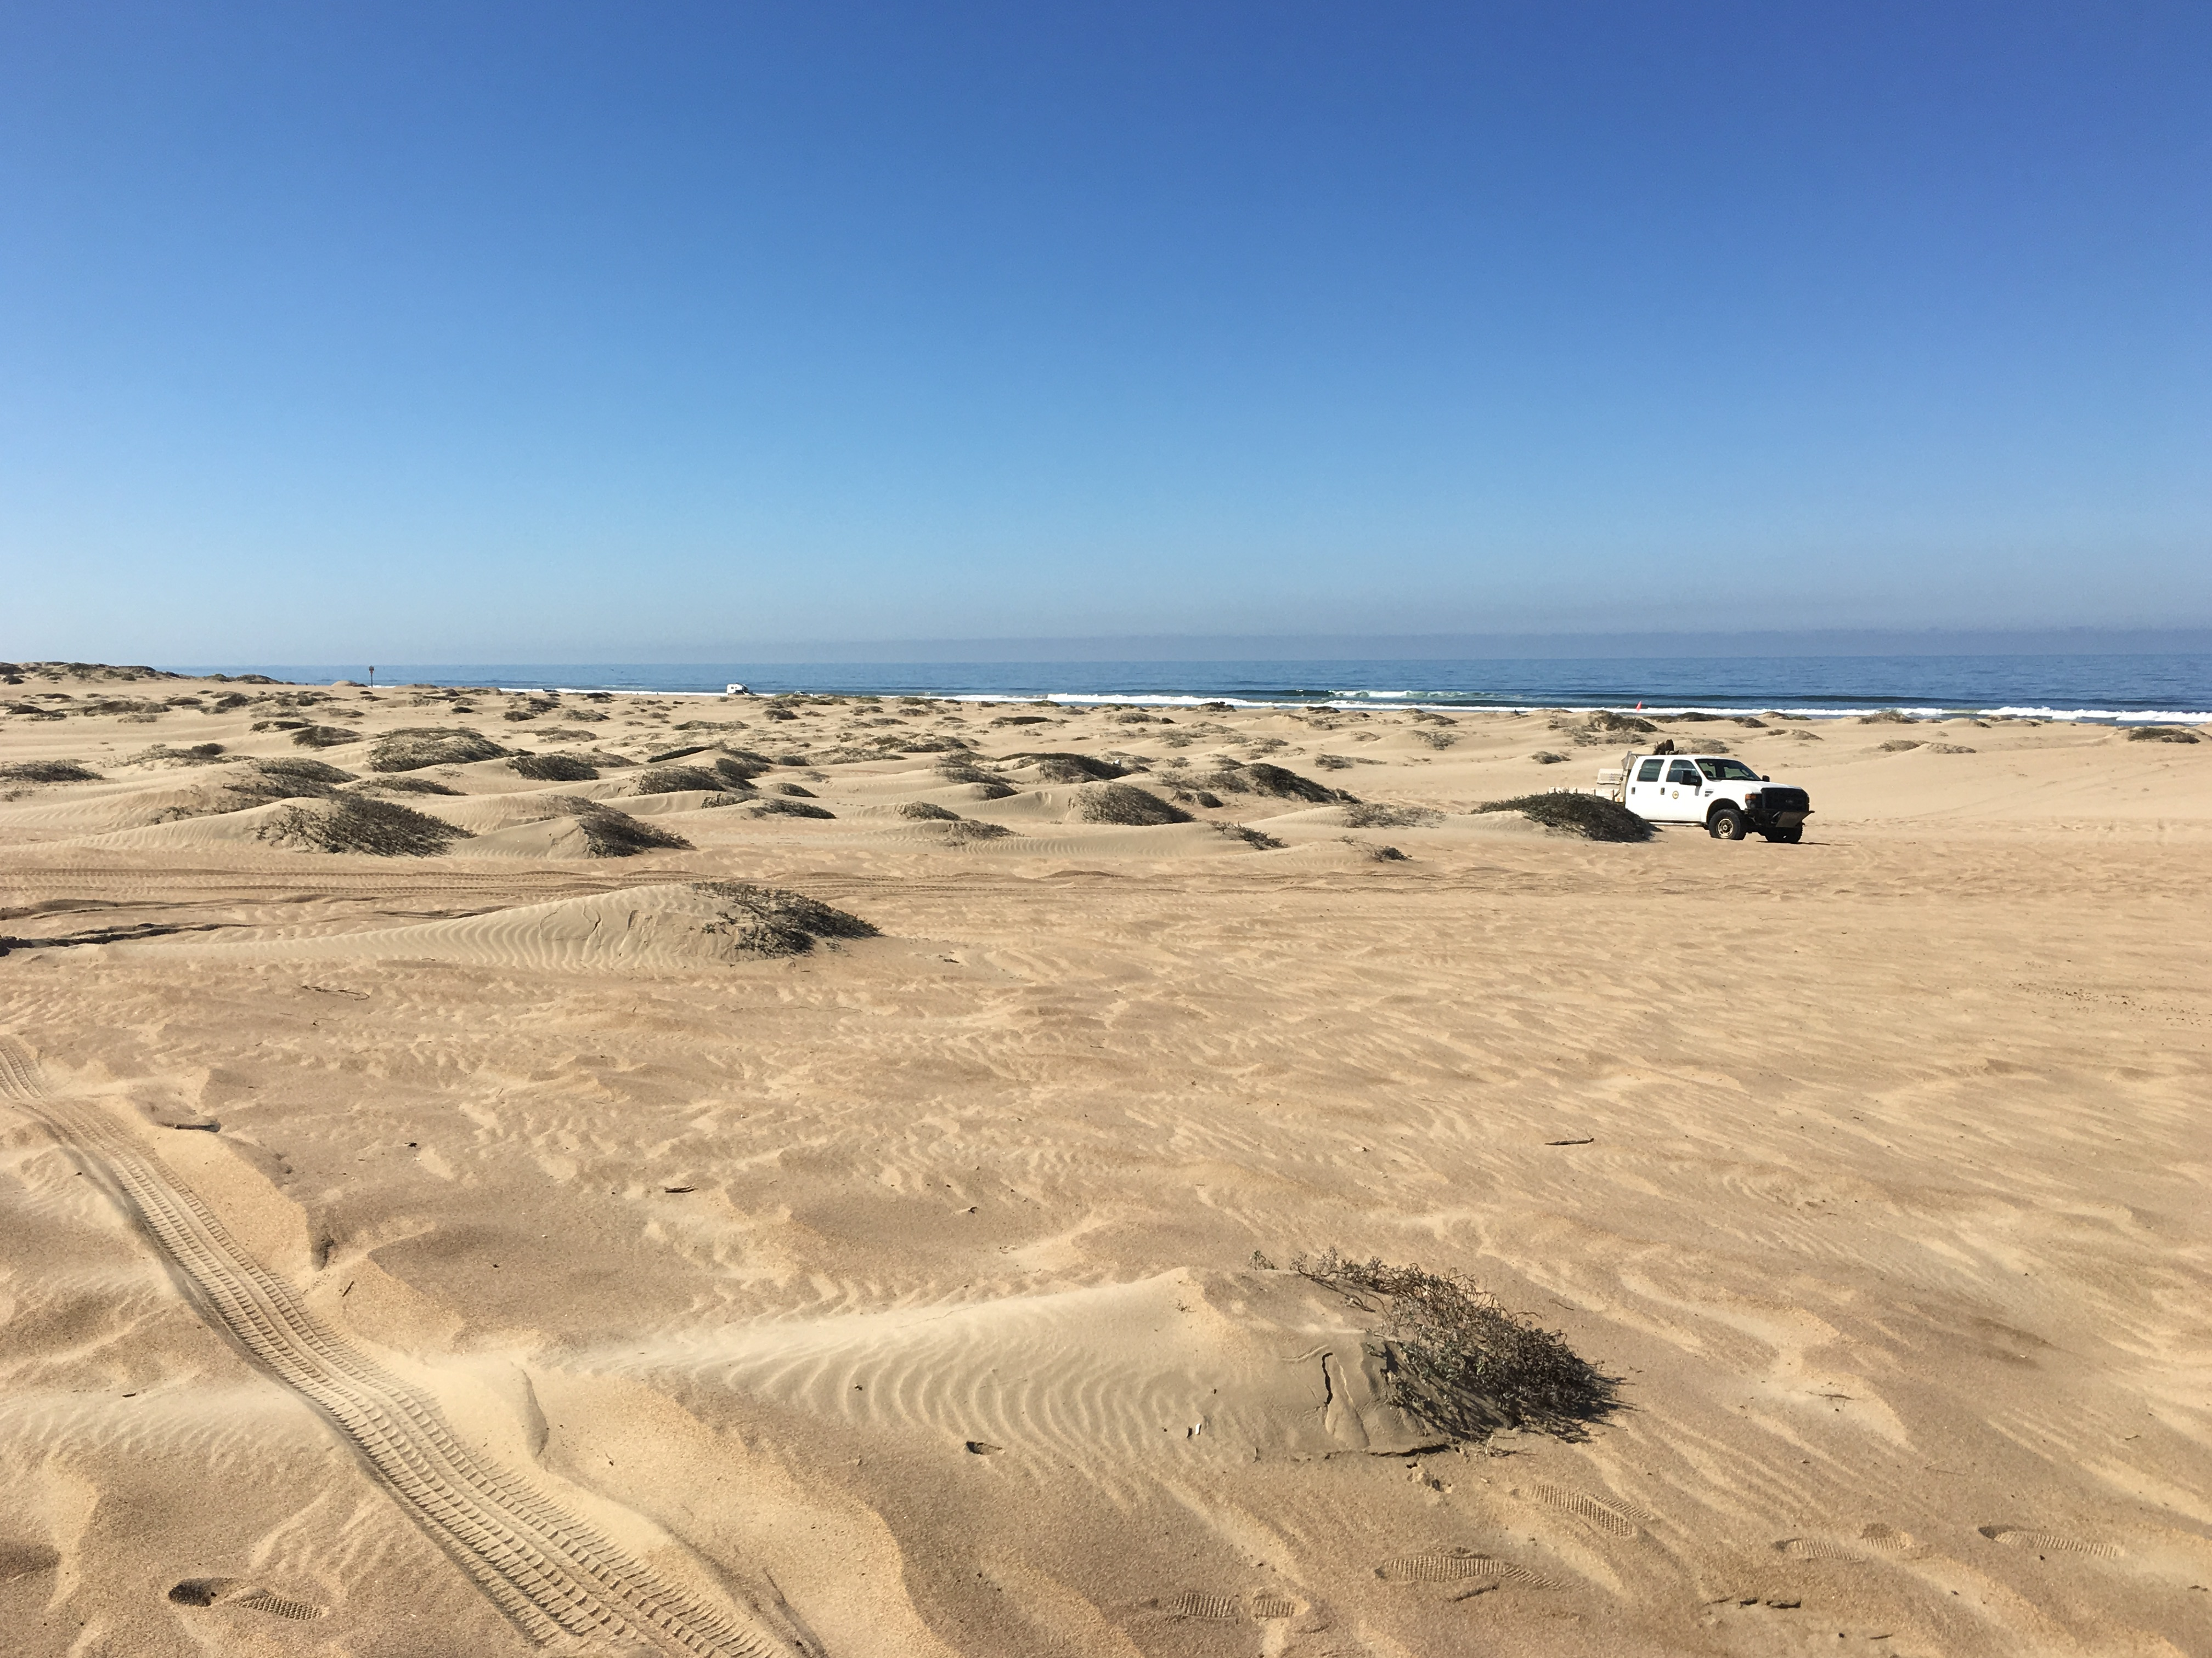
Early Phase Expected Development of Foredune

Slide 16
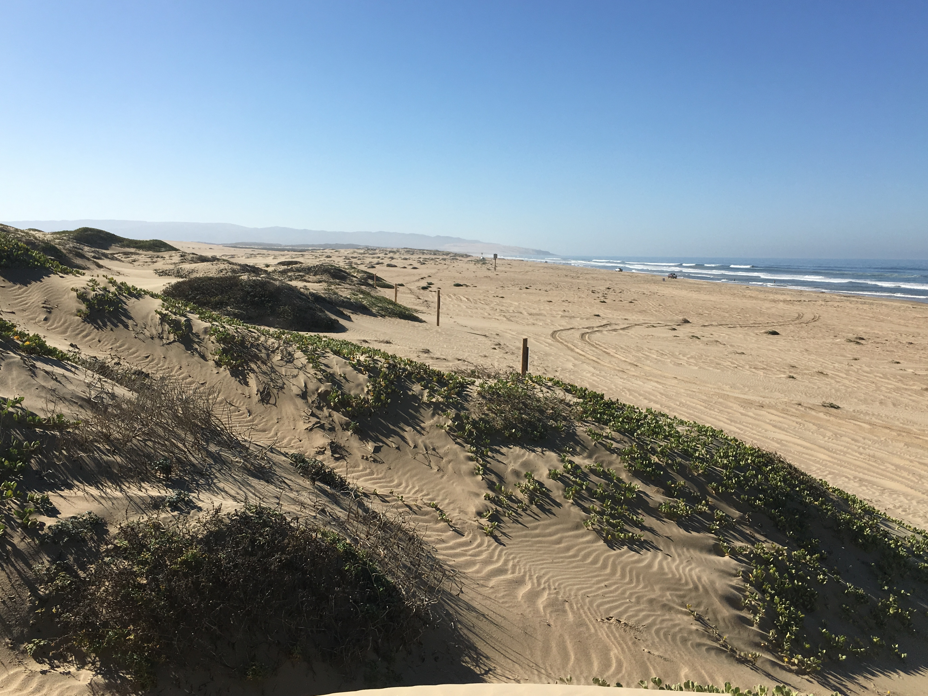
Mature Phase Expected Development

Slide 17
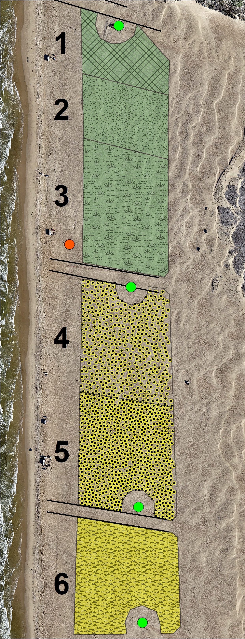
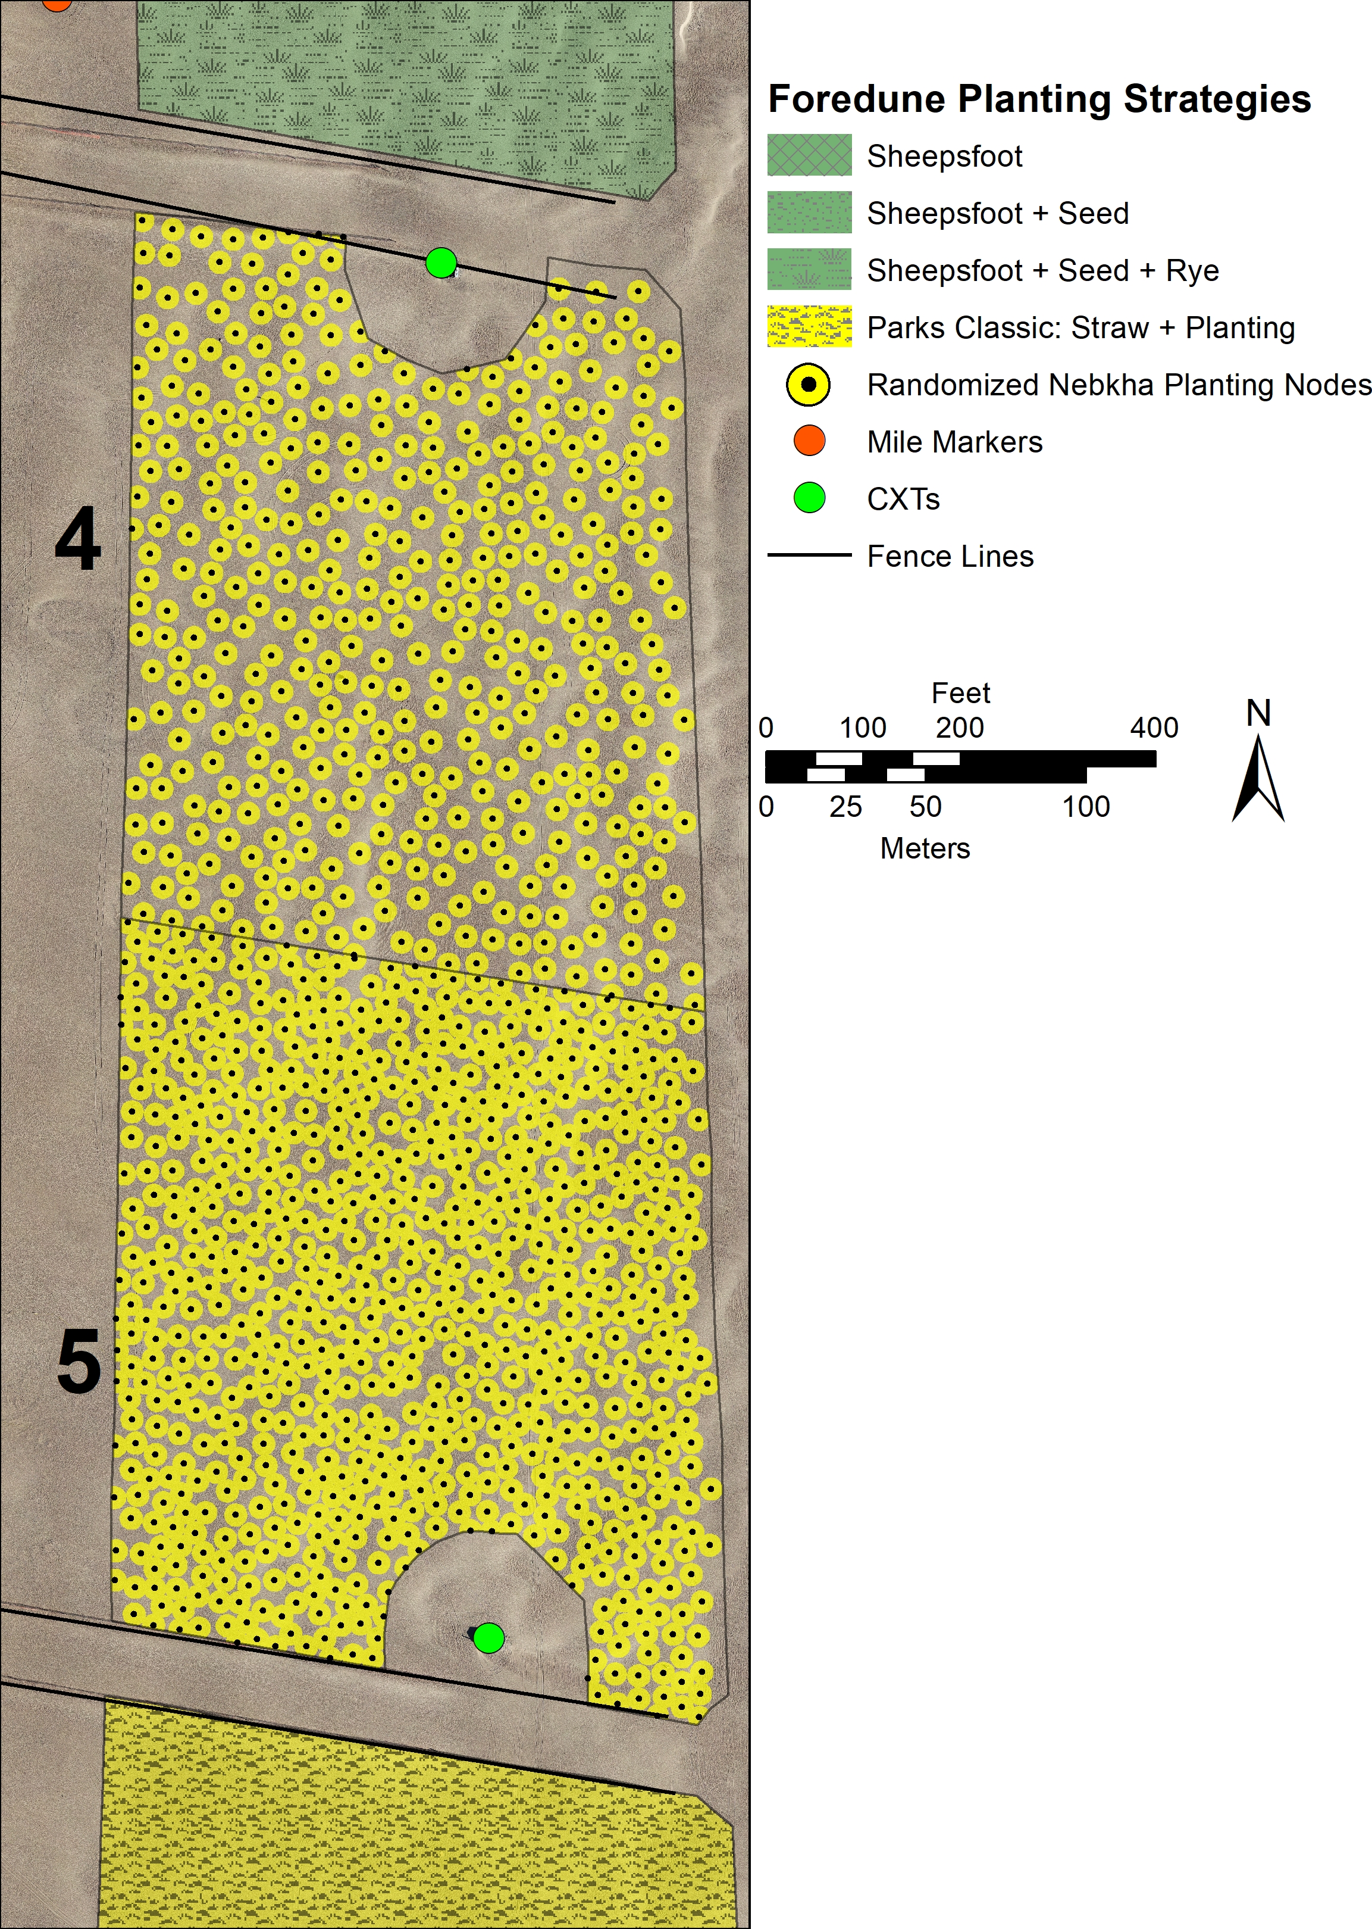
Oceano Foredune Restoration Treatments
1 Sheepsfoot only
2 Sheepsfoot plus native seed
3 Sheepsfoot plus seed + sterile grass
4 Randomized Nebkha Planting Nodes (density 1)
5 Randomized Nebkha Planting Nodes (density 2)
6 Parks “classic” (straw/plants/seed)

Slide 18
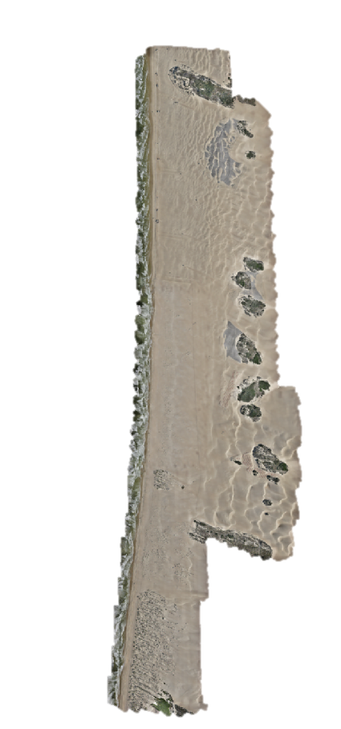
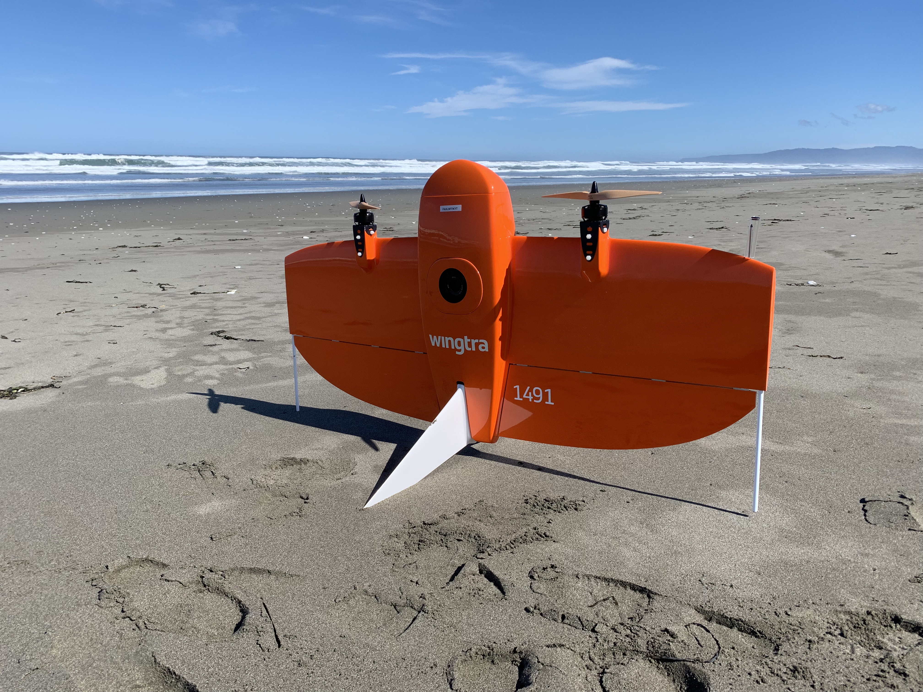
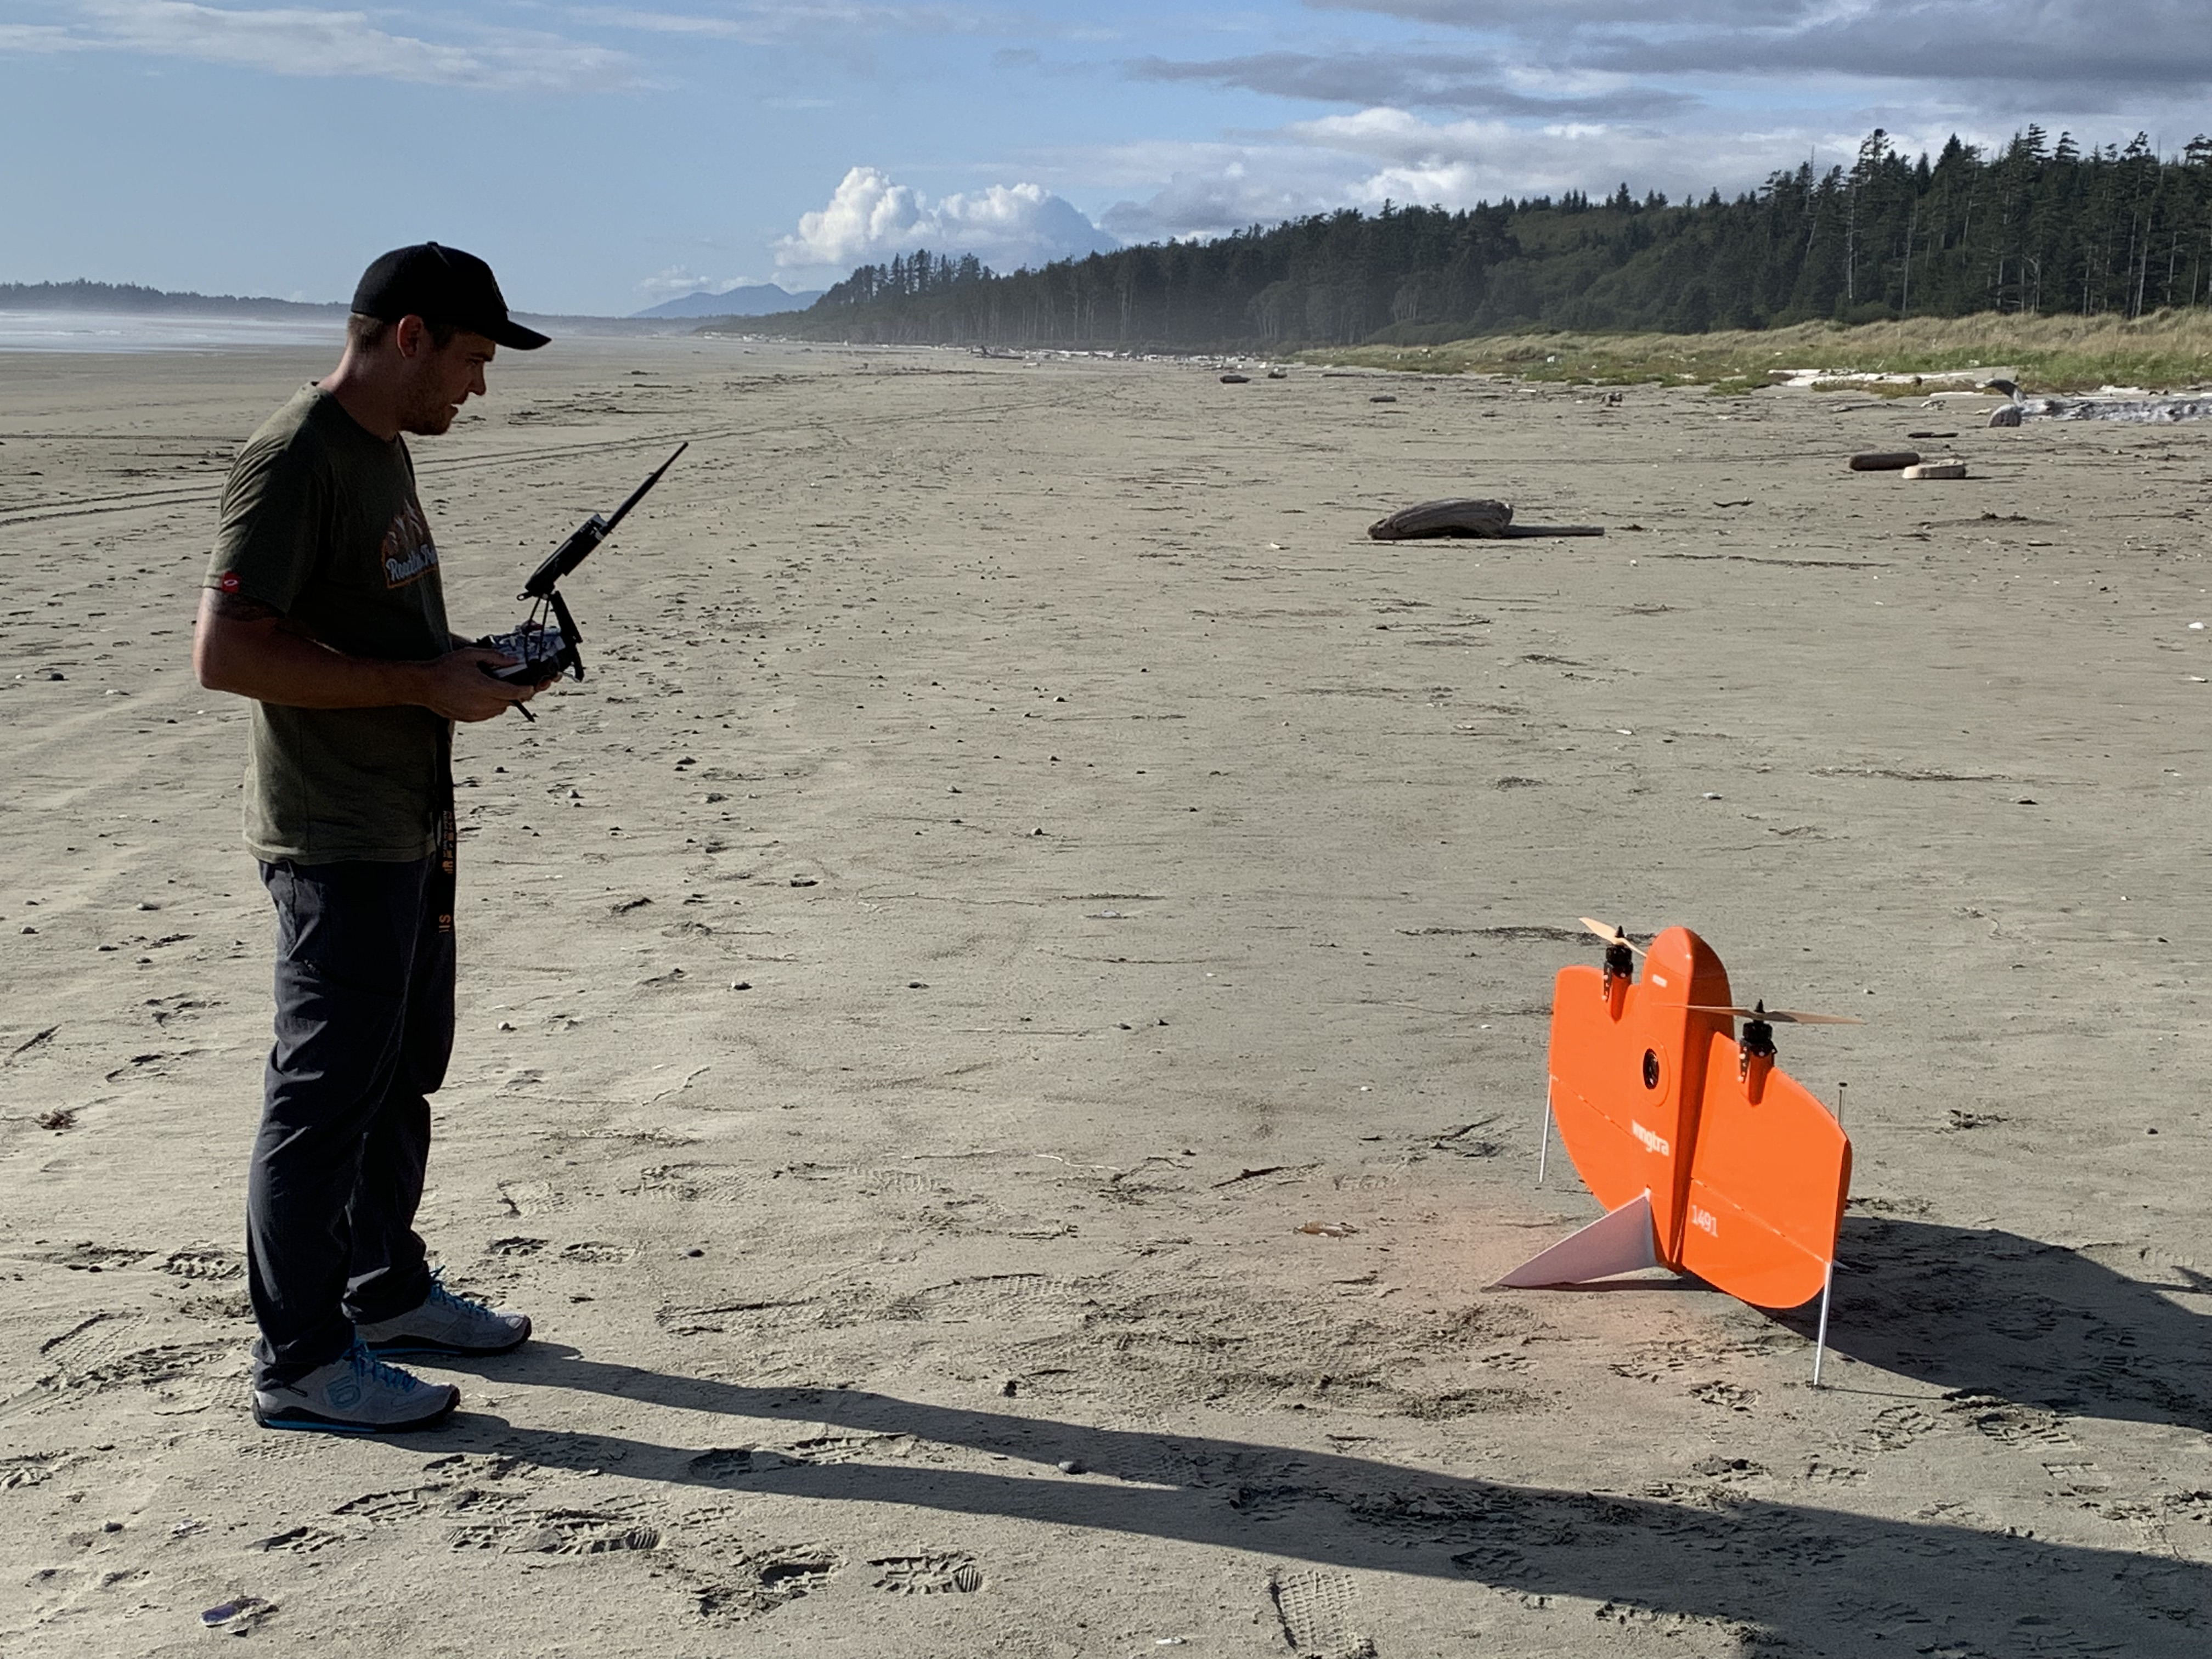
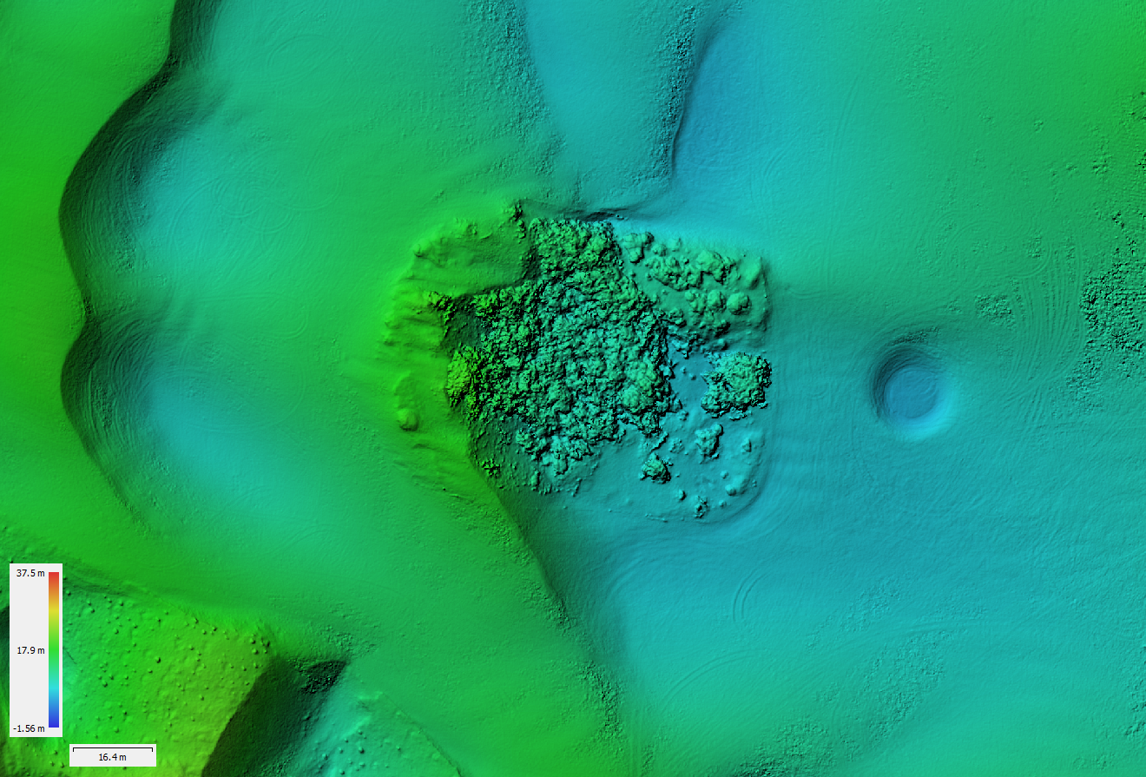
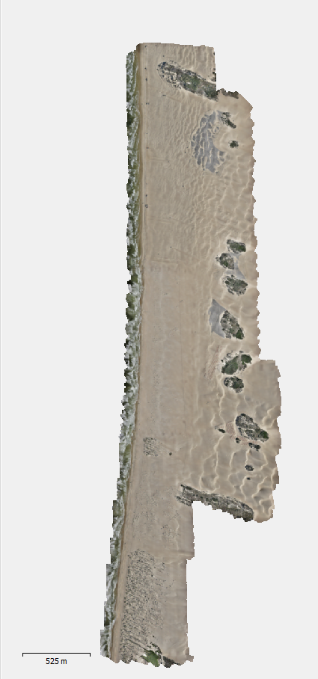
Oceano Foredune Restoration Monitoring: UAS
Platform: Wingtra One, 35 mm camera, 42 megapixels
Flight campaign: 100-120 m elevation, NADIR, 70% overlap and sidelap
~1-2 weeks post-processing
Products:
  Digital orthophoto mosaic @ resolution 1.45 cm/pix
  Bare-earth digital elevation model (DEM

Slide 19
Oceano Foredune Restoration Monitoring
  Produce maps of geomorphic change and sand transport corridors (UAS)
  Sand flux through treatment areas measured with sand traps (same as fences and vegetation projects)
  Threshold winds required to initiate movement within treatment areas
  MetOne Particle Profilers deployed upwind/downwind to evaluate changes in PM

Slide 21
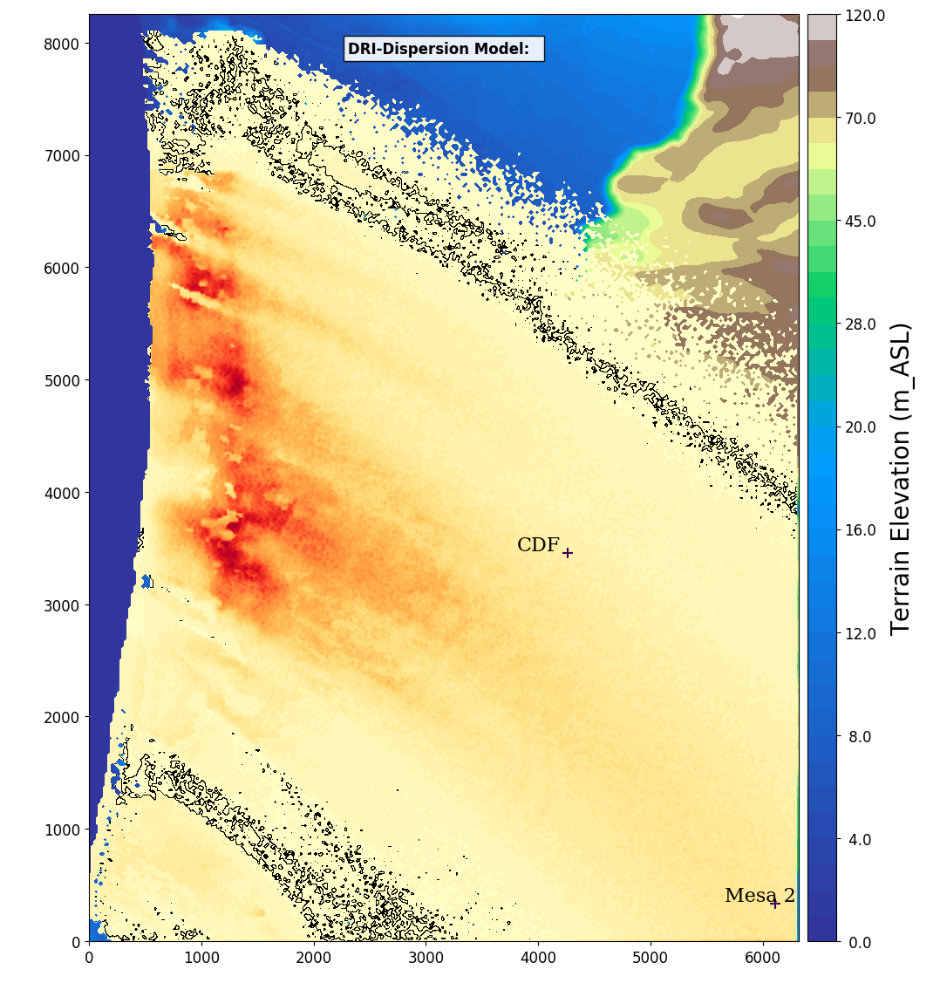
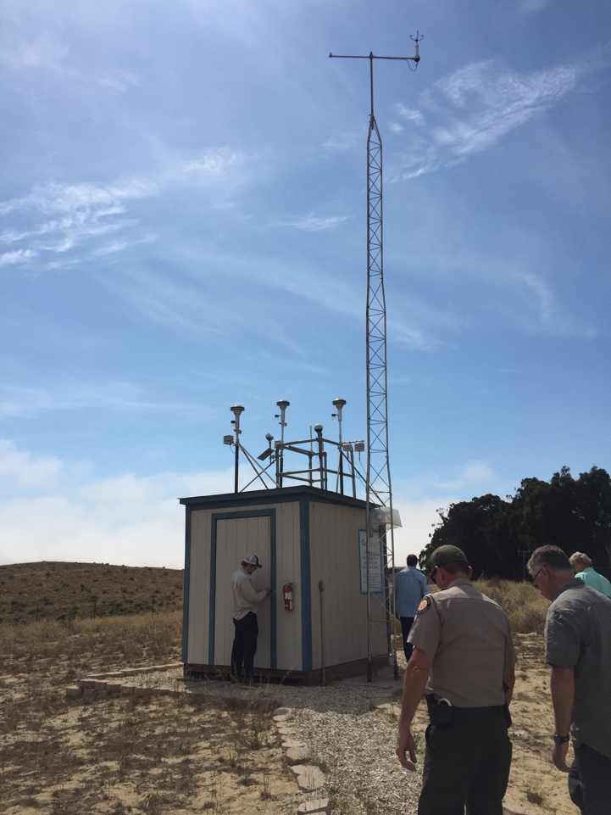
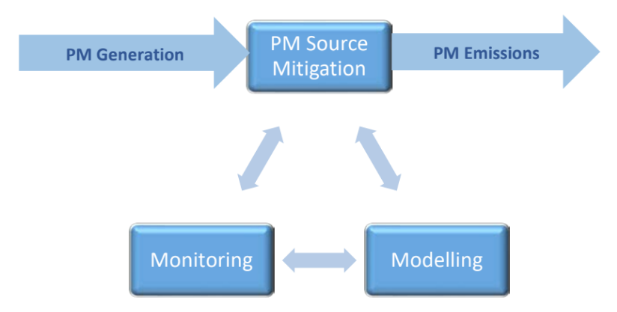

Dust Mitigation Plan
SOA Obj. 2.c requires establishing an initial target of reducing maximum 24-hour PM₁₀ baseline emissions by 50% using air quality modeling and a May-Aug 2013 observation period carried out by the California Air Resources Board (CARB), or other modeling groups, subject to the review of the Scientific Advisory Group (SAG).
Adaptive management approach

Slide 22
PM₁₀ Emission Patterns
Multi-day events are prevalent April - June
July – August, generally low winds
However, rare July – August events can result in higher dust levels for similar wind speeds in April-June (PM building up between longer intervals between events?)

