Slide 1
Furman university
Compensation Structure and Merit Process - 2017

Slide 2
introduction
Compensation Study
Salary Grades
Annual Increases

Slide 3
Introduction
In 2015, Furman University partnered with Towers Watson, a global professional services firm to perform a market assessment of jobs throughout the organization.
The primary objectives were to assess the competitiveness of Furman’s compensation levels, and to establish market-based salary ranges for jobs.

Slide 4
introduction
Furman HR met with managers to determine appropriate matches based on descriptions provided in the College and University Professional Association (CUPA).
Additional survey matches were gathered by Towers Watson using multidiscipline surveys from their own organization and Mercer.
Salary data was compiled from these surveys, utilizing the appropriate labor market.

Slide 5
Market data
Towers Watson provided market data for benchmark positions. Standard market data control points include the 25th percentile, median and 75th percentile.
Salary Data for Widget Maker
$20,000 $22,000 $24,000 $26,000 $28,000 $30,000 $32,000 $34,000 $36,000
25th percentile
Median
75th percentile

Slide 6
Salary grades
Internally, Furman HR developed Salary Grades.
Salary grades are used to group jobs of similar responsibility, requirements, experience level and market range data.
Grades have three control points:
Minimum,
Midpoint,
Maximum

Slide 7
Salary grades (2016)

Slide 8
Grade chart
Grade | Min | Mid | Max
1 | 20,000 | 25,000 | 30,000
2 | 23,000 | 28,800 | 34,500
3 | 26,500 | 33,100 | 39,700
4 | 30,000 | 38,200 | 46,400
5 | 34,600 | 44,100 | 53,600
6 | 40,100 | 51,200 | 62,200
7 | 45,700 | 59,300 | 73,000
8 | 53,000 | 68,900 | 84,700
9 | 61,400 | 79,900 | 98,300
10 | 70,200 | 93,000 | 115,900
11 | 81,800 | 108,400 | 135,000
12 | 95,300 | 126,300 | 157,200

Slide 9
Grade chart – hourly rate
Grade | Min | Mid | Max
1 | 9.62 | 12.02 | 14.42
2 | 11.06 | 13.85 | 16.59
3 | 12.74 | 15.91 | 19.09
4 | 14.42 | 18.37 | 22.31
5 | 16.63 | 21.20 | 25.77
6 | 19.28 | 24.62 | 29.90
7 | 21.97 | 28.51 | 35.10
8 | 25.48 | 33.13 | 40.72
9 | 29.52 | 38.41 | 47.26
10 | 33.75 | 44.71 | 55.72
11 | 39.33 | 52.12 | 64.90
12 | 45.82 | 60.72 | 75.58
Notes:
These will be placed on the website

Slide 10
GRADES – 2017
Grades will be updated at the start of the fiscal year, July 1.
Grades will be adjusted 1.0% (rounded to the nearest $100). The percentage is based on the increase in the cost of living.

Slide 11
Salary increases
Salary increase percentages are based on three metrics:
Cost of Living
Employee Performance
Employee position within the salary grade
Furman has implemented a plan to address those employees who fall below their grade minimum
For 2017, the cost of living and merit increase categories are combined.

Slide 12
New for 2017
Numeric Performance Ratings

Slide 13
New for 2017

Slide 14
New for 2017
Accomplished
Score 75 - 114
Exemplary
Score 115 - 132
Needs Improvement
Score 44 - 74
Numeric Performance Ratings

Slide 15
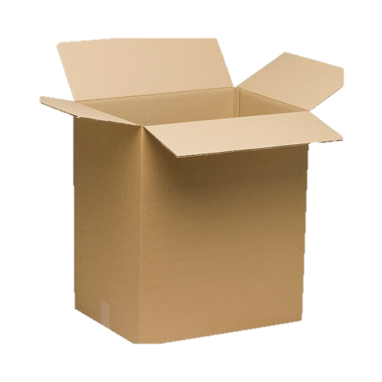
New for 2017
Cost of living and Merit Increase categories combined into one merit pool.

Slide 16
New for 2017
Stipends for staff over grade maximum will be an amount at managers’ discretion (within guidelines).

Slide 17
Salary increases
For employees below the salary grade minimum:
Performance Rating | Base Salary Increase
Accomplished (score 75 – 114) | 6.00%
Exemplary (score 115 – 132) | 7.00%

Slide 18
Salary increases
For employees within the salary grade:
Discretionary Pool Of up to 4.00%

Slide 19
Salary increases
For employees above the salary grade maximum:
Performance Rating | Base Salary Increase
Accomplished (score 75 – 114) | Up to 2.00% One Time Stipend
Exemplary (score 115 – 132) | Up to 2.50% One Time Stipend

Slide 20
Salary grades (2017)

Slide 21
Grade chart
Grade | Min | Mid | Max
1 | 20,300 | 25,400 | 30,500
2 | 23,300 | 29,200 | 35,000
3 | 26,900 | 33,600 | 40,300
4 | 30,500 | 38,800 | 47,100
5 | 35,100 | 44,800 | 54,400
6 | 40,700 | 52,000 | 63,100
7 | 46,400 | 60,200 | 74,100
8 | 53,800 | 69,900 | 86,000
9 | 62,300 | 81,100 | 99,800
10 | 71,300 | 94,400 | 117,600
11 | 83,000 | 110,000 | 137,000
12 | 96,700 | 128,200 | 159,600

Slide 22
Grade chart – hourly rate
Grade | Min | Mid | Max
1 | 9.76 | 12.21 | 14.64
2 | 11.20 | 14.04 | 16.83
3 | 12.93 | 16.15 | 19.38
4 | 14.66 | 18.65 | 22.64
5 | 16.88 | 21.54 | 26.15
6 | 19.57 | 25.00 | 30.34
7 | 22.31 | 28.94 | 35.63
8 | 25.87 | 33.61 | 41.35
9 | 29.95 | 38.99 | 47.98
10 | 34.28 | 45.38 | 56.54
11 | 39.90 | 52.88 | 65.87
12 | 46.49 | 61.63 | 76.73
Notes:
These will be placed on the website

