Slide 1
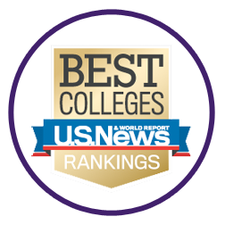
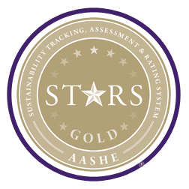
Furman Excellence
ACADEMICS
America’s Best Colleges
Furman is ranked No. 1 in South Carolina and top five in the Southeast by U.S. News & World Report.
SUSTAINABILITY
STARS Gold Rating
Furman earned a STARS Gold Rating from the Association of the Advancement of Sustainability in Higher Education. It is the most widely recognized report card in higher education for grading sustainability performance.
SUSTAINABILITY
LEED Certification
Furman has 8 LEED certified buildings on campus, signifying Leadership in Energy and Environmental Design.
CAMPUS BEAUTY
Most Beautiful Campuses in the World
BuzzFeed named Furman among the "25 of The Most Beautiful College Campuses in the World.”
CAMPUS BEAUTY
Arbor Day Foundation Tree Campus
Furman earned the Tree Campus USA designation for its commitment to effective urban forest management.
Notes:
Furman also won the AASHE Sustainability Achievement Award in 2016

Slide 2
Current University Initiatives
Furman Advantage
Four-year pathway that combines classroom learning with real-world experiences and self-discovery
Furman Engaged
First-year experience for students that provides easy transition via academic support by faculty/staff
Diversity
Chief Diversity Officer Michael Jennings
Sustainability
Charter signatory of the American College and University Presidents Climate Commitment. Goal: Carbon Neutral Campus by 2026.
First Sustainability Science major in the Southeast at a liberal arts college. 8 LEED-certified buildings on campus.
New 6-acre solar farm, plus 7 other solar electric and 2 solar hot water arrays on campus
Notes:
SUS is fastest growing major in the history of Furman.
Signed ACUPCC in 2007, created a sustainability master plan called “Sustainable Furman” and set goals for the university

Slide 3
Carbon Neutral 2026: We need you!
Shi Institute for Sustainable Communities – sustainability@furman.edu, www.furman.edu/sustainability
Recycle paper, cardboard, plastics #1 and #2, aluminum in blue bins; small electronics & batteries on the lower level of Trone
Composting available at the farm
Green Office Program – contact laura.bain@furman.edu
Green Purchasing Guidelines
Help us reach carbon neutrality (for free) when you shop at Ucapture.com/Furman
Notes:
Shi Center: Infusing sustainability across the curriculum. Began as a Southern Living Showcase Home featuring sustainable products. Go visit to learn more and get involved!
Recycle: Plastics #1 and #2, aluminum, paper/cardboard in bins around campus; Electronics recycling in Trone, lower entrance by the stairs.
Dining: Bon Appetit- focus on sustainability; local and scratch made food.
Composting: All pre and post consumer food waste from the DH is composted at the Furman Farm. You can add your compost to the farm pile, too! Currently piloting a paper towel composting program.
Farm: All organic produce, used in the DH and sold in summer as part of a CSA (Community Supported Agriculture; contact the Shi Center for more info).
Green Purchasing Guidelines: see http://www.furman.edu/sites/sustainability/Resources/Documents/Green_Purchasing_Guidelines.pdf
UCapture.com/Furman: create an account to offset your carbon footprint (for free); consider gifting carbon offsets to Furman to help us reach carbon neutrality.

