Slide 1
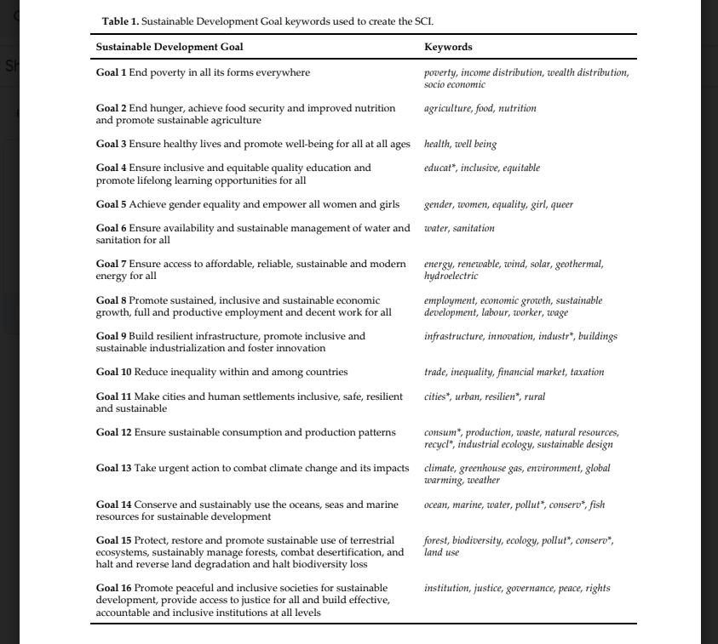
Keywords
-Credit to the Sustainable Development Solutions Network (SDSN) Australia/Pacific Branch
Notes:
How do we determine relevance? Environment vs business envrionment
http://ap-unsdsn.org/wp-content/uploads/2017/04/Compiled-Keywords-for-SDG-Mapping_Final_17-05-10.xlsx

