Slide 1
Pacific Impact Fund
Pacific University Oregon
Center for a Sustainable Society & College of Business
Spring 2018

Slide 2

What is Impact Investing?
Investments made into companies, organizations, or funds with the intention of generating social and environmental impact alongside a financial return.
Source: Global Impact Investing Network

Slide 3
Source: United Nations

Slide 4
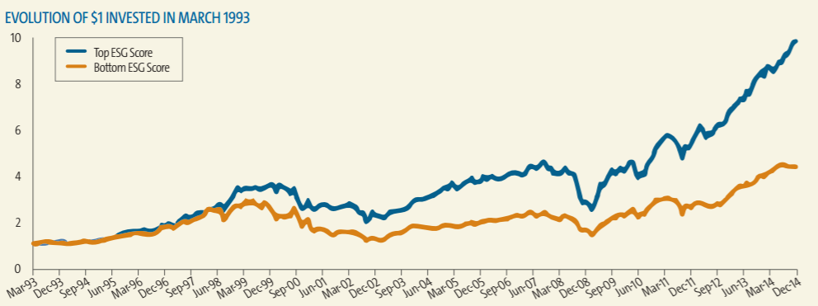
Rising Support
Promising returns
Peace of mind
Greater responsibility
Increasing research
Source: Calvert Investments

Slide 5
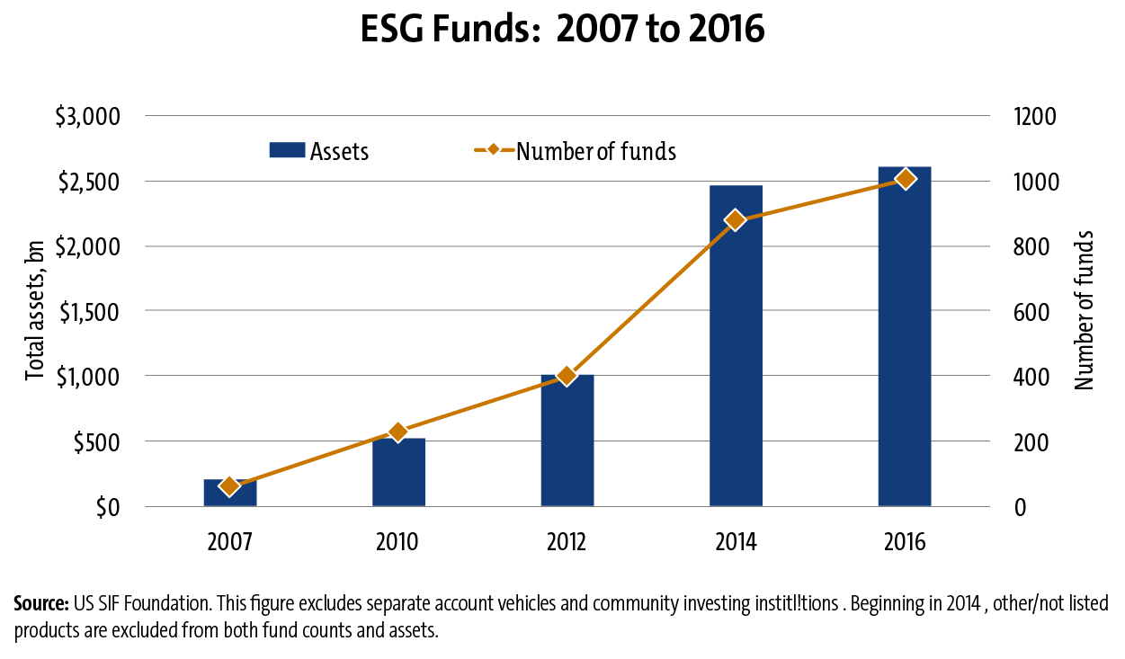
Increasing Popularity = Increasing Opportunities
More assets means more jobs
Relevance of a liberal arts education

Slide 6
Role of Pacific University
Sustainable Investments
Club & Pacific Impact Fund Continue
Student Movement
$10,000 Investment
Sustainable Investments Club Begins
Pacific Impact Fund Talk
Back Then
Today
Future
Strategic Plan Development

Slide 7
Fund Performance Since Inception
ROI = 12.65%
Performance propelled by high allocation equities
  US Equity allocation (80%)
  Global Equity Allocation (20%)
Inception Date May 2017 – End of 1Q2017

Slide 8
Strategic Plan
Student involvement
Investment Objectives
Continuity
“Sustainable Investing”
”Socially Responsible Investing”
“Values based investing”
“Ethical investing”
“ESG Investing”
Impact Investing

Slide 9
Mission
Utilize impact investing to demonstrate to the Pacific University community that investment returns and social responsibility are not mutually exclusive.

Slide 10
Vision
By 2021, the Pacific Impact Fund aims to:
Promote impact investing as a viable strategy to the Pacific University community.
Encourage Pacific University to allocate a portion of the university’s endowment towards impact investing.
Reach $20,000 in Assets Under Management (AUM).
  After reaching $20,000 AUM, the fund will begin to function as an endowed fund, distributing a percentage in the form of scholarship money.

Slide 11
Operating Principles
As a subsidiary of the Center for the Sustainable Society, the fund’s principles reflect the CSS goal of making Pacific University more sustainable. Additionally, the fund is centered around the following basic principles:
Investment returns and social responsibility are not mutually exclusive.
Consistent direct investment returns are best realized by qualified, professional investment managers.
Exposure to index funds can provide temporary advantages to investment portfolios.
Careful research and investment into socially responsible funds – in other words, avoiding funds which do not explicitly follow socially responsible investment practices – will yield the best long term investment results.
Portfolio risk is best mitigated by ongoing performance monitoring and portfolio rebalancing.
While environmental consciousness is fundamental in defining “sustainability,” true sustainability reflects a blend of economic, social, and environmental responsibility.
Investing is only one way to make a positive social impact. The Pacific Impact Fund team is encouraged to engage in and foster social responsibility in all areas of life.

Slide 12
Fund Structure
Absolute return investment strategy
Performance benchmark (6%-8%)
Fund of funds portfolio construction

Slide 13
Strategic Objectives
Provide a platform for Pacific University students to learn and apply investment strategies and support sustainability.
Consistent documentation of processes and decision-making by fund participants.
Encourage coordination between the CSS, COB and the rest of the Pacific community to include students and faculty who embody the principles of the fund.
Maintain integrity and transparency in investment decisions and day-to-day operations.

Slide 14
Investment Objectives
Highest possible risk adjusted rate of return.
Achieve reasonable diversification.
Rigorous due diligence regarding target funds’ alliance with sustainable and impact oriented strategies.
In the short-term, a reinvestment strategy which aims to accumulate AUM
In the medium to long-term, alter the fund’s risk profile to reflect an endowment-style fund (that is, a fund with a payout distribution).

Slide 15
A Note On Due Diligence

Slide 16
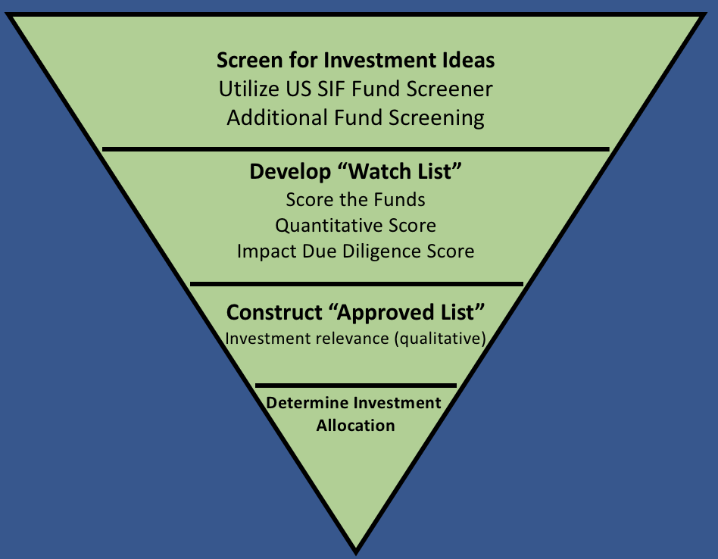
Investment Process
Screen
Score
Approve
Allocate
Monitor

Slide 17
Performance Monitoring
The most effective way to realize long term returns is to mitigate losses
Documentation of performance monitoring is necessary to develop a long term view of fund performance
Returns and risk should be measured during each evaluation

Slide 18
Deciding to Sell
Decisions to sell mutual funds and ETFs can be a function of a few things:
Consistent poor performance
Fund manager changes (mutual funds)
Changing fund strategy
Qualitative consideration (news, macroeconomic environment)

Slide 19
Coming Up
Contact:
skerben@pacificu.edu
michelle.larkins@pacificu.edu

Slide 20
Guidelines, Not Rules
Altering the investment process as the University acquires more resources (such as The Bloomberg Terminal, etc.)
Raising capital for the fund
Direct investment into companies that reflect a sound impact agenda
Seeking out and connecting with industry professionals in the impact investing space
Continued communication with Administration and Faculty regarding the importance of socially responsible investing to the University as well the global community

Slide 21
Thank you!

