Slide 1



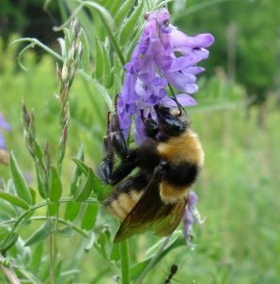
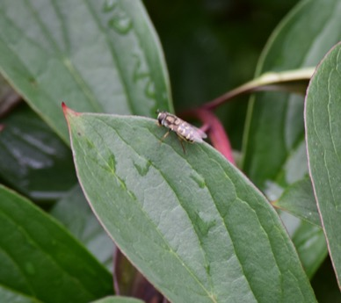
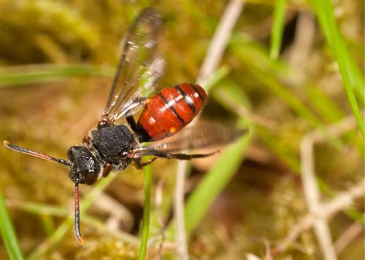
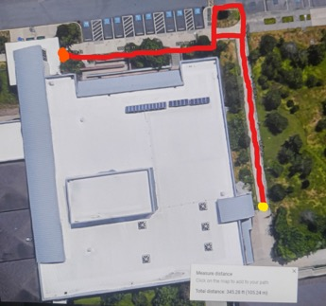
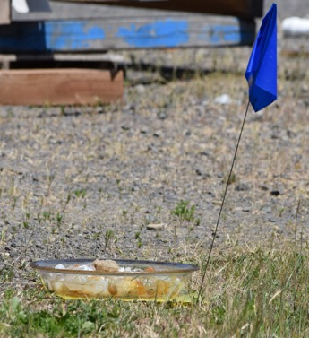
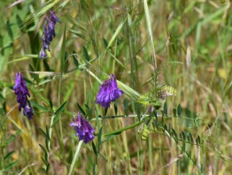
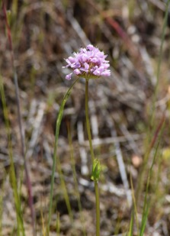
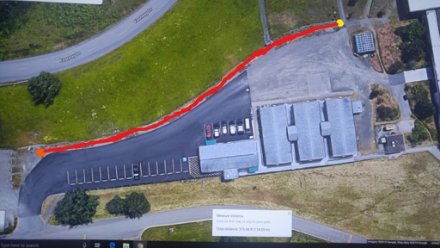
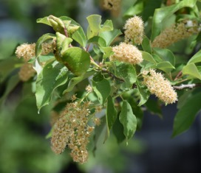
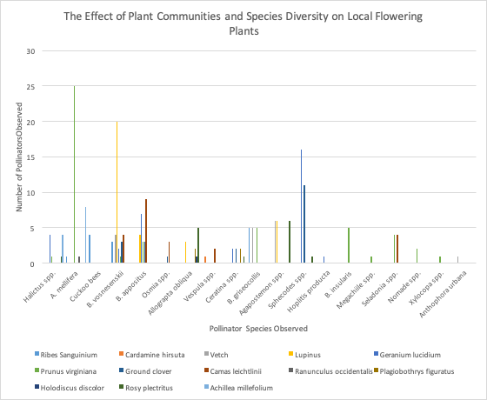
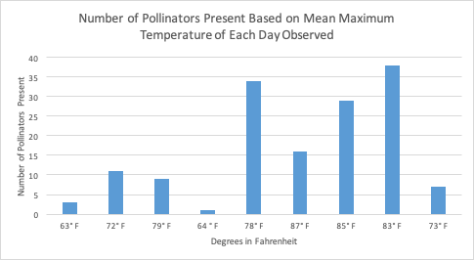
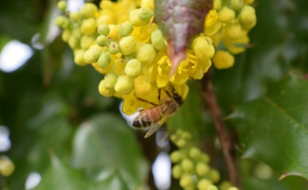
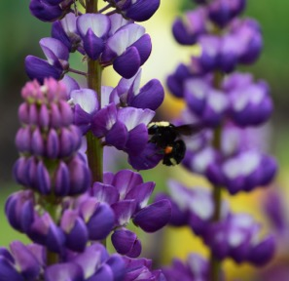
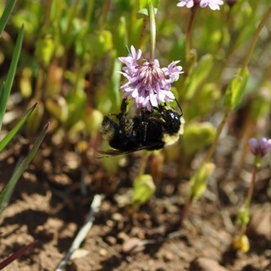
The Effect of Plant Communities and Species Diversity on Willamette Pollinators
Gayle Knapp, Lauren Leabeater, Hannah Albers
BOT 213 Principles of Botany Spring 2019 S. Holmes
MAIN GOAL – To set up a permanent protocol that will efficiently document the diversity of bees found on campus, to allow other researchers to collaborate their efforts in accordance to the ongoing efforts to continue being bee certified, to support ongoing restoration ecology of the campus, and to pave the way for further research.
Partially funded by: grant 1505081 “Tipping the Scale: Engaging Community College Science Faculty and Students in Course-Based Research Experiences (CBRE)
INTRODUCTION
Bee watering station: In attempts to identify the bees observed in a non-lethal way, as to support of being a bee certified campus, modified “bee bowls” where created. These bowls contained lightly sugared water placed in a 9” pyrex pie plate that was atop a colored paper (red, blue, yellow, white) and contained small white to clear stones for the bees to stand on. Sugar water was created at a ratio of 64 fluid ounces of water to 2 cups granulated sugar. Culinary flavorings such as vanilla, almond, and peppermint, floral scented waxes, and Borago officinalis flowers, where added to the bowls to simulate floral nectar and floral advertisement characteristics. As the bees partake of the “nectar” close up and macro photos are taken to document the varieties of species and to assist in the identification of pollinators. Bee bowls where be performed four times in total.
Pollination is largely responsible for flower reproduction. Pollination occurs when a pollinator (bees, butterflies, and even humans) carries a pollen grain from the anther of the stamen to the stigma of the pistil, which in turn fertilizes the plant and allows for reproduction. Biodiversity and food diversity are crucial ecological results of this fertilization process. Hence, pollinators play a huge role in our ecosystems (3). In our research, we will be focusing specifically on the role bees play in pollination and biodiversity. According to the National Resources Defense Council (8), bees are responsible for pollinating more than $15 billion a year in the United States. Unfortunately, bee populations have been declining at alarming rates in recent years. Biodiversity loss, destruction of natural habitats, and widespread farming practices that use monoculturing and pesticides are currently the biggest threats to bee populations (10). Rachael Winfred from Rutgers University found that while a few main species of bees are capable of pollinating on a smaller scale, biodiversity is necessary when considering the health of the region as a whole. Winfred found that on any single farm, five or six bee species were sufficient to provide half the pollination needed. However, most of the 100 species of bees observed in Winfref’s study were needed to meet the same scale of pollination across all 50 farms in the region.
Our hypothesis is that an increase in bee associated floral resource plants, those with accessible floral rewards, will in turn increase the amount of native bee species found. Floral rewards for bees include protein-rich pollen, fragrant oils, and resins (4). We predict that planting bee friendly plants with accessible floral rewards will in turn help to reconstruct the natural habitats for native and non-native bees, contributing to further biodiversity. Our research will be specific to the LCC campus as we have recently become a bee certified campus and wish to continue this pursuit.
Due to limited data from previous research on this topic, we don’t have a lot of directly corresponding data to compare our study to. In a study performed by previous students, titled “Critical Habitat for Bees”, they counted the populations of native to non-native bees at two different sites, one being our transect 1, and recorded the floral associations that occured within those populations. This study gave us a launching point for our monitoring protocol and gave us an idea as to which plants along our own transects are known to host bee pollinations (6). A second student research project, titled “The Restoration Ecology of a Wetland Swale”,gave us background information into the restoration ecology activities of transect 1. This allowed us to know what native plantings had been reintroduced and to what degrees there populations were now flourishing (2). Furthermore, published research done on bees visiting native versus non-native plants shows that bees travelled to plants with the most rewards and it didn’t matter if the plant was native or not (5); so recording all the floral associations that occur among the bee populations will be important.
bombus appositus
allograpta obliquaA
cuckoo bee
CONCLUSIONS/FUTURE SUGGESTIONS
Our goal was to set up a protocol for future research on this topic at Lane which we succeeded in doing, with some trial and error. We were able to establish an effective means of counting and documenting bees around LCC campus that can be used by multiple different fields of study.
For future research, we suggest getting better acquainted with local bees prior to the start of the observations.A bee identification class or even the field training section of Xerces Society monitoring guild will be helpful in this regard. Our sugar bowl experiment did not provide the success we anticipated, so we suggest other collection protocols. Our recommendation is to try the soap bee bowl method or netting with dry ice, which we avoided in order to not harm the bees. However, we found that in order to get proper identification, it would be helpful to do at least one of these one or two times during the monitoring period. A good resource for information and assistance in this would be August Jackson.
It would be interesting to see what planting more of the biggest floral attractors would do. It is hoped that future ecological restoration projects at Lane Community College will use this ongoing study to better understand the biodiversity the area bolsters. It is unclear what the full effects of the late spring we had this year will be, but seeing the correlation between warmer temperatures and pollinator presence (Figure 2), we predict there would be more pollinators in the earlier weeks with an earlier spring vs what we observed this year. Pollinators are essential to so many ecological interactions, we are excited to see what future research discovers.
Upper Photo: Unknown Vetch spp.
Upper Right Photo:Plectritis congesta
Lower Right Photo: Prunus virginiana
Fig. A Transect one
Fig. B Transect 2
Bee watering station with simulated nector rewards
RESULTS
The most predominant species found at the LCC campus were Apis meliferra (western honey bee) and Bombus vosnessenskii,(yellow-faced bumble bee) which were found most predominantly on Prunus virginiana and Lupinis bicolor, respectively.
Bombus appositus shows a high affinity for flowers in which floral rewards are easily accessible as seen in the frequency of visits to Camassia leichtiniii and Achillea millefolium.
Plants with the highest associations include Prunus virginiana, Achillea millefolium, Lupius bicolor and a ground clover.
METHODS
Upper: Fig. 1 Lower: Fig. 2
REFERENCES
The days with the heaviest percentage of pollinators had maximum temperatures of between 78 and 85 degrees.
Days with an average temperature under 65 degrees show very little pollinator activity.
The amount of pollinator activity starts to decline in temperatures over 84 degrees
Adamson, Borders, Kay Cruz, Xerces Society for Invertebrate Conservation (Dec 2017). Pollinator Plants Maritime Northwest Region. Pdf Download April 2019. https://xerces.org/wp-content/uploads/2016/10/2017-048_MaritimeNorthwestPlantList_Dec2017_web-3page.pdf
Brown Elizabeth, Bruhl Zach, Carroll Emily. “The Restoration Ecology of a Wetland Swale: The Effects of Native Plantings on Pollinator and Wildlife Diversity”. BI 103F, 2018. Unpublished Research Report
Kremen C, Williams NM, Thorp RW (2002) Crop pollination from native bees at risk from agricultural intensification.Proc. Natl Acad. Sci. USA. 99:16812–16816
Leonard, A. (n.d.). Nutritional Ecology of Floral Rewards. Retrieved May 17, 2019, from http://www.anneleonard.com/nutritional-ecology-of-floral-rewards
Mach, B. M., & Potter, D. A. (2018). Quantifying bee assemblages and attractiveness of flowering woody landscape plants for urban pollinator conservation. Plos One, 13(12). doi:10.1371/journal.pone.0208428
Dean Melissa, Sheppard Nisha, Krantz Meghan. “Critical Habitat for Bees”. BI 103F, 2016. Unpublished Research Report
Minnerath, Vaughan, Lee-Mader, Xerces Society for Invertebrate Conservation (2016). “Maritime Northwest Pollinator Citizen Scientist Monitoring Guild”. Pdf Download April 2019, https://xerces.org/xerces-bee-monitoring-tools
Sass, J. (2011, March). NRDC. Retrieved April 7, 2019, from https://www.nrdc.org/
Willmer, P. (2011). Pollination by Bees. Pollination and Floral Ecology. doi:10.23943/princeton/9780691128610.003.0018
"The Power of Pollinators: Why More Bees Means Better Food." Food and Agriculture Organization of the United Nations. August 24, 2016. http://www.fao.org/zhc/detail-events/en/c/428504
Winfred, R. Aguilar, R., Vázquez, D. P., Lebuhn, G., & Aizen, M. A. (2009). A meta-analysis of bees responses to anthropogenic disturbance. Ecology,90(8), 2068-2076. doi:10.1890/08-1245.
Monitoring:The protocol we utilized was created by the Xerces Society specifically for our maritime northwest ecoregion The primary purpose of this monitoring protocol to measure the relative species richness and abundance of bees in a specific area and to use these records to document the changes in bee populations over time (7). The protocol involves the establishment of multiple transects with markated points to ensure consistency in monitoring locations over time. Transect 1 (Fig.A), the swale next to the greenhouse extending towards the overflow parking lot, is positioned horizontally and measures 375’. Transect 2 (Fig.B), Bld 16 west walkway and around to the south entrance, is a lateral site that is 345’ in length and ranges in vegetative heights. Each data collection period starts with observing the weather, no samples being done in overly rainy conditions or in excessive winds. For these measurements personal observation of cloud coverage and weather information from NOAA online archives Monitoring of sites occurs 2 times a week for a period of 10 minutes per 100’. Recording of bees occurs as the researcher walks through the transect; looking on each side/vertical about 3’. As they walk the researcher will call out (to their partner) or write down a description of any bees that are actively visiting the reproductive parts of a flower, along with what flower it was visiting.A simple tally system is used for multiple occurances of the same species (or discription), with care taken not to record the same bee visiting multiple flowers.
Flower Identification: The identification of floral species may not be discernible as you observe the bees but a full description or collection of the flower will help with later identification. With all unknown plants being keyed out using a reliable flora book, such as Hitchcock
Bombus vosnesenskii
bombus insularis
apis mellifera
The bee watering station was ineffective in replicating floral rewards and characteristics, even when real flowers where used that have known bee friendly associations. During the four times the bee bowls where used only two ants and a single black fly appeared to be interested. Identification through photography of the bees was found to be a difficult at best as the photos where unable to capture unique characteristics of certain species.
Notes:
Photos should be at least 300dpi, but not more than 5-12 mgs each. Your poster is set to be enlarged 200% so do not change the page size to fit another poster size. Posters (3’ x 4’) will be printed. Please email your poster as a PPT file. You can change the font size, colors, column widths, add photos, institutional logos, graphics, etc. This template can also be used as a starting point and you can be as creative as you want in your poster. However, we would like to have all of the posters the same size and we will be printed at the same time, at the same print shop.

Slide 2
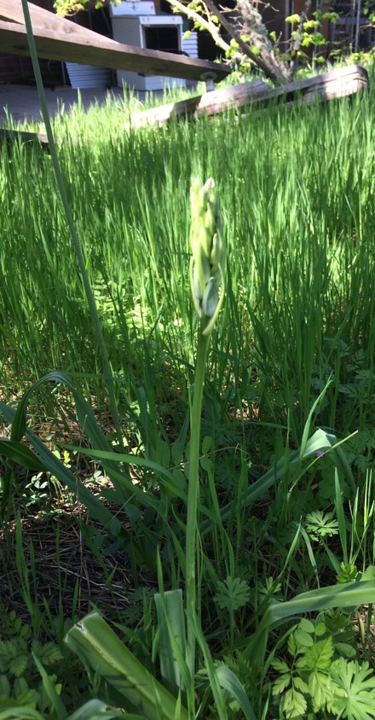
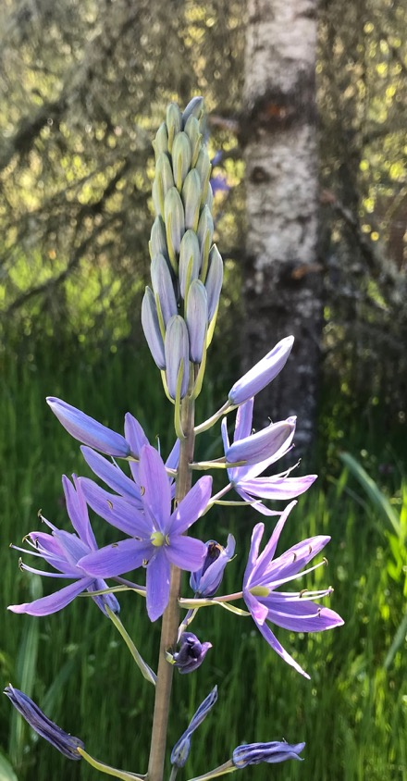
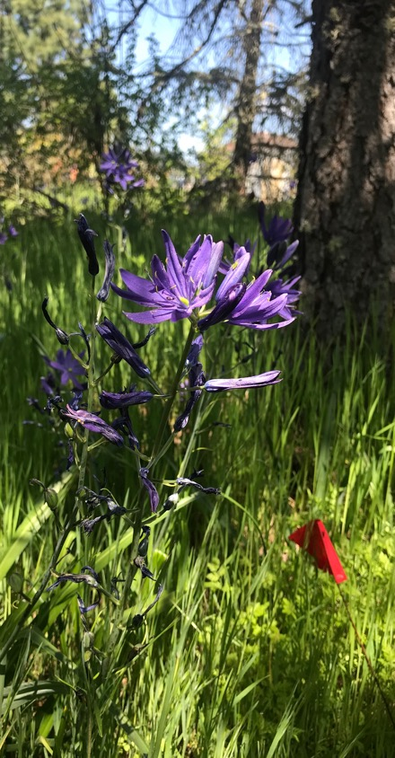
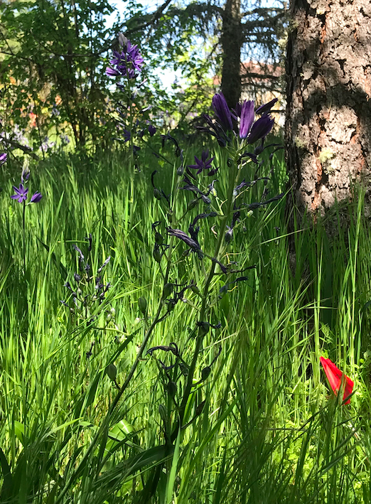
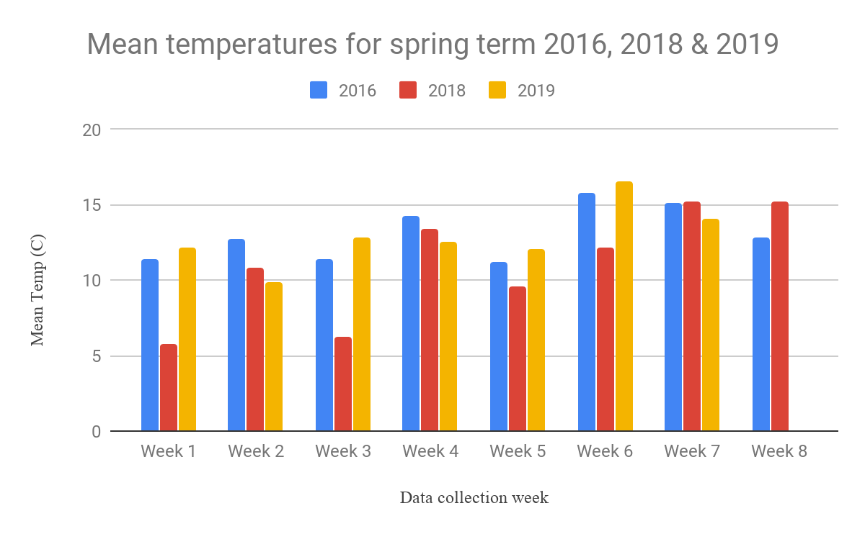
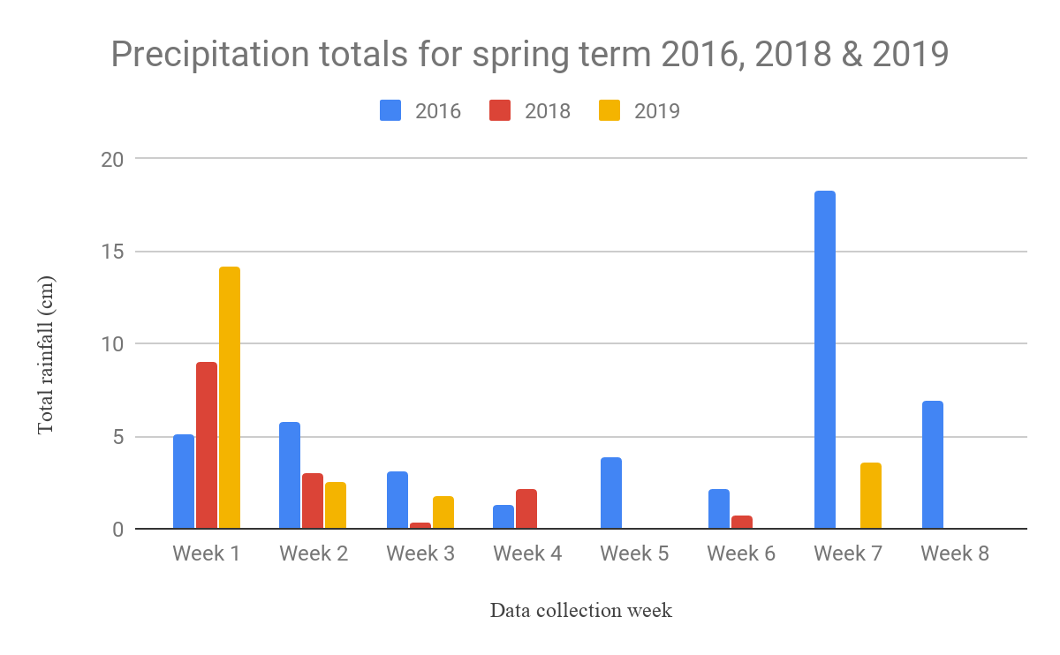
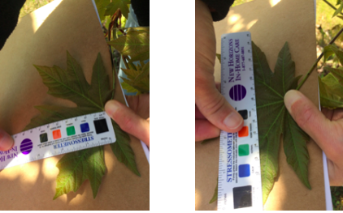
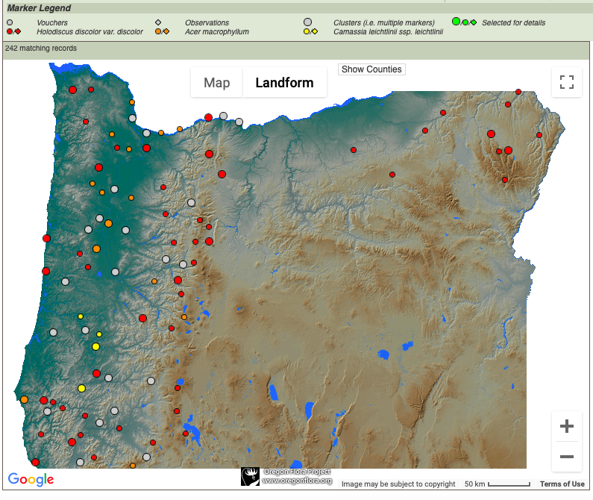
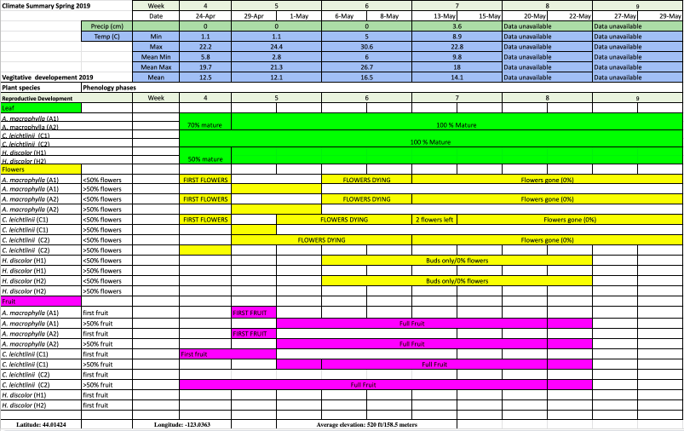
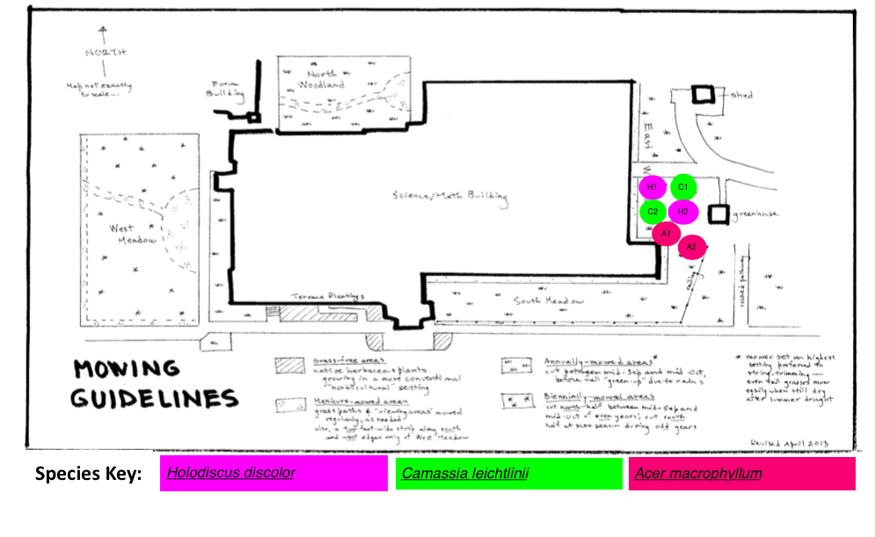
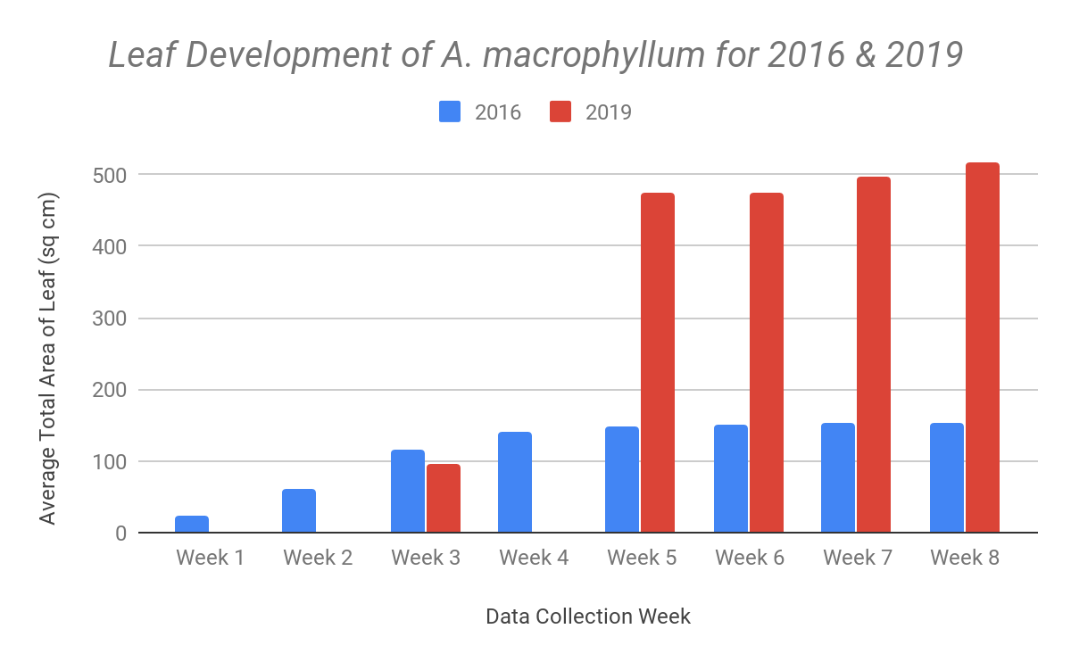
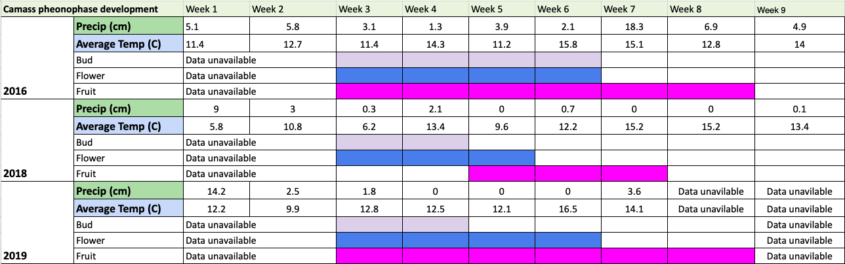
The effects of precipitation and temperature on spring phenophase development of Acer macrophyllum, Camassia leichtlinii and Holodiscus discolor
Adriana Brandner and Claire Ebert Spring 2019
MAIN GOAL – How short-term weather patterns and long term climate conditions affect the phenology of Camassia leichtlinii, Acer macrophyllum and Holodiscus discolor
Partially funded by: grant 1505081 “Tipping the Scale: Engaging Community College Science Faculty and Students in Course-Based Research Experiences (CBRE)
INTRODUCTION
Phenology is the study of the periodic plant and animal life cycle events and how they are influenced by seasonal variations such as a change in precipitation and temperature, as well as habitat factors (Franks et al., 2007). How plants and animals respond to climate change can be useful in predicting the growth or reduction in a population species and also in a community (Cowles et al., 2018). We hypothesize that short term seasonal changes in temperature and precipitation over time will affect the timing development of buds, flower and fruits of Camassia leichtlinii, Acer macrophyllum and Holodiscus discolor. These three species are important members of the local riparian, oak savanna and mixed woodland ecosystems in the the Willamette Valley and Western Cascades (See Fig. 1). Change in these species can lead to changes in a community structure which can alter other biological events that rely on phenological stages for food and breeding habitat (Both et al., 2006).
Figure 6. Mean temperatures recorded spring term 2016, 2018 & 2019. Data shows much warmer conditions in 2016 compared to 2018 and 2019 for the exception of weeks 3 and 6 where it was warmer in 2019. (LCC Weather Monitor System, Bldg 16).
Figure 7. Precipitation amounts recorded for spring term 2016, 2018 & 2019. Data shows higher precipitation amounts for week 1 in 2019 compared to other years. (LCC Weather Monitor System, Bldg 16).
CONCLUSIONS/FUTURE SUGGESTIONS
Figure 3. Phenophase development of Camassia leichtlinii on East side of building 16. When research began some of C. leichtlinii were still in bud, some were in partial bloom and some were already producing fruits.
According to our data, C. Leichtlinii was in flower early in the season while precipitation levels were high. It rapidly started to fruit as the precipitation levels decreased and temperatures increased during weeks 4, 5, and 6 (See Table 1, Fig. 6, 7). Flowering during high precipitation and producing fruit during low precipitation allows the flowers reproductive success through allowing pollination and fertilization to occur in conditions optimal for plant population survival (Howard et al., 2018). Also, there is a significant difference in the growth rates of A. macrophyllum between the years 2016 and 2019 (See Fig. 5). The precipitation early in the season was greater in 2019 than 2016 and the growth rate of A. macrophyllum was also greater in 2019 than 2016. This shows that abundant precipitation early in the year is ideal for growth of the Big Leaf Maple. Finally, camas started to fruit early in the season in 2018 which correlates to previous years data; that increased precipitation and warm temps in the beginning of the season increases the rate of phenophase timing (See Table 2). This indicates that the reproductive stages are extremely sensitive to varying changes in climates.
Future research is suggested to see if trends in data relative to climate changes continue. This is helpful in understanding how a biotic community and its habitat could change over time. Future experiments should start earlier in the season due to the plants flowering earlier and should measure multiple leaves per specimen of A.macrophyllum to get a wider view of the trees growth rate in relation to changes in climate .
Figure 4a &4B. Measuring the length (2a) and width (2b) of Acer macrophyllum.
RESULTS
Figure 1. Species distribution of C. leichtlinii, A. Macrophyllum & H. discolor. (Oregon Flora Project 2019)
METHODS
Temperature changes and precipitation amounts were our independent variables and the measurements of reproductive development and leaf growth was our dependent variables. Fieldwork was conducted on the east side of building 16 at LCC (See Fig. 2). We measured the timing of reproductive structure development of all three of our species by determining the percent abundance of buds, flowers and fruit (See Fig. 3). We recorded first flower, bud and fruit timing. We also determined the growth rate of A. macrophyllum by measuring the longest part of the leaf and the widest part of the leaf (See Fig. 4a & 4b). We then compared this years data of the Big Leaf Maple with spring term 2016, and for timing and abundance of reproductive structures of all three species within spring term 2016, 2018 and 2019.
REFERENCES
Both, C., Bouwhuis S., Lessells C.M., Visser, M.E. (2006, May 4). Climate change and population declines in a long-distance migratory bird. Nature. 441(7089), 81-3. doi:10.1038/nature04539
Cowles, J., Boldgiv, B., Liancourt, P., Petraitis, P. S., Casper, B. B. (2018, June). Effects of increased temperature on plant communities depend on landscape location and precipitation. Ecology and evolution, 8(11), 5267–5278. doi:10.1002/ece3.3995
Franks, S. J., Sim, S., Weis, A. E., (2007, January 23). Rapid evolution of flowering time by an annual plant in response to a climate fluctuation. PNAS, 104(4), 1278-1282. doi:org/10.1073/pnas.0608379104
Howard, R., Neville, A., Tolman, L. ( 2018). Phenological Development of Camassia quamash, Holodiscus discolor, and Acer macrophyllum. Botany 213 Principles of Botany. Unpublished Research Report.
Native Plant Society of Oregon. (2002)Vascular Plants of Lane County Oregon. Emerald Chapter, Native Plants Society of Oregon. 55
Table 1. Phenophase and climate summary of all species monitored for spring term 2019.
Figure 2. Map of study plot locations for Spring term 2019.
Figure 5. Weekly leaf measurement data for Spring term 2016 & 2019 for A. macrophyllum.
Table 2. Yearly comparison of C. Leichtlinii phenophase development for the years 2016, 2018 & 2019. Camas fruited later in 2018 than in 2019.
Notes:
Photos should be at least 300dpi, but not more than 5-12 mgs each. Your poster is set to be enlarged 200% so do not change the page size to fit another poster size. Posters (3’ x 4’) will be printed. Please email your poster as a PPT file. You can change the font size, colors, column widths, add photos, institutional logos, graphics, etc. This template can also be used as a starting point and you can be as creative as you want in your poster. However, we would like to have all of the posters the same size and we will be printed at the same time, at the same print shop.

Slide 3
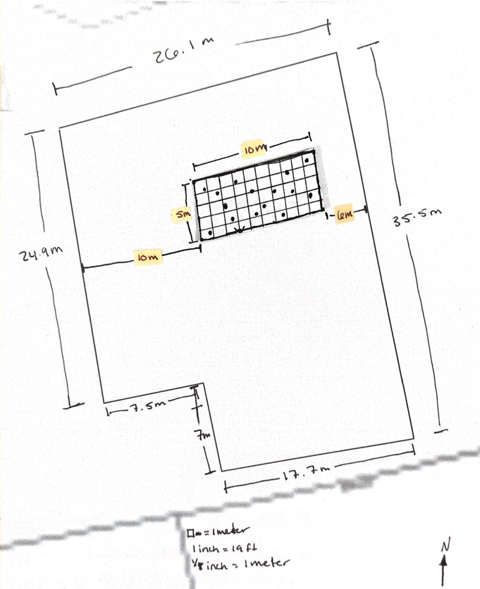
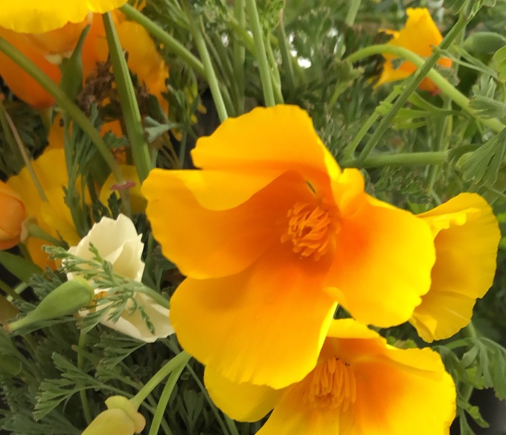
The Effect on Native Species by Weeding Invasive Species From an Upland Prairie
Authors Jessica Portillo, Lexi Terramana, Samantha Wagner
BOT 213 Principles of Botany Spring 2019_S. Holmes
Partially funded by: grant 1505081 “Tipping the Scale: Engaging Community College Science Faculty and Students in Course-Based Research Experiences (CBRE)
The goal of our project is to test how well hand removal of invasive species works and to establish long term monitoring protocols, as well as plant new native species in the targeted area.
INTRODUCTION
RESULTS
Ecological restoration is a process in which humans assist in the recovery of an ecosystem. We conducted research in restoration ecology, primarily focusing on the restoration of an upland prairie East of building 16 at Lane Community College. Our research project will not produce results immediately, so we hope that a future research group will continue this project with the data we collected this year. We predict that the hand removal of invasive species will be temporarily successful, but regular maintenance is required for the species to truly be rid of. The invasive species we removed are: Hypochaeris radicata, Daucus carota, Scandix pecten-veneris and Tragopogon porrifolius. The native species we planted are: Eschscholzia californica, Camassia leichtlinii, and Iris tenax.
Our project does not have an immediate conclusion, as it requires further research in future terms. We quantified/estimated the invasive species we removed by hand (Table 1), as well as the remaining species in the plot, both native and non-invasive non-natives (Graph 1). Our final data collected was the natives we planted and how many of each (Table 2).
Table 1
Species | Quantity pulled
Hypochaeris radicata | 33 (all)
Daucus carota | 266 1/3 population)
Tragapogon porrifolius | 78 (all)
Scandix pectin-veneris | 1/3 population
METHODS
CONCLUSIONS/FUTURE SUGGESTIONS
We quantified the native and invasive species within a 10 meter by 5 meter plot on the hillside above the swale. We then hand-removed as many of the invasive species in that plot as possible, and replaced them by planting a few different native species. The hillside had existing camas, irises and poppies growing in nearby areas, suggesting that those species may thrive on the hillside.
Our foreseen outcome for this project is to set a baseline of data for future research groups to consult and continue this project. Hopefully, invasive species can be pulled every year and native growth can be regulated. For next year we suggest obtaining some Wyethia seeds so they can replace Hypochaeris radicata. Timing of the plants should be noted, like the buttercups were gone by the time we started to count plants.
Removed invasive species by hand. S. pectin-veneris and D. carota were thinned.
Table 2
Introduced species | Quantity planted
Eschscholzia californica | 16 (from starts)
Iris tenax | 100 (from seed)
Camassia leichtlinii | 50 (from seed)
REFERENCES
1.Friends of Buford Park and Mt. Pisgah’s Native Plant Nursery donated Eschscholzia californica starts and Iris tenax seeds for us to plant.
2.Camassia leichtlinii seeds from Fisher Butte old growth prairie.
3. Vascular Plants of Lane County Oregon
4. Flora of the Pacific Northwest
Eschscholzia californica
Introduced species. Seeds were not obtained from E. californica so young plants were planted.
Map of plot and the dots indicate where we planted 16 Eschscholzia californica
Notes:
Photos should be at least 300dpi, but not more than 5-12 mgs each. Your poster is set to be enlarged 200% so do not change the page size to fit another poster size. Posters (3’ x 4’) will be printed. Please email your poster as a PPT file. You can change the font size, colors, column widths, add photos, institutional logos, graphics, etc. This template can also be used as a starting point and you can be as creative as you want in your poster. However, we would like to have all of the posters the same size and we will be printed at the same time, at the same print shop.

Slide 4
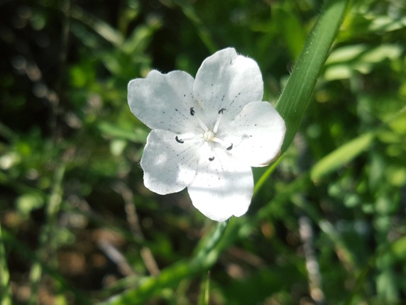
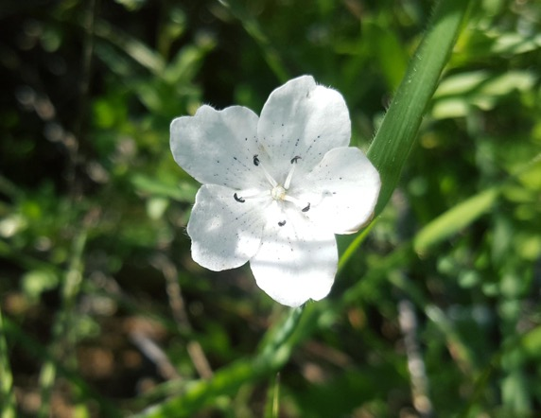

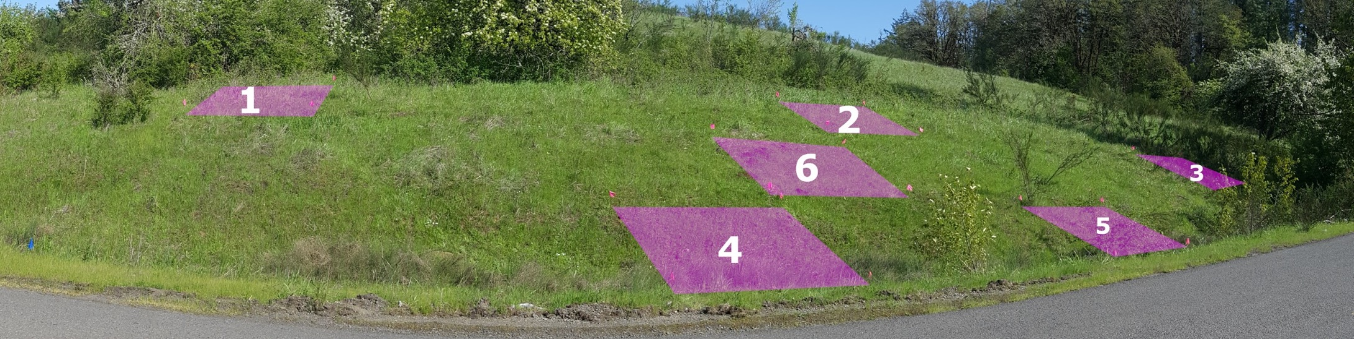
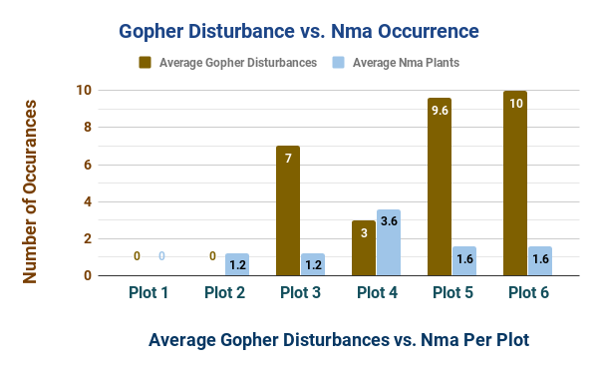
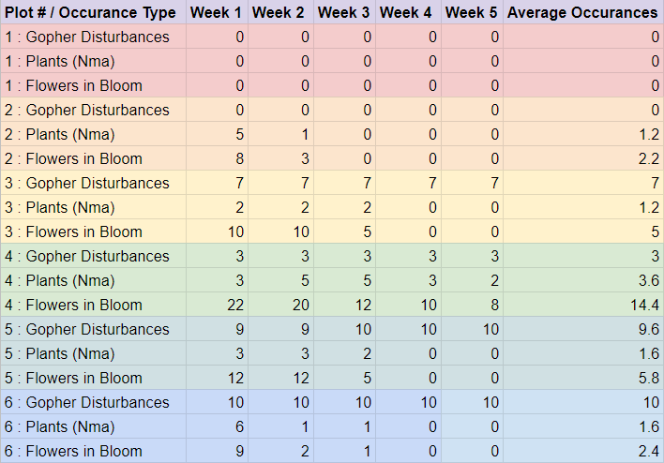
Population study of Nemophila menziesii var. atomaria
Jaycie Miller and Travis Roberts
BOT 213 Principles of Botany Spring 2019_S. Holmes
Partially funded by: grant 1505081 “Tipping the Scale: Engaging Community College Science Faculty and Students in Course-Based Research Experiences (CBRE)
MAIN GOAL – Understand impact of gopher hole disturbances on population of an endemic annual plant: Nemophila menziesii var. atomaria
INTRODUCTION
CONCLUSIONS/FUTURE SUGGESTIONS
Nemophila menziesii var. atomaria (Nma) is a local native plant species here in the Willamette Valley that can also be found along the coastal stretch of California and southern Oregon. However, because of its isolated presence here in the valley it is considered a rare plant (Holmes, Baker, 2012). Utilizing previous student research looking at the relationship between plants and gopher digs (Curtis, unpublished report) our group decided to look specifically at interactions between Nma and gopher digs in an effort to understand changes in population growth and decline. Points of interest include the proximity of our plant species to the gopher digs and whether or not the gophers might actually have a negative impact on our observed population (Case, 2012). We hypothesized that the presence of gopher holes and mounds would affect the population of Nma due to gopher holes providing loose turned soil free from competitive ground cover, an ideal environment for plant seedlings to germinate. Understanding factors that might influence Nma populations could help us to protect and improve our small populations of Nma. Native plants play important ecological roles in supporting other native flora and fauna.
Our site showed significant amounts of gopher activity both in and outside of the plots that were studied, however the results were inconclusive and did not support a direct correlation between population and gopher digs (see Table 1). Although weather data was not collected, a period of hot and dry weather through weeks 3 and 4 seemed to heavily impact our plots resulting in greatly reduced numbers of Nma present. Looking at the data in Table 2 there was a significant decline in plant populations while gopher activity remained fairly constant. Overall, more time and data Is needed to assert to any conclusions.
In retrospect it is likely that a longer study lasting through multiple generations of Nma populations would provide quantifiable data showing a correlation between gopher digs and Nma spread and growth. Specific variables that should be considered for future study include seed dispersal patterns and range, seed collection and germination rates and length, as well as the inclusion of more than one site of study.
Figure 1. The hillside containing our population of study. Plots highlighted in purple.
RESULTS
METHODS
REFERENCES
The area we monitored for our Nma population study in relationship to gopher digs is a small hillside located across from the LCC parking lot behind building 16. The hillside containing our population was measured out at approximately 30 by 9 metres using a survey tape and the perimeter marked out with blue flags. A representation of the area was drawn up and divided into 30 3m squares. Based off of random sampling protocols (Wilson, 2005) 6 squares were chosen for observation and study for 20% coverage of the total area. These six plots were then marked out with pink flags (see Figure 1). Our independent variable being the plots marked with gopher digs and Nma presence being the dependent variables. Visual and photographic observations and data collection started on 4/19/19 and continued bi-weekly for six weeks at these locations to determine the presence or absence of gopher digs and any changes in the Nma population over the course of five weeks. Post study the collected data was evaluated and summarized for future related research by LCC students.
Table 1. Chart comparing the average number of gopher disturbances vs. occurrences of Nemophila menziesii var. atomaria per plot.
Case, Madelon. (2012). Gopher Disturbance and Plant Community Dynamics in Mountain Meadows. (Unpublished senior thesis). Department of Ecology and Evolutionary Biology. Princeton University, Princeton, NJ. https://andrewsforest.oregonstate.edu/sites/default/files/lter/pubs/pdf/pub4746.pdf.
Curtis S, Burch M, O’Toole R. (Unpublished report). Plant growth as affected by gopher holes. Bio 103f Research Poster, Wildflowers.
Holmes S, Baker G, (2013) Watching For Signs of Spring: Pale Baby Blue Eyes. Mount Pisgah Arboretum. http://www.mountpisgaharboretum.com/wp-content/uploads/2012/01/Tree-Time-Sp-2013-for-website.pdf
Wilson, M. (2005). Simple random sampling in the field. [online] Oregonstate.edu. Available at: http://oregonstate.edu/instruction/bot440/wilsomar/Content/SRS.htm.
Table 2. Average occurrences of gopher disturbances, Nma plants, and flowers in bloom per plot for each week of the study, plus the averages of each for the entire six week study.
Notes:
Photos should be at least 300dpi, but not more than 5-12 mgs each. Your poster is set to be enlarged 200% so do not change the page size to fit another poster size. Posters (3’ x 4’) will be printed. Please email your poster as a PPT file. You can change the font size, colors, column widths, add photos, institutional logos, graphics, etc. This template can also be used as a starting point and you can be as creative as you want in your poster. However, we would like to have all of the posters the same size and we will be printed at the same time, at the same print shop.

Slide 5

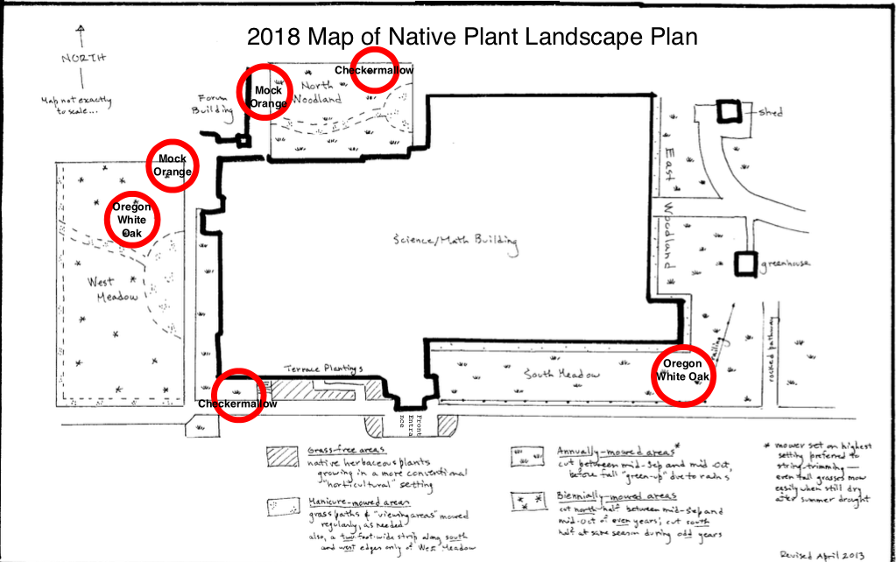
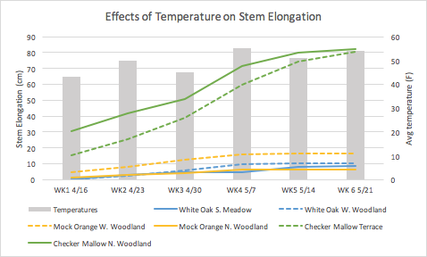
The Effects of Temperature and Sun Exposure on the Growth and Development of
Quercus garryana (Fagaceae), Philadelphus lewisii (Hydrangeaceae), and Sidalcea cusickii (Malvaceae)
Mariah Goodman, Paige Davis, Sylvie Stephens, and Marie Moore
Botany 213, Spring 2018 Instructor: Holmes
Partially funded by: gr
ant 1505081 “Tipping the Scale: Engaging Community College Science Faculty and Students in Course-Based Research Experiences (CBRE)
Hypothesis: Fluctuations of the daily temperature and microclimates of separate locations, in the north, east, south, and west, will affect vegetative growth and development of Quercus garryana, Philadelphus lewisii, and Sidalcea cusickii.
INTRODUCTION
RESULTS
CONCLUSIONS/DISCUSSION
What does crocus blooming in winter, carpets of prairie wildflowers in spring, and soft white drifts of cottonwood seeds have in common? These are all examples of phenological events that are triggered by the climate and changing seasons.
For our phenology study we hypothesize that micro-climates of separate locations, in the north, east, south, and west, will affect vegetative growth and development on Quercus garryana, Philadelphus lewisii, and Sidalcea cusickii. Our independent variables include the fluctuations of the daily temperature and the location of the plants (i.e. north, west, east, and south). We will be measuring the resulting dependent variables, such as blade length in cm, new growth of tree/shrub branch or herb stem elongation in cm, the flowering time, and the percentage of flower and fruit development.
In a previous experiment in 2016 on Quercus garryana, Bot. 213 students measured the stem elongation and blade length of Oregon White Oaks, as well as monitoring temperature. They found that a tree that was competing for sunlight, and by extension warmth, with conifer trees had underdeveloped stem elongation when compared to other Oregon White Oaks trees in the same area without competition (Carson et al. 2016). This is extremely relevant to our hypothesis that our research organism’s growth and development would be affected by temperature fluctuation. We predict that plants that are exposed to more sun availability and higher temperatures will develop faster.
According to our data (Fig. 2 below) the Sidalcea cusickii (checkermallow) growing in the north woodland developed faster than the Sidalcea cusickii in the south terrace. The Philadelphus lewisii (mock orange) in the west woodland out performed the one in the north woodland. Of the two Quercus garryana (Oregon white oak) trees we observed, the oak in the west woodland developed faster than the other one in the south meadow. As a whole, the plants in the west woodland grew to maturity faster than the other microclimates.
Our hypothesis is that temperature fluctuations in the different micro-climates of separate locations will affect vegetative growth and development. By analyzing the graph of our data (Fig. 2) we can see that the Sidalcea cusickii on the north woodland grew faster than the one on the south terrace. That could be due to being exposed to more sunlight. It had dappled light throughout the day, while the Sidalcea cusickii on the south terrace was completely in shade all day from a large madrone tree. These results support our hypothesis. The Philadelphus lewisii in the west woodland experienced mature leaves and flower buds before the Philadelphus lewisii in the north woodland. This also supports our hypothesis, since the north-facing habitat had large trees, as well as building 16, blocking smaller shrubs from getting full exposure to sunlight and increased temperatures. The surprising result comes from the two Quercus garryana trees. The Quercus garryana in the south meadow had sun exposure for most of the day, but it didn’t mature as fast as the Quercus garryana in the west woodland. This could be explained by the fact that western sun exposure arrived in the western woodland in the afternoon when the day is warmest. This increase in temperature and its effect on the western facing Quercus garryana could explain it maturing before the Quercus garryana in the south meadow.
Fig. 1 LCC Map of Native Plant Landscape Plan, Phenological Study Plant
Locations.
FUTURE RESEARCH SUGGESTIONS
METHODS
Future researchers should take temperatures several times throughout the day and average them. That way it will better reflect that day’s weather and not just one point in time. To better understand the growth habits of the plants in the study, it would be a good idea to test the soil’s pH. When taking measurements choose two or three aspects, such as blade length or stem elongation, to measure consistently on each plant. That way if one is broken off you’ll have backup data to continue with.
Data was collected twice each week, beginning April 16, 2018 and continuing through May 30, 2018. We observed and recorded the growth progression of our six plants for a total of seven weeks. The characteristics of the plants we measured were branch and blade elongation, the presence of both leaf buds and mature leaves, the presence of flower buds, and the existence and percentage of flowers. No fruit was observed in any of our plants during this time.
We also took weekly temperature readings at around the same time every day. We placed a thermometer at every plant in order to measure its specific micro-climate temperature.
REFERENCES
Anadon-Rosell A, Rixen C, Cherubini P, Wipf S, Hagedorn F, Dawes MA. (2014).
Growth and Phenology of Three Dwarf Shrub Species in a Six-Year Soil Warming
Experiment at the Alpine Treeline. PLoS ONE 9(6): e100577. https://doi.org/10.1371/
journal.pone.0100577
Carson, A., A. Ramirez. (2016).The Influence of Weather Patterns on the Phenology of
Quercus garryana. Botany 213 Phenology Project, unpublished data.
Cleland, E. E., Chuine, I., Menzel, A., Mooney, H. A., & Schwartz, M. D. (2007, May 02).
Shifting plant phenology in response to global change. Retrieved April 09, 2018, from
https://www.sciencedirect.com/science/article/pii/S0169534707001309
Common Trees of the Pacific Northwest. (n.d.). Retrieved from https://oregonstate.edu/
trees/broadleaf_genera/species/oak_spp.htm
Fig. 2 Temperature in Individual Micro-Climates Effected Species Growth and Development.
Notes:
Photos should be at least 300dpi, but not more than 5-12 mgs each. Your poster is set to be enlarged 200% so do not change the page size to fit another poster size. Posters (3’ x 4’) will be printed at WWU using the same purchase order at the same time. Please email your poster as a PPT file to by Joann Otto at WWU by April 20, 2015. Please contact Joann Otto (Joann.Otto@wwu.edu) with questions about poster printing. Also please put your institution “logo” on your poster.
Please note that this template is provided to simplify your effort to prepare a poster for the NW Biology meeting. You can change the font size, colors, column widths, add photos, institutional logos, graphics, etc. This template can also be used as a starting point and you can be as creative as you want in your poster. However, we would like to have all of the posters the same size and we will be printed at the same time, at the same print shop in order to easily pay for printing with one purchase order.

Slide 6
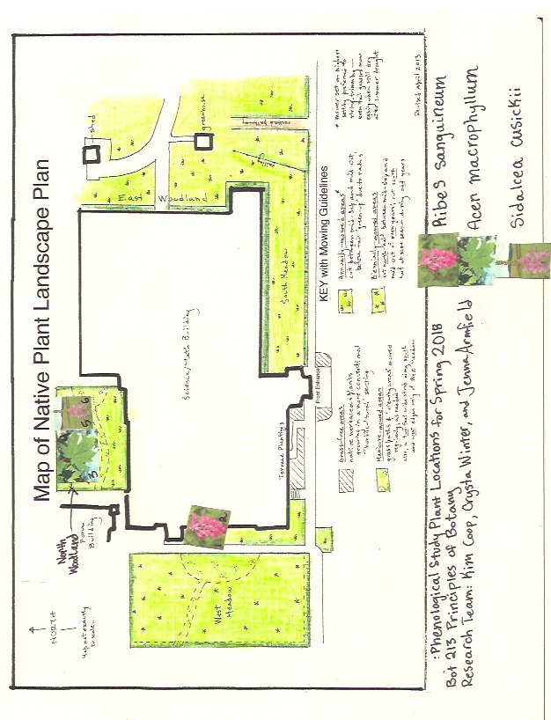
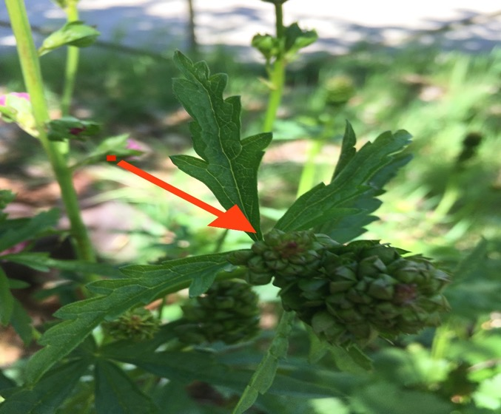
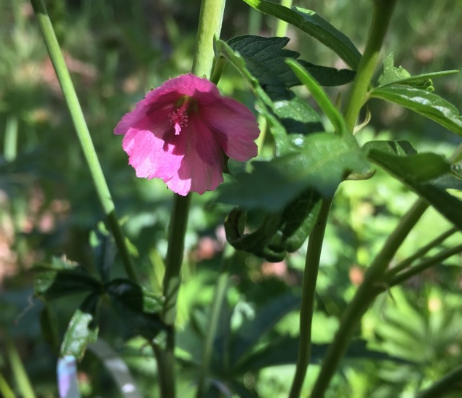
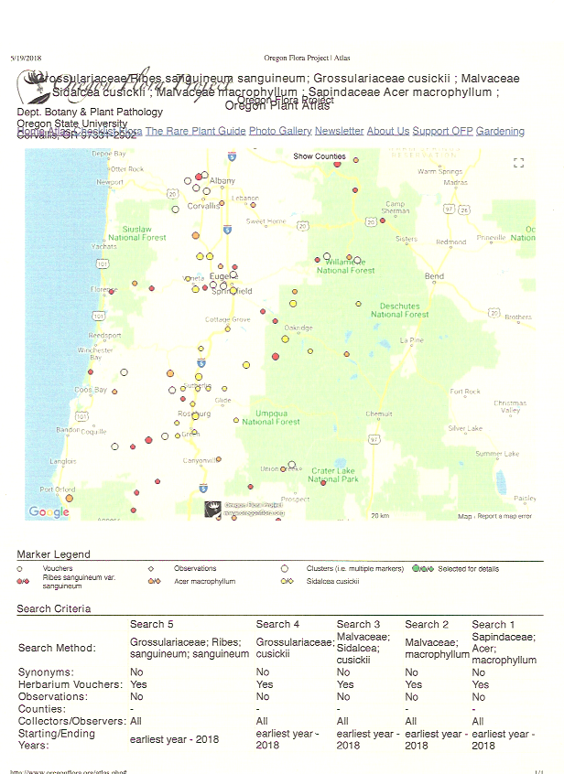
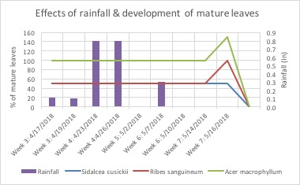
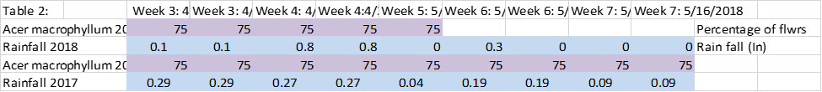
Phenological development of Sidalcea cusickii, Ribes sanguineum, and Acer macrophyllum
in the LCC Native Landscape surrounding Building 16
Jenna Armfield, Kimberly Coop, Crysta Winter
Botany 213, Spring 2018 Instructor: Holmes
Partially funded by: grant 1505081 “Tipping the Scale: Engaging Community College Science Faculty and Students in Course-Based Research Experiences (CBRE)
Main Hypothesis: The amount of precipitation this spring season will influence the growth of Sidalcea cusickii, Ribes sanguineum, and Acer macrophyllum.
INTRODUCTION
METHODS
CONCLUSIONS/DISCUSSION
Phenology can help us understand the key seasonal changes in plants and animals and relationship with weather and their climate (USA). The LCC campus has a wide array of herbs, flowers, shrubs, and trees native to the Pacific Northwest. In our research we observed the phenological development of Ribes sanguineum, Sidalcea cusickii, and Acer macrophyllum in correlation to the amount of precipitation in the Spring 2018 growing season on the LCC campus. With the knowledge obtained we can propose that the amount of precipitation during this spring season will influence the vegetative growth of the plants studied. Our independent variable is the amount precipitation and our dependent variables include the vegetative growth (leaf development, leaf buds), and flowering time (% of flowers open, buds, fruit development) of the plant species observed. Based on our variables, we predict that the flowering and vegetative growth of the Sidalcea cusickii and the Ribes sanguineum will mature later than the previous spring seasons based on the increased precipitation this season. We also predict that the flowering and vegetative growth for the Acer macrophyllum will mature at a regular and consistent rate based on the data shown from previous spring seasons.
Sidalcea cusickii, or Checkermallow, is a perennial herb in the Malvaceae family with simple alternate leaves, commonly palmately lobbed. It can grow to be 5 ft. in height and is native to Western North America where it grows in wet meadows, marshes and forest edges 0-9800 ft. Flowers are pollinated by a variety of bees, wasps, flies and beetles (Hitchcock et al). Ribes sanguineum, or red flowering currant, is a deciduous shrub in the Grossulariaceae family with simple alternate palmately lobbed leaves that can grow to be 8 ft. tall. Native to Western North America, it grows by forest edges and clear-cuts. Ribes produces globose shaped berries that ripen by late July to August and are edible. Bees, hummingbirds and butterflies pollinate this shrub (Hitchcock et al). Acer macrophyllum, or big leaf maple, is a large deciduous tree in the Aceraceae family that matures in height at 60 feet and is native to Western North America. It has schizocarp fruits and grows in moist, well-drained soils from valley bottomlands up to mountains. Its compound leaves grow opposite and are mostly palmately lobbed. Its yellow flowers grow on corymbose branches (Vascular Plants of Lane Country Oregon).
Figure 1: Oregon Flora Project Map
Our team recorded phonological observations twice weekly by monitoring two
plants of each species by noting estimated percentages of the following
phenophases; first flower buds, flower bud development, mature flower
progression, fruit development and progression, leaf bud development, and mature
leaf development (See Figures 3 and 4). Phenological observations were
recorded from April 17, 2018 until May 24, 2018. We took photographic records
once a week and anytime a pollinator appeared on the plant.
Our data suggests that the increased amount of precipitation in the beginning of the spring term did influence the phenological development of the plants studied. The Sidalcea cusickii did not produce flowers until 3 weeks into taking measurements. Ribes sanguineum was already producing over 75% mature flowers and we did not see any other changes in this plant until it began to fruit in week 5. Acer macrophyllum was also between 50-75% in bloom before we began taking measurements. We were able to gather data twice a week on these plants, but more data would’ve been preferable to support our hypothesis. We can not prove or disprove our hypothesis due to the lack of measuring other factors that may have also contributed to the phenological development of the species studied.
Figure 2: Phenological Study Plant Locations
RESULTS
Figure 3. Flower bud development of Sidalcea cusickii (4/26/2018)
Figure 4. First mature flower of Sidalcea cusickii (5/2/2018)
FUTURE RESEARCH SUGGESTIONS
Suggestions could include to research the phenology of the plants studied before taking measurements to see what other factors could contribute to the development of the plants. Measuring more than twice a week so that the data is more in depth and that will further help to prove or disprove the hypothesis.
REFERENCES
Hitchcock, L. C., Cronquist, A., & Janish, J. R. (1973). Flora of the Pacific Northwest an illustrated manual. Seattle: University of Washington Press.
Project Budburst. 2011. Phenology. Co-managed by NEON and the Chicago Botanic Garden. https://budburst.org/phenology-defined Accessed 4/5/19
Cleland, E. E., Chiariello, N. R., Loarie, S. R., Mooney, H. A., & Field, C. B. (2006, September 12). Diverse responses of phenology to global changes in a grassland ecosystem. http://www.pnas.org/content/103/37/13740.short Accessed 4/5/18
Phenology. (n.d.). https://www.nature.com/subjects/phenology Accessed 4/5/18
Instructions for Using the Oregon Plant Atlas. (n.d.). http://oregonflora.org/atlas.php Accessed 4/29/18.
USA NPN National Phenology Network. Wikipedia, Wikimedia Foundation, 3 Apr. 2018, en.wikipedia.org/wiki/Phenology. USA National Phenology Network,www.usanpn.org/usa-national-phenology-network. Accessed 4/3/18.
Shifting plant phenology in response to global change. (2007, May 02). https://www.sciencedirect.com/science/article/pii/S0169534707001309
(n.d.). Retrieved April 29, 2018, from https://plants.usda.gov/java/
Accessed 4/11/18.
Notes:
Photos should be at least 300dpi, but not more than 5-12 mgs each. Your poster is set to be enlarged 200% so do not change the page size to fit another poster size. Posters (3’ x 4’) will be printed at WWU using the same purchase order at the same time. Please email your poster as a PPT file to by Joann Otto at WWU by April 20, 2015. Please contact Joann Otto (Joann.Otto@wwu.edu) with questions about poster printing. Also please put your institution “logo” on your poster.
Please note that this template is provided to simplify your effort to prepare a poster for the NW Biology meeting. You can change the font size, colors, column widths, add photos, institutional logos, graphics, etc. This template can also be used as a starting point and you can be as creative as you want in your poster. However, we would like to have all of the posters the same size and we will be printed at the same time, at the same print shop in order to easily pay for printing with one purchase order.

Slide 7
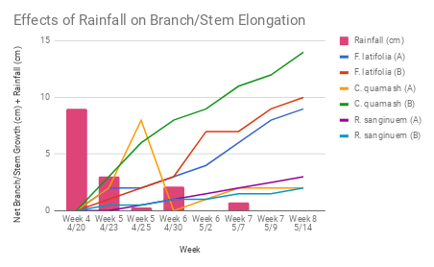
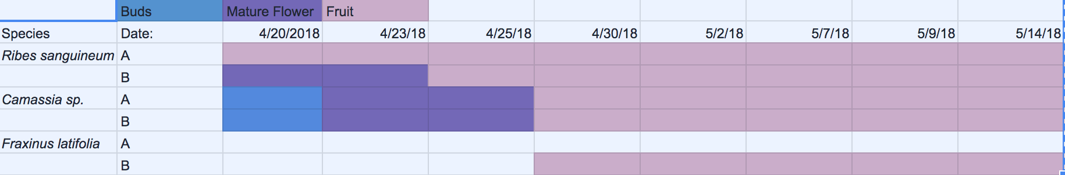
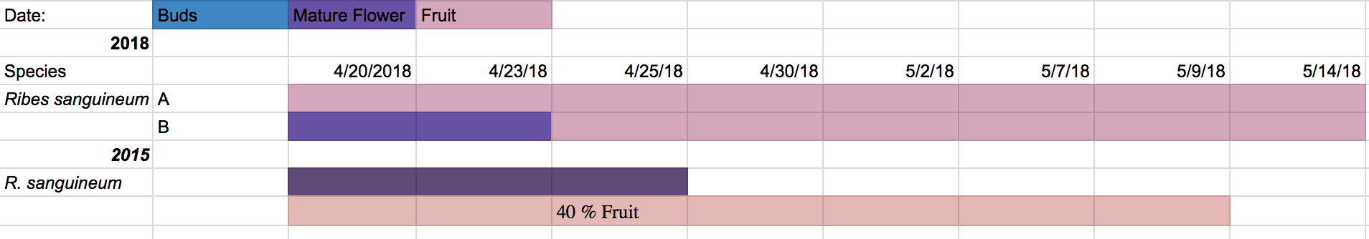
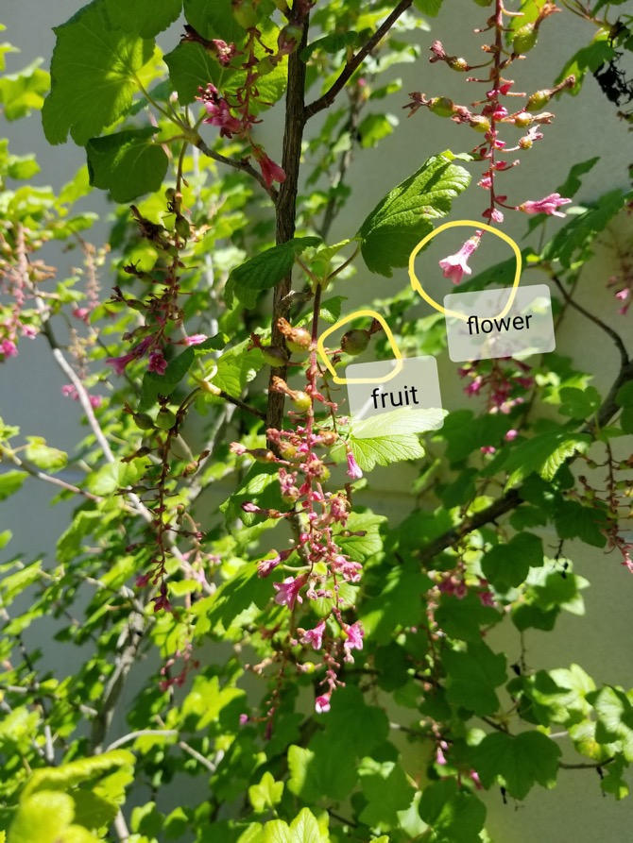
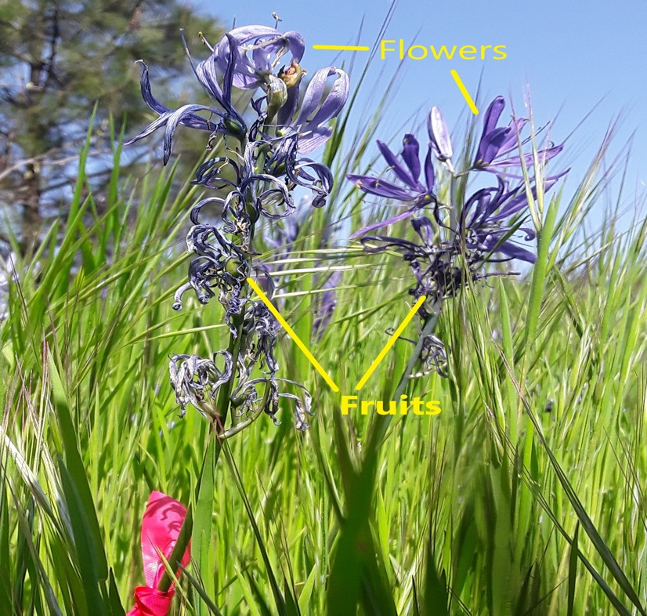
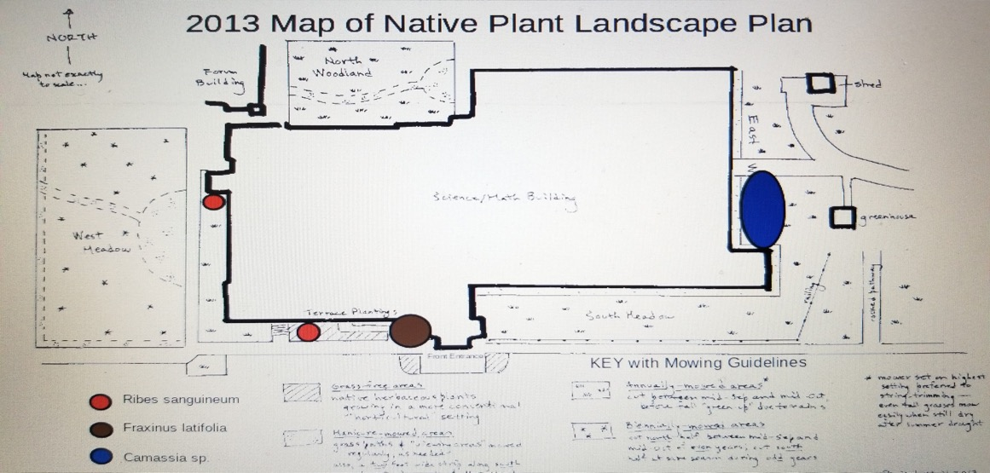
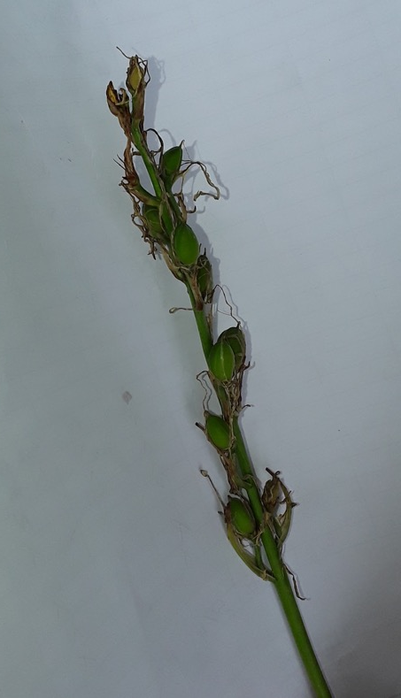
Phenological Development of Camassia quamash, Fraxinus latifolia
and Ribes sanguineum
Leonardo Zavala, Chris Bochum, Colby Yeh-Tinetti
Botany 213, Spring 2018 Instructor: Holmes
Partially funded by: grant 1505081 “Tipping the Scale: Engaging Community College Science Faculty and Students in Course-Based Research Experiences (CBRE)
MAIN GOAL – Growing season parameters such as time of year, temperature, precipitation, and photoperiod all influence the
sequence of development stages of our research species’ spring seasonal phenophases.
INTRODUCTION
RESULTS
CONCLUSIONS/DISCUSSION
Phenology is the study of the timing of recurring biological events in their annual cycle, including dates that leaves and flowers emerge and that migratory birds arrive, and their relation to abiotic and biotic forces like climate and predation (USA NPN National Phenology Network, 2018). All definitions describe phenology as the timing of cyclic or temporal events associated with climate, plant, or animal life, but some further specified it as an area of scientific inquiry and described it as being a sensitive indicator of climate change (Menzel). Phenology is important whether it’s used to deepen our understanding of the flower life cycle or to track the effects of climate change on plants and the impacts beyond them (Calinger, Kellen M, 2013). In our research we try to answer what sequence of development was found for each of the species listed above by tracking structures like fruits, flowers and vegetative growth. We hypothesize that the growing season parameters like time of year, temperature and precipitation will influence the sequence of development stages of leaf development, branch elongation, flowering time, and fruits.
Our three species in this experiment were at different stages of seasonal development. C.quamash and R.sanguineum had just begun to bloom; whereas, F.latifolia has a distinguishable characteristic where vegetative features (leaves) can begin with or after the flowers, and in our case it was after. Over the course of the term, we generally have observed our plants develop more vegetatively tracking changes with leaf buds, breaking leaf buds, and stem elongation. C.quamash (A) was grazed upon by a herbivore on 4/25/18 explaining the negative slope in graph (Fig 2). Another mishap noticed on 4/30/18 was that the branch selected for monitoring on female ash tree, F.latifolia (B), was too hidden under the canopy that even though fruiting was observed on higher branches no fruits came about for data collection on our selected branch.
Observing the budding leaves of R.sanguineum from a state of dormancy, monitoring the flowering/fruiting of the C.quamash , and tracking F.latifolia’s branch elongation as the season changes, supports our hypothesis that the changing environmental parameters will promote plant growth and encourage perennials to come out of dormancy.
METHODS
Figure 2: The effect of rainfall on branch elongation
FUTURE RESEARCH SUGGESTIONS
Our research team measured a total of 6 plants (2 of each species) twice a week by tracking the development of certain phenological phases. On each plant, we tracked a rough estimate of the available buds, flowers, fruits, and leaves that were present on the entire plant or selected branch at the time. We also recorded branch/stem elongations of a single branch/plant for each of the species as well.
Camassia. quamash has long narrow basal leaves with 6 tepals, 6 stamen, and 3 stigmas. This plant grows in moist areas with moderate to high sunlight levels at a mid to low elevation range and blooms from May-June.
F. latifolia is a dioecious tree. The leaves are odd compound pinnate and generally develop after or with the flowers. Flowers have much reduced calyx’s generally 4-lobed, corolla 2, but usually lacking, . Fruits a long leafed samara around March-May, and are ripe August-September.
R.sanguineum is a deciduous shrub growing up to 2m tall and broad. The leaves of this shrub are palmately lobed along with 5 lobes. The flowers and leaves appear early in spring on dangling racemes; flowers have 5 red or pink petals. This plant fruits a dark purple oval berry.
Figure 2: Graph on the effects of rainfall on branch/stem elongation
When choosing a herb pick one that's in a location relatively safe from herbivores.
Take pictures every time you record data.
When marking your plants, make sure to put in on an easy to see area.
Mind other people's plants.
Figure 3: Phenophase data for each species
REFERENCES
Calinger, Kellen M., et al. “Herbarium Specimens Reveal the Footprint of Climate Change on Flowering Trends across North-Central North
America.” Ecology Letters, vol. 16, no. 8, 2013, pp.1037–1044.
Matthews, Elizabeth R., and Susan J. Mazer. “Historical Changes in Flowering Phenology Are Governed by Temperature Precipitation Interactions in a Widespread Perennial Herb in Western
North America.” New Phytologist, vol. 210, no. 1, 2015, pp. 157–167.
Menzel, Annette. “Phenology: Its Importance to the Global Change Community.” Climatic Change, vol.54, no. 4, 2002, pp. 379–385.
USA NPN National Phenology Network. (n.d.). Retrieved April 06, 2018, from
https://www.usanpn.org/about/why-phenology
Woodruff, A. and Wilkens, V. 2014. Phenological Development of Fraxinus latifolia Botany 213
Principles of Botany Unpublished Research Report.
Figure 4 Yearly Overlap of Phenophases
Figure 1: NPLP Phenological Study Plant Locations
Figure 5: Ribes sanguineum, Wk 6
Figure 6: Camassia spp., #B, Wk 6 and Wk8
Notes:
Photos should be at least 300dpi, but not more than 5-12 mgs each. Your poster is set to be enlarged 200% so do not change the page size to fit another poster size. Posters (3’ x 4’) will be printed at WWU using the same purchase order at the same time. Please email your poster as a PPT file to by Joann Otto at WWU by April 20, 2015. Please contact Joann Otto (Joann.Otto@wwu.edu) with questions about poster printing. Also please put your institution “logo” on your poster.
Please note that this template is provided to simplify your effort to prepare a poster for the NW Biology meeting. You can change the font size, colors, column widths, add photos, institutional logos, graphics, etc. This template can also be used as a starting point and you can be as creative as you want in your poster. However, we would like to have all of the posters the same size and we will be printed at the same time, at the same print shop in order to easily pay for printing with one purchase order.

Slide 8
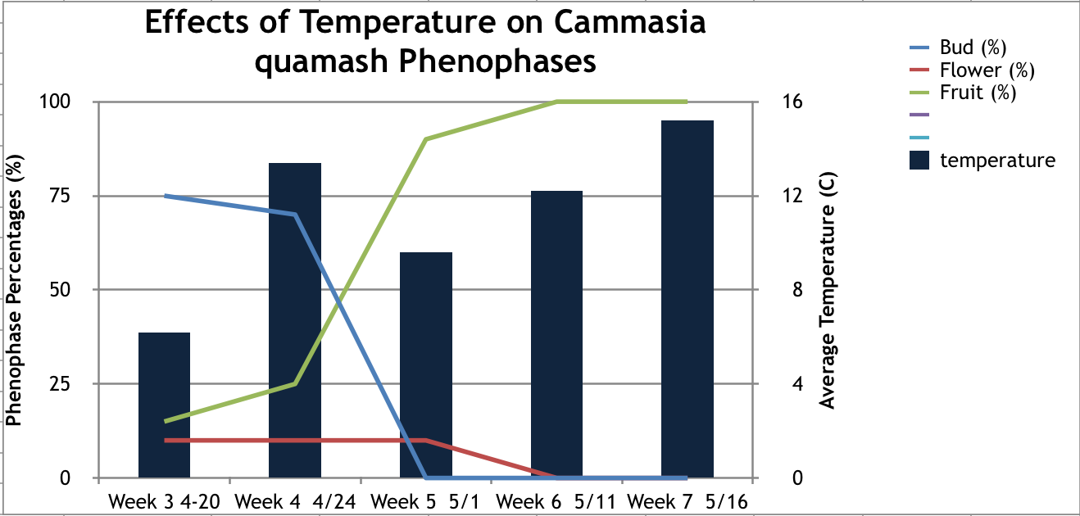
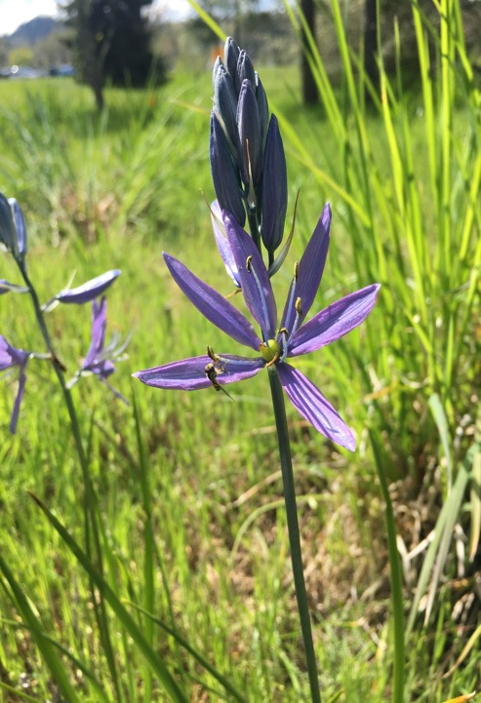



Effects of Climate Change on Acer macrophyllum, Holodiscus discolor, and Camassia quamash
Raven Howard Avery Neville Lacey Tolman
Botany 213, Spring 2018 Instructor: Holmes
Partially funded by: grant 1505081 “Tipping the Scale: Engaging Community College Science Faculty and Students in Course-Based Research Experiences (CBRE)
INTRODUCTION
RESULTS
CONCLUSION
Phenology is the study of annually recurring life cycle events such as migrations, peak insect abundance, and flowering (1). Phenology focuses on the timing of these events and how they are influenced by environmental factors like climate (2). In their study published in Nature, Edwards and Richardson (3) suggest that phenology may yield otherwise subtle indicators of climate change, and that changes in phenological relationships will have serious ramifications for trophic interactions, leading to ecosystem-level changes. Phenology can help us to understand the relationships of organisms to their environment as well as between different groups of organisms. By better understanding the timing of important life cycle events for different organisms, we can begin to see more patterns in ecosystems and possible disruptions of those patterns due to climate fluctuation. Phenology may help us in predicting how ecosystems will be affected by climate change, and it allows us to make more informed decisions regarding conservation and restoration efforts. We can apply our understanding of phenology to help maintain the balance that supports us and provides the many resources and services we depend on (4).
We will examine how recent changes in regional climate including growing season parameters such as rainfall and temperature affect the timing of the developmental stages of reproduction and vegetative growth in Acer macrophyllum, Holodiscus discolor, and Camassia quamash. Because of the recent droughts and increased temperature that the Willamette Valley has experienced we predict that these angiosperms may flower earlier than they have historically. In the case of the perennial monocot Camassia quamash, we predict that it will also produce its seeds earlier. By completing their life cycles before the dry season, they may increase their chances of reproductive success by adapting to a changing growing season (5).
Based on our observations and the observations of previous LCC students for the timing of phenophases in Camassia quamash on campus. We can see a trend since 2008 until now that flower buds have been both opening sooner and their flowers senescing earlier in the year. Average high temperatures saw an general increase during since 2008, and average rainfall saw an overall decrease. Flowering earlier may allow C. quamash to take advantage of the optimal weather conditions that used to occur later in the season. By getting a head start on it’s reproductive cycle during the milder conditions earlier in spring, C. quamash may avoid some of the hotter drier conditions that might lessen it’s chances of survival or reproductive success.
We did not find the timing of fruiting to follow the same trend. The pollinator population may not have had a corresponding phenological shift, which could delay the timing of fruiting, even though C. quamash is flowering earlier.
Fig. 1 Graph of Avg. Temperature and Camassia quamash Phenophases
FUTURE RESEARCH SUGGESTIONS
A study could be done to find out how pollinators are adapting to phenological shifts in the flowers they pollinate, and what effects that has on the reproductive success of the flowers. researching the rate at which the fruits form has any effect on seed production and whether the stress of changing temperatures and precipitation levels affects the rate at which the plants sexually reproduce.
Fig. 2A: 4-18
Fig. 2B: 4-27
Fig. 2C: 5-14
REFERENCES
Fig. 2 Phenophase Progression of Camassia quamash
METHODS
1. Schwartz, M. D. (2013), Springer Science & Business Media, Phenology: An integrative environmental science.
2.Wikipedia, contributors (2018), Wikipedia, Phenology
3.Edwards, M., & Richardson, A. J. (2004), Nature International Journal of Science, Impact of climate change on marine pelagic phenology and trophic mismatch.
4.Armatas, C. A., T. J. Venn, B. B. McBride, A. E. Watson, and S. J. Carver. 2016. Opportunities to utilize traditional phenological knowledge to support adaptive management of social-ecological systems vulnerable to changes in climate and fire regimes. Ecology and Society 21(1):16.
.Franks, S. J., Sim, S., & Weis, A. E. (2007), Proceedings of the National Academy of Sciences, Rapid evolution of flowering time by an annual plant in response to climate fluctuation.
6.Holodiscus: Oceanspray. (n.d.). Retrieved from https://portlandnursery.com/natives/holodiscus/
7.Hitchcock (1973), Flora of the Pacific Northwest
Materials: LabQuest data logger, temperature probe, humidity probe, soil moisture probe.
Methods: We measured twice a week using the various probes and the LabQuest. We measured soil moisture and temperature by putting the probes in the soil near the plant base. We also measured ambient temperature and ambient humidity with the probes placed in the general area of the plants we were measuring. Along with measuring the microclimates of each plant we also measured the phenophase data such as buds, flowers, and fruits present on the plant. We took measurements of all 6 plants using the equipment to get a full report of the microclimate around each plant.
Fig 3.
Fig. 3 Phenophase and Climate Summary of all species monitored with year 2018

Slide 9









The Circle of Life: How Decaying Organic Matter Affects Plant Growth
Rianna Piatt, Rachel Rose, Jensen Dohman, Celeste Dax
BOT 213 Principles of Botany Spring 2019 S. Holmes
Partially funded by: grant 1505081 “Tipping the Scale: Engaging Community College Science Faculty and Students in Course-Based Research Experiences (CBRE)
How does the taphonomy of hog heads effect surrounding plant community growth?
INTRODUCTION
RESULTS OBSERVED
Taphonomy is the study of the process of organic decay, its effects on the local environment, and the process of fossilization [1]. Due to being such a broad study, taphonomy has many uses in science. It is commonly studied for its applications in forensics to locate where a body has been buried, or if a body or other organic matter was at the location of the burial before or after death [2]. Another use of taphonomy and possibly the most important is the testing of soil nutrient levels around decomposing organic matter [3]. Our research will primarily be useful in evaluating nutrient cycling through an ecosystem, as examined through the plant community. This connects to the current issue of climate change, many communities of fauna are experiencing mass extinction at the hands of anthropogenic alterations to the environment [4]. The work in this experiment could help measure the effects of this mass decay of dying plants and animals on the soil health, by either showing how a lack of decaying organic matter could reduce the soil health and in return plants dying.
If microbes that assist with the breaking down of organic matter are present in the soil of the 1/2㎡ plot with the decomposing pigs head, we predict that the plant growth will increase and the density of plants will increase, compared to a plot with no decomposing organic matter at all. If no discernable difference between the two plots is visible we predict in the following year the plants grown near the location of the decomposing pig heads will grow much more than plants grown further from the source. However, our data may not be in support of our predictions in the beginning because the sooner after the carcass is placed, the less density of plant growth there will be according to an article by Towne [5]. It takes time for there to be results, so hopefully the duration of this term will be enough for our data to support or deny our predictions.
Table 2.1) Mean weekly temperatures in °F and weekly rainfall in inches.
CONCLUSIONS/FUTURE SUGGESTIONS
Graph 1b) The average plant community growth over five weeks comparing what the presence of decaying organic matter has on the communities growth. Three different kinds of plots were monitored, one control with no pig head, one with an old decayed pig head, and one with a fresh pig head.
The average plant community growth increased overall. Given the amount of rainfall followed by sunshine, see table 2.1, we attest this growth to the spring season. However, it is evident that the new hog heads plots experienced far less plant growth than the control and old head plots. The controls were farther away from the decomposing matter. The plants directly underneath the new decomposing matter died within days of the new heads being placed on the plot.
The current data does not support our hypothesis that the plots with the decayed head would have increased in growth, and instead the control plots had a huge increase in growth. The fresh heads have also done something unexpected, and the plants growing directly around and beneath them died back for four of the past five weeks of monitoring, but during week 5 there was a large increase in growth of about 80% compared to early weeks. We suspect this is due to a hot and dry week followed by rain allowing time for seeds to germinate then get sufficient water, or allow some of the NPK build up to be diluted.
In years to come we suspect that the plots where the old and fresh heads are will have an increase in plant growth once the amount of nitrogen, phosphorus, potassium, and hydrocarbons are diluted. Since “Cadaver decomposition releases chemical components into the soil, which can remain trapped within the soil matrix for extended periods of time”[7] and if in too high of a concentration will kill off some plants that are less hardy. However after a few seasons of rain and heat, the concentrations of chemicals will dilute and become optimal for more plant growth.
In future experiments we suggest that a control plot just outside the taphonomy lab fence be set up to ensure that it is far enough away from decaying organic matter that the control will not be affected by nearby decay. We also suggest that the locations where the old and new heads are continue to be monitored as we are hypothesizing that in those locations in future seasons plants will have an increase in growth compared to areas further from the decaying heads.
METHODS
Independent variables in our experiment include weather, size and decay class of the hog heads, type of plants being monitored, and location of each plot. Dependent variable in our experiment are relative density and number of species growing, nutrient availability, plant growth and flowering time. Our control is an untouched plot the same size as the pig head plots which are 1/2㎡ and 2 meters south of the plots. We spaced our control plots in this way to avoid bias because some points are harder to access within the taphonomy lab plot. The data we measure is heavily based on close observation of the photographic evidence we collect once a week, starting on April 15th, 2019. We then observed the photographs, using the visual evidence to decipher an average growth of plants within the plots.
The overarching hypothesis is that the presence of decaying organic material positively influences the growth, diversity and flowering time of grass and other vegetation such as scotch broom (Cytisis scoparius), blackberry bushes (Rubus urcinus), and teasel (Dipsacus fallonum), see Figure 1a for full list. Materials we used include PVC plots about ½ ㎡, pencil and paper for observations, map of site, phone camera for taking photos of plots, and flags for marking plots.
Data Collection Evidence from Plot 1A 4/24/19
Fig. 2a) Increase in the amount of Schedonorus arundinaceus and Bromus rigidus growing compared to week 1. Grass is tall and abundant, but not dense. An average growth of about 100% increase from week one. | Fig. 2b) Fatty sludge still appears to be inhibiting growth around the area where the sludge remains. The patches of grass that are present are more dense and green. Weed growth also appears to be greater so far. An average of about 75% increase from week one. | Fig. 2c) A fresh hog head was added to compare how spring weather will affect the decay and availability of nutrients, to the old heads that were out over winter.
The taphonomy lab was placed in an area with heaping bushes of Cytisis scoparious and Rubus urcinus. This space holds a lot of vegetative diversity, the species include:
REFERENCES
Data Collection Evidence from the same plot 4 weeks later: Wednesday May 15th
[1] Domínguez-Rodrigo, M., Fernández-López, S., & Alcalá, L. (2007). How Can Taphonomy Be Defined in the XXI Century? Retrieved from http://eprints.ucm.es/24165/1/151_11_Taphonomy_definition.pdf
[2]Ubelaker, D. H. (1997). Introduction to Forensic Anthropology. Forensic Anthropology and Medicine, 3-12. doi:10.1007/978-1-59745-099-7_1,
https://edisciplinas.usp.br/pluginfile.php/4263611/mod_resource/content/0/cap%205%20Haglung%20e%20sorg.pdf
[3] Benninger, L.A.,Carter, D.O., Forbes, S. L. “The biochemical alteration of soil beneath a decomposing carcass”, Forensic Science International, Volume 180, Issues 2–3, 2008, https://www.sciencedirect.com/science/article/pii/S0379073808002922
[4] Dirzo, R., Young, H. S., Galetti, M., Ceballos, G., Isaac, N. J., & Collen, B. (2014). Defaunation in the Anthropocene. Science, 345(6195), 401-406. doi:10.1126/science.1251817
https://science.sciencemag.org/content/345/6195/401
[5] Towne, E. Oecologia (2000) 122: 232. “Prairie vegetation and soil nutrient responses to ungulate carcasses” Springer-Verlag,1432-1939, https://doi.org/10.1007/PL00008851
[6]Carter, D.O., Yellowlees, D. & Tibbett, M. Naturwissenschaften (2007) 94: 12. “Cadaver decomposition in terrestrial ecosystems”, “https://doi.org/10.1007/s00114-006-0159-1
[7] Adilah, N., and Mohd Abas. June 2015, “EFFECT OF DECOMPOSITION ON SOIL TAPHONOMY P2.”,www.academia.edu/26064617/EFFECT_OF_DECOMPOSITION_ON_SOIL_TAPHONOMY_P2.
Species | Common Name
Cytisus scoparius | Scott’s broom
Rubus armeniacus | Armenian blackberry
Schedonorus arundinaceus | tall red fescue
Bromus rigidus (or diandrus) | ripgut brome
Dipsacus fallonum | teasel
Holchus lanatus | velvet grass
Valerianella corniculate | European corn salad
Geranium molle | dovefoot geranium
Rumex salicifolia | willow dock
Plantago lanceolate | narrow-leaf plantain
Chrysanthemun leucanthemum | oxeye daisy
Daucus carrota | Queen Anne’s lace
Hypochaeris radicata | hairy cat’s ear
Convolvulus sp. | bindweed
Fig. 3a) Rain resumed and weather cooled back down to mid 60°F. Plant growth compared to week one was about 140%. | Fig. 3b) Plant growth has increased to about 125% compared to week one. | Fig. 3c) Plants have began to grow again around edge of plot.
Summary of evidence:
Not all of our plots are pictured here, only plot 1A. We took an average of growth from the control, old head, and new head in all four of the plots. In all the new hog head plots, plant density hardly increased over time as the heads were decomposing. Figure 3a acts as an example to how the density of control plot plants goes from 100% to 140%. Not pictured is plot 1C, which had successful growth of taller grass and blooming scotch broom around the new head. Other plots that aren’t pictured experienced a greater increase of growth, especially in the grass species Schedonorus arundinaceus and Bromus rigidus.
Fig. 1a) This map of the taphonomy lab includes the location of our four plots. It also contains the species list of all plant species present within the chain link fence that are being affected by the pigs heads. We are monitoring the growth effects that the decomposing hog heads have on these species.
Notes:
Photos should be at least 300dpi, but not more than 5-12 mgs each. Your poster is set to be enlarged 200% so do not change the page size to fit another poster size. Posters (3’ x 4’) will be printed. Please email your poster as a PPT file. You can change the font size, colors, column widths, add photos, institutional logos, graphics, etc. This template can also be used as a starting point and you can be as creative as you want in your poster. However, we would like to have all of the posters the same size and we will be printed at the same time, at the same print shop.

Slide 10




Investigating the “Basics” of Taphonomic Effects on Soil pH
Yuyin Weller, Katherine Levy, Yu Shiuan Yang, Michael Getz
BOT 213 Principles of Botany, Spring 2019, S. Holmes
Table 1. Summary of Results 04/24/19
Partially funded by: grant 1505081 “Tipping the Scale: Engaging Community College Science Faculty and Students in Course-Based Research Experiences (CBRE)
Determining the effects of carcass decomposition on soil pH, establishing baseline protocols.
INTRODUCTION
RESULTS
CONCLUSIONS/FUTURE SUGGESTIONS
Taphonomy is the study of decay and fossilization - the ongoing research at Lane aims to study the effects of decaying vertebrate carcasses on local plant ecology. Carcasses create an “ephemeral resource patch”, affecting soil nutrient content, microbial ecology, and plant communities in predictable, though understudied patterns (Barton, 2013). These nutrient “hotspots” may provide success opportunities for disturbance-specialist plants or effect the phenology of established plants by encouraging microbial diversity (Melis, 2007). Taphonomy offers a dramatic demonstration of nutrient cycling, as animal matter decomposes faster than plant matter, resulting in a spike in arthropod, fungal, and microbial activity (Carter 2007). Our study aimed to research the effects of carcass decomposition on soil pH, attempting to correlate the independent variables of distance from carcasses and time of decay. We predicted there will be a spike in soil basicity in the areas around the cadaver decomposition islands.
An initial soil pH testing was conducted on April 24th at carcass plot H1A. This pre-test is set to determine the proper testing range for extracting soil sample. The control soil sample was taken next to the camera pole facing H1A, and the pH was about 6. One soil sample was extracted directly underneath the carcass, the pH was about 9, significantly higher than the control group. It confirmed the results from the background research. The soil underneath the carcass turned alkaline due to ammonification of organic nitrogen and protein (Hopkins, et al.2000, as cited in Ll, et al.).
Three soil samples were taken 30 cm away from the carcass at east, south, and west direction. The north direction was overlapping with an old carcass plot. Therefore no soil sample was extracted here. The average pH was about 6, showing no difference from the control group. Considering the carcasses were placed 5 days ago and due to the clayey soil slowing the drainage (Perkins, et al.) at the taphonomy site, it is expected to see no difference at this point.
Table 1. Summary of Results 04/24/19
Based on our research, the surface soil pH increases due to the decay of the pig head. The soil becomes more basic under and around the carcass. However, this is within a short period of time, and there are many questions we are still not able to answer. Therefore, for future research, we have several suggestions:
During the research, the pH was tested with pH strips. This shows the change of the soil pH, but doesn’t provide a specific pH number. For more accurate result, it is necessary to use pH meter.
We only collected the surface soil samples. We are unable to collect soil sample vertically without disturbing the research plot.
So far, we are able to clearly see the change in pH within a 15 cm range. However, we are still not sure how much the soil pH will continue to rise within the 15 cm range. In addition, we are not able to determine how much farther the organic matter can travel on the surface due to wildlife interference, which will eventually affect the soil pH level.
METHODS
The taphonomy project at Lane is a new research endeavor starting 2019 spring term. There is no existing data to compare with, therefore our team aimed to establish a baseline for future data. Our team used 0.5 m² plots placed around the cadavers (Fig. 2) and conducted a field survey at the project site (Fig. 1). Soil pH testing was focused on horizontal variation, using a simple random sampling method by “taking soils samples at predetermined random points within the entire study area” (Perkins et al. 2013). Four soil samples were collected at locations 30 cm away from each carcass, in the north, south, east, and west directions to ensure randomness, and measured with pH strips. The pH of the four samples was averaged to indicate the plot pH. Control samples were selected from a fixed, randomized position relative to the carcass plots. The process was repeated at the end of the research period, and pH change was determined (Tables 1-3).
Fig 1. Location of the taphonomy research site near LCC
Sample | Control | 30cm around the head | Under head
Average pH | 6 | 6 | 9
Table 2. Summary of Results 04/30/19
Sample | H4A | H1A
Average pH | 7 | 6
Fig 2. Plot design and carcass staggering
REFERENCES
Barton, P., Cunningham, S., Lindenmayer, D., & Manning, A. (2013). The role of carrion in maintaining biodiversity and ecological processes in terrestrial ecosystems. Oecologia, 171(4), 761–772.
Carter, D., Yellowlees, D., & Tibbett, M. (2007). Cadaver Decomposition in Terrestrial Ecosystems. Die Naturwissenschaften. 94. 12-24. 10.1007/s00114-006-0159-1.
Hopkins DW, Wiltshire PEJ, Turner BD, Microbial characteristics of soils from graves: An investigation at the interface of soil microbiology and forensic science, Applied Soil Ecology, 2000, 14, 3, 283, 288, 10.1016/S0929-1393(00)00063-9
Melis, C., Linnell, J. D. C., Andersen, R., Skarpe, C., Selva, N., & Teurlings, I. (2007). Soil and vegetation nutrient response to bison carcasses in Bia¿‚owie¿ơa Primeval Forest, Poland [electronic resource]. Ecological Research, 22(5), 807–813 Schoenly.
Perkins, B. L., Blank, R. R., Ferguson, D. S., Johnson, W. D., Lindemann, C. W., & Rau, M. B.(2013). Quick start guide to soil methods for ecologists. Perspectives in Plant Ecology, Evolution and Systematics, 15, 237-244. http://dx.doi.org/10.1016/j.ppees.2013.05.004
Table 3. Summary of Results 05/20/19
Sample | H4A | H3A
Average pH | 7 | 7
Notes:
Photos should be at least 300dpi, but not more than 5-12 mgs each. Your poster is set to be enlarged 200% so do not change the page size to fit another poster size. Posters (3’ x 4’) will be printed. Please email your poster as a PPT file. You can change the font size, colors, column widths, add photos, institutional logos, graphics, etc. This template can also be used as a starting point and you can be as creative as you want in your poster. However, we would like to have all of the posters the same size and we will be printed at the same time, at the same print shop.

Slide 11

Are Mycorrhizae All That the Rain Promises?
Y. Burks, D. Cave, L Eversole, C Sanchez, K Scout
BIO103H, Holmes, 2018
Partially funded by: grant 1505081 “Tipping the Scale: Engaging Community College Science Faculty and Students in Course-Based Research Experiences (CBRE)
It is said that mushrooms are all that the rain promises (and possibly more!), and what greater promise than a basket full of Oregon’s most sought-after mycorrhizal mushrooms? A group of undergraduate students in Lane Community College’s Mushroom Biology class set out to discover if there was a correlation between the diversity (or richness) of mycorrhizal mushroom species and local rainfall before collection. We found that mycorrhizal richness is roughly independent of precipitation on LCC campus.
INTRODUCTION
RESULTS
CONCLUSIONS/DISCUSSION
The ecosystems of our planet will change over time. Phenology is the study of the ”relationship between climate and ecological change over time.” (Merriam-Webster) It’s important to keep track of how fungi are responding to that change to give us much-needed insight into the mysterious world of fungal species, the silent recyclers of the woods and potentially healers of the human body.
Research has shown that mycorrhizal fungi can respond to levels of low climate moisture by either spreading their hyphae further, or by drying out and shrinking, depending on the substrate (Getty 2016). Contrarywise, according to unpublished research by Lane Community College students Alder et al (2017), found that there was no significant correlation between precipitation and species richness on LCC campus.
Knowing that mycorrhizal fungi need water to produce fruiting bodies (Arora), we set out to discover the link between precipitation and the richness of mycorrhizal fruiting bodies on LCC campus. We hypothesized that higher precipitation the month before collection would result in a higher species richness of Mycorrhizal fungi because the mycelium will expand into other substrates, which would help expand species richness.
We checked the null hypothesis, that precipitation levels were independent of mycorrhizal species richness, against our own hypothesis, that precipitation levels were strongly positively correlated with mycorrhizal richness over time.
Table 1: Ordered Data Richness vs. Precipitation
Knowing that hyphae can either dry out or shrink (Getty 2016), we hypothesized that with more precipitation levels, the hyphae/mycelium will expand into other substrates, which would help expand species richness/diversity over time.
Originally, we studied the correlation between variables of precipitation and mycorrhizal richness over time, but the data yielded no discernable pattern when time was included.
We mapped goodness of fit using linear regression, and expected to see positive correlation of $r^{2}≥.85$ to consider rejecting the null hypothesis. Because our goodness of fit measure of $r^{2}$ was .3165, we can conclude that we do not have the data available to reject the null hypothesis at this time, that precipitation levels are roughly independent of mycorrhizal species richness over time.
Mycorrhizal Growth v. Precipitation Data
Year | Month |  | Precipitation (in) | Mycorrhizal Species Richness (Month Following)
2009 | Sep |  | 0.05 | 2
2009 | Oct |  | 0.09 | 16
2010 | Sep |  | 0.06 | 17
2010 | Oct |  | 0.18 | 22
2011 | Sep |  | 0 | 0
2011 | Oct |  | 0.05 | 14
2012 | Sep |  | 0 | 0
2012 | Oct |  | 0.09 | 2
2013 | Sep |  | 0.17 | 21
2013 | Oct |  | 0.02 | 24
2014 | Sep |  | 0.04 | 22
2014 | Oct |  | 0.13 | 25
2015 | Sep |  | 0.03 | 1
2015 | Oct |  | 0.09 | 4
2016 | Sep |  | 0.03 | 3
2016 | Oct |  | 0.34 | 9
2017 | Sep |  | 0.02 | 3
2017 | Oct |  | 0.12 | 9
2018 | Sep |  | 0.01 | 1
2018 | Oct |  | 0.04 | 1
Hey Kyle, thanks for your response, I want to refer you to the following campus resource if you have concerns about Jamie or anyone else. I look forward to seeing you in class next week.
https://www.lanecc.edu/studentconduct
Susie Holmes
Instructor of Biology & Plant Sciences
Science Division
Lane Community College
Eugene OR 97405
541-463-5084
holmess@lanecc.edu
Hey Kyle, thanks for your response, I want to refer you to the following campus resource if you have concerns about Jamie or anyone else. I look forward to seeing you in class next week.
https://www.lanecc.edu/studentconduct
Susie Holmes
Instructor of Biology & Plant Sciences
Science Division
Lane Community College
Eugene OR 97405
541-463-5084
holmess@lanecc.edu
Table 1 data represents the total rainfall of each fall season one month prior to collection and the corresponding total species richness.
Graph 1: Richness vs. Precipitation Linear Regression
FUTURE RESEARCH SUGGESTIONS
Research suggest that the size of fruiting bodies is affected by precipitation, humidity and first frost dates (Getty 2016). Interesting future results may appear if the size and weight of sporocarps are measured, including volume and total mass. Results of rainfall vs. total sporocarp mass could be measured, giving us an understanding of how precipitation affects mushroom size on LCC campus.
Some fruiting bodies will not start producing until they experience certain temperatures and humidity (Arora). For clearer future results, temperature and humidity could be recorded. This would give us a better understanding of when and why mycelium produces fruiting bodies and how it affects the richness and abundance of mushrooms on LCC campus.
Graph 1 represents the goodness of fit, represented by linear regression. The $r^{2}$ = 0.3165. The 2016 October observation was a statistical outlier and was removed from this representation.
Figure A: Map of Study Area
METHODS
We used data gathered twice yearly over the course of a 10-year period in the fall months, three weeks apart, and compared it to the average rainfall in inches of the month preceding the collection.
Data has been collected by Mycology students at Lane Community College. Students were assigned plots of land on Lane Community College campus (see Figure A). Students made observations throughout the assigned plot, reporting species richness and abundance two times per year; once early in the mushrooming season (around the beginning of October) and again three weeks later in the mushrooming season (around the beginning of November). Students recorded their findings both on paper and on iNaturalist.org during the year(s) iNaturalist.org was available.
REFERENCES
“phenology.” Merriam-Webster.com. Merriam-Webster, 2011.
Web. 3 Oct 2018
Alder et al. Fall 2017 BIO103H unpublished data
Arora, D, 1986. Mushrooms Demystified: A comprehensive guide to the fleshy fungi. Berkeley: Ten Speed Press p7-8
Getty, Tatum. “An Analysis of Climate Change Effects on Arbuscular Mycorrhizal Fungi.” Sacramento State University, 2016, pp. 16–24.
Figure B
Gymnopus dryophilis collected on 10-31-18 from Plot 10 (see Fig. A)
Figure C
D. Cave (left), L. Eversole (middle), K. Scout (right) and Y. Burks (front) pose with a Fomitopsis pinicola colony discovered in Plot 1 on 10-31-18 (see Fig. A)
Figure D
C. Sanchez searches in vain for any mycorrhizal species in Plot 1 (see Fig. A) on 10-31-18
Notes:
Photos should be at least 300dpi, but not more than 5-12 mgs each. Your poster is set to be enlarged 200% so do not change the page size to fit another poster size. Posters (3’ x 4’) will be printed. Please email your poster as a PPT file. You can change the font size, colors, column widths, add photos, institutional logos, graphics, etc. This template can also be used as a starting point and you can be as creative as you want in your poster. However, we would like to have all of the posters the same size and we will be printed at the same time, at the same print shop.

