Slide 1
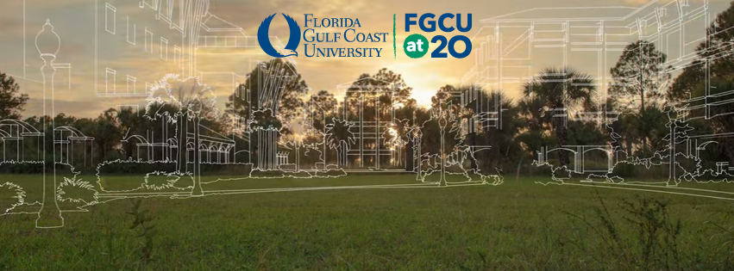
Cross-curricular integration of the Florida Gulf Coast University campus as a “living laboratory”
Brian Bovard and Win Everham
Department of Marine and Ecological Sciences

Slide 2
Cross-curricular integration of the Florida Gulf Coast University campus as a “living classroom”
Mary I. Abercrombie, Kathy Byrne-Bailey, Noemi Creagan, Dean A. Croshaw, Randall E. Cross, Nora E. Demers, Chad Evers, Laura Frost, Anna Goebel, Charles W. Gunnels IV, John Herman, Rhonda Holtzclaw, Joseph Kakareka, Simeon Komisar, Kara Lefevre, Katie Leone, James H. MacDonald, Vikki McConnell, Jessica Phillips, Ricky Pires, Mike Savarese, Heather Skala-Acosta, Brenda Thomas, Serge Thomas, S. Greg Tolley, Haruka Urakawa, Hidetoshi Urakawa, & Mary Voytek

Slide 3

What is the role of higher education?
Notes:
Train my students for their job.
But that is wrong and incomplete.
3 parts to our mission: Education
Expected to Scholarship and the devel
opment of new knowledge and insight.
Obligation to serve the community
Not trying to get their first job but instead teaching critical thinking, effective communication, problem solving skills to make them responsible citizens and help prepare them for their second job.
Service required of students
Faculty: Teaching, Scholarship & Service
Students: Knowledge, Skills & Scholarship & Community Service

Slide 4
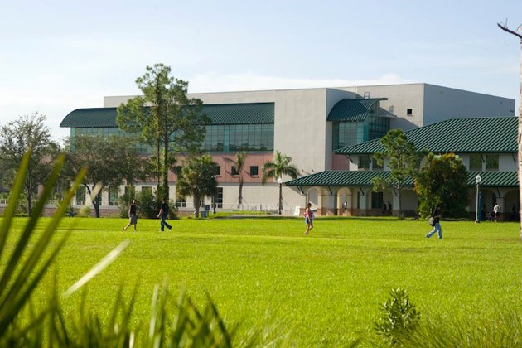
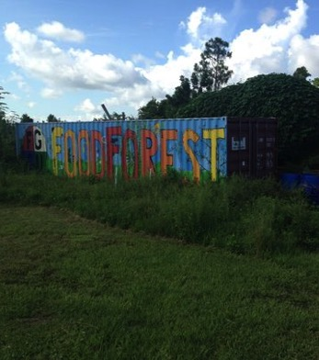
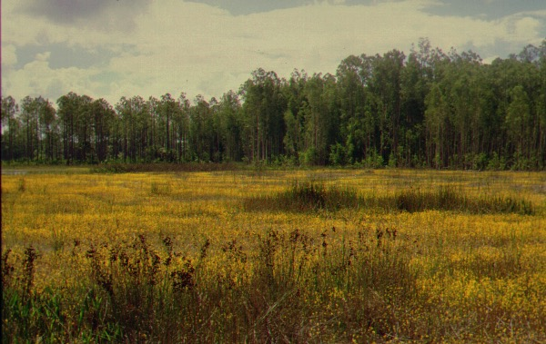
The Setting
Site: ~800 Acres of a mixture of upland and wetlands
Active restoration/mitigation program
Diversity of available habitats: marshes, lakes, swamps, hardwood hammocks, pine uplands, a food forest & urbanized novel landscapes
Location: One of the fastest growing populations in the country – including our campus!
From ~2500 students in 1997 to ~15,000 today

Slide 5
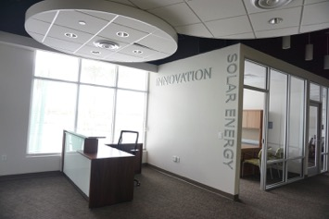
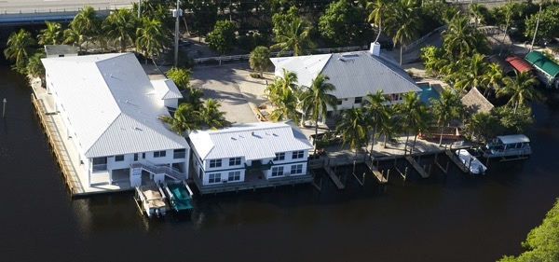
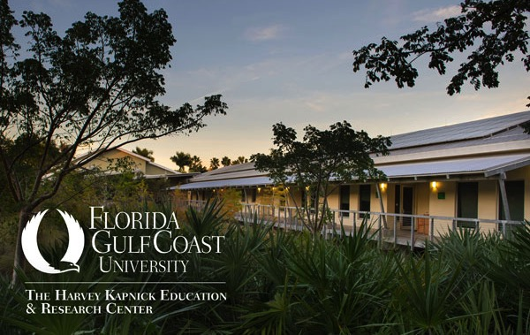
The Setting
Auxiliary Campuses:
Vester Marine and Environmental Science Research Field Station, Bonita Springs
Naples Botanical Garden Kapnick Center (Everglades Wetland Research Park), Naples
Emerging Technologies Institute, Fort Myers

Slide 6
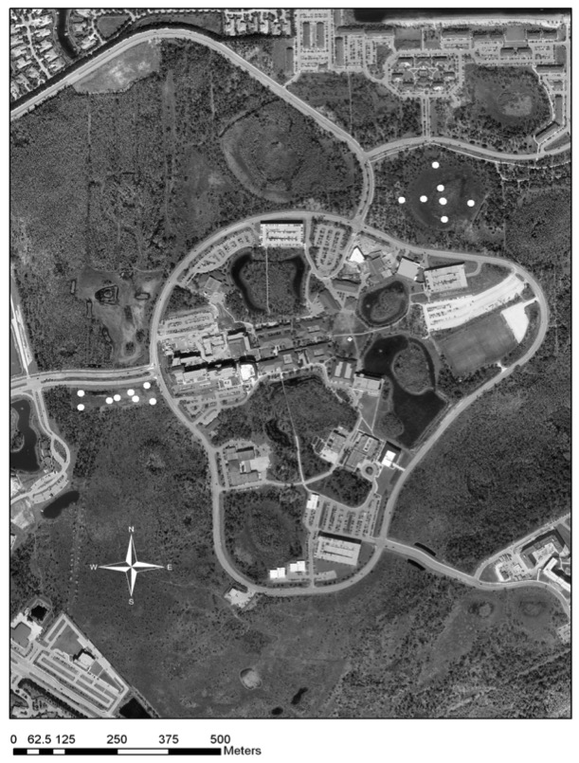
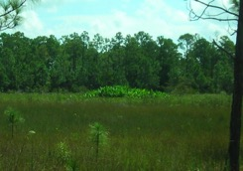
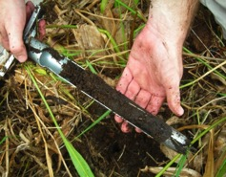
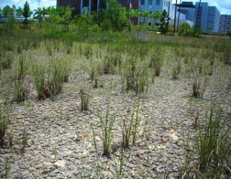
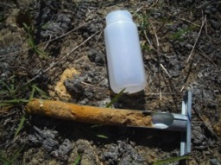
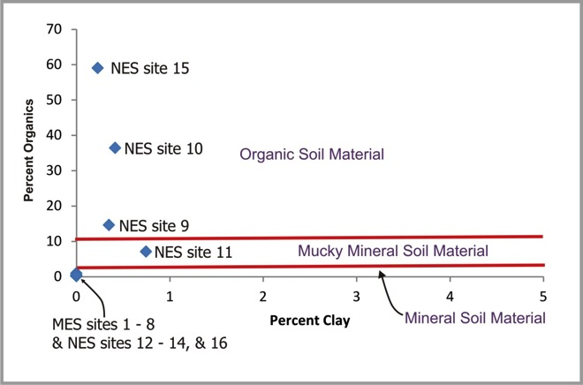
Comparison of soil quality of constructed wetlands vs. enhanced natural wetlands at FGCU
Test Site Locations
12
11
Natural
(NES)
13
10
16
Alligator flag (left) and organic soil sample (right) from the middle of the natural site (NES)
14
9
15
8
7
2
1
4
3
6
5
Constructed
(MES)
Exposed soil (left) and oxidized, organic deficient mineral soil sample (right) from the constructed wetland site (MES)
Soil quality of the constructed wetlands on the FGCU campus are poor compared to natural wetlands (Foster et al., 2008). Constructed wetland soils are organic deficient “mineral soils” at the studied site.
Wetland Soils Graph Modified From Mitsch and Gosselink (2000; after NRCS 1998)
Notes:
Siting of university was contraversial
Ongoing restoration

Slide 7
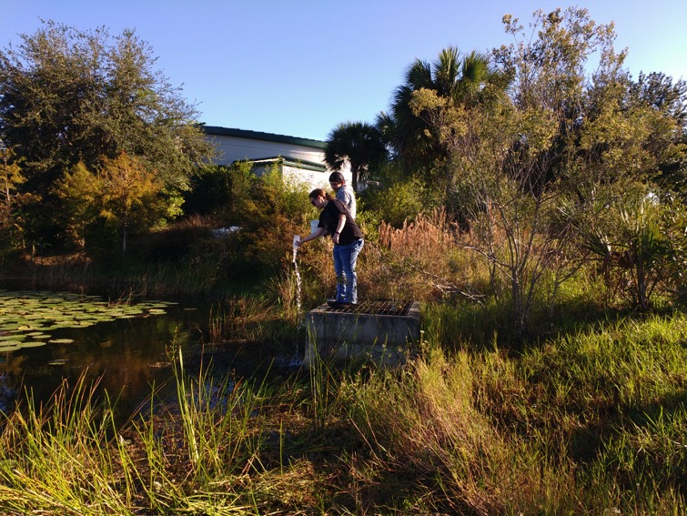
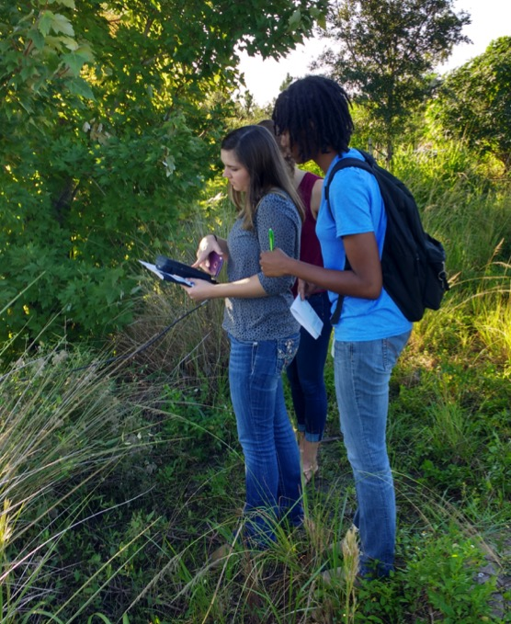
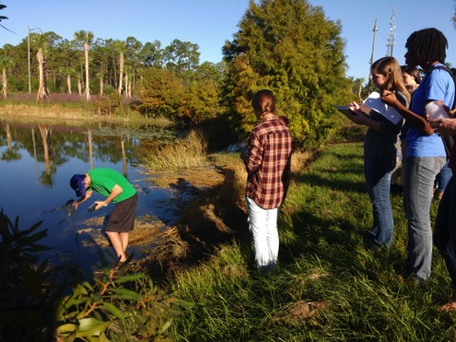
Environmental Chemistry

Slide 8
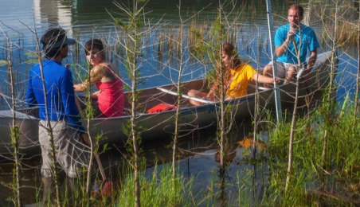
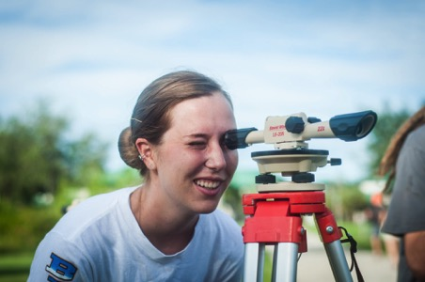
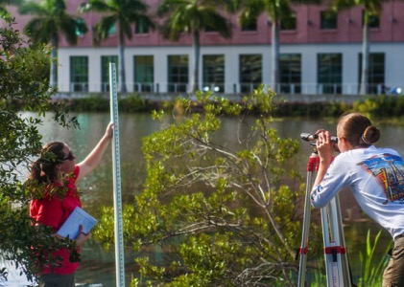
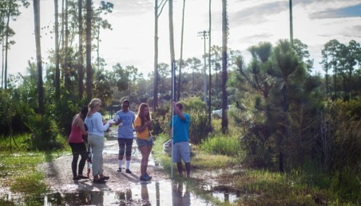
Limnology: Bathymetry
Hydrology & Ecohydrology:

Slide 9
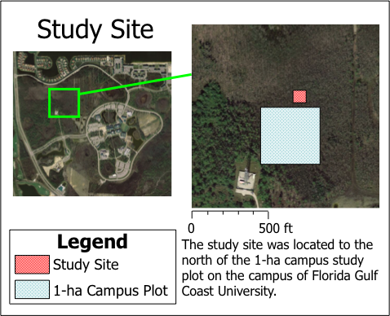
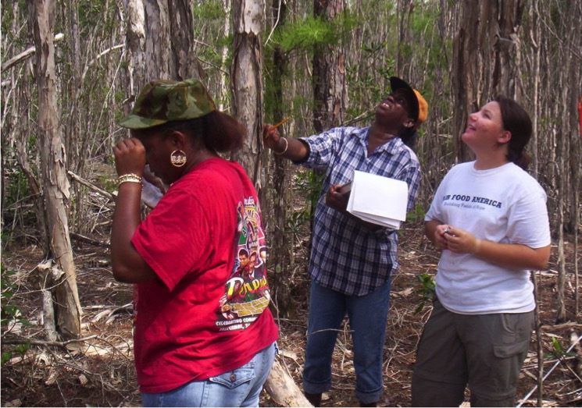
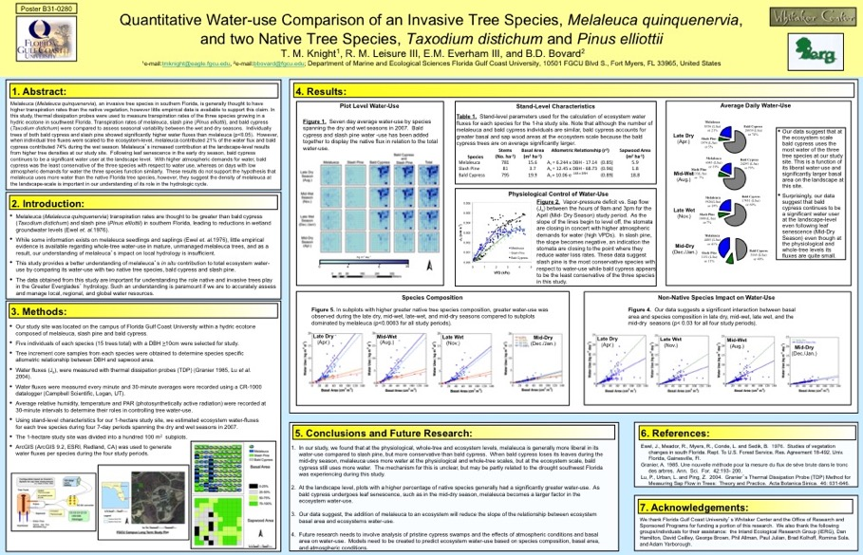
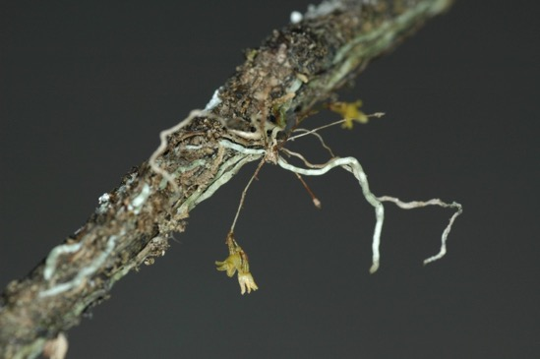
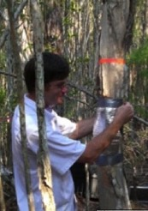
Long Term 1-Ha Study Plot

Slide 10
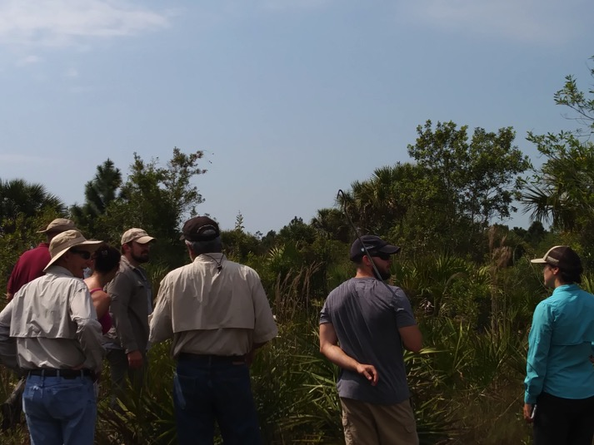
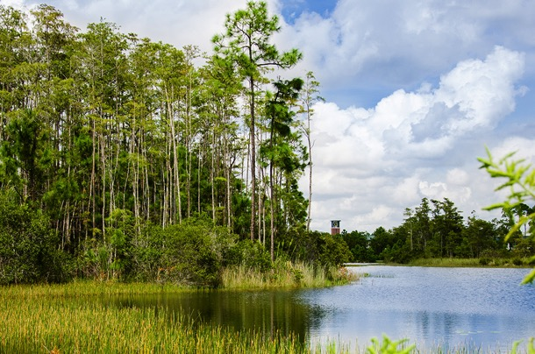
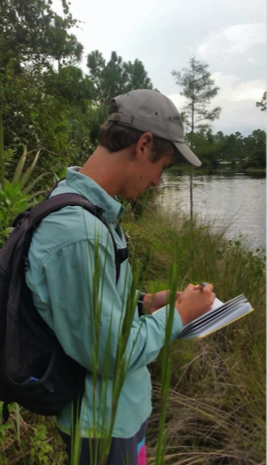
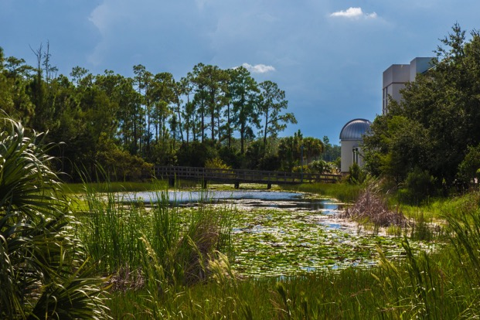
Snake Radio Tracking
Bird Diversity
Notes:
Motus network towers on campus to track any birds with nanotechnology in bird bands
Exploring boundaries of new technologies

Slide 11
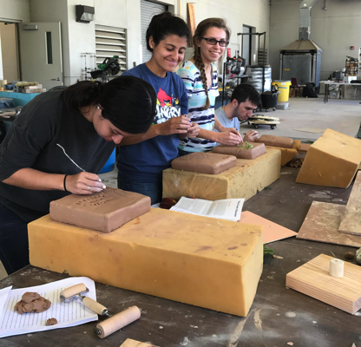
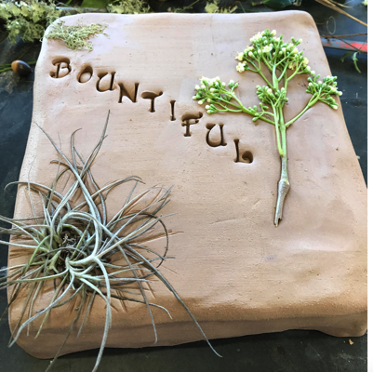
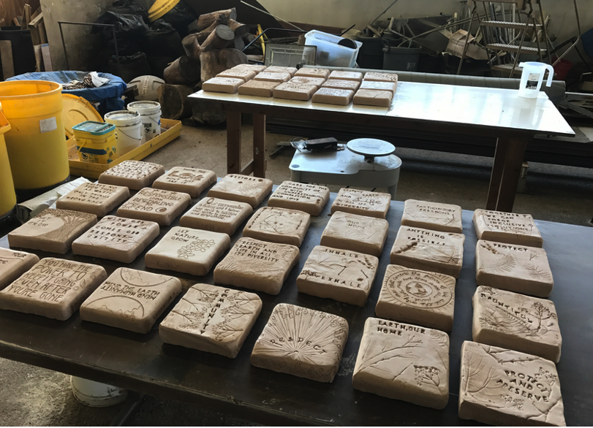
Ceramics Program
Ceramic Stepping Stones
Tied to the Earth Charter
Plants from campus used to create textures in the clay.
Informal Teaching

Slide 12
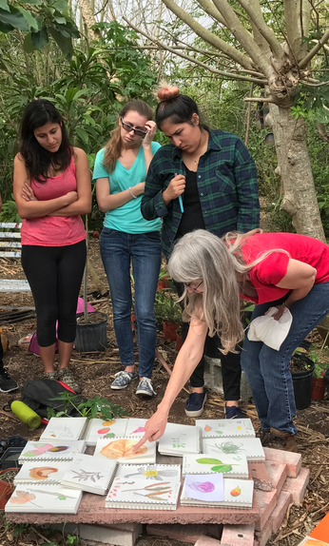
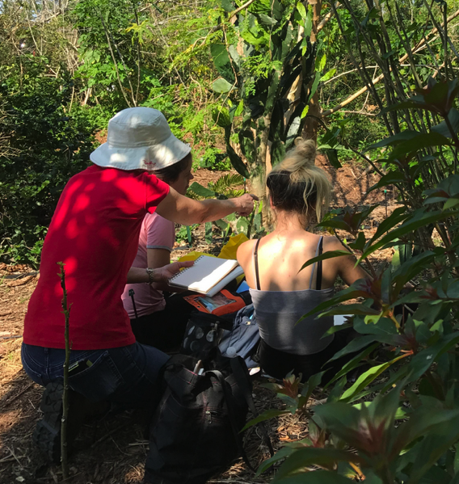
Observational Drawing
In the Food Forest
Permaculture

Slide 13
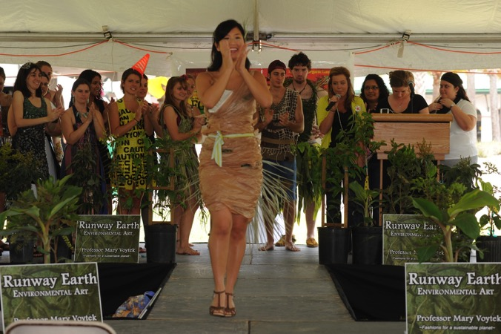
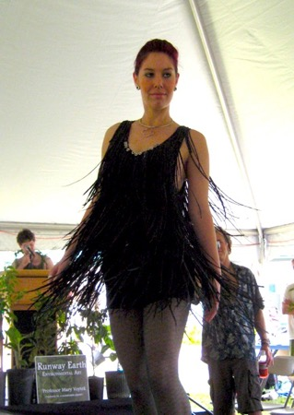
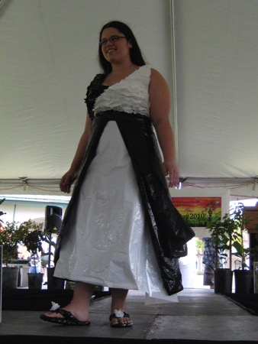
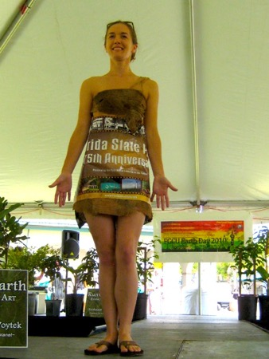
Runway Earth Fashion Show at FGCU Earth Day Festival
Plastic Grocery
Bags
State Park
Posters
Tires
Plastic Garbage Bags

Slide 14
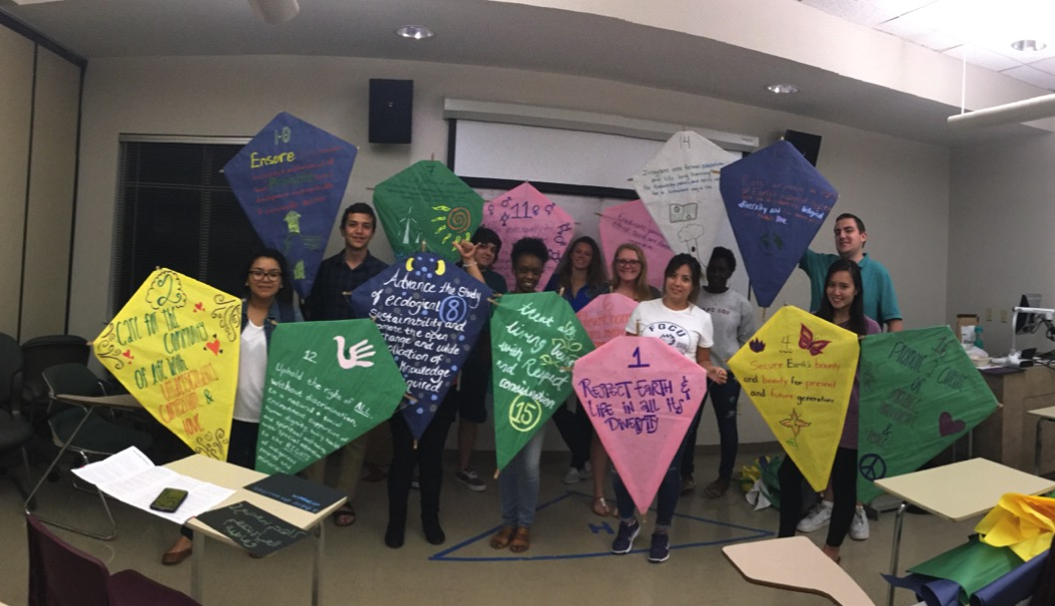
Service Learning with the Environmental Health and Safety Dept.
Earth Day Earth Charter Kites

Slide 15
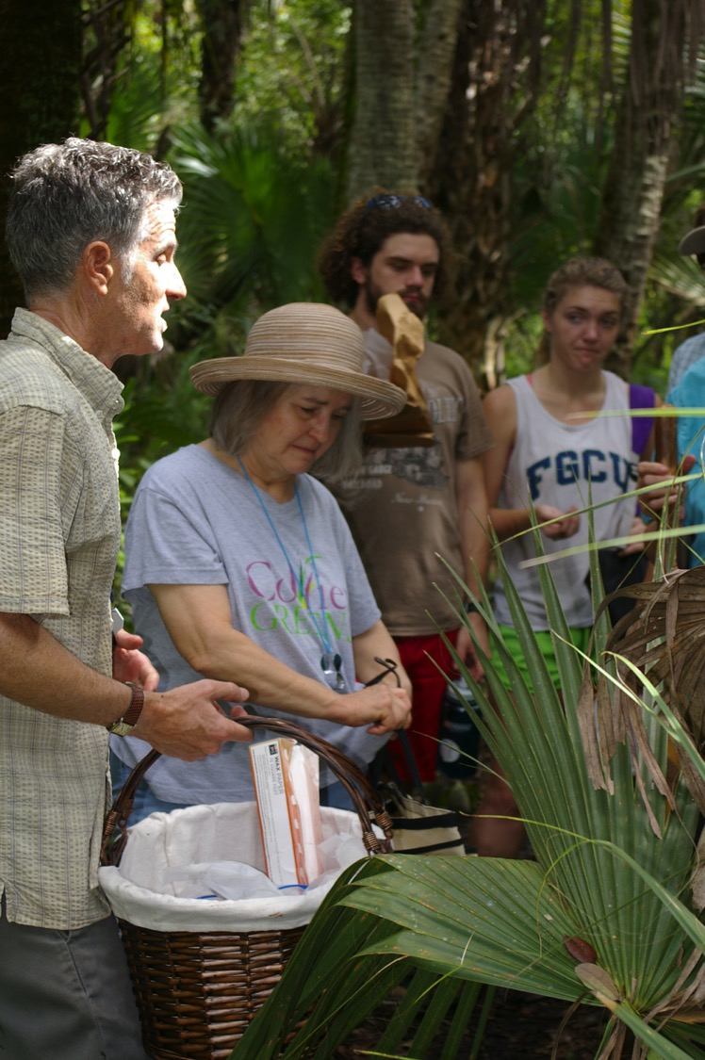
Fungus Foray

Slide 16

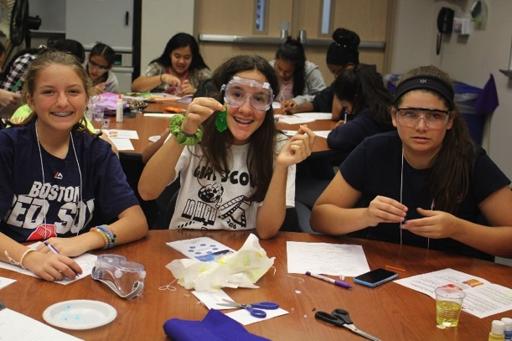
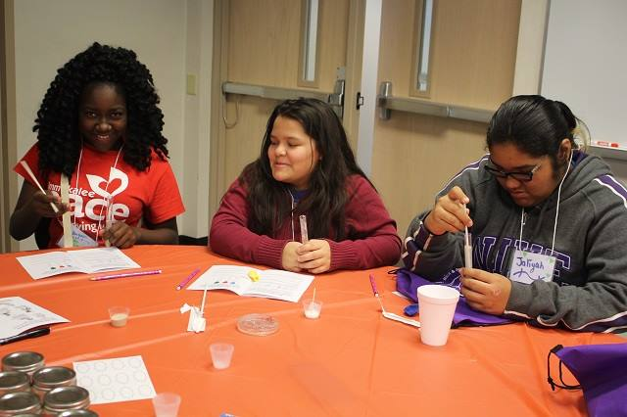
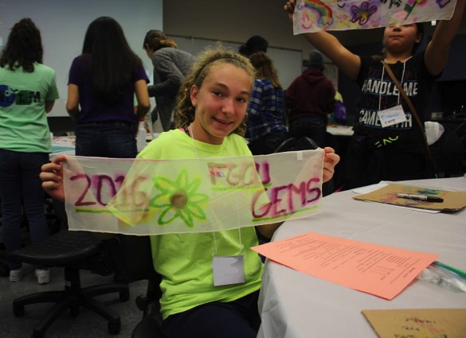
Girls in Engineering, Math, and Science (GEMS)
Notes:
This is a Saturday program for middle school girls that we run 4x during the school year with hands on activities to encourage girls in STEM. Some activities that we have run that connect students to the environment have been: recycling (Jessie Phillips), don’t be afraid of sharks (Rookery Bay partners), food webs (Heather Skaza-Acosta), microbiomes (FGCU student), silkworm life-cycle and dissection (FGCU student)

Slide 17
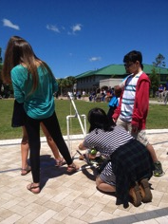
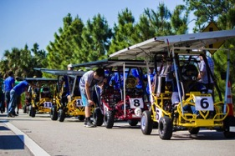
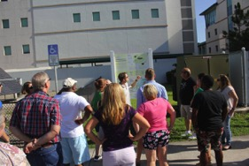
Other Whitaker Center STEM Activities Using our campus as a classroom:
K-12 Programs:
Middle School Summer Research Opportunity (SRO) Lee/Charlotte & Collier County
High School Summer Research Opportunity (SRO)
STEM@Work-Forensic Anthropology & WCE
SunChase - FGCU High School Solar Go-Kart Challenge
SunChase - Elementary and Middle School Solar Car Challenges
K-12 Educator Programs:
Schulze Summer STEM Institute Workshop for K-12 Teachers
Notes:
This is a Saturday program for middle school girls that we run 4x during the school year with hands on activities to encourage girls in STEM. Some activities that we have run that connect students to the environment have been: recycling (Jessie Phillips), don’t be afraid of sharks (Rookery Bay partners), food webs (Heather Skaza-Acosta), microbiomes (FGCU student), silkworm life-cycle and dissection (FGCU student)

Slide 18
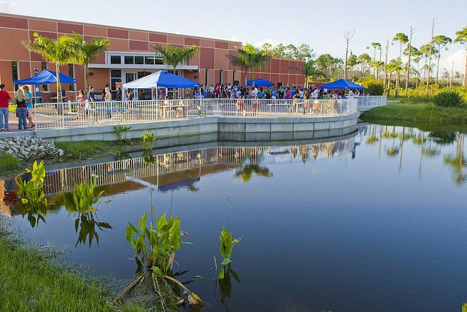
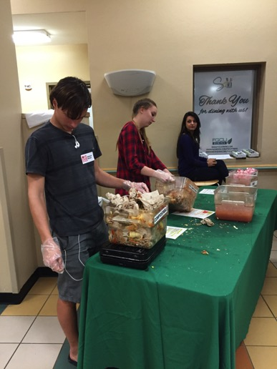
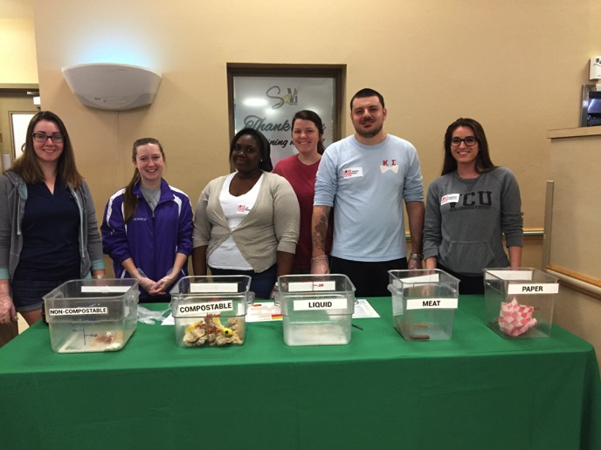
Colloquium Class: Weigh the Waste Activity
https://www.youtube.com/watch?v=mSAkCK4Qfns

Slide 19
Cross-curricular integration of the Southwest Florida
as a “living laboratory”
Brian Bovard and Win Everham
Department of Marine and Ecological Sciences

Slide 20
Students on the Value of Using our Campus as a Classroom:
“… it's right next to your classroom where you can apply the concepts learned in a classroom setting. ”
“Doing research on campus is not only enjoyable but also gives insight into my career activities. It teaches me how to conduct research in a professional way. I learn from my classmates and my classmates learn from me as well. Collectively research on campus provides a full circle learning experience and helps equip me with the tools I need to pursue my goals.”
“FGCU's campus is a living learning laboratory...this means that it was built to be used as a laboratory and it was built to be the object of research inquiries. The experience of using FGCU’s campus as the object of research is very enjoyable….”
“We are very fortunate to go to a university that has endless research possibilities. That being said our school can provide students with a wide variety of research experiences.”
“…. it demonstrates what conditions you will potentially be working under in the future and gives you experience.”
“…because FGCU has a wide diversity of Florida habitats to study from. This diversity of environments can provide a plethora of interesting and informative experiments for the class to do.”

Slide 21
Students on the Value of Using our Campus as a Classroom:
We are very fortunate to go to a university that has endless research possibilities. That being said our school can provide students with a wide variety of research experiences.
FGCU's campus is a living learning laboratory...this means that it was built to be used as a laboratory and it was built to be the object of research inquiries. The experience of using FGCU’s campus as the object of research is very enjoyable….
…. it demonstrates what conditions you will potentially be working under in the future and gives you experience.
…because FGCU has a wide diversity of Florida habitats to study from. This diversity of environments can provide a plethora of interesting and informative experiments for the class to do.
Doing research on campus is not only enjoyable but also gives insight into my career activities. It teaches me how to conduct research in a professional way. I learn from my classmates and my classmates learn from me as well. Collectively research on campus provides a full circle learning experience and helps equip me with the tools I need to pursue my goals.
… it's right next to your classroom where you can apply the concepts learned in a classroom setting.

Slide 22
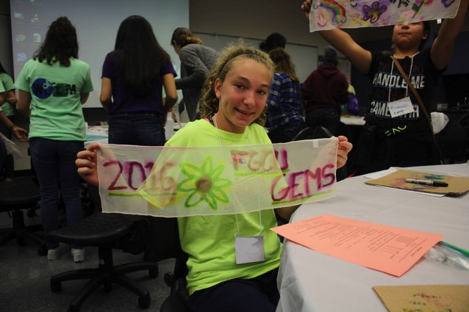
Girls in Engineering, Math, and Science (GEMS)
Notes:
This is a Saturday program for middle school girls that we run 4x during the school year with hands on activities to encourage girls in STEM. Some activities that we have run that connect students to the environment have been: recycling (Jessie Phillips), don’t be afraid of sharks (Rookery Bay partners), food webs (Heather Skaza-Acosta), microbiomes (FGCU student), silkworm life-cycle and dissection (FGCU student)

Slide 23





SRO Lee/Charlotte
Notes:
Between 25-30 students a year. This past year the FGCU outdoors was definitely featured through the Forensic Anthropology program (Dr. Walsh-Haney) who has pigs buried on campus. FYI in case you don’t get anything from her, she uses the campus semesterly as a learning lab – she has mock burial sites around campus. The middle school students were tasked with identifying, excavating, and mapping the burial sites.

Slide 24





SRO Collier
Notes:
Brian will know what to say about this.

Slide 25


K-12 Outreach
High School Summer Research Opportunity (SRO)
Held Summer 2016 AB7 Chemistry labs
Facilitators: Ju Chou and Greg Boyce, Chemistry, CAS
Water sampling for Cl⁻ content
Notes:
This is up from 2014 pilot by 4 students and 1 teacher.

Slide 26



STEM@Work - Forensic Anthropology & WCE
13 Lee County High Schools participate
7 high schools come to campus for activities in FA and Engineering during 2016-2017
Foundation for Lee County Public Schools, Lee County High School students
Notes:
This is a partnership with the Foundation for Lee County Public Schools. Lee Cty high school students come to campus and learn about engineering and Forensic Anthropology. The goal of the program is to get students thinking about STEM careers that they might not have previously considered and to also have them realize that there are opportunities in their own backyard to pursue them. For the past three years we have also hosted the wrap-up event where all 13 H.S. in Lee Cty come to campus and do an engineering blind challenge on the library lawn. May 10, 2017.

Slide 27





SunChase - FGCU High School Solar Go-Kart Challenge (5th year this year)
Notes:
5 teams, 10 teams, 12 teams, 15 teams, 12 teams
This is with the College of Engineering. High school teams are encouraged to retrofit a go kart to be powered by the sun (renewable energy – connect to the environment – is that a stretch?).
This activity brings about 500 students, teachers, and parents annually to our campus where the race is held.

Slide 28





SunChase - Elementary and Middle School Solar Car Challenges
Notes:
Part of Sunchase involves K-8 students building small solar cars and racing them. I love the excitement.

Slide 29


K-12 Educator Programming
Schulze Summer STEM Institute Workshop for K-12 Teachers
Two one-week sessions each summer
Held at the Conservancy of SW FL
Encourages teachers to develop integrated STEM lesson plans that focus on the environment.
Funded for 2016-2019 by Richard M. Schulze Foundation

Slide 30




STEM Institute 2016
Notes:
Some activities they are doing (clockwise from top) teachers learning about ozobots, little programmable robots. Teachers exploring Forensic anthropology through bone vs. non-bone identification, visit to FGCU campus itself to learn about our STEM offerings (here they are learning about the solar panels), teachers measuring irradiance with some Vernier Equipment.

Slide 31


















Assessment of agricultural runoff from the Florida Gulf Coast University Food Forest
Luka K. Ndungu¹, Haruka Urakawa¹, Irma L. Sanchez¹, Ernesto Lasso de la Vega² and Hidetoshi Urakawa¹
¹ Department of Marine and Ecological Science, Florida Gulf Coast University, Fort Myers FL 33965
² The Lee County Hyacinth Control District, Lehigh Acres, FL 33971
Introduction
Since 2011 summer, students from FGCU have been practicing agricultural activities like planting cultures tropical edible plant species adapted to the climate of South Florida. Student have been using organic manure and we wanted to either confirm or question if nutrients from the compost have effect the water quality of nearby pond. Food Forest Pond (FF) and Sugden Welcome Center Lake (SWC) are the two water bodies within Florida Gulf Coast University (Figure 1) where water samples were collected for physiochemical, nutrient and microbial community analyses.
Motivation
Among a lot of water quality studies conducted by FGCU undergraduate and graduate students, we were interested in checking microbial communities inhabiting at Food Forest Pond and Sugden Welcome Center Lake. Microorganisms play a key role for biogeochemical cycling in freshwater lake/pond environments.
Research goal
The purpose of this study is to check water quality in the Food Forest Pond comparing with Sugden Welcome Center Lake as a reference lake. This research helped to explain how water quality of Food Forest Pond has been affected by agricultural runoff from the botanical garden.
Summary
The YSI sonde data indicating that most of the parameters have less potential to cause pollution to aquatic life (Table 1).
The microbial phenotypic profiling using EcoPlates showed that bacteriplankton at FF was more active than that of SWC (Figure 3).
The nutrient results after lab quantification was generally low in all parameters tested: nitrate (NO₃) nitrite (NO₂), ammonia (NH₄) and phosphorus (P) (Figure 4).
After the extraction of DNA from water samples (250 mL) , the composition of bactrialplankton was determined using a high-throughput sequencing technique targeting the 16S rRNA gene (Figure 6A & B). Both profiles were similar and dominated by Betaproteobacteria. About 10% of bacterioplankton was Cyanobacteria.
FIG 2: Food Forest soil temperature (6 in) and Welcome Center pond water temperature in relation to precipitation during sampling days (arrow). Precipitate data was obtained from FGCU weather station for the entire period this research was conducted.
Table 1: Water quality parameters obtained using YSI sonde from August to November 2016
seasons | sample site | date | Time | Temp (°C) | salinity | pH | DO % | DO _{mg/L} | Chl a (µg/L) | turbidity (NTU) | Cond (µs/cm) | TDS (mg/L) | CDOM
wet season | FF | Aug 24 2016 | 1506 | 32.5 | 0.17 | 7.64 | 91.8 | 6.64 | 1.61 | ND | 420.5 | 239.2 | 329.9
 | SWC | Aug 24 2016 | 1437 | 32.2 | 0.29 | 8.08 | 85.3 | 6.20 | 1.17 | ND | 683 | 390 | 536.5
 | FF | Sep 12 2016 | 0848 | 28.5 | 0.17 | 7.11 | 18.00 | 1.36 | 1.98 | ND | 380.5 | 231.6 | 306.1
 | SWC | Sep 12 2016 | 0913 | 30.1 | 0.23 | 7.39 | 74.43 | 5.66 | 0.25 | ND | 537 | 318.5 | 427.8
 | FF | Sep 16 2016 | 15:28 | 32.5 | 0.23 | 8.09 | 90.7 | 6.51 | ND | ND | 480 | ND | ND
 | SWC | Sep 16 2016 | 15:38 | 31.1 | 0.17 | 7.96 | 92.1 | 6.83 | ND | ND | 365 | ND | ND
 | FF | Sep 20 2016 | 1455 | 31.9 | 0.26 | 7.62 | 73.90 | 5.20 | 1.51 | 6.35 | 602.3 | 355.3 | 321.3
 | SWC | Sep 20 2016 | 1437 | 30.6 | 0.24 | 7.80 | 79.06 | 5.73 | 1.72 | 9.47 | 582.7 | 335.8 | 309.3
dry season | FF | Oct 12 2016 | 1405 | 27.4 | 0.17 | 7.60 | 50.63 | 4.00 | 2.42 | 0.37 | 375.8 | 233.90 | 203.4
 | SWC | Oct 12 2016 | 1420 | 23.16 | 0.25 | 7.74 | 63.17 | 4.65 | 1.47 | 0.86 | 533 | 331.5 | 288.5
 | FF | Oct 26 2016 | 0953 | 23.1 | 0.17 | 7.33 | 30.03 | 2.73 | 1.16 | 1.11 | 353.3 | 238.6 | 197.7
 | SWC | Oct 26 2016 | 0930 | 23.9 | 0.28 | 7.44 | 54.77 | 4.60 | 2.1 | 3.54 | 558.3 | 370.5 | 310.8
 | FF | Nov 14 2016 | 0908 | 23.6 | 0.18 | 7.43 | 40.07 | 3.38 | 0.13 | 3.87 | 373.2 | 249.4 | 208.8
 | SWC | Nov 14 2016 | 0935 | 23.6 | 0.32 | 7.5 | 57.3 | 4.87 | 0.02 | 3.7 | 635.3 | 424.8 | 354.6
A
B
A
B
C
FIG 4: Nitrate (A) and soluble reactive phosphorus (B) concentration.
A
A
FIG 5: (A) The relationship of temperature (C°) and dissolved oxygen (mg/L) , the two circles show the dry and wet season. The left circle represent dry season and right circle represents wet season. (B) Data from Conductivity µs/cm and TDS mg/L. (C) The percentage of dissolved oxygen in two seasons (Dry and wet).
D
FIG 1: The Google earth image of FGCU including locations of sampling site (A), Food Forest botanical garden site located near Food Forest Pond (B), The arrow shows a ditch of agricultural runoff from Food Forest botanical garden to the pond (D), Sugden welcome center located neighboring Food Forest (D).
A
B
Methods
Field work
Water samples measurements will be conducted from Food Forest Lake and Sugden Welcome Lake.
samples will be collected twice a month from two stations, for four months. From August to November 2016
Water Samples collection will be conducted within two seasons; by the end of wet season and the beginning of dry season.
Samples will be collected on surface less than 10 meters from the land by use of plastic bucket hand thrown to the lake.
The YSI data sonde was dipped on the pond and 2 minutes allowed for parameter to stabilize before recording water quality
The microbial community water sample was collected on sterile 50mL centrifuge before transported to the laboratory for analysis.
One sample taken to the Lee County Hyacinth Control District, in Lehigh Acres for analysis.
Laboratory analysis
Nutrients were measured using spectrometer for analysis between Food forest and Welcome Center; Nitrate using wave length 400nm, Nitrite using wavelength 507 nm, Ammonia using wavelength 655 nm and phosphorus using wavelength 530 nm .
Chlorophyll a and turbidity were also measured by used of spectrometer .
Microbial community were inoculated onto Biolog EcoPlates and incubated for 48 hours before recording the results.
B
B
C
FIG 6: The composition of bacterioplankton at Food Forest Pond (A) and Sugden Welcome Center Lake (B).
C
CONCLUSION
The assessment of water quality in Food Forest Pond and Welcome center Lake was beneficial in identifying if the agricultural runoff from botanical garden have any effect to the pond. Even though there was evidence of runoff flushing to Food Forest Pond during wet season, there was no significance water pollution resulting from compost manure used by the students. With a high-throughput sequencing analysis for the composition of bacterioplankton, the result was promising that the Food Forest Pond receives no remarkable runoff impact from the botanical garden.
FIG. 3: Numbers of positive EcoPlate wells (A) and the utilization patterns of each substrate on the EcoPlate: Food Forest Pond (A) and Sugden Welcome Center Lake (B).

Slide 32



Microbial Ecology and Coliform Analysis

