Slide 1

239-590-1414
ehs@fgcu.edu
www.fgcu.edu/ehs

Slide 2
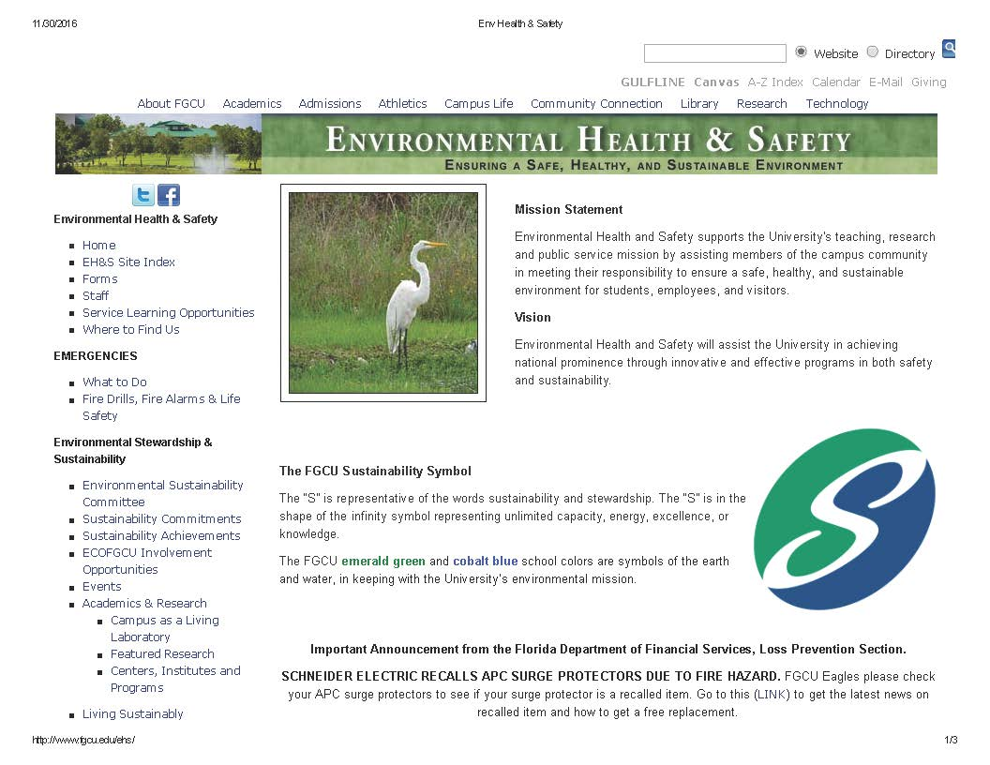

Slide 3
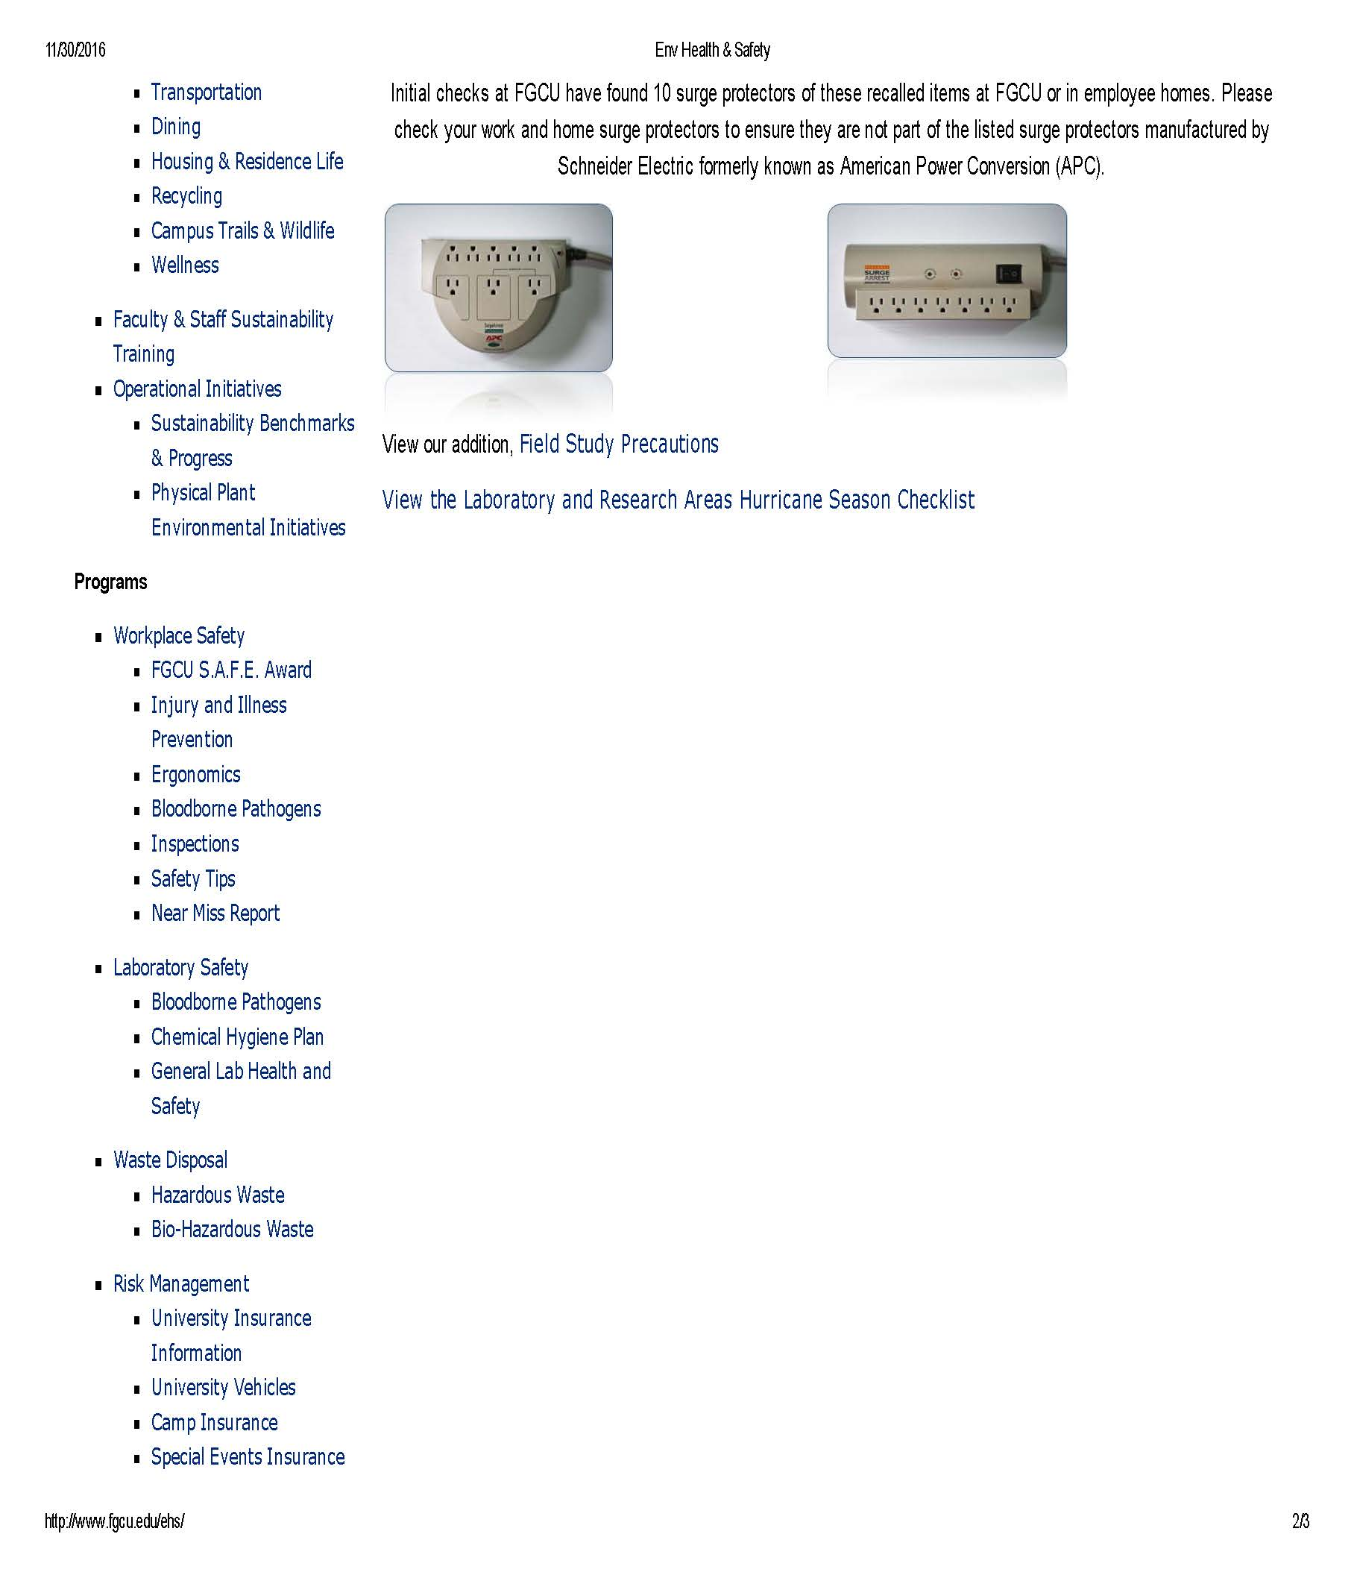
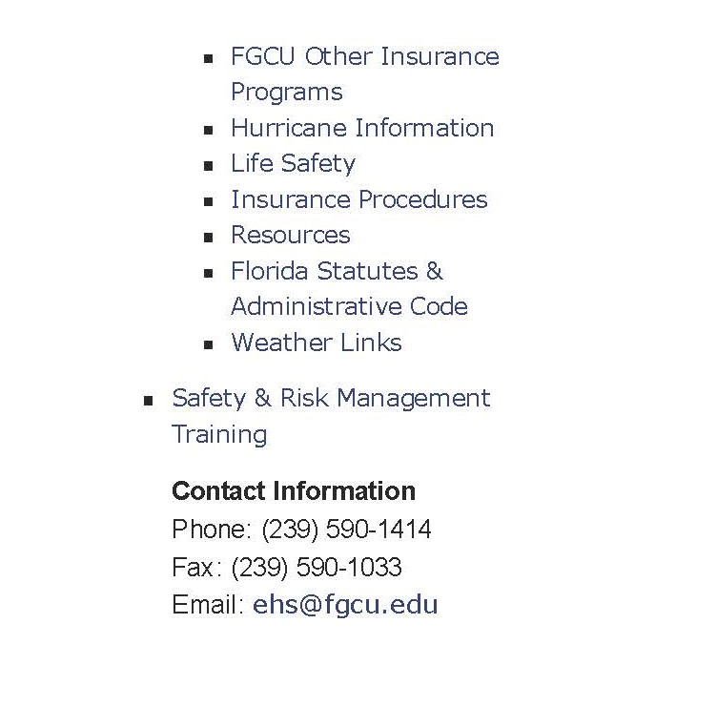

Slide 4

Campus Emergencies
If you have an on-campus EMERGENCY requiring assistance for fire or ambulance, call 911 without delay.
Be aware of your surroundings, and report any suspicious activities.
Be informed and prepared in advance. Don’t wait until an emergency strikes to know what to do.

Slide 5
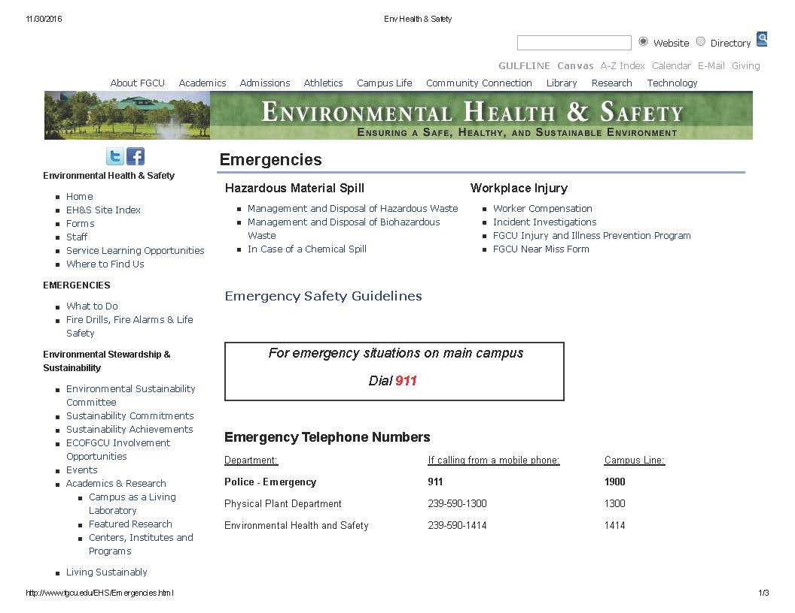
What to Do
Click here
Notes:
Clicking on “What to do” brings up this page of information

Slide 6
Workers’ Compensation
In a medical emergency, call 911
And immediately call AmeriSys at 1-800-455-2079 to report the claim.
If the injury is not an emergency, the supervisor should immediately report the claim to AmeriSys.
Whenever possible, have the injured employee present with the supervisor when the claim is reported.
Additional info: http://www.fgcu.edu/HR/workcomp2.html
Notes:
Worker’s comp is handled by HR

Slide 7
Workplace Injuries
All workplace injuries also require completion of a Workplace Hazard Investigation Report
Available on the EH&S website: http://www.fgcu.edu/EHS
Additional info: http://www.fgcu.edu/EHS/Emergencies.html
Notes:
All workplace injuries also require completion of a Workplace Hazard Investigation Report
This form is available on the EH&S website. http://www.fgcu.edu/EHS http://www.fgcu.edu/EHS/Emergencies.html

Slide 8
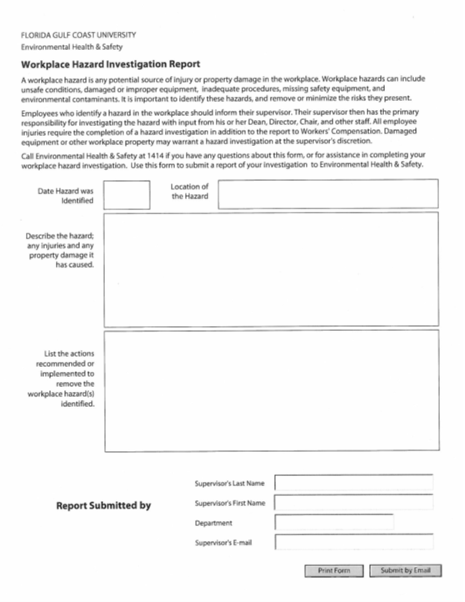
Workplace Hazard Investigation Report
A simple on-line form
What was the date and location?
Describe the hazard.
An investigation is required to determine the root cause of the incident, so we can prevent it from happening again.
Notes:
A simple on-line form – what was the date, and the location? Then describe the hazard. And it does require an investigation into the root cause of the incident.
While at work, employee slipped and fell in a puddle of water in the kitchen. This caused injury to her left shoulder.

Slide 9
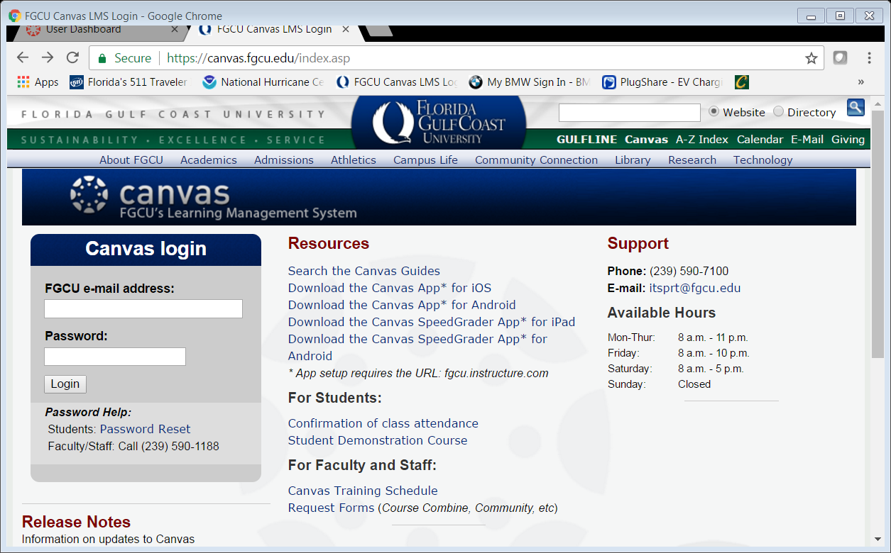

Slide 10
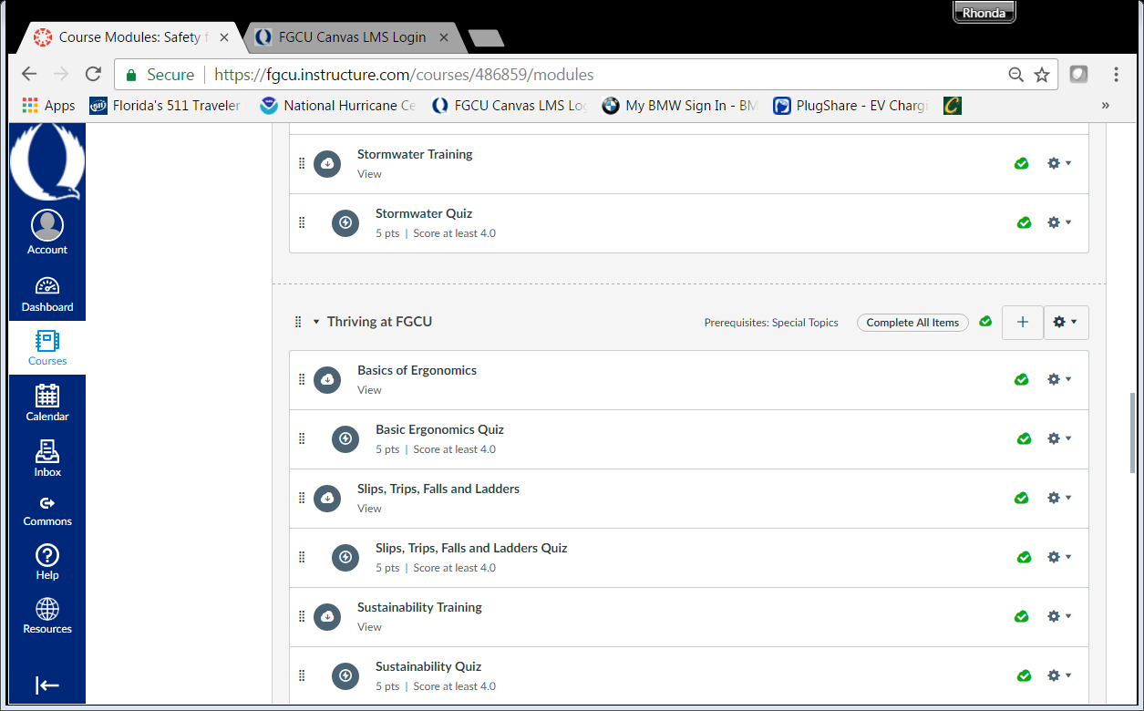

Slide 11
Environmental Management
Notes:
As you all know, in Fl, we are surrounded by water, so it is very important that we not contaminate our lakes, bays, rivers, or other wetlands.

Slide 12
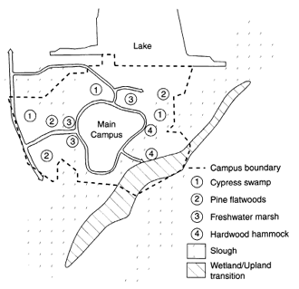
Storm Water Management
Florida Gulf Coast University is part of a regional watershed that eventually spills into the Estero Bay, and joins the Gulf of Mexico.
This watershed helps maintain healthy estuaries and a healthy bay.
FGCU
More information: http://www.fgcu.edu/CAS/CEM/watershed.html

Slide 13
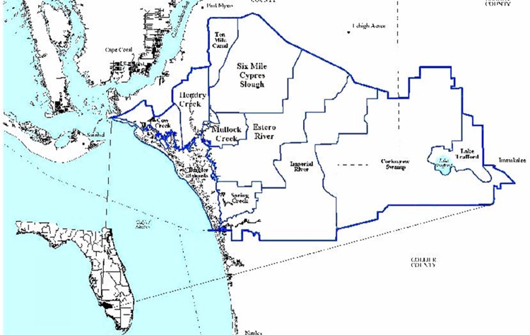
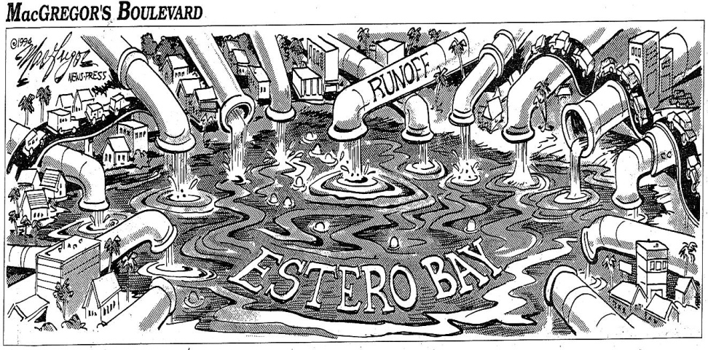
The Estero Bay Watershed. The water that falls on the approximately 200,000 acres of land finds its way to Estero Bay.
Notes:
The Estero Bay Watershed. The water that falls on the approximately 200,000 acres of land that make up the Estero Bay watershed finds its way to Estero Bay. This is why it is so important to protect the lands surrounding our bays.
Estero Bay Preserve State Park, at present, manages approximately 10,000 acres of land surrounding Estero Bay to protect the waters of the bay. In addition to the state lands that buffer and protect the aquatic preserve Lee County, US Fish and Wildlife and private land acquisition groups also own lands within the watershed that serve to protect the bay.

Slide 14
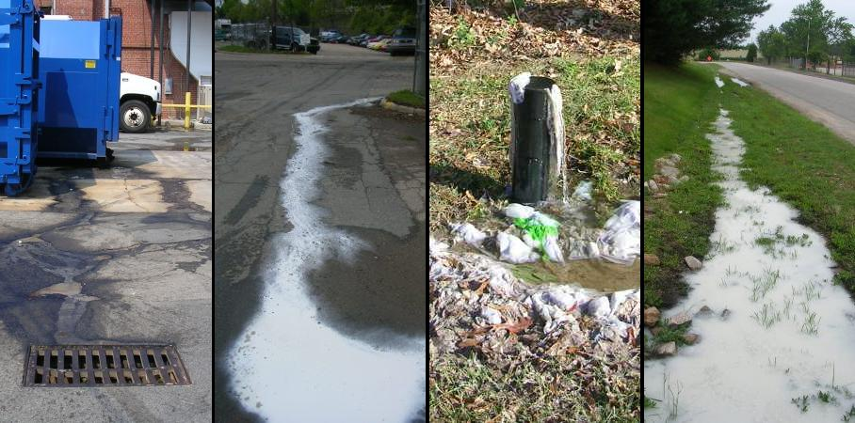
Help Stop Illicit Discharging
What is illicit discharging?
Any discharge that enters the storm drains that is not entirely composed of stormwater

Slide 15
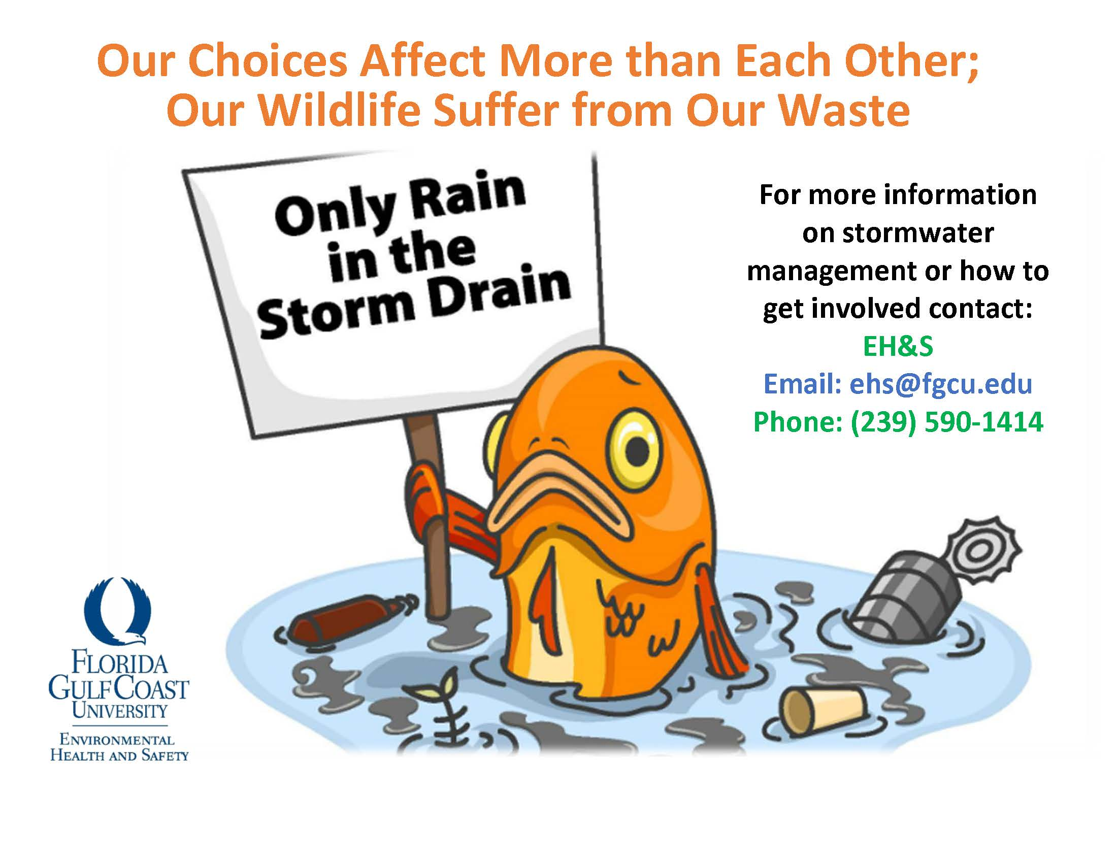

Slide 16
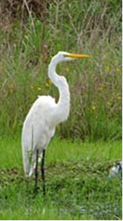
Environmental Management Goal
Avoid human and environmental exposure.
The University will manage all waste with the goal of continuing as a Conditionally Exempt Small Quantity Generator of hazardous waste.
Notes:
FGCU shall take every precaution against hazards normally associated with handling and disposal of hazardous chemicals and wastes to avoid human and environmental exposure.

Slide 17
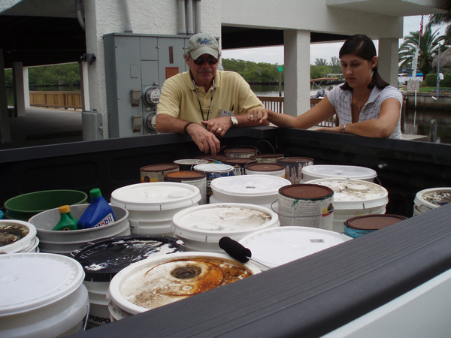
…that pose a hazard to human health or the environment
Notes:
Hazardous waste poses a hazard to human health or the environment. This may be reagents from a science lab or things found in any home, such as pesticides and herbicides, oil-based paints and stains, automobile fluids (antifreeze, motor oil, transmission, steering and brake fluids, gasoline), batteries (automotive and household), pool chemicals, or cleaning agents. They are all regulated by the USEPA and the FL DEP.

Slide 18

Waste Minimization Techniques
Purchase small quantities
Only purchase what you need
Check with others before you buy
Share extras
Reuse and recycle materials
Notes:
Purchase small quantities / only purchase what you need – Check with other areas on campus to see if they have what you need, and share your extras. Reuse and recycle materials where practical.

Slide 19

The 5 things you really need to know
Pay attention to ingredients in things you use.
Buy only what you need.
Recycle wherever possible.
Ensure you and others are aware of any hazards associated with with the products being used.
Call EH&S for pick-up and questions.
Notes:
Identify potential hazardous wastes in your area; Minimize wastes where possible; Train people handling hazardous substances;

Slide 20

Know what hazards are present in your work area
Use your personal observations—such as visual appearance or smell to detect the presence of a hazardous chemical in your environment.
Especially if you have an obvious one – like gasoline or xylenes – know what is normal to smell, and what isn’t.
Appearance or smell-
Normal?
Notes:
Training should include Methods and observations—such as visual appearance or smell—workers can use to detect the presence of a hazardous chemical to which they may be exposed. Especially if you have an obvious one – like gasoline or xylenes – make people understand what is normal for them to smell, and what isn’t.

Slide 21
Wear appropriate personal protection
Use engineering controls:
hoods, cabinets, safety cans, trays
Understand your work practices:
operating procedures
Use personal protective equipment (PPE):
safety glasses, lab coats, gloves, boots..
Wear appropriate attire for the job

Slide 22

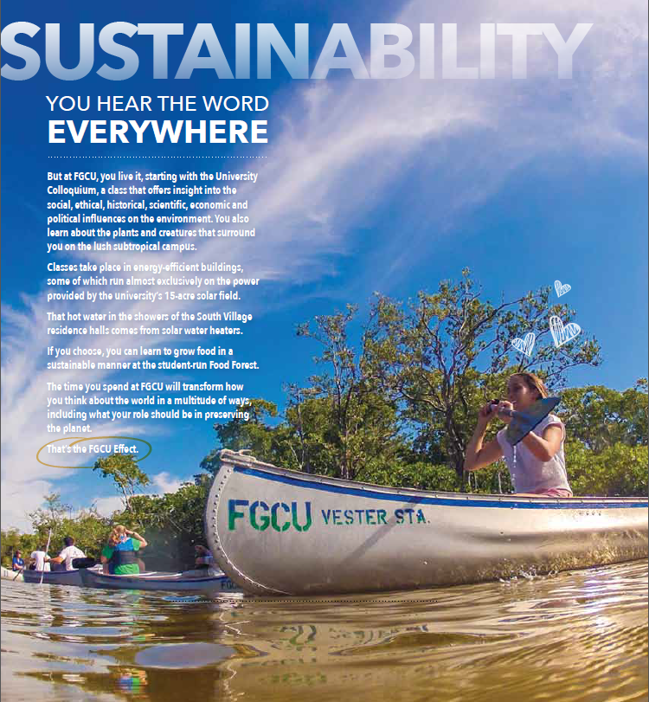
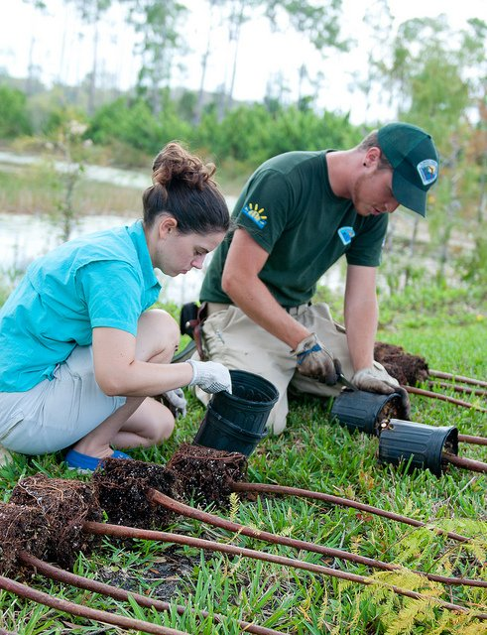

Slide 23

What is sustainability?
to Higher Education?
to your job functions at FGCU?

Slide 24
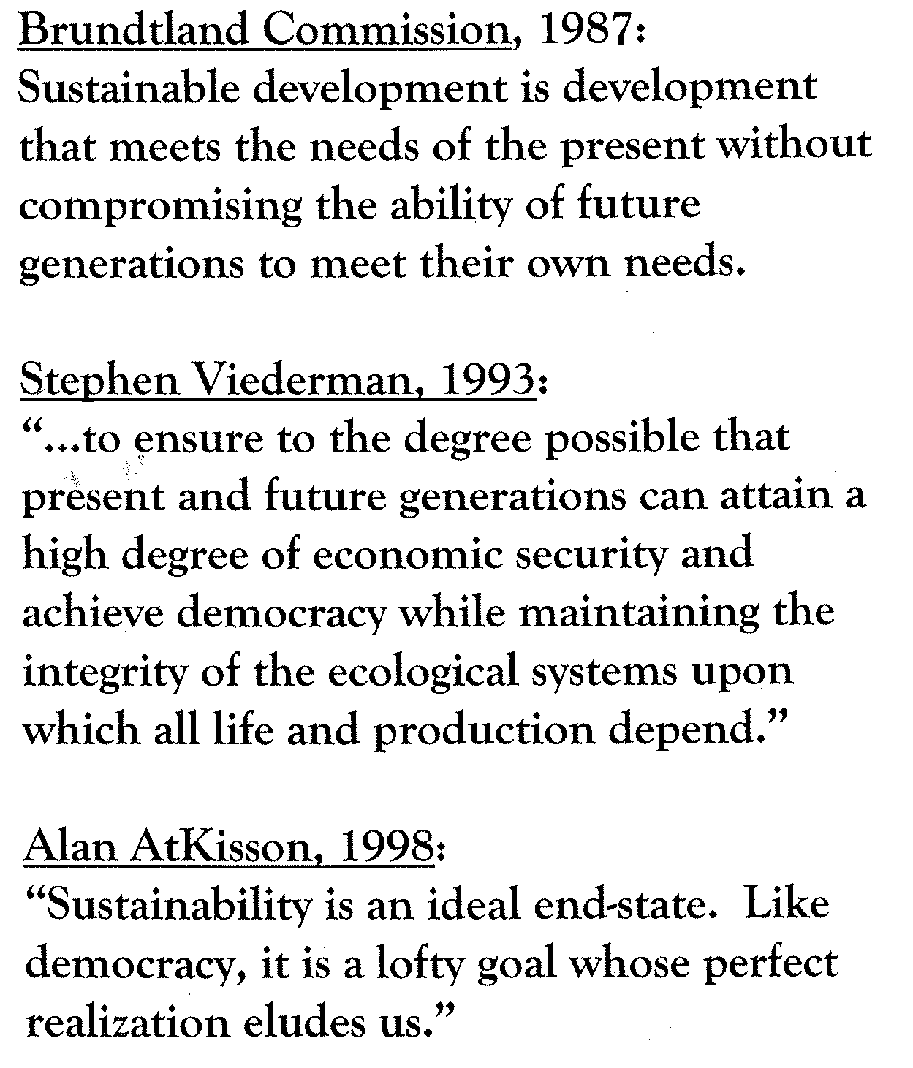
Common definitions of sustainability
People
Planet
Profit
Environment
Society
Economy
The Earth Charter, 2000:
“declaration of fundamental ethical principles for building a just, sustainable and peaceful global society in the 21st century.”

Slide 25
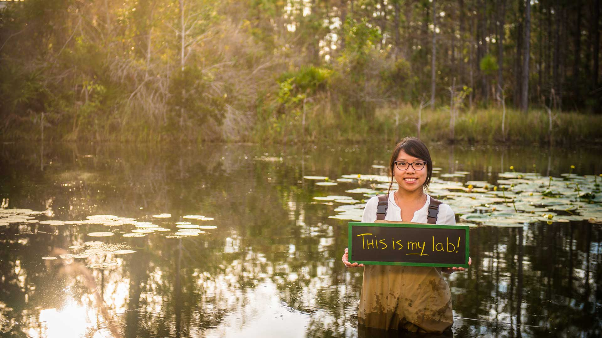
What is higher education’s role in contributing to a sustainable society?
Prepare students to solve the most pressing sustainability challenges
Model innovative solutions through campus operations, buildings and infrastructure, and business practices

Slide 26
Sustainability in Higher Education
Curriculum
University
Operations
Research
Neighborhood
& Community

Slide 27


Sustainability & Environmental Stewardship
A key tenant of FGCU’s mission, vision, and guiding principles
Our institutional DNA
Notes:
Vision: “FGCU emphasizes innovative, student-centered teaching and learning, promotes and practices environmental sustainability, embraces diversity, nurtures community partnerships, values public service, encourages civic responsibility, and cultivates habits of lifelong learning and the discovery of new knowledge.”
Mission: “FGCU emphasizes innovative, student-centered teaching and learning, promotes and practices environmental sustainability, embraces diversity, nurtures community partnerships, values public service, encourages civic responsibility, and cultivates habits of lifelong learning and the discovery of new knowledge.”
Guiding Principles: “Student success is at the center of all University endeavors…”
“…expects civility and mutual respect to be practiced in all deliberations.”
“Diversity is a source of renewal and vitality. The University is committed to developing capacities for living together in a democracy whose hallmark is individual, social, cultural, and intellectual diversity. It fosters a climate and models a condition of openness in which students, faculty, and staff engage multiplicity and difference with tolerance and equity.”
“Informed and engaged citizens are essential to the creation of a civil and sustainable society…. Through service learning requirements, the University engages students in community involvement with time for formal reflection on their experiences. Integral to the University's philosophy is instilling in students an environmental consciousness that balances their economic and social aspirations with the imperative for ecological sustainability.”

Slide 28

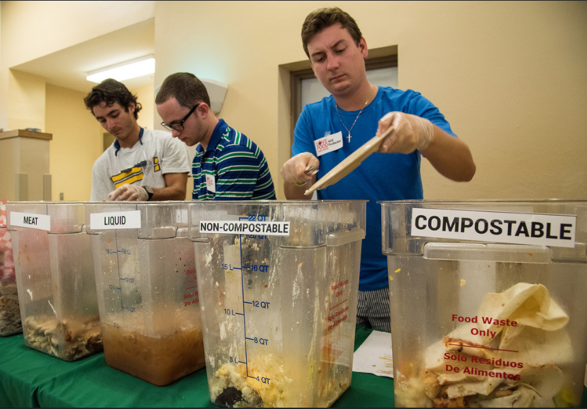
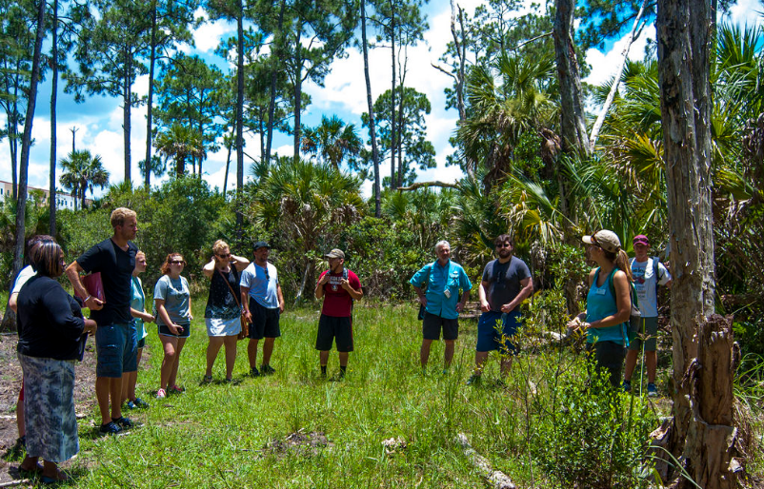
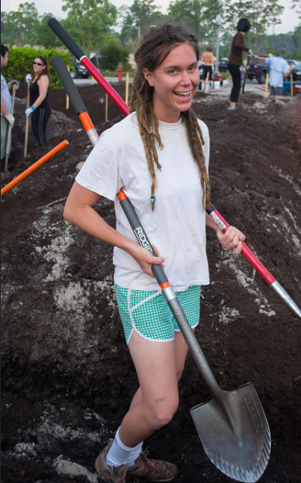
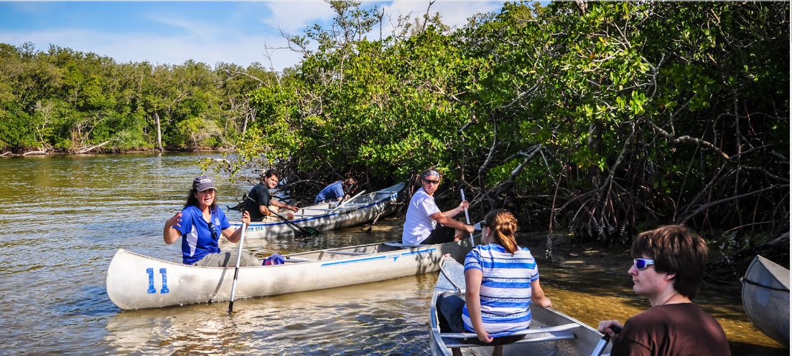
Sustainability milestones at FGCU
Notes:
From our founding, FGCU established a focus on environmental sustainability, service-learning, and civic engagement. All students must successfully complete the University Colloquium, FGCU’s signature course on sustainability, and complete 80 hours of service in order to graduate.

Slide 29
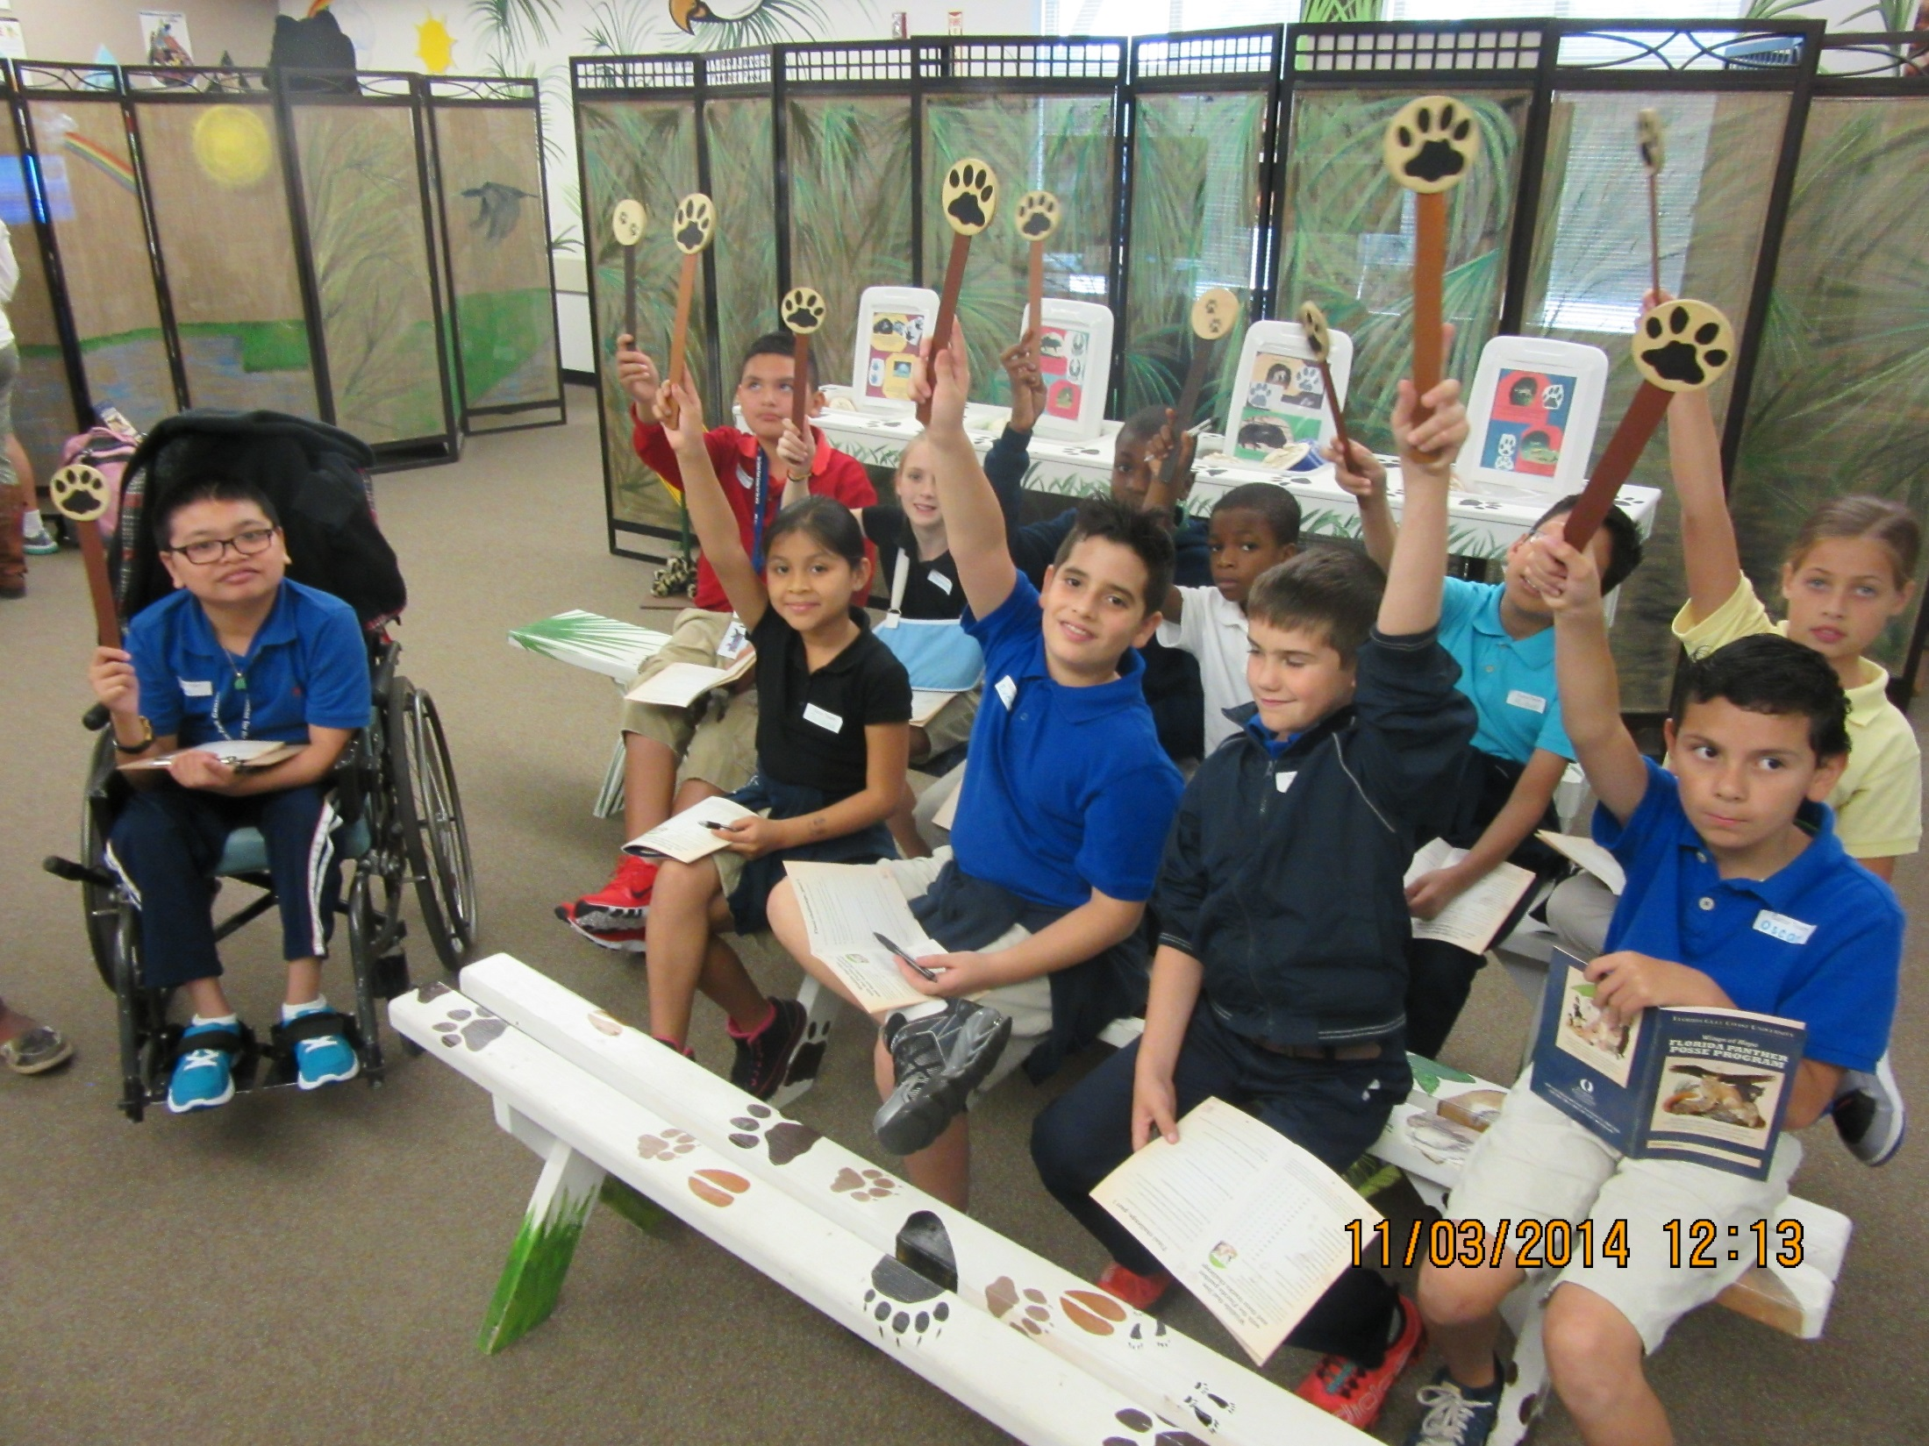
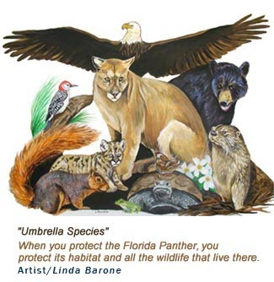
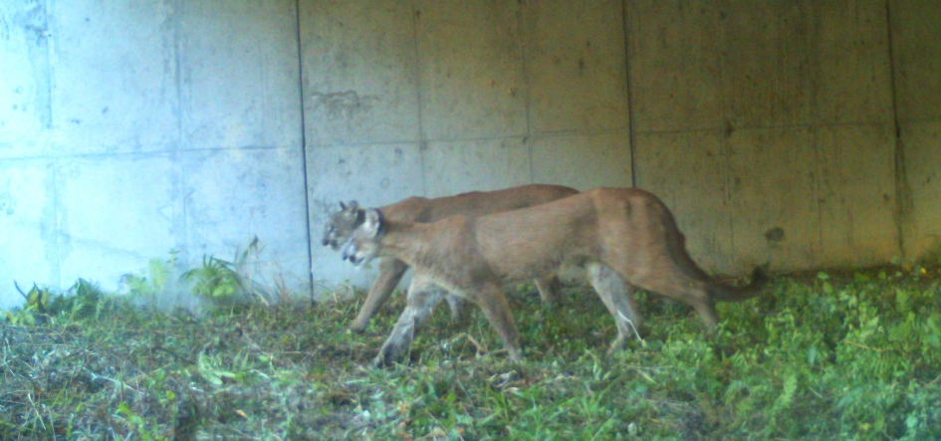
Sustainability milestones at FGCU
Wings of Hope
Panther Posse
Notes:
Established in 2000, Florida Gulf Coast University’s (FGCU) Wings of Hope program seeks to protect the panther through transformational environmental education. Every year, more than 5,000 fourth and fifth grade students learn about the natural systems that support Southwest Florida’s biodiverse ecology and the Florida Panther. FGCU Environmental Humanities students take the elementary-aged pupils through hands-on learning stations in the Panther Posse classroom. Afterwards, students connect what they learn in the classroom to the natural world by visiting the Corkscrew Regional Ecosystem Watershed Land and Water Trust where they collect field data and journal about their experience.

Slide 30

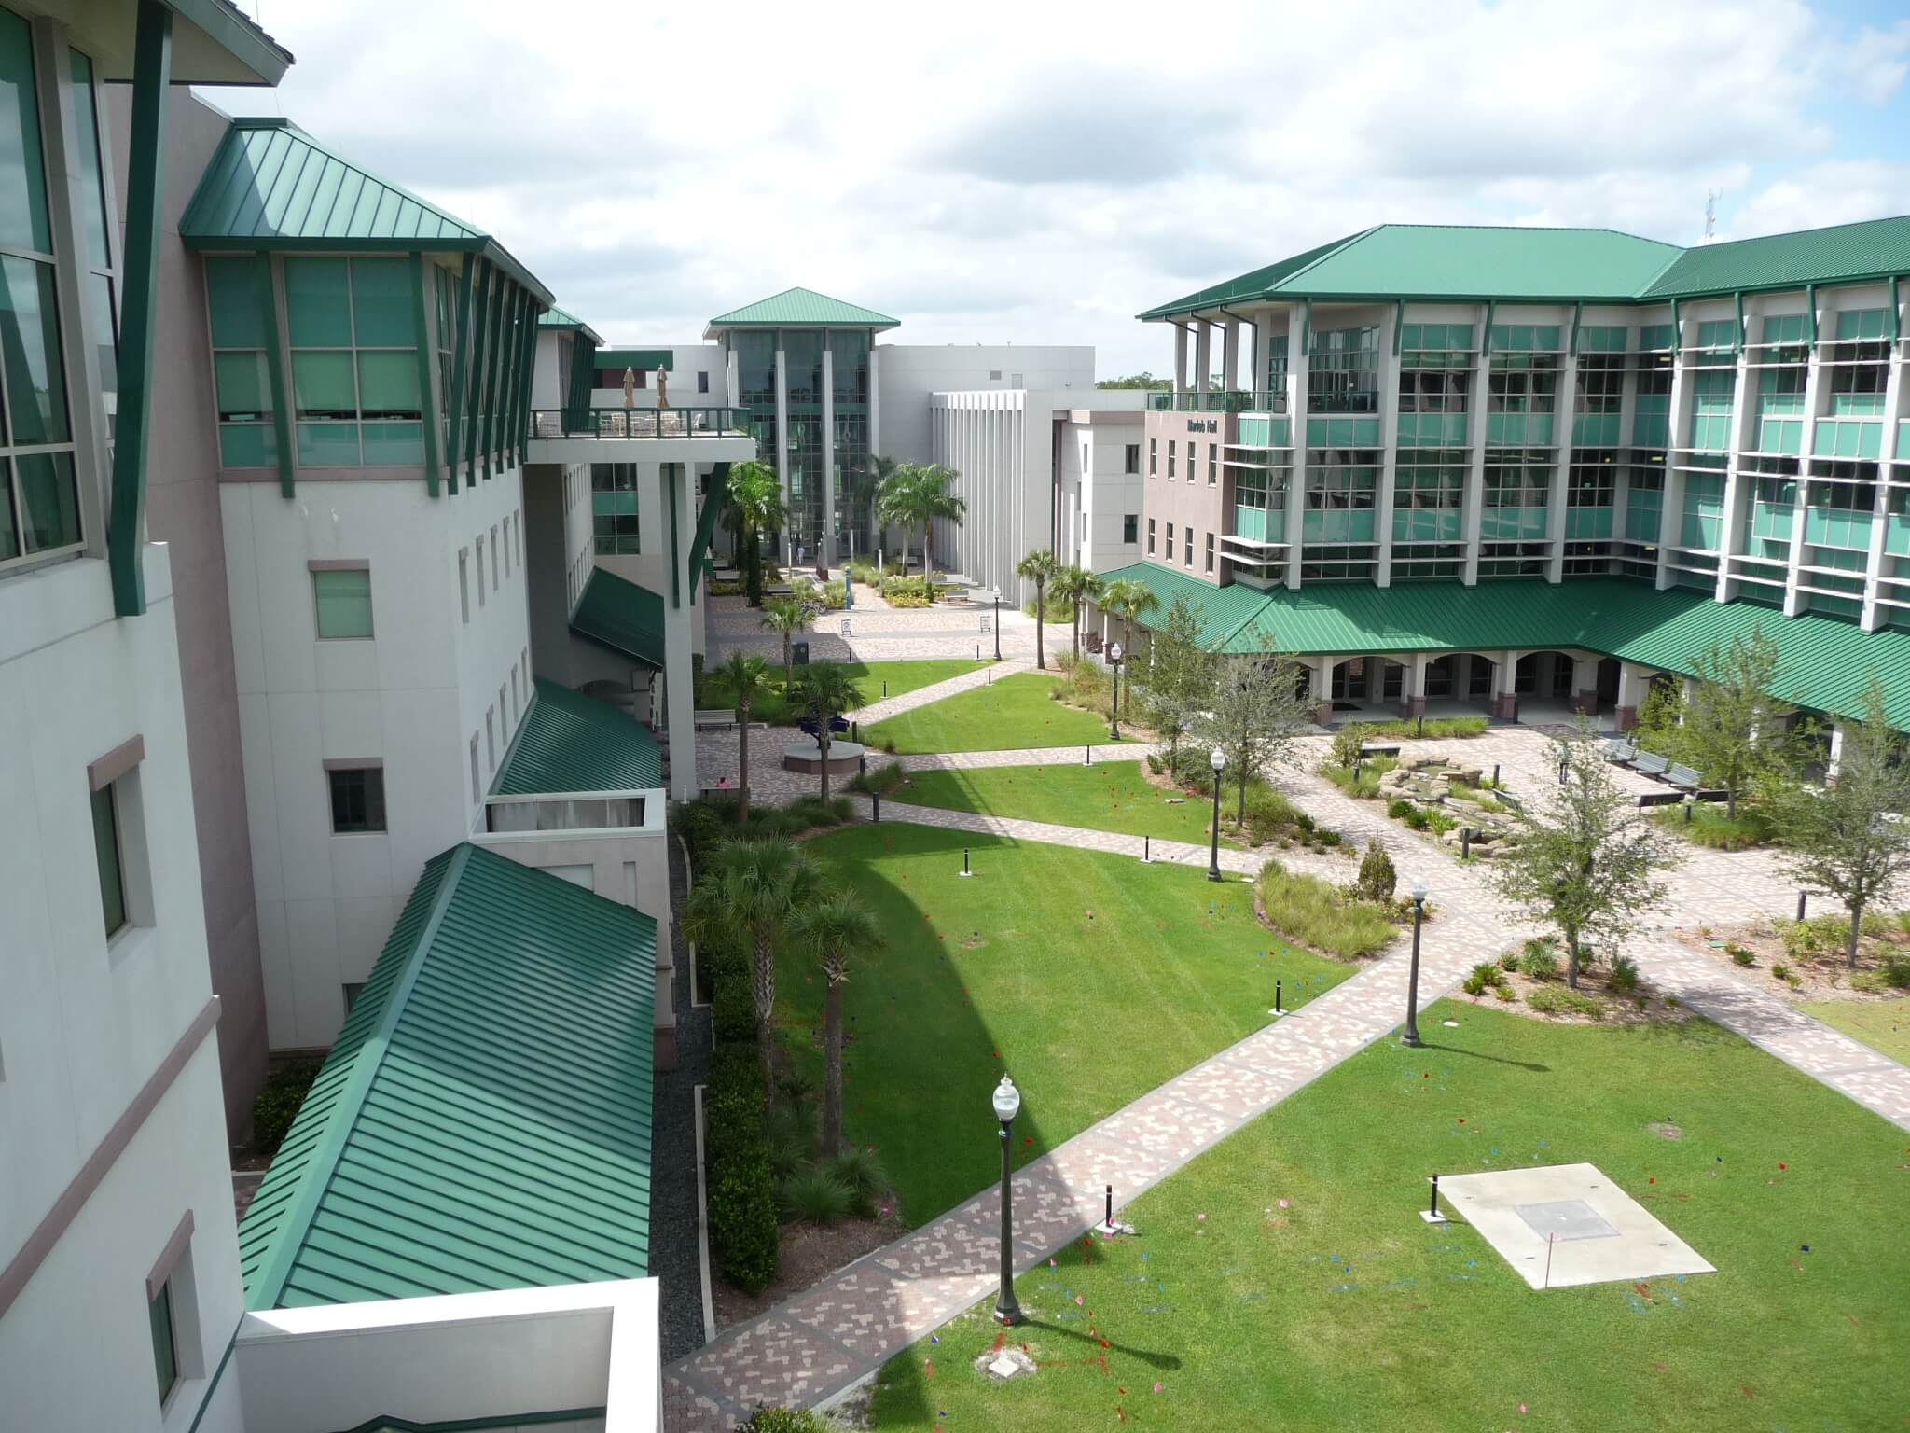
Sustainability milestones at FGCU
Carbon neutrality by 2050
Notes:
The largest aspects of our carbon footprint are emissions from purchased electricity and student commuting.

Slide 31
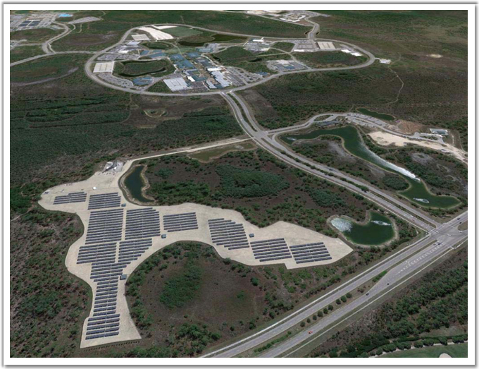
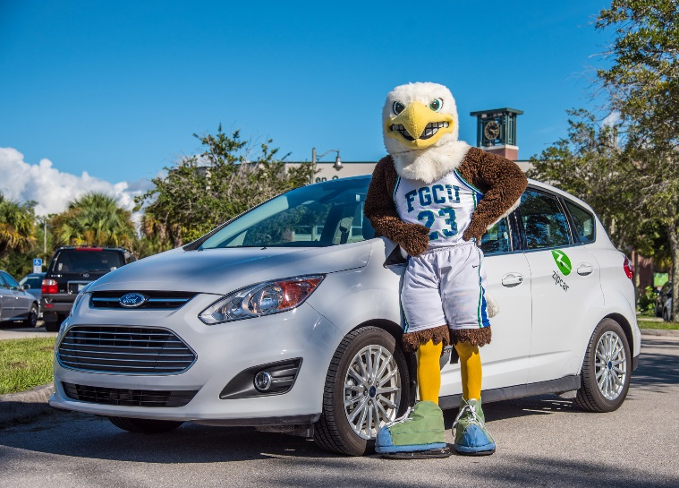




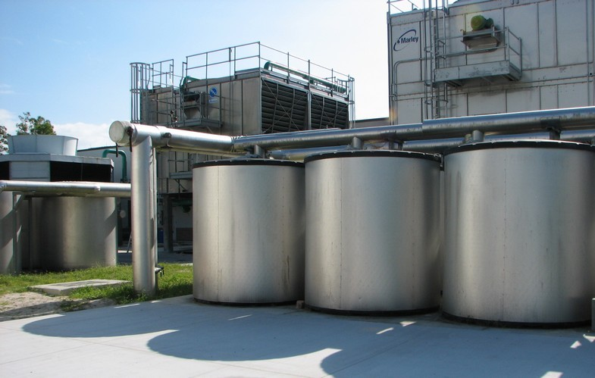
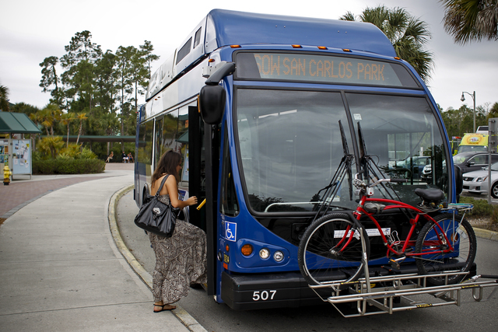
Sustainability milestones at FGCU
Zipcar
LeeTran
Chiller Plant
Notes:
Solar field provides 85% of the power to 3 of our largest academic buildings and reduces our carbon footprint by nearly 9,000 MTeCo2 per year. Chiller Plant is energy efficient and cools buildings at off-peak hours further reducing out energy savings and carbon footprint and our commitment to LEED buildings ensures that our build environment is energy efficient. Transportation options such as LeeTran, Wheeli, Zipcar, and biking help reduce emissions from commuting.

Slide 32

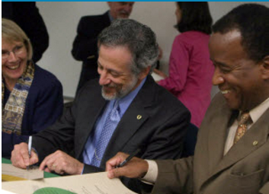
Sustainability milestones at FGCU
Read the 16 principles and endless possibilities of the Earth Charter
at http://earthcharter.org/discover/the-earth-charter/
President Wilson G. Bradshaw and Provost Ronald B. Toll signing the Earth Charter Affiliation Agreement in 2009.
Notes:
Made possible by FGCU’s Center for Environmental and Sustainability Education, which works toward realizing the dream of a sustainable and peaceful future for Earth through scholarship, education, and action. The Center’s signature events include an annual Rachel Carson Distinguished Lecture Series and Terry Tempest Williams Student Dialogue. They also offer mini-grants to students and faculty conducting research that aligns with their mission and the principles of the Earth Charter. They also support the newly established Integrating Sustainability Across the Curriculum (ISAC) Academy which provides time, space, and resources for faculty at all career stages across the university to engage in inter- and cross-disciplinary discussions for sustainability curriculum development.

Slide 33
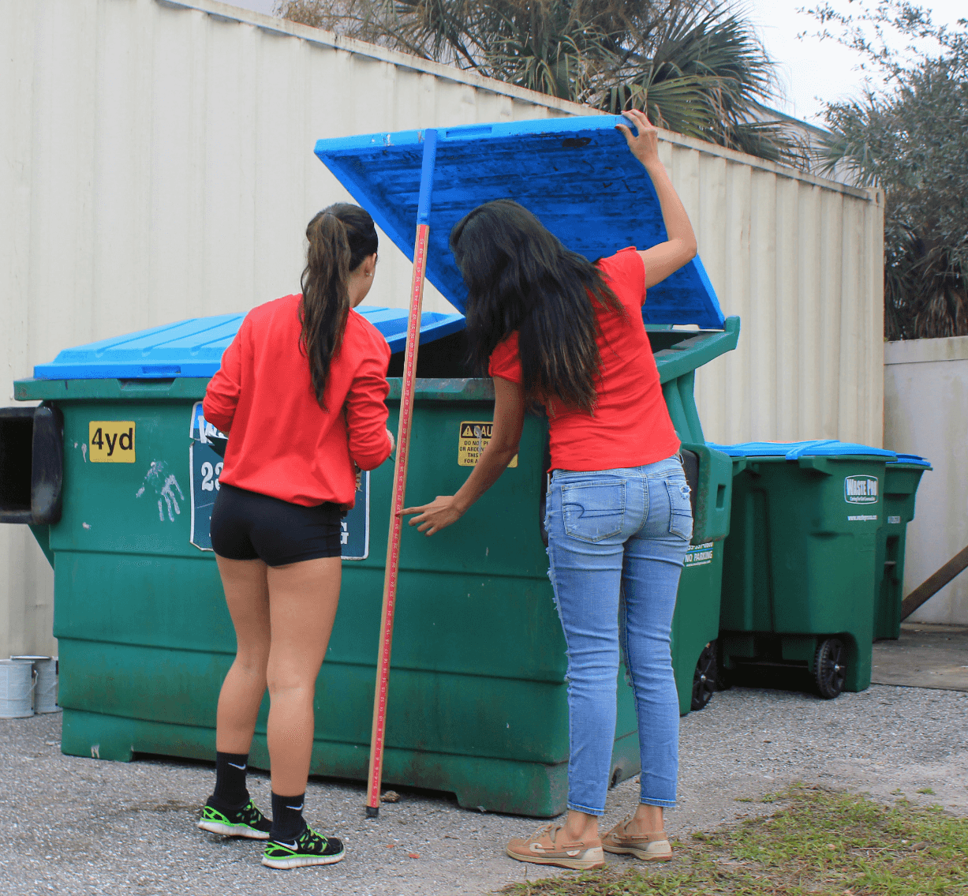


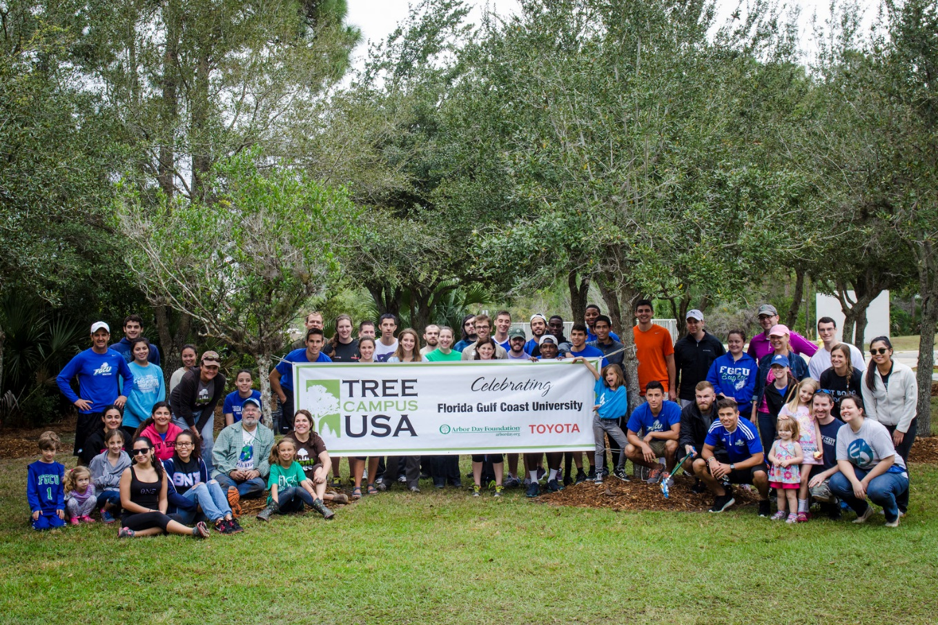

Sustainability milestones at FGCU
Notes:
FGCU has became certified as a Tree Campus USA for tree care and education efforts on campus and has been participating in the RecycleMania Tournament since 2009.

Slide 34

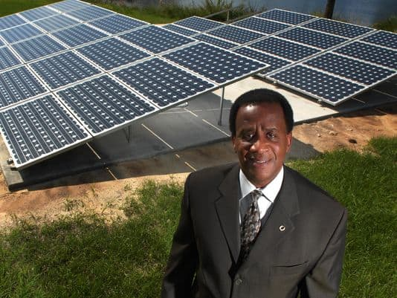

Sustainability milestones at FGCU
Notes:
Rated Gold in 2014!

Slide 35
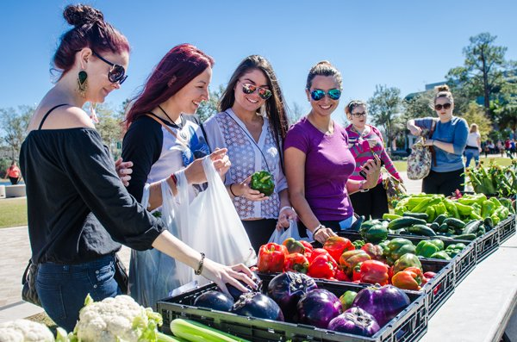
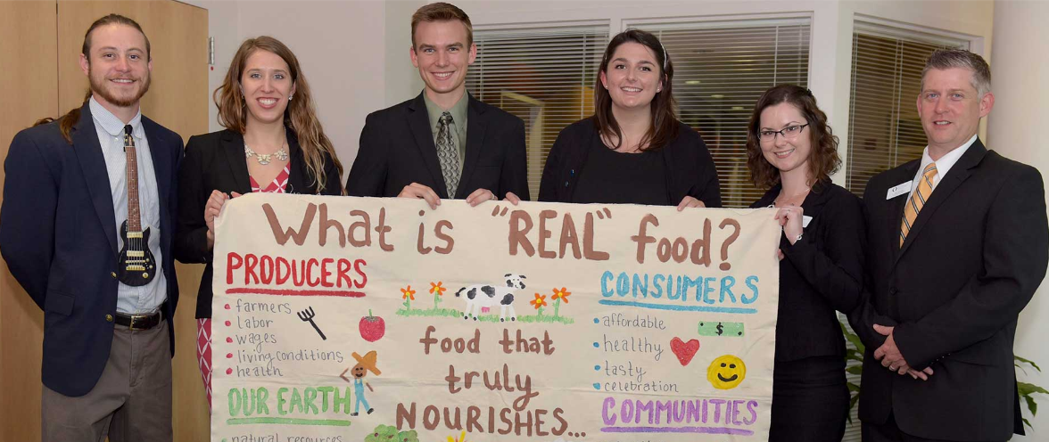

Sustainability milestones at FGCU
Student Government’s biweekly Farmers Market
Real Food Campus Commitment

Slide 36


What’s your piece of the puzzle?

Slide 37
How can YOU contribute to sustainability at FGCU?
Bus, bike, or carpool to campus
Conserve energy and water
Protect campus ecosystems and wildlife
(Don’t liter, don’t feed!)
Green up your business practices
Minimize wastes and properly dispose of items
Eat Real
Create or join on-campus service learning opportunities
Participate in shared governance
Take advantage of professional development opportunities such as OIEC’s Diversity & Inclusion Certificate
Join ECOFGCU

Slide 38
Call Environmental Health & Safety
at x1414
With questions or for help
Notes:
Call Environmental Health & Safety at 1414 if you have any questions about the investigation form, or for assistance in completing your workplace hazard investigation.

Slide 39
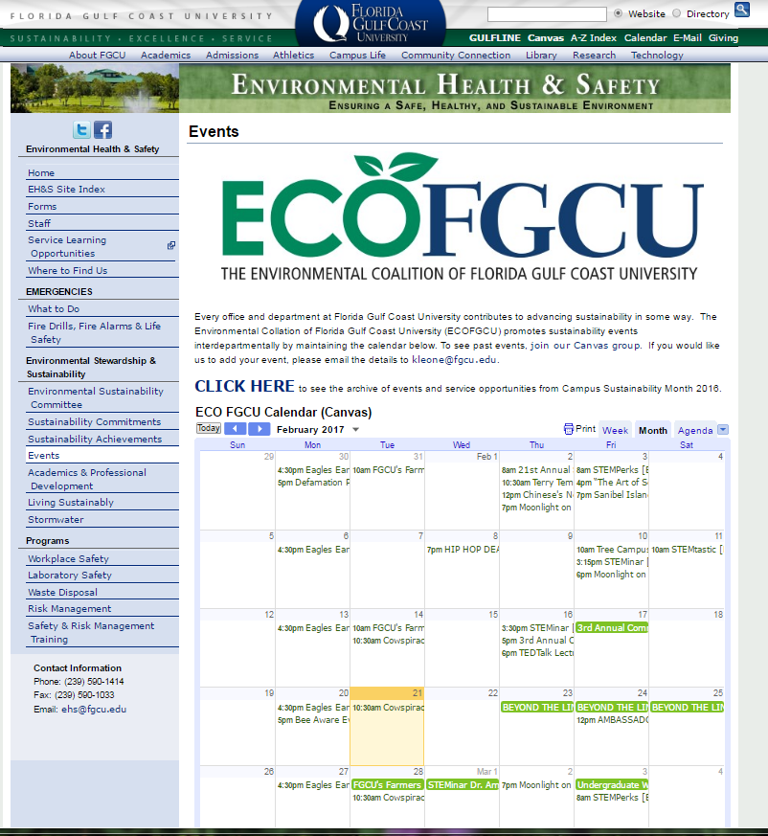

Follow our calendar, social media pages, and service opportunities
Campus-based sustainability service-learning
tinyurl.com/j3awxbs
ECOFGCU Canvas Page
https://fgcu.instructure.com/courses/178518

Slide 40

When there’s a huge solar energy spill, it’s just called a “nice day”.

