Slide 1
Welcome to STARS Review
Tips for a simpler way to review

Slide 2
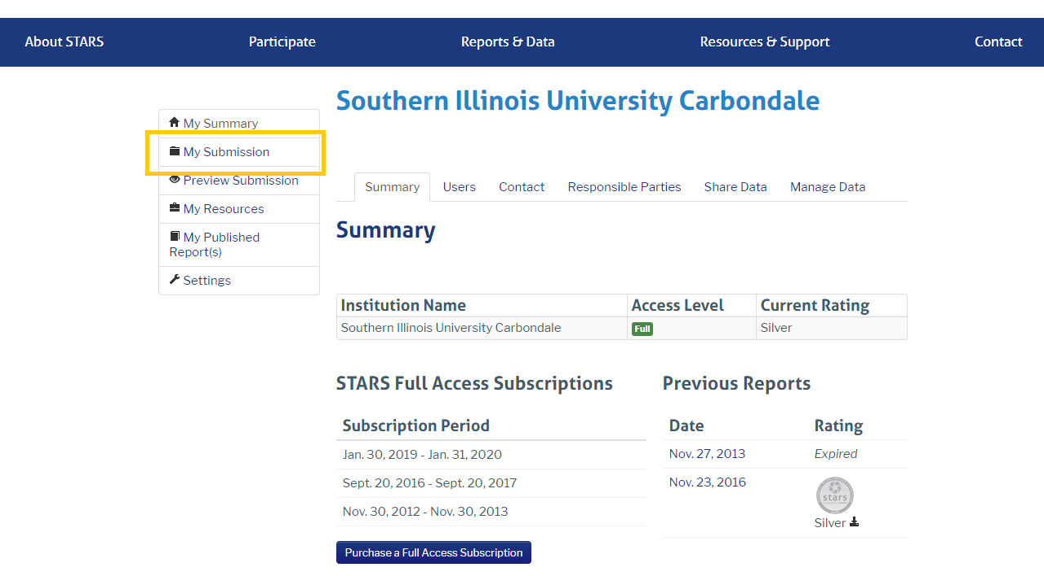
Instructions & Reviewer Info
The STARS credits are divided into three groups , each group will be emailed with their group assigned credits.
You will be able to login to or submission STARS page , Here.
Username: sustainabilitystars2019@outlook.com Password: *******
Note: A detailed outline of all of the STARS credits can be found in the STARS Technical Manual. The “Reporting Fields” section of each credit outlines the required information that our institution is responsible for documenting.

Slide 3
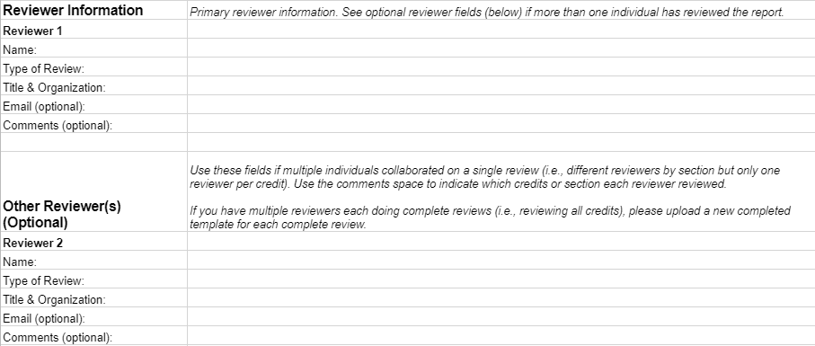
Getting Started:
How it works:
1
Start the review by open the Review Template excel sheet > click on the credit you need to start working to open the STARS Reporting tool.
2
Read and navigate the credit reporting tool page and open the uploaded documents if any. Hint: You can know more about the credit’s requirements, by going to credit info tab.
3
Now you have read the credit page , please go to the Review Template excel
First, at the Instructions & Reviewer Info tab, please confirm the Reviewer information.
Reviewer(s) should review each credit, mark any issues in the dropdown fields, and provide a "First Review Status" decision for each credit.
Multiple rounds of review may be needed. While the current template includes two review rounds, additional columns may be added if needed.
Note: If Reviewers are unsure about a particular response, or if responses are not satisfactorily addressed, please send your feedback to Hala Jaber by sustain@siu.edu.

Slide 4
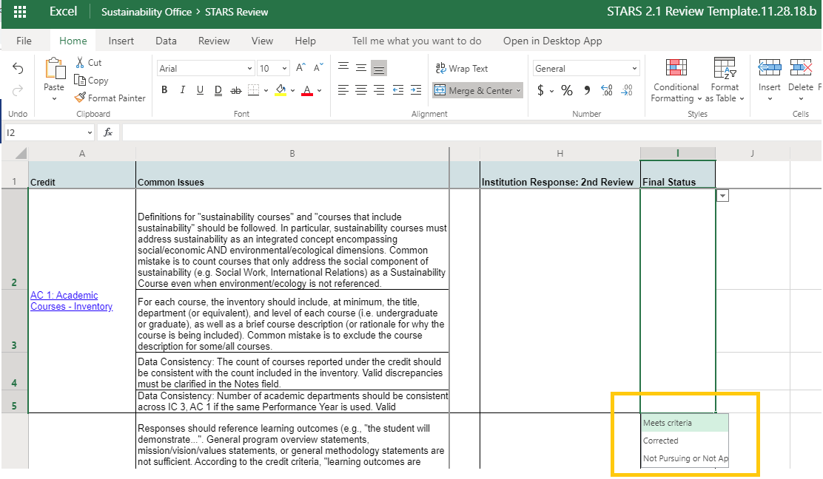
Getting Started:
How it works:
4
At the Review Template excel
The STARS liaison is responsible for addressing the reviewer questions through edits and clarifications in the STARS Reporting Tool. Reviewer should check that responses now satisfy credit criteria in any areas that were marked as requiring revision.
Once all issues have been addressed, "Final Status" for each credit should be updated in the last column of each sheet to indicate that all issues have been addressed.
Note: Reviewer(s) should review each credit, mark any issues in the dropdown fields, and provide a "First Review Status" decision for each credit.

Slide 5
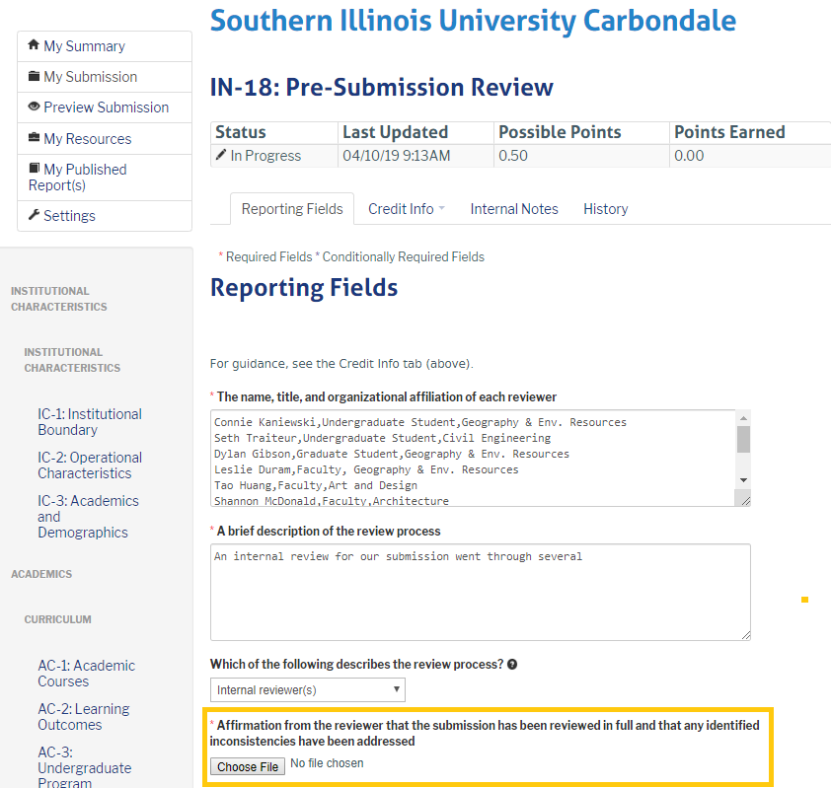
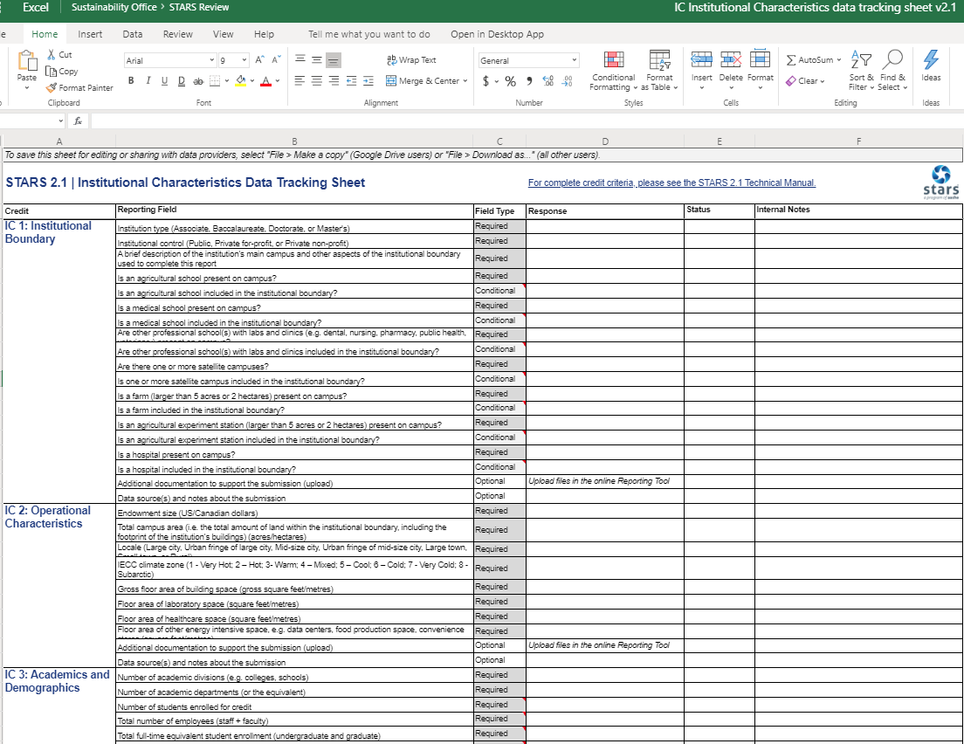
Getting Started:
How it works:
5
At the Review Template excel
The reviewer must submit an upload affirming that the reviewer responsibilities outlined in the Exemplary Practice credit criteria have been fully addressed.
Note: For Institution Characteristic credits , additional review is recommender by walking through the STARS 2.1 | Institutional Characteristics Data Tracking Sheet

Slide 6
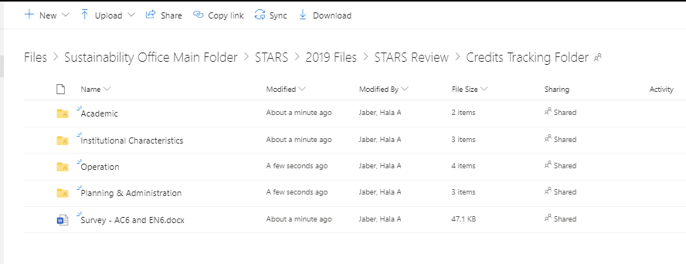
Getting Started:
Moreover:
*
Some Credits have an additional supporting documents in Credits Tracking Tool Files folder, these documents might not be uploaded , but they can help in the review process. So, please access the folder for potential clarification and review .

Slide 7
More questions?
Please Email us on :
*****
Give feedback about this tour
Notes:
In Slide Show mode, select the arrows to visit links.

