Slide 1

SURVEY Results

Slide 2
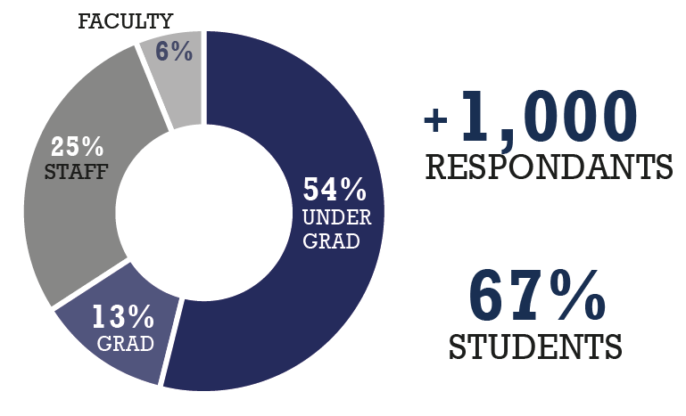
RESPONDENTS

Slide 3
How DID YOU HEAR ABOUT THE SURVEY?
4 %
SOCIAL MEDIA
4 %
WORD OF MOUTH
4%
4%
54 %
PITT PORTAL
34 %
EMAIL

Slide 4
Responses BY affiliation
36%
21%

Slide 5
What does sustainability mean to you?
ENVIRONMENT RELATED

Slide 6
How important is the overall Sust. of pitt to you?
1
2
3
4
5
4.44
do you see pitt as a leader in sust. practices?
1
2
4
5
3.05
do you think pitt incorporates sust. into its culture?
1
2
4
5
2.95

Slide 7
Are you involved in any of these sustainability activities at pitt?

Slide 8
Which of the following initiatives and organizations are you aware of at pitt?

Slide 9
Are you AWARE OF ANY OF THESE ON THE PITT CAMPUS?

Slide 10
WHAT DO YOU FEEL ARE THE
MOST PRESSING SUST. ISSUES AT PITT?

Slide 11
Which of the following sustainability-related academic and extracurricular initiatives do you feel Pitt should pursue?

Slide 12
How might you be willing to contribute to sustainability initiatives on campus?

