Slide 1
Sustainability
at Seattle Colleges
Adam Maurer
Sustainability Coordinator

Slide 2
Topics for today
What does sustainability mean?
Why does sustainability matter?
Sustainability initiatives at Seattle Colleges
What you can do?

Slide 3
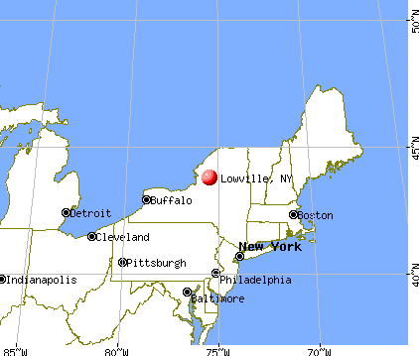
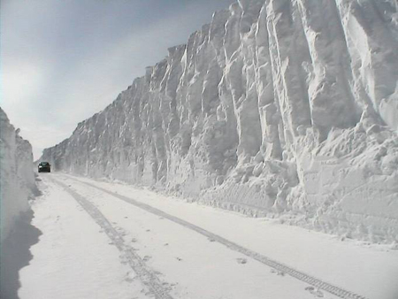
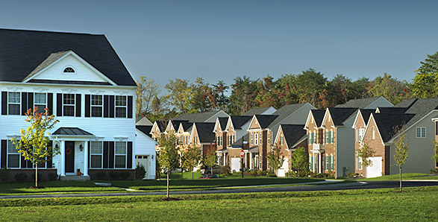

Slide 4
Sustainability: What does it mean to you?

Slide 5
One Definition
“Sustainability is the capacity to improve the quality of human life while living within the carrying capacity of the Earth’s supporting ecosystems.”

Slide 6
3-Nested-Dependencies Model
Economy
Society
Environment

Slide 7
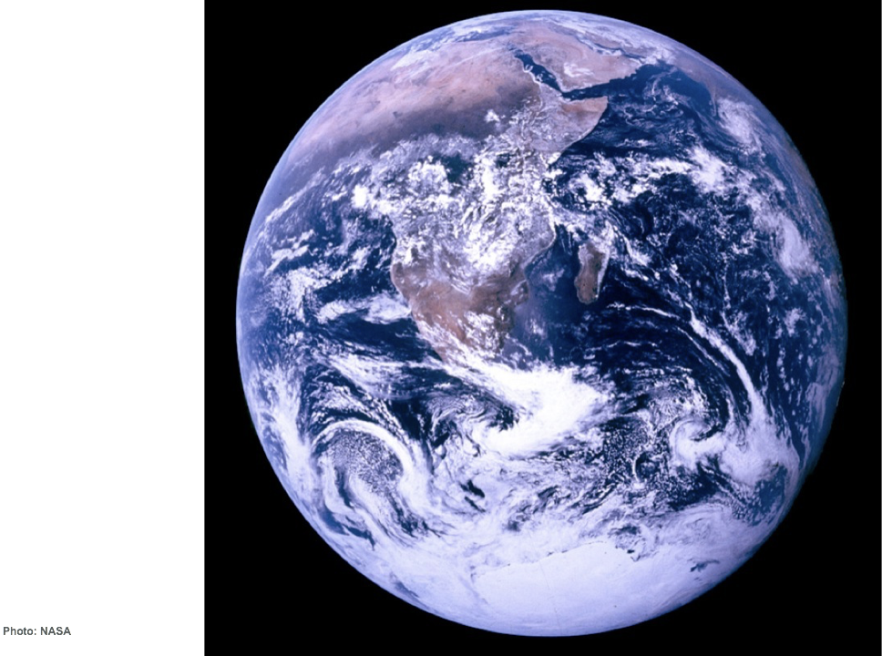
Notes:
TALKING POINTS
This is the first picture of the earth fully illuminated that any of us ever saw. It was taken on the last of the Apollo missions and it changed the way that humanity thought about our common home.
It reminds us that we are all connected, and that our actions have an impact on our planet.
PHOTO: “Blue Marble” photo of Earth from NASA’S Apollo 17 mission, taken as the crew was traveling toward the moon, December 7, 1972

Slide 8
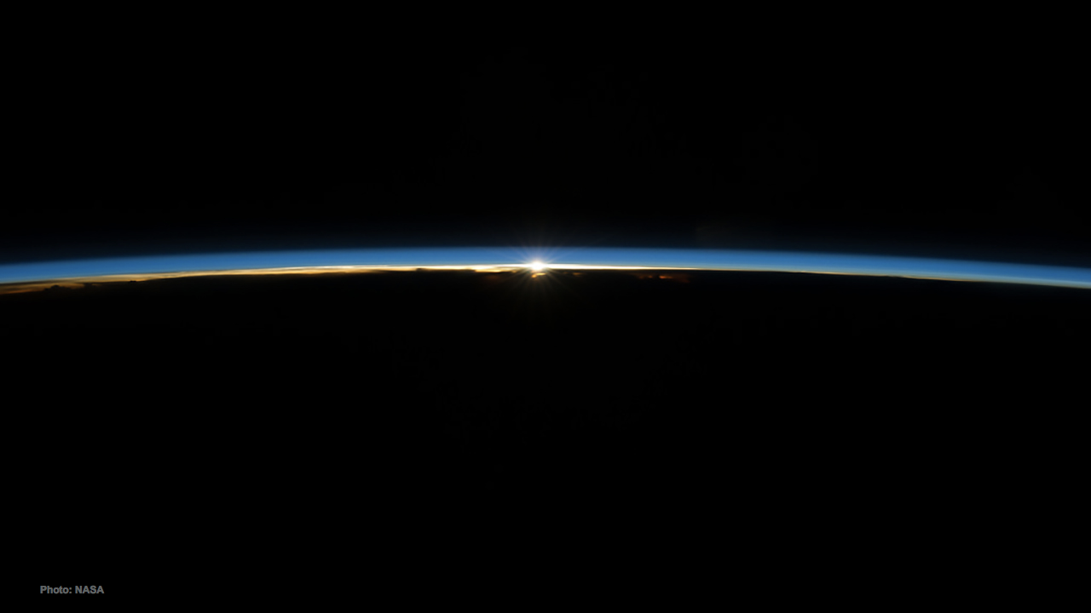
Notes:
TALKING POINTS:
The sky is not a vast and limitless expanse the way it appears to us as we stand on the ground and look up.
In reality, there is just a thin shell of atmosphere surrounding the planet.
PHOTO: The sun shining over Earth’s horizon through the two lowermost layers of the atmosphere: the troposphere and the stratosphere. Photo taken from the International Space Station.

Slide 9
2017 Seattle Colleges STARS Scores
North Seattle College (60 points)
Seattle Central College (41 points)
South Seattle College (43 points)

Slide 10
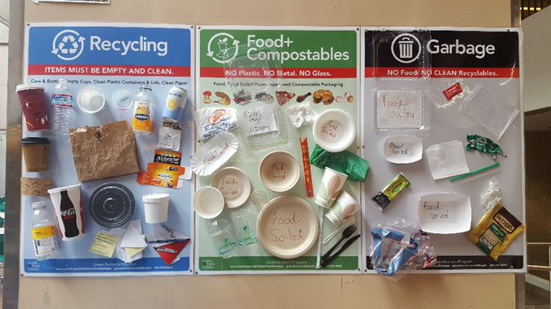
STARS Categories
Academics
Learning Outcomes @
Sustainable Building Science Technology (SBST) Bachelor’s @
Engagement
Sustainability Office and Student Leadership @
Operations
Energy- annual greenhouse gas inventory, Energy Benchmarking, etc.
Water- Seattle 2030 District
Waste
Food- Fair Trade
Transportation (flyer)
Planning & Administration
Sustainability Office
Associate Vice Presidents of Equity, Diversity, and Inclusion

Slide 11
Planning & Administration: How to get involved

Slide 12
What You Can Do!...Energy
Lights
Shut off when not in use (offices, bathrooms, etc.)
Heat
No space heaters (fill out a work order request so Facilities can address the issue more appropriately. Only Seattle Colleges issued equipment approved for use)
Electronics (including monitors and computers)
Turn off monitors and all other electronics at the end of the day
Place computers in sleep mode
Note: Seattle Colleges spends over $3,000,000 annually on natural gas, electricity, and steam. That’s enough to pay for 2,538 resident students at 12 credits

Slide 13
What You Can Do!...Waste
Prevent Waste
Bring Your Own Water Bottle, Coffee/Tea Mug, Bag, etc.
Limit printing (Think: does this really need to be printed?)
Desk Side Receptacles
If you do not have both a recycling and garbage bin at your desk, please request one from Facilities
Prevent Contamination
Compost
NO plastic (not even a sticker)
Industrial compostable service ware only (NO plastic)
Recycling
NO loose liquid (cap your drinks or dump liquid in garbage or compost)
NO paper towels, tissue paper, or similar
NO materials with food on them
Garbage
When in doubt, throw it out…in the garbage
Note: Seattle Colleges spends nearly $400,000 annually on waste hauling (i.e. municipal compost, recycling, and garbage). Could be used to hire approx. 4 full-time faculty

Slide 14
What You Can Do!...Water
Leaks
Report small to large leaks to Facilities (fill out work order)
Shut it off
Shut off faucets, showers, etc. when not being used
Note: Seattle Colleges spends nearly $400,000 annually on water and sewer

Slide 15
What You Can Do!...Food
Choose Organic
Purchase organically grown produce to reduce harmful environmental and health impacts of pesticides, herbicides, etc. used in conventional agriculture
Choose Local
Purchase local vegetables, meats, and food to support our local businesses and keep money in our local economy
Food Pantries
Donate to your school’s food pantry to directly help our students

Slide 16
Sorting Game
2 Teams
3 Streams (Compost, Recycle, Garbage)
Place items in the correct receptacle
2 Minutes
All winners!

Slide 18
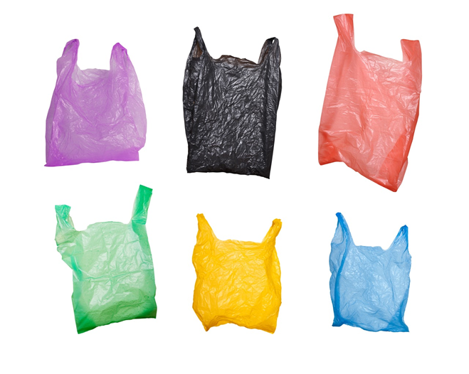
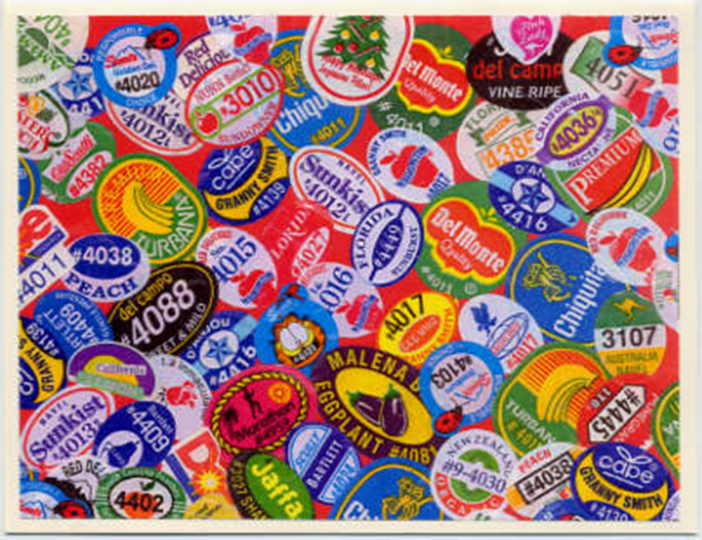
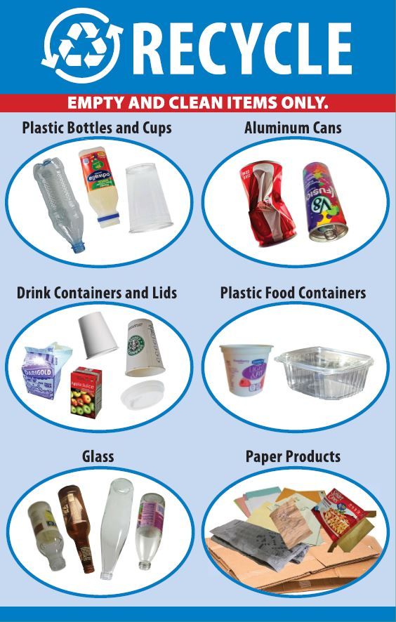
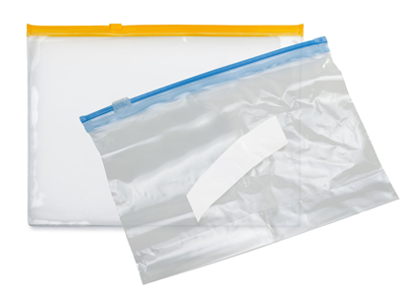
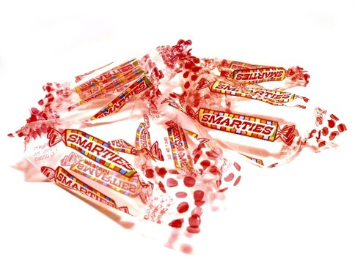
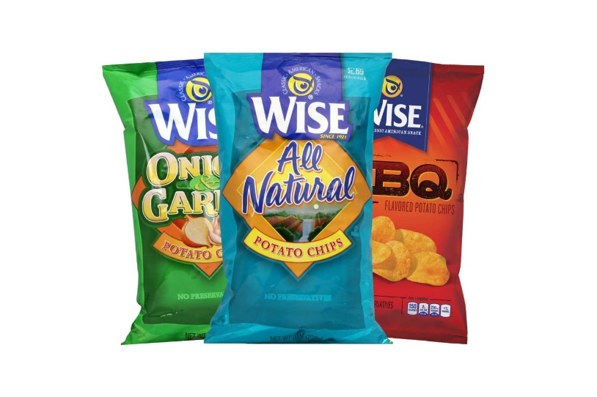
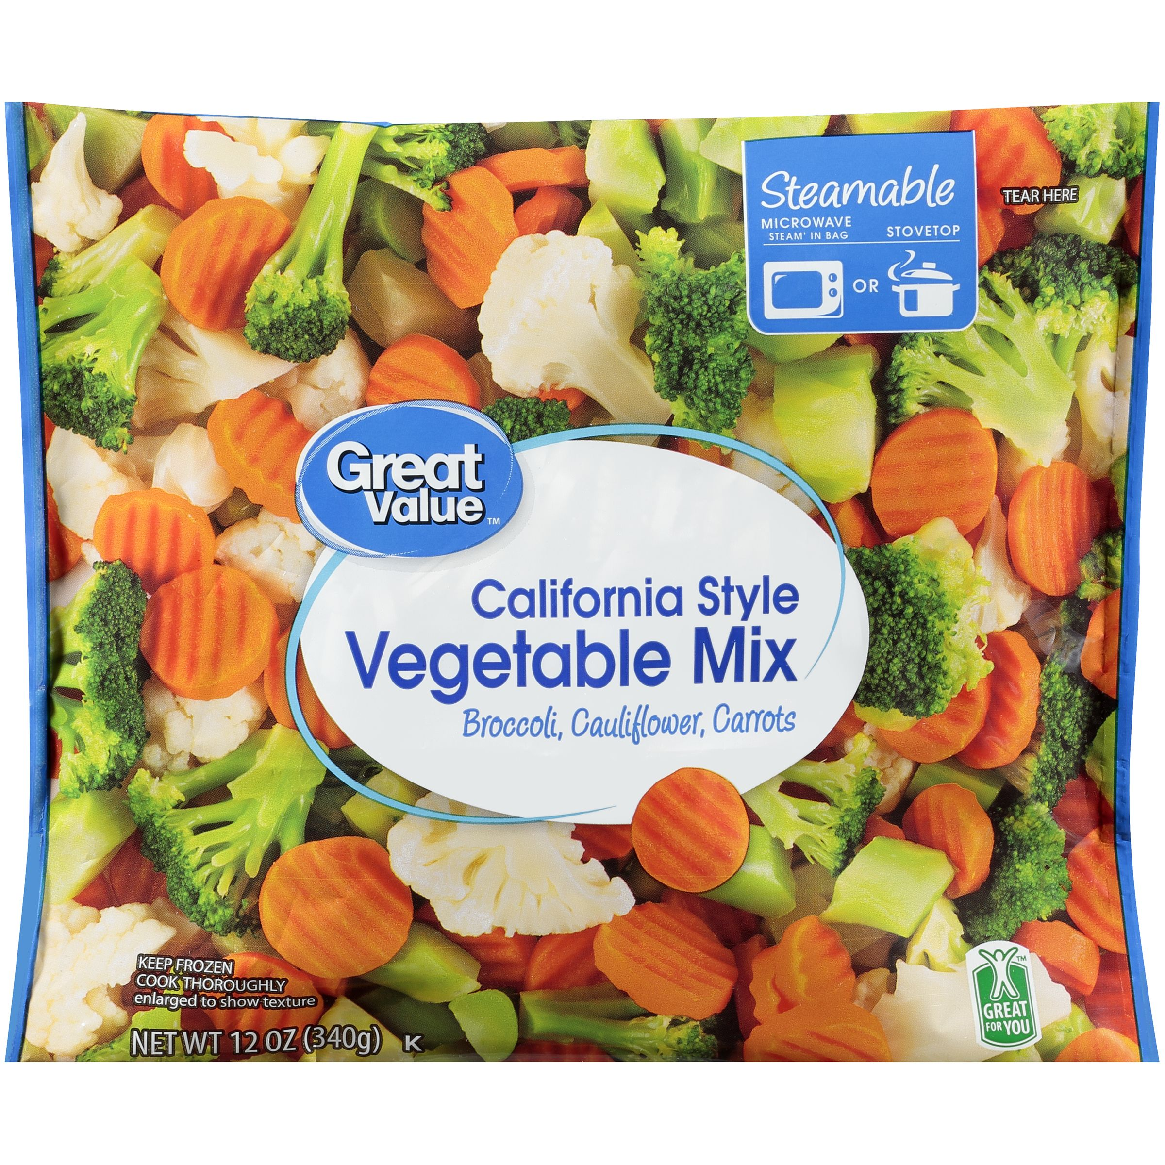
Crap Plastic
Crap Plastic
Produce Stickers

Slide 19
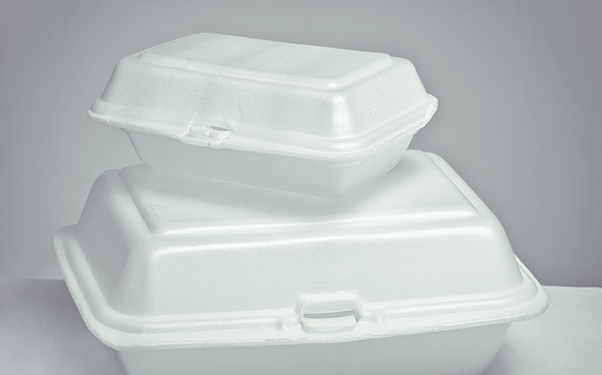
Styrofoam
Styrofoam

Slide 20
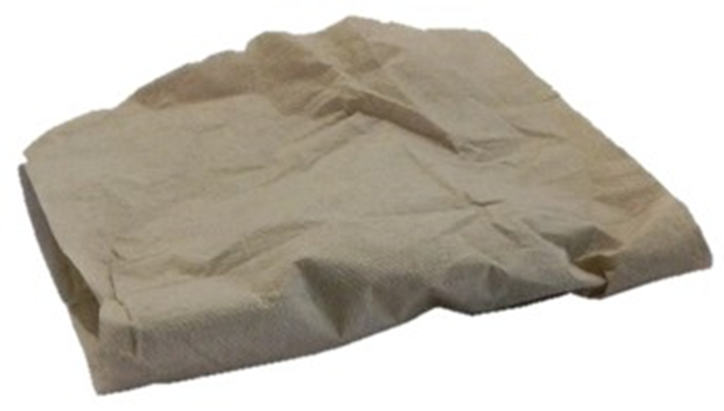
Napkins & Paper Towels

Slide 21
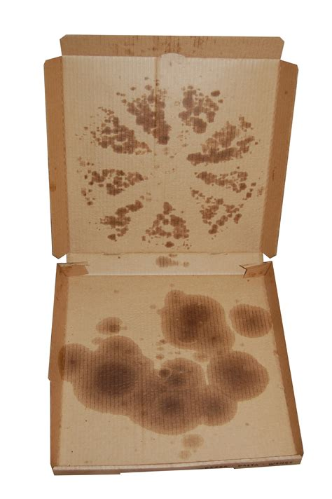
Greasy Pizza Box

Slide 22
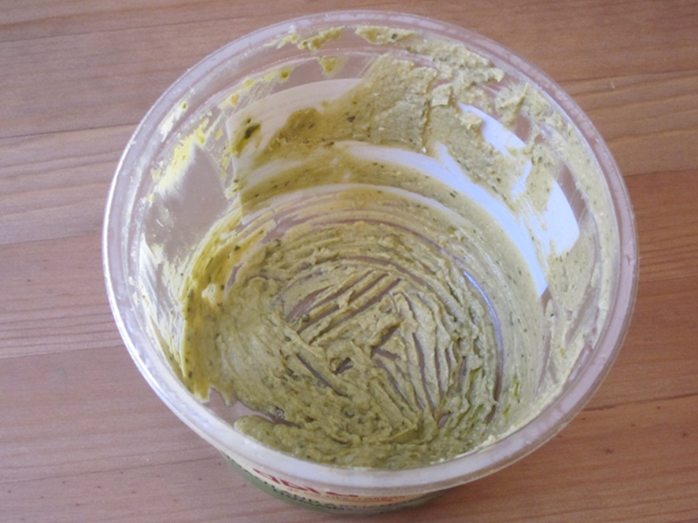
Food Soiled

Slide 23
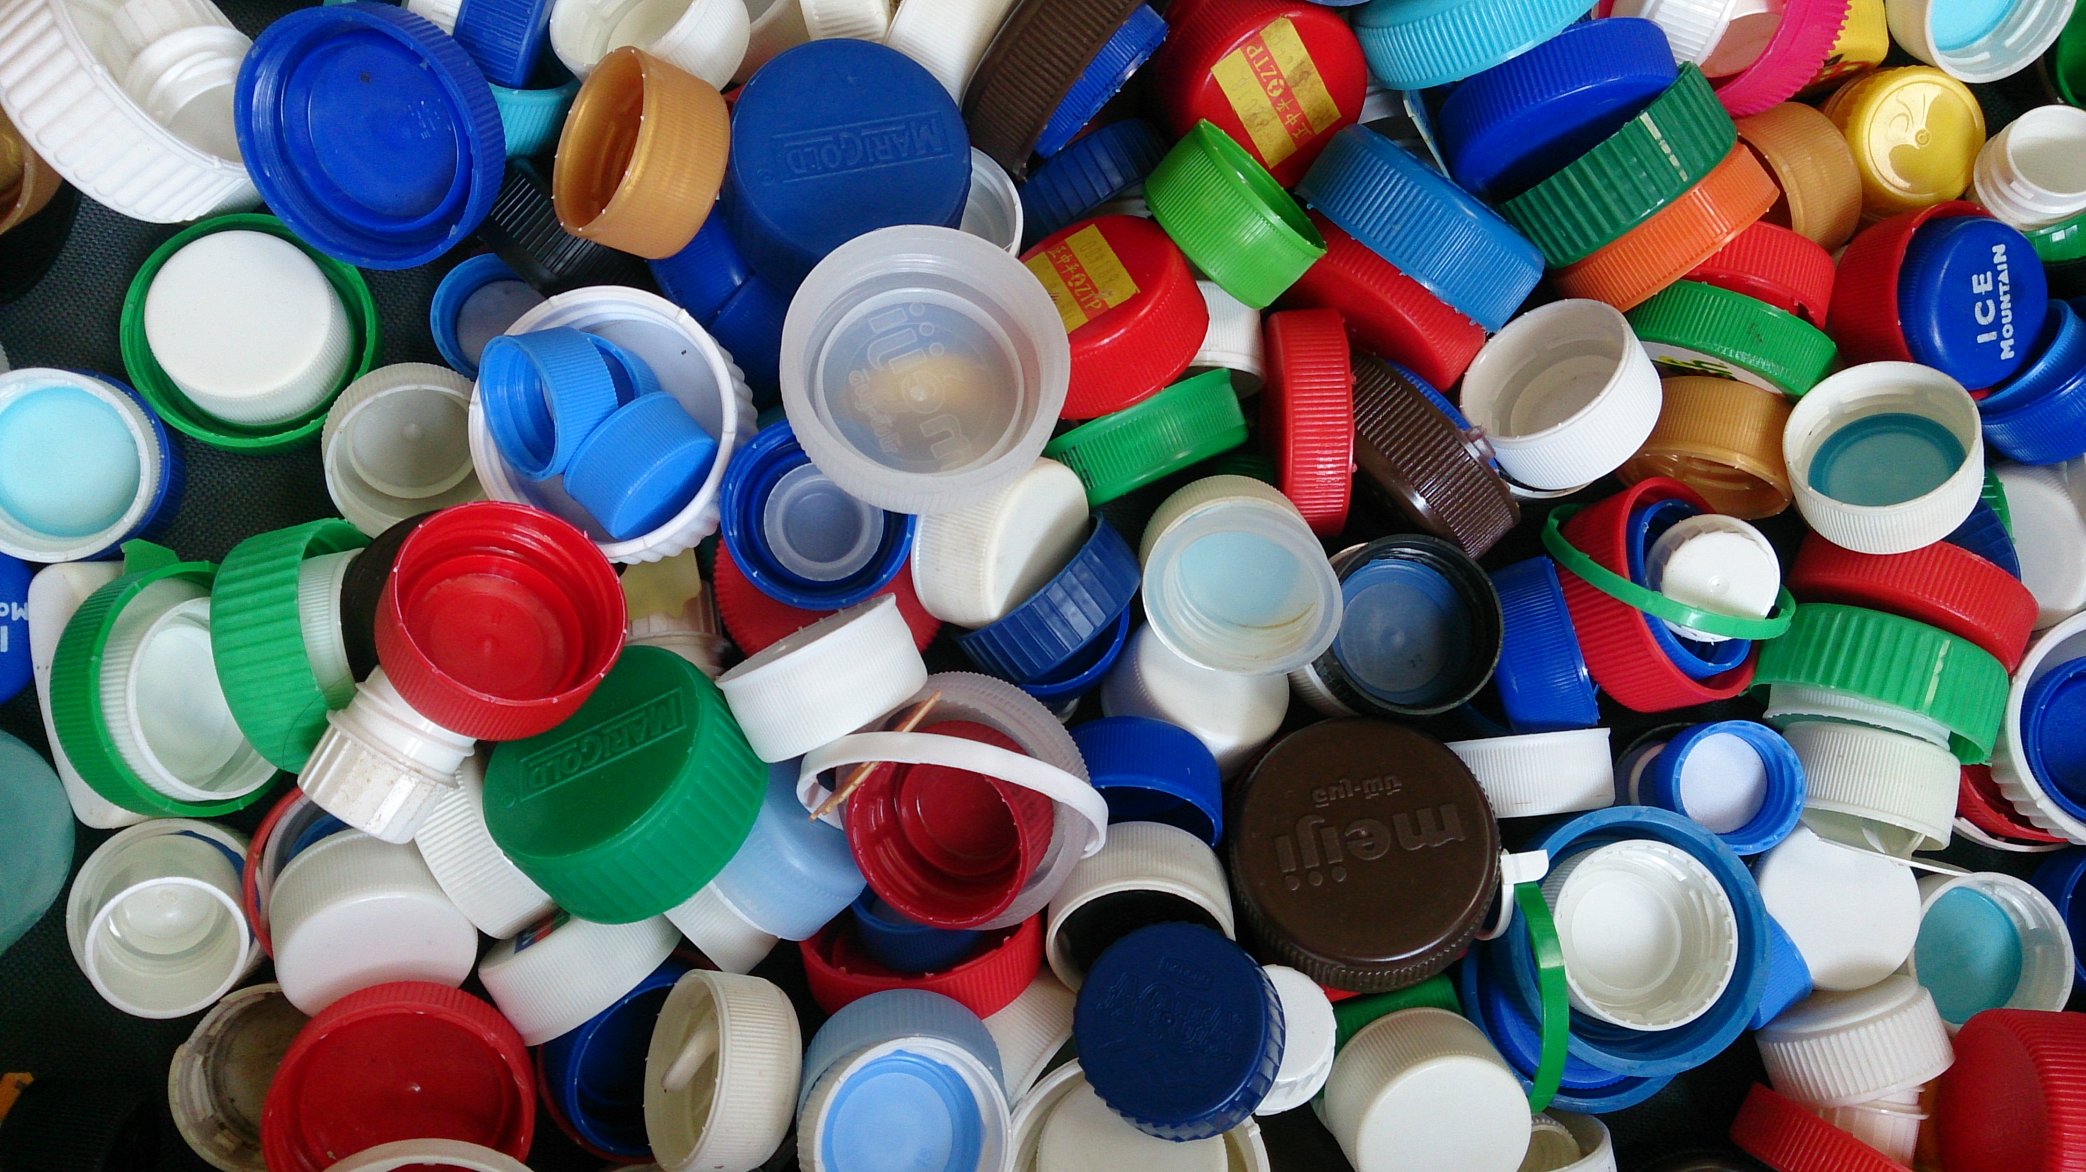
Bottle Caps
3 Inches

Slide 24
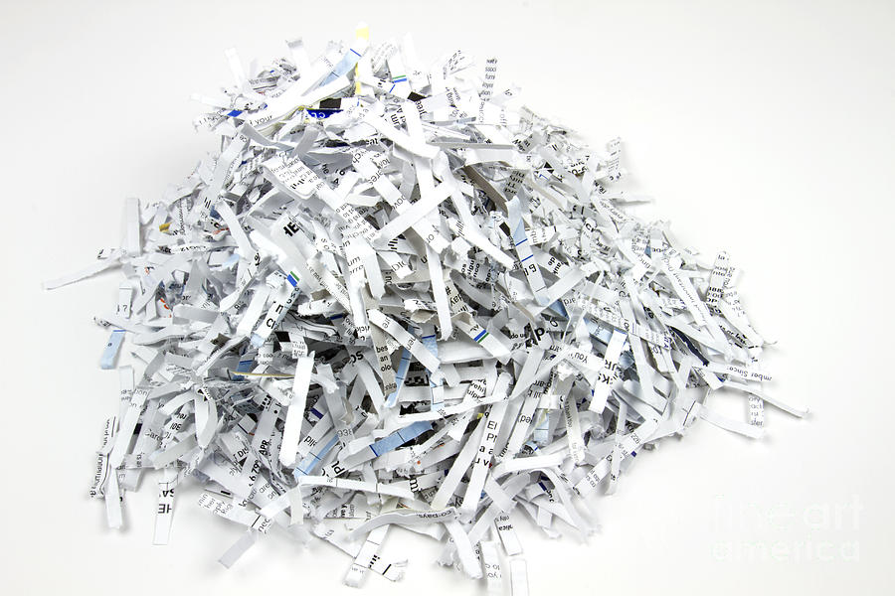
Shredded Paper

Slide 25
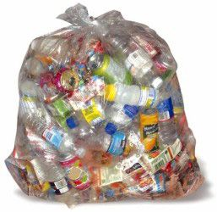
Put recyclables into bags. NOPE!
Place your recyclables into your recycling bin loose

Slide 26
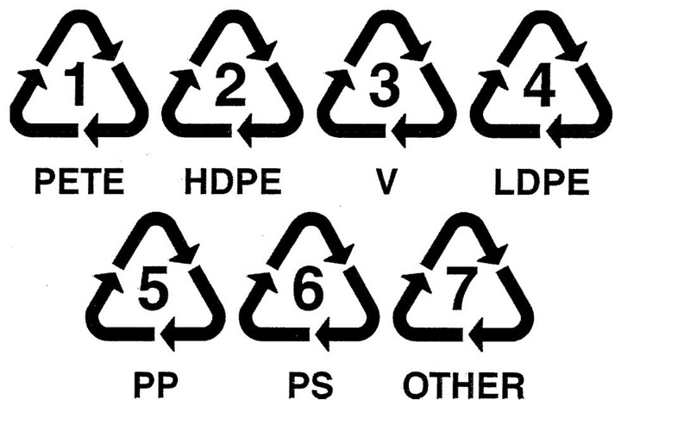
Myths
DISREGARD
Check your municipality (Seattle Public Utilities Where Does It Go?)

Slide 27
Thank you for your time!
Questions?
To learn more about sustainability at Seattle Colleges, visit our webpages, http://sustainability.seattlecolleges.edu/

