Slide 1
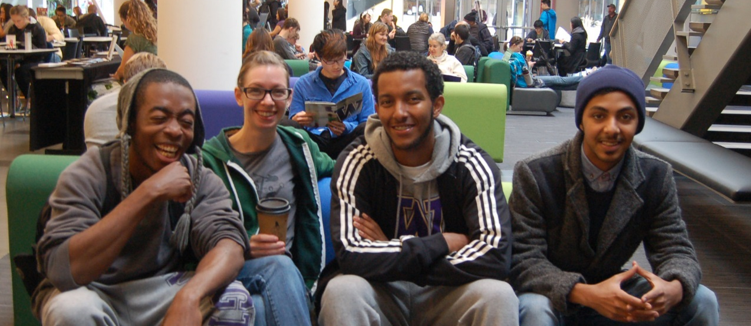
District – Wide Employee Survey – Spring 2020 SUMMARY
September 28, 2020

Slide 2
Background
In the spring of 2020, the Seattle College District launched its first – ever district – wide employee survey.
Respondents were asked to respond to a common set of items, as well as campus – specific items for employees of North Seattle, Seattle Central College, and South Seattle College.
A total of 813 employees responded to the survey across all primary work locations.
However, not all respondents provided a response to all of the common items.

Slide 3
Missing Data
Demographic Data | Percent Missing Data ¹
What employee type best describes the work you do? | 13.9 %
Ethnicity / Race | 31.8 %
Gender Identity | 31.6 %
Sexual Orientation | 38.0 %
Years Worked at Seattle Colleges (range) | 18.0 %
Respondent Age (range) | 29.4 %
¹ Percent of respondents indicating “prefer not to answer” or providing no answer at all
Large percentages of respondents chose to either indicate “prefer not to answer” or provided no answer at all for demographic questions.
This makes it challenging to conduct meaningful statistical analyses by these demographic variables.

Slide 4
Interpretive Guidelines
For items that use a five – point rating scale, the following guidelines can be used as benchmarks of good performance for comparing item statistics:
Means equal to or greater than 4.0
Top two most positive response frequencies equal to or greater than 80.0 %
Missing Data – Results of items with more than 3 % missing data should be interpreted with caution.
Sample Size – Results of items with sample sizes less than 30 respondents should be interpreted with caution.

Slide 5
Respondents by Primary Work Location
Primary Work Location |  |  |  | Total Employee Headcount – Winter 2020 ¹ | % of Total Employees |  | Survey Response Rate
Response | % of Total Respondents | n |  | N | %
District Office | 6.9 % | 56 |  | 123 | 7.0 % |  | 45.5 %
North Seattle College | 25.8 % | 210 |  | 472 | 26.7 % |  | 44.5 %
Seattle Central College | 39.4 % | 320 |  | 729 | 41.3 % |  | 43.9 %
South Seattle College | 27.9 % | 227 |  | 442 | 25.0 % |  | 51.4 %
Total | 100.0 % | 813 |  | 1,766 | 100.0 % |  | 46.0 %
¹ Most recently available official data from SBCTC. Source: https://www.sbctc.edu/colleges-staff/research/data-public/faculty-and-staff-data-dashboard.aspx
Respondents to the 2020 Seattle College District employee survey are represented roughly proportionally to their composition of the overall district employee base.
South Seattle College has the highest survey response rate at 51.4 % of its employees responding to this survey.

Slide 6
Top Four Predictors of Engagement Items
What is your overall satisfaction with being an employee at your primary workplace? (Adjusted R² = .384) | What is your overall satisfaction with being an employee of Seattle Colleges? (Adjusted R² = .321) | To what extent do you agree with the following: “I would recommend my as a place to work.“(Adjusted R² = .400) | To what extent do you agree with the following: “I would recommend Seattle Colleges as a place to work.“ (R² = .346)
The climate at my primary work location … values and supports differences of opinions and beliefs. | How satisfied are you with the overall effectiveness of strategic planning? | The climate at my primary work location … values and supports differences of opinions and beliefs. | How satisfied are you with the overall effectiveness of strategic planning?
Overall, I am satisfied with professional development opportunities. | I am provided the resources I need to engage in professional development activities. | Physical safety when on campus | I am provided the resources I need to engage in professional development activities.
Physical safety when on campus | The climate at my primary work location … values and supports differences of opinions and beliefs. | Overall, I am satisfied with professional development opportunities. | The climate at my primary work location … values and supports differences of opinions and beliefs.
How satisfied are you with the extent to which the mission is reflected in the work that you do? | Physical safety when on campus | How satisfied are you with the extent to which the mission is reflected in the work that you do? | Physical safety in classrooms
Based on stepwise multiple linear regression analysis, the top predictor of both overall satisfaction with one’s primary work location and the likelihood to recommend one’s primary work place is the extent to which the climate value and supports differences of opinion and beliefs.
Based on stepwise multiple linear regression analysis, the top predictor of both overall satisfaction with being an employee of the Seattle College District and the likelihood to recommend the Seattle Colleges as a place to work is satisfaction with the effectiveness of strategic planning.

Slide 7
Recommendations
Predictors of Engagement Items – The Seattle Colleges and its constituent institutions should conduct additional research to operationalize the variables that have been identified as key predictors of engagement items. Once these predictors are operationalized, interventions should be implemented to increase satisfaction with these variables.
Missing Data – Large percentages of missing data on demographic variables makes it difficult to conduct meaningful analyses to identify differences by subgroup. Efforts should be made to increase the percentage of employee respondents who respond meaningfully to demographic variables.
Power of Predictive Models – The R² (r – square) is a statistic that indicates the predictive power of a given linear model. The values of R² range from 0 (zero) to 1 (one). The closer an R2 is to 1.0, the greater the percentage of variance in an outcome it predicts. Additional research should be conducted to determine what other factors are predictive of the engagement variables measured in this survey.
Frequency of Administration of this Survey – This survey should be administered again in Spring 2021 to measure any changes that have occurred in the variables measured in this survey.

Slide 8
Executive Summary
Overall Comment: Mean ratings by primary work location typically do not meet or exceed 4.0 on a five - point scale across items on this survey.
Employee Engagement
Employees tended to give higher engagement ratings to their own work location than to the Seattle College District overall.
Mean ratings of engagement by employees of North Seattle College were significantly higher than those at Seattle Central College on the following items:
Satisfaction with being an employee of one’s primary work location
Likelihood to recommend one’s primary work location as a place to work

Slide 9
Executive Summary – Continued
Professional Development
There are no statistically significant differences in mean satisfaction with professional development opportunities by primary work location.
Mean ratings are significantly higher for employees of North Seattle College than either Seattle Central College or South Seattle College on the following aspects of professional development:
The opportunity to take part in formal professional development activities
Being provided the resources I need to engage in professional development activities

Slide 10
Executive Summary – Continued
Employee Safety
Mean ratings for employees of both North Seattle College and South Seattle College are statistically significantly greater than Seattle Central College on the following aspects of physical safety:
While on campus
In classrooms
In hallways
In restrooms
Parking lots and garages
Outside of one’s primary work location

Slide 11
Executive Summary – Continued
Equity, Diversity, and Inclusion (EDI)
Across all respondents, more than one in four employees (26.9 %) report having felt discriminated against within the current academic year.
There are no statistically significant mean differences by primary work location regarding the following aspects of equity, diversity, and inclusion:
Satisfaction with the use Inclusion Advocates in the hiring process
Satisfaction with the progress being made on equity, diversity, and inclusion (EDI) initiatives at one’s work location
Being able to apply new skills acquired at EDI activities to one’s day to day work
One’s own contributions to the progress their college is making in realizing its commitment of creating a more equitable, diverse, and inclusive workplace

Slide 12
Executive Summary – Continued
Mission and Goals
Mean ratings of employees of the district office are significantly greater than those of employees of Seattle Central College on the following aspects of mission and goals:
Having a good understanding of the mission and goals of the Seattle Colleges
Understanding how one’s work directly contributes to the overall success of the Seattle Colleges
Satisfaction with the extent to which the mission is communicated
Strategic Planning
Mean ratings of employees of the district office are significantly greater than those of employees of both North Seattle College and Seattle Central College on the following aspects of strategic planning:
Satisfaction with one’s involvement in strategic planning
Satisfaction with the overall effectiveness of strategic planning
Mean ratings of North Seattle College employees are significantly greater than those of employees of both Seattle Central College and South Seattle College on the following aspects of strategic planning:
Encouragement by one’s unit administrator to participate in college-wide planning activities
Faculty sharing participation and responsibility for committee work

Slide 13
Executive Summary – Continued
Faculty
Mean ratings by North Seattle College respondents are significantly greater than those of Seattle Central College regarding the degree of agreement with following aspects of curriculum and instruction:
Support for faculty in developing and using innovative teaching methods.
Effectiveness of the process for evaluating curriculum
Canvas
Prior to March 2020, the most frequently cited ways that Canvas had been utilized were for the following:
Communicating with students
Making course materials available
Mean ratings by respondents from North Seattle College are significantly greater than both Seattle Central College and South Seattle College on the following:
Satisfaction with the reliability of classroom technology
Satisfaction with the support provided by the Teaching and Learning Center (TLC)
Satisfaction with the adequacy of classroom technology

Slide 14
District – Wide Employee Survey – Spring 2020 Seattle Central Summary
Full survey details are available here: https://tableau.sbctc.edu/#/site/Seattle_Colleges-Sandbox/workbooks/8502/views

Slide 15
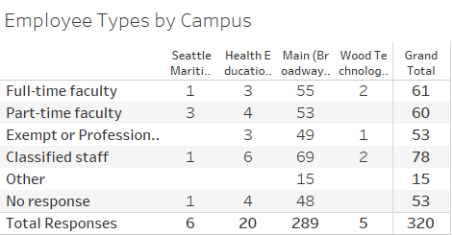

Slide 16
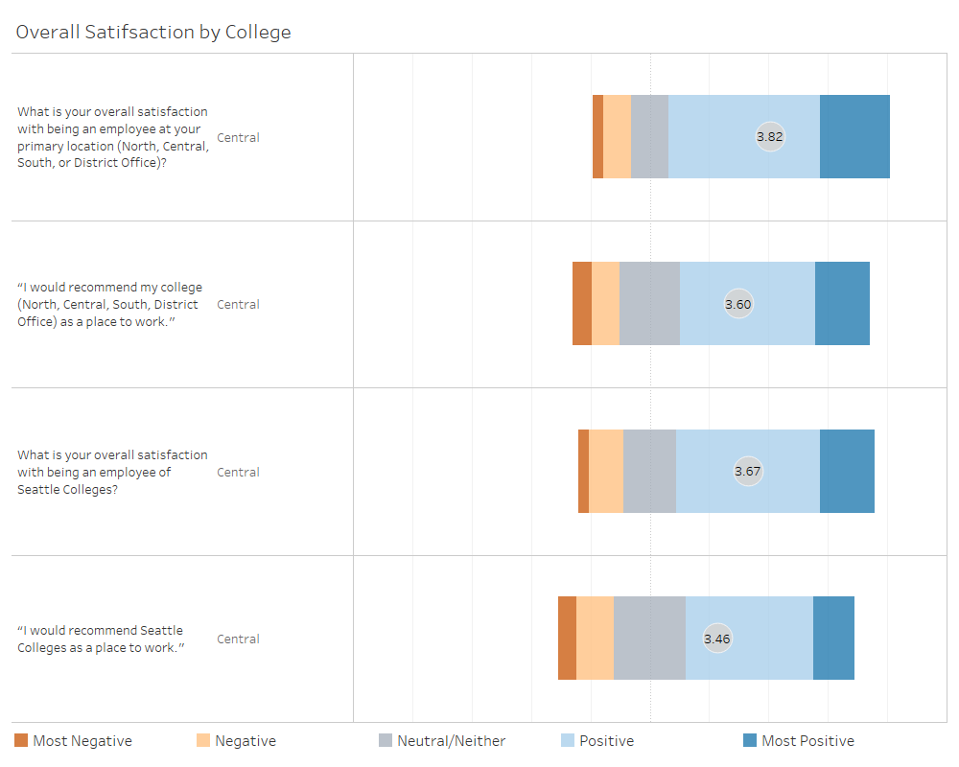
Overall Satisfaction

Slide 17
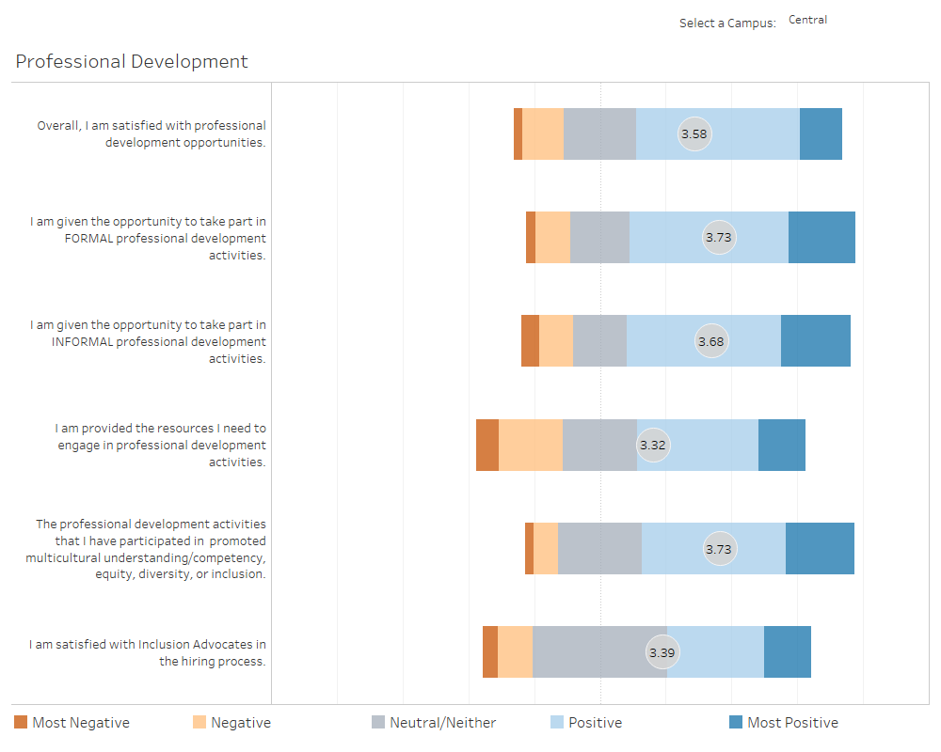
Professional Development

Slide 18
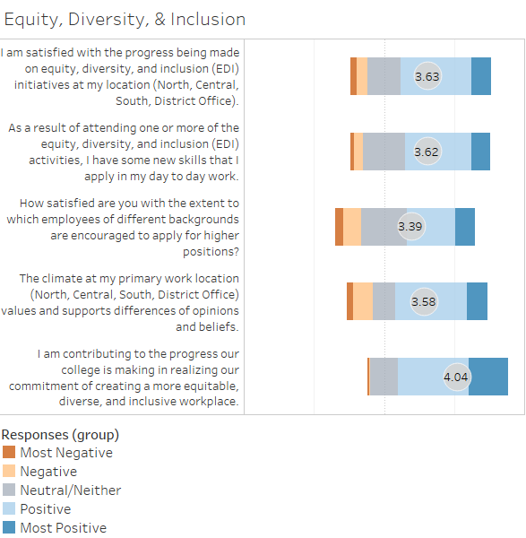
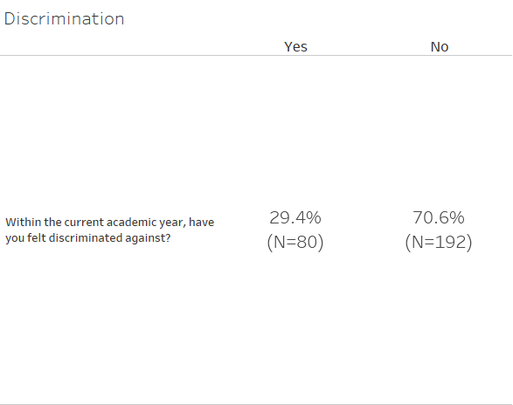
Equity, Diversity & Inclusion

Slide 19
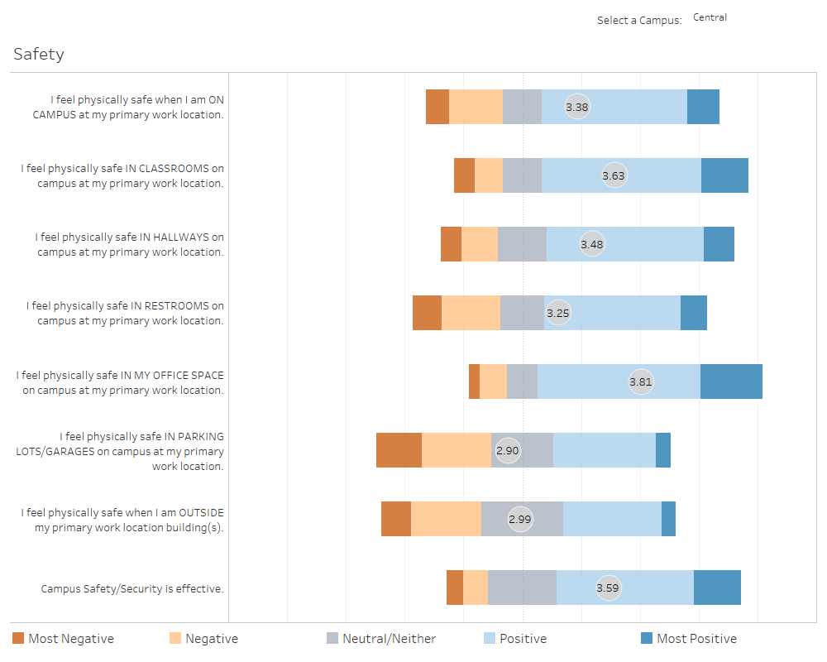
Safety

Slide 20
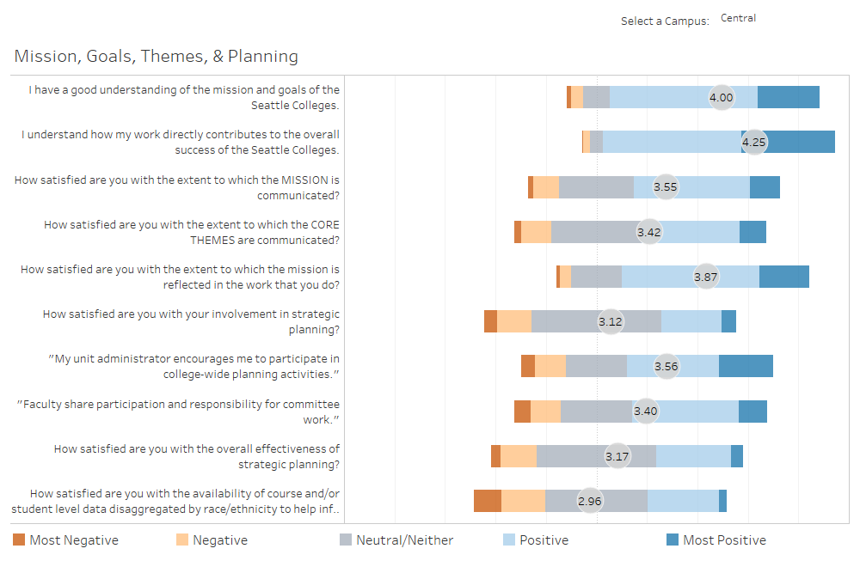
Mission, Goals, Themes & Planning

Slide 21
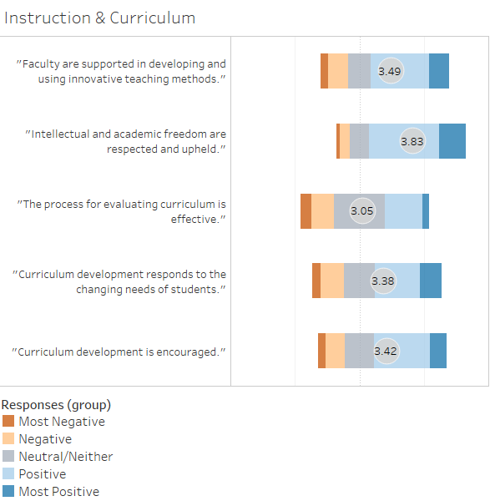
Faculty – Instruction & Curriculum

Slide 22
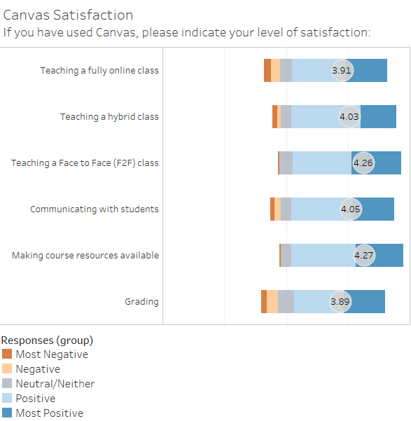
Faculty – Canvas Satisfaction

