Slide 1
Utility Data
Comparison of FY16 and FY17 annual and quarterly data

Slide 2
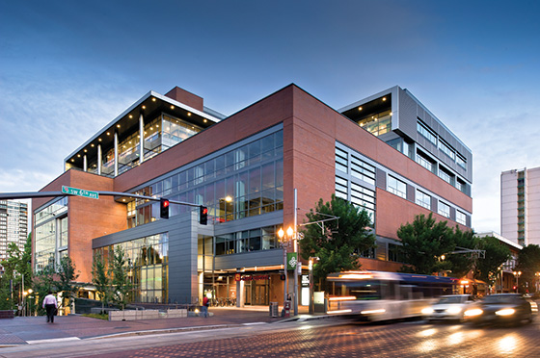
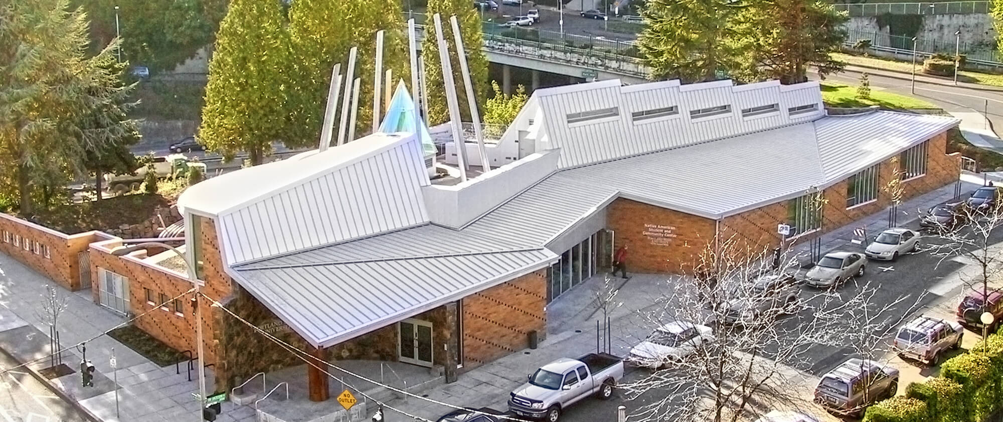
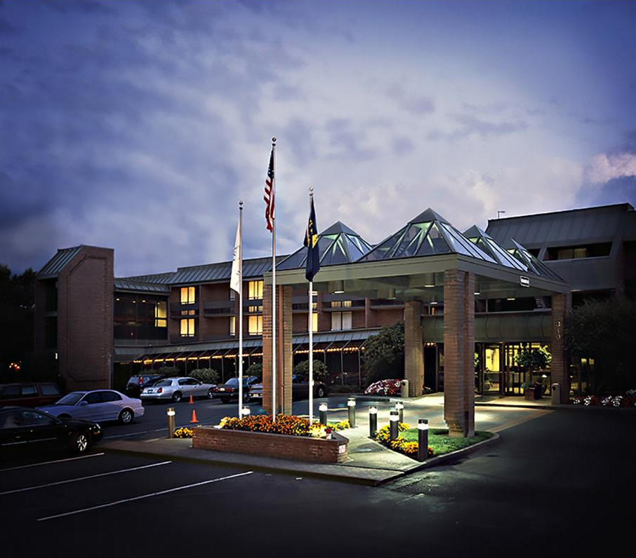
Auxiliary Buildings
FY16 & FY17 comparison of energy use intensity, electricity use, gas use, and water use

Slide 3
Auxiliary Building Annual EUI Average

Slide 4
Q1 Auxiliary Building Average EUI

Slide 5
Q2 Auxiliary Building Average EUI

Slide 6
Q3 Auxiliary Building Average EUI

Slide 7
Q4 Auxiliary Building Average EUI

Slide 8
Auxiliary Buildings Annual Electricity Use

Slide 9
Auxiliary Building Annual Natural Gas Use

Slide 10
Auxiliary Building Annual Water Use

Slide 11
Academic & Student Recreation Center Monthly Electricity Use

Slide 12
Academic & Student Recreation Center Monthly Gas Use

Slide 13
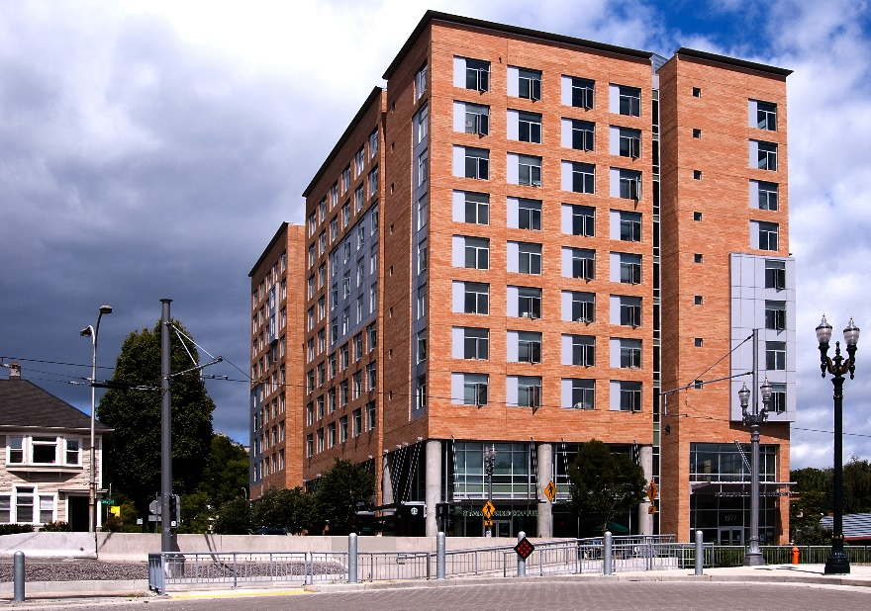
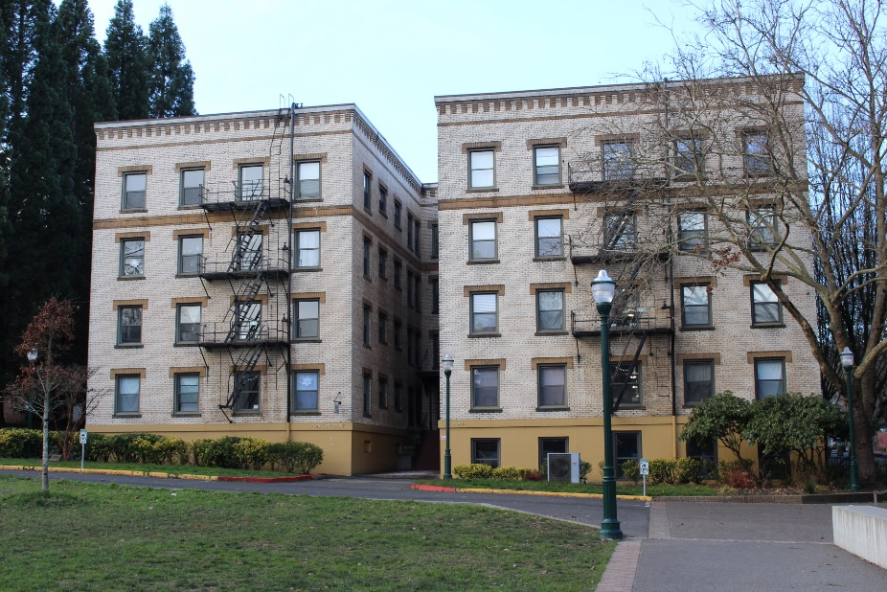
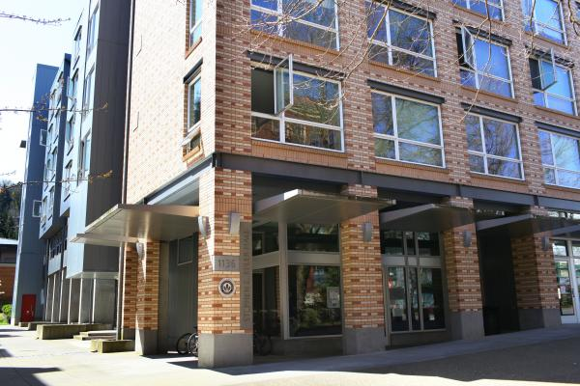
Housing Buildings
FY16 & FY17 comparison of energy use intensity, electricity use, gas use, and water use

Slide 14
Housing Building Average EUI

Slide 15
Q1 Housing Building Average EUI

Slide 16
Q2 Housing Building Average EUI

Slide 17
Q3 Housing Building Average EUI

Slide 18
Q4 Housing Building Average EUI

Slide 19
Housing Building Annual Electricity Use

Slide 20
Housing Building Annual Natural Gas Use

Slide 21
King Albert Monthly Electricity Use

Slide 22
King Albert Monthly Gas Use

Slide 23
Housing Building Annual Water Use

Slide 24
Montgomery Monthly Water Use

Slide 25
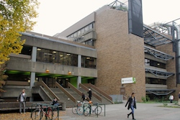
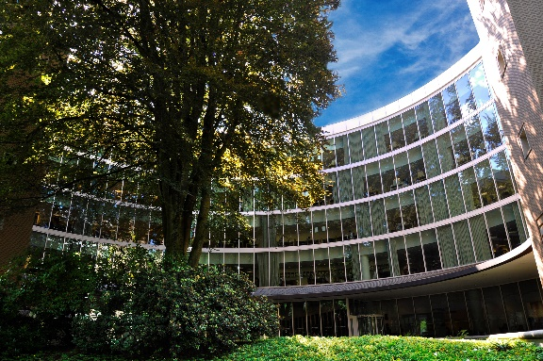
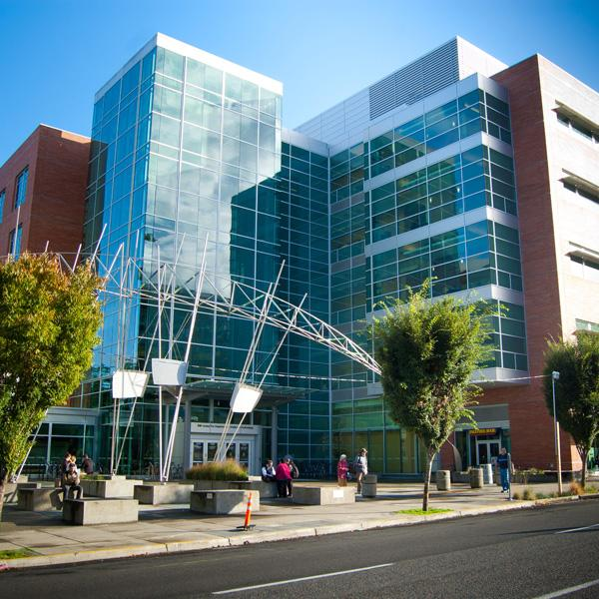
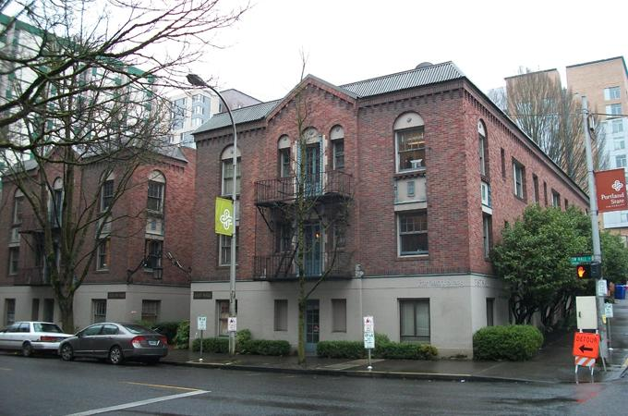
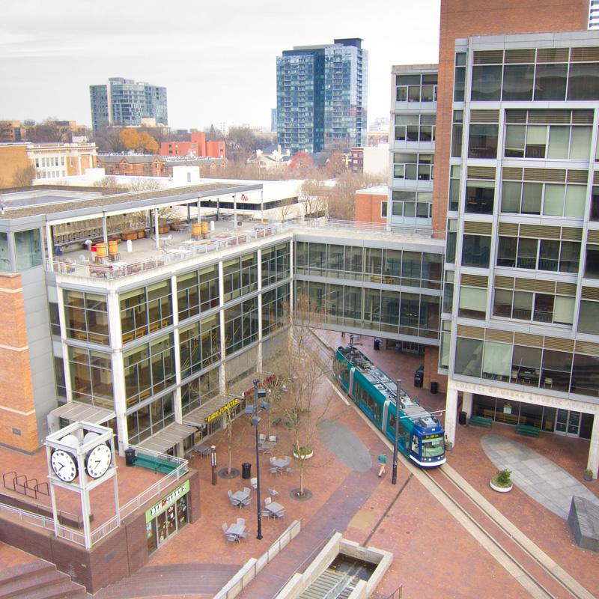
E&G Buildings
FY16 & FY17 comparison of energy use intensity, electricity use, gas use, and water use

Slide 26
E&G FY17 Average Annual EUI (highest – lowest)

Slide 27
E&G (>30,000gsf) Average Annual EUI

Slide 28
Q1 E&G (>30,000gsf) Average EUI

Slide 29
Q2 E&G (>30,000gsf) Average EUI

Slide 30
Q3 E&G (>30,000gsf) Average EUI

Slide 31
Q4 E&G (>30,000gsf) Average EUI

Slide 32
E&G (>30,000gsf) Annual Electricity Use

Slide 33
Harrison Street Building Monthly Electricity Use

Slide 34
Campus Public Safety Monthly Electricity Use

Slide 35
E&G (>30,000gsf) Annual Natural Gas Use

Slide 36
Harrison Street Building Monthly Gas Use

Slide 37
Campus Public Safety Monthly Gas Use

Slide 38
E&G (>30,000gsf) Annual Water Use

Slide 39
President’s Residence Monthly Water Use

Slide 40
E&G (30,000-130,000gsf) Average Annual EUI

Slide 41
Q1 E&G (30,000-13,000gsf) Average EUI

Slide 42
Q2 E&G (30,000-130,000gsf) Average EUI

Slide 43
Q3 E&G(30,000-130,000gsf) Average EUI

Slide 44
Q4 E&G (30,000-130,000gsf) Average EUI

Slide 45
E&G (30,000-130,000gsf) Annual Electricity Use

Slide 46
Parkmill Monthly Electricity Use

Slide 47
Science Building 1 Monthly Electricity Use

Slide 48
E&G (30,000-130,000gsf) Annual Natural Gas Use

Slide 49
Parkmill Monthly Gas Use

Slide 50
Science Building 1 Monthly Gas Use

Slide 51
E&G (30,000-130,000gsf) Annual Water Use

Slide 52
Parkmill Monthly Water Use

Slide 53
E&G (over 130,000gsf) Average Annual EUI

Slide 54
Q1 E&G (<130,000gsf) Average EUI

Slide 55
Q2 E&G (<130,000gsf) Annual EUI

Slide 56
Q3 E&G (<130,000gsf) Average EUI

Slide 57
Q4 E&G (<130,000gsf) Average EUI

Slide 58
E&G (<130,000gsf) Annual Electricity Use

Slide 59
E&G (<130,000gsf) Annual Natural Gas Use

Slide 60
E&G (<130,000gsf) Annual Water Use

Slide 61
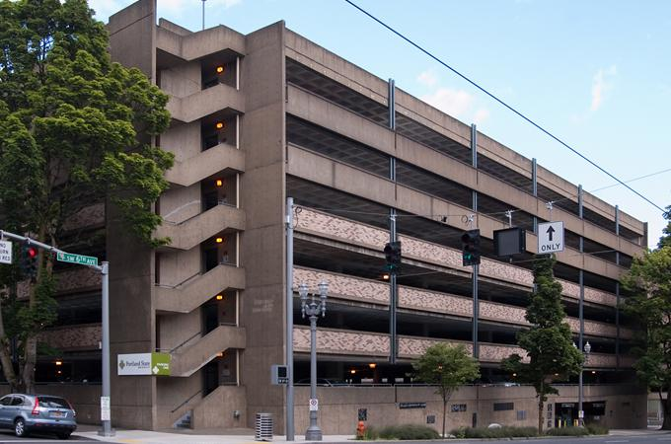
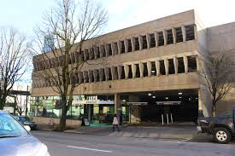
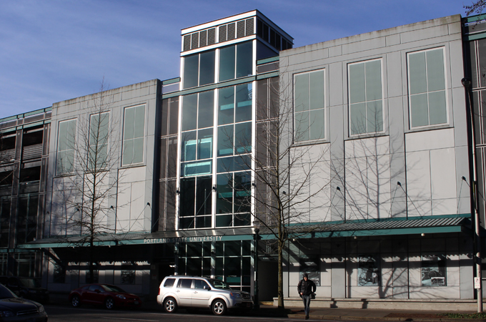
Parking Buildings
FY16 & FY17 comparison of energy use intensity, electricity use, gas use, and water use

Slide 62
Parking Building Average Annual EUI

Slide 63
Parking Building Annual Electricity Use

