Slide 1
SUSTAINABILITY @ ACG
Because ACG Cares!

Slide 2
What is Sustainability?

Slide 3
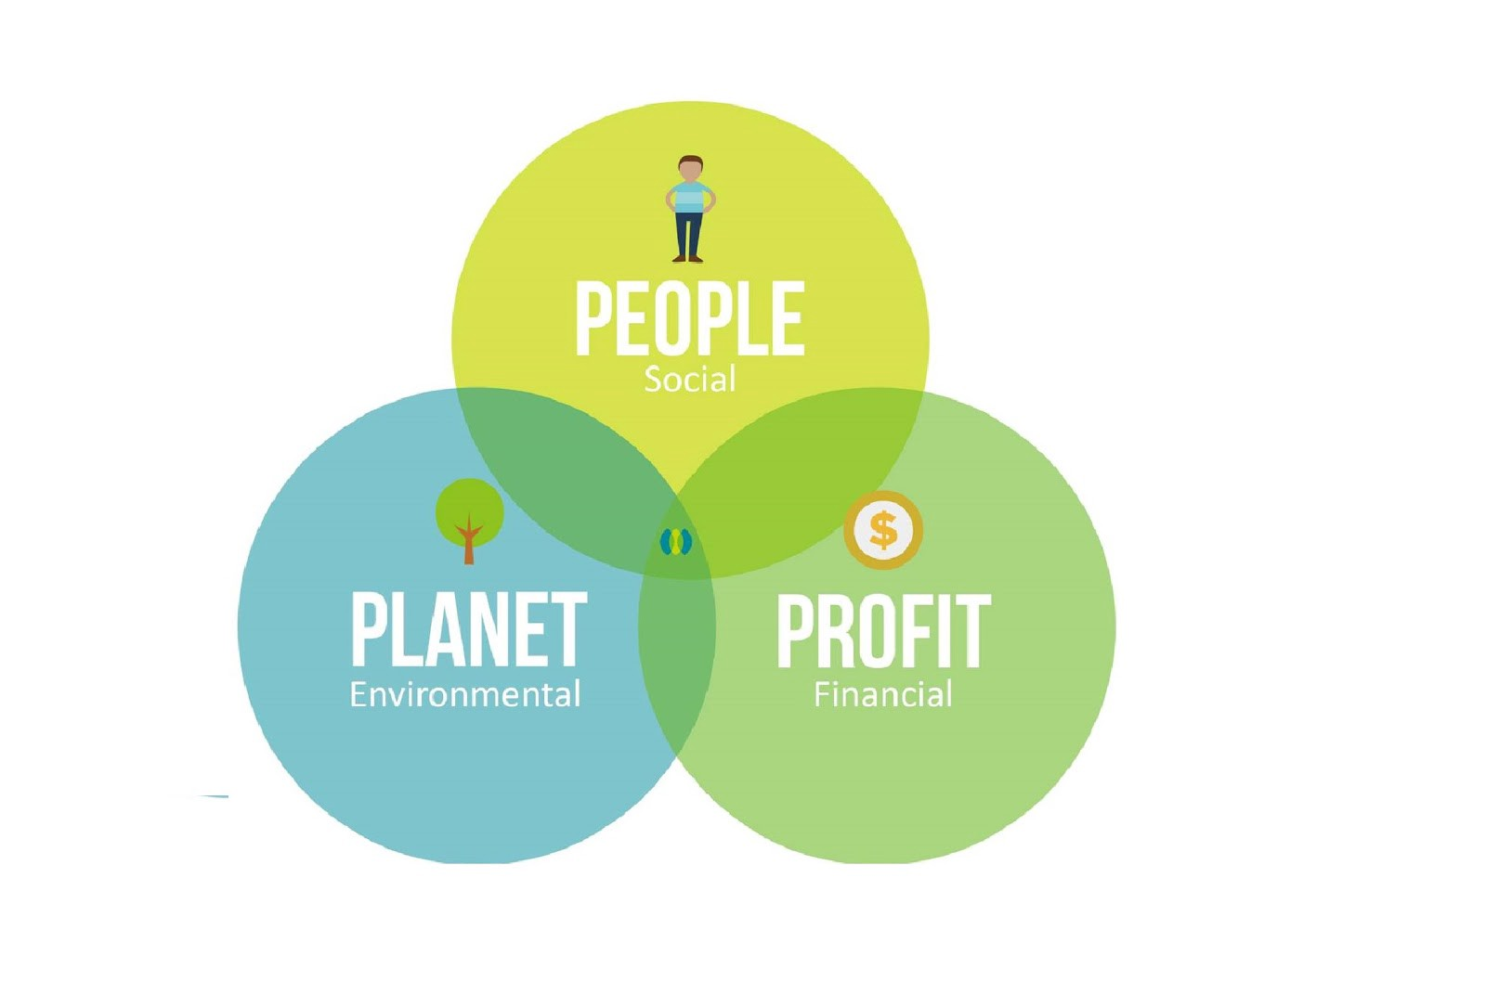
Sustainability and the UN SDGs
“Meeting the needs of the present without compromising the ability of future generations to meet their needs.”

Slide 4
Sustainability@ACG: FORGING A SUSTAINABLE FUTURE!
Our Vision
ACG aims to be a national leader in sustainability among academic institutions, by actively contributing to a more inclusive, socially responsible, financially viable and environmentally sustainable society.
Our Mission
To raise awareness and engagement of ACG students with sustainability best practices and empower them to become knowledgeable, sensitized and responsible citizens of the world.

Slide 5
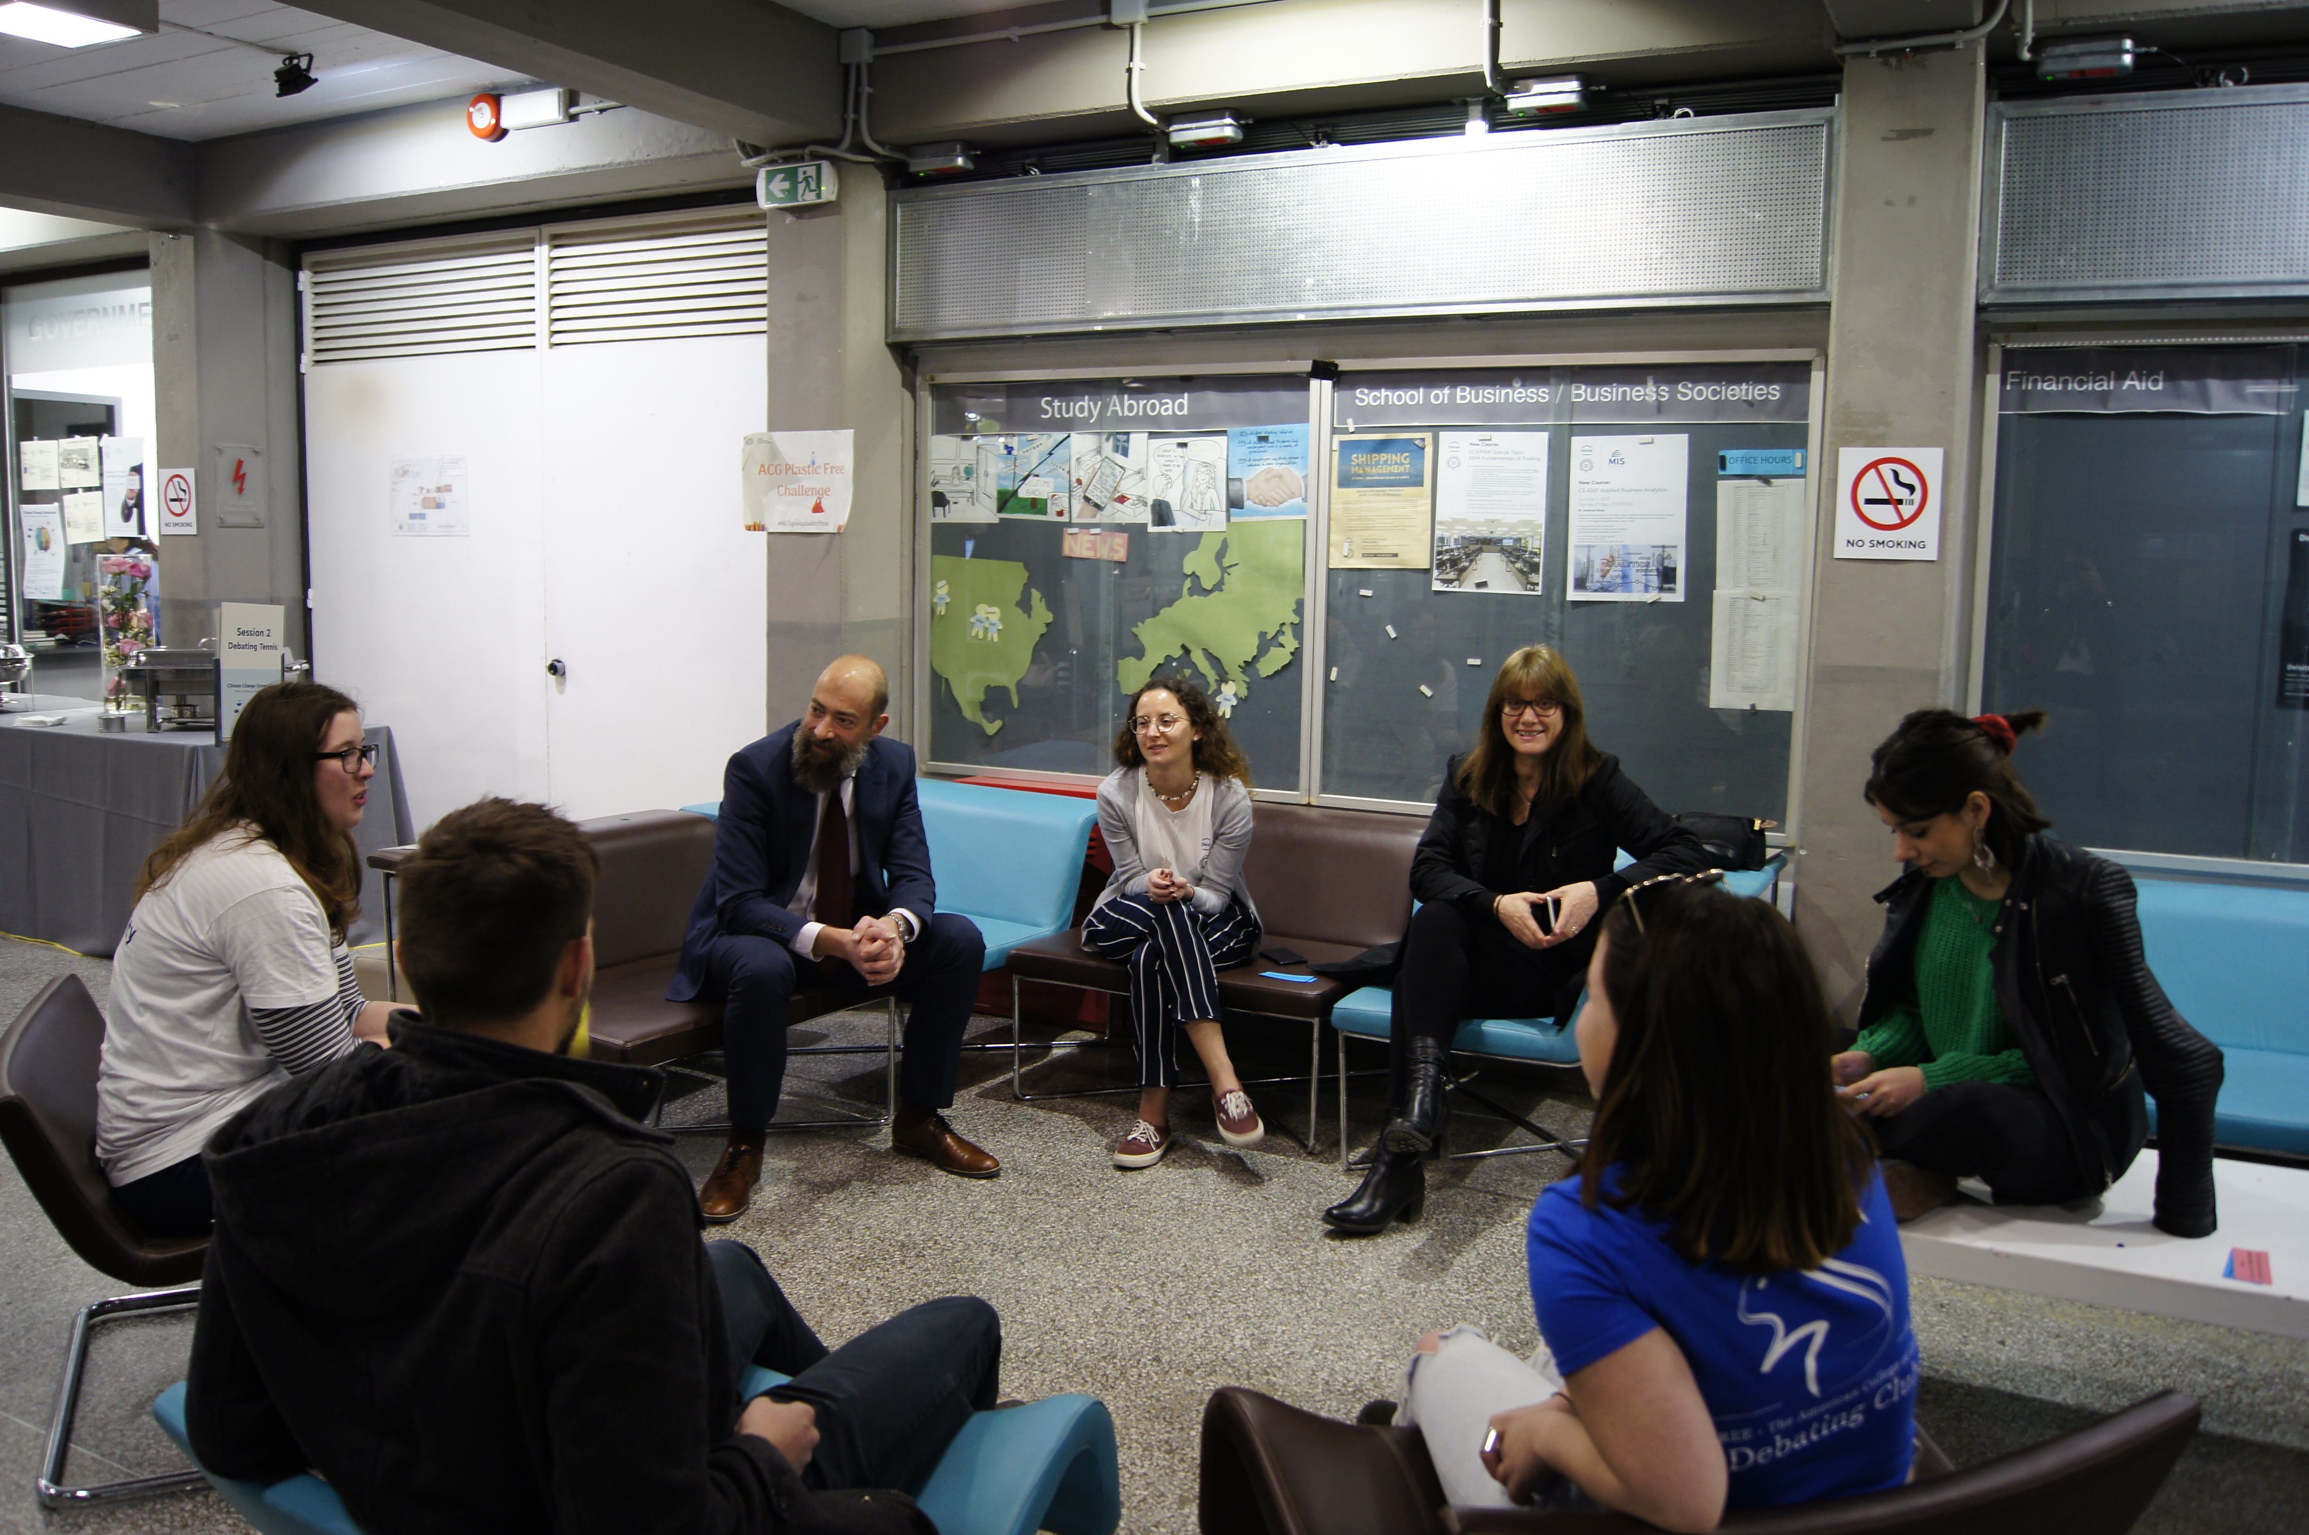
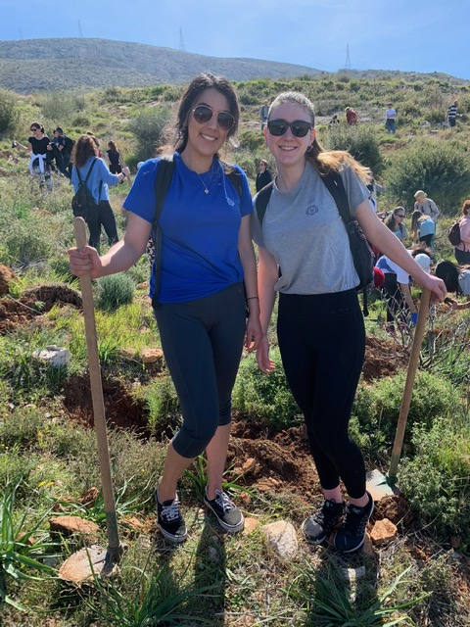
Sustainability@ACG: FORGING A SUSTAINABLE FUTURE!
We commit to
EDUCATE
INSPIRE
EMPOWER

Slide 6
#ACGGoesplasticfree campaign
84,684 WATER BOTTLES
125,800 COFFEE CUPS
ON CAMPUS!

Slide 7
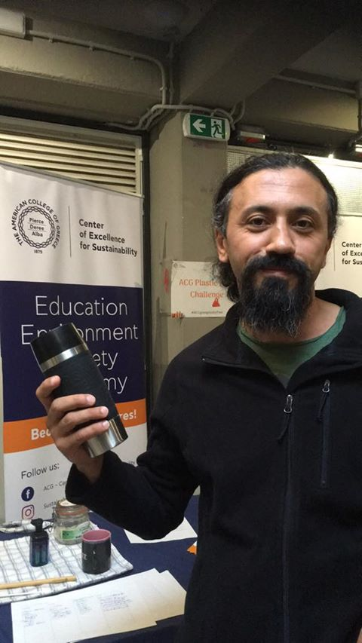
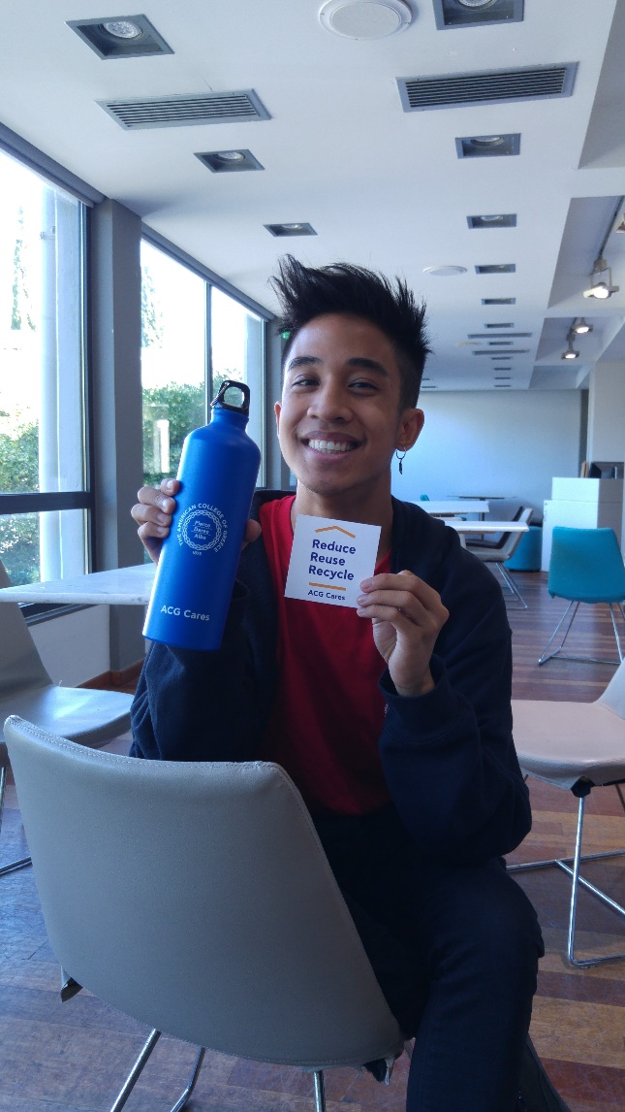
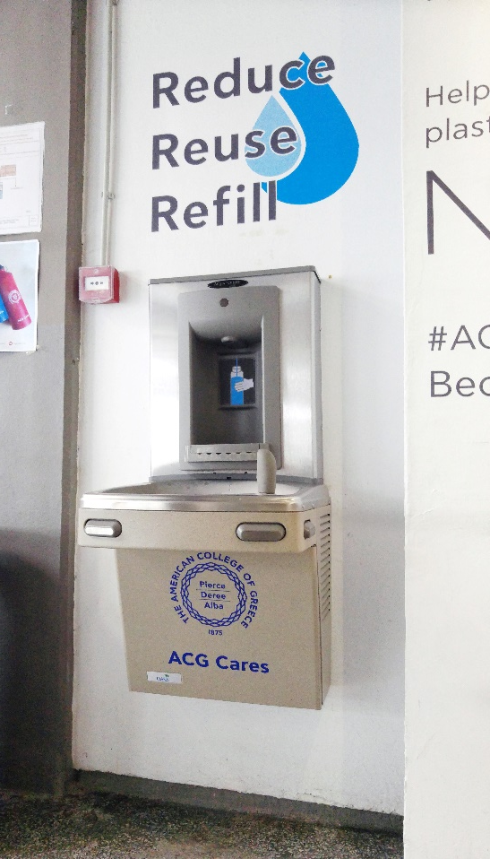
#ACGGoesplasticfree campaign

Slide 8
#ACGGoesplasticfree campaign

Slide 9
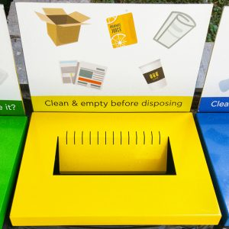
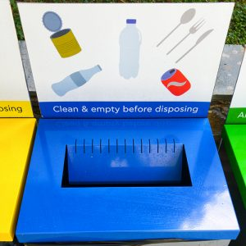
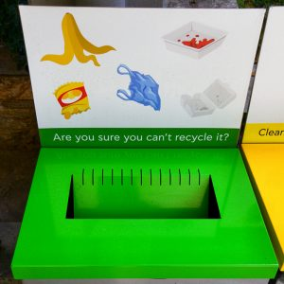
REDUCE - REUSE - RECYCLE
Various recycling points on campus
Three bins – yellow, blue, and green
Mixed recyclable items
(glass, plastics, aluminum)
Residual waste aka non-recyclable items!
Paper & cardboard items

Slide 10
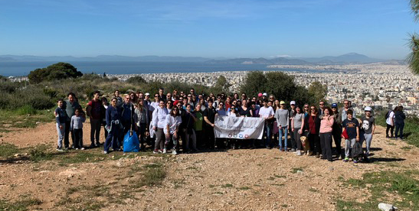
ACG Community service day
Volunteering and participation in community service activities form a major part of ACG’s social contribution and impact.
Fall 2016: «ACG Community Service Day» is established.
Twice a year, celebrating Thanksgiving & Easter spirit.
The ACG Community (students, faculty, staff and alumni) get together voluntarily!

Slide 11
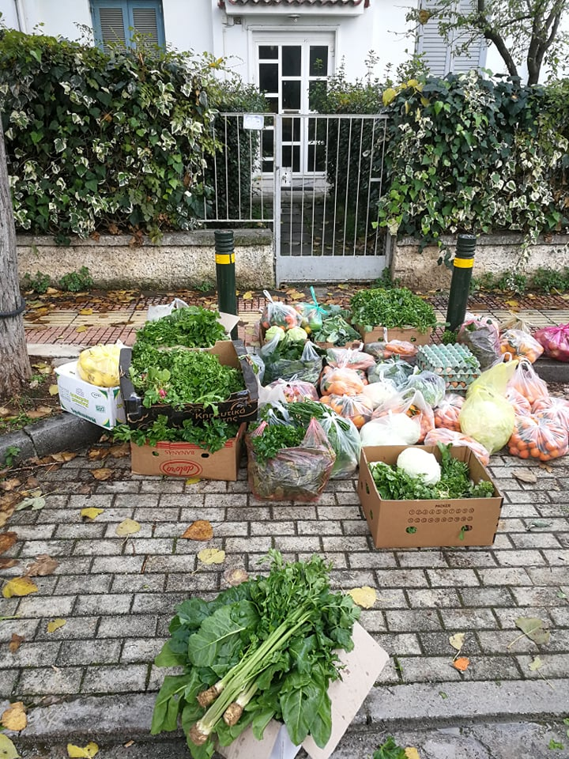
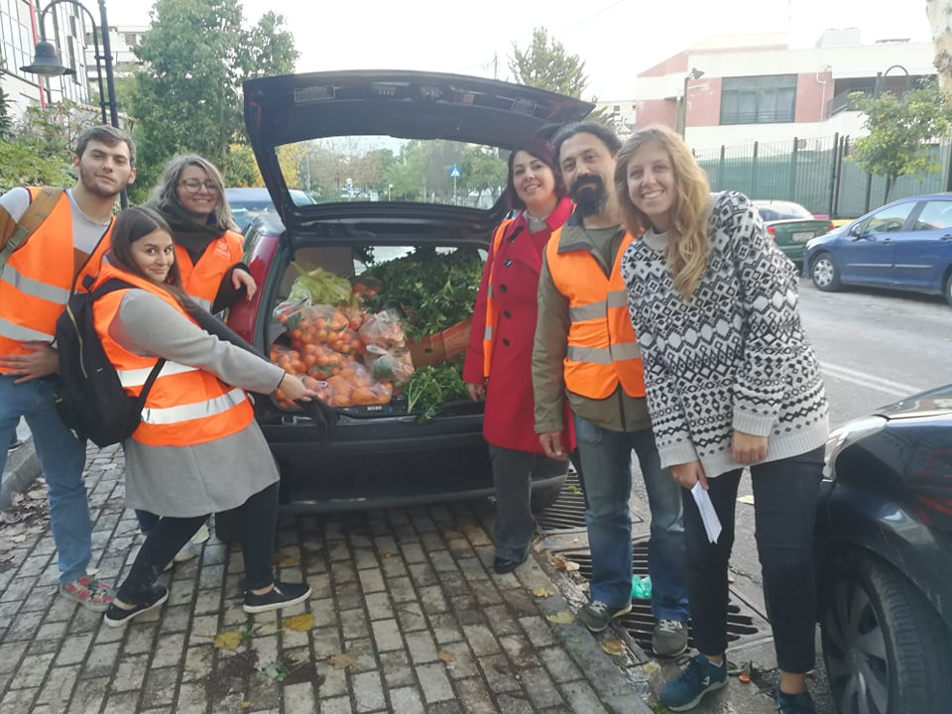
ACG FARMERS’ MARKET: COLLABORATION WITH ‘BOROUME’
3394 kg of fruits, veggies, fish, and eggs
194 volunteer hours
Supporting the Ieros Naos Faneromenis at Neo Psychiko

Slide 12
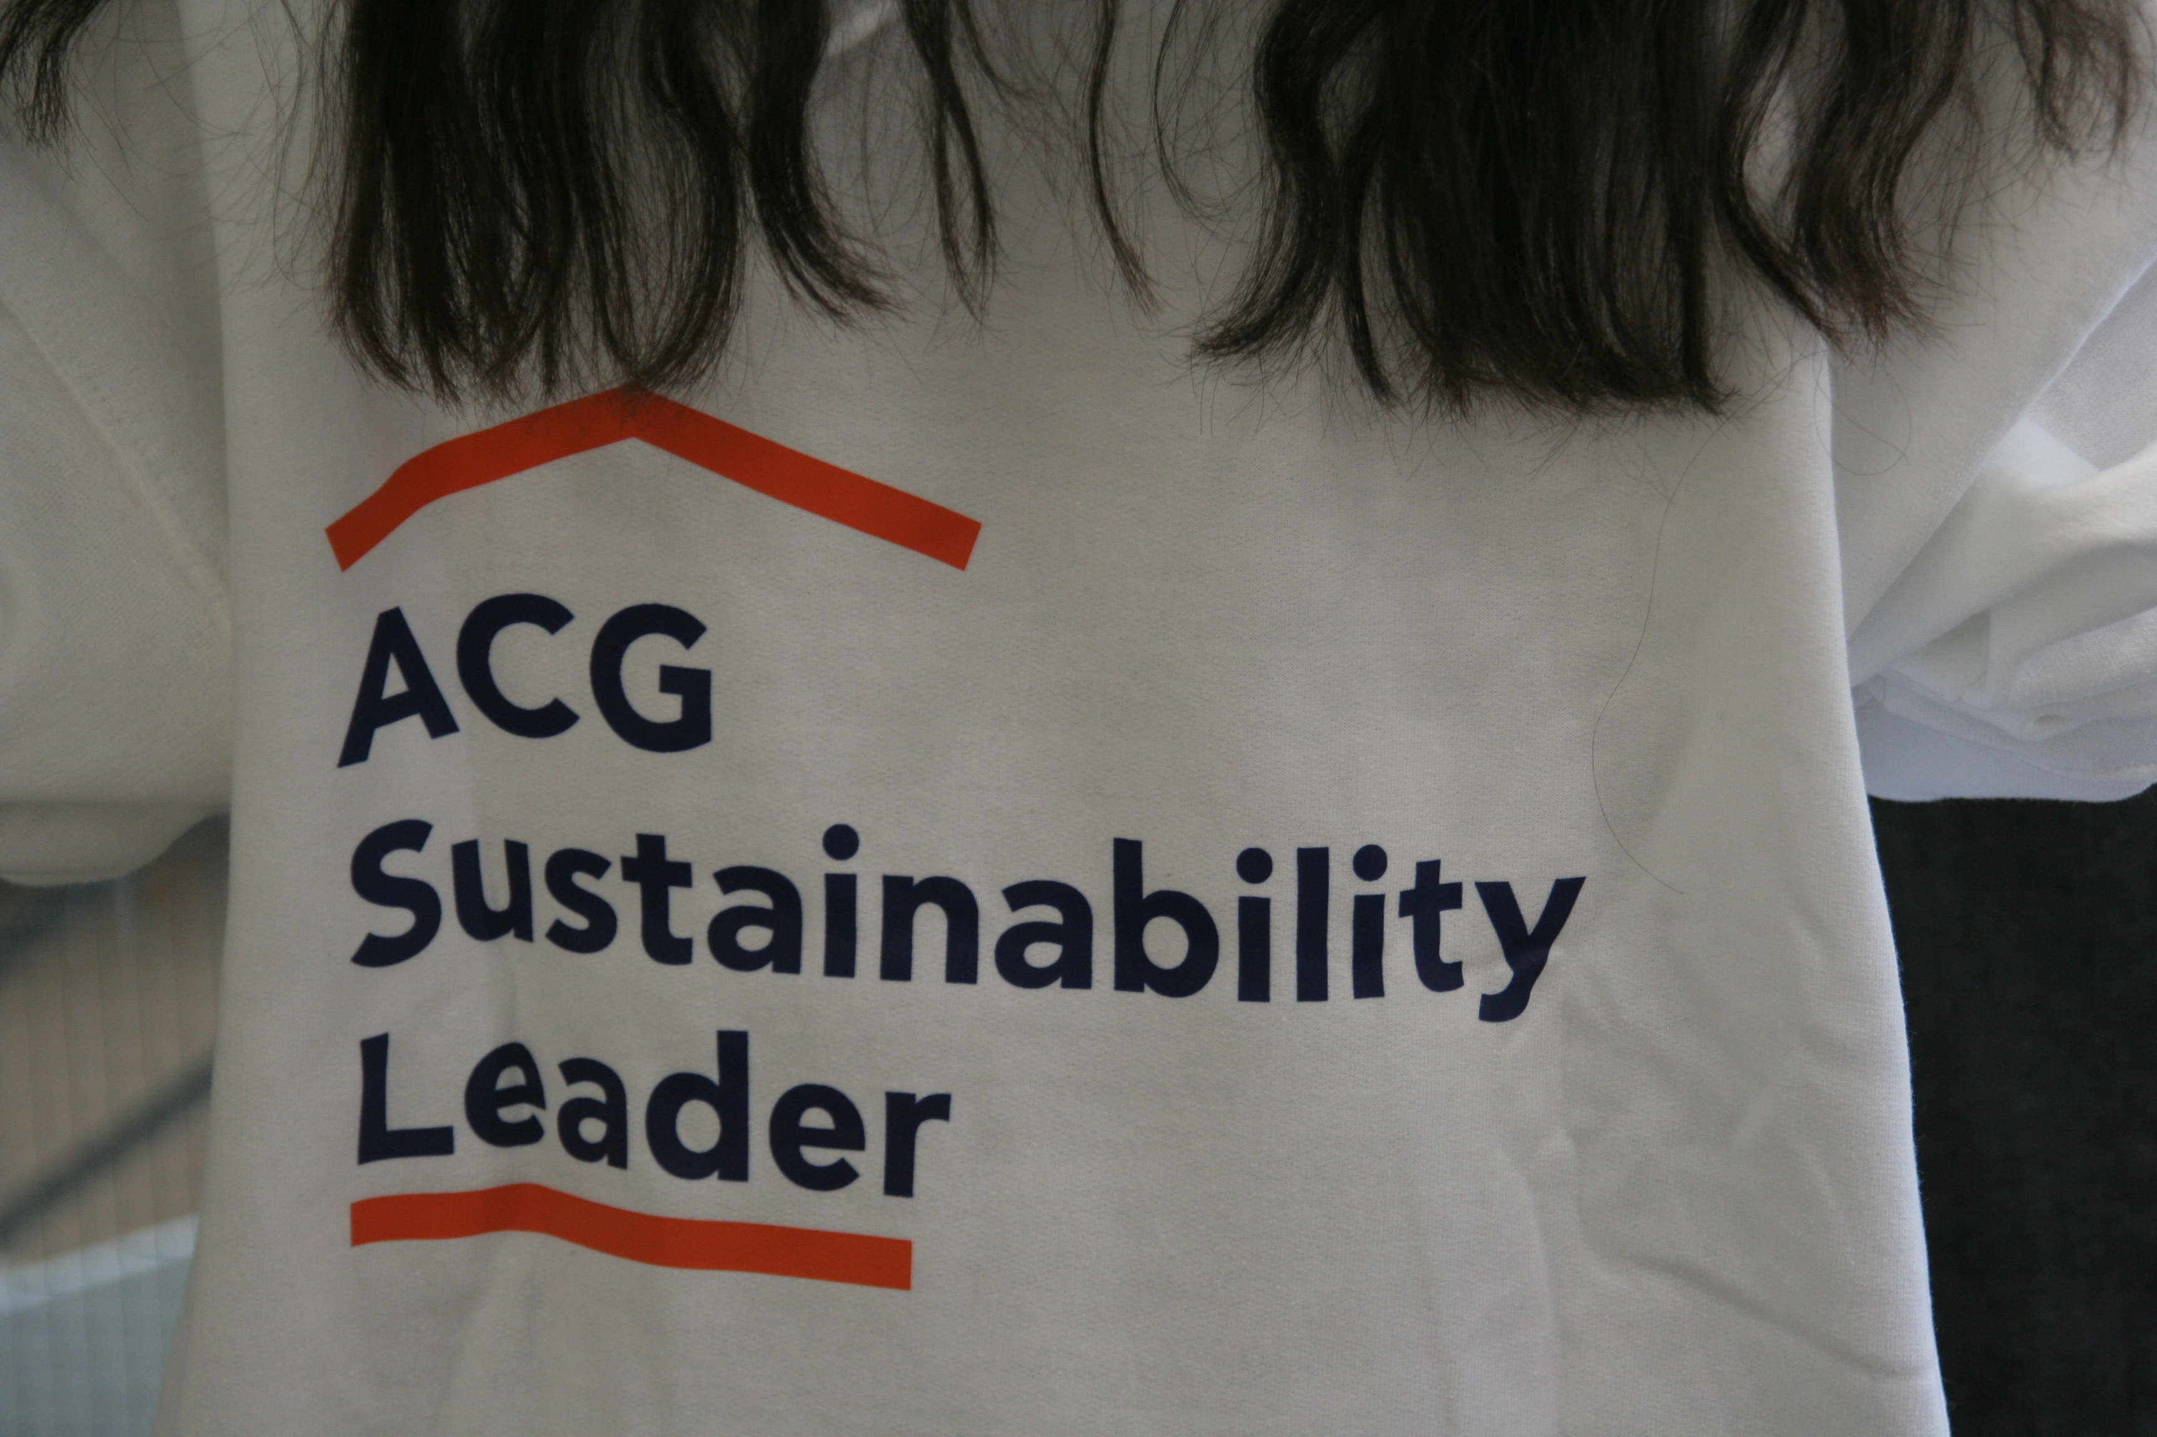
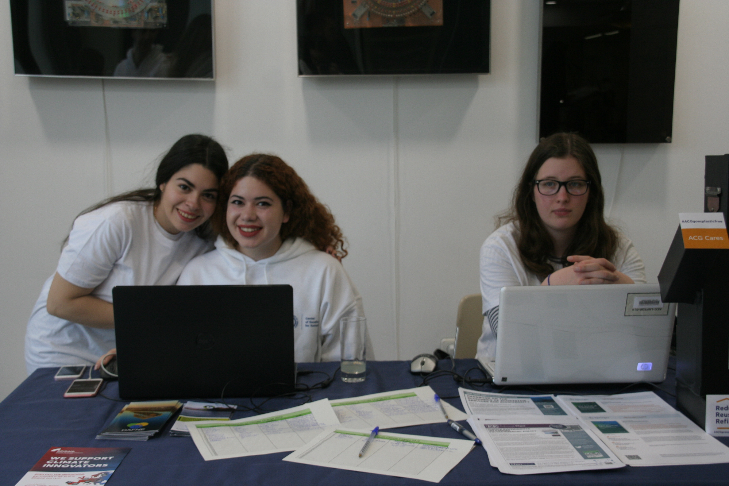
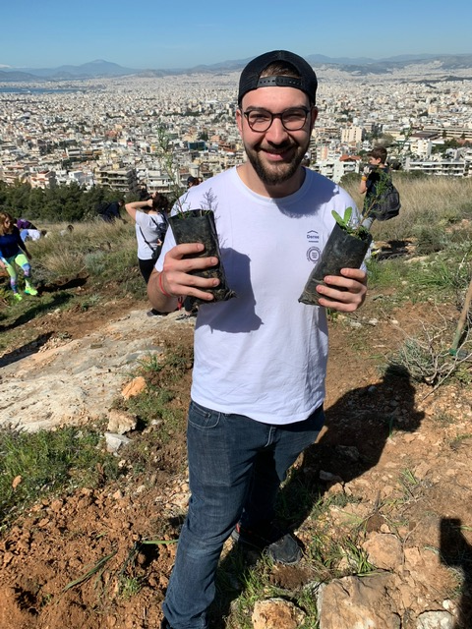
ACG SUSTAINABILITY LEADERS
The Sustainability Leader profile:
Mission
The ACG Sustainability Leaders group is a team of student volunteers who participate in diverse activities and events aimed at motivating, inspiring and raising awareness towards a culture of Sustainability both on and off the ACG campus.
Passionate about environmental, social, and economic issues.
Enthusiastic about learning and promoting sustainable living among peers, faculty and staff.
Wanting to make a difference in our community.

Slide 13
Sustainability @ACG ON SOCIAL MEDIA
@SustainabilityAtACG
@SustainableACG

Slide 14
Contact us!
Pass by the Office of Public Affairs (room 209)
sustainableacg@acg.edu
DC Student Services
Sustainabilty@ACG

