Slide 1
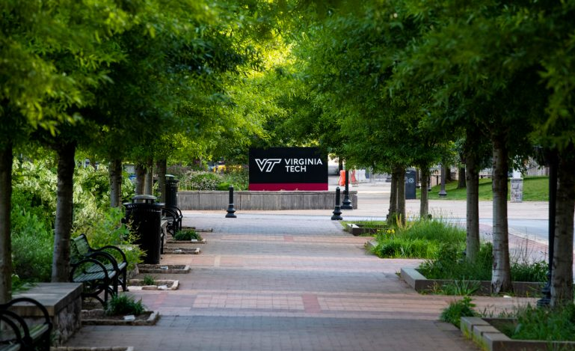
Sustainability at Virginia Tech
Sustainability is the simultaneous pursuit of environmental quality, economic prosperity, and social justice and equity, through action, education, and engagement to address current needs without compromising the capacity and needs of future generations.
Vision of the Virginia Tech Climate Action Commitment: “In the spirit of Ut Prosim, Virginia Tech will be a leader in climate action in service to our community, the Commonwealth, and the world.”
Sustainable Dining: https://dining.vt.edu/sustainability.html
Alternative Transportation: https://parking.vt.edu/alternative.html
Waste Management (Recycling & Trash): https://www.facilities.vt.edu/sustainability/recycling.html
The Virginia Tech Office of Sustainability serves as the primary, central source of sustainability information and coordination to the campus community. More information is available on their website: https://www.facilities.vt.edu/sustainability.html. For specific questions, contact the Campus Sustainability Manager at sustainability@vt.edu.

