Slide 1
ROPA
&
Sustainability Solutions
FY16 Emerson College
Presenters: Dan Willman & Cesar Perez
December 2016

Slide 2
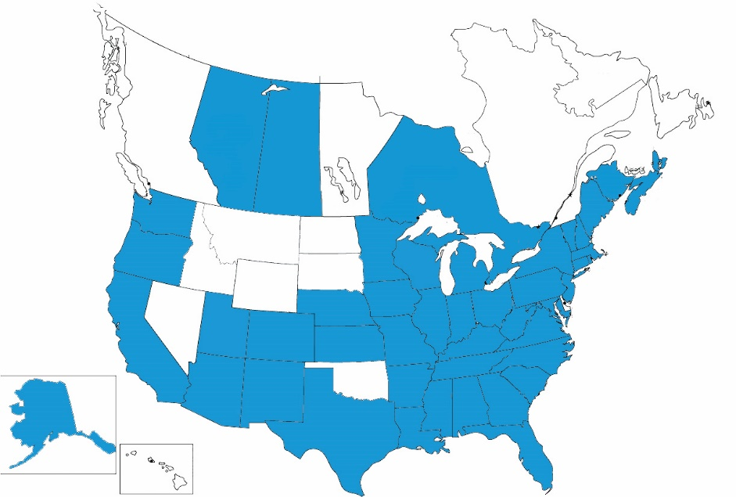
Who Partners with Sightlines?
Robust membership includes colleges, universities, consortiums and state systems
Sightlines is proud to announce that:
450 colleges and universities are Sightlines clients including over 325 ROPA members.
Consistently over 90% member retention rate
We have clients in over 40 states, the District of Columbia and four Canadian provinces
More than 125 new institutions became Sightlines members since 2013
Sightlines advises state systems in:
Alaska
California
Florida
Hawaii
Maine
Massachusetts
Minnesota
Mississippi
Missouri
Nebraska
New Hampshire
New Jersey
Pennsylvania
Texas
Serving the Nation’s Leading Institutions:
70% of the Top 20 Colleges*
75% of the Top 20 Universities*
34 Flagship State Universities
14 of the 14 Big 10 Institutions
9 of the 12 Ivy Plus Institutions
* U.S. News 2016 Rankings

Slide 3
A Vocabulary for Measurement
The Return on Physical Assets – ROPASM
The annual investment needed to ensure buildings will properly perform and reach their useful life
“Keep-Up Costs”
The accumulation of repair and modernization needs and the definition of resource capacity to correct them
“Catch-Up Costs”
The effectiveness of the facilities operating budget, staffing, supervision, and energy management
The measure of service process, the maintenance quality of space and systems, and the customers opinion of service delivery
Annual
Stewardship
Asset
Reinvestment
Operational
Effectiveness
Service
Asset Value Change
Operations Success

Slide 4
Building Connections
Facilities intelligence toolkit that connects the dots between space, capital and operating policies

Slide 5
Peer Institutions
ROPA+ Analysis includes 1.18M GSF
Institution | Location
Berklee College of Music | Boston, MA
Drexel University | Philadelphia, PA
Illinois Institute of Technology | Chicago, IL
Massachusetts College of Art and Design | Boston, MA
Northeastern University | Boston, MA
Pace University | New York City, NY
The College of Saint Rose | Albany, NY
The New School | New York, NY
University of San Francisco | San Francisco, CA
Widener University | Chester, PA
Peer Avg = 513
Peer Avg = 3.0
Comparative Considerations
Size, technical complexity, region, geographic location, and setting are all factors included in the selection of peer institutions

Slide 6
Putting Your Campus Building Age in Context
See Edit Data – calculations now done via the BI template and pasted in
standard is for the years to lead up to the increment.
Examples:
2010 includes all GSF from 2006-2010
2015 includes all GSF from 2011-2015
The campus age drives the overall risk profile
Pre-War
Built before 1951
Post-War
Built from 1951 to 1975
Modern
Built from 1976 to 1990
Durable construction
Older but typically lasts longer
Complex
Lower-quality construction
Already needing more repairs and renovations
Quick-flash construction
Low-quality building components
Built in 1991 and newer
Technically complex spaces
Higher-quality, more expensive to maintain & repair
Pre-War
Post-War
Modern
Complex
Emerson = 78%
Emerson = 22%

Slide 7
Campus Age Profile – “Barbell” Campus
Understanding the impact of age on capital & operations
Buildings over 50
Life cycles of major building components are past due. Failures are possible. Core modernization cycles are missed.
Highest risk
High Risk
High Risk
High Risk
Buildings 25 to 50
Major envelope and mechanical life cycles come due. Functional obsolescence prevalent.
Higher Risk
Buildings 10 to 25
Short life-cycle needs; primarily space renewal.
Medium Risk
Buildings Under 10
Little work. “Honeymoon” period.
Low Risk

Slide 8
Resetting the Clock Through Renovations
*Peers ordered by increasing tech rating.

Slide 9
Asset Value Change

Slide 10
Total Capital Investment
Average total investment of $30.1M from FY07-FY16
Paramount Theater
LA Campus
2 Boylston

Slide 11
Total Capital Investment into Existing Space
Average investment of $7.0M into existing space from FY07-FY16

Slide 12
Similar, But Inconsistent Investment Into Existing Space
Emerson spending in existing space has decreased the past 3 years
Peers
Emerson
5-year Avg: $5.89/GSF
5-year Avg: $4.25/GSF

Slide 13
Defining an Annual Investment Target
$8M Annual Investment would keep backlog at steady state
Replacement Value: $574M
Functional obsolescence drives investment prior to life cycles & discounts the annual investment target

Slide 14
Chasing a Moving Target
Increasing Net Asset Value
Lowering Risk Profile
Increasing Backlog & Risk

Slide 15
Funding by Age Category
Annual Stewardship (AS) and Asset Reinvestment (AR)
Notes:
G doesn't have a grounds dept.

Slide 16
Comparing Funding Strategies
Peers
Emerson

Slide 17
Project Package Breakout
Higher investment into higher ROI projects than peers
Emerson
(FY07 – FY16)
Peers
Emerson
Peers
(FY07 – FY16)

Slide 18
Underfunding Target Increases Backlog on Campus
Emerson’s asset reinvestment need increased 26% in the last 5 years
Peers
Emerson

Slide 19
Net Asset Value Compared to Peers
Emerson’s manageable backlog helps maintain NAV close to peer levels
Investment Strategy
“Keep Up” Stage: Primarily new or recently renovated buildings with sporadic building repair & life cycle needs
Balanced Profile Stage: Buildings are beginning to show their age and may require more significant investment and renovation on a case-by-case basis
“Catch Up” Stage: Buildings require more significant repairs; major building components are in jeopardy of complete failure; large-scale capital infusions or renovations are inevitable
Transitional/Gut Renovation/Demo Stage: Major buildings components are in jeopardy of failure. Reliability issues are widespread throughout the building.
Net Asset Value =
Replacement Value – Backlog
Replacement Value
Increasing Tech Rating

Slide 20
Operations Success

Slide 21
Operating Actuals vs. Peers (Unadjusted)
Peers
Emerson

Slide 22
Daily Service & Planned Maintenance (Unadjusted)
Increasing Tech Rating
Increasing Tech Rating
Notes:
MWCC = $3.98
Peers = $5.46

Slide 23
Daily Service & Planned Maintenance (COLI Adjusted)
Increasing Tech Rating
Increasing Tech Rating
Notes:
MWCC = $3.98
Peers = $5.46

Slide 24
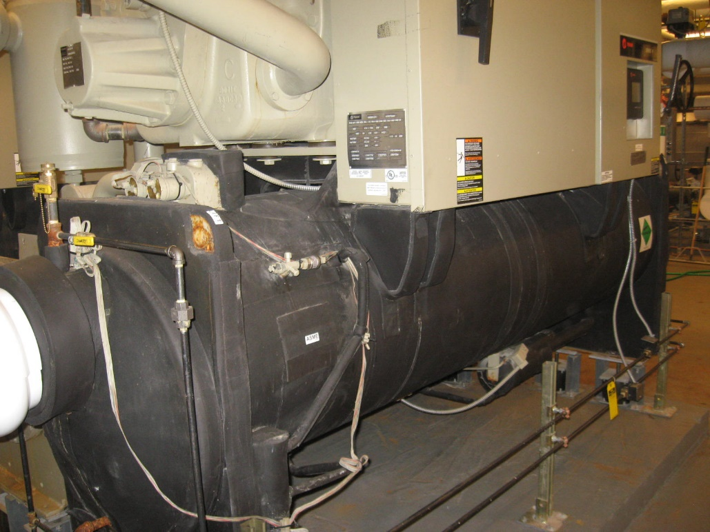
Emerson’s Regional Energy Peer Group
Energy Peer Institutions
Babson College
Bentley University
Berklee College of Music
Boston College
Fitchburg State University
Framingham State University
University of Massachusetts - Lowell
Worcester State University
Westfield State University
Comparative Considerations
Size
Technical Complexity
Climate Zone

Slide 25
Energy Consumption vs. Regional Peers
Both Fossil and Electric consumption have trended down the last 3 years
Peers
Emerson
38.8K
49.3K
Peers
Emerson
64.9K
55.3K
Peers ordered by technical complexity
Energy Peers: Babson College, Bentley University, Berklee College of Music, Boston College, Fitchburg State University, Framingham State University, Umass – Lowell, Worcester State University, Westfield State University

Slide 26
Energy Cost vs. Regional Peers
Fossil cost impacted by steam use
Peers
Emerson
$0.14
$0.17
Peers
Emerson
$13.2
$19.8
Peers ordered by technical complexity
Energy Peers: Babson College, Bentley University, Berklee College of Music, Boston College, Fitchburg State University, Framingham State University, Umass – Lowell, Worcester State University, Westfield State University

Slide 27
Maintenance Department
Maintenance staff covering similar space with closer supervision
12.5
81K
$0.23
General Repair Score
Peers ordered by technical complexity

Slide 28
Custodial Department
Custodial staff covering similar space than peers with higher density
16.9
32K
$0.18
Cleanliness Score
Peers ordered by density factor

Slide 29
Sustainability Peer Comparison Group
Emerson College | 4,454 | 3.1 | 2 | Large City
Institution | Student Enrollment (FY16) | Technical Complexity (1-5) | Climate Zone | Urbanization
Babson College | 2,801 | 2.5 | 2 | Urban Fringe
Bentley University | 5,119 | 2.8 | 2 | Mid-Size City
Fitchburg State University | 5,046 | 2.6 | 2 | Large Town
Framingham State University | 5,743 | 2.7 | 2 | Large Town
University of Massachusetts - Lowell | 13,926 | 3.0 | 2 | Mid-Size City
Worcester State University | 5,340 | 3.2 | 2 | Mid-Size City
Westfield State University | 5,637 | 2.5 | 2 | Large Town

Slide 30
Overall Utility Consumption at Emerson: FY07-16
Scope 1
Scope 2

Slide 31
Overall Scope 1 Over Time
Stationary fuel consumption drives Scope 1 emissions

Slide 32
Overall Scope 1 vs. Peers
Peer average stationary emissions = 3.89 MTCDE/1,000 GSF
*Benchmark arrayed by Total BTU/GSF

Slide 33
Utility Breakout Differs from Peers
Scope 1 & Scope 2 Energy Consumption Over Time
(BTU/GSF)
Peers
Emerson

Slide 34
Utility Breakout Differs from Peers
Scope 1 & Scope 2 Energy Emissions Over Time
(MTCDE/1,000 GSF)
Peers
Emerson

Slide 35
Scope 3 Distribution
Study abroad and commuting attributes for more than half of scope 3 MTCDE

Slide 36
Total Waste on Campus
Equates to 0 MTCDE at Emerson due to type of landfill used

Slide 37
Total Air Travel Emissions

Slide 38
Total Scope 3 Emissions vs. Peers

Slide 39
FY16 Total MTCDE: 15,936
Energy consumption on campus makes up 62% of emissions profile
1,562

Slide 40
Total Gross Emissions

Slide 41
Normalized Emissions

Slide 42
2016 Performance Versus Peers
Scope 2 emissions push Emerson at or above peer average
11.7
*Benchmark arrayed by Density Factor
*Benchmark arrayed by Total BTU/GSF

Slide 43
2016 Net Emissions Versus Peers
Emerson normalized net emissions fall below peer average
11.1
3.4
*Benchmarks arrayed by Total BTU/GSF
*Benchmark arrayed by Total BTU/GSF

Slide 44
Questions & Discussion

Slide 45
Concluding Comments
Concluding Comments to be discussed during on campus presentation

