Slide 1
Telstra Internet Direct (TID) Lite

Slide 2
What are your internet needs?
High speed internet access
Value for money
Flexibility
High speed symmetrical internet access for your staff to access apps, information, and collaborate effectively
For businesses which can meet their needs with 99.9% uptime target and an end of next business day SLA for fault restoration
Choice of 4 bandwidth options to grow with your business needs. Select from 100M, 200M, 400M or 1000M.
Notes:
Business
Do your business applications increasingly depend on internet access? Do you use cloud services like Office 365, Dynamics CRM, hosting or storage?
Is a poor internet service slowing - or even stopping - business activities and causing user frustration?
Are you thinking of using new capabilities like video conferencing or Voice over IP to improve the way you work? Do you have the bandwidth and reliability to support them?
Do you need to connect to staff or customers interstate, in regional areas or overseas?

Slide 3
Get a 100Mbps fibre internet connection from $595 per month over 36 months
Speed
Enterprise Grade
Symmetrical
Network speeds to keep your staff and customers happy
Carrier grade performance, delivered via our own fibre network
Symmetrical speeds to ensure optimal experience when using Video or VoIP.
You’re never more than 2 hops away from our internet backbone core network – the fewer the hops, the lower the latency, the less points of failure and higher quality content.
We own the largest core internet backbone in Australia with multiple high-speed links to the global internet. This enables you to get better performance by avoiding congestion and configuration issues
Download speed is important but so is upload speed.
If you had an asymmetrical speed of 100Mpbs download and only 10Mpbs upload, it would result in application downgrading itself to perform most likely to the lowest of the two
Notes:
Symmetrical:
You have the same fast speeds for upload as download.
Benefits:
Email large files with less delay.
• Work together on cloud based documents with less lag.
• Upload documents to cloud storage faster.
• Perform external backups more quickly.
• Enjoy better quality video calls.
Further technical information re disclaimer:
Re: Hardware and software capability and configuration - Customer speeds depend on what they have in their network as well as what is in ours.
For example, if they have a server with a 100Mbit/s connection it will never get a higher speed than that, even if they have bought a 400Mbit/s connection from us.
Re: Type and source of content downloaded – Because customer speeds depend on the servers on the Internet that they are communicating with.
For example, data transfer to a database server in California will generally be much slower than a server in Sydney, and often it will also be slower than a simple file download because it is more demanding on the server.

Slide 4
How does TID Lite work?
You’ll have high bandwidth over Telstra Internet network* with a carrier-grade link to the largest internet backbones in Australia.
A secure contended connection to one of the largest internet backbones in Australia and global internet
Local internet
Global internet
Local customer
Telstra access network
Telstra internet direct access network
Telstra internet direct core network
Telstra international network
Global customers
Remote user
Other
Telstra
customers
Remote user
Branch office
Branch office
Telstra access network
TID access edge
TID core network
International Internet Peering
Partner site
Australian Internet Peering
Global Internet Peering Locations including:
Hong Kong
Singapore
Tokyo
California
Amsterdam
Partner site
Data centre/cloud
Data centre/cloud
*Offer is available at selected, eligible sites only

Slide 5
The right balance of control, features and performance
Improve visibility and control with self management tools
Flexibility of bandwidth options
Business continuity with 99.9% uptime target and end of next business day SLA for fault restoration

Slide 6
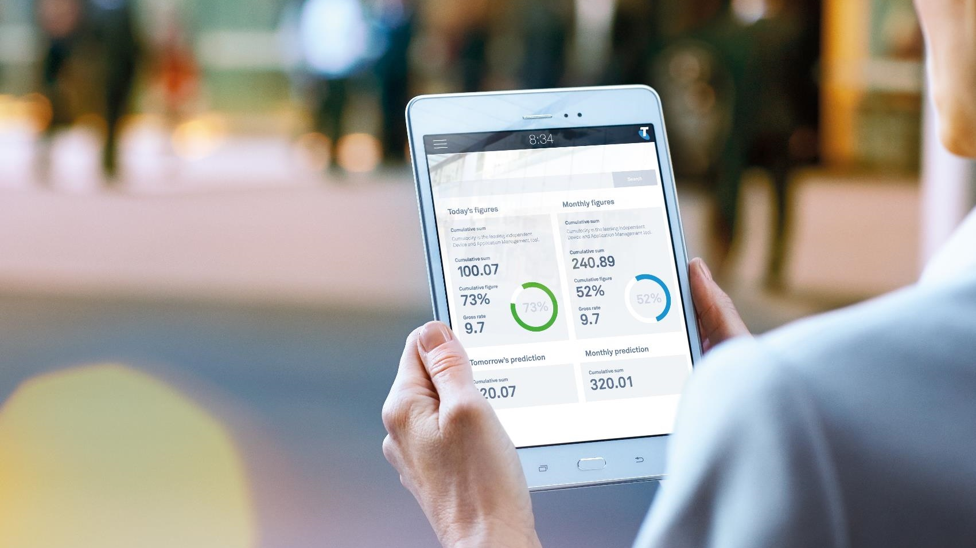
Why Telstra?
We have one of Australia’s most powerful and reliable internet solutions
We provide exceptional experience and expertise
We offer end-to-end control and visibility to ensure superior performance
Notes:
One of Australia's most powerful and reliable internet solutions
Greater coverage, Points of Presence, redundancy and inbuilt security
Dedicated internet infrastructure in over 15 different countries and partner Points of Presence across the globe
We continually invest in upgrading and expanding our capabilities. In fact, we've spent over $400M on our core network.
Exceptional experience and expertise
More than 16,000 business connections Australia-wide
Deep network, architecture and solution expertise from designing, deploying, managing and improving some of the largest technology environments in Australia.
Unrivalled experience protecting Australia’s largest networks – our own.
End-to-end control and visibility
24x7 help desk and management using advanced tools and state-of-the-art network operations centres to keep things running smoothly.

