Slide 1
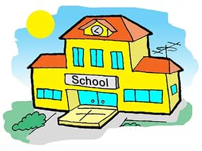
Англійська мова 1 клас Тема уроку:School Підготувала вчитель початкових класів: Чернишова С.В.

Slide 2
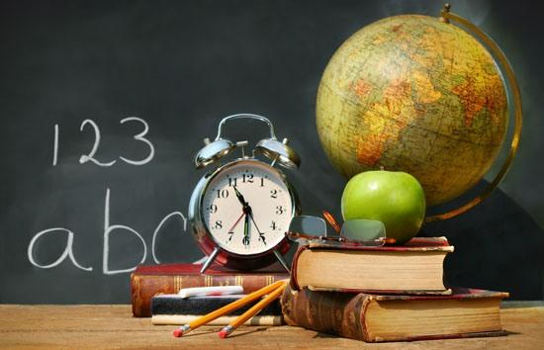
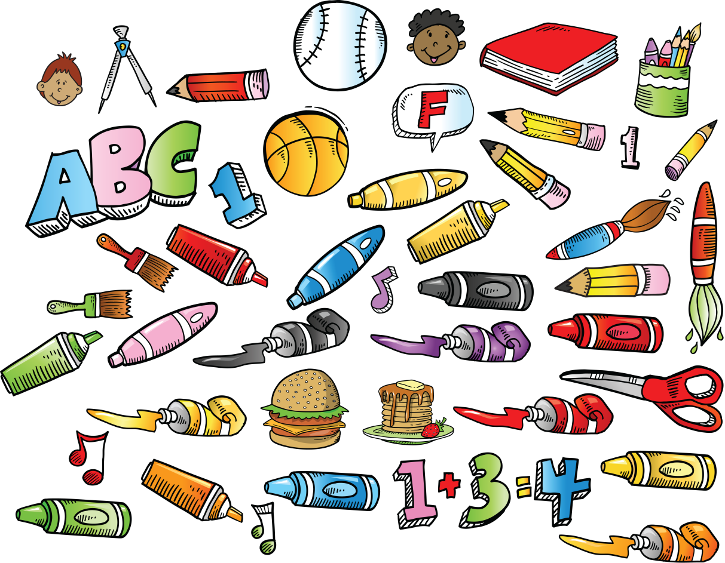
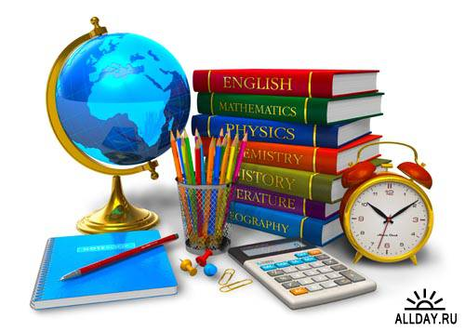
School

Slide 5
The flower

Slide 6
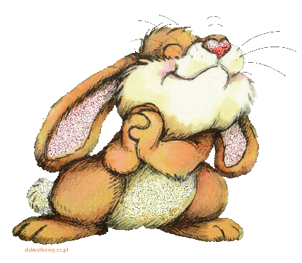
Hare

Slide 7
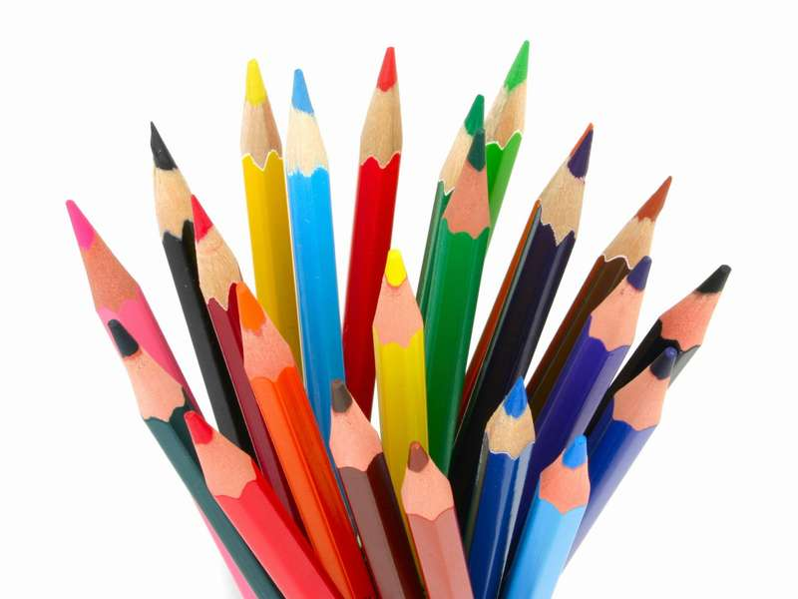
Iменник
Однина
Множина
There is
There are
There is a pencil.
There are pencils.

Slide 8
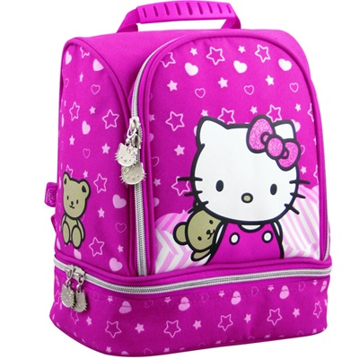
There is a schoolbag.
There are
schoolbags.

Slide 9
There is a book.
There are books.

Slide 10
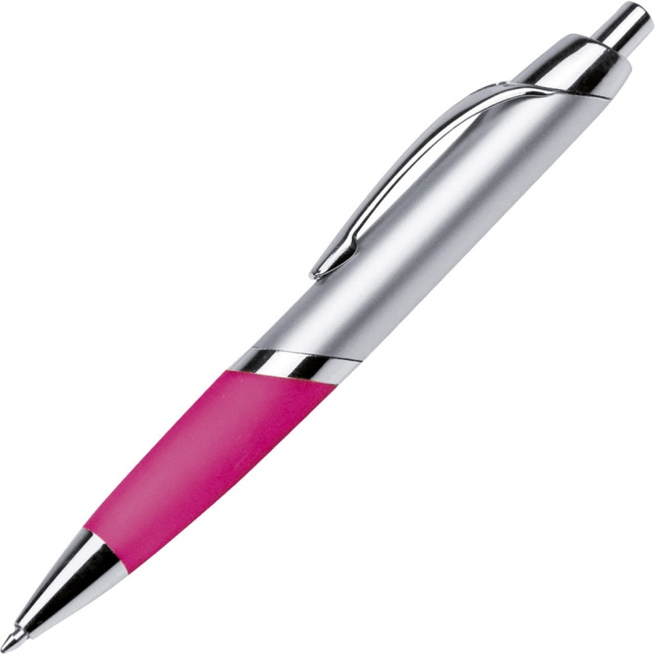
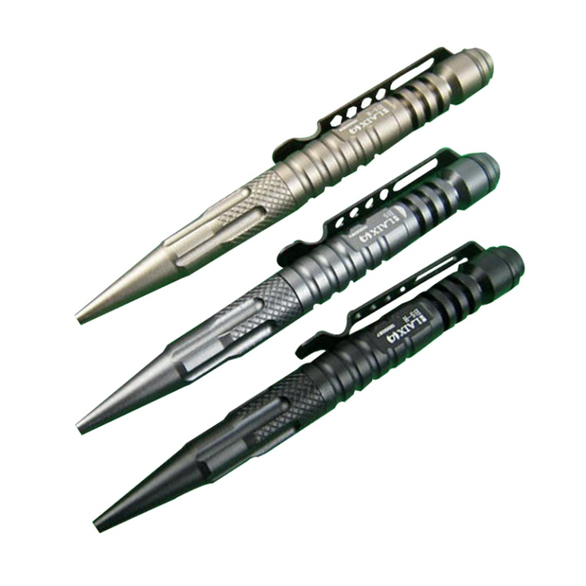
There is a pen.
There are pens.

Slide 11
There is a pen.
There are pens.

Slide 12
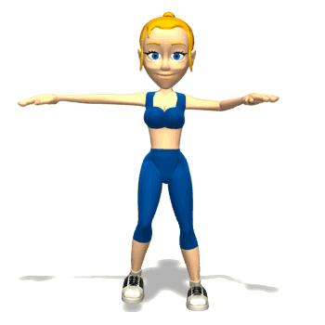
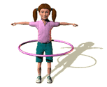
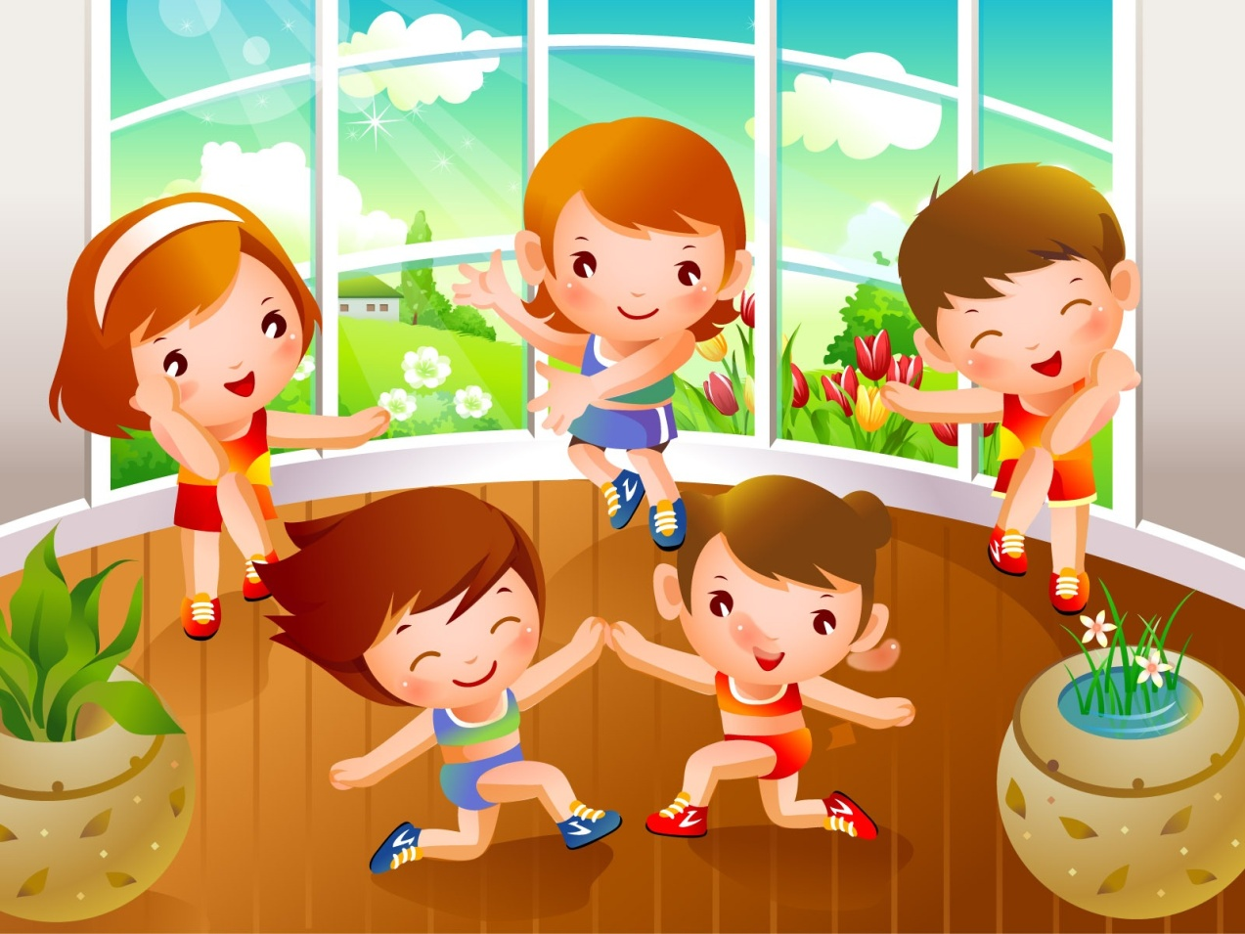

Slide 13
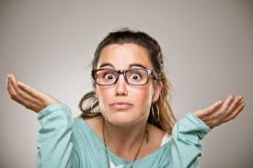
I can - Я можу I can't - Я не можу

Slide 14
- Урок закінчено. До побачення! - A lesson is complete.

