Slide 1
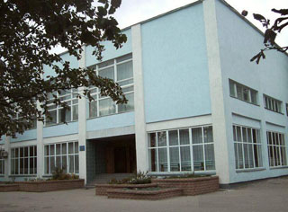
Our professional lyceum

Slide 2
Our professions

Slide 3
Driver

Slide 4
My future profession is a driver. I like driving very much. I think this profession is the very important one. I can driving. I hold the wheel like a professional.

Slide 5
As for me there is nothing better than to travel by car – a good, fast car I mean. Travel by car is a more personal experience.

Slide 6
You just sit down at the wheel, switch on the motor, step on the pedal with your foot and off the car goes.

Slide 7
You can go as slowly or as fast as you wish, stop when and where you choose; you park the car on the side of the road, get out and go where you like.

Slide 8
I like to feel the wind in my face, to see houses, trees and people flash past, to feel the real joy of speed.

Slide 9
Indeed your impressions are unforgettable.

Slide 10
Auto – fitter A car is a symbol of freedom and responsibility. But teen driving is full of risk.

Slide 11
The mixture of alcohol and driving is specially dangerous. Frankly speaking I haven’t been in a single accident.

Slide 12
I can repair cars. I help my father at the service station. I can change a tyre. I can fill the tyres with air and wash the car.

Slide 13
I can start the engine and charge the battery. I want to continue my father’s career.

Slide 14
My future profession is interesting, important and highly-paid. The profession of an auto -fitter demands a high level of manual skills and a certain period of practical and theoretical training

Slide 15
We are trained to be highly qualified auto -fitter. We must know the structure of a car. We study it at the special subjects. We study features of metals at the Physics and Chemistry lessons.

Slide 16
Once a week we have practical training in our workshop and can remove disrepairs with the help of such tools as a file.

Slide 17
a drill

Slide 18
a probe, a spanner

Slide 19
a chisel a nut

Slide 20
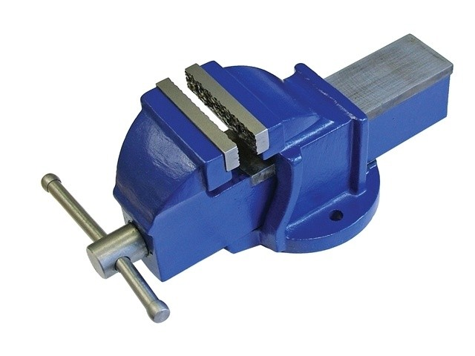
a screwdriver, a vice

Slide 21
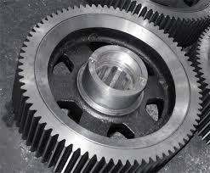
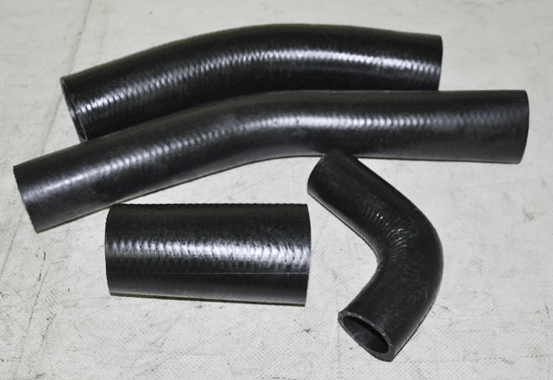
a hammer, a special equipment.

Slide 22
It is necessary to follow the rules of safety techniques to prevent accidents. In future I want to have my own business and my own car. I think studying at the lyceum helps my dream to become true.

Slide 23
Plasterers mix and then paste plaster onto the interior surfaces of buildings to prepare them for decoration.

Slide 24
The main role of a plasterer is to paste layers of plaster onto walls, floors and ceilings. Plastering serves a protective function, it makes buildings stronger, and it has an aesthetic function.

Slide 25
Plastering is a dusty and wet job, and in winter you get very cold hands; your skin can develop painful cracks. It’s also tiring and sometimes unpredictable; things can go wrong, meaning that a job can take longer than predicted.

Slide 26
It is, however, a skilled job that impresses many people. Every day is different and you never come across the same job twice.

Slide 27
To be a good plasterer, you need an eye for detail, the ability to pick up specialist techniques quickly, and good health.

Slide 28
Being good at maths is also useful, as you have to work out material quantities and costs in order to price jobs accurately.

Slide 29
You also need good people skills, as it is important to keep your customers happy. It is a skilled job and there is a high need in good plasterers.

Slide 30
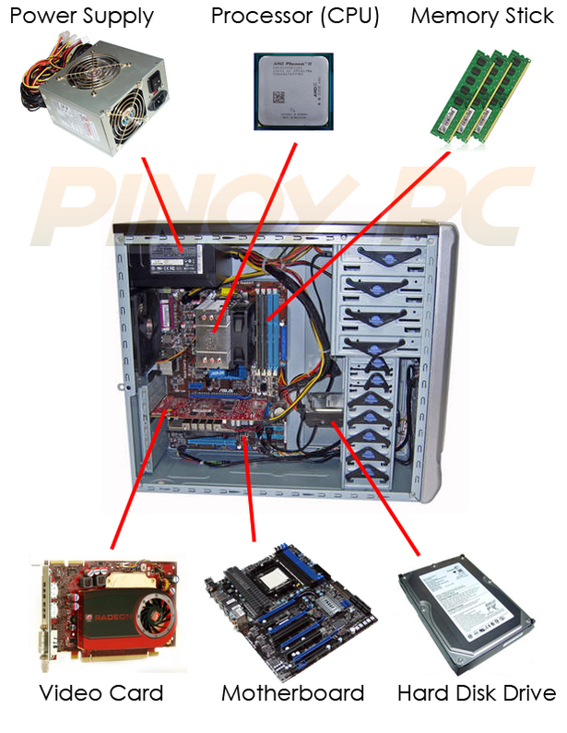
I want to become an operator of computer. I am interested in computers. It is a whole new world.
(The system unit)
Блок живлення - Power supply
Відеокарта - Graphics Card
Слоти розширення - Expansion slots
Материнська плата - Motherboard
Порти - Ports
Процесор - Processor
Оперативна пам'ять - Memory
Дисковвід CD (DVD)- Dyskovvod CD (DVD)
Дисковвід для дискет -
Dyskovvod for floppy disks
Вінчестер - Winchester

Slide 31
Many people continue careers of their parents or grand parents but it is not the case with me. My mother is a teacher and my father is a driver. But I don't want to be neither a teacher nor a driver.

Slide 32
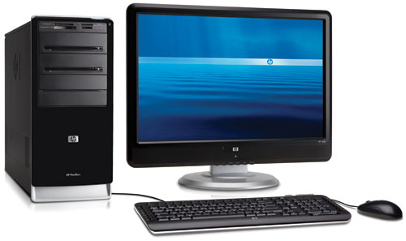
My favourite subjects are mathematics, physics, and, of course, computer science. I am not interested in such subjects as geography, biology or chemistry. My hobby is computer games and computer programming.
Монітор – Monitor
Колонки – Columns
Принтер – Printer
Клавіатура – Keyboard
Миша – Mouse
Сканер – Scanner
Системний блок –
The system unit

Slide 33
I have a computer at home and can spend hours working at it. It is much easier to do things on computer, for example to write a composition.

Slide 34
You can change the text as many times as you want and you don't need to rewrite everything if you changed something.

Slide 35
I think that the profession can give many opportunities. Computers are the most rapidly changing sphere of modern technology.

Slide 36
We are living in the age of information. And I think that the future is just filled with computers.

Slide 37
Today people can work, go shopping or even go on dates sitting at their computers.

Slide 38
Welder Nowadays welding is used instead of bolting and riveting. It is also a basic process in the manufacture of machinery

Slide 39
There are two kinds of welding: pressure welding and heat welding. Pressure welding is the process, when the weld is achieved by pressure.

Slide 40
Heat welding is the process when the weld is achieved by heat. The welding process depends greatly on the properties of the metals, the purpose of their application and the available equipment

Slide 41
Welding processes are classified according to the sources of heat and pressure.

Slide 42
Other joining processes are laser welding and electron-beam welding. Gas welding is a non – pressure process using heat from gas flame.

Slide 43
Should I Become a Secretary?

Slide 44
Secretaries are responsible for the administrative, planning, and organizational duties involved in maintaining a business.

Slide 45
They have a wide variety of daily tasks, such as manning the phones, making appointments and scheduling meetings, handling filing systems, and organizing mail.

Slide 46
Most commonly, secretaries work for businesses, law or medical offices, or hospitals, but some positions allow secretaries to work from home.

Slide 47
Most secretaries have full-time schedules, though those who work from home may have schedules that are more flexible.

Slide 48
Secretaries often handle confidential information, so they must be discreet and respectful of their employers and clients.

Slide 49
I really enjoy talking to people, making company and being responsible for organizing and scheduling things.

Slide 50
I have been doing this for years and have a good skills in it, so I believe I can be a pretty good secretary.

Slide 51
I can see myself doing a good job here and enjoying it. That is the main reason for my job preferences.

Slide 52
From my point of view, secretary is a very important element in the office. She keeps the boss informed about important things, takes care of the schedule and represents a first line of contact for the guests.

Slide 53
What more, a good secretary should do her best to keep the atmosphere in an office positive and motivating, what I always try to do.

Slide 54
I would really love to carry out these duties and that’s why I want to get this position. However, it is up to you to consider if I am a right candidate, or not.

