Slide 1
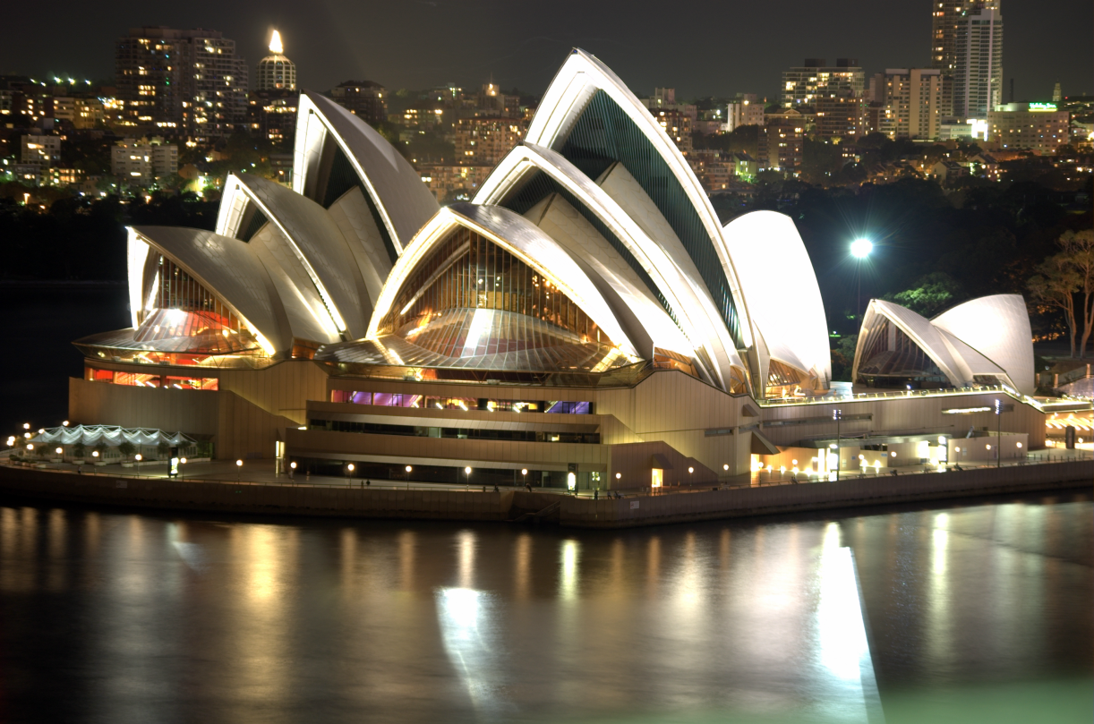
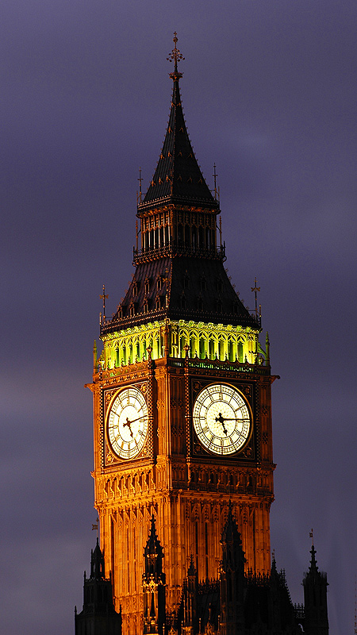
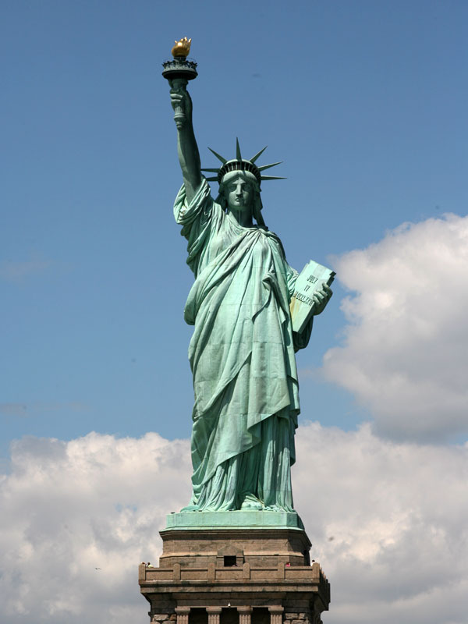
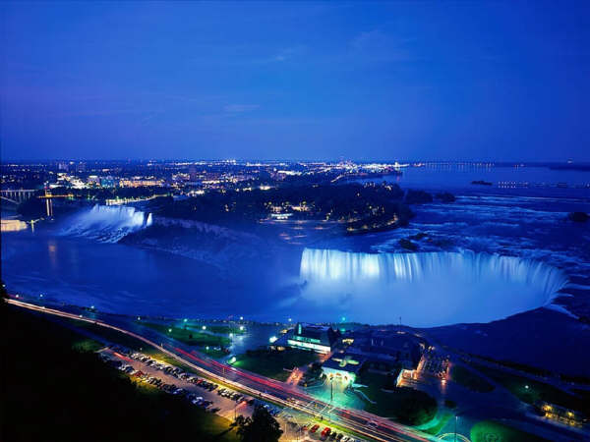
English speaking countries

Slide 2
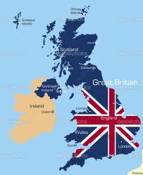
The United Kingdom of Great Britain and Northern Ireland is situated on the British Isles.
The British Isles are separated from the continent by the English Channel. The country is washed by Atlantic Ocean, the North Sea, and the Irish Sea.
The United Kingdom consists of four parts: England, Scotland, Wales and Northern Ireland. The population of the Great Britain is over 57 million people.
The official language of Great Britain is English. The UK is a highly developed industrial country. It is known as one of the world’s largest producers and exporters of machinery, electronics, textile, aircraft, and navigation equipment. One of the chief industries of the country is shipbuilding. The UK is constitutional monarchy.

Slide 3
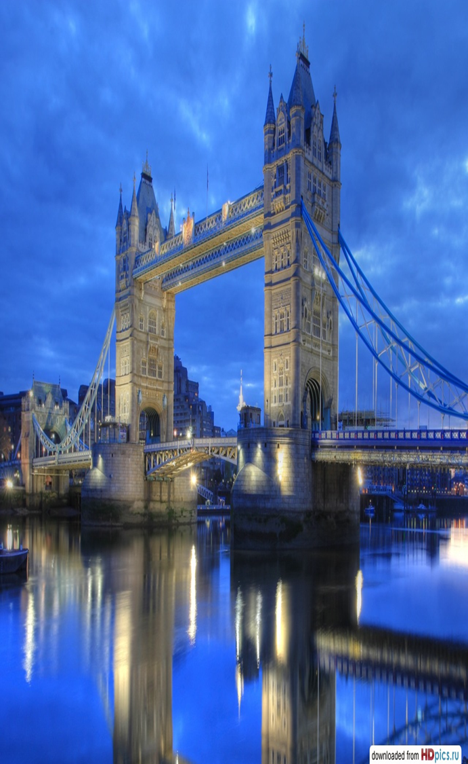
The capital of the UK is
situated on the river
Thames.
London is the capital of
Great Britain and England.
It is one of the largest
cities in the world and it was founded more than 2,000 years ago.
London is divided into 4
parts: the City, the West
End, the East End and
Westminster.
Its population is more
than 11 million people

Slide 4
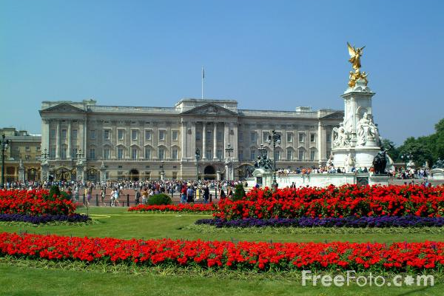
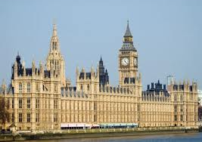
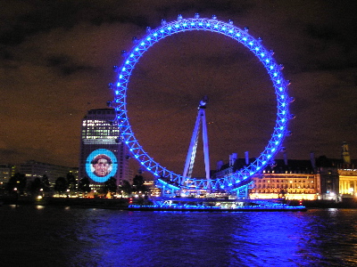
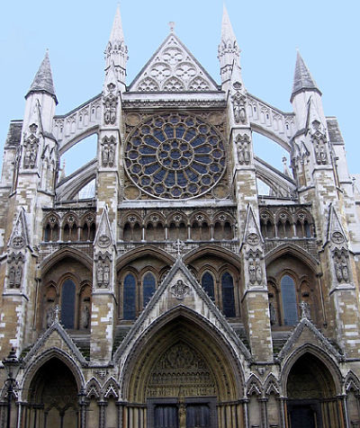
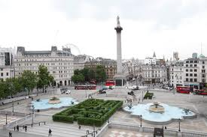
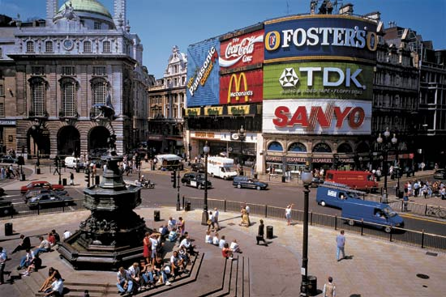
Houses of parliament
Buckingham palace
The London Eye
WESTMINSTER ABBEY
Trafalgar square
Piccadilly Circus

Slide 5
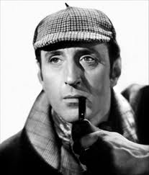
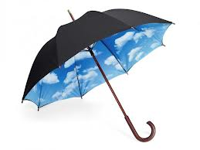
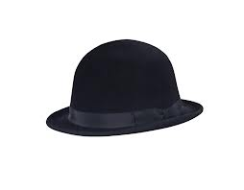
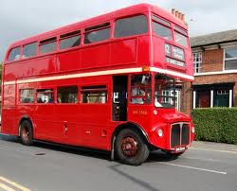
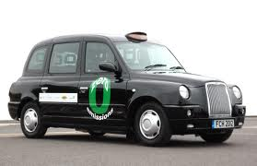
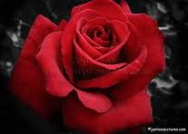
So many countries so many customs, an English proverb says.
English traditions and symbols can be subdivided into the traditions dealing with private life of the English national & religious holidays, public celebrations, traditional ceremonies & traditional sporting events.
The British have many traditions, symbols, manners & customs of which they can be proud. Some of them are famous all over the world. Bowler hats, tea, the red rose, double-deckers, cabs, Sherlock Holmes and talking about the weather, for example.

Slide 6
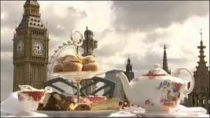
Tea is Britain's favourite drink. From 4 to 6 there is a very light meal called 5 o'clock tea. It is a snack of thin bread and butter and cups of tea with small cakes. This became a kind ritual. At this time everything stops for tea. You can eat tea at home or in a hotel. Tea at the Ritz hotel in London is very good. You can drink Indian or China tea. There are cucumber sandwiches and scones. (Scones are plain cakes. You eat them with jam and cream.) There are chocolate cakes and cream cakes too.

Slide 7
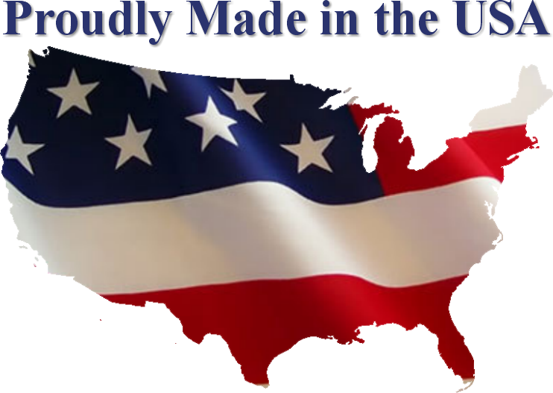
The United States of America is one of the greatest countries in the world.
It is situated on the North American continent and is washed by three oceans: the Pacific, the Atlantic and the Arctic.
America has fifty states and one federal District of Columbia where the capital of the country is situated.
More than 250 million people live in the United States. Most of the people live in towns. People of different nationalities live in the USA. The United States is a young country. Its written history is only a few hundred years old. The official language of the country is English.
The USA is a federal republic, consisting of fifty states. Each of these states has its own government. Congress is the American Parliament which consists of two Chambers.
The president is the head of the state and the government. He is elected for four years.

Slide 8
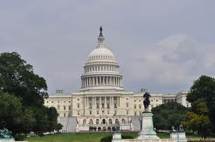
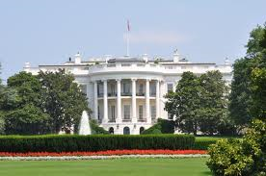
Washington-the capital of the USA
Washington D.C. is the capital of the USA and the centre of its government. The capital was named after the first president George Washington and was founded in 1790. It is situated on the Potomac River in the District of Columbia. Washington is not the largest city in the USA. It has a population of 1 million people.
Washington is the residence of American government. The White House is the President’s, the Capitol - the seat of the American Congress.
Washington is a large scientific and culture centre, where there are many research institutes, five universities, the National Academy of science and the Library of Congress.

Slide 9
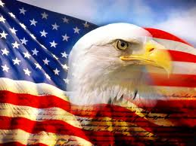
American symbols
The American flag is often called “The Stars and Stripes” or “Old Glory”. It represents the growth of the nation. The eagle is the national emblem of the country.
The Statue of Liberty is the symbol of American democracy. It stands on Liberty Island in New York. It is one of the first things people see when they arrive in New York by sea. This National Monument was a present from France to the USA.

Slide 10
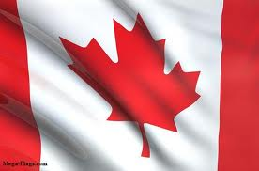
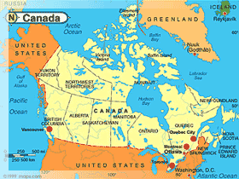
Canada
Canada is the second largest country in the world.
It is situated in North America.
About 28 million people live in Canada.
Canada is a federation of 10 provinces and 2 territories.
Much of the rest of Canada is uninhabited because of severe natural conditions.
Both English and French are official languages of the country.
Ottawa is the capital of Canada.
Toronto and Montreal are the largest urban areas.

Slide 11
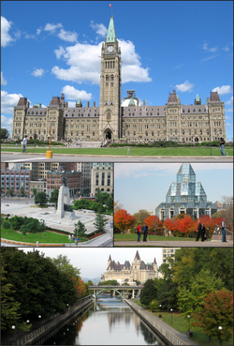
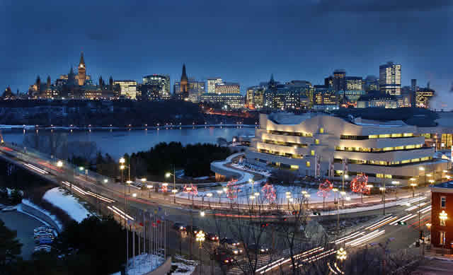
Ottawa – the capital of canada

Slide 12
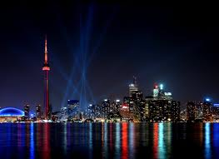
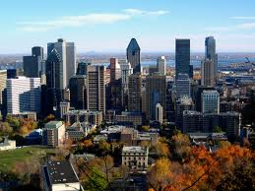
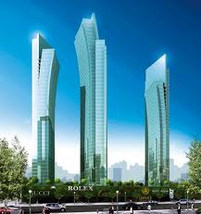
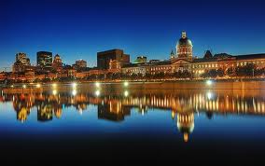
Toronto
Montreal

Slide 13
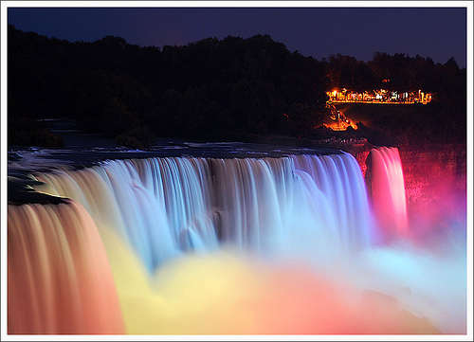
Niagara Falls: One of the Seven Wonders of the World
The Niagara Falls are very wide. The length of brink is 1060 feet while its overall height is 176 feet. Niagara Falls are one of the most powerful waterfalls in North America. Niagara Falls are located on the international border that separates the Canadian province of Ontario and the American state of New York. Niagara Falls are located on the international border that separates the Canadian province of Ontario and the American state of New York.

Slide 14
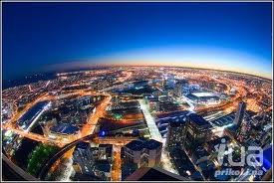
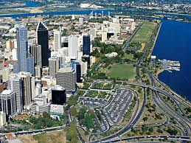
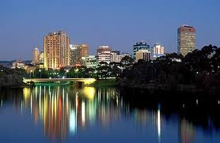
Australia. The Land of Blue Mountains.
Australia, or the Commonwealth of Australia, as it is officially called, is situated on the island continent. Australia is the only country in the world that is also a continent. It is the sixth large country and the smallest continent. There are the Blue Mountains in Australia. Australia is an island, like Britain, but unlike Britain, it is vast. It is, in fact, nearly twenty-five times as large as the British Isles. Its area is about 8,000,000 square km. The population of Australia is about 18 mln. Australia is an independent federative state consisting of 6 states and 2 territories. It is a member of the Commonwealth headed by the British Queen. The national language is English. The capital of Australia is Canberra; the largest cities are Sidney, Melbourne, Adelaide and Perth.

Slide 15
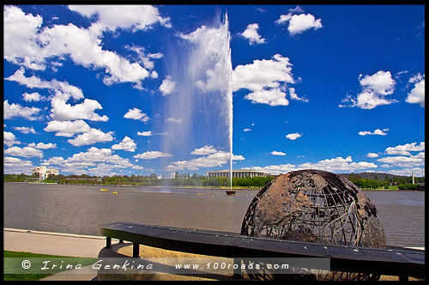
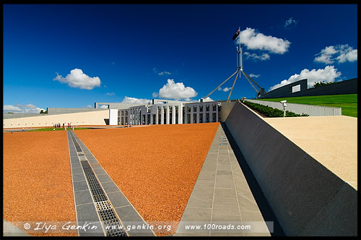
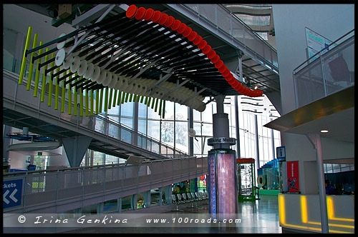
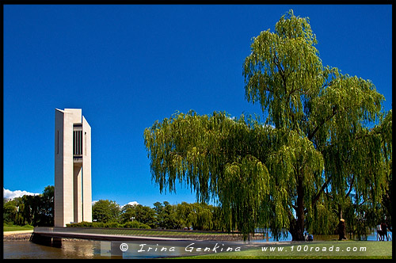
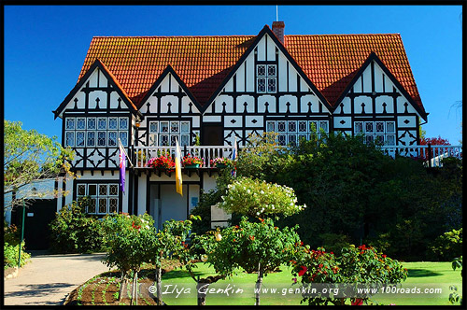
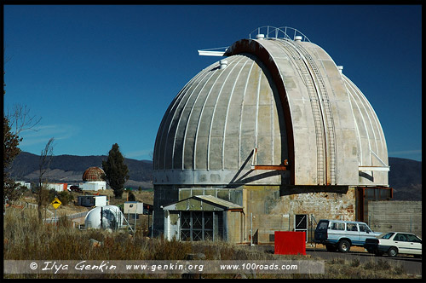
The Capital of australia-canberra
The Captain James Cook Memorial
Parliament House
Australian War Memorial
Questacon
National Carillion
Commonwealth Bridge
Cockington Green Gardens
Refractor

Slide 16
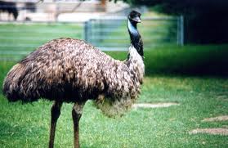
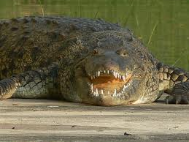
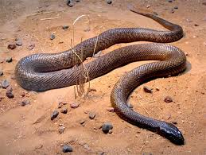
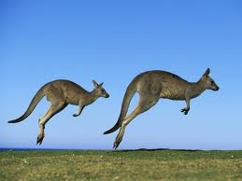
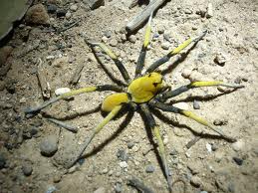
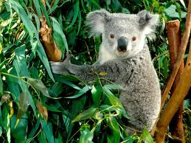
Emu
Many of the Australian animals are unique and can be found nowhere else in the world.
Australia is also home to some of the most dangerous animals on earth.
Crocodile
Animals of Australia
Snake
Kangaroo
Spider
Koala

