Slide 1
Презентація до уроку англійської мови в 6 класі на тему:
“ Ukraine is my native land”
Вчителя англійської мови
Новоайдарської санаторної школи-інтернату
Гречишкіної Надії Олексіївни

Slide 2
Welcome

Slide 3
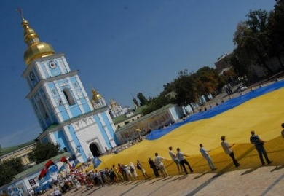
Ukraine became an independent state in 1991. Ukraine is a unitary republic under a semi-presidential system.

Slide 4
The national symbols of Ukraine are : the National Flag, the National Emblem and the National Anthem.

Slide 5
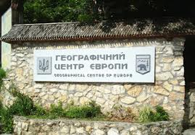
The geographical centre of Europe is near the western town of Rakhiv.

Slide 6
Ukrainian is the official language of Ukraine. Its alphabet is Cyrillic.

Slide 7
Ukrainian language took the second place on melodic criteria after Italian and it was ranked as the third most beautiful language in the world on such criteria as phonetics, vocabulary, phraseology and sentence structure after French and Persian at a linguistic contest held in Paris in 1934.

Slide 8
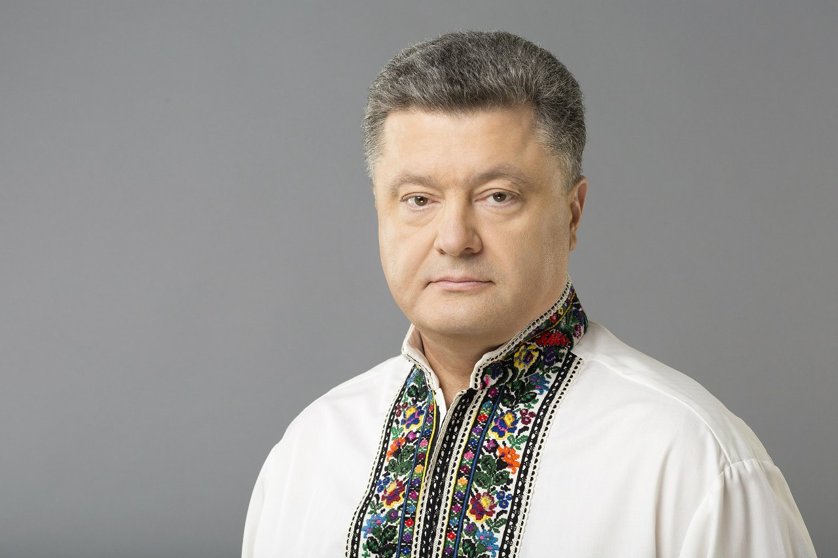
The Ukrainian President is Petro Poroshenko.

Slide 9
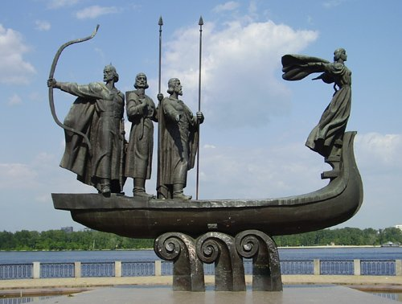
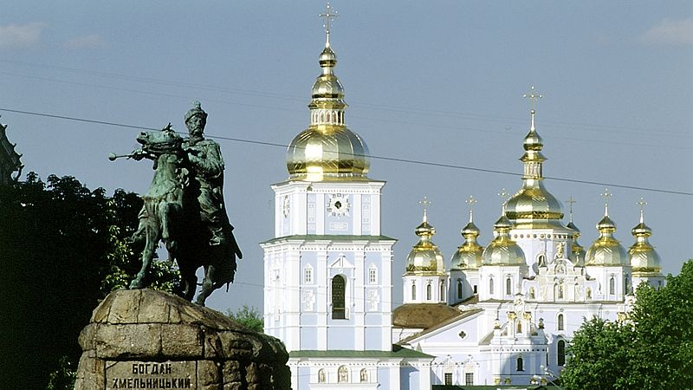
Kyiv is the capital of Ukraine. It’s the largest cultural, historical and educational centre in the country. And it is also one of the most beautiful European cities.

Slide 10
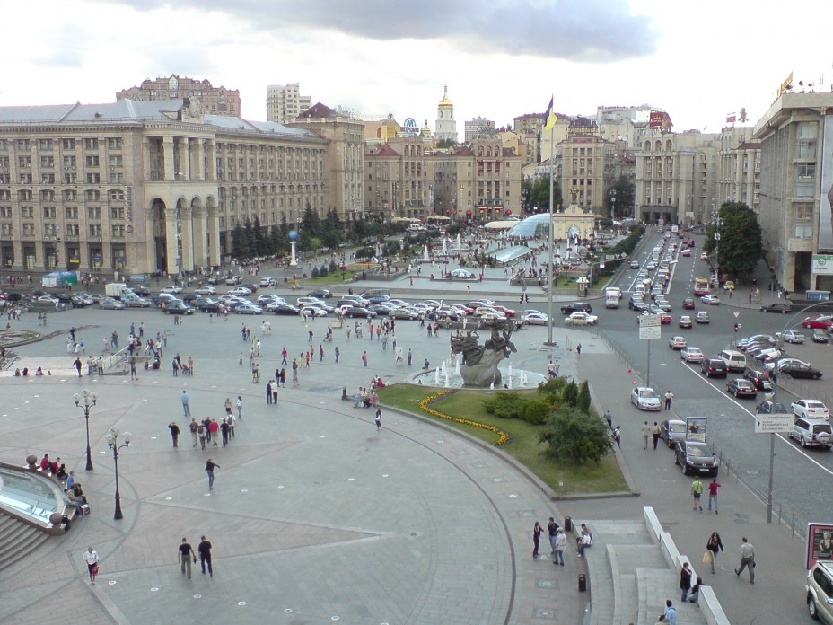
The heart of Kyiv is Independence Square. The main structure in the square is a monument to the Independence of Ukraine.

Slide 11
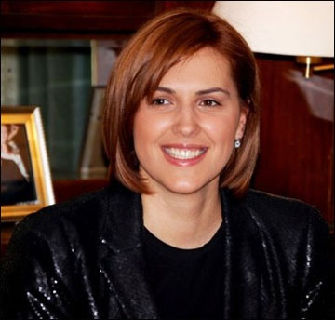
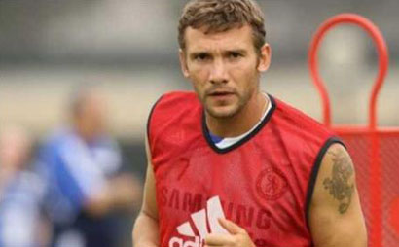
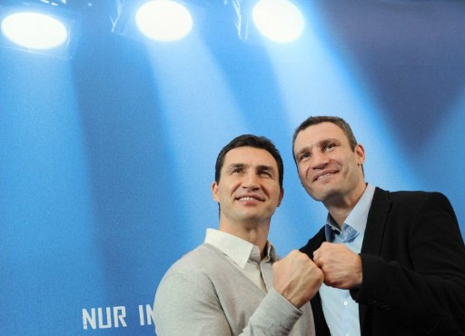
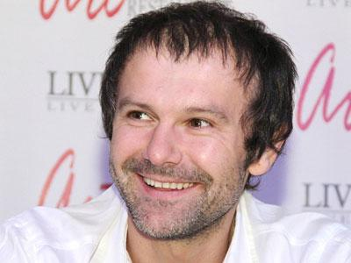
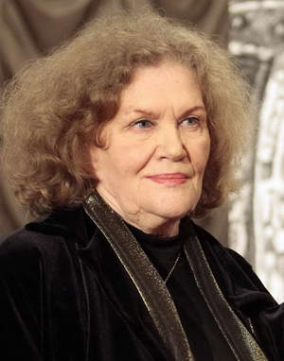
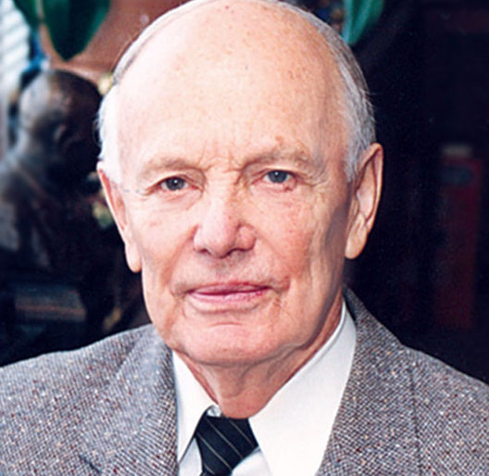
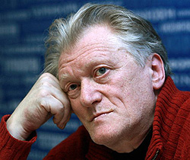
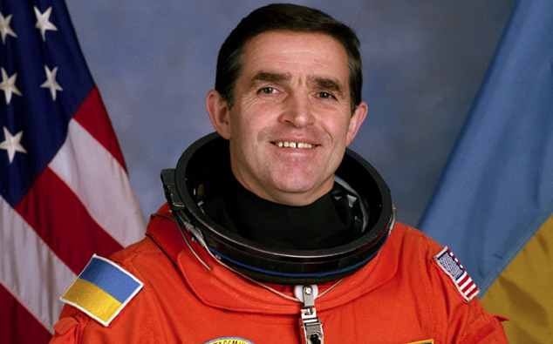
In Ukraine live many famous people :

Slide 12
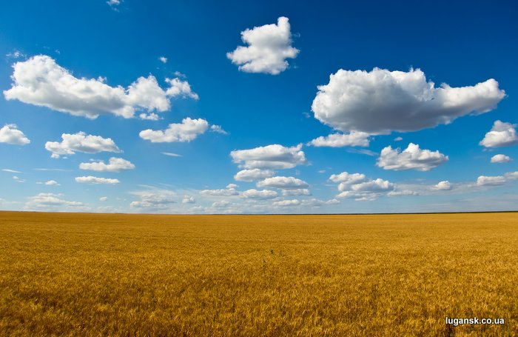
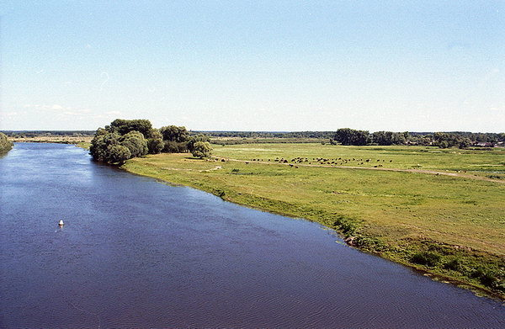
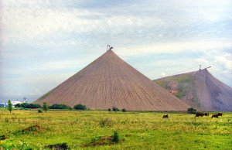
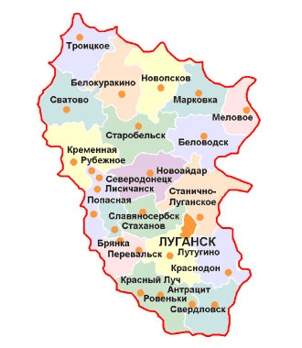
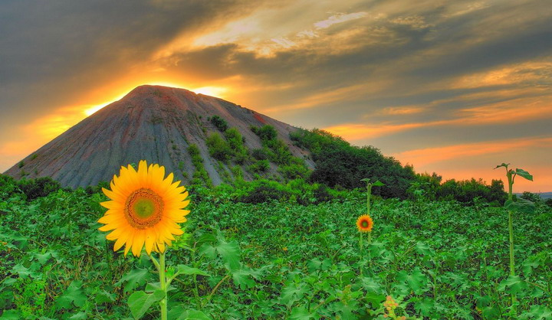
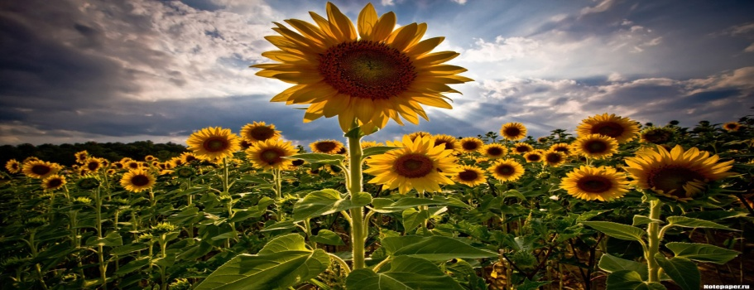
My sunny native land – Luhanshchyna!
Who has never been to Luhanshchyna – has never seen the beauty

Slide 13
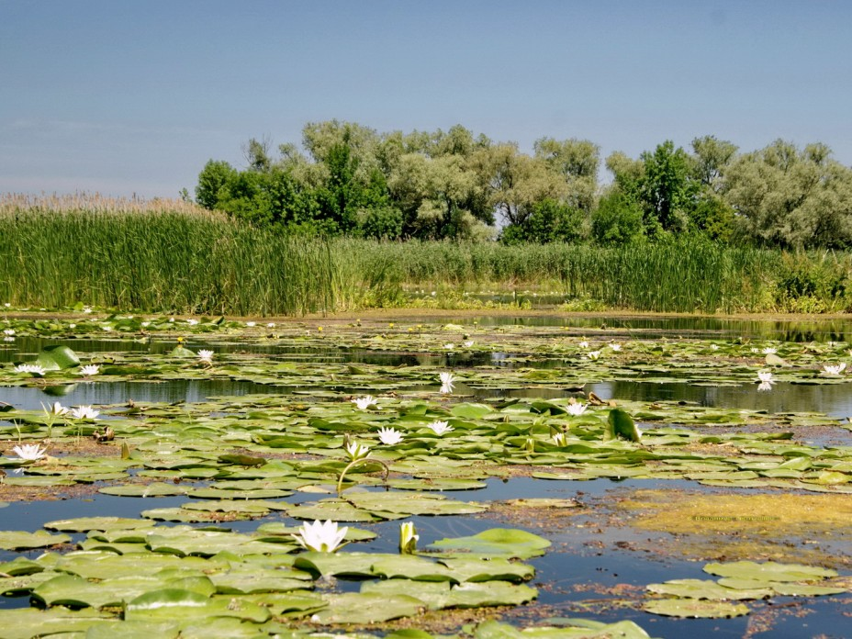
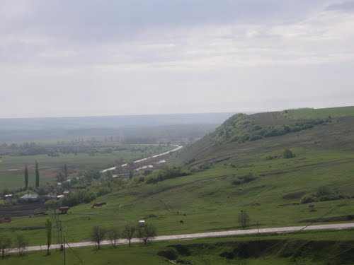
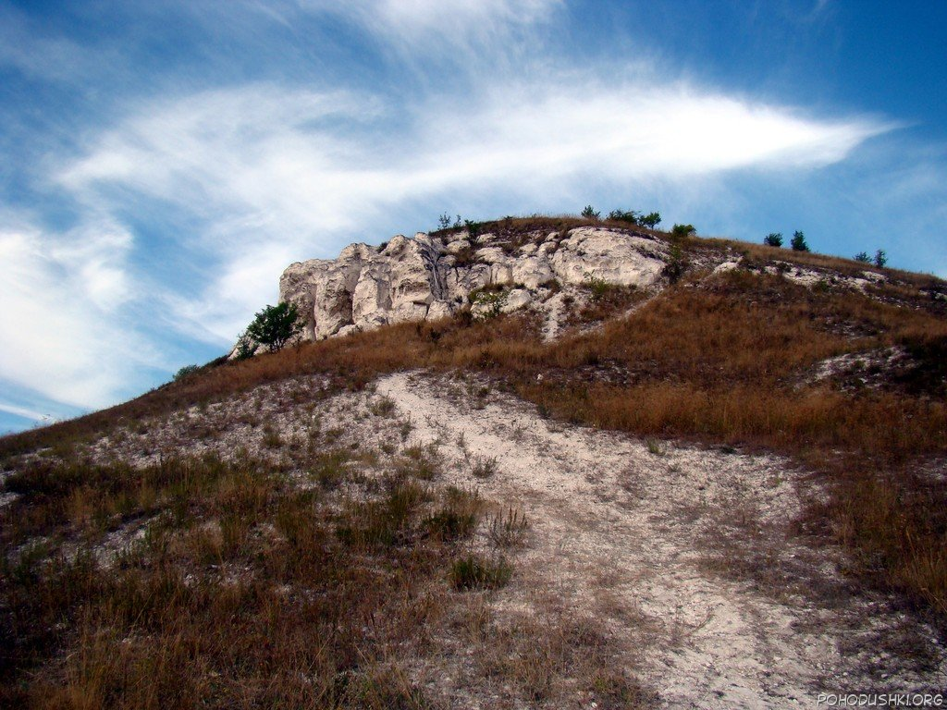
Novoaidar – amazing and attractive
Streets are well-kept and clean
Occupies on the banks of river Aidar
Offers a lot of fun
Novoaidar is a picturesque
Small town with the cherry trees
Yards full of children and beautiful flowers
We love it and proud of it!

Slide 14
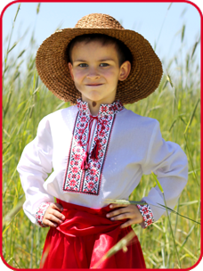
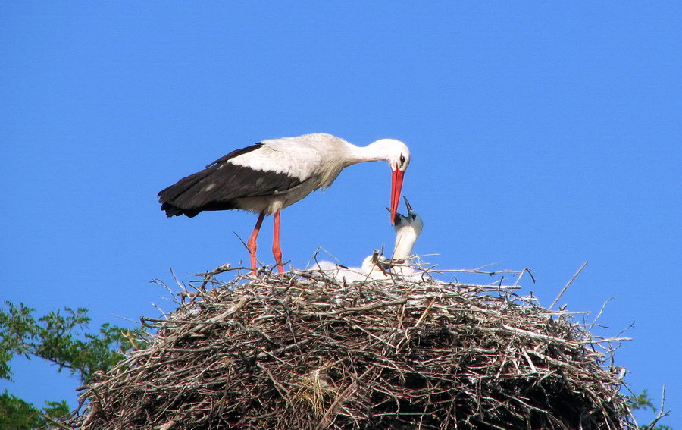
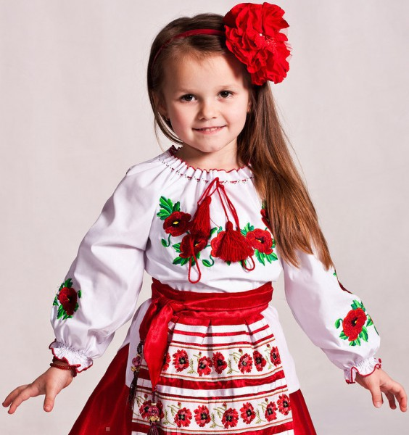
I love your towns, stars and blue sky…
My dear land, both in joy and grief.
I go with you to the top of life.
How happy I am to be your son!

