Slide 1
Інтегрований навчальний комплекс
з англійської мови для учнів 5-8 класів з теми
“Inventions”
Учитель англійської мови Уманської
спеціалізованої школи I-III ступенів №12
з поглибленим вивченням англійської мови
Кравченко І.В.

Slide 2
Inventions

Slide 3
The science survey
1) Do you enjoy your science lessons?
a) usually
b) sometimes
c) rarely
2) Which is your favourite science subject?
a) Physics
b) Chemistry
c) Biology
3) Are you good at Math?
a) Yes
b) Average
c) No
4) Would you like to do more science experiments in school?
a) yes
b) no
5) Do you use a computer?
a) A lot
b) sometimes
c) rarely
6) What do you use your computer for?
a) to do homework
b) to play

Slide 4
Look for the hidden words in each group of letters
1) A F K C O M P U T E R
2) T E R R A D I O K S Y
3) A D K T L A M P I U Y
4) T R P R O C K E T Z M
5) V E S S L O U G V N
6) F E S T E L E V I S I O N

Slide 5
Match the inventions with the years when they took place
1) telephone
2) CD
3) writing for the blind
4) computer mouse
5) airship
A) 1824
B) 1852
C) 1876
D) 1963
E) 1985

Slide 6
Match the words with the inventors
1) “ You can have any colour you want as long as it is black.”
2) “Watson, come here. I want you”.
3) “Eureka! I have found it!”.
4) “ But it does move!”.
5) “ You press the button, we do rest”.
A) Alexander Graham Bell
B) Archimedes
C) George Eastman
D) Henry Ford
E) Galileo Galilei

Slide 7
Find twelve kinds of machines
r | r | e | t | u | p | m | o | c
b | a | u | v | s | n | o | q | p
o | d | t | f | r | i | d | g | e
b | i | c | y | c | l | e | a | i
i | o | c | l | a | j | m | g | w
s | d | l | o | r | f | n | h | a
e | n | o | h | p | e | l | e | t
t | s | c | a | n | n | e | r | c
v | u | k | o | e | d | i | v | h

Slide 8
Who invented these things? Match the inventions with the names
1) the telephone
2) the record player
3) the lift
4) radio
5) colour photography
6) electric light
7) the computer disk
8) television
9) the aeroplane
10) film
John Logie Baird
the Lumiere brothers
Elisha Otis
Eadweard Muybridge
The Wright brothers
Alexander Graham Bell
Alexander Popov
Thomas Edison
Yoshiro Nakamata

Slide 9
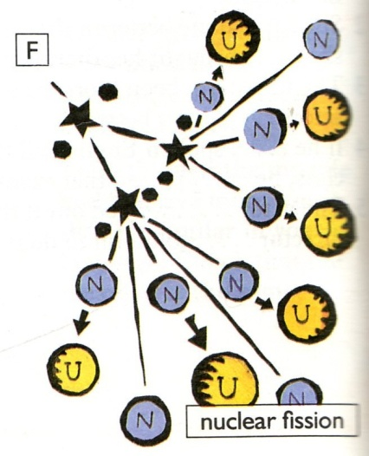
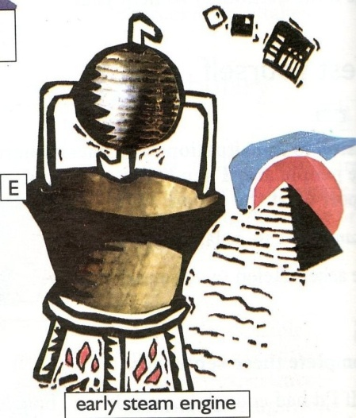
Match the pictures with the people and dates
Hero of Alexandria in AD 100
Thomas Edison in 1879
Karl Benz in 1885
Marie Curie in 1911
Lise Meitner in 1939
Texas Instruments in 1958

Slide 10
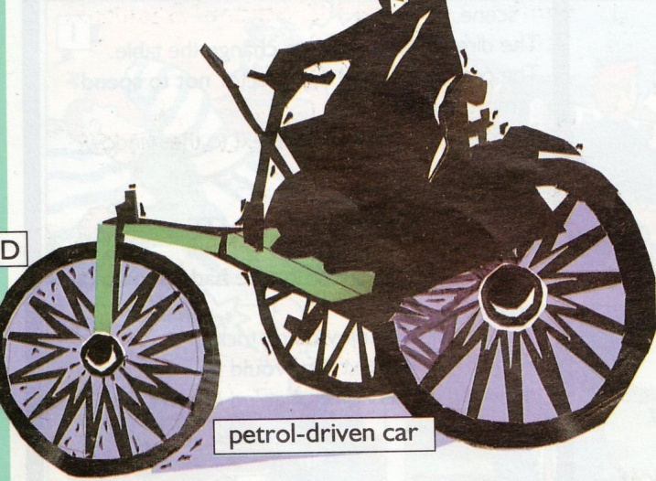
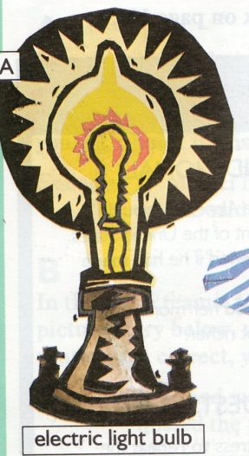
Match the pictures with the people and dates
Hero of Alexandria in AD 100
Thomas Edison in 1879
Karl Benz in 1885
Marie Curie in 1911
Lise Meitner in 1939
Texas Instruments in 1958

Slide 11
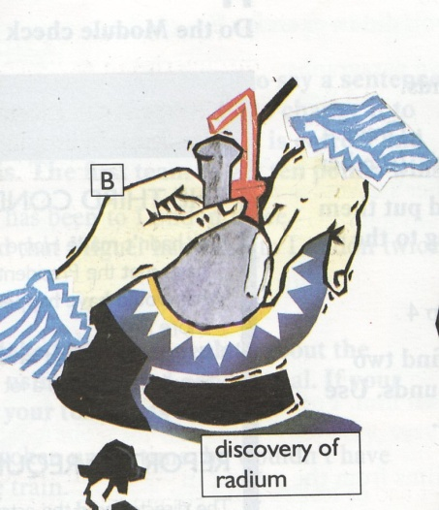
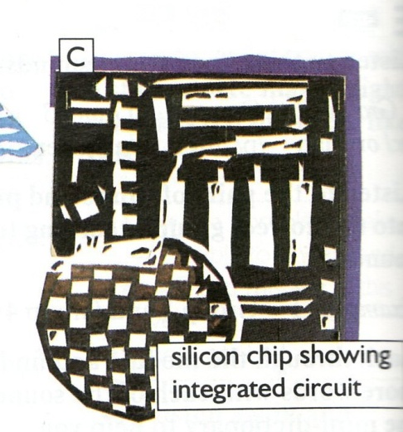
Match the pictures with the people and dates
Hero of Alexandria in AD 100
Thomas Edison in 1879
Karl Benz in 1885
Marie Curie in 1911
Lise Meitner in 1939
Texas Instruments in 1958

Slide 12
Complete the sentences
1.This instrument …be considered the most important in the history of communication.
2. New technology …developed.
3. Before satellites existed, connections …made by cables.
4. This instrument … thought by Alexander Bell.
5.They …used in private homes and public places.
6. The first long-distance …set up in 1884.
is/are done
was/were done
have/has done
can/could/might/must be done

Slide 13
Complete the text, using the past tense forms of the verbs. Use negatives too.
When Joseph Merlin…..roller skates in 1760, he decided to demonstrate them at a large party. Half way through the party, he appeared in the ballroom wearing his skates and playing a violin.
Unfortunately he..…how to turn or stop, and ..…into a large mirror at the end of the room. He ..… the mirror and his violin, and ended up in hospital.
invented/was invented
knew/did not know
crashed/was crashed
break/broke

Slide 14
Complete the text, using the past tense forms of the verbs. Use negatives too.
A customer in an expensive New York restaurant complained to head waiter that he …. His chips because they were too thick. Grum… annoyed. He … into the kitchen, … a potato into very thin slices, and …the slices into a par of hot oil. Then he … them back to the customer, who … that they tasted delicious. They .. the worlds first potato crisps.
be(3)/was/were
came/was come
cut/cutted
threw/thrown
take/took

Slide 15
Ukrainian inventors and scientists. Text1. Read the text
Many Ukrainian inventors and scientists have made a great contribution to the world science.
Mykola Kybalchych(1853-1881) was born in the Chernihiv Region. He died at the age of 28, but he managed to create a great deal. While waiting for capital punishment after the attempt upon Alexander II life he prepared in a prison cell an original design of an aircraft with rocket engine.

Slide 16
1.true/false (V-true), (X-false) 2.make the words from the letters
1. Mykola Kybalchych was born in 1853.(T/F)
He died at the age of 38.(T/F)
He tried to kill Alexander II.(T/F)
He was waiting for one year punishment. (T/F)
He designed an aircraft with rocket engine.( T/F)
2. etroc
deralexa
bucontirtion
mentupnish
ripson
cafiarrit
aedl
inevortsn

Slide 17
Ukrainian inventors and scientists. Read Text 2
Petro Capitsa(1894-1984) was a noted scientist in the field of nuclear physics and technologies of field of super powerful magnetic fields. Petro Capitsa was awarded with the Noble Prize for his works. He was Ukrainian who made a great contribution into development of physics working in England and Russia.

Slide 18
Match the words to make word combinations
noted
magnetic
noble
field of
great
development of
physics
prize
fields
contribution
scientist
technologies

Slide 19
Fill in the correct form of the verbs. (Active/Passive)
During the Napoleonic wars, the French (was needed/needed) to feed their army. Napoleon offered a prize of 12,000 francs for a solution. That is when the tin can (was invented/ invented). Tin cans (were sent/sent) to the battlefield. But the problem was how to open them. This was very difficult. Many soldiers (were gone/went) into battle with only nine fingers! This went on for some time until finally the tin opener (was invented/invented).

