Slide 1
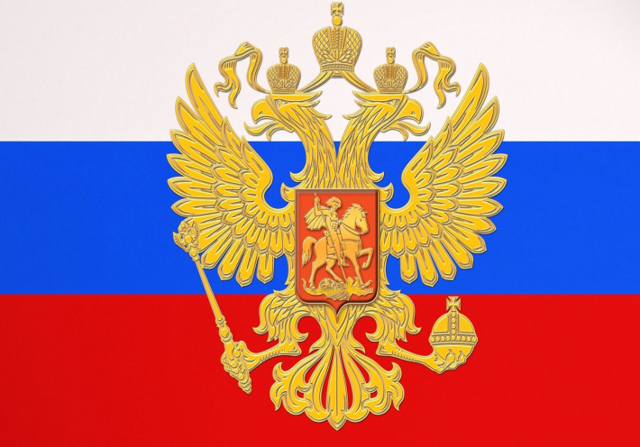
Education in Russia
by Krivtsova Victoria, 33-SH

Slide 2
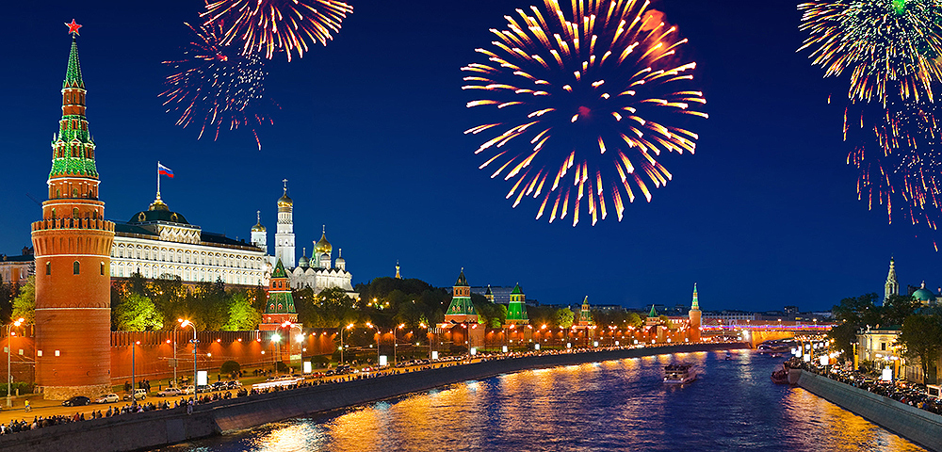
Russia

Slide 3
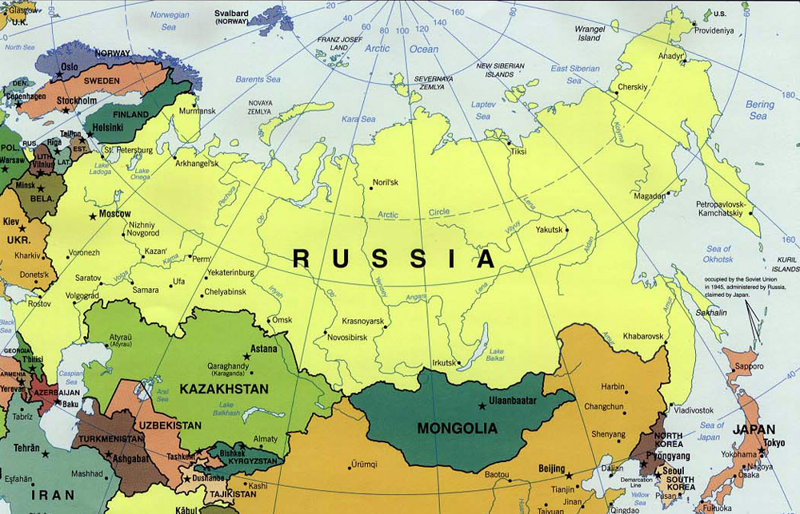

Slide 6
Education in russia

Slide 7
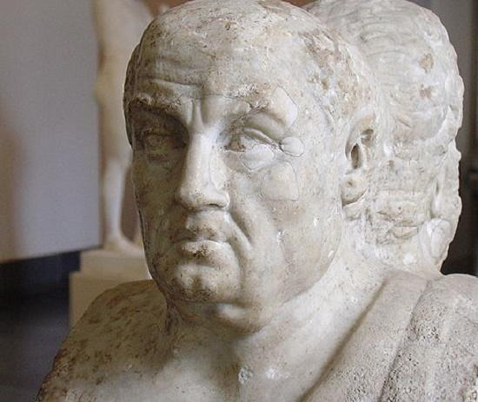
Education is the face of mind.
Kay-Cavus

Slide 8
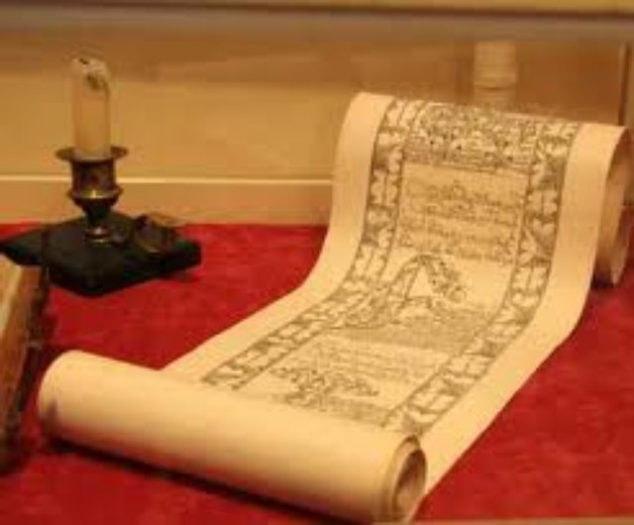
Тhe history of education in russia

Slide 9
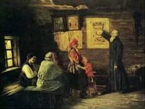
Тhe first school in rus
The first school in Rus was opened the 10th century by the order of Prince Vladimir. Schools were opened in monasteries and parish churches. Taught children of chiefs and priests.

Slide 10
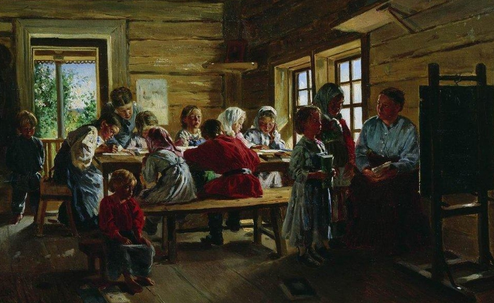
In Novgorod in 1030 school was established by Yaroslav the Wise, where students learned reading, writing, Russian language and the Christian faith.

Slide 11
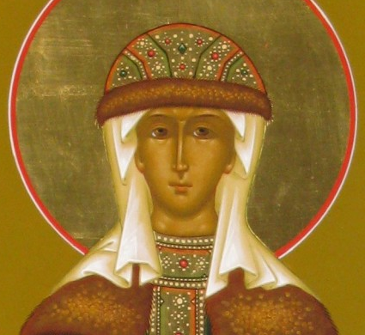
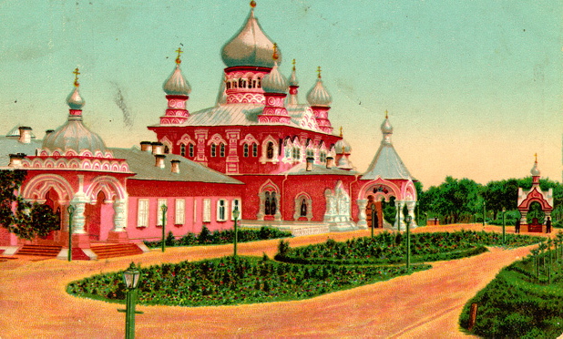
Initially had the right to study only boys. But in 1086 it was opened the first female school in Kiev, by sister of Vladimir Monomakh Anna.

Slide 12
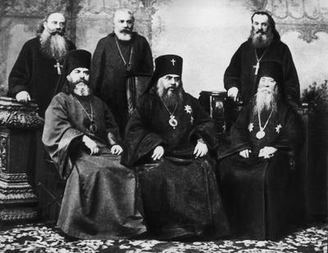
Тhe main objective of the school
Training managerial staff and priests.

Slide 13
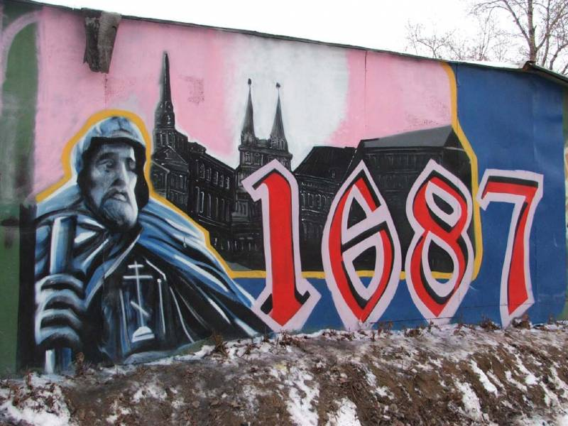
In ancient times learned people have valued very highly and was called "bookish men.“In 1687 in Russia was opened the first higher educational institution, the Slavonic-Greek-Latin Academy. It was a graduate of M. V. Lomanosov.

Slide 14
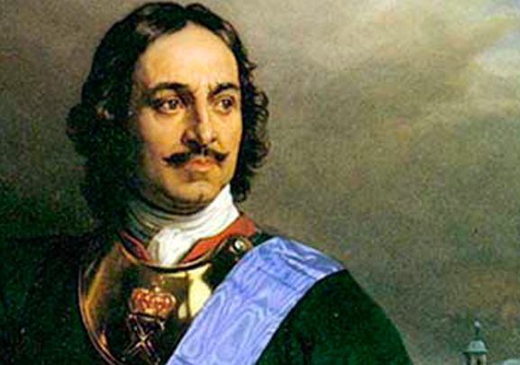
School education has been in decline, but in Peter I it have got a new development.
.

Slide 15
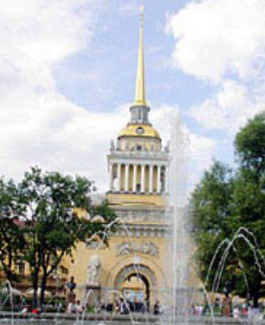
The first Russian school of mathematic and navigation Sciences was established by Peter I in 1700. The school enrollment from 200 to 500 pupils. It became the first Soviet school in Moscow and Europe.

Slide 16
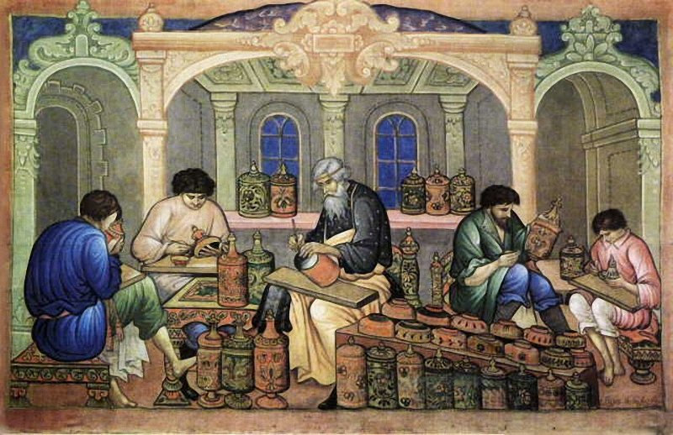
Here had been studied the children of the rich and wealthy people. The children of ordinary people were trained by masters of various crafts. Education has received state value.

Slide 17
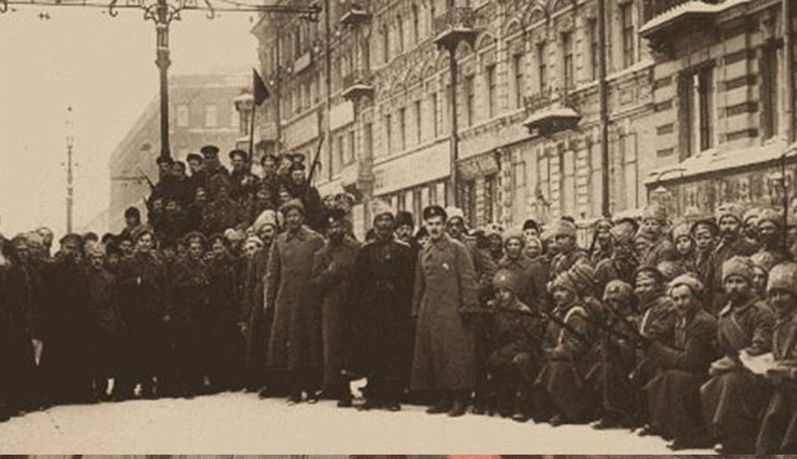
The development of schools in russia after the october revolution of 1917
Soon after the revolution began the destruction of the existing system of education. The school was separated from the Church, abolished the national, class, religious constraints in education, destroyed the old structures of school management, abolished the teaching of ancient languages. It was introduced a simplified spelling, which facilitated the literacy.

Slide 18
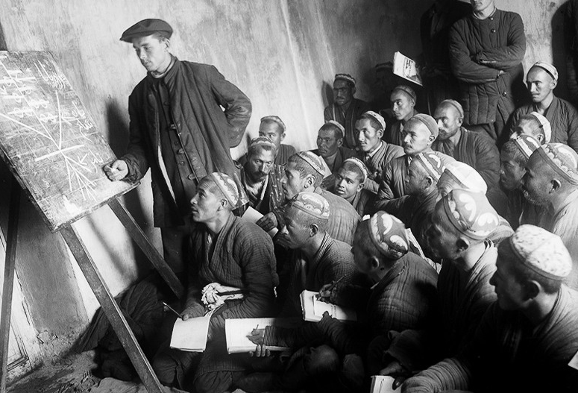
In 1920-1925 years was announced for the elimination of illiteracy among the population. The basis of education was a seven year labor school.

Slide 19
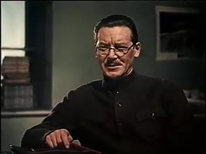
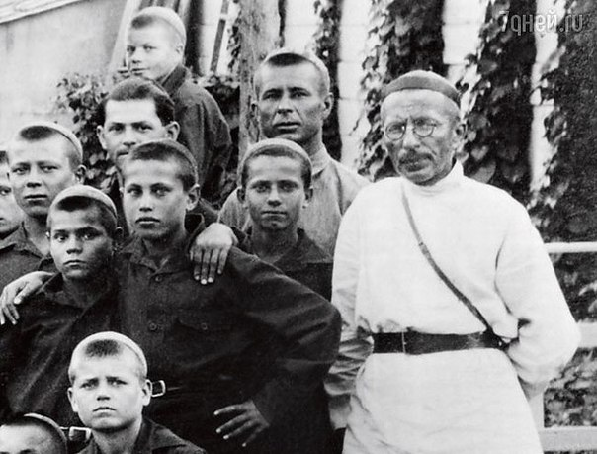
In 1931 it adopted a resolution "On primary and secondary school". Created a sustainable education system. One of the outstanding teachers was A. S. Makarenko the author of the theory of education of the individual in the team. The basic ideas he laid out in works of "Pedagogical poem", "Flags on towers", "the Book for parents". His theory had a great influence on the organization of the educational process in the Soviet school to the present time is one of the basic theories of education.

Slide 20
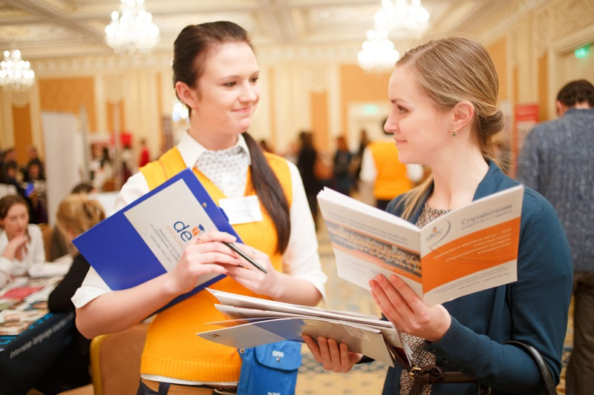
Education in russia today
Education is a single purposeful process of education and training.

Slide 21
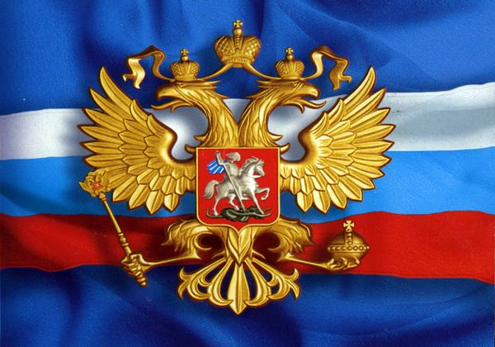
Law on Education in the Russian Federation
Law about education in the Russian Federation Act was passed by the State Duma on December 21, 2012.

Slide 23
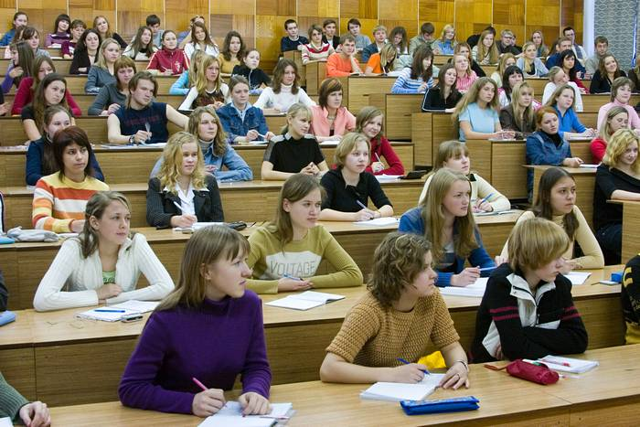
the Еducation system in russia
The education system provides the possibility of realizing the right to education throughout life.
The Russian education system - a powerful set of cooperating agencies and intended to extend the professional component.

Slide 24
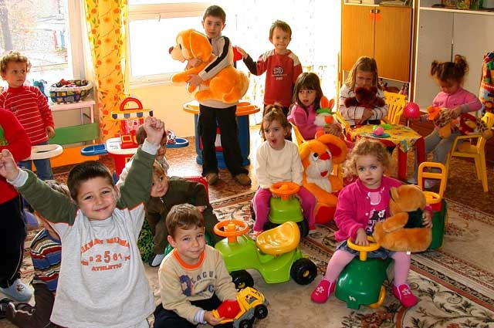
Тypes of education in russia
- General education: ■ preschool education; ■ primary general education; - Basic education; - General secondary education; - Professional education: ■ secondary vocational education; ■ higher education-bachelor; - University degree - Specialist, Master; - Higher education - training of highly qualified personnel; - Additional arr.

Slide 25
Diagram of the education system in Russia
The first link - doshkonoe education (kindergartens, day nurseries, kindergartens, early childhood development centers, preschools);
The second link - educational institutions (schools, lyceums, gymnasiums, proposed the initial, primary and secondary education);
The third link - secondary vocational education (colleges, technical schools, lyceums, colleges);
The fourth element - higher education (universities, institutes, academies);
The fifth link - the post-graduate education (graduate school, doctoral, residency).

Slide 26
Forms of education in Russia
Full-time (day); - Part-time (evening); - Correspondence; - Remote;
External studies;
Family education;
self-education.

Slide 27
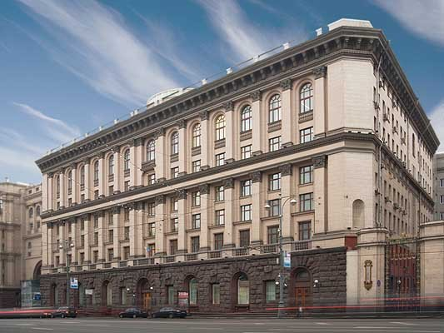
Еducational institutions in russia
Government (regional or federal unit);
Municipal;
Non-governmental (private).

Slide 28
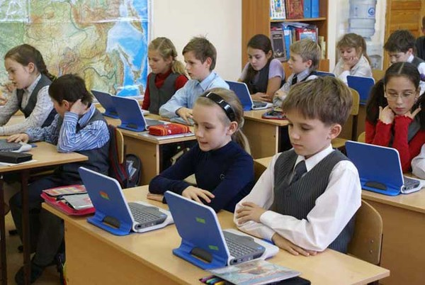
Today in Russia there are a huge number of schools. They offer a variety of destinations, methods of teaching, choice of subjects, languages and disciplines.

Slide 29
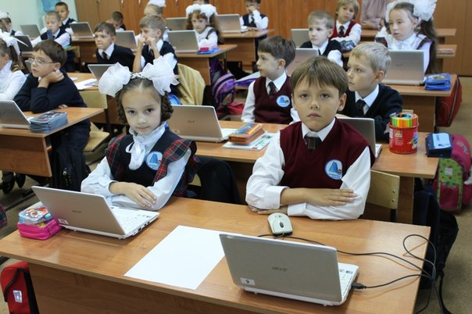
School education is an important element of education in modern society.

Slide 30
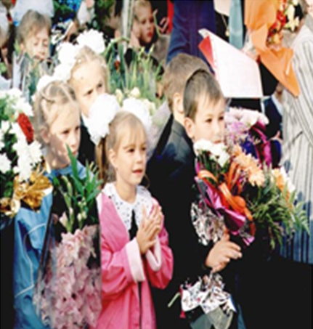
School education in Russia is free and compulsory for all. Training is conducted in Russian. The schools is multinational. Girls and boys go to school from 7 years. Academic year starts September 1.

Slide 31
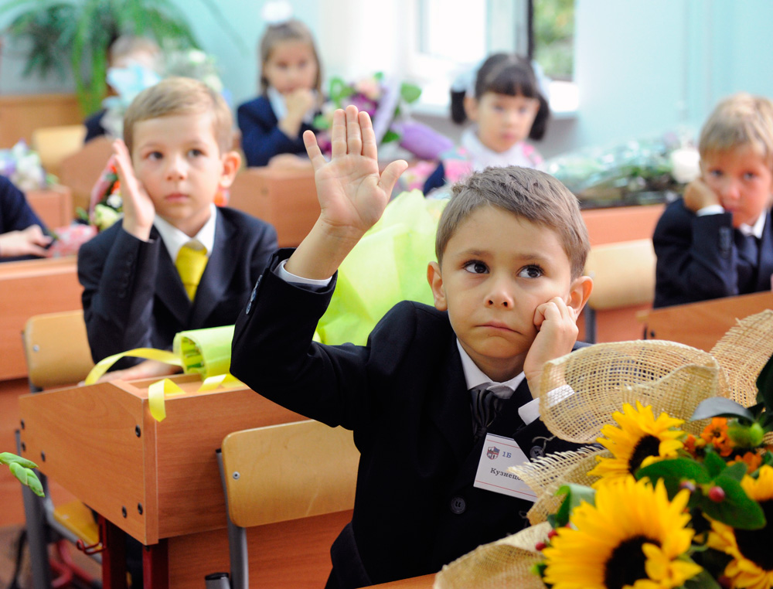
Тhree stages of education in the modern school
- elementary General education (grades 1-4);
- basic General education (grades 5-9);
- secondary (complete) education(grades 10-11).

Slide 32
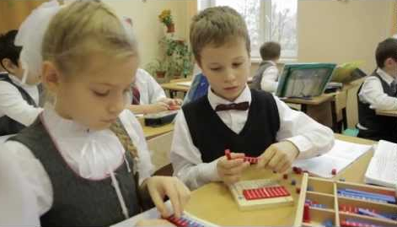
Primary Education
Primary education is the first stage of the overall development of children. Children first acquire knowledge about the world, skills in communication, solving applied problems. At this stage begins to develop the child's personality, which emphasizes its importance for society and the state. Primary education is compulsory and accessible for all. Education for children starts with they reach age 7. Children who successfully complete primary education continue their education at the stage of basic General education.

Slide 33
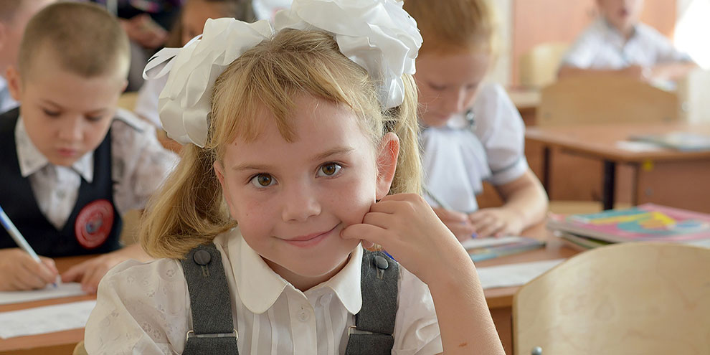
Subjects in primary school
Penmanship;
Reading;
Work;
Science;
Math;
Music(Singing);
Visual art(Drawing);
Russian language;
Physical education;
Native language;
Basics of religious cultures and secular ethics;
Foreign language.

Slide 34
Basic general education
This is the second stage of General education in Russia, which is the creation of conditions for development and formation of student's personality, development of his aptitudes and interests. Basic General education is a necessary step for obtaining secondary(complete) General education and primary professional education. It is mandatory and public. At the end of the last 9-th year students pass the state final attestation, the results of which determined the ability of each student to complete secondary education or secondary vocational.

Slide 35
Subjects in the basic general education
Chemistry;
Physics;
Geometry;
Algebra;
Mechanical Drawing;
Social Studies;
Computer science;
Biology;
Geography;
Technology;
Life safety(Basics of life safety);
Literature, Physical Training;
History, Local History, Civics, Foreign language.

Slide 36
Secondary (complete) education
The third final stage of general education in Russia, the objectives of which is to develop the creative abilities of the learner and the formation of independent learning skills. Secondary education is available to the public, but not mandatory, but a necessary step to get higher education. The main purpose of high school - preparation for entry into higher education. Secondary education is completed by passing the state exam (EGE), the results of which determine the possibility of entering the university. In Russia, the average (full) education refers to primary, basic general education and 2 years of high school (grades 10 and 11).

Slide 37
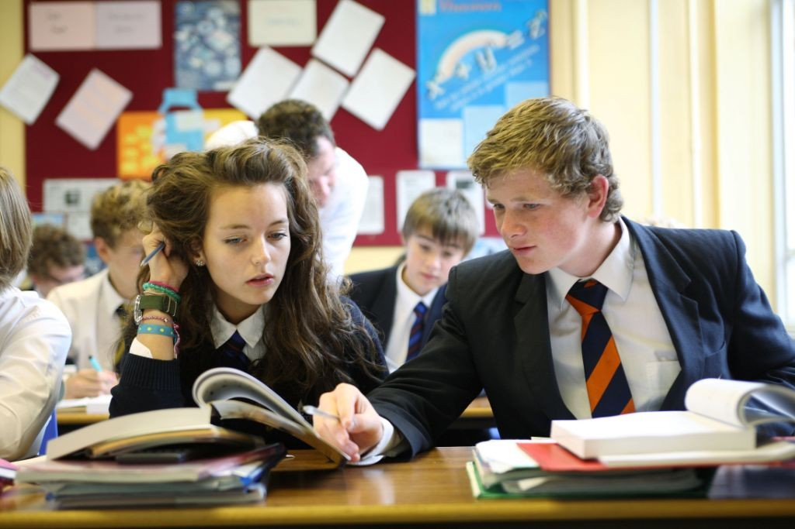
Subjects of the average (full) Education
Chemistry;
Physics;
Geometry;
Algebra;
Social Studies;
Computer science;
Biology;
Geography;
Technology, Astronomy, Basic Military Training;
life safety(Basics of life safety);
Literature, Basic Economics, Law, Philosophy, Ecology;
History, Natural History;
Local History;
Civics;
Foreign language, Physical Training.

Slide 38
The education optional-Rhetoric and World culture. In addition, some schools made training in advanced and specialized programs.

Slide 39
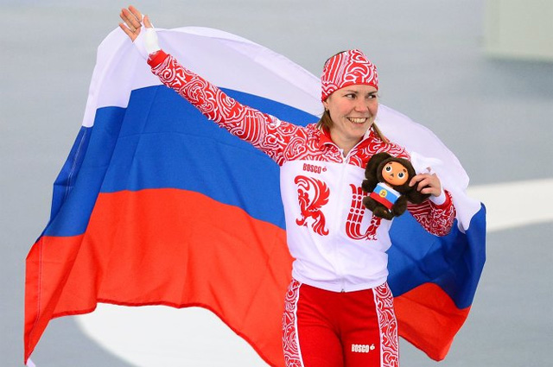
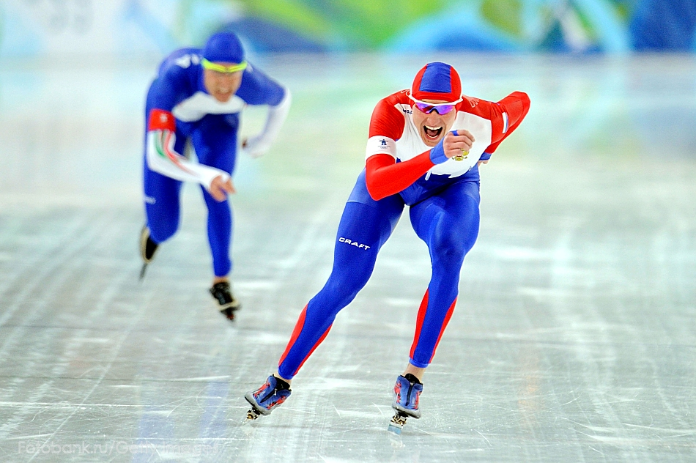
In Russia pays great attention to the sport. Healthy children are the future of the nation, state.

Slide 40
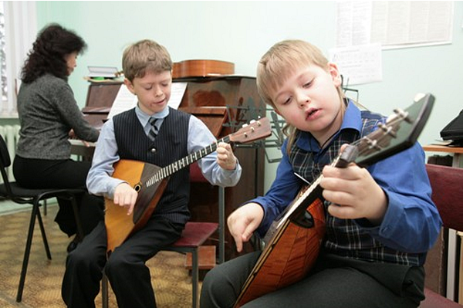
Тypes of schools in russia
Gymnasium;
College;
Center and complex;
The author's school;
Additional education establishments;
Remedial schools;
Specialized schools;
Driving schools.
General education is given in the framework of public municipal and private organizations.

Slide 41
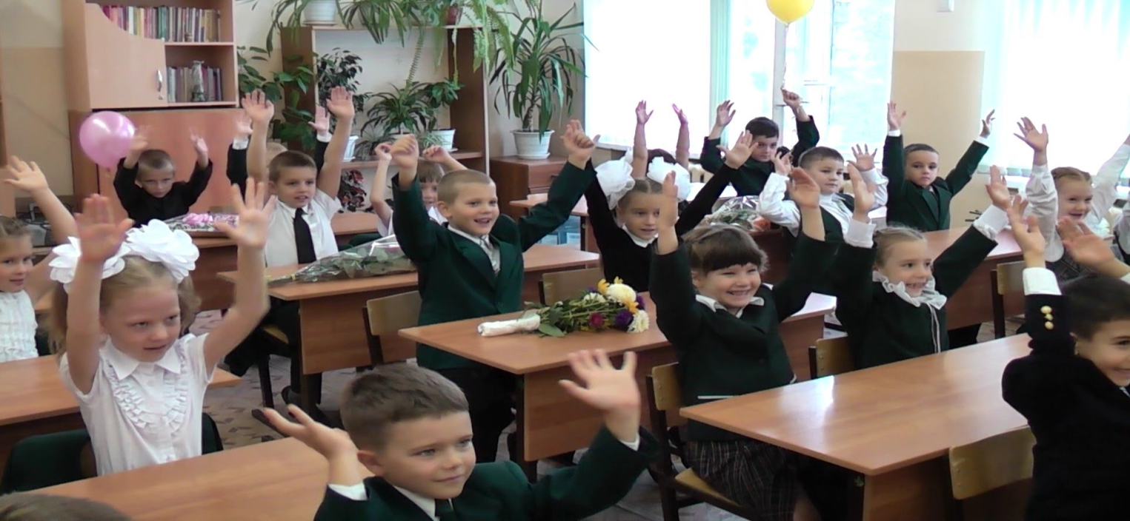
Тypes of school in russia
State;
Private;
Public-private (with private and public funding of the program control).
There are 58 thousand schools in Russia.

Slide 42
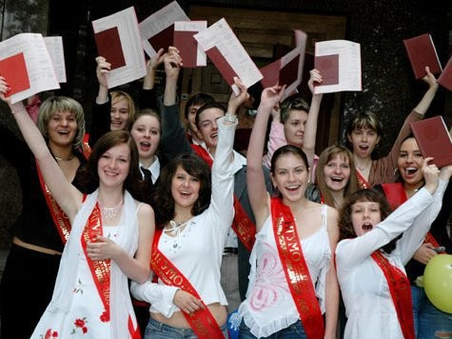
After graduating from high school and receive a certificate of education the children can continue their education at other institutions.

Slide 43
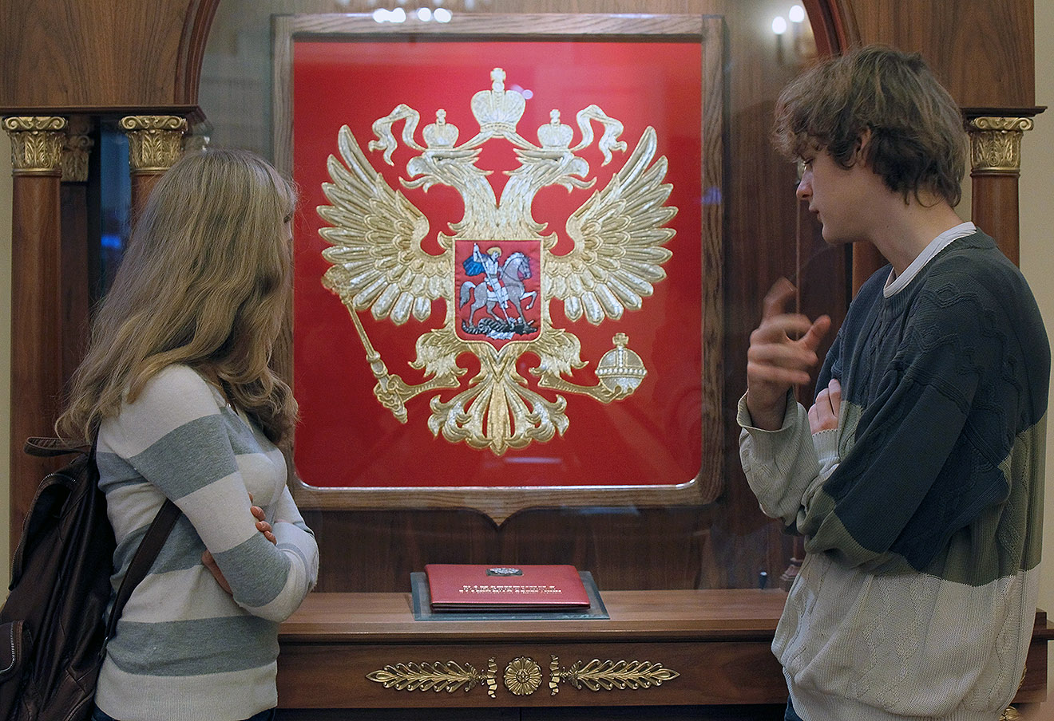
The Russian Constitution guarantees Russian citizens the right to free higher education on a competitive basis.

Slide 44
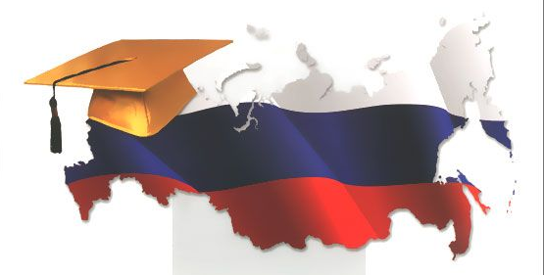
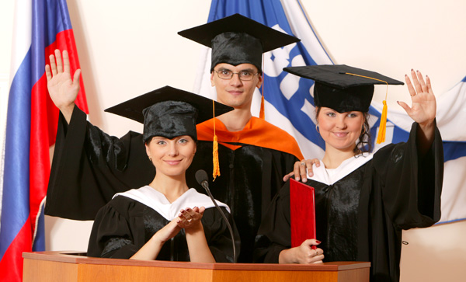
Higher education in russia

Slide 45
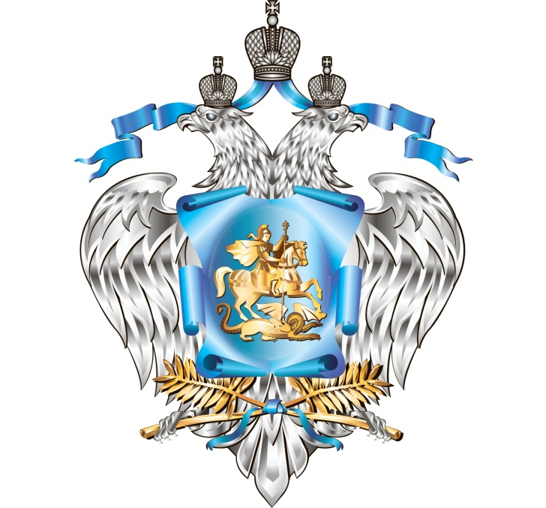
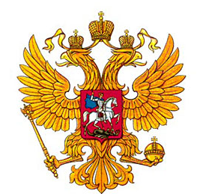
Higher education is provided by public and private accredited higher education institutions. Most public institutions of higher education is regulated by the Ministry of Education of the Russian Federation. Some of them are regulated by other government ministries such as the Ministry of Health, Ministry of Railways, Ministry of Culture, Ministry of Foreign Affairs and others.

Slide 46
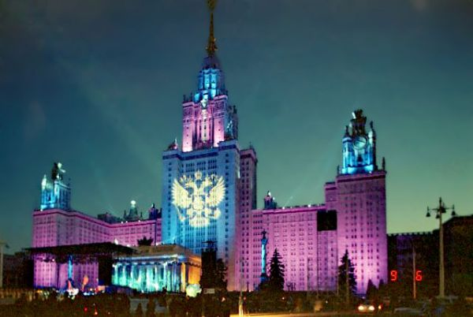
Higher education - training of highly qualified personnel. Higher education in Russia - the part of a professional education aimed at training highly skilled personnel for all basic directions of socially useful activity in accordance with the needs of society and the state, the needs of the individual in intellectual, cultural and moral development, deepening and expansion of education, scientific-pedagogical qualifications.

Slide 47
Levels of higher education in Russia
Higher education - bachelor;
Higher education - specialist, master;
Higher education - training of highly qualified personnel.
At the undergraduate and professional programs can proceed on the basis of secondary education, for the master's program - on the basis of higher education at other levels, for the training program of training of highly qualified personnel, must have higher education specialist, master.

Slide 48
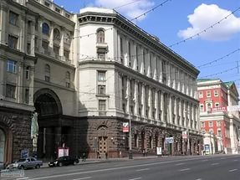
The Ministry of education and science of the Russian Federation established in 2004.
The Ministry of education and science of the Russian Federation - Federal body of the Executive power authorities of Russia, responsible for drafting state policy and legal regulation in the sphere of education, scientific-technical and innovative activity, development of Federal centers and science towns, intellectual property, and also in the sphere of youth policy, education, guardianship, trusteeship, social support and social protection.

Slide 49
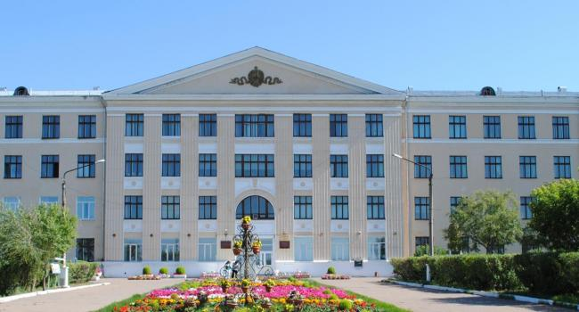
In Russia there are 1,100 higher education institutions(of which more than 600 state and 400 private).

Slide 50
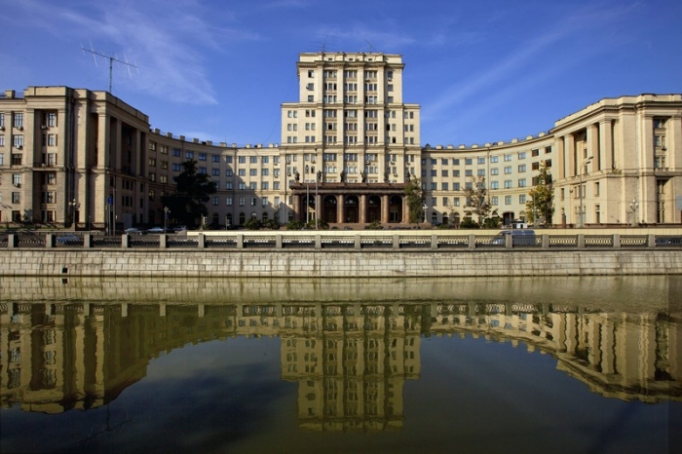
The best universities in russia
Moscow State Technical University named after NE Bauman;

Slide 51
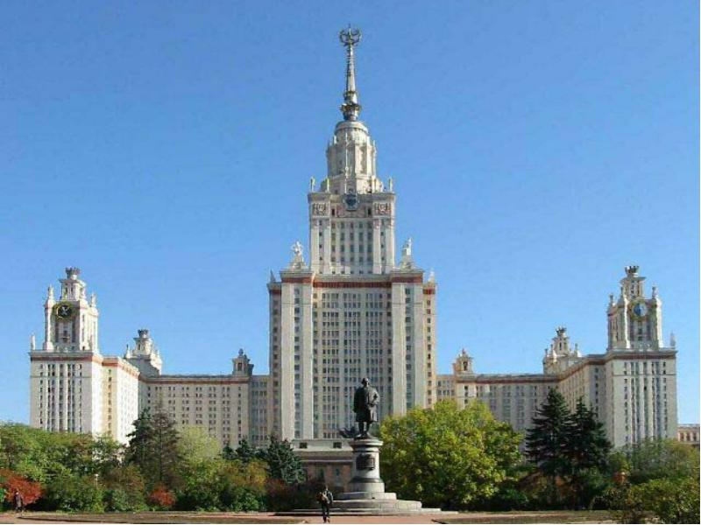
Moscow State University named after
M. V. Lomonosov;

Slide 52
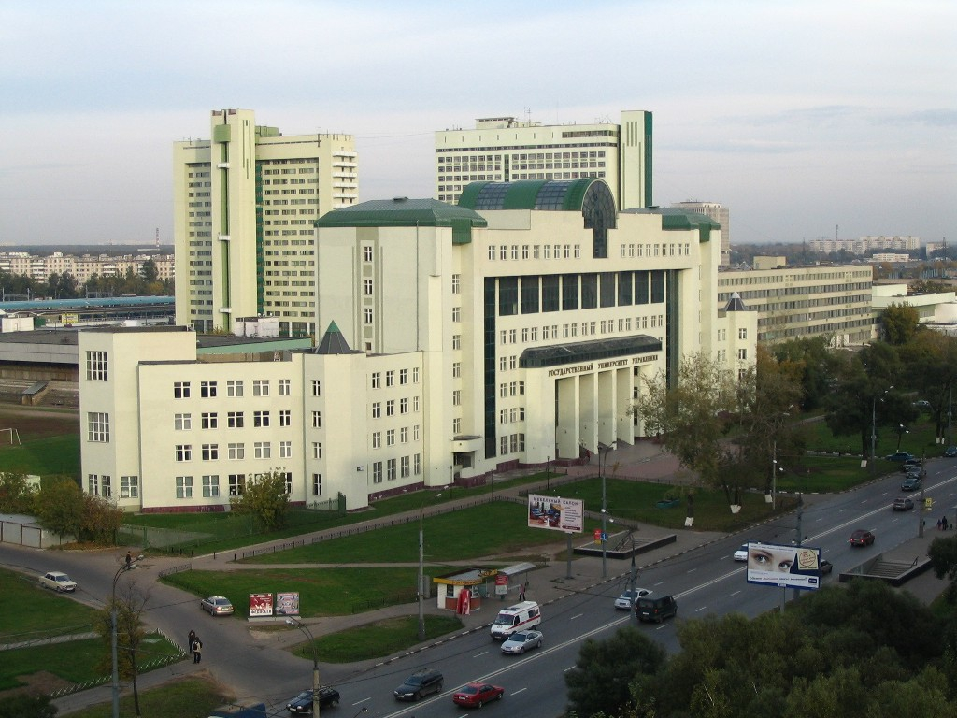
Moscow State University of Management;

Slide 53
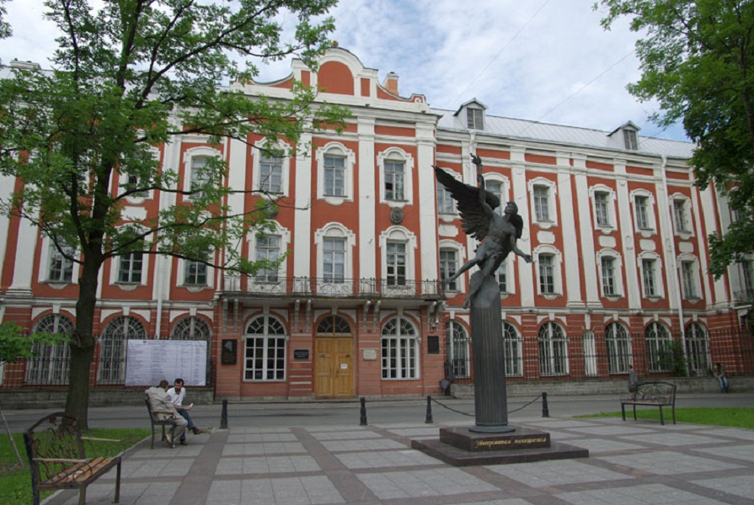
Saint Petersburg State University;

Slide 54
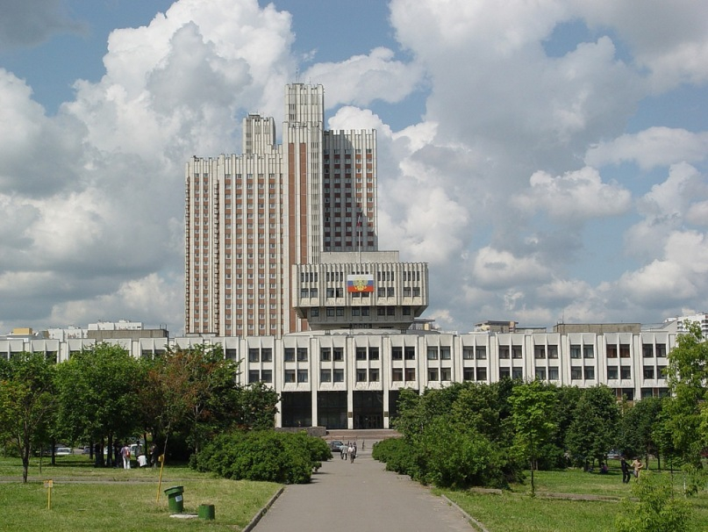
Russian Academy of National Economy and Public Administration;

Slide 55
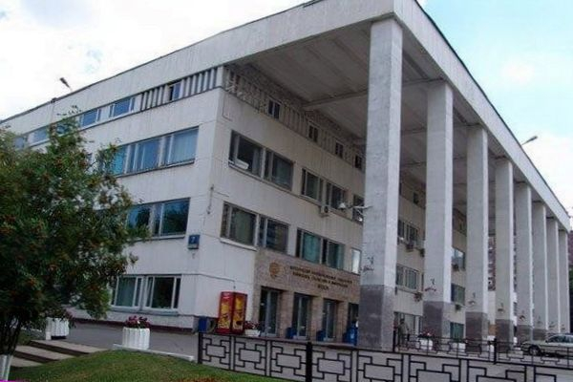
Moscow State University of Economics, Statistics, and Informatics;

Slide 56
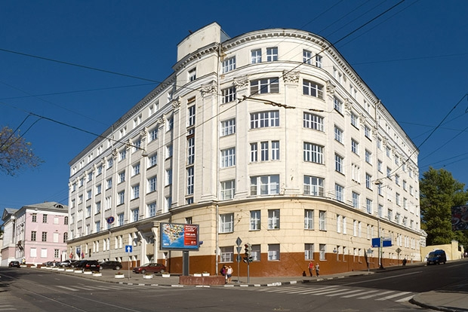
National Research University;

Slide 57
Kazan Federal University;

Slide 58
Russian University of Peoples' Friendship;

Slide 59
Ural State University.

Slide 60
Education in Russia is multifaceted and, as we have seen, pays a lot of attention.
Quality education is the future of the state, a resource of sustainable development of society.

Slide 61
The End

Slide 62
Questions
When did the first school appear in Russia?
When was the first school opened?
What is the language of instruction?
Is education in schools of Russia free of change?
How many all educational establishments are in Russia?
Are schools multinational in Russia?
Why is sport paid much attention?
How many years do children go to in school in Russia?
What is the school education?
When the school year starts in Russia?

