Slide 1
Інтегрований навчальний комплекс
з англійської мови для учнів 5-8 класів з теми
“Sport and hobbies”
Учитель англійської мови Уманської
спеціалізованої школи I-III ступенів №12
з поглибленим вивченням англійської мови
Кравченко І.В.

Slide 2
What sort of person are you?
1.How often do you help around the house?
a) most days b) once a week c) never
2. How often do you tidy your room?
a) more than once a week b) once a week c) never
3. How often do you go out with friends?
a) a lot b) two evenings c) not very often
4. How often do you stay up after midnight?
a) most nights b) not very often c) never
5. How often do you do sports?
a) 2-3times a week b) every day c) never
6. How often do you paint, play, do smth. creative?
a) every day b) sometimes c) never

Slide 3
Find and circle the hobbies words in the line.
Footballtennisbadmintonswimmingskatesledgeskivolleyballplaymodellingdancingreadingcoinsguitarcrosswordschessdrawingmusicgolfaerobicshockeydominoeskaratetelevisioncricketviolincollectingpuzzles.

Slide 4
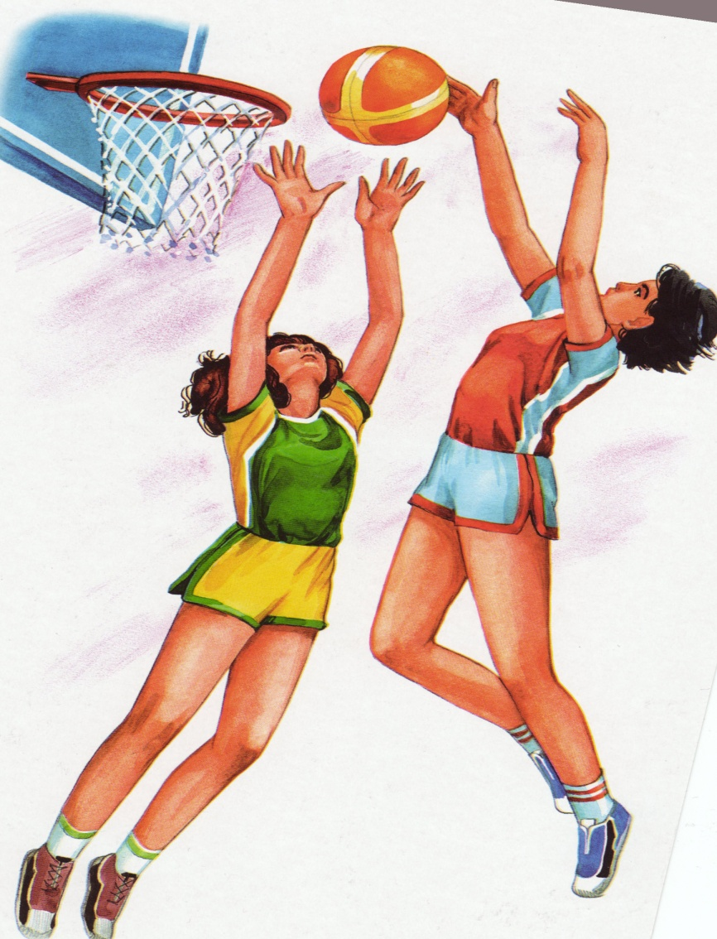
Match the picture with the word-combination
Play volleyball
Play basketball
Play badminton

Slide 5
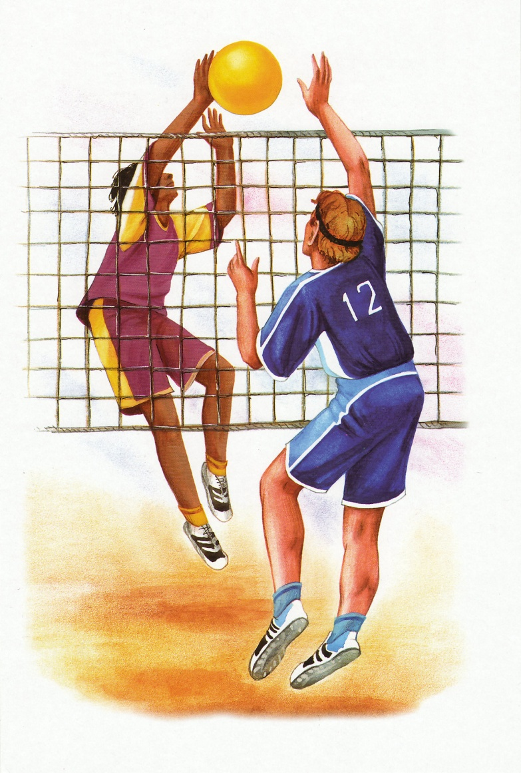
Match the picture with the word-
combination
Play tennis
Play volleyball
Play basketball

Slide 6
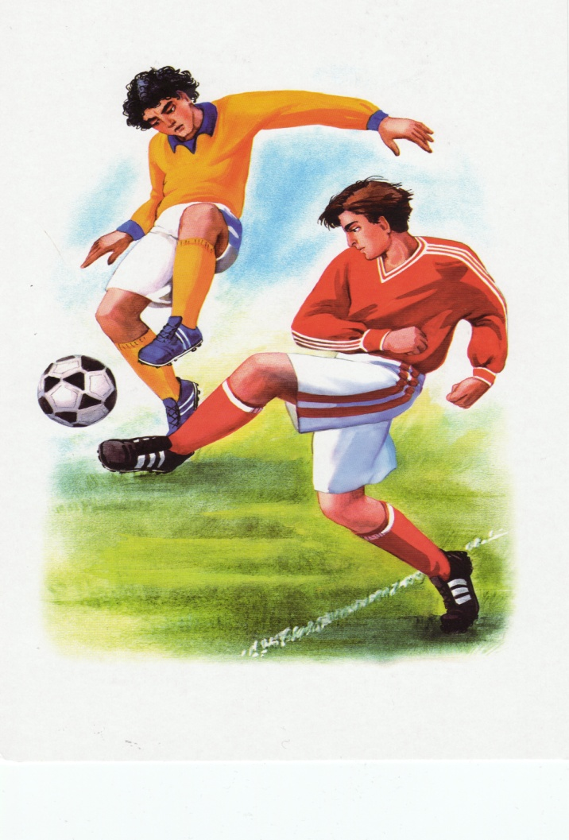
Match the picture with the word-combination
Play cards
Play rugby
Play football

Slide 7
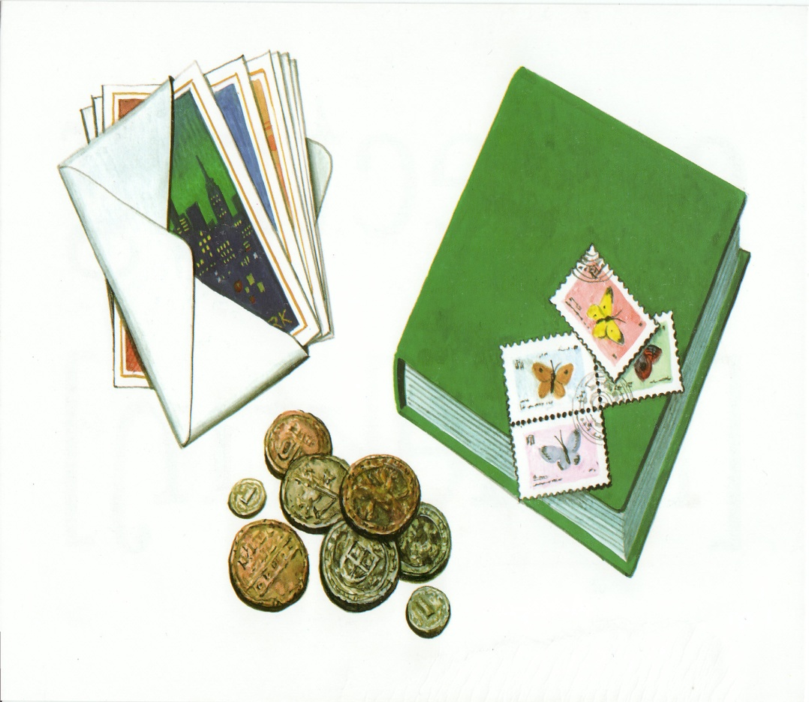
Match the picture with the word-combination
Collection
Dominoes
Cards

Slide 8
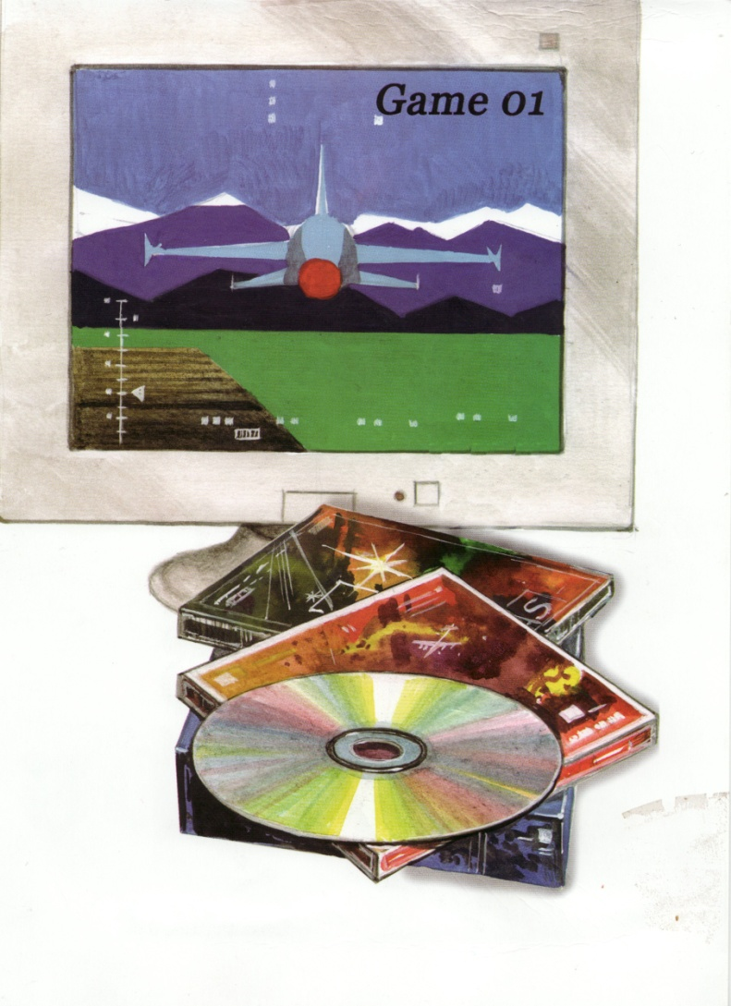
Match the picture with the word-combination
Computer games
Board game
Word game

Slide 9
Write out the word that does not go
with others
football, basketball, volleyball, tennis
ski, swimming, sledge, skate.
play, swim, skate, ball, run.
jump, run, read, ski, play.
piano, stamp, guitar, computer, cards.
watch TV, draw, skate, write, read.

Slide 10
Match the parts of the sentences
different hobbies
hobbies is collecting
fond of sports and that is their hobby.
fond of travelling and gardening
doing different things
like to do in your free time
Different people like
Different people have
A hobby is something you
One of the most popular
Some people are
Many boys and girls

Slide 11
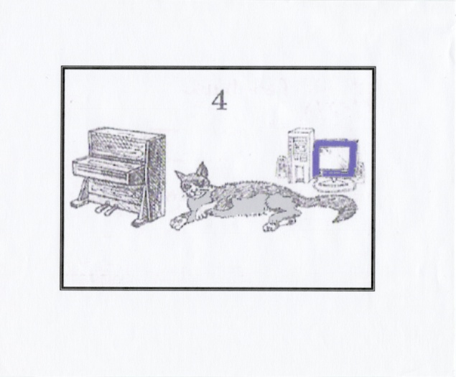
Read the texts. Match the texts with the right picture
A) Alex usually gets up 7.45. He goes to school every day by bus. In the evenings he plays the piano or plays computer games. They are his hobby. Alex has a pet cat. It is grey and white.
B) Dave goes shopping every day. He buys fruits and vegetables. He likes apples sand tomatoes. He has a pet dog. It is black. After school Dave likes to watch videos. His favourite sport is tennis. His hobby is music.

Slide 12
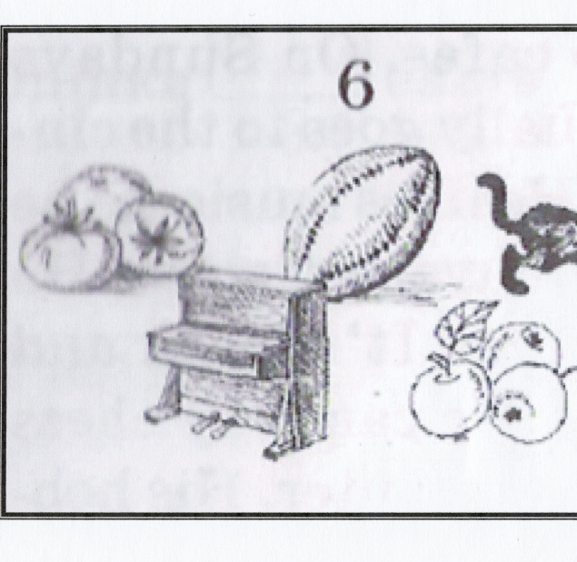
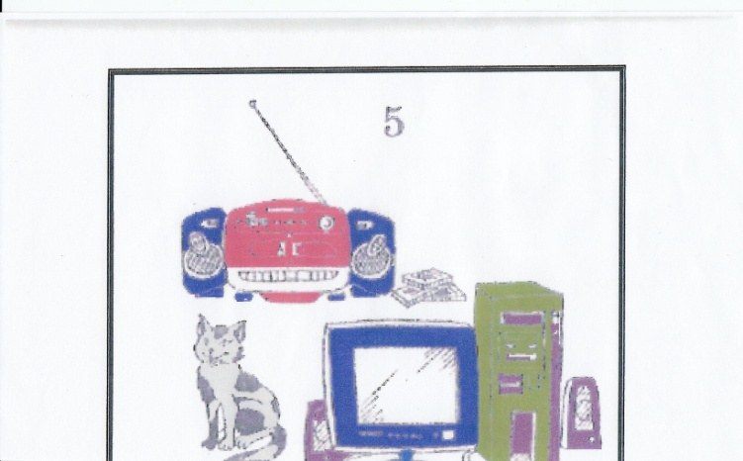
Read the texts. Match the texts with the right picture.
C) Larry likes to go to cafes. On Sundays he usually goes to the cinema. He likes music, so he often buys cassettes. He has a cat. It is black and white. He can play chess on his computer. His hobby is photography.
D) Robert goes out at 6 every morning and plays basketball. Sport is his hobby. Robert has a pet cat. It is black and grey.

Slide 13
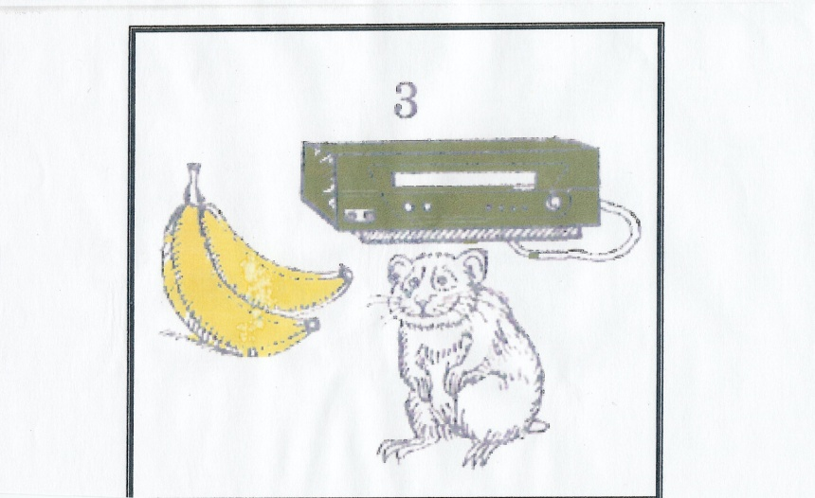
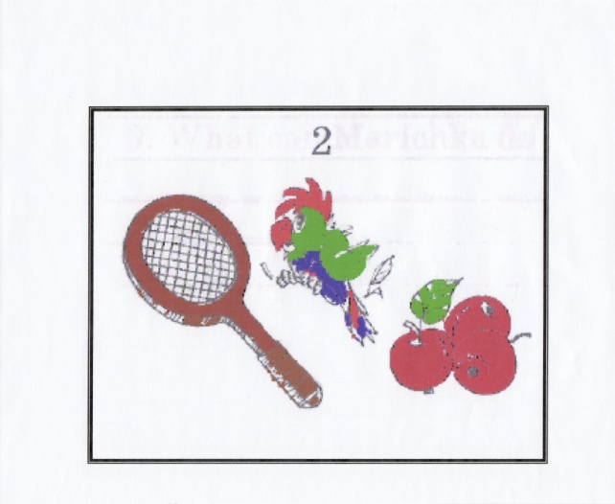
Read the texts. Match the texts with the right picture
E) Sam goes to school on foot. For breakfast he usually eats bananas. He likes to go to discos. His hobby is cooking. In the evenings he likes to watch videos. He has got a hamster.
F) Bob goes to play tennis every Sunday. His hobby is painting. He likes to paint animals very much. He has a pet parrot. It can speak a little. Bob usually buys apples for it on his way back home.

