Slide 1
«…Две равно уважаемых семьи В Вероне, где встречают нас событья, Ведут междоусобные бои И не хотят унять кровопролитья. Друг друга любят дети главарей, Но им судьба подстраивает козни, И гибель их у гробовых дверей Кладет конец, непримиримой розни. Их жизнь, и страсть, и смерти торжество, И поздний мир родни на их могиле На два часа составят существо Разыгрываемой пред вами были….»

Slide 2
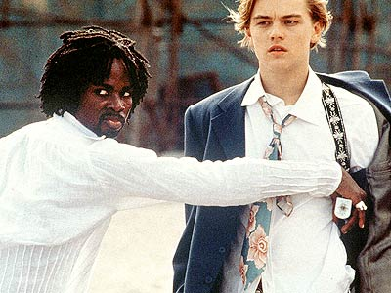
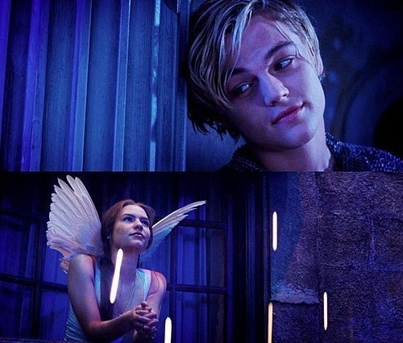
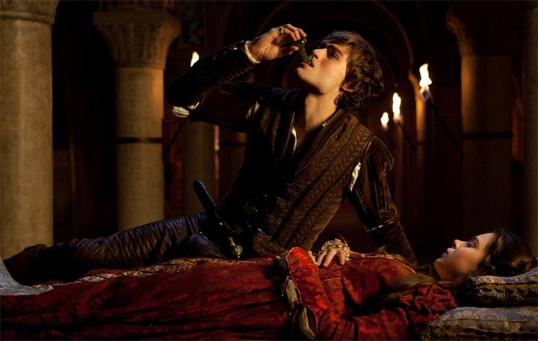

Slide 3
Уильям Шекспир
( англ. William
Shakespeare)

Slide 4
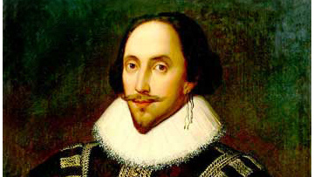
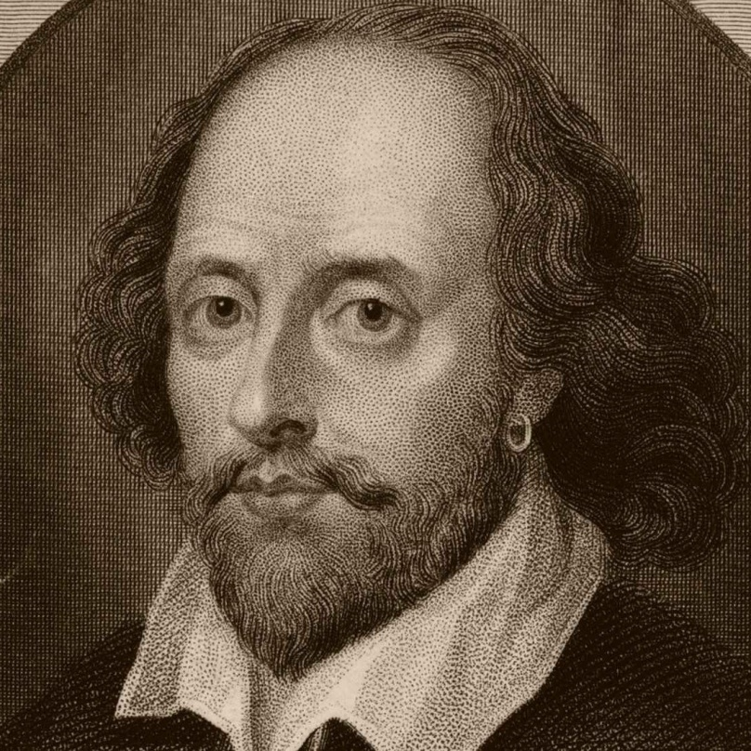
He is the most
famous poet,an actor
and a playwriter
in Britain and around the world.

Slide 5
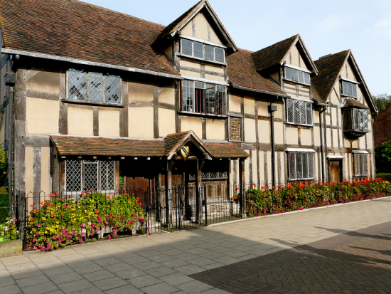
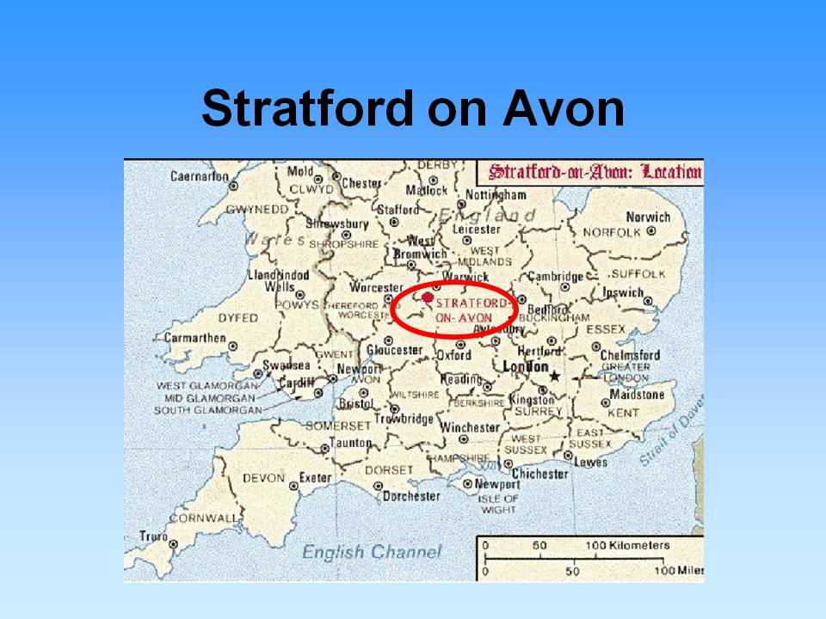
He was born in 1564 in 23 April in English town Stratford on Avon .
And he died there too.

Slide 6
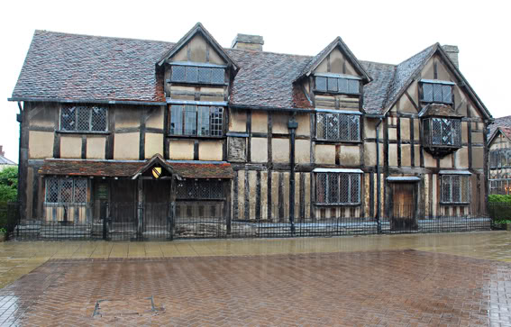
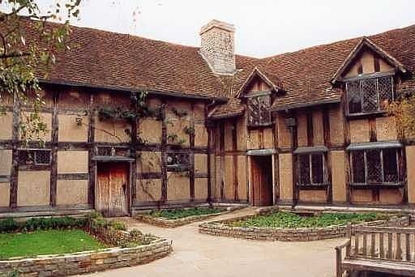
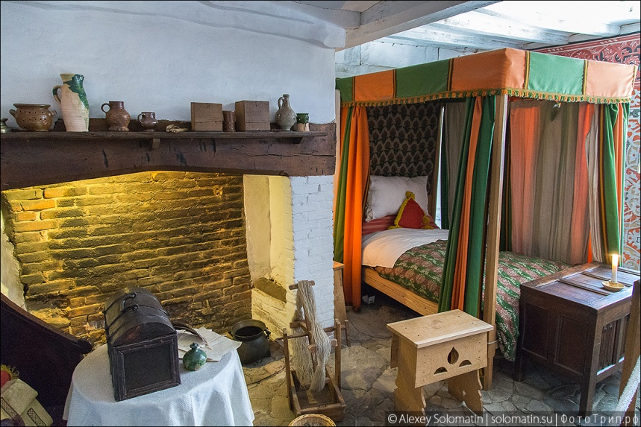
He lived in Henly Street.His parents were rich.
His father was a seller of gloves.

Slide 7
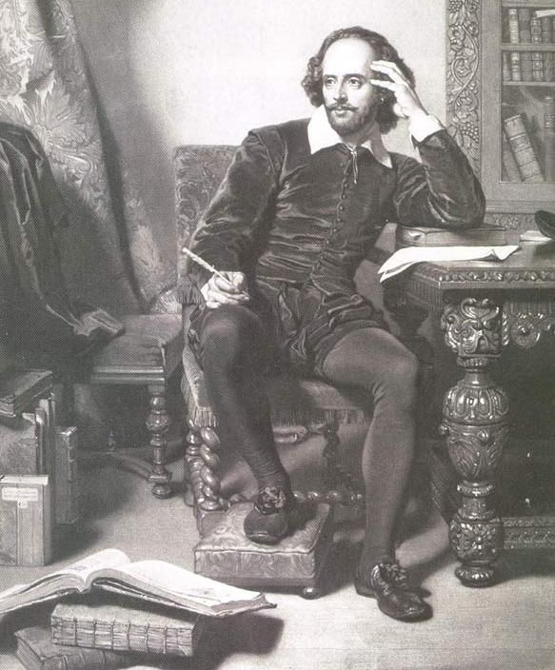
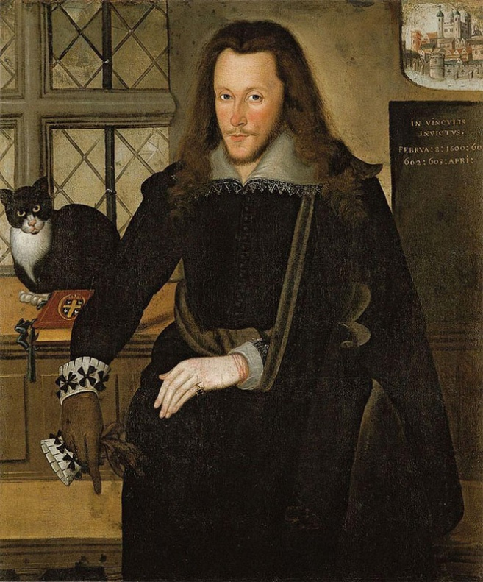
William went to a grammar school .
He studied grammar, logics, rhetoric and Latin. Then he was a student of a butcher.

Slide 8
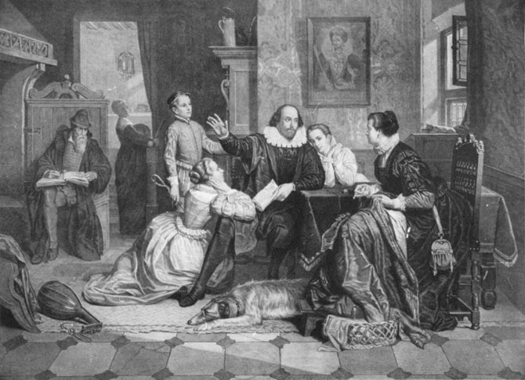
In 1582 Shakespeare married Anne Hathaway. They had a daughter Susanna and two sons (twins), Hamnet and Judith. But the girl died.

Slide 9
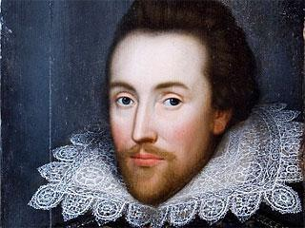
In 1585 Shakespeare left his hometown and moved to London.

Slide 10
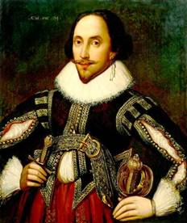
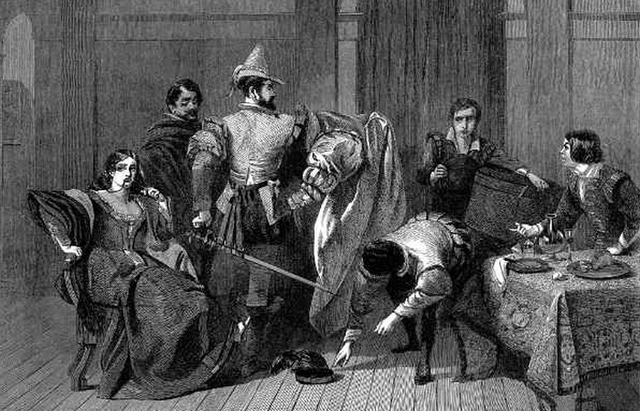
He was the co-owner of a playing company. In 1603, the company came under the patronage of King James I

Slide 11
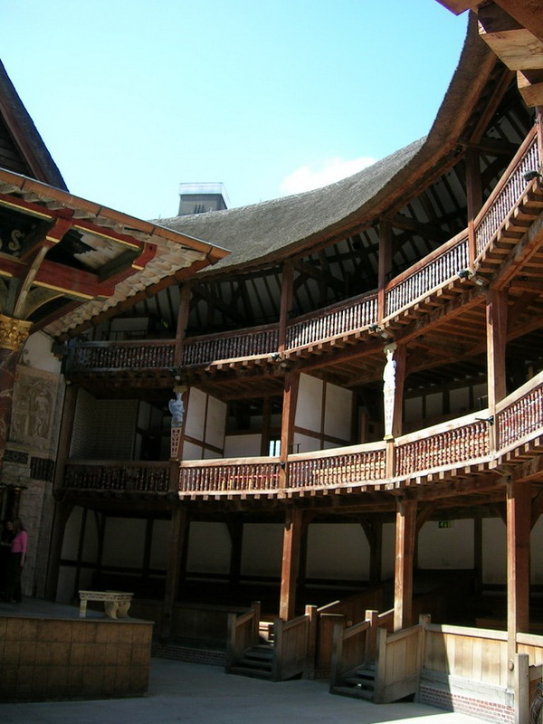
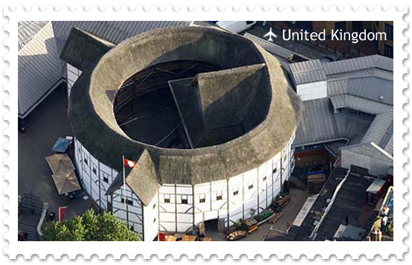
In 1596 the troupe founded their own theater called the Globe . A lot of Shakespeare’s plays were performed on its stage.

Slide 12
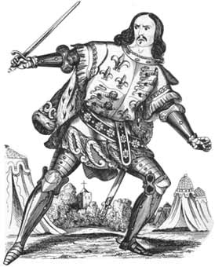
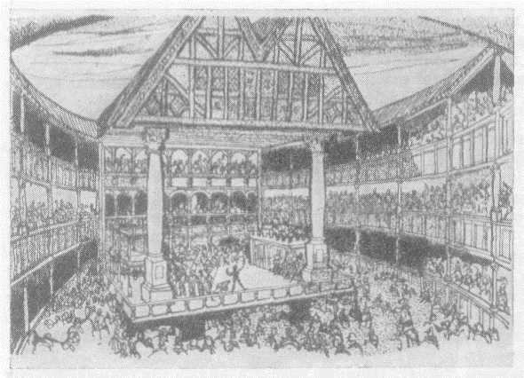
He sometimes played in his plays.

Slide 13
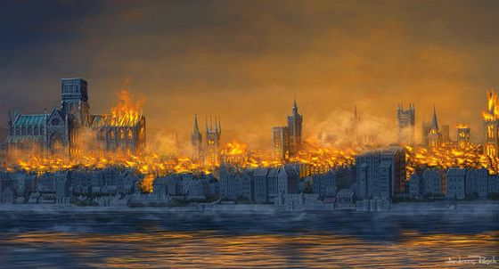
But it was destroyed in the Big Fire in London .

Slide 14
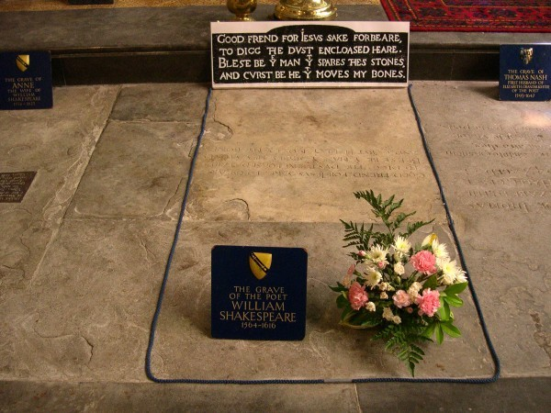
Shakespeare died in Stratford on 23 April 1616.
Moй добрый друг, во имя бога,
Ты прах под камнем сим не трогай.
Сна не тревожь костей моих.
Будь проклят тот, кто тронет их.

Slide 15
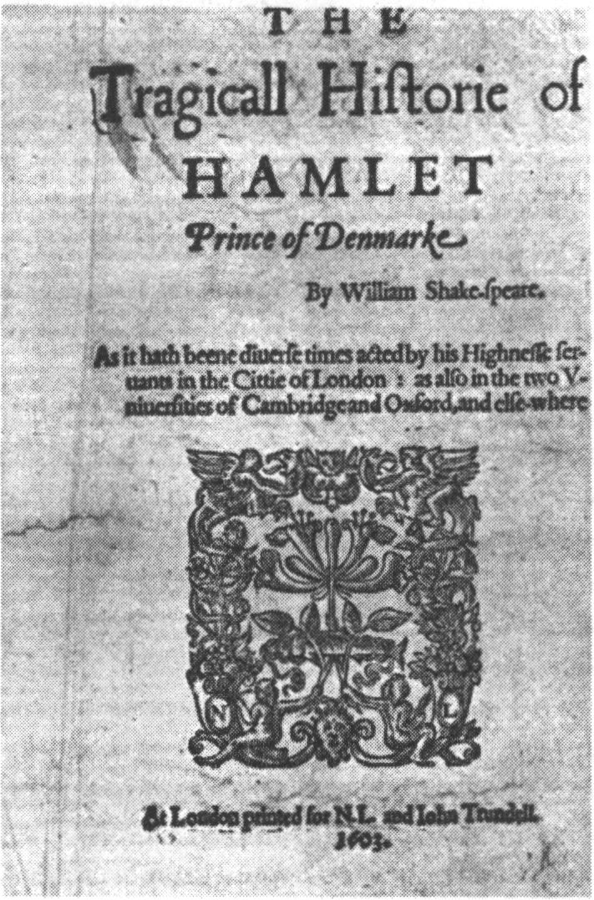
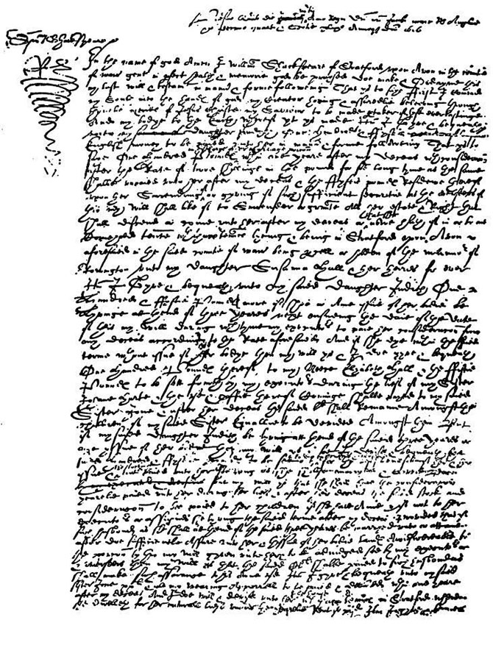
He wrote 38 plays, 154 sonnets and some poems.

Slide 16
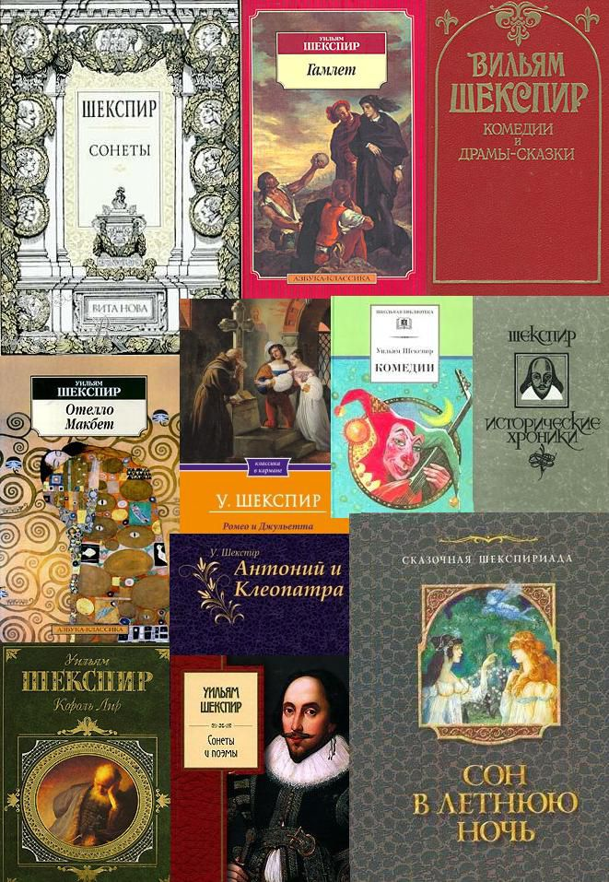
In
all languages
of the
world.
His
books.

Slide 17
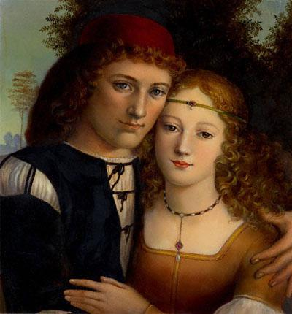
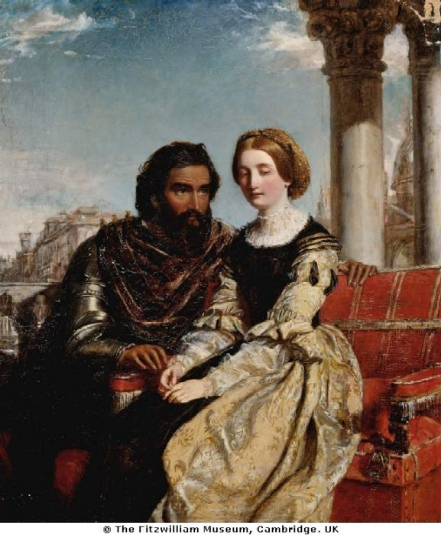
His characters are like Romeo , Juliet ,Hamlet, Ophelia, Lady Macbeth, Othello and King Lear.

Slide 18
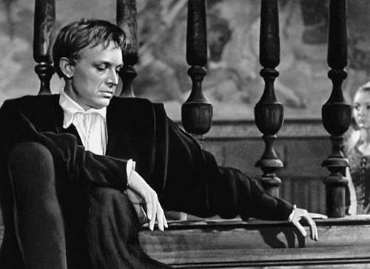
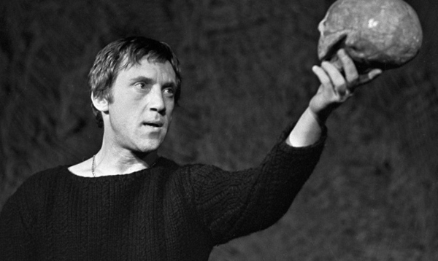
«To be or not to be.
It`s a question…»
Hamlet

Slide 19
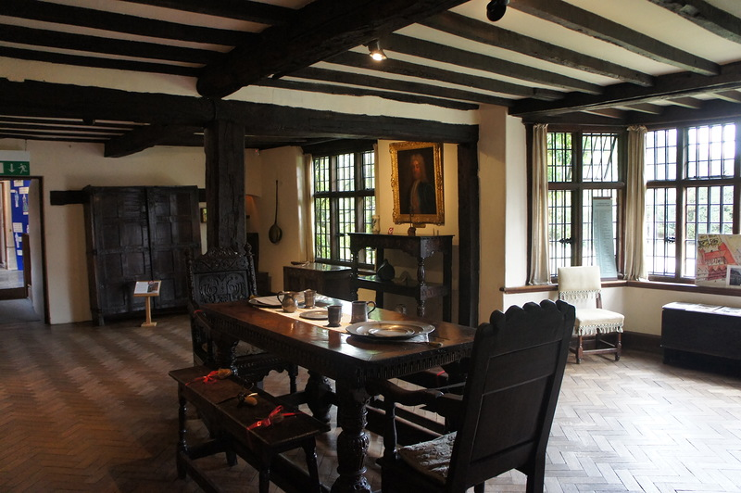
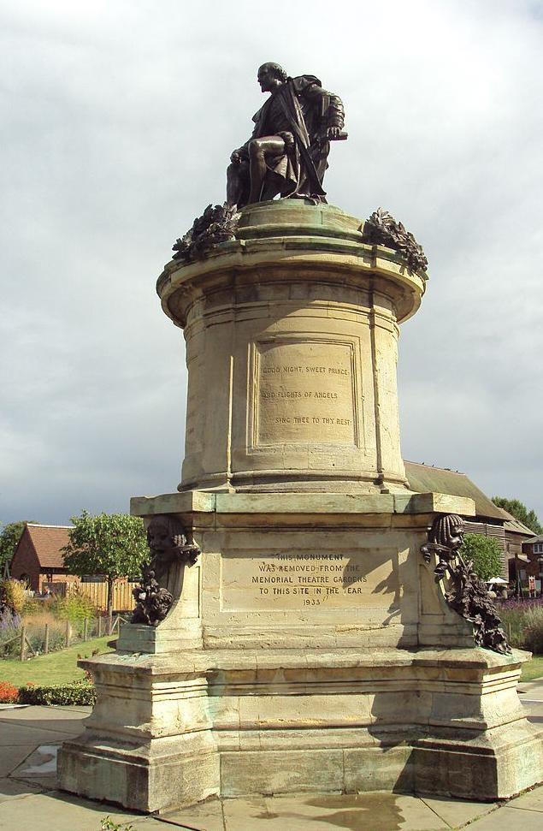
Shakespeare`s museum.
Shakespeare`s monument .

Slide 20
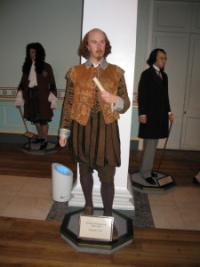
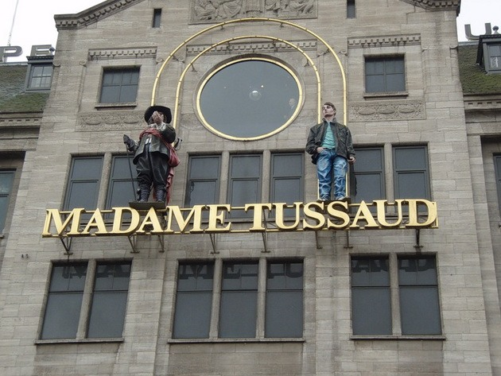
Shakespeare`s
monument in the …

Slide 21
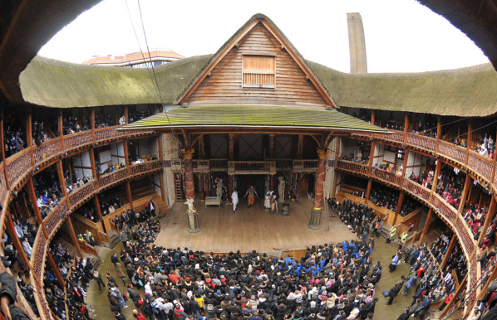
Globe theatre now.

Slide 22
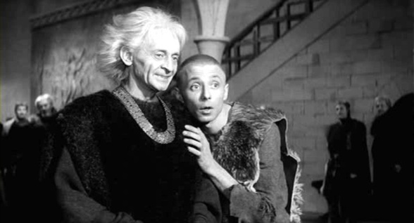
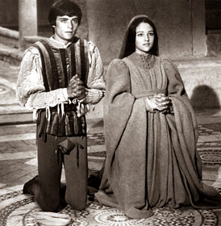
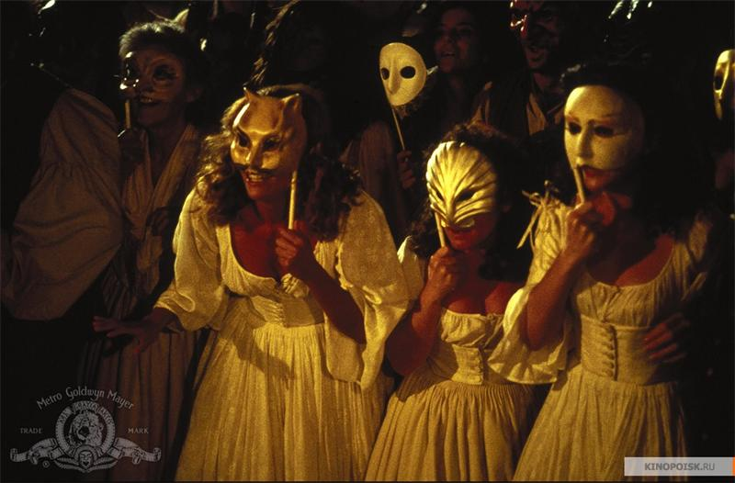
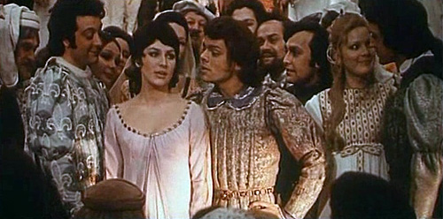
Shakespeare’s plays are often performed in the theatres, and most of them have been filmed.

Slide 23
Thank you for your attention!
I hope you
will meet Shakespeare`s books
in the future!

