Slide 1
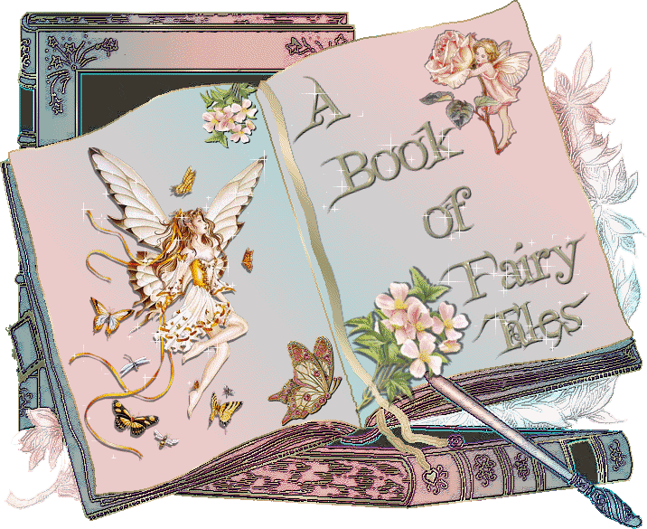

Slide 2
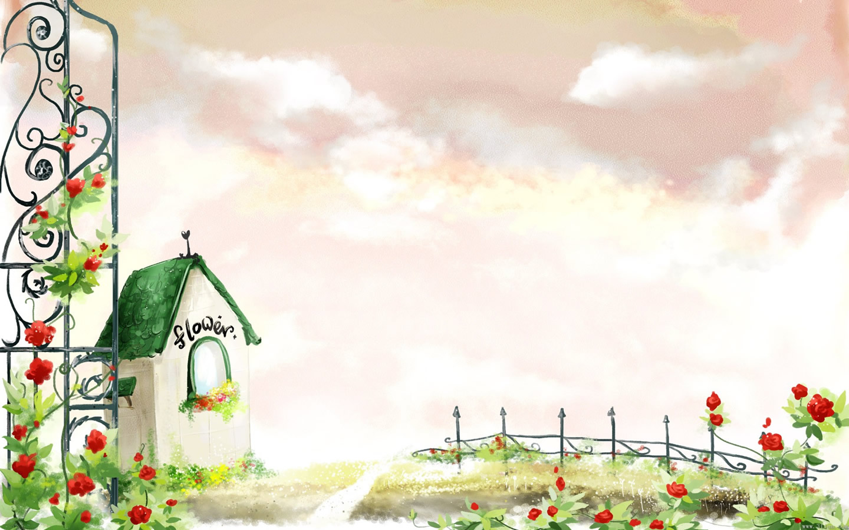
The ugly duckling Дикі лебеді Three little pigs Попелюшка Three bears and Goldilocks Рапунцель Cinderella Гидке каченя The wild swans Русалонька The goose with the golden eggs Три поросятка Snow White Три ведмеді The wolf and the seven little goats Гуска,що несе золоті яйця Rapunzel Білосніжка The little Mermaid Вовк та семеро козенят

Slide 3
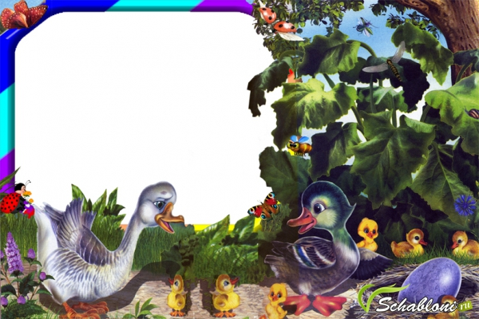
The u…ly d……kling

Slide 4
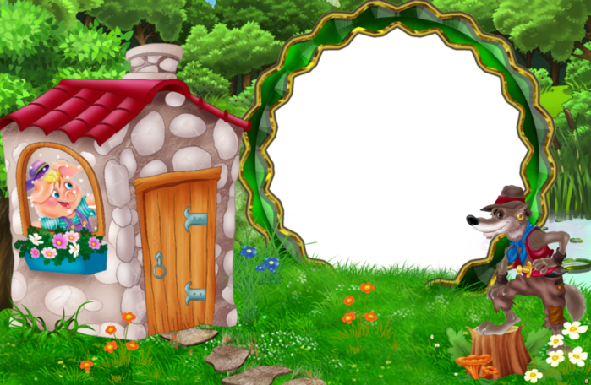
T…ree li……le p…gs

Slide 5
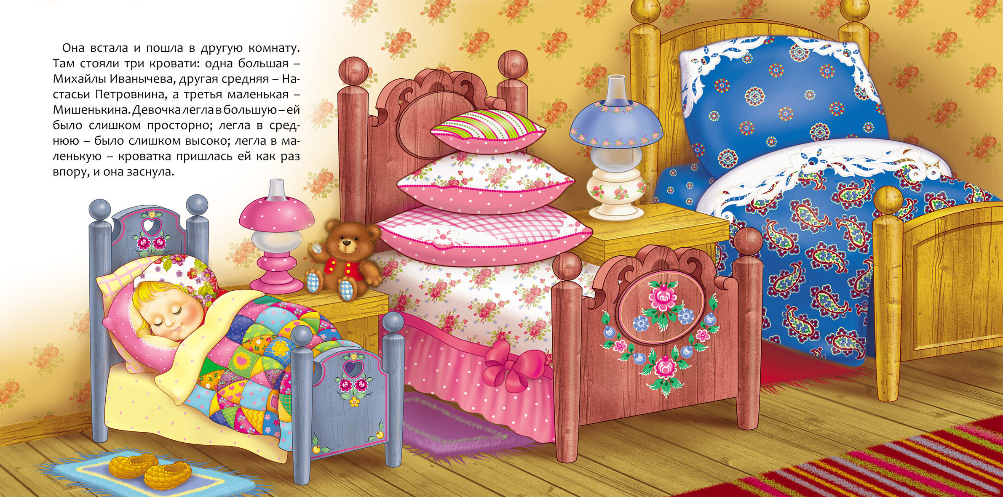
Three be…rs and Gol……locks

Slide 6
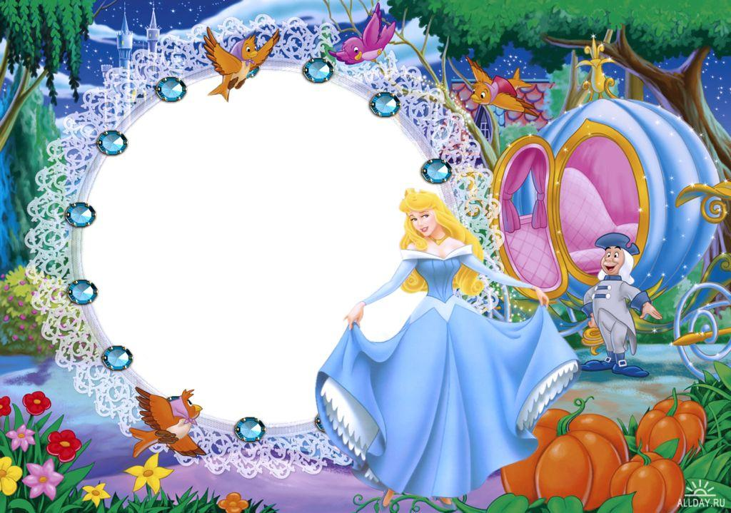
Ci…der…lla

Slide 7
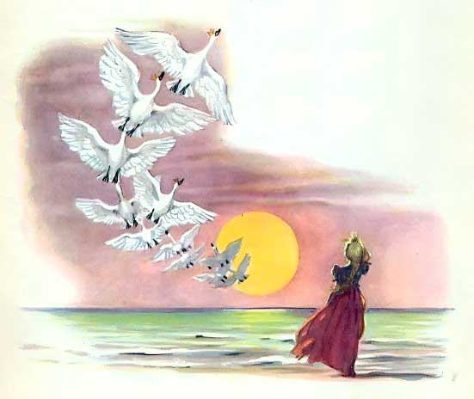
The w…ld sw…n…

Slide 8
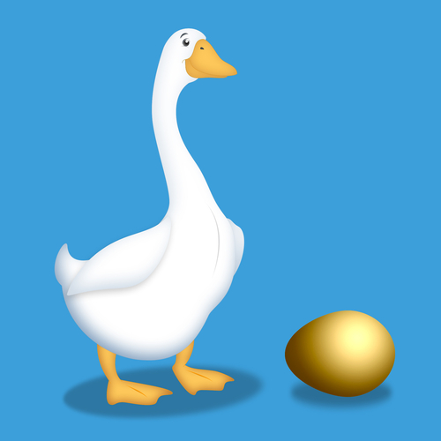
The g……se with the go….den …ggs

Slide 9
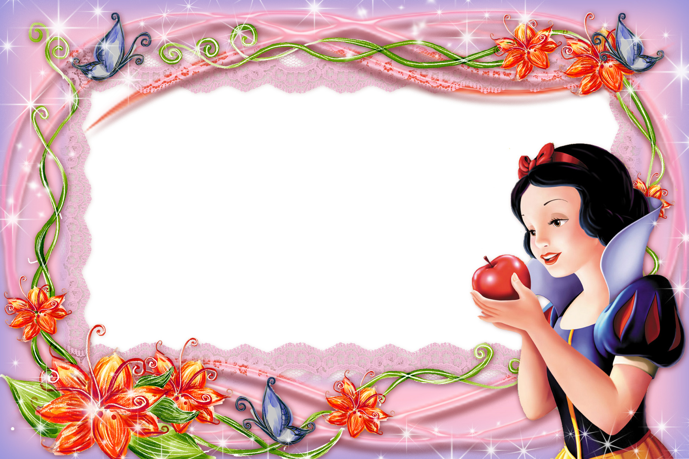
S…ow W…i…e

Slide 10
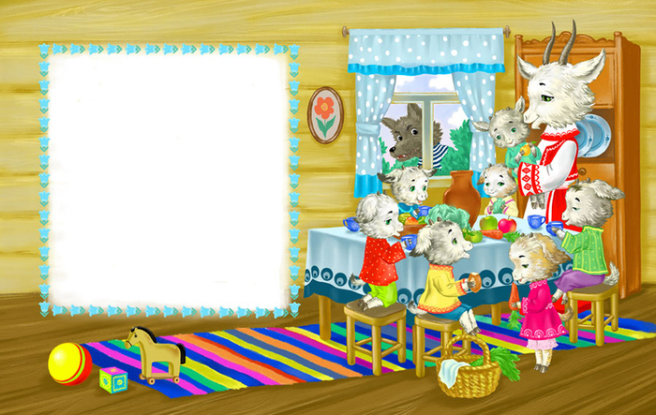
The w…lf and the s…v…n li…tle go…ts

Slide 11
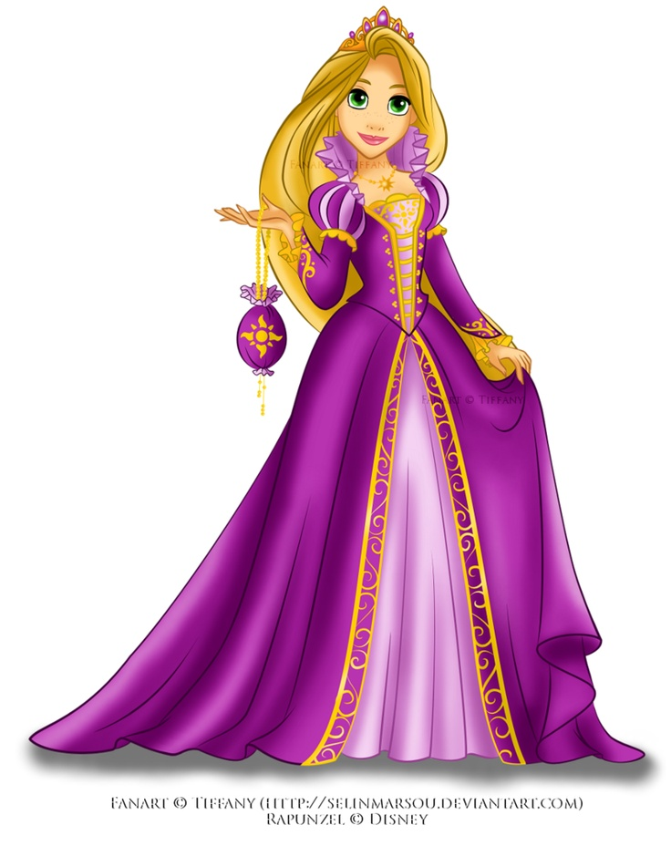
Ra…un…el

Slide 12
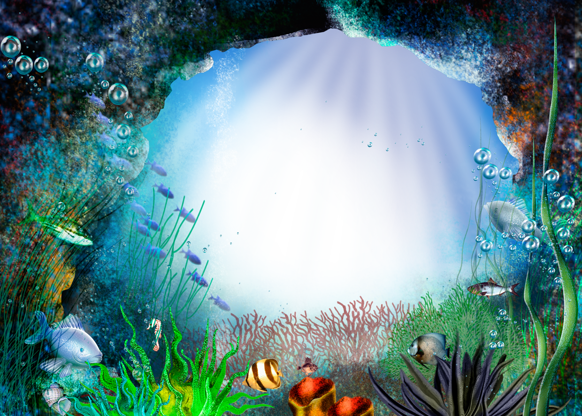
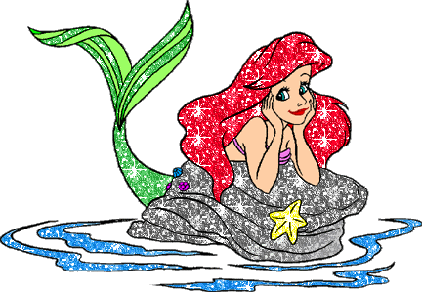
The little M……ma…d

Slide 13
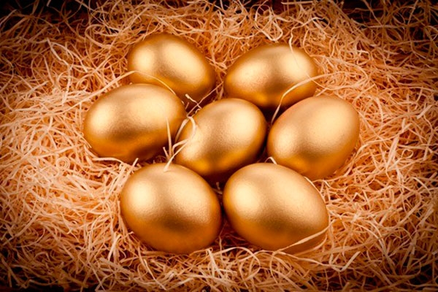
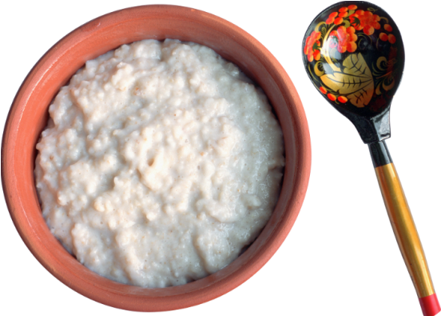
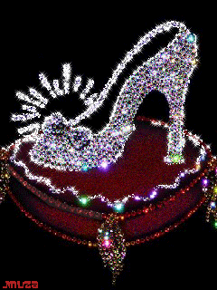
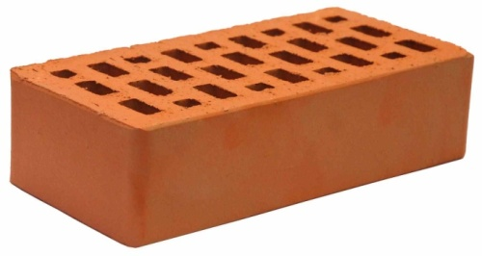
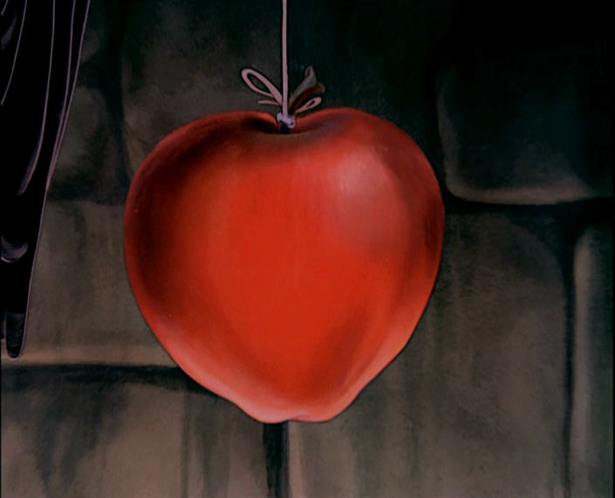
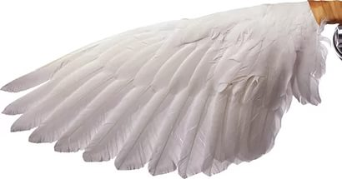
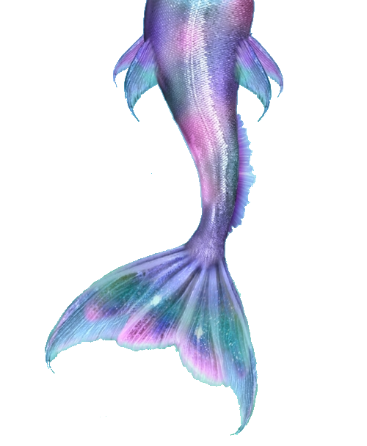
Whom belongs this thing?

Slide 14
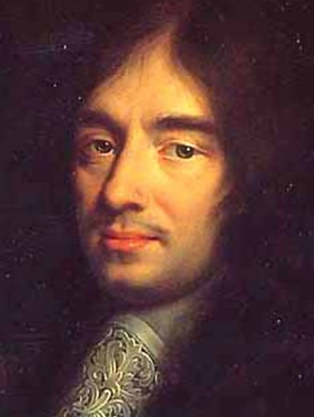
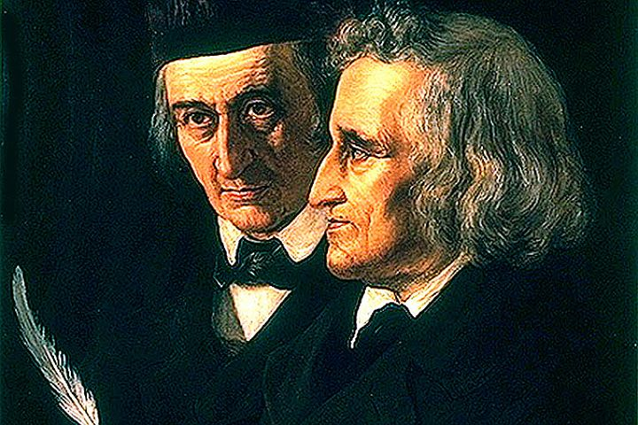
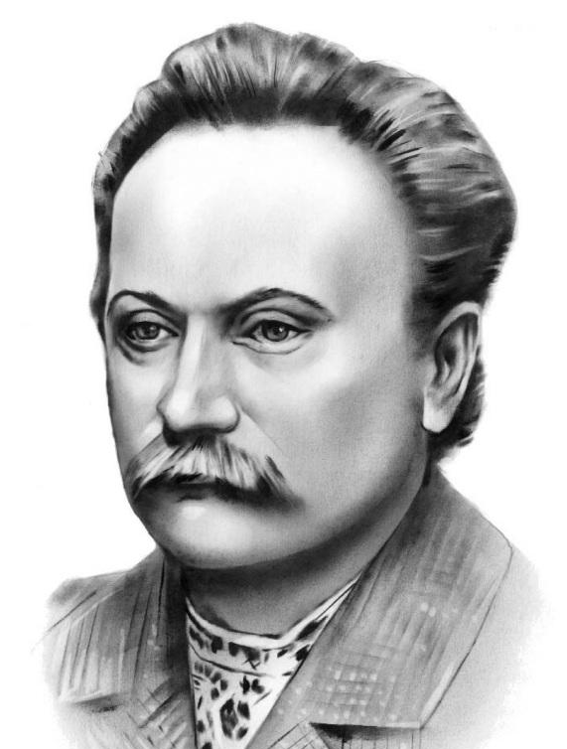
Guess the writer
Charles Perrault
Hans Christian Andersen
Brothers Grimm
Wilhelm Hauff
Ivan Franko

Slide 15
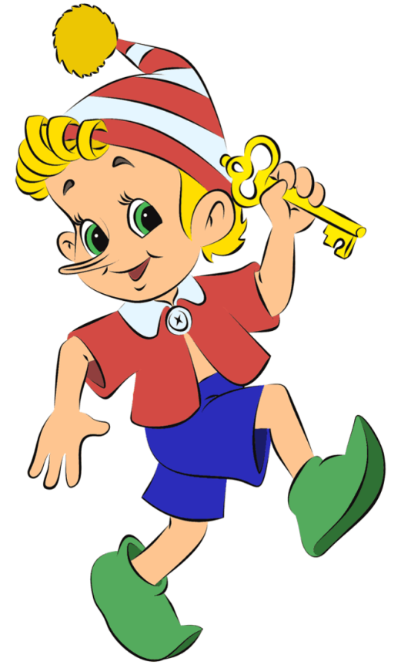
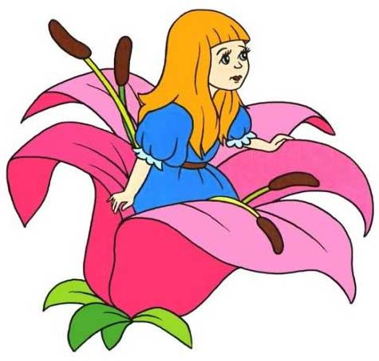
Describe the character of the fairy tale

Slide 16
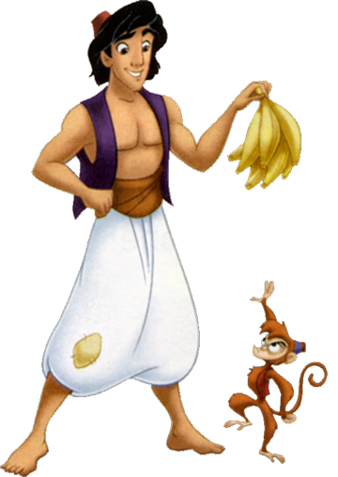
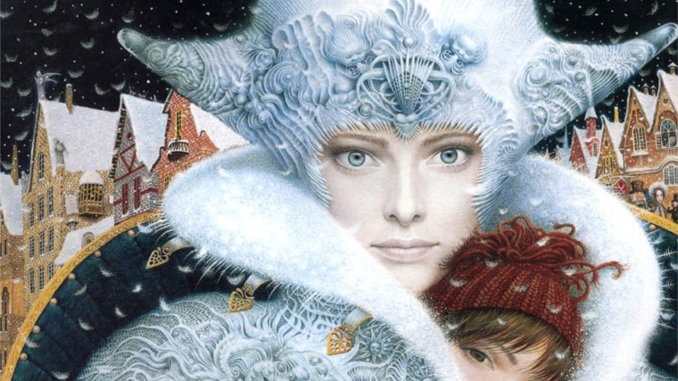
Describe the character of the fairy tale

Slide 17
Complete the sentences The fairy tales are magic because … The fairy tales teach us … They can help us … My favourite fairy tale is … This story is about … The main characters are … To my mind … I recommend …

Slide 18
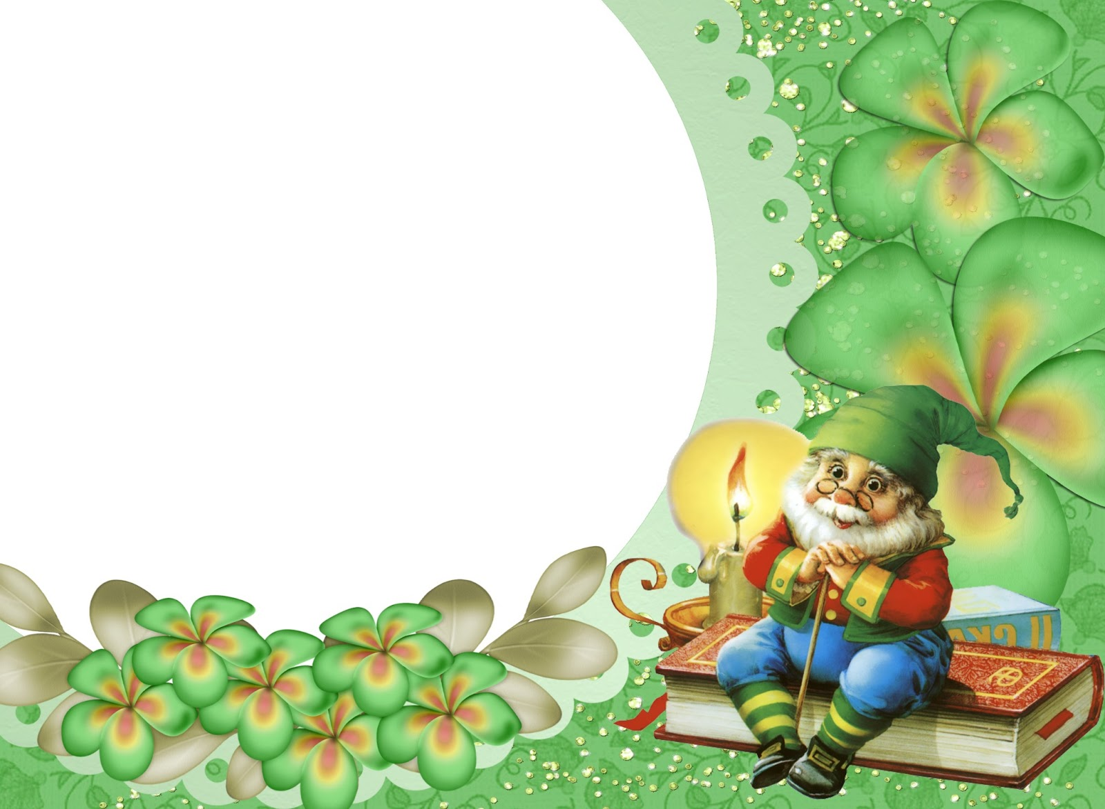
Have a nice day

