Slide 1
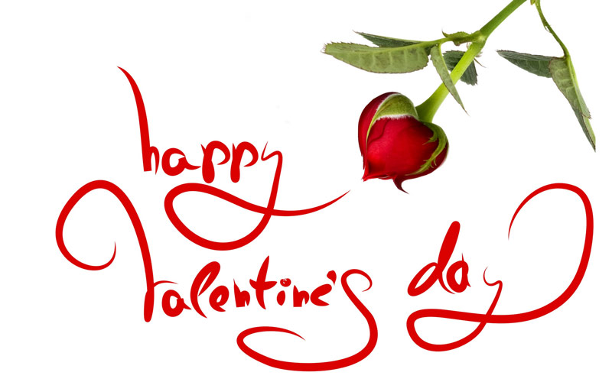

Slide 2
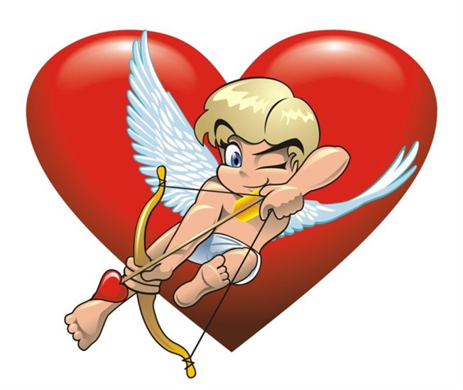
Facts about St. Valentine's Day
1. Valentine’s Day has been claimed to be, “Number 1 holiday for florists”. This one particular day brings in business of worth $14.7 billion
2. The average number of wedding proposals taking place on Valentine’s Day is 220,000 and it is 10% of the total marriage proposals taking place in a year.
3. Interesting for those who have pets, well 9 million people prefer celebrating Valentine’s Day with their pets and get them gifts
4. Each color of rose sent on Valentine’s day means something: Red rose means love and respect Pink says,
“I am having sweet thoughts about you”
5. White rose stands for purity and states: I am worthy of you”
6. The number of roses is also very important: One rose stands for love at first sight 12 roses bunch is to say: “I love you”
7. 108 roses are recommended for marriage proposals
8. 999 roses bouquet means: “We’ll always be together” We’ll always be with you

Slide 3
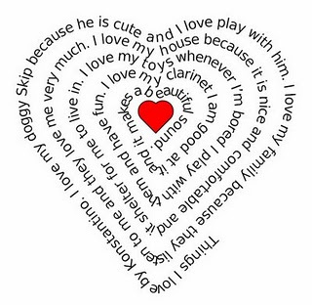
How is Valentine’s Day Celebrated in Different Countries?
Different countries have different traditions and festivals. Though Valentine's Day is celebrated in different parts of the world, but the manner of celebrations differ from country to country. Each country celebrates Valentine's in its own way.

Slide 4
Valentine’s Day Celebrations in India In India, Valentine’s Day is just an infant because it has only been few years that people have started celebrating this day. But now, it has become a very important day among the Indian youth. They celebrate it as a day of expressing their love. Girls and boys gift roses, teddy bears, chocolates, cards to each other on Valentine’s Day. Several hotels and restaurants organize parties and choose Mr. and Ms. Valentines.

Slide 5
Valentine’s Day Celebrations in Italy On this day of Valentine’s in Italy, the Italian girls sit by the window side of their room early in the morning waiting for the guy of their choice. It is believed that the boy whom they see the first on this day, will marry them within the span of one year.

Slide 6
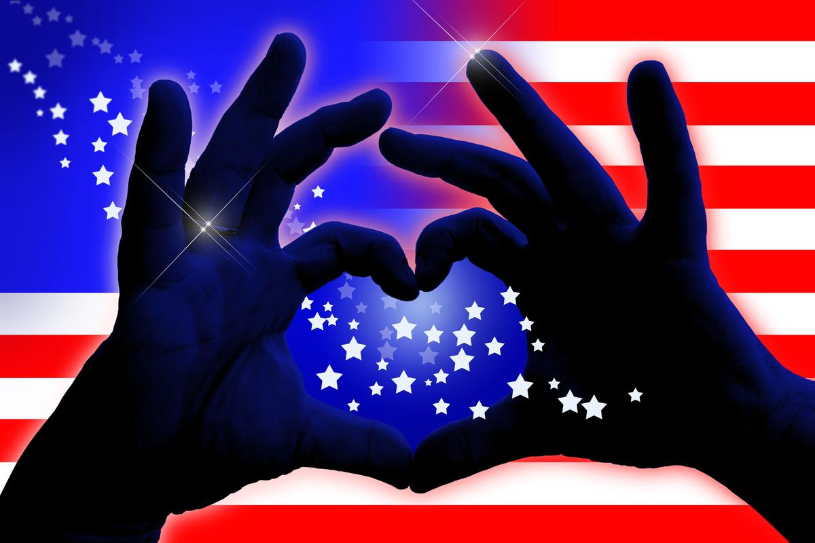
Valentine’s Day Celebrations in America In America, on this auspicious day of Valentine’s people send Valentine cards, gifts, chocolates, roses to their friends and loved ones. Estimates reveal that on this day chocolates boxes are sold and sales of gifts is at peak. Functions are also organized in the schools in America on Valentine’s Day, because it is believed that Saint Valentine had a deep affection for the children and kids.

Slide 7
Valentine’s Day Celebrations in England, Wales and Scotland In England, people gifts each other flowers and candy on Valentine’s Day. Making cakes garnished with dates, dry fruits are specialization of this day in England. Children sing the Valentine’s Day songs in groups in various functions. In Wales, on Valentine’s Day, beautiful designs are engraved on wooden spoons by the artists and people gift these spoons to their loved ones . Whereas in Scotland, people gift lovers knot made up of ribbon to their loved ones, which is regarded as a traditional gift in Scotland on Valentine’s Day.

Slide 9
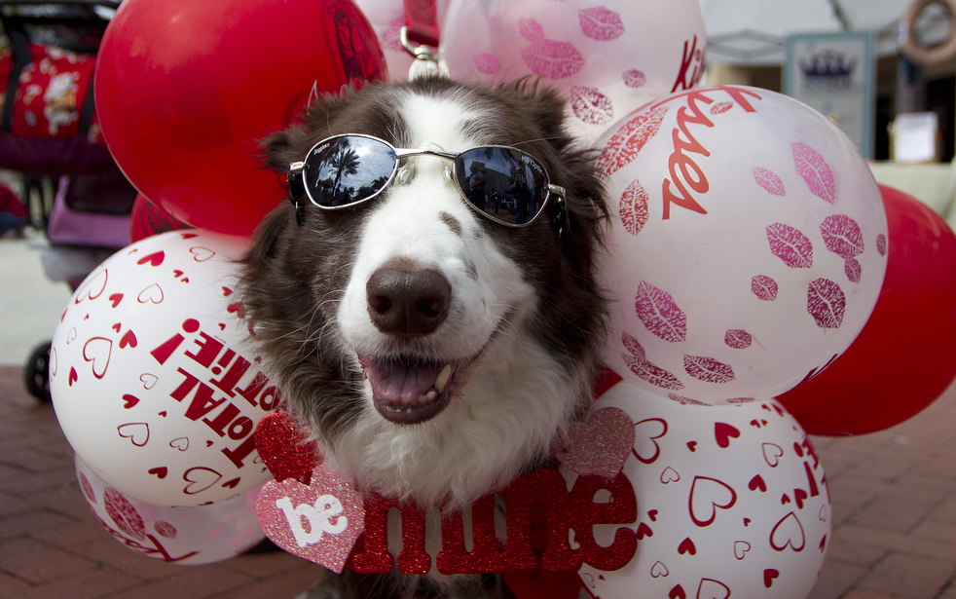

Slide 10
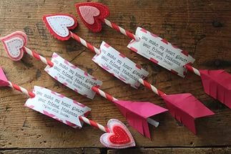
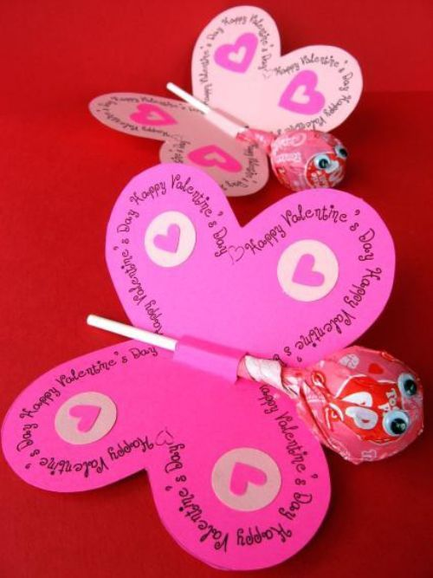
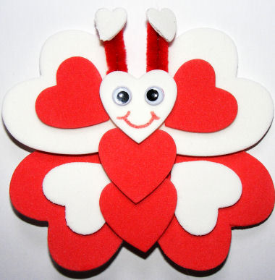
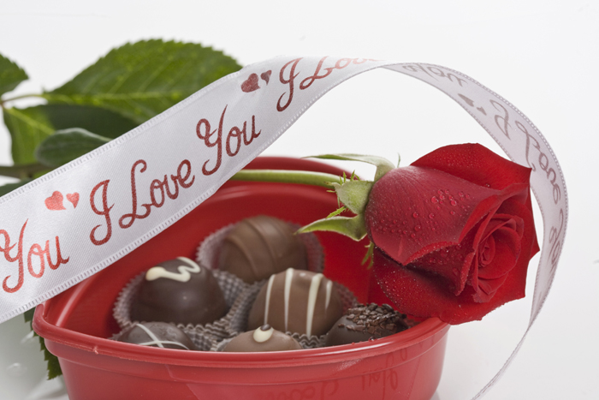
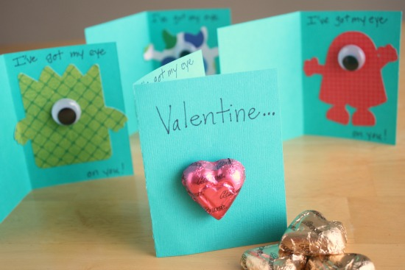

Slide 11
