Slide 1

Ukraine is our Homeland

Slide 2







UKRAINE

Slide 3

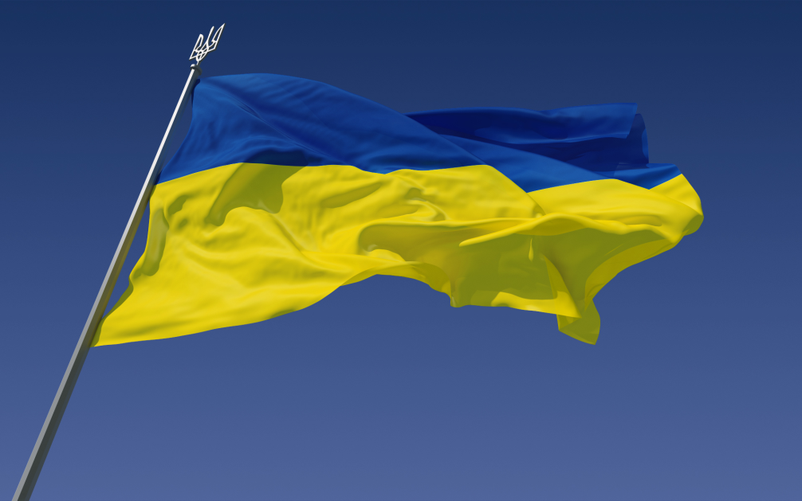
- unique
U

Slide 4
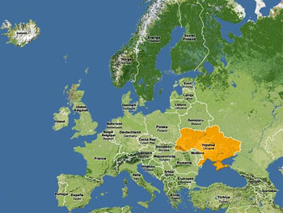
Ukraine is the largest state in Europe
Ukraine, the largest state, situated entirely in Europe, appeared on the map of the world in 1991. It was quickly recognized by the international community. It has an area of 603,628 km2, making it the largest contiguous country on the European continent

Slide 5
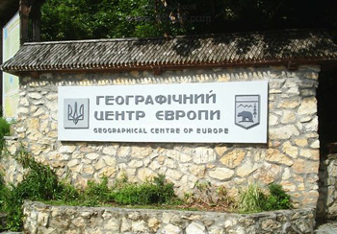
Ukraine is geographic center of Europe
The geographic center of Europe is on the territory of Ukraine not far from Rakhiv in Zakarpatia region. As far back as 1887, experts of Austria determined this point. They engraved special words there, which were permanent, exact and eternal place. Austrian scientists used special instruments and scaled the meridians and parallels and they set the center of Europe.

Slide 6

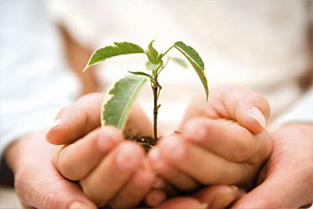
- kind
K

Slide 7
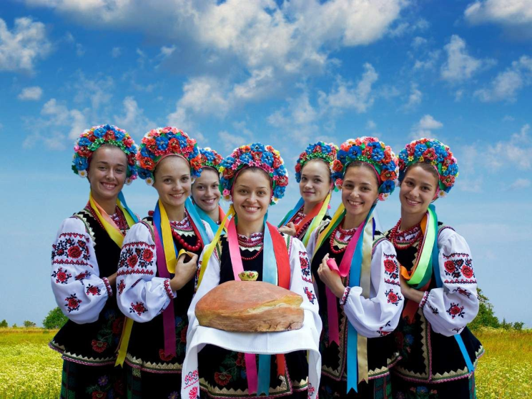
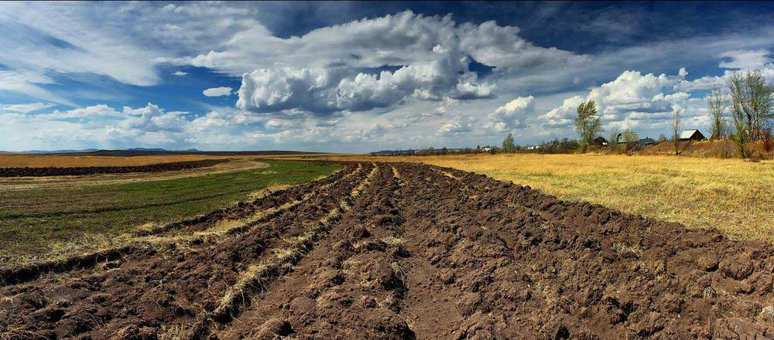
As everybody knows we are very kind, hard-working and hospitable with great sense of humor. No doubt, Ukrainian people are given everything by the land but other nationalities have nothing . Love doesn't depend on it, but this feeling depends on the person and his or her patriotism.

Slide 8
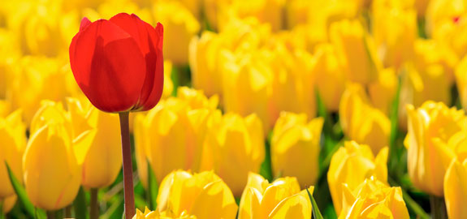

- remarkable
R

Slide 9
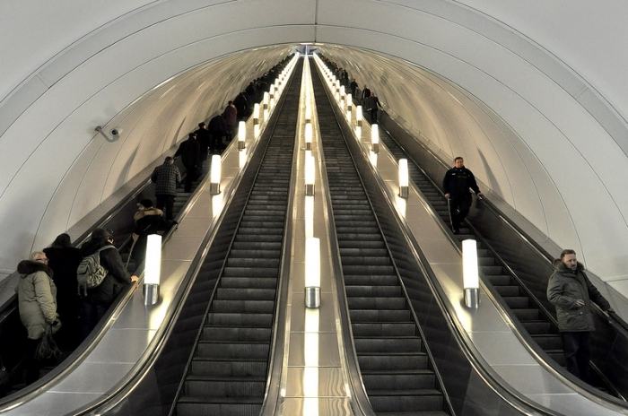
The deepest metro station in the world is Arsenalna station in Kyiv going down at 105.5 meters. It was made for military purposes with a huge secret bunker hidden between Arsenalna and Khreshatic stations.

Slide 10
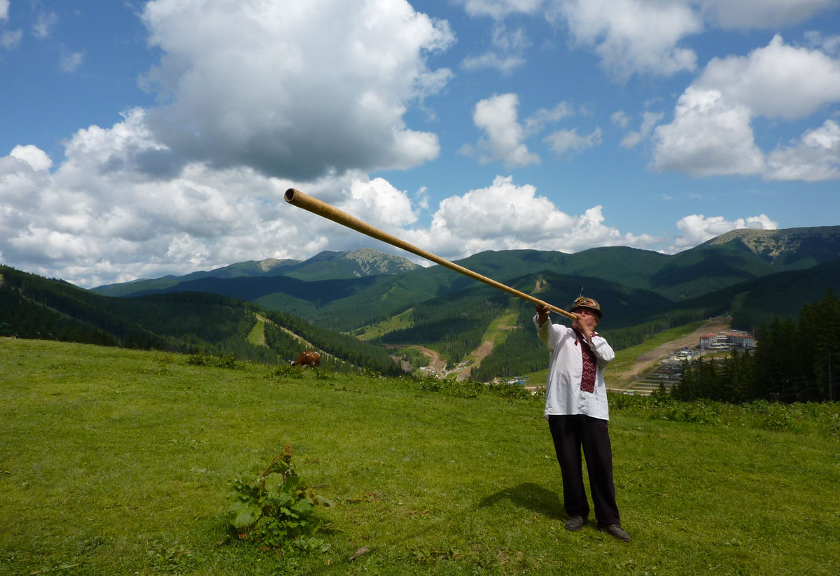
It is interesting to know that trembita is the longest musical instrument in the world. It is a very long pipe that the Hutsul ethnicity from the Carpathian Mountains loves to play.

Slide 11


- ambitious
A

Slide 12
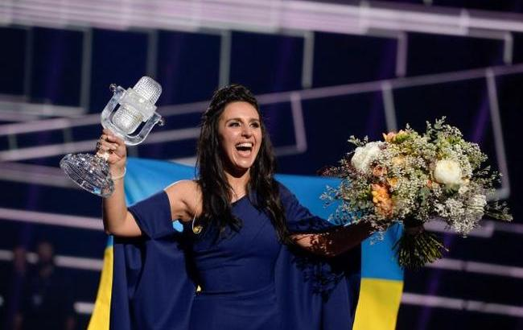
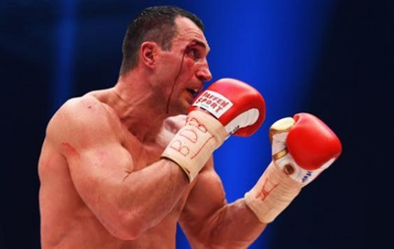
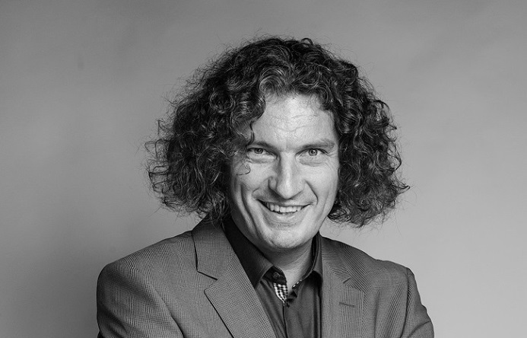
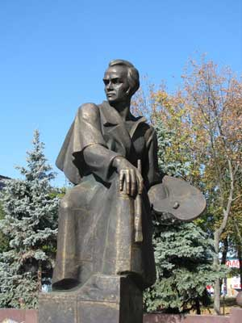
There are many talented people in Ukraine. I think all of nationalities know such celebrities as Scriabin, Jamala, Klitchko, especially Taras Shevchenko. There are 1384 monuments to Taras Shevchenko in the world.

Slide 13

k
- independent
I

Slide 14
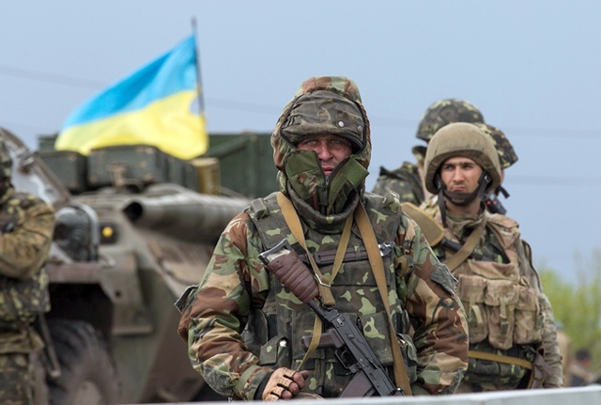
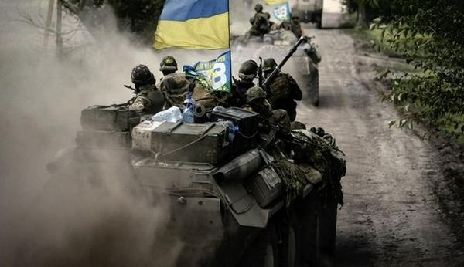
We are happy that we are independent! This year we have celebrated 25th anniversary of the independence of our country. We fight persistently for our independence. We should remember Shevchenko's words “Fight and you will overcome, any enemies will not come on our land!”

Slide 15
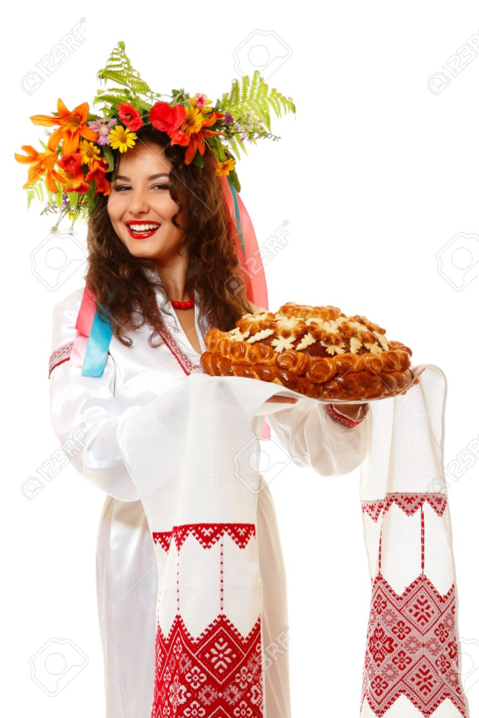
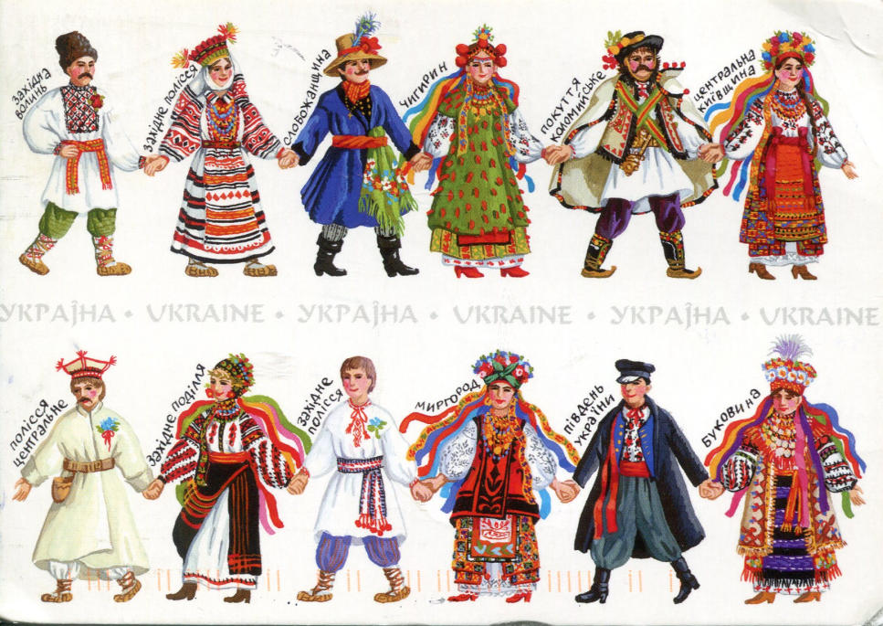
- native
N

Slide 16
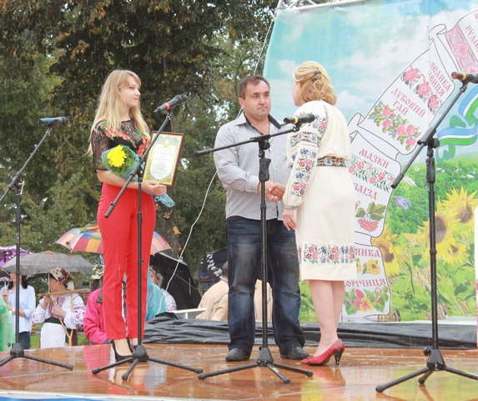
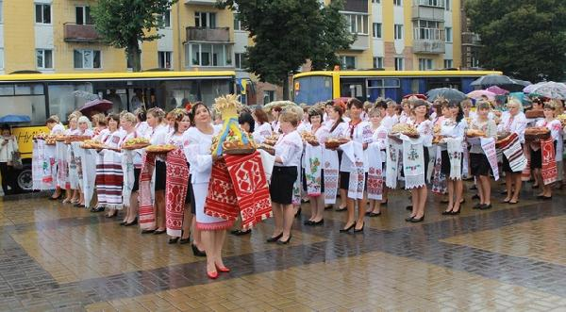
My native town is Pryluky. It is a place, where I was born, where I said my first word and made first steps. Here I went to school and was taught to love my land.
I strongly believe, Pryluky is a patriotic and persistent town. Why? Because we celebrated the 25th anniversary of the Independence of Ukraine with 99 round loaves baked by the citizens of Pryluky and it is Ukrainian record!

Slide 17

- English
E

Slide 18

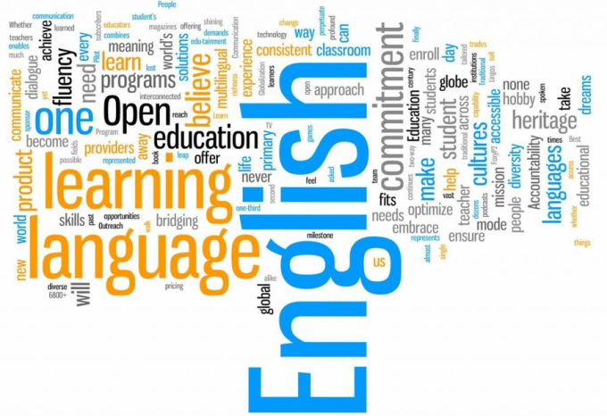
This year is the year of the English language in Ukraine. We want to integrate into European family with perfect knowledge of English. We, the Ukrainians, try to do all our best to communicate with English speaking friends not only in the Internet, but in the real life. It so useful and important to understand each other without borders.

Slide 19
Thank`s for attention

