Slide 1
Good afternoon, sun! Good afternoon, sky! ‘Good afternoon’, say together. We love this day the best of all and start the English lesson!

Slide 2
Family. Professions.
7

Slide 3
Aims:
навчальна: забезпечити повторення та закріплення лексичного матеріалу по темі «Професії» та граматичного матеріалу: The Present Simple Tense; формувати уміння конкретизувати набуті знання по вивченій темі;
розвиваюча: розвивати вміння аналізувати вивчений навчальний матеріал, систематизувати, узагальнювати; сприяти збагаченню словникового запасу та розвитку зв’язного мовлення; розвивати емоції, використовуючи яскраві приклади; формувати вміння працювати за зразком і вказівками вчителя; розвивати навички аудіювання, читання, усного та писемного мовлення;
виховна: виховувати уважність, зібраність, спостережливість, сумлінне ставлення до праці, повагу до представників різних професій, готовність до вільного вибору професій, пізнавальний інтерес до вивчення англійської мови.
Методи навчання: бесіда, розповідь, діалог, робота в групах, робота з роздатковим матеріалом, перегляд відеоролику.
Тип уроку: урок узагальнення та систематизації знань.

Slide 4
Phonetic exercise:
[Ɔ] – all, small, tall, doll
[Ɵ] – healthy, wealthy
[ɜ:] – serve, work, worker, person, nurse, burglar
[ai] – sky, pilot, librarian, driver, hairstyle, type
[ƏƱ] – postman, programmer

Slide 5
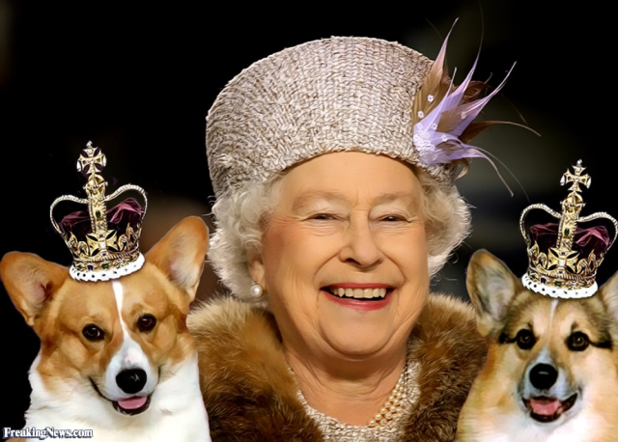
A Letter From Queen Elizabeth II
Dear children,
I send you the greetings with all winter holidays and I wish you to be healthy, wealthy and smart.
I prepared a present for you but a cruel burglar stole it! I didn’t know what to do! But the best English detective decided (вирішив) to help me. His name is Sherlock Holmes. He is going to Ukraine now. He has got some versions (версій). Help him if you can.
The best wishes,
the Queen.

Slide 6
Listening. Watch a video ‘Professions’
Complete the sentences:
Peter’s dad is a __________.
Jenny’s mum is a ______________.
Yasmin’s dad is a ________.
Ben’s mum is a ___________.
Mark’s mum is a _________.
farmer
hair-dresser
waiter
dentist
singer

Slide 7
Revise the professions:
A doctor
A teacher
A dancer
A pilot
A policeman (a police officer)
An actor (an actress)
A worker
A farmer
A seller (a shop-assistant)
A secretary
A businessman (businesswoman)
A waiter (a waitress)
A singer
A librarian
A painter
A driver
A dentist
A burglar
A nurse
A postman
A vet
A reporter
An editor
A computer programmer
A cook
A hairdresser
A mechanic
c

Slide 8
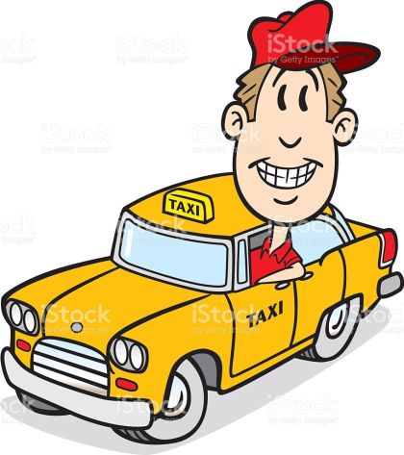
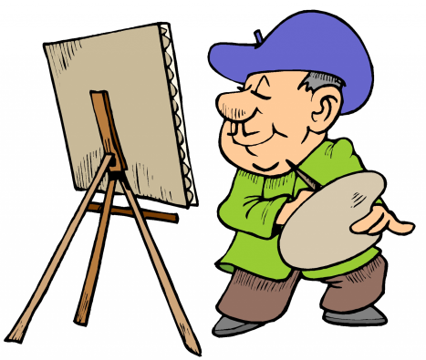
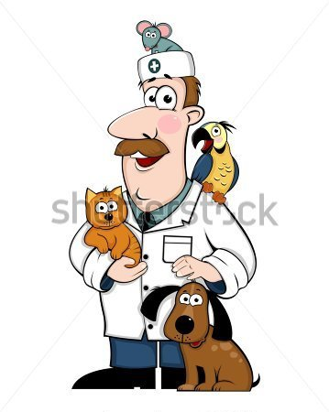
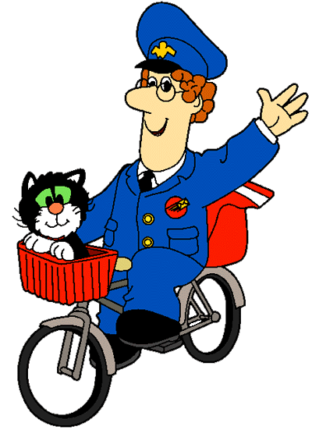
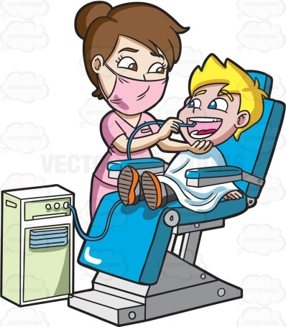
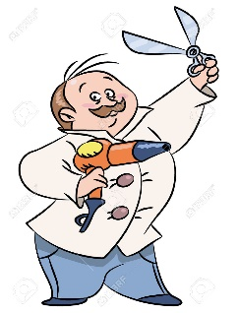
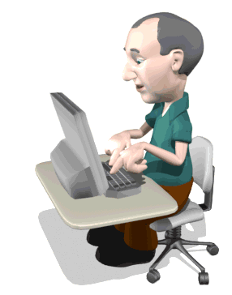
Speaking. Version 1. Work in Pairs.
What is he / she? - ___ is a ___.

Slide 10
Version 2. The Place of Working. Work in pairs. Where does a (an) ___ work?
-S (-ES)
works | on a farm. in the garden. in a hospital. at school. in a library. at the post office. at the police station. in a workshop (garage). in an office. in the café. at the agency. at the hair-dresser’s.

Slide 11
Version 3. The Activities They Do. Try to guess
teach children
catch burglars
help sick people
help sick animals
repair teeth
repair a car
bring letters
drive a car
9. make cakes
10. take care of children
11. take care of animals
12. літати в небі
13. подавати їжу
14. грати у фільмі
15. продавати речі
16. друкувати листи
17. розробляти програми
18. робити зачіску
19. брати інтерв'ю
a

Slide 12
Fill in with the name of a profession:
nurse
A _____________ helps the doctor.
A _____________ catches burglars.
A _____________ types letters and makes coffee for her boss.
An ___________ works in the theatre.
A ____________ helps sick animals.
A _____________ repairs cars.
A _____________ brings letters.
A _____________ repairs teeth.
police officer
secretary
actress
vet
mechanic
postman
dentist

Slide 13
-S (-ES)
The activities they do. Fill in with a correct word-combination:
works in the theatre and acts in the films.
An actress ________________________________________.
A librarian ______.
A hairdresser _______.
A waiter _______.
A pilot _______.
A reporter ______.
A cook ______.
A nurse ______.
n

Slide 14
Fill in with: to help / to teach / to cook / to make/ to grow/ to bake and match with the correct sentence.
-S (-ES)
makes
She ________________ a hairstyle.
He ________________ sick animals.
She ________________ children at school.
She ________________ bread.
He _________________fruit and vegetables.
She ________________ dinner.
She is a teacher.
She is a hairdresser.
He is a farmer.
She is a cook.
He is a vet.
She is a baker.
helps
teaches
bakes
grows
cooks

Slide 15
Version 4. Your Parents’ Help. Speaking. Game ‘An Interpreter’
У тебе є родина?
Вона велика чи маленька?
Як звуть твого тата?
Скільки йому років?
Хто твій тато?
Де він працює?
Як звуть твою маму?
Скільки їй років?
Хто твоя мама?
Де вона працює?
d

Slide 16
Speaking. Work in Pairs. Talk with your friend about your family members’ professions.
i
Checking the hometask. Project Work. A story about parents’ professions.

Slide 17
Talk with your friends: I’m going to be a pilot because I like fast travels. A pilot flies in the sky and travels a lot.
e
What are you going to be and why?
I’m going to be a ___ because
I like ___. A ____ ____.

Slide 18
Work in Groups. Making a short story.
s
There is a puzzle for every group.
1. Make the picture.
2. Write a story to describe it, then read it.
Meet ____________.
__________ is a ___________.
He / She works ____________.
She / He ___________.

Slide 19
As you see, there are a lot of different professions in the world. What profession is the most important and why?
I guess (I think) the most important profession is the profession of a ____because _______.

Slide 20
Hometask:
Напишіть декілька речень про найважливішу, на вашу думку професію (2-4 речення).

Slide 21
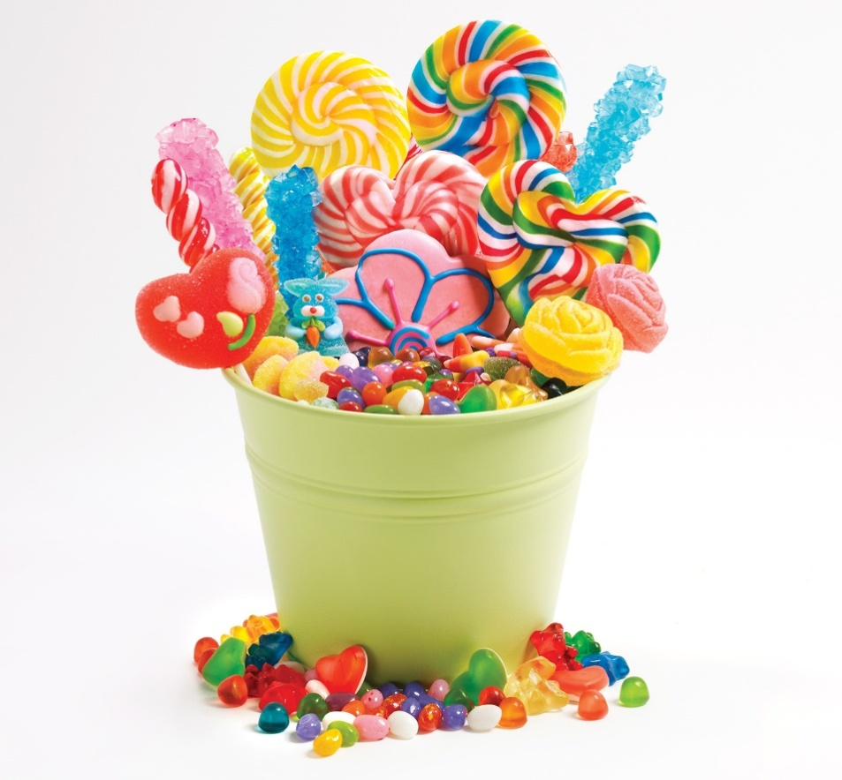
sdicean

