Slide 1
Seasons. Weather. Clothes.
11

Slide 2
Phonetic exercise:
[i:] – leaves, mittens, jeans
[ʌ] – sunglasses, gloves
[ɛ:] – skirt, shirt, T-shirt
[z] – trousers
[Ɔ:] – storm, warm, walk, strong

Slide 3
As you know the weather in different seasons is various. Read and translate the word-combinations which will help you to do different tasks:
degrees centigrade
above zero
below zero
hot and sunny
warm and dry
windy and cloudy
wet and foggy
snowy and frosty
freezing and slippery
chilly and rainy
thunderstorm
lightning
To be careful in the streets
To swim and sunbathe
seasons and weather
different parts of the world
changeable weather
a strong wind
high temperature
wet climate
Various climate
frosty morning
dry summer
a rainy day
to rain heavily outside
Heavy showers

Slide 4
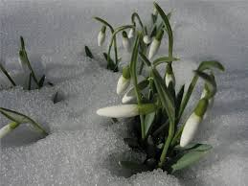
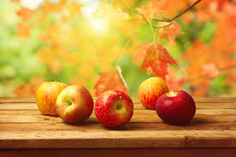
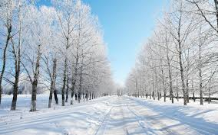
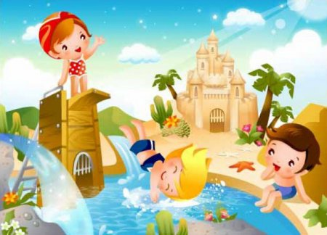
Read the poem, guess the season
This is a season
when nights are short.
And children are full
of fun and sport.
Playing and swimming all day long
Will make them
healthy and strong.
This is a season When mornings are dark, And birds do not sing In the forests and parks.
This is the season When children ski,
Play snowballs and dance
round the New Year Tree.
This is a season
When snowdrops bloom,
When nobody likes
To be in the room.
This is a season
When birds make their nests;
This is a season
We all like best.
This is a season when fruit is sweet,
This is a season when school friends meet,
When noisy and gay, and brown in the sun,
With their books and bags to school they run This is a season when leaves fall down
Red, orange, yellow, brown.

Slide 5
Watch a video ‘Weather and Clothes’ then read short texts and name the season:
It’s raining heavily and it’s windy. The trees are yellow, red and green. We put on our raincoats, boots and take umbrellas.
It’s hot and sunny. The trees are green and there are a lot of flowers everywhere. We put on T-shirts, skirts and shorts. We wear sandals on our feet. We like swimming and riding bikes.
It’s cold, slippery and windy. It often snows. We put on warm coats, jackets, hats and mittens. We go skating, skiing and sledging.
It’s warm and sunny. It sometimes rains. There are small green leaves in the trees. You can see the first flowers in the forests and in the gardens. We put on sweaters, jeans, trainers and shoes.

Slide 6
There is no bad weather, there is bad clothes.
When it’s hot and sunny, I put on my light dress, shorts or T-shirts, sandals or flip-flops. I never forget about my cap and sunglasses.

Slide 7
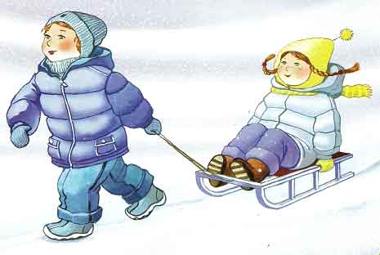
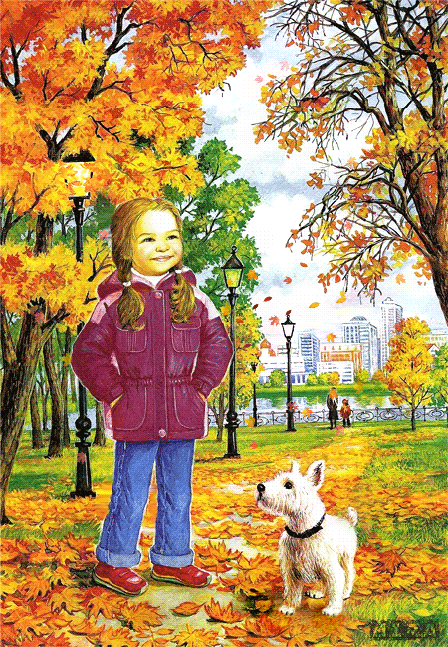
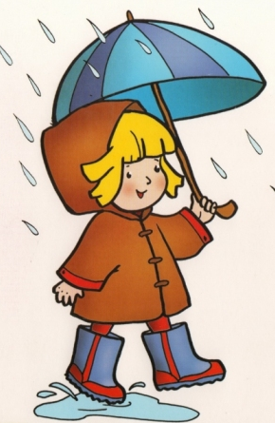
When it’s ____, I put on ____.

Slide 8
Answer the questions:
How many seasons are there in a year?
What are they?
How many months are there in a year?
What are winter (spring / summer / autumn) months?
What is the weather like in ___?
It’s ____ in ____.
What can you do in ___?
Tell about your favourite season.

Slide 9
Use the words from the box to fill in the gaps: boots / tracksuit / pyjamas /swimsuit / trainers / slippers /swimming trunks / gloves
When we go to swim in the river or in the sea, girls put on a _________ and boys put on _____________.
When Peter goes to play football, he puts on a ________ and _______.
When I come home, I put on _______ on my feet.
When Ann’s hands are cold, she puts on her ______.
When the weather is rainy or cold Jim puts on ______ on his feet.
We put on ________ when we go to bed.
swimsuits
swimming trunks
tracksuit
trainers
slippers
gloves
boots
pyjamas

Slide 10
Check your hometask. Ex.1, p.165
What do you wear at school?
What don’t you wear?
What does your father usually wear at work?
What doesn’t he wear at home?
What does your mum like to wear at home?
What doesn’t she like to wear at home?

Slide 11
Weather forecast reports.
So it’s time for the weather report. There are different kinds of weather all around the world. This is because different places have different climates. Let’s see what the weather is like around the world today. Imagine that you are journalists.
Don’t forget about grammar!
The Present Continuous Tense
___ am / is / are (not) + Ving
Look!
Listen!
now

Slide 12
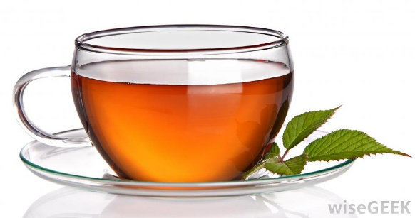
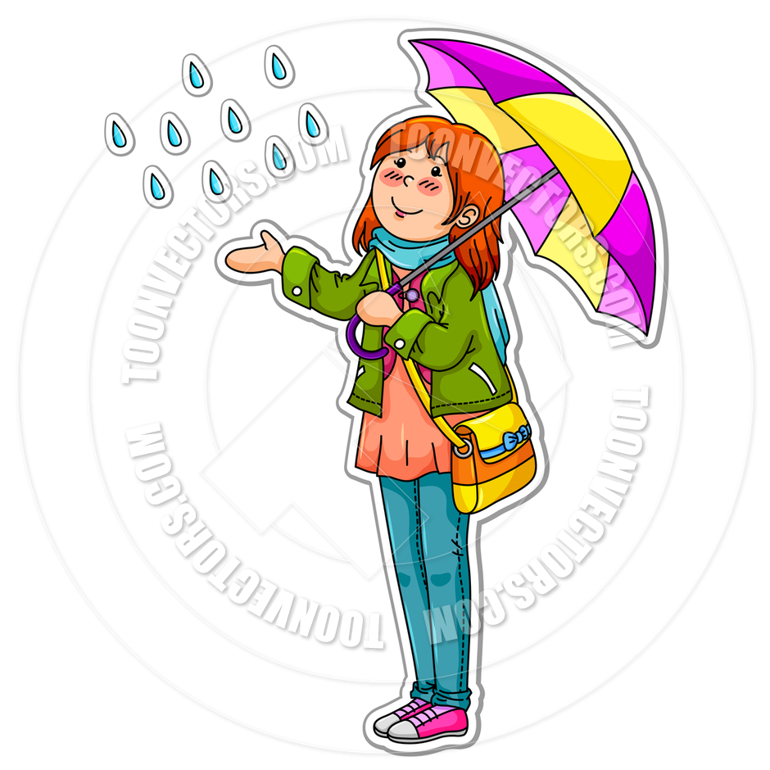
Hi! I am ___.
I’m from ___.
It’s ___.
The temperature is ___.
I’m wearing a ___.
I have got ___.
I’m going to ___.
London, +12, chilly / wind

Slide 13
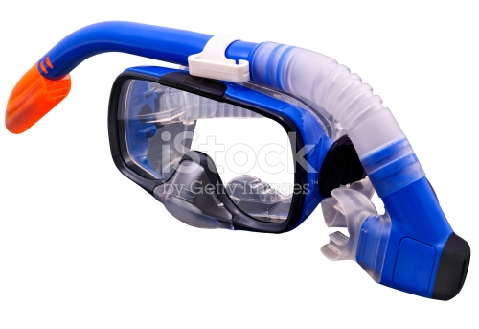
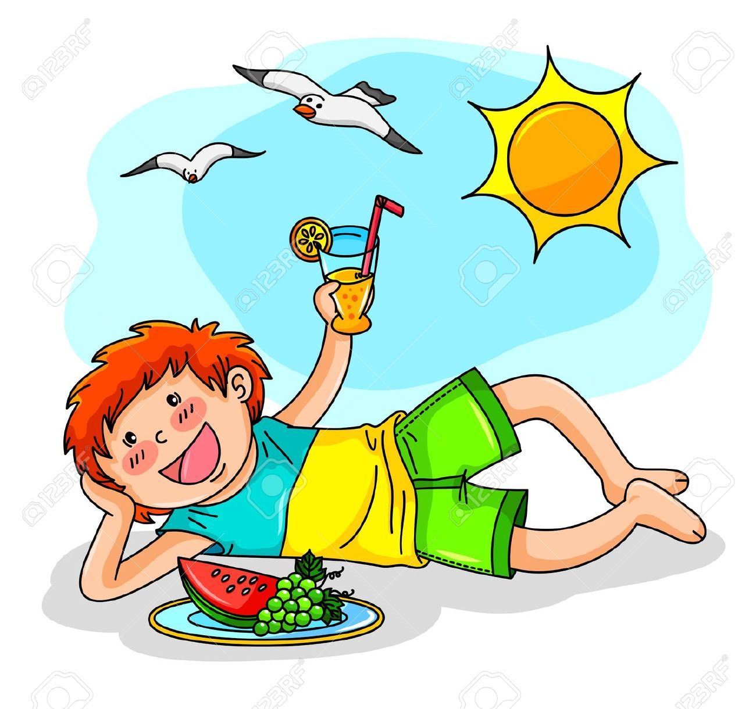
Hi! I am ___.
I’m from ___.
It’s ___.
The temperature is ___.
I’m wearing a ___.
I have got ___.
I’m going to ___.
Los Angeles, +27, hot/ sun

Slide 14
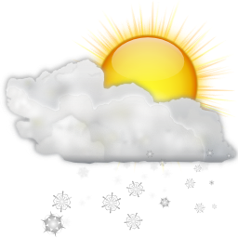
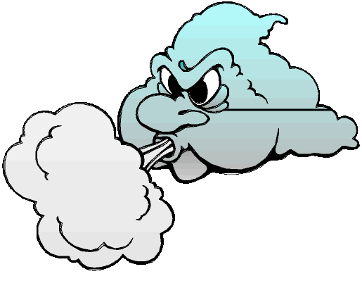
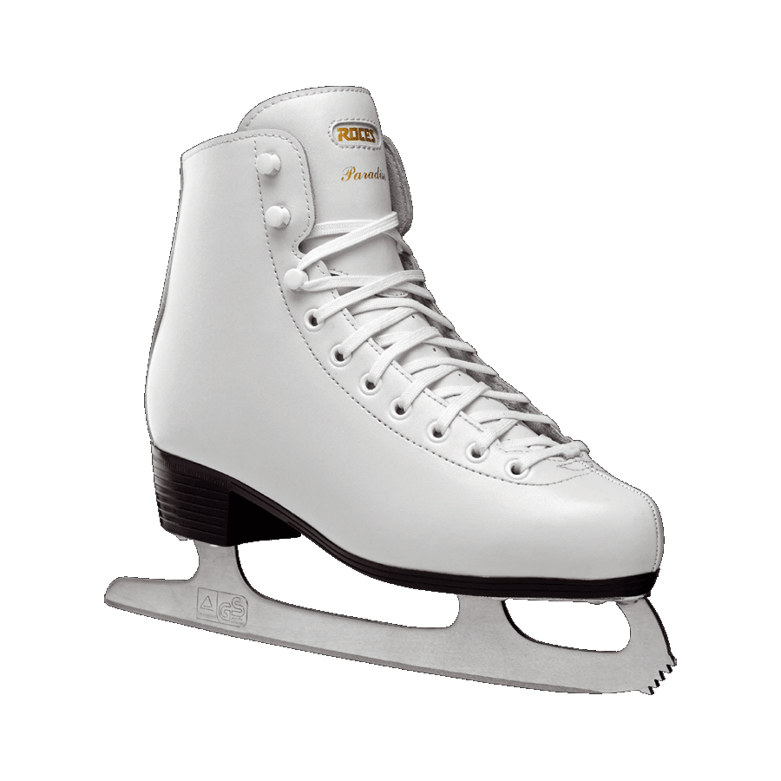
Hi! I am ___.
I’m from ___.
It’s ___.
The temperature is ___.
I’m wearing a ___.
I have got ___.
I’m going to ___.
Oslo, -7, cold

Slide 15
At our last lesson we read Alina’s letter. This is Jill’s answer. Read and answer his questions.
Dear Alina,
Greetings from Australia! Thank you for your letter.
Today is Saturday. It’s a holiday. I don’t go to school on Saturdays and Sundays.
It’s rainy and cloudy today. But it isn’t windy. It’s warm. I like such weather. I am listening to music and writing a letter. My dad is reading a newspaper. My mother is cooking in the kitchen now.
My brother Jim is repairing his walkman. My dog Rex is not sleeping, it’s playing with his toy bone.
And, what is the weather like now? What are you doing?
Write back.
Your friend,
___________________
W$rite the answer$

Slide 16
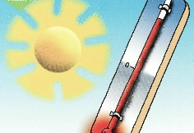
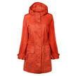
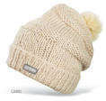
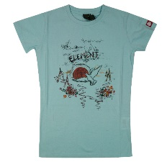
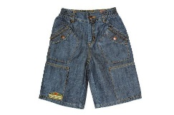
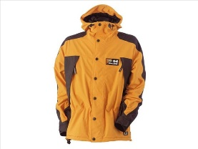
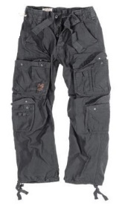
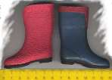
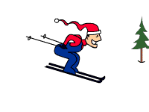
Make short dialogues:
Name | Jane | Tom | David
Where is ___? | London | Los Angeles | Berlin
What is the weather like? | + 12 cool | + 27 | + 4 cool
What is he / she wearing?
What is ___ doing? | at the cafe

Slide 17
Home work:
Ex.6, p.167 – make a project work.

