Slide 1
MY SCHOOL
UNIT 2

Slide 2
CONTENTS
Lesson 1
Lesson 2
Lesson 3
Lesson 4
Lesson 5
Lesson 6
Lesson 7
Lesson 8
Lesson 9
Lesson 10

Slide 3
Lesson 1

Slide 4
[ae] — bag, dad, apple, daddy; [ei] — name, table, take, game; [i] — big, sit, is, children.

Slide 6
pupils

Slide 7
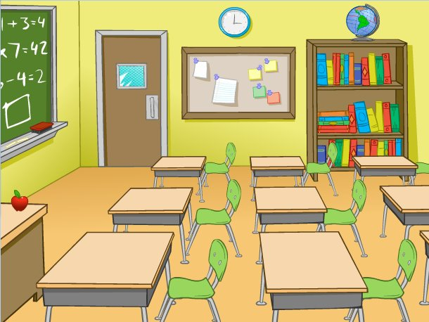
classroom

Slide 8
Book
Bag
School
Pen
Pencil
Copy-book
Pupil
Desk
Teacher
Pupils
Pencils
Copy-books
Books
Pens
Bags
Schools
Teachers
Desks

Slide 11
Lesson 2

Slide 12
[ae] — bag, dad, apple, daddy; [ei] — name, table, take, game; [i] — big, sit, is, children.

Slide 13
Book
Bag
School
Pen
Pencil
Copy-book
Pupil
Desk
Teacher
Pupils
Pencils
Copy-books
Books
Pens
Bags
Schools
Teachers
Desks

Slide 14
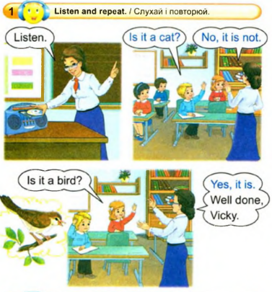

Slide 15
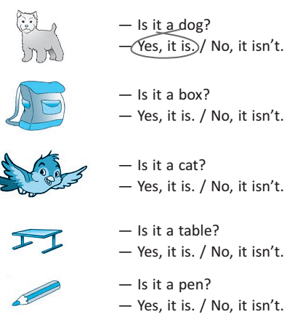

Slide 16
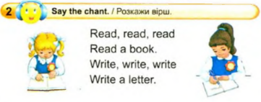
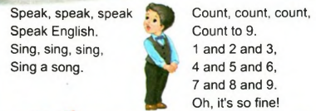

Slide 17
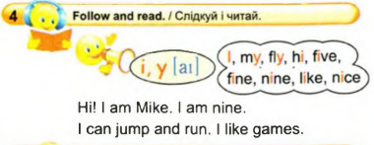

Slide 19
Lesson 3

Slide 20
[ai] — my, fly, time, nine, fine; [ei] — name, table, take, game; [æ] — cat, rat, and, fat.

Slide 21
Book
Bag
School
Pen
Pencil
Copy-book
Pupil
Desk
Teacher
Pupils
Pencils
Copy-books
Books
Pens
Bags
Schools
Teachers
Desks

Slide 22
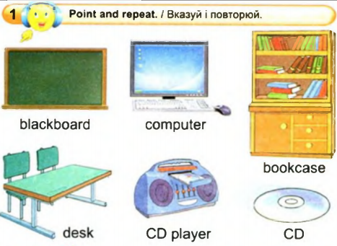

Slide 23
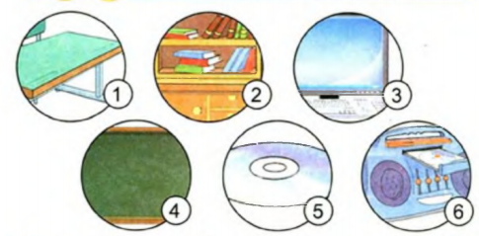

Slide 24
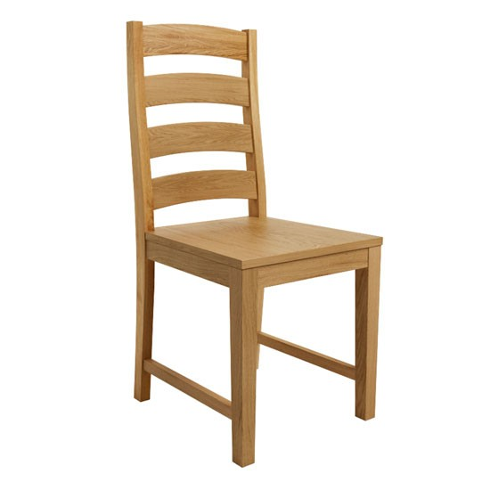
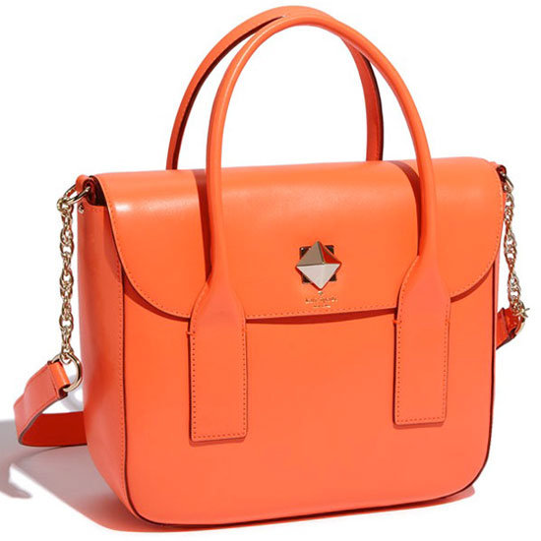
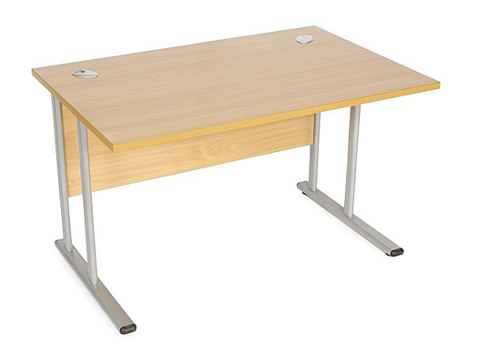
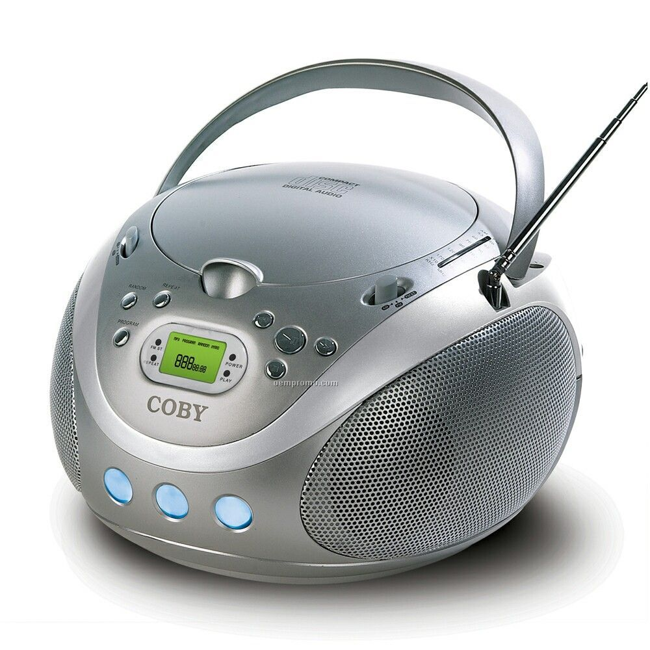
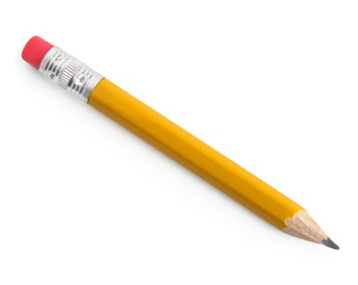
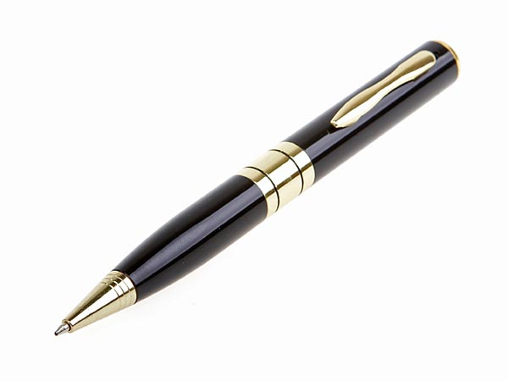
It is a …

Slide 25
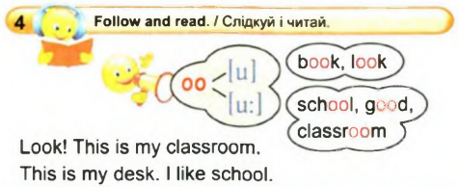

Slide 26
Find and write right words

Slide 28
Lesson 4

Slide 29
ANSWER
What is your name?
How old are you?
How are you?

Slide 30
[u:] — school, room, classroom;
[ai] — my, fly, nice, nine, like
[ei] — name, table, take, game;
[æ] — cat, rat, and, fat.

Slide 31
Book
Bag
School
Pen
Pencil
Copy-book
Pupil
Desk
Teacher
Pupils
Pencils
Copy-books
Books
Pens
Bags
Schools
Teachers
Desks

Slide 32
READ AND TRANSLATE
This is my classroom.
This is my desk.
I am nine.
This is my computer.
I like CD.

Slide 33
Computer
Desk
Pen
CD player
Bookshelf
Blackboard
Chair
Book
Bookcase
Eraser
Гумка
Парта
Книжна полиця
СD програвач
Книжкова шафа
Комп’ютер
Ручка
Дошка
Стілець
Книга

Slide 34
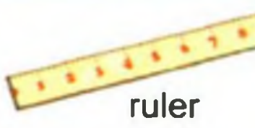
NEW WORDS

Slide 36
Фізкультхвилинка

Slide 37
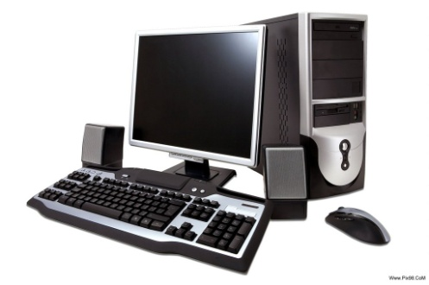
That is a computer.
This is a book.

Slide 38
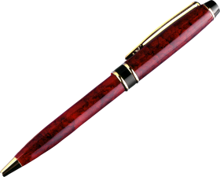
That is a bookshelf.
This is a pen.

Slide 39
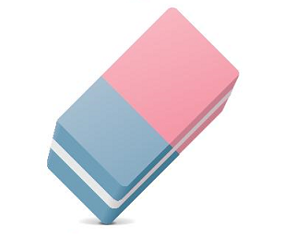
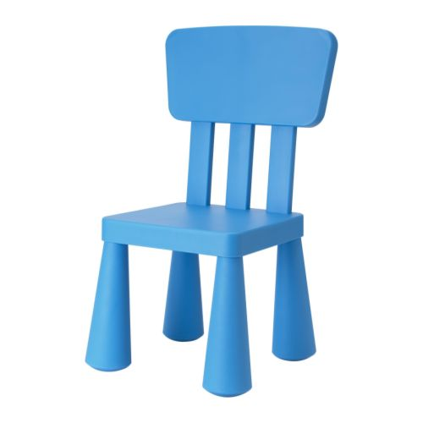
What is that?
That is eraser.
What is this?
This is a chair.

Slide 42
Find and write right words

Slide 43
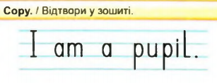

Slide 44
Lesson 5

Slide 45
ANSWER
What is your name?
How old are you?
How are you?

Slide 46
[u:] — school, room, classroom;
[a] — my, fly, nice, nine, like
[ei] — name, table, take, game;
[æ] — cat, rat, and, fat.
[ju:] — pupil, tune, tube.

Slide 47
Book
Bag
School
Pen
Pencil
Copy-book
Pupil
Desk
Teacher
Pupils
Pencils
Copy-books
Books
Pens
Bags
Schools
Teachers
Desks

Slide 48
READ AND TRANSLATE
This is my classroom.
This is my desk.
I am nine.
This is my computer.
I like CD.

Slide 49
Computer
Desk
Pen
CD player
Pencil
Blackboard
Chair
Book
Bookcase
Bag
Сумка
Парта
Олівець
СD програвач
Книжкова шафа
Комп’ютер
Ручка
Дошка
Стілець
Книга

Slide 50
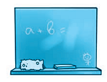

Slide 51
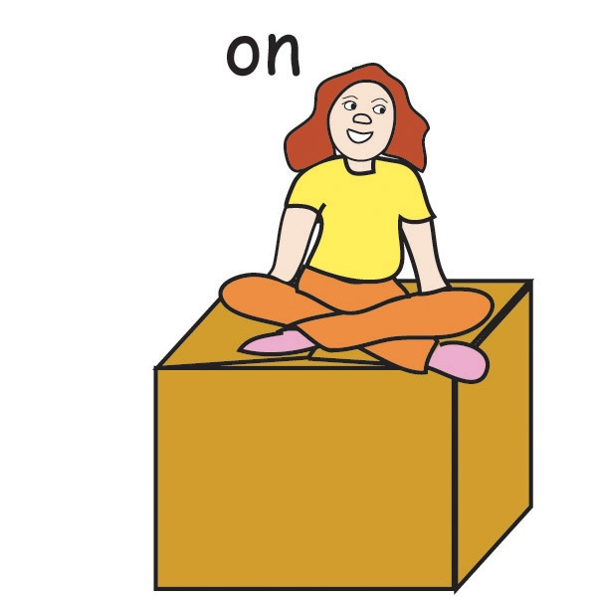
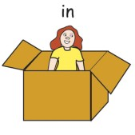
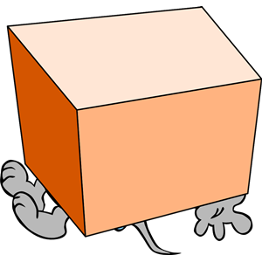
under

Slide 52
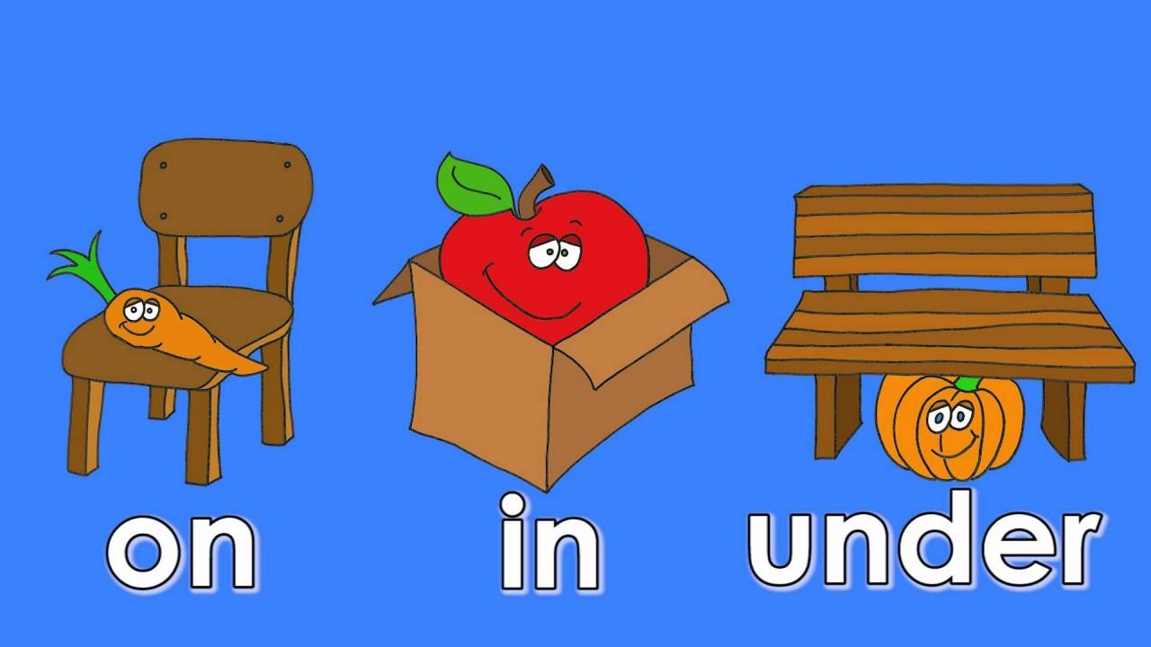

Slide 53
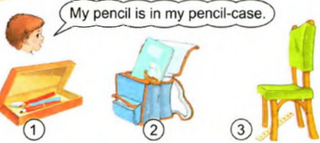

Slide 54
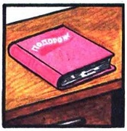
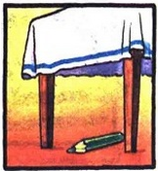
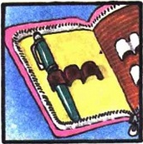
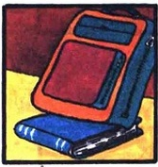

Slide 55
Фізкультхвилинка

Slide 56
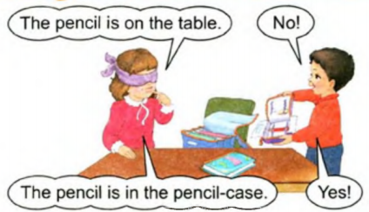

Slide 60
Lesson 6

Slide 61
ANSWER
What is your name?
How old are you?
How are you?

Slide 62
[əʊ] — no, hello, open, close;
[ʃ] — fish, ship, shelf, she;
[w] — why, wet, white, Willy.

Slide 63
Why do you cry, Willy? Why do you cry? Why, Willy, why, Willy, Why, Willy, why?

Slide 64
READ AND TRANSLATE
This is my classroom.
This is my desk.
I am nine.
This is my computer.
I like CD.

Slide 65
Computer
Desk
Pen
CD player
Pencil
Blackboard
Chair
Book
Bookcase
Bag
Сумка
Парта
Олівець
СD програвач
Книжкова шафа
Комп’ютер
Ручка
Дошка
Стілець
Книга

Slide 66
READ AND TRANSLATE
My book is on the desk.
My cat is under the bookcase.
My ruler is under the chair.
My pencil-box is on the bookshelf.
My CD is under the desk.

Slide 67
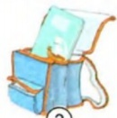
Where is my copybook?
It is in my bag.

Slide 68
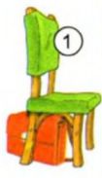
Where is the bag?
It is under the chair.

Slide 69
Where is the copybook?
It is on the shelf.

Slide 70
Where is the pen?
It is in the pencil-box.

Slide 71
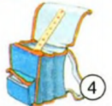
Where is the ruler?
It is in the bag.

Slide 72
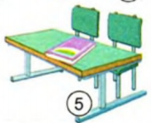
Where is the book?
It is on the desk.

Slide 73
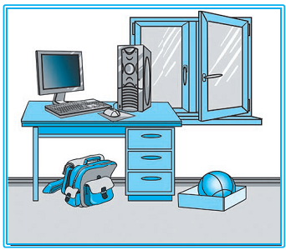
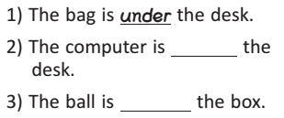
under
on
in

Slide 74
Фізкультхвилинка

Slide 76
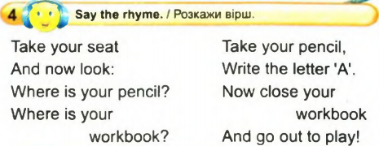

Slide 79
Lesson 7

Slide 80
ANSWER
What is your name?
How old are you?
How are you?

Slide 81
[əʊ] — no, hello, open, close;
[ʃ] — fish, ship, shelf, she;
[w] — why, wet, white, Willy.

Slide 82
Why do you cry, Willy? Why do you cry? Why, Willy, why, Willy, Why, Willy, why?

Slide 83
Computer
Desk
Pen
CD player
Pencil
Blackboard
Chair
Book
Bookcase
Bag
Сумка
Парта
Олівець
СD програвач
Книжкова шафа
Комп’ютер
Ручка
Дошка
Стілець
Книга

Slide 84
READ AND TRANSLATE
My book is on the desk.
My cat is under the bookcase.
My ruler is under the chair.
My pencil-box is on the bookshelf.
My CD is under the desk.

Slide 85
is my game.
Take ____
My name ____
This____
I am____
a pupil.
is Kate.
the book.

Slide 86
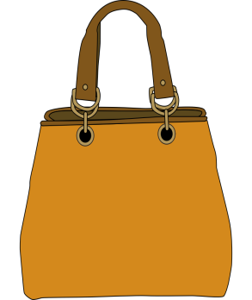
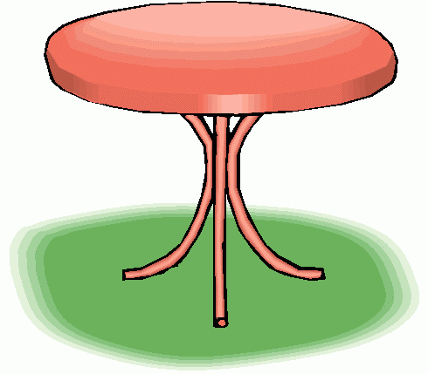
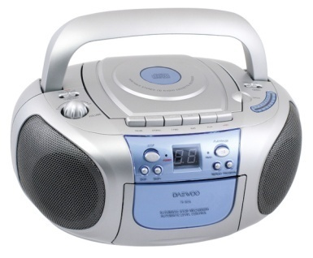
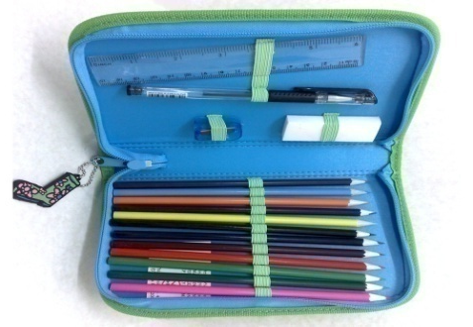
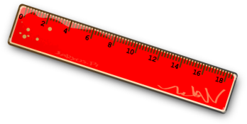

Slide 88
Знайди та випиши слова:
shelfwpupilzwrulerqwbookzwdeskqwbagzwcomputer
shelf
pupil
ruler
book
desk
bag
computer

Slide 89
Фізкультхвилинка

Slide 92
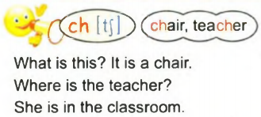

Slide 94
Lesson 8

Slide 95
[əʊ] — no, hello, open, close;
[ʃ] — fish, ship, shelf, she;
[w] — why, wet, white, Willy.

Slide 96
Why do you cry, Willy? Why do you cry? Why, Willy, why, Willy, Why, Willy, why?

Slide 97
ANSWER
What is your name?
How old are you?
How are you?

Slide 98
Computer
Desk
Pen
CD player
Pencil
Blackboard
Chair
Book
Bookcase
Bag
Сумка
Парта
Олівець
СD програвач
Книжкова шафа
Комп’ютер
Ручка
Дошка
Стілець
Книга

Slide 99
READ AND TRANSLATE
My book is on the desk.
My cat is under the bookcase.
My ruler is under the chair.
My pencil-box is on the bookshelf.
My CD is under the desk.

Slide 100
is my game.
Take ____
My name ____
This____
I am____
a pupil.
is Kate.
the book.

Slide 101
Перевірка домашнього завдання.

Slide 104
Знайди та випиши слова:
shelfwpupilzwrulerqwbookzwdeskqwbagzwcomputer
shelf
pupil
ruler
book
desk
bag
computer

Slide 105
Where is the…? - The … is (in, on, under) the … .

Slide 106
Фізкультхвилинка

Slide 107
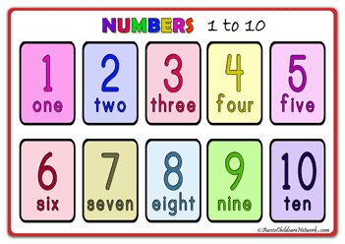

Slide 108
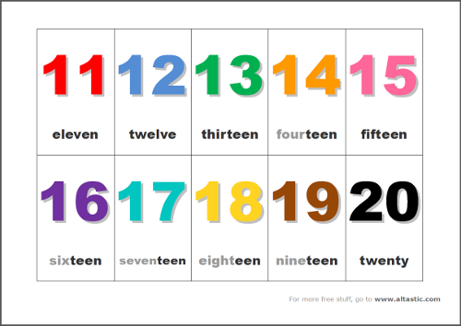

Slide 109
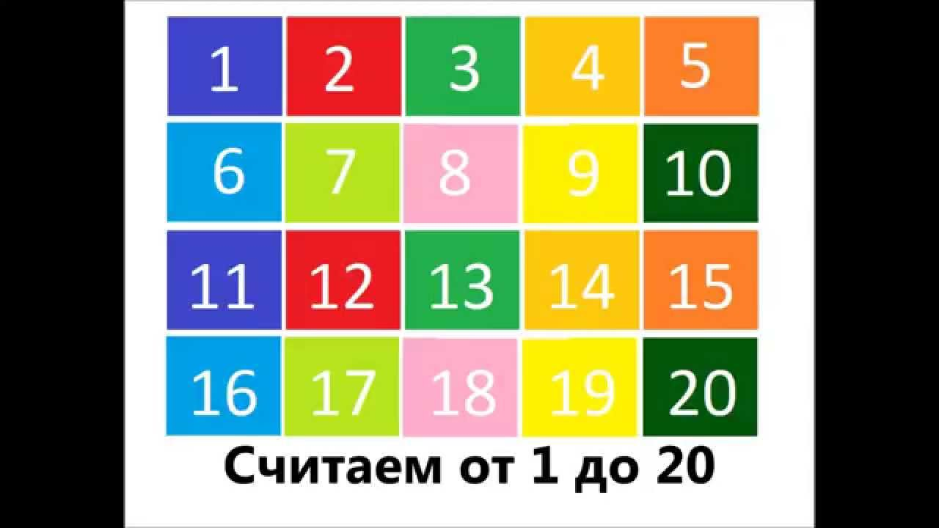

Slide 113
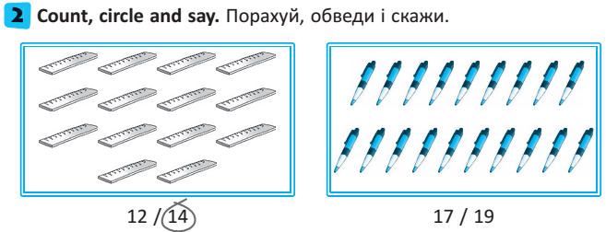

Slide 114
Ten –
Twenty –
Fifteen –
Six –
Nineteen –
Eleven –
Thirteen –
Eight –
Twelve –
Fourteen –
Sixteen –
Eighteen –
Five –
Seventeen –
One –
Seven –
10
12
20
14
15
16
6
18
19
5
11
17
13
1
8
7

Slide 115
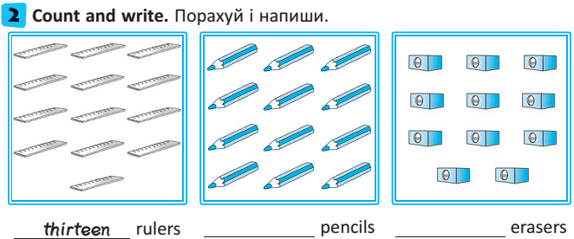
twelve
eleven
seventeen
fourteen

Slide 117
He is thirteen.
The book is on the desk.

Slide 118
Lesson 9

Slide 119
[əʊ] — no, hello, open, close;
[ʃ] — fish, ship, shelf, she;
[w] — why, wet, white, Willy.

Slide 120
Why do you cry, Willy? Why do you cry? Why, Willy, why, Willy, Why, Willy, why?

Slide 121
ANSWER
What is your name?
How old are you?
How are you?

Slide 122
Computer
Desk
Pen
CD player
Pencil
Blackboard
Chair
Book
Bookcase
Bag
Сумка
Парта
Олівець
СD програвач
Книжкова шафа
Комп’ютер
Ручка
Дошка
Стілець
Книга

Slide 123
Book
Bag
School
Pen
Eraser
Shelf
Pupil
Desk
Ruler
Pupils
Erasers
Shelves
Books
Pens
Bags
Schools
Rulerss
Desks

Slide 124
READ AND TRANSLATE
My book is on the desk.
My cat is under the bookcase.
My ruler is under the chair.
My pencil-box is on the bookshelf.
My CD is under the desk.

Slide 125
is my ruler.
Take ____
My name ____
This____
I am____
seventeen.
is Bill.
the copybook.

Slide 126
Перевірка домашнього завдання.

Slide 128
That is a computer.
This is a book.

Slide 129
That is a bookshelf.
This is a pen.

Slide 130
What is that?
That is eraser.
What is this?
This is a chair.

Slide 131
Where is my copybook?
It is in my bag.

Slide 132
Where is the bag?
It is under the chair.

Slide 133
Where is the copybook?
It is on the shelf.

Slide 134
Where is the pen?
It is in the pencil-box.

Slide 135
Where is the ruler?
It is in the bag.

Slide 136
Where is the book?
It is on the desk.

Slide 137
Фізкультхвилинка

Slide 139
Прочитай та переклади усно:
The book is on the shelf.
The sharpener is under the desk.
The ruler is under the chair.
The pencil is in the pencil-box.

Slide 140
Find and write right words

Slide 141
Lesson 10

Slide 142
ANSWER
What is your name?
How old are you?
How are you?

Slide 143
[u:] — school, room, classroom;
[ai] — my, fly, nice, nine, like
[ei] — name, table, take, game;
[æ] — cat, rat, and, fat.
[əʊ] — no, hello, open, close;
[ʃ] — fish, ship, shelf, she;
[w] — why, wet, white, Willy.

Slide 144
Why do you cry, Willy? Why do you cry? Why, Willy, why, Willy, Why, Willy, why?

Slide 146
Find and read right words

Slide 147
Computer
Desk
Pen
CD player
Pencil
Blackboard
Chair
Book
Bookcase
Bag
Сумка
Парта
Олівець
СD програвач
Книжкова шафа
Комп’ютер
Ручка
Дошка
Стілець
Книга

Slide 148
Book
Bag
School
Pen
Eraser
Shelf
Pupil
Desk
Ruler
Pupils
Erasers
Shelves
Books
Pens
Bags
Schools
Rulerss
Desks

Slide 149
READ AND TRANSLATE
My book is on the desk.
My cat is under the bookcase.
My ruler is under the chair.
My pencil-box is on the bookshelf.
My CD is under the desk.

Slide 150
is my ruler.
Take ____
My name ____
This____
I am____
seventeen.
is Bill.
the copybook.

Slide 152
Фізкультхвилинка

Slide 156
Ten –
Twenty –
Fifteen –
Six –
Nineteen –
Eleven –
Thirteen –
Eight –
Twelve –
Fourteen –
Sixteen –
Eighteen –
Five –
Seventeen –
One –
Seven –
10
12
20
14
15
16
6
18
19
5
11
17
13
1
8
7

Slide 160
Read and write the words
Bookcasevipensudeskppclassroomwzbookttpupilyscomputer
Bookcase pen desk classroom book pupil computer

