Slide 1
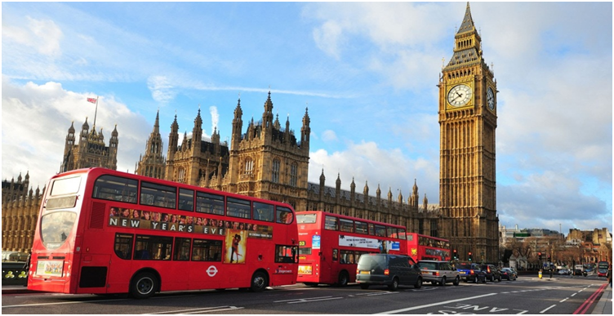

Slide 2
Match parts of the UK with their capitals:
1. England | a) Cardiff
2. Wales | b) London
3. Scotland | c) Edinburgh
4. Northern Ireland | d) Belfast

Slide 3
Keys

Slide 4
What happened in the summer of
1666 in London?
The Olympic Games
The Great Fire
The Festival

Slide 5
Keys

Slide 6
What is the most northern capital city?
Wellington in NewZealand
Tokyo in Japan
Reykjavik in Iceland

Slide 7
Key

Slide 9
Find four things that are good for you. Find four things that are bad for you.
asperg lothcoaec
klmi ksace
sewset iscistub
otats eshece

Slide 10
Keys
Grapes sweets chocolate
biscuits milk cakes
cheese toast

Slide 11
Where does Queen Elizabeth live?
а. Tower of London
b. Buckingham Palace
c. Trafalgar Square

Slide 12
Key

Slide 13
Put in the correct verb to be (am/is/are)
1. I …a pupil.
2. You … from England.
3. My dad … tall and strong.
4. My mum … very good.
5. This dog … fat.
6. We …big.
7. Pete and Bob … students.

Slide 14
Find and correct the mistakes
1. Ann and Mike is pupils.
2. We English are.
3. I have five book.
4. They has two stars.
5. What is your names?
6. I see one dogs.
7. Pete run in the park.

Slide 15
What countries are English-speaking?
Canada The USA Great Britain Brasilia Ukraine China
Australia Germany Spain France Japan New Zealand

Slide 16
Keys
Canada The USA Great Britain Brasilia Ukraine China
Australia Germany Spain
France Japan New Zealand

Slide 17
What is the capital of the country?
The USA, Great Britain , Ukraine, Germany, Spain, France, Japan, New Zealand

Slide 18
What cities are situated in Great Britain?
Boston Liverpool
Chicago Florida
Oxford Manchester
London New-York
Glasgow Cardiff

Slide 19
Keys
Boston Liverpool
Chicago Florida
Oxford Manchester
London New-York
Glasgow Cardiff

Slide 20
“Sights of Great Britain”
Big Ben | Statue of Liberty | Disneyland | Madame Tussauds wax museum
Tower | Royal Park | Westminster Abbey | Covent Garden
Hollywood | Stonehenge | Wembley Stadium | The National History Museum
The Royal Observato ry | Buckingham Palace | The Houses of Parliament | White House

Slide 21
Keys
Big Ben
Tower
Royal Park
Buckingham Palace
Westminster Abbey
The Houses of Parliament
Madame Tussauds wax museum
Covent Garden

Slide 22
So
great job,
you guys!!!

Slide 23
Thank you for your attention !!!

