Slide 1
Урок англійської мови 5 клас «Я завжди так роблю»

Slide 2
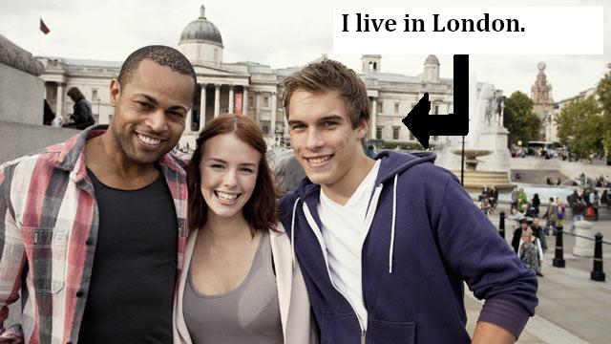
Use of Present Simple

Slide 3
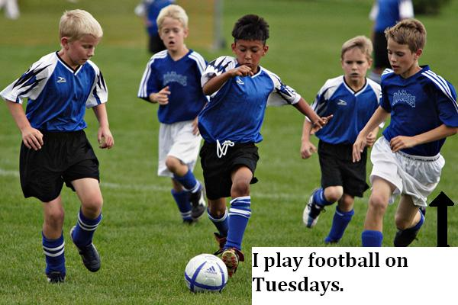
Use of Present Simple

Slide 4
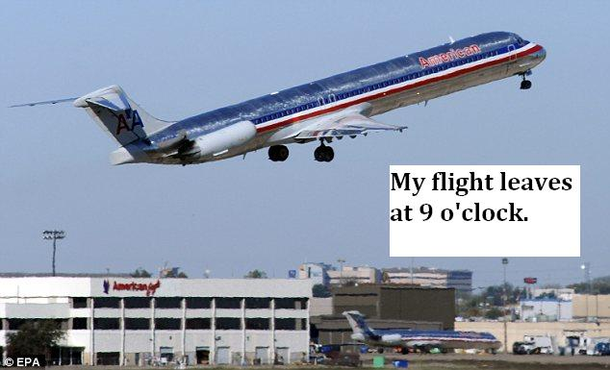
Use of Present Simple

Slide 5
Use of Present Simple
Permanent states
Habits
Timetables
Keywords:
Every Monday/week/month etc.
On Tuesdays/ Sundays etc.
In the morning/afternoon/ summer etc.
At Christmas/ Easter etc.

Slide 6
Adverbs of Frequency

Slide 7
Adverbs of Frequency
Adverbs of Frequency are also keywords for Present Simple.
They are placed before the main verb. ( EXCEPTION: verb “be”)
I always have breakfast.
I usually do my homework in the afternoon.
I often eat fish.
BUT: I am never late for school.

Slide 8
Present Simple Affirmative – Question - Negative
I work Do I work? I don’t work
You work Do you work? You don’ work
He works Does he work? He doesn’t work
She works Does she work? She doesn’t work
It works Does it work? It doesn’t work
We work Do we work? We don’t work
You work Do you work? You don’t work
They work Do they work? They don’t work
do+not: don’t does+not: doesn’t

Slide 9
Verb Conjugation 3rd singular
MOST VERBS --> We add –s : works, speaks, writes, loves
e.g. She always talks about school.
VERBS ENDING IN –S, -CH, -SH, -X, -O --> We add -es: kisses, reaches, washes, fixes, goes.
e.g. Ben never washes his hands!
VERBS ENDING IN CONSONANT+Y -->We remove “y” and add –ies : studies, worries, cries, studies
e.g. Mary sometimes studies at night.

Slide 10
Short Answers
We form short answers with:
Yes/No + Subject Pronoun +do/don’t/does/doesn’t
Do you like ice – cream? Yes, I do.
Does he play football every day? No, he doesn’t.
Do they wash the car on Mondays? Yes, they do.
Does Penny work? No, she doesn’t.
Do Paul and Jim go to school? Yes, they do.
Does Liam watch TV at night? No, he doesn’t.

Slide 11
Interview
Present Simple

Slide 12
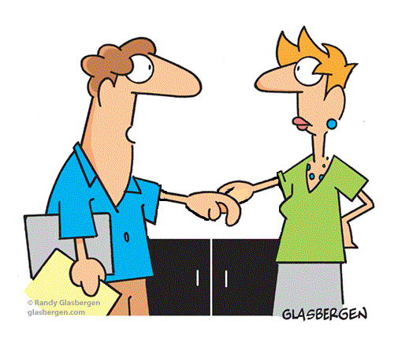
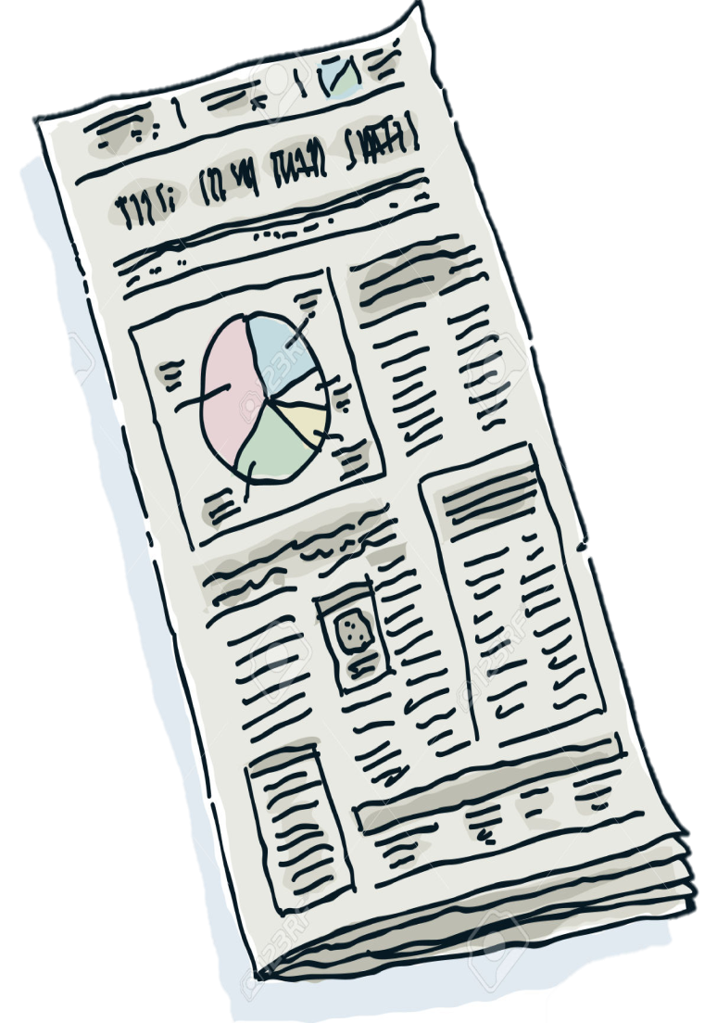
THIS IS YOU. You are A newspaper columnist.
This is john and his wife terry.
TASK:
INTERVIEW John about his daily life!

Slide 13
like films
Smoke
go to the theatre
like pop music
like dogs
read books
watch TV
drink coffee
speak any foreign languages
listen to the radio
play a musical instrument
drive a car
live in London
play golf
- Do you live in London?
- Yes, I live in north London.

Slide 14
like films
Smoke
go to the theatre
like pop music
like dogs
read books
watch TV
drink coffee
speak any foreign languages
listen to the radio
play a musical instrument
drive a car
live in London
play golf
- Does your wife play golf?
- No, but she plays tennis.

Slide 15
like films
Smoke
go to the theatre
like pop music
like dogs
read books
watch TV
drink coffee
speak any foreign languages
listen to the radio
play a musical instrument
drive a car
live in London
play golf
- Do you speak any foreign languages?
- Yes, I speak French.

Slide 16
like films
Smoke
go to the theatre
like pop music
like dogs
read books
watch TV
drink coffee
speak any foreign languages
listen to the radio
play a musical instrument
drive a car
live in London
play golf
- Do you watch TV?
- Yes, I like all the programmes on TV.

Slide 17
like films
Smoke
go to the theatre
like pop music
like dogs
read books
watch TV
drink coffee
speak any foreign languages
listen to the radio
play a musical instrument
drive a car
live in London
play golf
- Does you wife Terry listen to the radio?
- Yes, she listens to the radio in the morning.

Slide 18
like films
Smoke
go to the theatre
like pop music
like dogs
read books
watch TV
drink coffee
speak any foreign languages
listen to the radio
play a musical instrument
drive a car
live in London
play golf
- Does your wife like dogs?
- No, but my wife loves cats.

Slide 19
like films
Smoke
go to the theatre
like pop music
like dogs
read books
watch TV
drink coffee
speak any foreign languages
listen to the radio
play a musical instrument
drive a car
live in London
play golf
- Do you like films?
- No, I don't like films.

Slide 20
like films
Smoke
go to the theatre
like pop music
like dogs
read books
watch TV
drink coffee
speak any foreign languages
listen to the radio
play a musical instrument
drive a car
live in London
play golf
- Does Terry drink coffee?
- Yes, she has two cups in the morning.

Slide 21
like films
Smoke
go to the theatre
like pop music
like dogs
read books
watch TV
drink coffee
speak any foreign languages
listen to the radio
play a musical instrument
drive a car
live in London
play golf
- Do you drive a car?
- No, but I have a bicycle.

Slide 22
like films
Smoke
go to the theatre
like pop music
like dogs
read books
watch TV
drink coffee
speak any foreign languages
listen to the radio
play a musical instrument
drive a car
live in London
play golf
- Does Terry play a musical instrument?
- Yes, she plays the piano.

Slide 23
like films
Smoke
go to the theatre
like pop music
like dogs
read books
watch TV
drink coffee
speak any foreign languages
listen to the radio
play a musical instrument
drive a car
live in London
play golf
- Do you like pop music?
- No, I prefer classical music.

Slide 24
like films
Smoke
go to the theatre
like pop music
like dogs
read books
watch TV
drink coffee
speak any foreign languages
listen to the radio
play a musical instrument
drive a car
live in London
play golf
- Do you go to the theatre?
- Yes, I love musicals.

Slide 25
like films
Smoke
go to the theatre
like pop music
like dogs
read books
watch TV
drink coffee
speak any foreign languages
listen to the radio
play a musical instrument
drive a car
live in London
play golf
- Do you read books?
- Yes, read one book every week.

Slide 26
like films
Smoke
go to the theatre
like pop music
like dogs
read books
watch TV
drink coffee
speak any foreign languages
listen to the radio
play a musical instrument
drive a car
live in London
play golf
- Does your wife smoke?
- No, she doesn't like cigarettes.

Slide 27
Present Simple
Do you like Maths? – Yes, I ________
Do
Does
Don´t
Doesn´t
10
9
8
7
6
5
4
3
2
1
End

Slide 28
Present Simple
_____ she play football?
Do
Does
Don´t
Doesn´t
10
9
8
7
6
5
4
3
2
1
End

Slide 29
Present Simple
______ the students have good marks?
Do
Does
Don´t
Doesn´t
10
9
8
7
6
5
4
3
2
1
End

Slide 30
Present Simple
Does Mark travel a lot? – No, he _______
Do
Does
Don´t
Doesn´t
10
9
8
7
6
5
4
3
2
1
End

Slide 31
Present Simple
_____ the cat like lying in the sun?
Do
Does
Don´t
Doesn´t
10
9
8
7
6
5
4
3
2
1
End

Slide 32
Present Simple
Does she live in Lisbon? – No, she _______
Do
Does
Don´t
Doesn´t
10
9
8
7
6
5
4
3
2
1
End

Slide 33
Present Simple
Do they go to bed late? – No, they ________
Do
Does
Don´t
Doesn´t
10
9
8
7
6
5
4
3
2
1
End

Slide 34
Present Simple
_____ they speak French?
Do
Does
Don´t
Doesn´t
10
9
8
7
6
5
4
3
2
1
End

Slide 35
Present Simple
Do you go to the cinema? – No, I ______.
Do
Does
Don´t
Doesn´t
10
9
8
7
6
5
4
3
2
1
End

