Slide 1
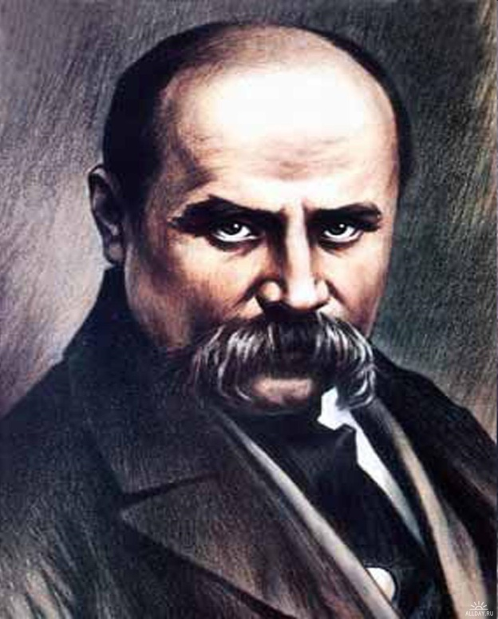
«My Testament» Taras Shevchenko

Slide 2
When I am dead, bury me In my beloved Ukraine,

Slide 3
My tomb upon a grave mound high amid the spreading plain,

Slide 4
So that the fields, the boundless steppes,

Slide 5
The Dnieper’s plunging shore

Slide 6
My eyes could see, my ears could hear The mighty river roar.

Slide 7
When from Ukraine the Dnieper bears Into the deep blue sea

Slide 8
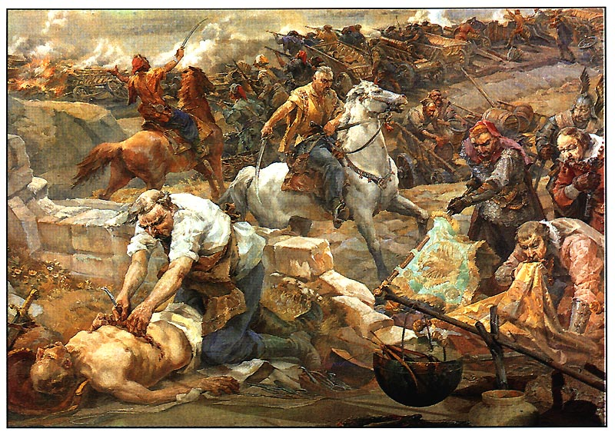
the blood of foes…

Slide 9
Then will I leave
These hills and fertile fields –

Slide 10
I’ll leave them all and fly away to the abode of God,

Slide 11
And then I’ll pray … But till that day I nothing know of God.

Slide 13
And water with the tyrant’s blood The freedom you have gained.

Slide 14
And in the great new family, The family of the free,

Slide 15
With softly spoken, kindly word remember also me.

Slide 16
Thank you for attention

